Slide 1
Project 4: XML Product Browser
(Not Graded)

Slide 2
Objectives
This project is an exercise of the following knowledge and skills:
Accessing and displaying information from an XML file.
Using the generic List<T> class.
Dynamically updating the options in DropDownLists based on user selections in previous lists.

Slide 3
Eyewear Product Browser
Write a web application that permits users to browse the contents of an XML file describing eyewear products.

Slide 4
The Eyewear Products Database
There are several hundred products in the file.
Each product element has the same form.
Products are divided into categories.
Some categories are further divided into subcategories.

Slide 5
Product Information
We have the following information about each product:
  ID
  Category
  Subcategory
  Description
  Retail Price
The XML file is available in the Downloads area of the class web site:
http://www.cse.usf.edu/~turnerr/Web_Application_Design/Downloads/Products.xml

Slide 6
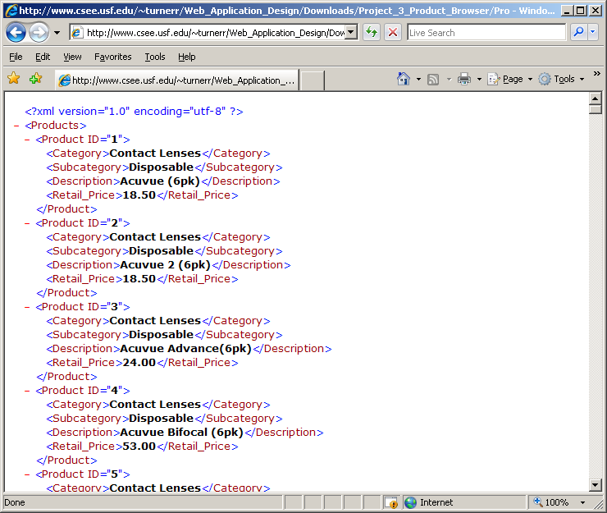
Sample Data

Slide 7
Categories without Subcategories
Products in categories that do not have subcategories have a subcategory value of “N/A”
Example:
    <Product ID="181">
    <Category>Eyeglass Frames</Category>
    <Subcategory>N/A</Subcategory>
    <Description>Brookes Brothers</Description>
    <Retail_Price>154.80</Retail_Price>
    </Product>

Slide 8
The Product Browser
The Product Browser should permit the user to identify a product by selecting
  The Category.
  The Subcategory, if applicable
  The Description
All selections are from dropdown lists.

Slide 9
Dropdown Lists
The Category dropdown list never changes.
The Subcategory dropdown list shows only subcategories that are applicable to the selected category.
  Disappears if not applicable.
The Product dropdown list shows product descriptions for products in the selected category and subcategory (if applicable.)

Slide 10
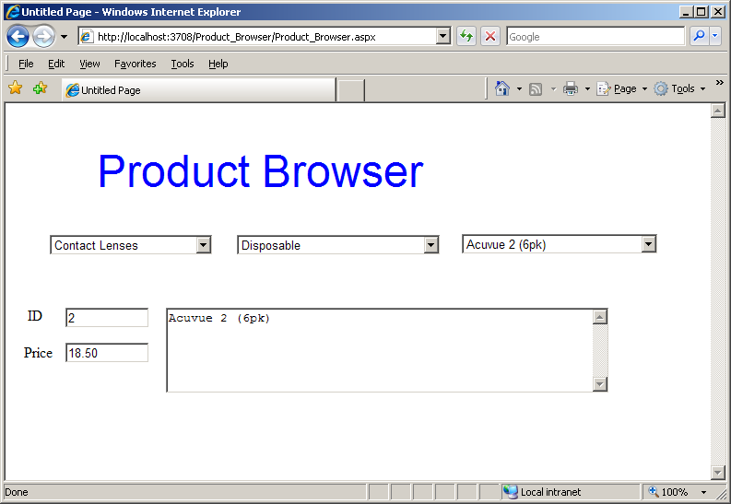
Sample Run
Each time the user selects a product, the browser displays its ID, Description, and Retail Price in textboxes.

Slide 11
Demonstration
A working implementation is available on the Internet.
http://rollinsturner.net/Product_Browser/Product_Browser.aspx
Your app should look similar and demonstrate essentially identical behavior.

Slide 12
Implementation Specifications
Define a class, Product, to hold all information about a product.
On initial Page_Load, process the XML file and create a list of Product objects.
  Preserve the list as an Application variable.
  Use the list to dynamically update the page.
Use the generic List<T> class
  List<Product>

Slide 13
List<Product>
If you are not familar with C# generics see:
  http://www.cse.usf.edu/~turnerr/Web_Application_Design/053_Generic_Collections.pdf
  or
  http://www.cse.usf.edu/~turnerr/Web_Application_Design/053_Generic_Collections.ppt
  Textbook, pages 77-78
Also see the Microsoft documentation
  Search for “generics” in Visual Studio Help
  Search for “List generic class” in Visual Studio Help
You will not need to define any new generic classes.
  Just use the generic List class provided in the .NET Framework.

Slide 14
The Dropdown Lists
Create new Item collections for the Subcategory and Product DropDown lists as needed.
Provide handlers for SelectedIndexChanged event for each DropDown list.
  Category change – Populate new Subcategory DropDown list
    If no subcategories, populate new Product DropDown List.
  Subcategory change – Populate new Product DropDown list.

Slide 15
Product Selection Change
On SelectedIndexChanged for the Product DropDown list, fill in the textboxes with information for the selected product.
Clear textboxes whenever there is not a selected product.
  When Category or subcategory changes.

Slide 16
Submission
Zip your website folder and submit the zipped file using Blackboard Assignments.
Deploy your application to your directory on the scorpius web site.
  OK to use a different web site if you have access to one.
Put the URL for your page into the Blackboard submission comments box.
  Example:
    http://cis4930wp.eng.usf.edu/wpusr40
Substutite your user ID for wpusr40.
I should be able to view your page by copying and pasting the link

Slide 17
Ground Rules
You may work with one or more other students.
  OK to work alone if you prefer.
If you do work in a group
  All members are expected to contribute.
  All members should understand the program in detail.
  Each member should submit the app.
  Each member should deploy the app to their own website.
Do not share your work with other students.
  Before or after submitting the project.
  OK to discuss the project.
Do not copy any other student’s work.
  Don’t look at anyone else’s program.

Slide 18
Ground Rules
Except for code posted on the class web site
Do not copy code from the Internet
  or any other source.
Write your own code.

Slide 19
Submission
Project is due by 11:59 PM, Wednesday, June 13.
Deliverables:
  Website Folder (zipped)
Zip the entire website folder and submit a single file.
  Use the Windows "Send to Compressed Folder" command.
  DO NOT use RAR
If you work with a group, each member of the group should deploy the app to their own website and do their own submission.
  Include own URL in the Blackboard submission comment.

