Slide 1
Project 5: Count Northwind Orders
Graded Project

Slide 2
The Northwind Traders Database
The Northwind Traders database was created by Microsoft for training and demonstration purposes.
There is a read-only copy on scorpius available to all users.
  Database name: Northwind
There are 13 tables in the database
  In this project we are only concered with two of them.
  And only a few of the columns in those two tables.

Slide 3
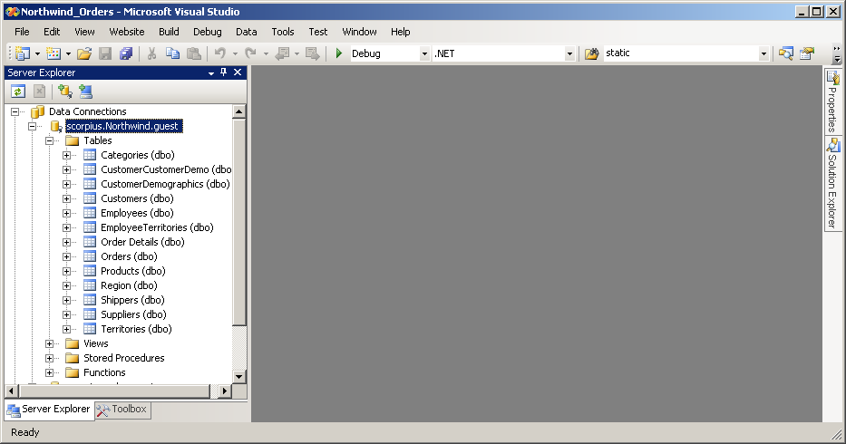
Northwind Database

Slide 4
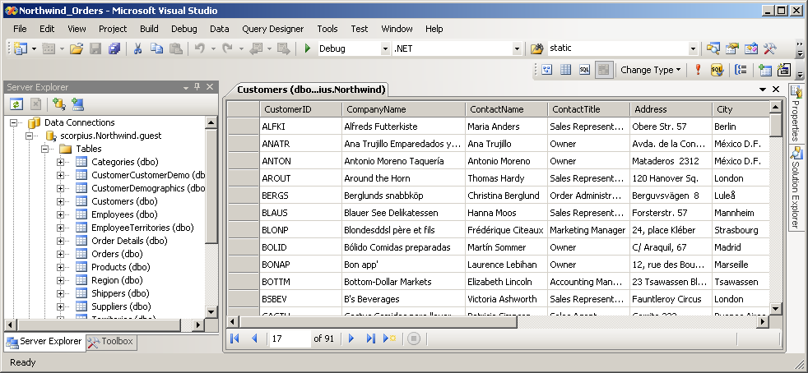
Table Customers
In table Customers, we will be concerned with CustomerID and CompanyName.
CustomerID is the primary key.

Slide 5
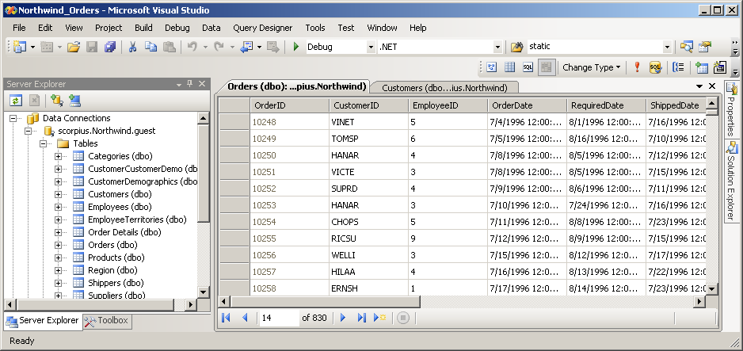
Table Orders
Table Orders has a row for each order that has been entered.
The customer for each order is identified by the CustomerID column.
This is the same CustomerID that appears in the CustomerID column of table Customers.

Slide 6
Assignment
Write an ASP.NET app that permits the user to determine the number of orders that have been entered for a specified customer.
The user identifies a customer by typing the first few letters of the CompanyName (not CustomerID) into a TextBox.

Slide 7
Requirements
If there are multiple customers whose CompanyName matches the letters entered by the user, the app will display a DropDownList with those companies' names as choices.
The user can then select the company from the DropDownList.

Slide 8
Requirements
When the user has uniquely identified a company, the app determines the number of orders in the database for that company and displays the result.

Slide 9
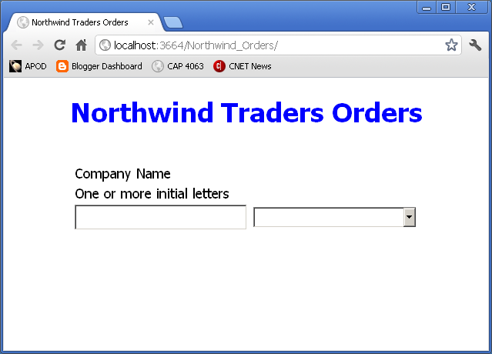
Initial Page
User enters one or more initial letters of company name.

Slide 10
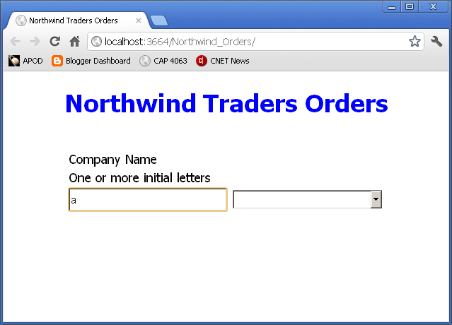
After user has entered initial letters
User presses Tab or Enter, or clicks outside the TextBox.

Slide 11
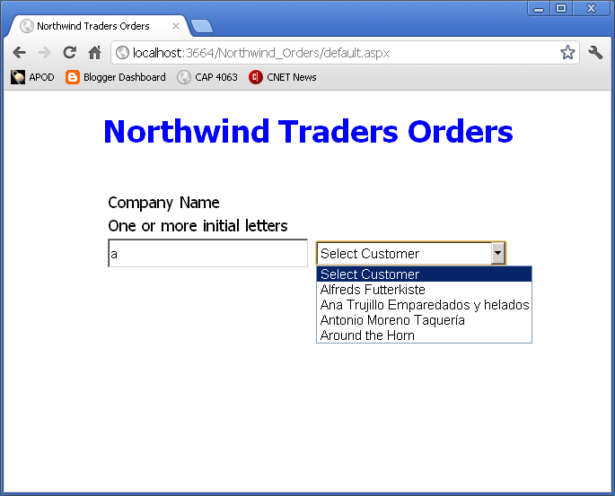
After tabbing out of the TextBox

Slide 12
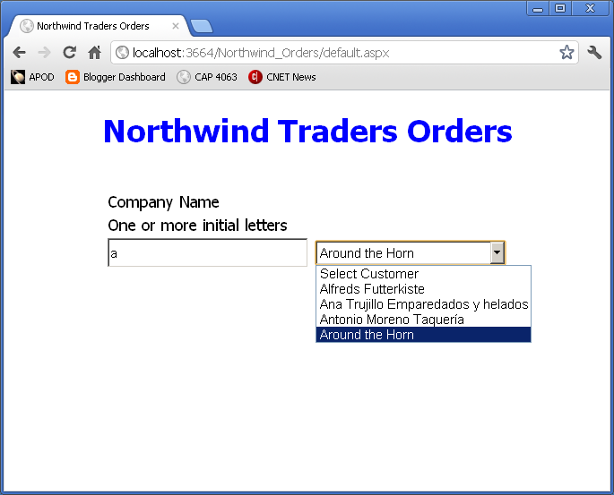
Selecting from the DrowDownList
User selects an item from the DropDownList.

Slide 13
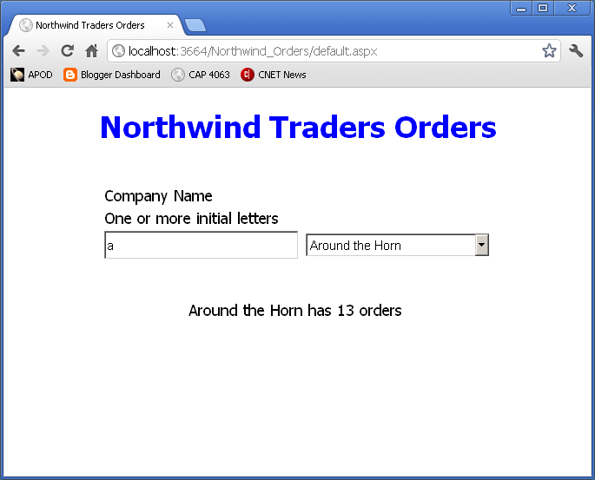
Result Displayed
App displays the number of orders for the selected customer.
User can now select another customer from the DropDownList or enter new initial letters into the TextBox.

Slide 14
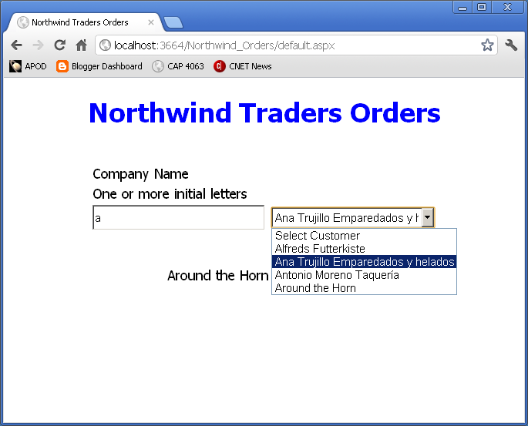
User selects another customer from the DropDownList.

Slide 15
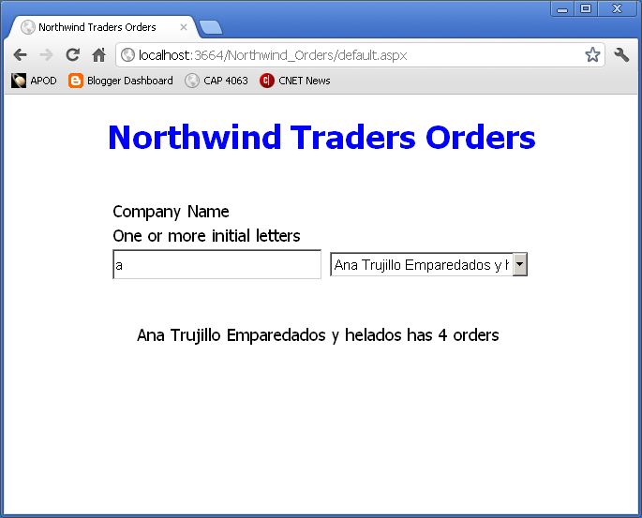
New Result
App displays number of orders for newly selected customer.

Slide 16
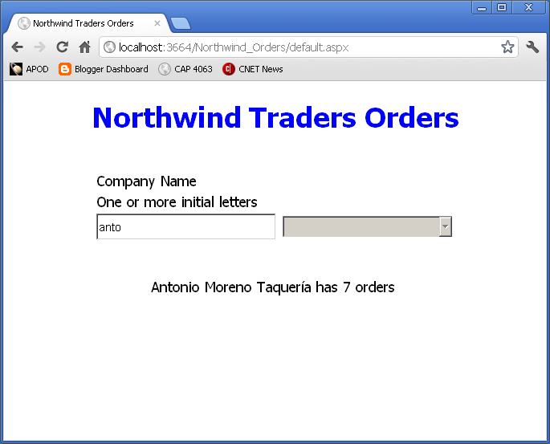
User enters letters that uniquely identify a customer.
When user tabs out of the TextBox, app immediately displays number of orders.
DropDownList is empty and disabled.

Slide 17
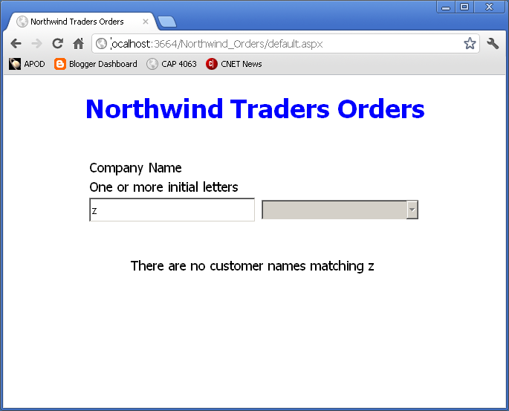
User enters letters with no matching customer name.
App displays error message.
DropDownList is empty and disabled.

Slide 18
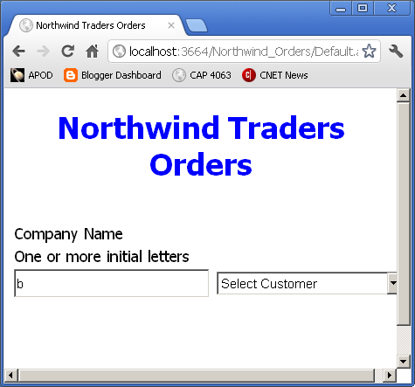
User Resizes Browser Window

Slide 19
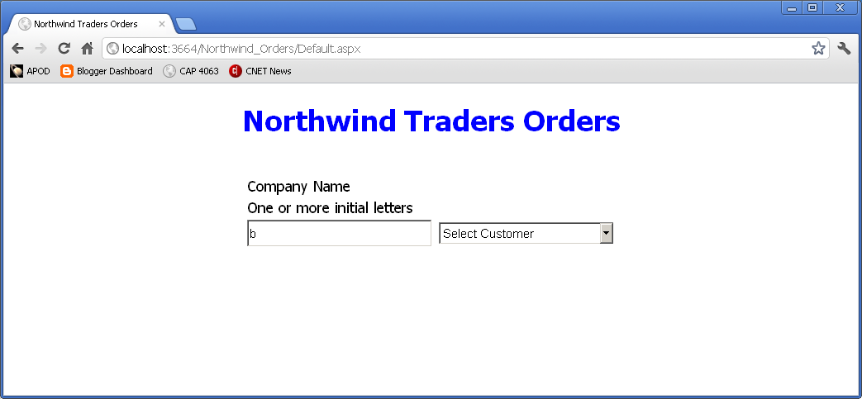
User Resizes Browser Window
Page content remains centered.

Slide 20
Requirements
Page layout should match the examples.
Use CSS styling as shown and discussed in class.

Slide 21
Requirements
Cursor should be in the TextBox when the page is initially shown on the browser.
  User can start typing immediately without having to click on the TextBox.
Remove any leading and trailing spaces from the text that the user enters before looking for matching company names.
  See C# string class Trim method.
When the user tabs out of the TextBox after making a change, any previous output disappears.
  If there are no non-space characters in the TextBox, nothing more happens.
  Don't look for matches to a zero length string.

Slide 22
Requirements
DropDownList has a dummy initial item "Select Customer".
  If user selects that item, any previous output disappears, but nothing else should happen.
  DropDownList is unchanged.

Slide 23
Design Matters
Apply the principles of object oriented design that have been shown and discussed in class.
Projects will be graded on software design as well as functionality.

Slide 24
Deployment
Deploy your application to your virtual directory on the scorpius web site.
  OK to use a different IIS server if you have access to one.
    Must be publically accessible on the Internet.
Put the URL for your app into the Blackboard submission comments box.
  Example:
    http://cis4930wp.eng.usf.edu/wpusr40
Substitute your user ID for wpusr40.
Grader should be able to view your page by copying and pasting the link

Slide 25
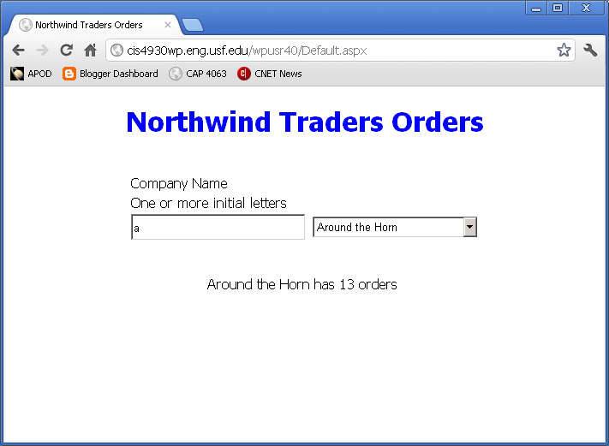
App on scorpius

Slide 26
Ground Rules
No collaboration on this project.
It is OK to use anything on the class website or in the textbook.
It is OK to reuse code that you have written previously or submitted as a group member on previous project.

Slide 27
Ground Rules
Do not share your work with other students.
Before or after submitting the project.
  OK to discuss the project.
  OK to look at others’ web sites with a browser.
Do not copy any other student’s code.
  Or even look at it.
Do not let anyone copy or examine your code.

Slide 28
Ground Rules
Except for code posted on the class web site
Do not copy code from the Internet
  or any other source.
Write your own code.

Slide 29
Submission
Submit your web site files via Blackboard Assignments.
Zip your web site folder using the Windows “Send to Compressed Folder” command.
Attach the .zip file to your Blackboard submission.
  Be sure to click Attach after selecting the file.
  Be sure to click Submit after attaching the file.

Slide 30
Due Date
Project is due by 11:59 PM, Wednesday, June 20.
  Late submissions will be seriously penalized.
End of Presentation

