Slide 1
Project 6: Tic Tac Toe

Slide 2
Tic Tac Toe
A Challange Project
10 Points extra credit on final grade
OK to work in groups of 2 or 3.

Slide 3
Assignment
Write a web app to permit users to play Tic Tac Toe.
One user starts a game.
  Gets a Game ID.
Other user joins the game.
  Must learn Game ID outside the system.
App supports an arbitrary number of simultaneous games.

Slide 4
Tic Tac Toe App
There is a working example on scorpius:
http://cis4930wp.eng.usf.edu/wpusr40/Default.aspx
Note: If you run both players on the same computer, you must use different browsers.
  Not just different browser windows, different browser programs.

Slide 5
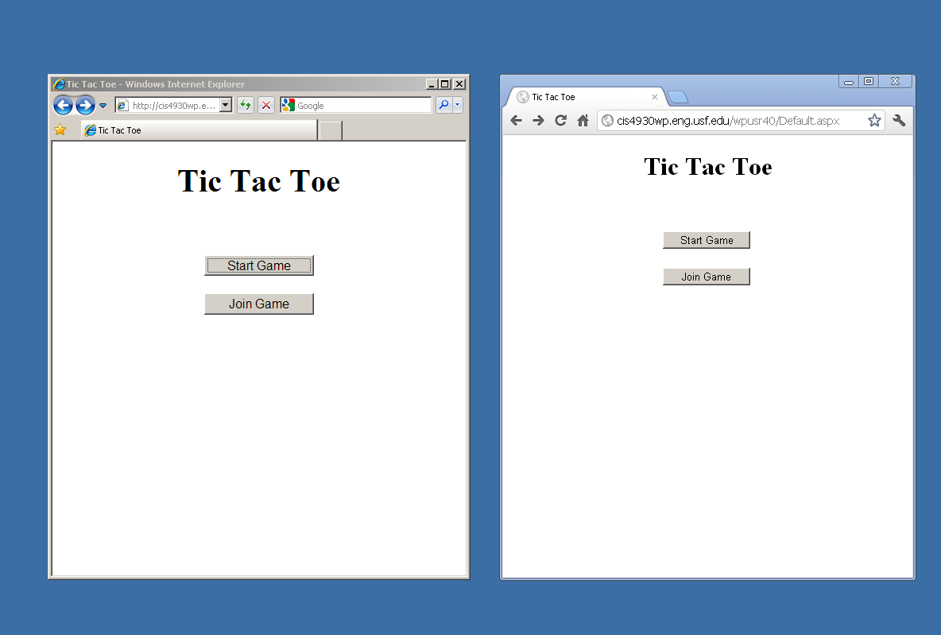
User clicks Start Game

Slide 6
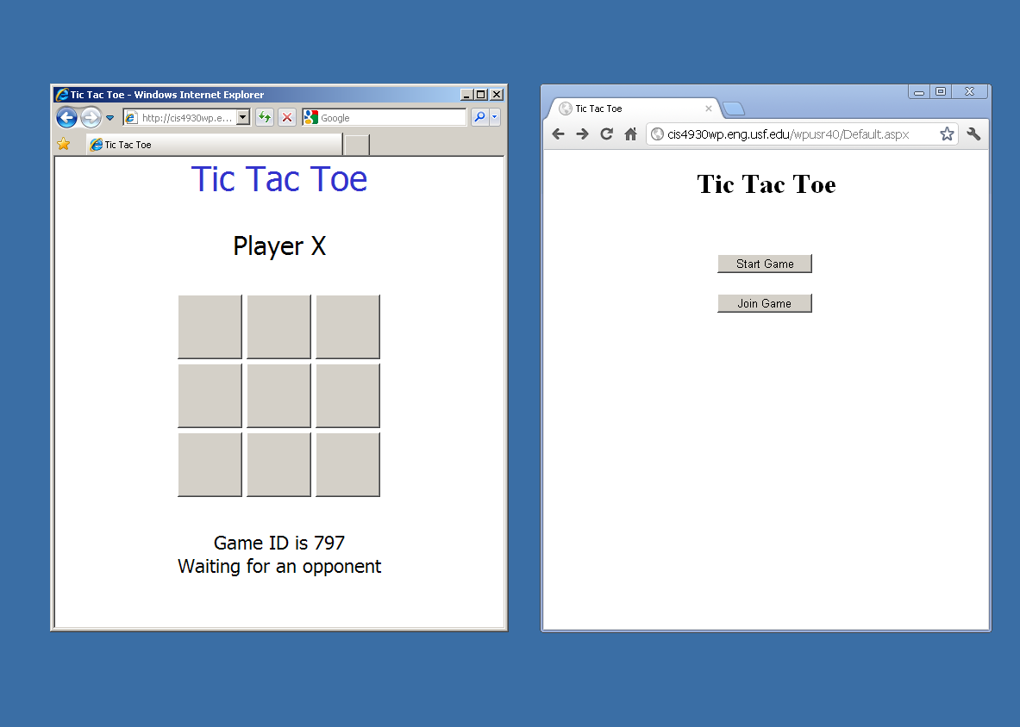
User clicks Join Game

Slide 7
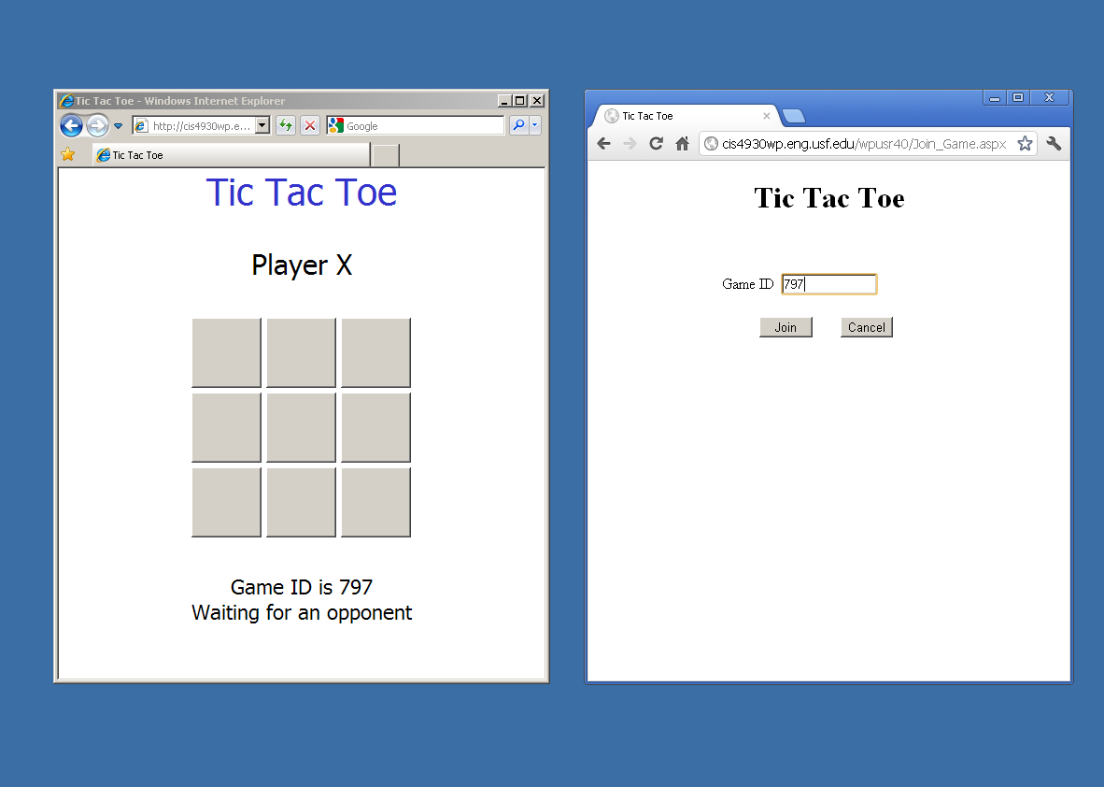
User enters Game ID and clicks Join

Slide 8
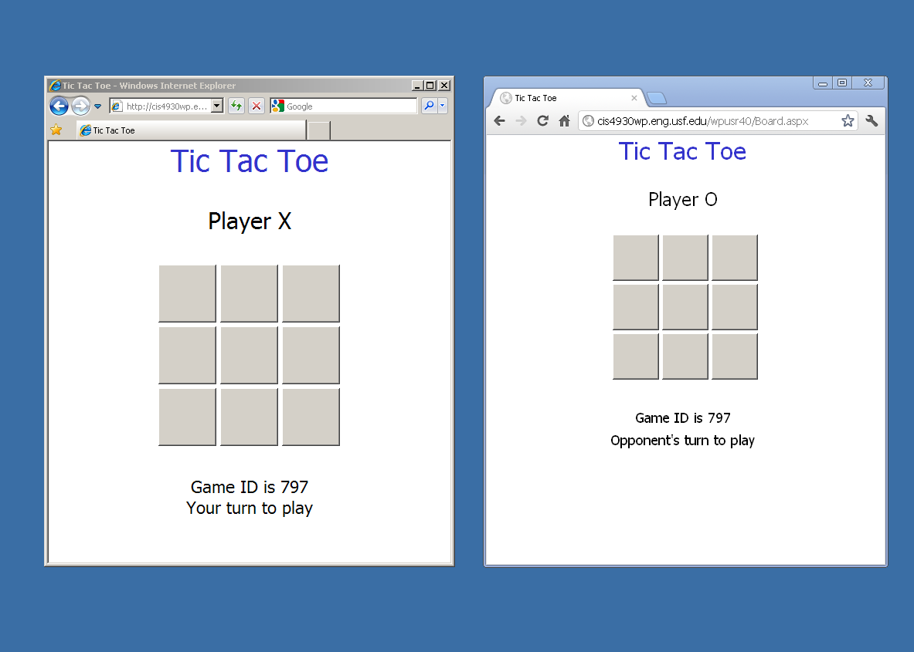
User clicks this tile

Slide 9
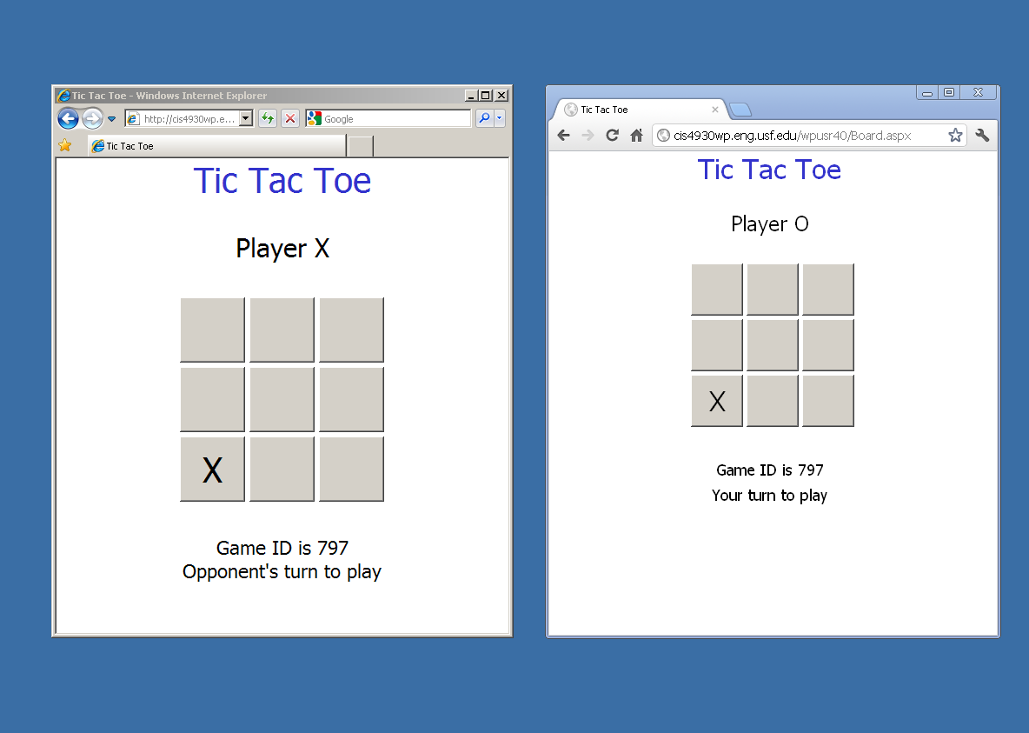
User clicks this tile

Slide 10
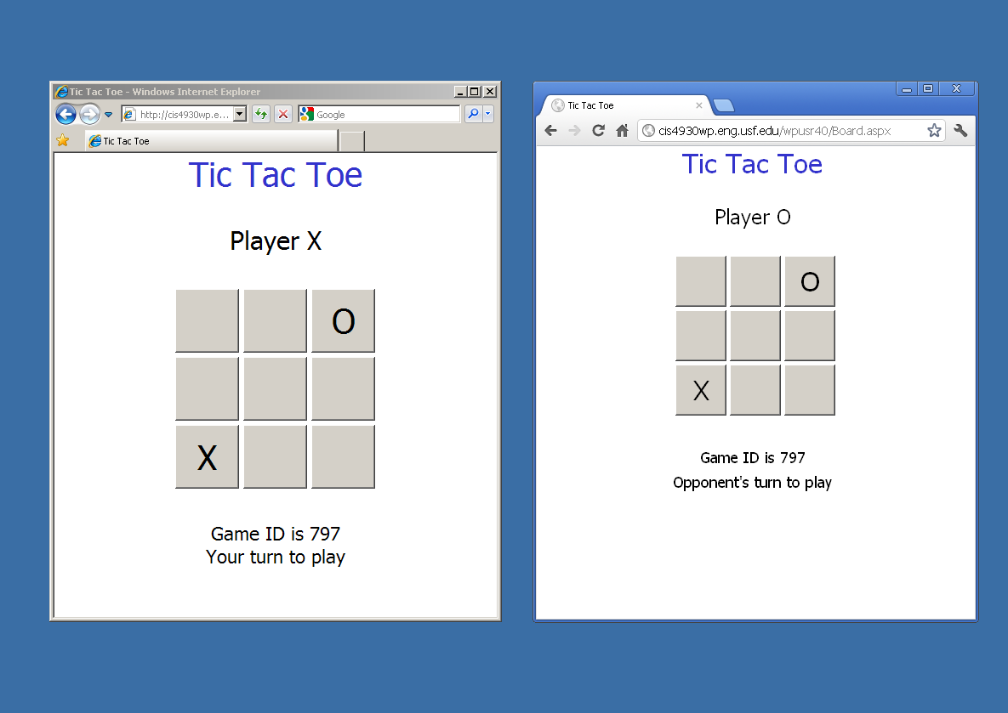

Slide 11
Play continues
Players alternate.
Each player's browser shows current game state.

Slide 12
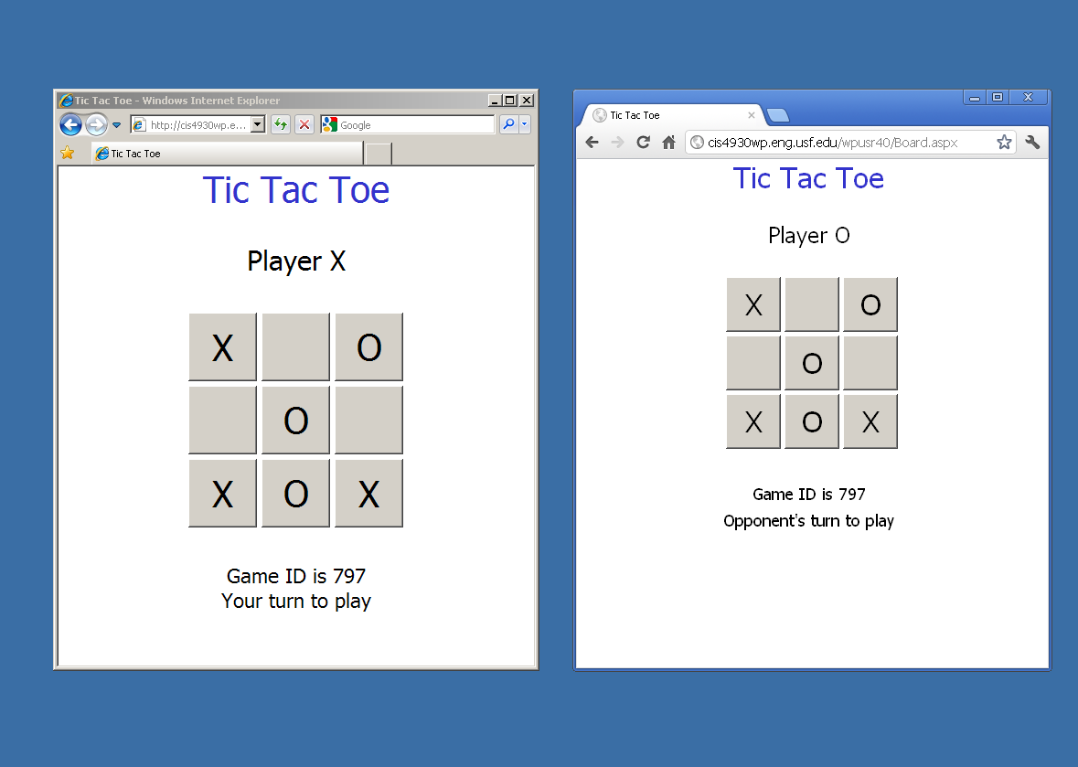
User clicks this tile

Slide 13
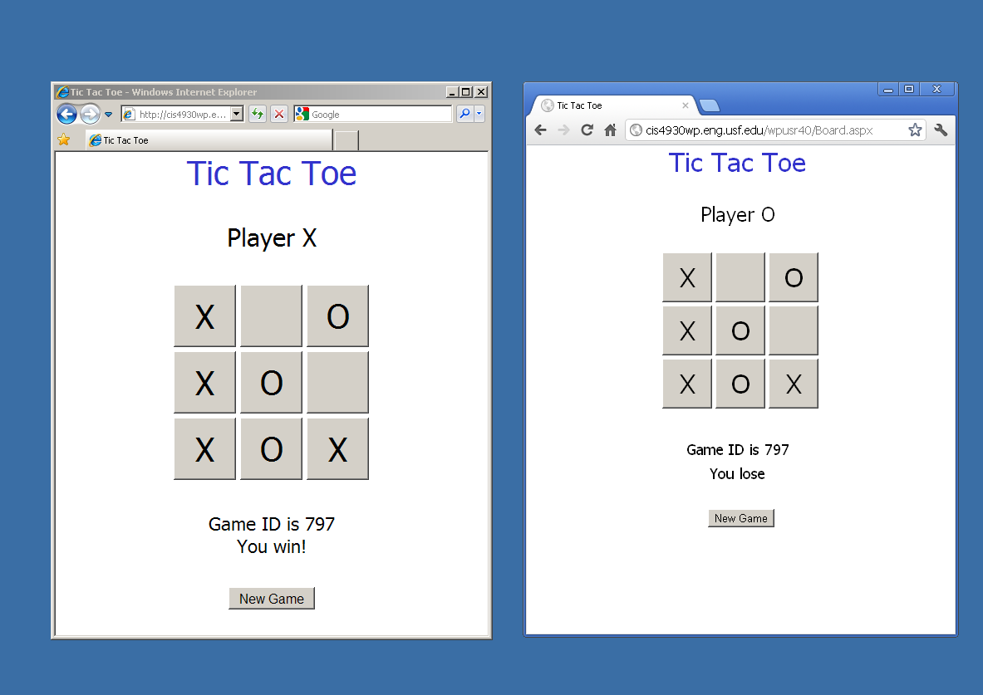

Slide 14
Requirements
Your app should match the example in appearance and functionality.
  Permits users to play in turn.
  Prevents illegal actions.
  Detects game completion.
    Determines winner or stalemate.

Slide 15
Requirements
Use a web service to control the games.
C# code for ASPX pages invokes web methods:
  Start_Game
  Join_Game
  Play
  Get_Status
  Remove_Game

Slide 16
A Fundamental Problem
No way for the server to tell one browser that the other browser has entered a new play.
  Every exchange of information must be initiated by the browser.
The browser waiting for the other user to play must periodically check the game status to determine that the other user has played.
Game Status
  Current board state
  Whose turn to play
  (More)

Slide 17
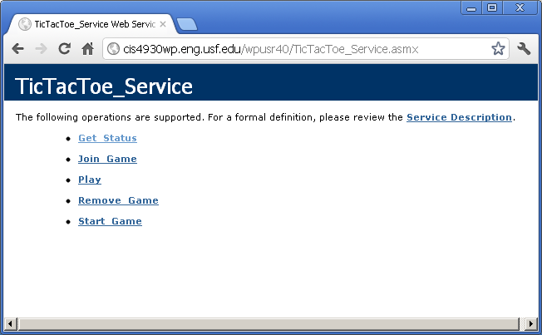
A Tic Tac Toe Web Service
http://cis4930wp.eng.usf.edu/wpusr40/TicTacToe_Service.asmx

Slide 18
A Tic Tac Toe Web Service
You can use this web service during development if you wish.
But you should create your own implementation for submission.
Your web service does not have to match the example.

Slide 19
Web Service Example
public Status Start_Game()
public bool Join_Game(int game_id)
public Status Play(int game_id, char player, int row, int col)
public Status Get_Status(int game_id)
public void Remove_Game(int game_id, char player)
Notes:
player is 'X' or 'O'
row and col are 0 – 2

Slide 20
Class Status
public class Status
{
private int game_id;
private char[] board; // 3x3 array represented as 1D array
private char turn; // X or O (Player to play next)
private bool game_started;
private bool play_started; // false while waiting for
// second player to join
private bool game_over;
private char winner; // X or O, or N for None
private bool x_finished;
private bool o_finished;
This is just an example, not a requirement.

Slide 21
Implementation Tip
You will probably find it convenient to use cookies.
  Perhaps even necessary!
See page 269 in textbook
Microsoft documentation:
http://msdn.microsoft.com/en-us/library/ms178194.aspx
http://msdn.microsoft.com/en-us/library/aa289495(v=vs.71).aspx

Slide 22
Implementation Tip
Remember that web services are recreated on each request, like web pages.
Any information to be retained between requests must be preserved in some form of persistent storage.

Slide 23
Reality Check
This is actually not a good way to implement a two person game.
  Due to the polling overhead.
  Better to use peer to peer communcation.
But this is a course in web application development.
Think of this project as a purely academic exercise.

Slide 24
Submission
Submit your web site files via Blackboard Assignments.
Zip your website folder using the Windows “Send to” command.
  Please do not use WinRAR.
Submit the zipped folder.

Slide 25
Submission
Deploy your application to your virtual directory on scorpius.
Put the URL for your start page into the Blackboard submission comments box.
  Example:
    http://cis4930wp.eng.usf.edu/wpusr40/Default.aspx
Substutite your scorpius user ID for wpusr40.
Grader should be able to run your app by copying and pasting the link

Slide 26
Ground Rules
You may work with one or two other students.
  OK to work alone if you prefer.
If you do work in a group
  All members are expected to contribute.
  All members are expected to understand the code.
  All members deploy the project to their scorpius web sites.
  Submit only one set of website files for the group.
    One member submits the files.
    Enter all names in Assignment Comments
    Enter submitter’s URL in Assignment Comments
  Other group members should submit just a Blackboard comment including own scorpius URL and names of other group members.

Slide 27
Ground Rules
Do not share your work with other students.
  Before or after submitting the project.
  OK to discuss the project.
  OK to look at others’ web sites with a browser.
Do not copy any other student’s code.
  Or even look at it.
Do not let anyone copy or examine your code.

Slide 28
Ground Rules
Except for code posted on the class web site
Do not copy code from the Internet
  or any other source.
Write your own code.

Slide 29
Due Date
Project is due by 11:59 PM, Monday night, July 9.
  No late submissions will be accepted.
End of Presentation

