Slide 1
Project 7: My Photo Album
Graded Project

Slide 2
Assignment
Write a web app to permit users to upload and view photos.
User can keep up to five photos on the website.
As user uploads additional photos, beyond five, older photos are deleted on a first in first out basis.

Slide 3
Assignment
A real app would require users to log in and would maintain a separate set of photos for each user.
That is not a requirement for this assignment. Assume that there will be only one user. (Or all users share the same collection.)

Slide 4
The Album
The app displays small "thumbnail" images of each photo along the left side of the page.
  In order loaded, oldest at the top.
  Thumbnails are fixed size square images, regardless of size and aspect ratio of the photos.
    Nonsquare photos will be distorted. This is OK.
When the user clicks on a thumbnail, the app displays that photo in a larger ASPX image near the center of the page.
  The larger image has the same aspect ratio as the photo, so that the photo is not distorted.
There is a File Upload control, and Upload button at the top of the page.

Slide 5
The Album
When the page first comes up, the app displays the current photos in the thumbnails, and one photo in the larger frame.
  Upspecified which photo is displayed in the frame.
There is a working example on scorpius
  http://cis4930wp.eng.usf.edu/wpusr40/Start.aspx
  (The Upload button is disabled.)
Your app should have approximately the same appearance and behavior.

Slide 6
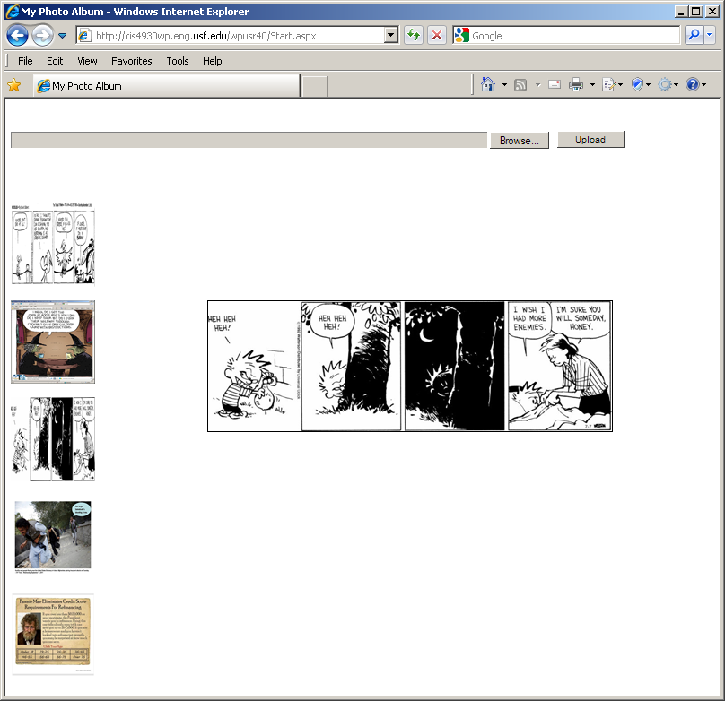
User clicks here

Slide 7
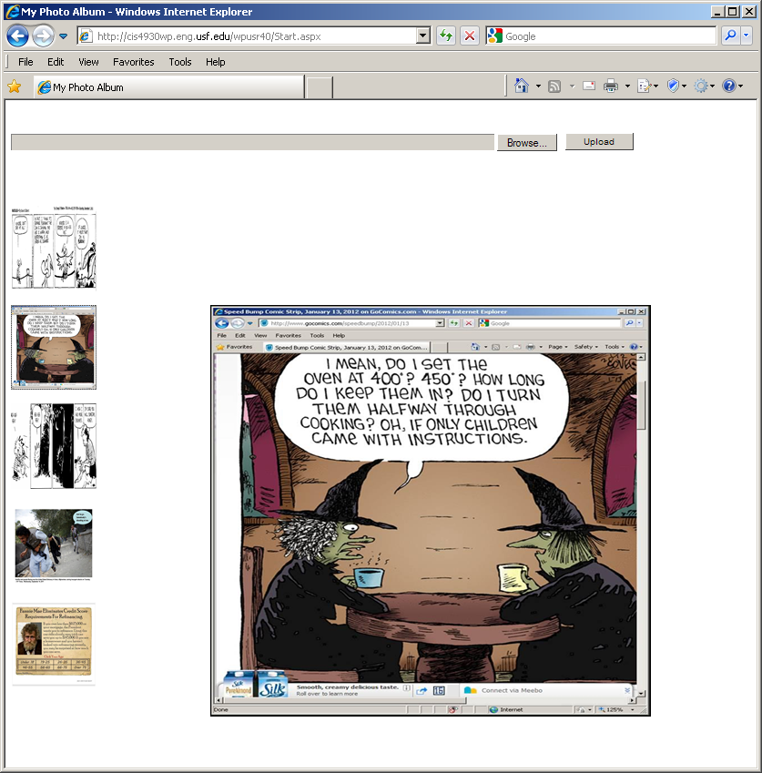
http://www.facebook.com/photo.php?fbid=2851742146287&set=a.1943795808196.108288.1641516843&type=1&theater

Slide 8
Requirements
Clicking on an image does not cause a postback.
  Use JavaScript to update the large image.
Thumbnails are displayed in the order in which they were uploaded.
Whenver a sixth photo is uploaded, app deletes the oldest photo.
  Maximum of five thumbnails displayed
Don't upload a file that is not an image.
  Accept .jpg, .gif, .png

Slide 9
Requirements
Save uploaded files in a folder within the website folder.
Use a database table to keep track of information that the app needs to retain between sessions.
  App should work correctly even if the server is restarted.

Slide 10
Nonrequirements
It is OK to upload a photo that is already there.
  App does not need to check for duplicates.
  OK for multiple thumbnails to display the same photo when the photo has been uploaded multiple times.
The Upload button can cause a postback.
  Also the Browse button in the FileUpload control.

Slide 11
Implementation Tips
Consider the ASPX ImageButton for the thumbnails.
  http://msdn.microsoft.com/en-us/library/system.web.ui.webcontrols.imagebutton.aspx
The .NET FileUpload control is described on pages 604-607 of the textbook.
Microsoft documentation:
http://msdn.microsoft.com/en-us/library/system.web.ui.webcontrols.fileupload(v=vs.90).aspx
.NET has two different Image classes.
  System.Windows.Controls.Image
    Displays an image on a web page.
    http://msdn.microsoft.com/en-us/library/system.windows.controls.image.aspx
  System.Drawing.Image
    Useful for determining the dimensions of an image file.
    http://msdn.microsoft.com/en-us/library/system.drawing.image.aspx

Slide 12
Submission
Submit your web site files via Blackboard Assignments.
Zip your website folder using the Windows “Send to” command.
  Please do not use WinRAR.
Submit the zipped folder.

Slide 13
Submission
Deploy your application to your virtual directory on scorpius.
Put the URL for your start page into the Blackboard submission comments box.
  Example:
    http://cis4930wp.eng.usf.edu/wpusr40/Default.aspx
Substutite your scorpius user ID for wpusr40.
Grader should be able to run your app by copying and pasting the link

Slide 14
Ground Rules
You may work with one or two other students.
  OK to work alone if you prefer.
If you do work in a group
  All members are expected to contribute.
  All members are expected to understand the code.
  All members deploy the project to their scorpius web sites.
  Submit only one set of website files for the group.
    One member submits the files.
    Enter all names in Assignment Comments
    Enter submitter’s URL in Assignment Comments
  Other group members should submit just a Blackboard comment including own scorpius URL and names of other group members.

Slide 15
Ground Rules
Do not share your work with other students.
  Before or after submitting the project.
  OK to discuss the project.
  OK to look at others’ web sites with a browser.
Do not copy any other student’s code.
  Or even look at it.
Do not let anyone copy or examine your code.

Slide 16
Ground Rules
Except for code posted on the class web site and in the textbook
Write your own code.
Do not post this assignment or questions about it on the Internet.
Do not copy code from the Internet
  or any other source.

Slide 17
Due Date
Project is due by 11:59 PM, Monday night, July 16.
  Substantial penalty for late submission.
End of Presentation

