Slide 1

Target and Context Aware Transformer for Visual Search Task
CCDS25-0028
by
Nguyen Tuan
Notes:
Good Afternoon, Prof. Zhang Mengmi and Prof. Lim Wei Yang Bryan to my FYP presentation about Target and Context Aware Transformer for visual search task

Slide 2
Outline
Introduction
Literature Review
TCT Architecture
Experiments
Contributions and Future Directions
Notes:
There are 5 main points which will be covered in the presentations

Slide 3

Introduction
Notes:
We will begin with the introduction

Slide 4
Introduction – Outline
The current existing visual search models are limited to the context image and neglect the target image.
E.g. DeepGazeIII (Kümmerer et al., 2022)
Recognition task-based rather than an attention-map-based visual search model.
=> Propose a new attention-map-based top-down visual search model mimicking human search behaviour
Notes:
Most current existing visual search model are only depend on the context image information to infer the attention map to find the target. Most of the models are recognition task-based rather than an attention-map-based visual search model.
Therefore, we propose a new attention-map-based and top-down visual search model that mimicking human search behavior

Slide 5
Introduction – Visual search
Definition: A process of locating a target in a search scene, display, images, etc. that contain multiple distractors (Treisman & Gelade, 1980).
Notes:
Before any further deep dive into the topic, we need to understand what is visual search.
Visual search is academically defined by Treisman and Gelade in 1980 is a process of locating a target in a search scence, display, images, etc, that contain multiple distractors.

Slide 6
Introduction - Contributions
Examine Invariant Visual Search Network (IVSN) (Zhang et al., 2018) as an inspiration for building a computational top-down visual search model.
Introducing different augmentation methods on the COCO-Search18 dataset (Yang et al., 2020) to train the Context-aware Recognition Transformer Network (CRTNet) (Bomatter et al., 2021) for the visual search task.
Propose a modified CRTNet architecture for global modulation in the Target and Context-aware Transformer (TCT) visual search model.
Assess TCT visual search model on different benchmark datasets

Slide 7
Literature Review
1980
Notes:
We then move on to literature review to understand more on the cognitive search theory to understand how human conduct visual search and how it can be transformed into computational model

Slide 8
C0gnitive visual search Theory
1980
1980
1984
1994
1998
2018
2021
Treisman and Gelade proposed the widely adopted cognitive model of visual search, namely Feature Integration Theory (FIT).
The theory introduced different approaches for visual search:
- Bottom-up (Search image saliency)
- Top-down (Goal/Target driven searching)
- Combination of bottom-up and top-down approaches
FIT proposed that visual search require attention and sequential search from the subject.
Notes:
In 1980, Treisman and Gelade proposed an Feature Integration Theory that human require attention map to overlay a scene to conduct a sequence of searching.
There are 3 main approach
Bottom-up: we focus on the scence saliency
Top-down: which is goal driven
Or the combination of both

Slide 9
C0gnitive visual search Theory
1980
1980
1984
1994
1998
2018
2021
1980
Shortly after the FIT publication, Posner conducted different experiments to formalize the relationship between eye movement and the attention map.
There are 2 types of Attention:
Covert Attention: No head, no eye movement. Attention from the current scene
Overt Attention: Requires head and eye movement, producing an attention shift.
=> Covert Attention is the means of routing information and controlling search priority.
Notes:
Later in the 1980, Posner conducted many various experiments to formalize the relationship between the eye movement and the attention map
There are 2 types of attention:
Covert Attention: which require no head or eye movement, the attention are produced from the the current scene.
The other one is the overt attention which requires head and eye movement, producing an attention shift
=>He discovered that Covert attention is the means of routing information and controlling search priority.

Slide 10
C0gnitive visual search Theory
1980
1980
1984
1994
1998
2018
2021
1980
Posner and Cohen discovered the Inhibition of Return in human search behavior through many experiments.
- Humans react more slowly to the previously attended area.
Proposed that the inhibited area is located in the mental map, rather than in retinotopic coordinates, which prevents humans from revisiting the attended area.
=> Laid foundation for bio-inspired Deep Neural Network (DNN) visual search model.
=> Is regarded as Inhibition of Return (IOR), embedded into every visual search model to prevent them from revisiting the attended area.
Notes:
In 1984, Posner and his partner Cohen discovered Inhibition of Return which prevent human from revisiting attended area.
They proposed that the Inhibited area is located in the mental map rather than in the retinotopic coordinates inside our eyes.
Their finding laid the foundation for bio-inspired DNN visual search model
It is regarded as IOR, which is embedded into every visual search model to prevent them from revisiting the attended area.

Slide 11
C0gnitive visual search Theory
1980
1980
1984
1994
1998
2018
2021
1980
Wolfe reconstructed a conceptual model to demonstrate the combination of both bottom-up and top-down approaches in human visual search.
Provided a detailed framework for later researchers to build better conceptual models and computational models.
Methodological and visual model illustrating the bottom-up and top-down approach
The bottom-up approach emphasizes the distinction of items from their surroundings
The top-down approach enforces similarity and matching to categorical properties of the target.
The combination of both creates a weighted activation map rather than a uniformly summed one.
Notes:
In 1994, Wolfe reconstruct a conceptual model to demonstrate the theory of combination of bottom-up and top-down approach
The model can illustrate and emphasis the role of each approach:
The bottom-up approach help human to distinguish item from each other
The top-down approach help human to find similarity between item and guide the search process
The combination of both build a weighted map rather than equally summed

Slide 12
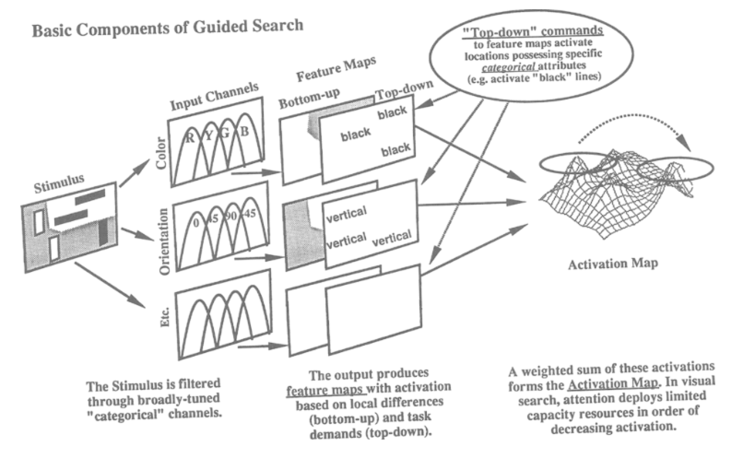
C0gnitive visual search Theory
1980
1980
1984
1994
1998
2018
2021
1980
Guided Search Version 2.0 Architecture (Wolfe, 1994)
Notes:
We can clearly see different path but they are combined together to build an attention map to overlay the search scene

Slide 13
C0gnitive visual search Theory
1980
1980
1984
1994
1998
2018
2021
1980
Chun & Jiang proposed visual context guides human attention to the target in complex visual inputs.
Context are implicitly learned from encountered historical instances, which optimize and automate target detection through interaction with visual attention.
Knowledge obtained from implicit learning could guide the search process.
The authors concluded that a model or an intelligence system without a learning mechanism to capture the context information is considered maladaptive (unable to adapt/generalize).
Notes:
In 1998, Chun & Jiang proposed human required a visual context to guides the search process
They argue that context could be learned implicitly from historical encounter which optimize the search process
They conclude the model or an intelligence system without any learning mechanism is maladaptive to visual search task.

Slide 14
C0gnitive visual search Theory
1980
1980
1984
1994
1998
2018
2021
1980
Wolfe refined his Guided Search version 2.0 model to version 6.0 by adding the scene guidance mechanism:
Syntactic guidance: Follow the world's physical laws.
e.g. A toaster doesn’t float
Semantic guidance: Follow the norms of society.
e.g. A toaster doesn’t belong in the bathroom
Knowledge learned by humans through implicit or explicit learning (context cueing), as discussed by Chun & Jiang (1998).
Context guidance is not mere saliency from the features in the context scene
A standardized framework for the development of computational models in the modern stage.
Notes:
Recently in 2021, Wolf refined his previous model and introduced a scene guidance mechanism
There are 2 main types of guidance syntactic guidance and semantic guidance.
We can see that Wolfe leveraged proposal from Chun & Jiang in 1998 to refine his model.

Slide 15
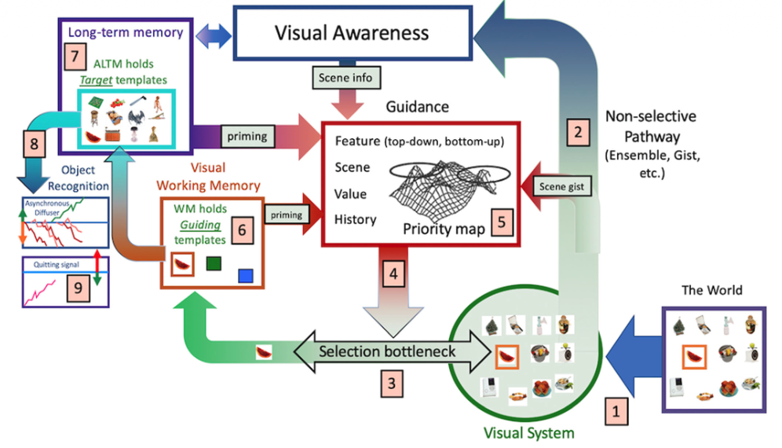
C0gnitive visual search Theory
1980
1980
1984
1994
1998
2018
2021
1980
Schematic representation of Guided Search 6.0 (Wolfe, 2021)
Notes:
This is an more illustrative image on Wolfe model as we can see, the propose model now have awareness and context guidance to contribute into the visual search process.

Slide 16
C0mputational visual search Theory
1980
1980
1984
1994
1998
2018
2021
1980
Dr. Zhang Mengmi and her research colleagues were inspired by biological cognitive function in visual search and proposed the Invariant Visual Search Network (IVSN).
Top-down approach architecture.
The attention map is generated by a first-order approximation (dot product between target output tensor and each entry of the output tensor)
The output attention map is resized to match the original input context image to apply searching algorithm
Notes:
Right after VGG16 model is published in 2018, Dr. Zhang Mengmi and her colleague proposed an bio-inspired model, IVSN which use top-down approach for visual search through first order approximation, the attention map is resize to match the original context image to conduct visual search process.

Slide 17
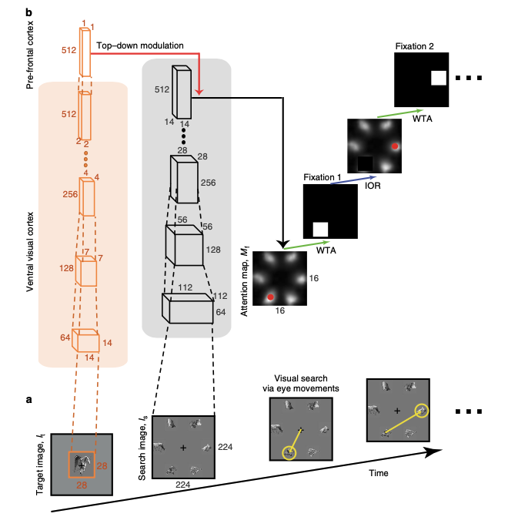
C0mputational visual search Theory
1980
1980
1984
1994
1998
2018
2021
1980
Top-down modulation illustration
IVSN model schematic (Zhang et al., 2018)
Notes:
We can take a look into how the IVSN model construct an attention map.
We can see that the model take in both Context and Target image at the same time, and they are both going through the VGG16 model, but at the final layer, in the target side, the model apply a max pool layer while on the context side the model keep the size intact.
On the left-hand side, we can see how it conducts a first-order approximation, the final output of the target side is then dot-product with each entry of the context output side to produce a 1D attention map.

Slide 18
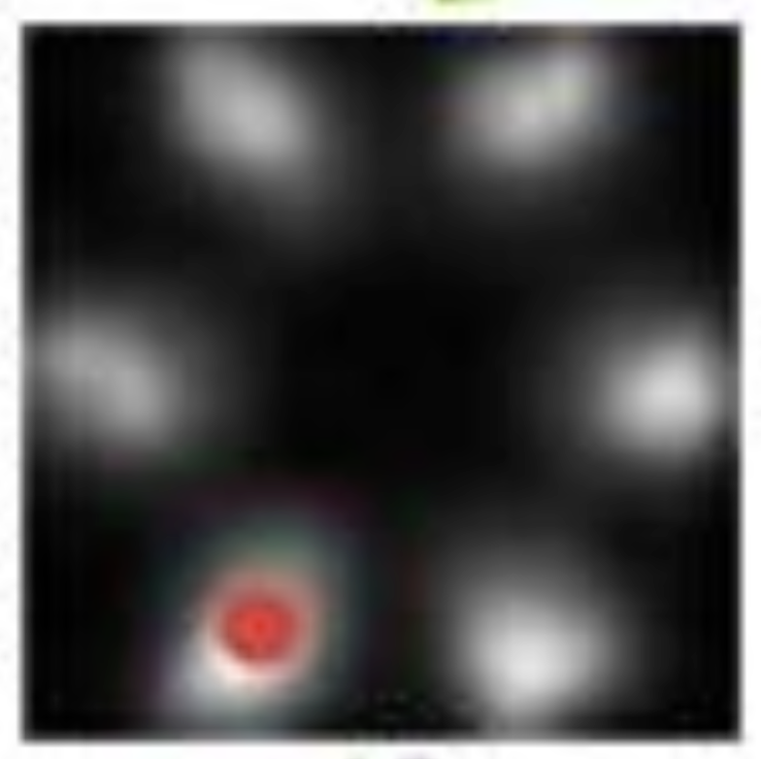
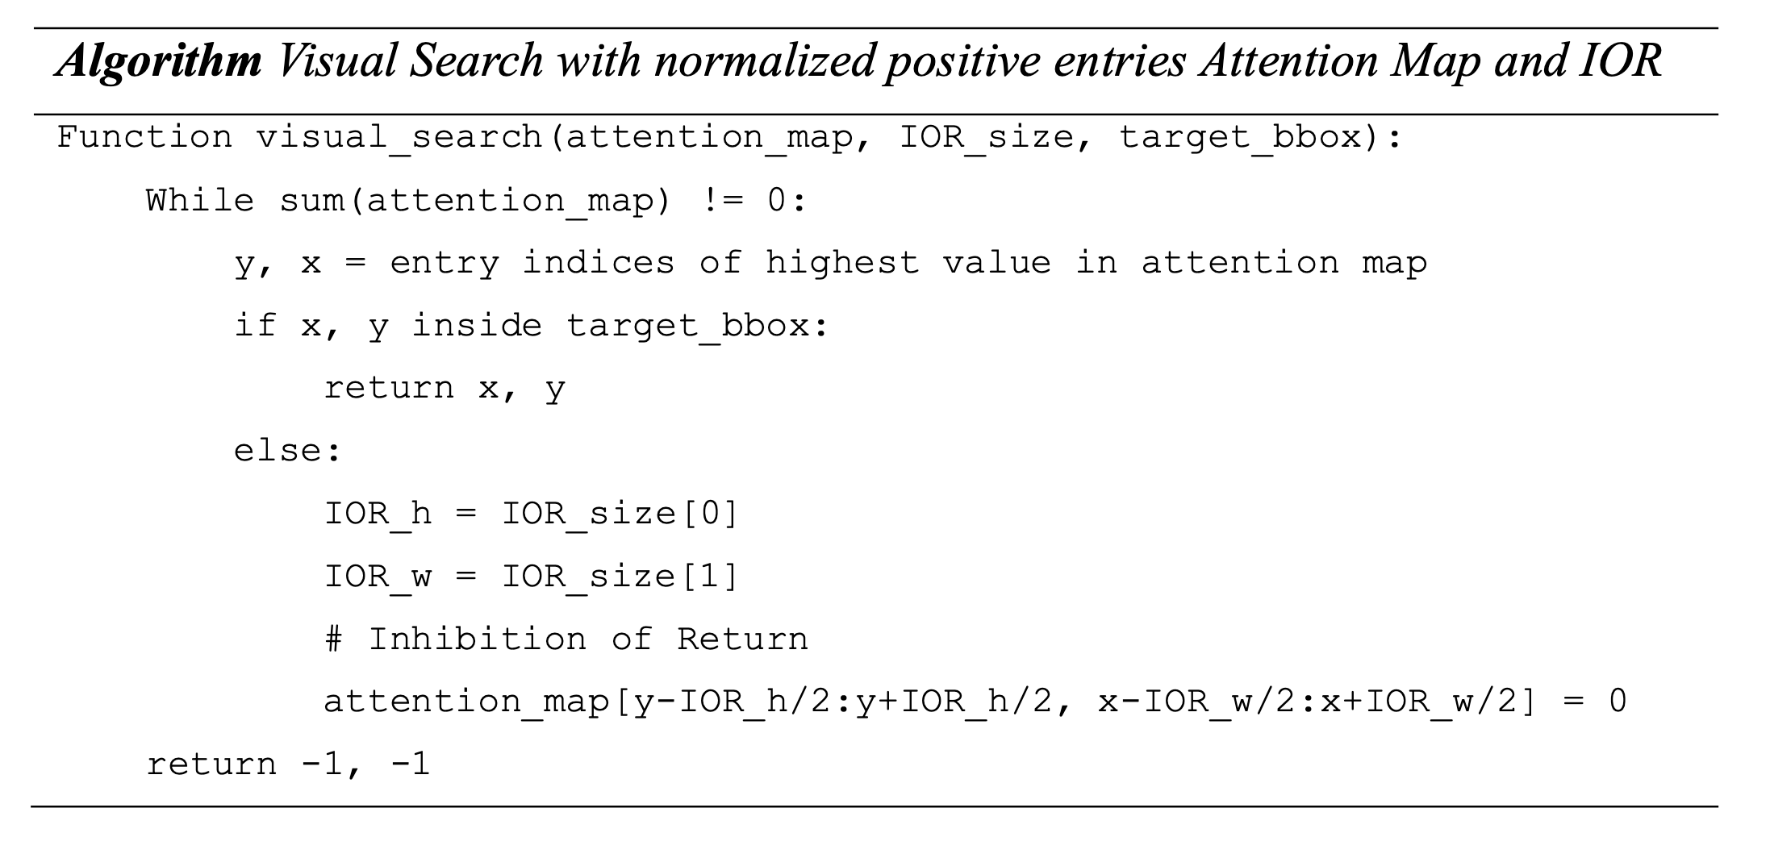

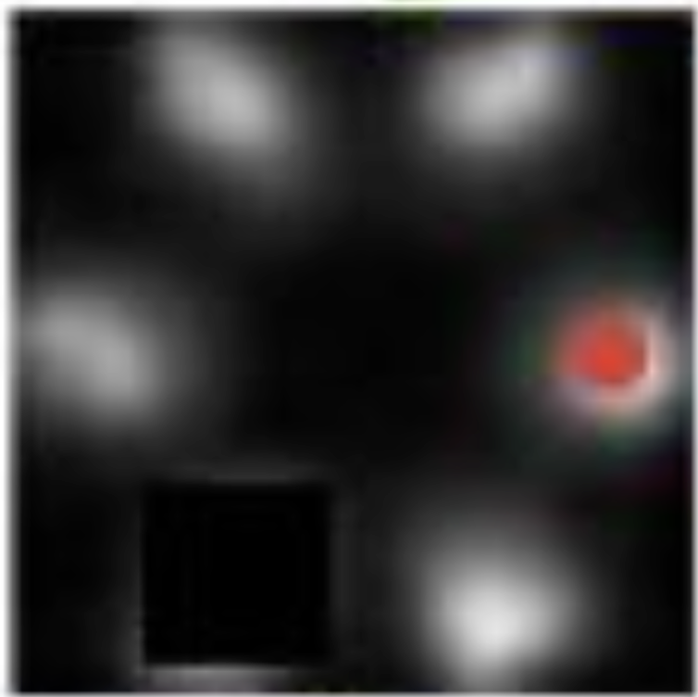

C0mputational visual search Theory
1980
1980
1984
1994
1998
2018
2021
1980
Notes:
But we do not stop at that point, we still need to find where the target is
This algorithm will show how can we find the target with Inhibition of return IOR.

Slide 19
C0mputational visual search Theory
1980
1980
1984
1994
1998
2018
2021
1980
Notes:
First we will find the highest similarity between the target and the context (the brightest spot on the attention map)

Slide 20
C0mputational visual search Theory
1980
1980
1984
1994
1998
2018
2021
1980
Notes:
If that spot is the desire destination we will return the result

Slide 21
C0mputational visual search Theory
1980
1980
1984
1994
1998
2018
2021
1980
Notes:
Otherwise we will continue with the following steps

Slide 22
C0mputational visual search Theory
1980
1980
1984
1994
1998
2018
2021
1980
Notes:
We will set them to “0” which effectively means that we will never visit that spot again in the future

Slide 23
C0mputational visual search Theory
1980
1980
1984
1994
1998
2018
2021
1980
Notes:
And we keep repeating until we find the target

Slide 24
C0mputational visual search Theory
1980
1980
1984
1994
1998
2018
2021
1980
Notes:
Let say this spot is the target

Slide 25
C0mputational visual search Theory
1980
1980
1984
1994
1998
2018
2021
1980
Notes:
We return the value

Slide 26
C0mputational visual search Theory
1980
1980
1984
1994
1998
2018
2021
1980
Dr. Zhang Mengmi and her research colleagues were inspired by biological cognitive function in visual search and proposed the Invariant Visual Search Network (IVSN).
Top-down approach architecture.
The attention map is generated by a first-order approximation (dot product between target output tensor and each entry of the output tensor)
The output attention map is resized to match the original input context image to apply the searching algorithm
The model validates the cognitive theory of Guided Search 2.0 (Wolfe, 1994), and demonstrates the capacity of realizing a mental model through a Deep Neural Network (DNN)
The IVSN shows the capacity for zero-shot invariant, allowing for searching for different appearances in a search scene without retraining.
Notes:
Dr. Zhang Mengmi and her colleague research validate the cognitive theory proposed by Wolfe in 1994.
On top of that, the model also show its capability of zero-shot invariant, which allow for searching object of the same categories but with different appearance.

Slide 27
Proposed TCT architecture
Notes:
Just as Wolfe refined his model, our effort in this FYP is to introduce contextual information to guide the visual search task through the TCT architecture.

Slide 28
TCT model components
Target image
Modified CRT model
Global Modulation
(Element-wise multiplication)
Modified ViT model
Attention Map
Context image
Note:
CRT Model: Context-aware Recognition Transformer Network (Bomatter et al., 2021)
ViT Model: Vision Transformer (Dosovitskiy et al., 2021)
Notes:
We can take a look at the overall structure of the TCT model:
The model take both target and context as inputs in to both channels to process.
Then, the final result of CRTNet is passed in the ViT model through the Global modulation process for further processing before outputting the attention map.

Slide 29
Modified Visual Transformer (one encoder block)
Self-Attention (
Key,
Query
)
Target Key
Attention Score (
Attention
Value
)
Target Attention Output
Target Query
Target Value
Cross-Attention (
Key,
Query
)
Keep Max Only
Local Modulation (
Scale Tensor
Attention
)
Context Attention Output
Context Key
Attention Score (
Attention
Value
)
Self-Attention (
Key,
Query
)
Context Query
Context Value
Notes:
We now take a closer look inside the ViT model architecture
We can see one very unique feature inside this ViT model is that it takes both target Query and Context Query into the Cross Attention layer and apply an keep max only operation before apply the local modulation operation.
This sequence of operations represents the top-down approach where they try to find the similarity of both the target and context information.

Slide 30
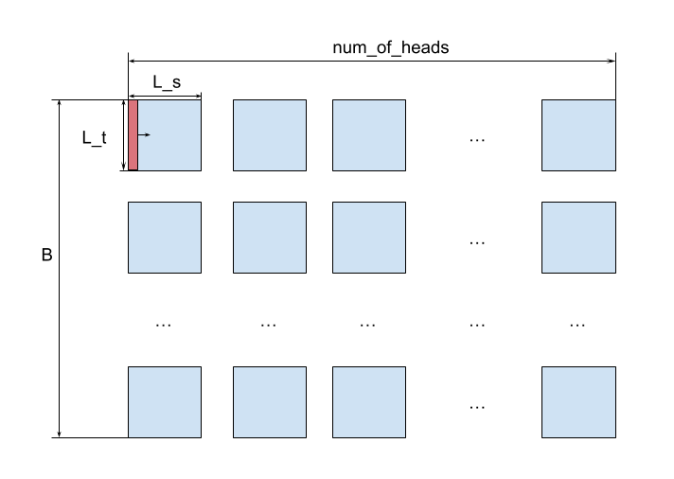
Keep Max Only
The keep-max only operation is a sequence of operations that retains the highest value in each column (L_t axis).
Intuitively:
Keep the highest similarity of the target features in each context image patch.
Each image patch is a segment of a picture that behaves similarly to a singular embedding token in natural language processing.
Cross-attention output
Notes:
Let’s see what does keep max only operation do.
The keep-max operation intuitively will try to keep the highest similarity of the target features in each context image patch. (each visual window)

Slide 31
Keep Max Only
Cross-attention output
Query Relevance
Notes:
Through the keep max operation the L_T will collapse to 1 and only keep the context sequence length.

Slide 32
Local Modulation operation
The local modulation is just a broadcasting element-wise multiplication along the Query axis on the self-attention output of the context attention.
The resulting tensor is a locally modulated attention map, which will be multiplied with the context Value tensor to generate the output for the next encoder block.
Note: This operation will only be applied to the user-defined last_n_layers of the ViT encoder block; it is not applied to all the encoder blocks in the ViT.
Query Relevance
Local Modulation
Notes:
The previous output is regarded as query relevant is then passed into locl modulation operation which will be scale along the target sequence length dimension to guide the top-down search process.
This operation is only applied in the last n layers of the ViT Encoder block rather than applied to all the Encoders in the ViT.

Slide 33
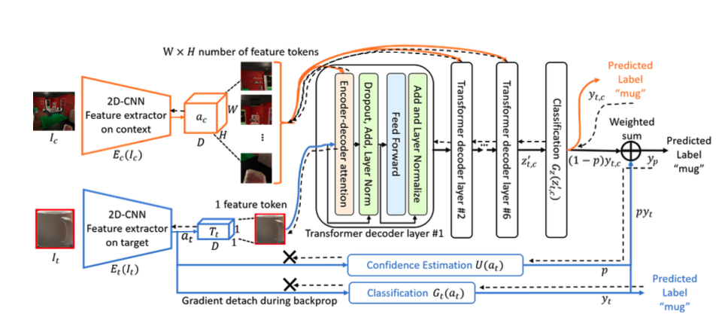
original CRTNet architecture
DenseNet (Gao et al., 2018)
CRTNet Architecture (Bomatter et al., 2021)
Notes:
We now move on to the CRTNet Architecture of the TCT model.
We can see that the original model from the original paper takes both the target and context image into 2 separate channels to process them. The context token output and the target token output from the DNN are then placed into the decoder sequence to predict the label of the object. The target also has an independent prediction path. The CRTNet is then takes the weighted guest by summing up both prediction paths.

Slide 34
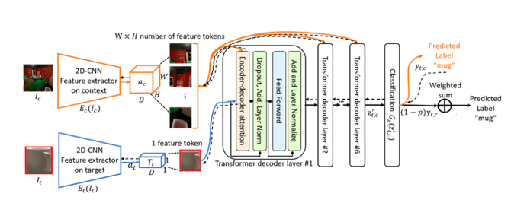
Modified CRTNet architecture
DenseNet (Gao et al., 2018)
CRTNet Architecture (Bomatter et al., 2021)
Notes:
Since attention is important in visual search we will incentivize the model to take more learning in the decoder path, therefore we will remove the independent path from the target token.

Slide 35
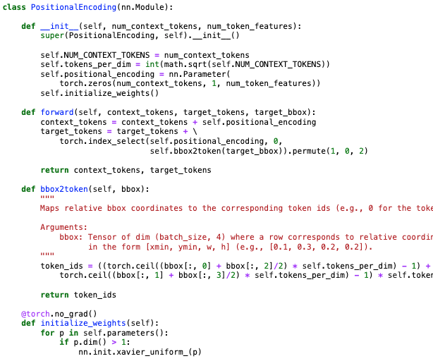
Modified CRTNet architecture
However, there is one vital issue:
The Positional Encoding in the Transformer takes a bounding box (bbox) as an input.
Why is it a fundamental issue?
- The model is responsible for conducting a visual search task to locate the target.
By having the bbox coordinate in the first place, the model is no longer required to locate the target.
Note:
The original structure is perfectly fine if the model is required to conduct object identification (classification).
Notes:
However, in the development process, we figured out that the original model take bouding box coordinate as an input to guide the model where is the object in the image to help the model perform better in object recognition task, it is a fundamental issue for visual search task since we already provide the destination in which the model purpose is to find it.

Slide 36
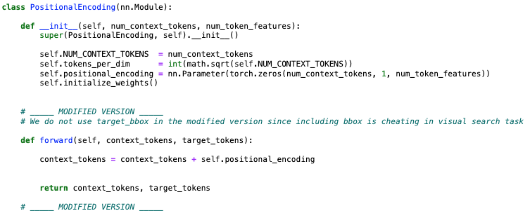
Modified CRTNet architecture Naïve Solution
- We simply remove the target_bbox as the parameter, and we don’t need to modify the target_encoding.
- We just need to modify the context_encoding.
=> The model might lose the “sense” of the target present in the context surrounding.
Notes:
To resolve it, the naïve way is just to remove it and does not apply any Positional encoding on the target token.
However, the model could be struggle to find the target in the context scene due to discrepancy from the positional encoding.

Slide 37
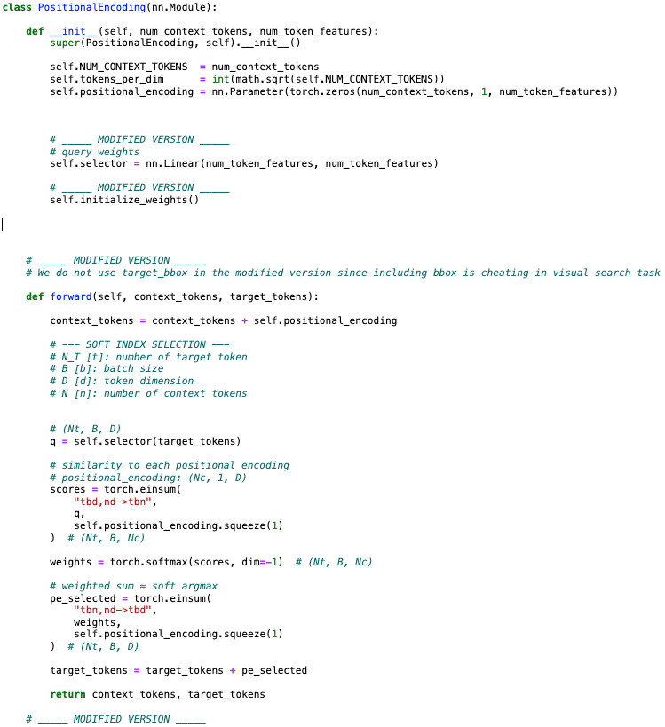
Modified CRTNet architecture heuristic bbox solution
Solution:
Added a Light-weight Attention layer
Query: Target token
Key: Context PE
Value: Context PE
Notes:
We then come up with the more innovative solution:
We decided to add a light-weight attention layer which take in target token as a query, context PE as Key, and context PE again as a value tensor and we try to output a weighted attention to summed the context PE and produced a target PE.

Slide 38
Modified CRTNet architecture heuristic bbox solution
Original Architecture
Modified Architecture
Context PE tensor
Bbox coordinates (1, 1)
Target token
Context PE tensor
Attention
Target token
0
1
2
0
1
2
0
1
2
0
0
0
1
1
1
2
2
2
+
*
⅀
+
Target token
Target token
Notes:
This is visualize comparison between the original PE and our innovative solution
On the left hand side, the original CRTNet just select the Context PE and add it to the target token.
While ours on the right hand side take the weighted sum of the context PE and add the result to the target token.

Slide 39
Global Modulation (TCT architecture)
Global Modulation is an element-wise multiplication between the CRT attention output and the second residual output of the ViT Transformer Architecture.
The global modulation output is then summed with the final feed-forward layer output, resulting in the final attention map for that encoder block.
Note:
This operation is only applied ONCE in a pre-selected (user-defined) ViT Encoder Block (other encoder blocks do not have a global modulation operation)
Notes:
We now take a look at global modulation.
Global modulation is just a element-wise multiplication between the CRTNet attention output and the second residual of the ViT Transformer architecture.
This operation is only applied ONCE in the pre-defined manner.

Slide 40
Data Augmentation for CRTNet training
We select 18 image categories from the COCO dataset (Lin et al., 2015) and conduct augmentation on both context and target images.
There are 3 selections for Context Image and 3 selections for Target Image to form 1 image pair.
Context input selections:
Original context image with original target image.
Original context image with a random target of the same category.
Original context image with a black rectangle covering the target region.
Target input selections:
Original target image.
Random target image of the same category.
Black rectangle of the target image size.
Notes:
To further encourage the CRTNet to leverage its decoder attention mechanism, we introduce some more augmentation in the training process
From the COCO dataset, there are 3 selection for Context Image and 3 selection for target image.
So there are 9 combinations of selection is total to form an image pair

Slide 41
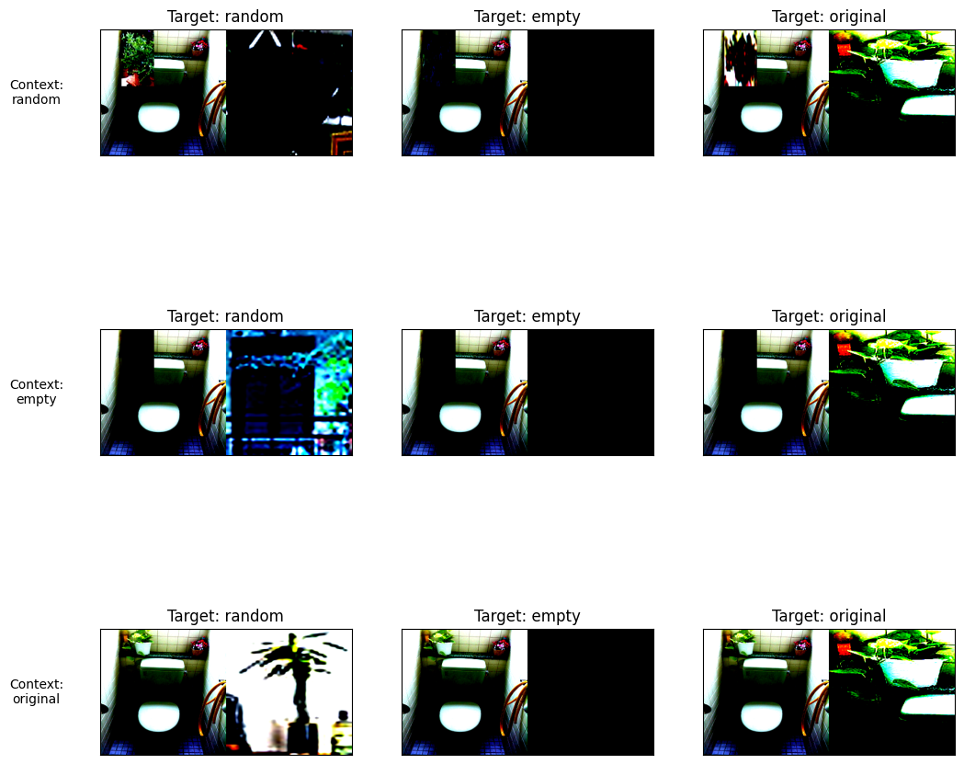
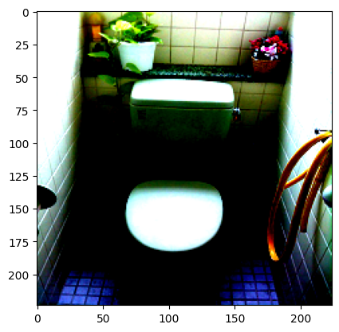
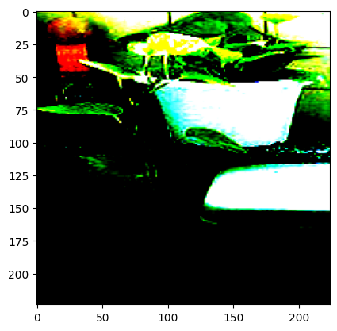
Data Augmentation for CRTNet training
Original Context
Original Target
All the Target and Context combinations for CRTNet Training
Notes:
This is a visualization of how the data augmentation that are used in the training process

Slide 42
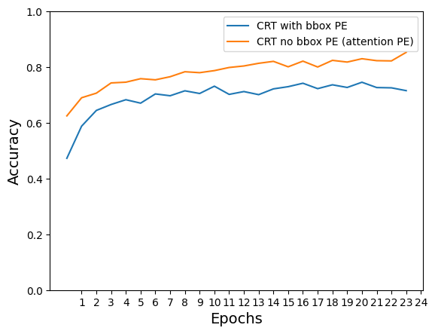
CRTNet Recognition TEST Performance
Epoch | Test Accuracy (CRT cross-attention PE) | Test Accuracy (CRT bbox-guided PE)
7 | 75.44% | 70.38%
24 | 85.31% | 71.56%
Notes:
After testing and benchmark both the bbox PE model and the innovative PE version we find out that the innovative PE version learn faster and perform better in recognition task.

Slide 43
Experiment
TCT model performance on different benchmark datasets
Notes:
Now, let’s move on to the experiment where we will see how TCT model perform on different benchmark datasets

Slide 44
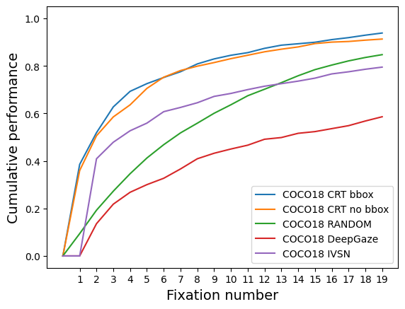
Benchmark dataset COCO-Search18 (Lin et al., 2015)
Notes:
In the COCO-Search18 dataset, we can see that our final model (Orange line) performs better than other benchmark models, it is also expected since the model is also trained on the same set of the dataset, so it is expected to perform better on the same distribution.
One notable point is that our model performs as well as the “cheat” model, where a bounding box is provided in the positional encoding layer.

Slide 45
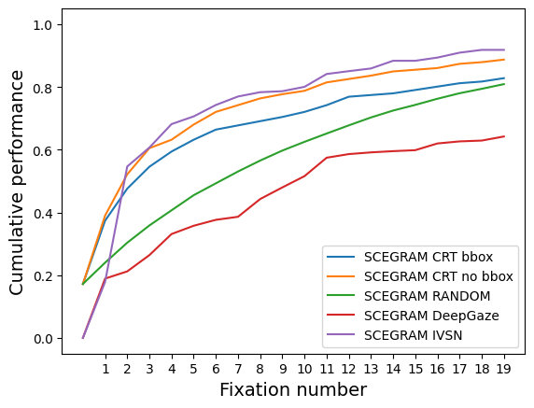
Benchmark dataset SCEGRAM (Öhlschläger & Võ, 2017)
Notes:
In the SCEGRAM dataset, where objects with same category but have different appearance, our model tend to perform worse than Dr. Zhang Mengmi IVSN model.
However, it is also important to note that our model outperforms the bbox TCT model and is comparable to the IVSN model.

Slide 46
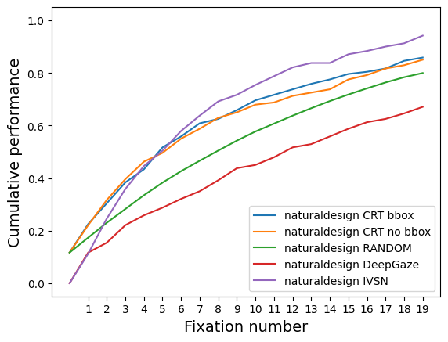
Benchmark dataset NaturalDesign (Zhang et al., 2018)
Notes:
In the natural design dataset introduced in the IVSN paper, the dataset challenges the model's ability to find targets in the surroundings with similar shapes and colours like faces and small objects.
TCT model tends to underperform IVSN model in this dataset, but overperform RANDOM searching and DeepGaze model which only depends on Context image and log searching algorithm.

Slide 47
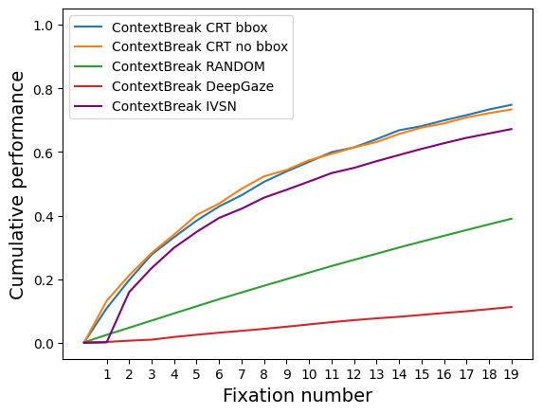
Benchmark dataset ContextBreak
Notes:
Finally, we introduce ContextBreak dataset, this dataset contain 24000 images with some images is of the same context scene but in different contexts visual angle to simulate human search behavior in reality “over attention”. Our model over perform random search by a large margin and overperform all benchmark models.

Slide 48
Contributions and future directions
Notes:
Finally, we conclude by summarizing what is possible limitaitons, our contributions and future directions

Slide 49
Possible limitations
The TCT model’s performance is not mathematically justified, as its components, ViT and CRTNet, are trained on different datasets and are linked only through a global modulation operation.
The selected last_n_layers for the local modulation operation, and the selected encoding layer for global modulation are chosen from an iterative process rather than rationally or intuitively selected.
Notes:
Even with such impressive performance, it is not mathematically justify since both Transformer components inside the TCT are refined on different dataset and are linked only through global modulation operation
Moreover, every user-defined variable chosen for the TCT model are through iterative process rather than rationally or intuitively selected or explain which make the model unstable for further scaling and enhancement.

Slide 50
Contributions
Rebuild the CRTNet architecture through code inspection and modify the PE layer for the visual search task by introducing a light-weight attention layer.
Modify the ViT structure by introducing the local modulation operation inside the encoder architecture.
Conduct image augmentation for the CRTNet recognition task training to “encourage” the model to leverage the attention mechanism of the decoder layer.
Perform a visual search task using the TCT model on different benchmark datasets with different attribute to evaluate the model performance.
Notes:
The contribution of my FYP is as follows:
We reconstruct the CRTNet and modified the PE layer to make it suitable for the visual search task
We also modify the ViT structure by introducing the local modulation.
Introducing image augmentation to encourage CRTNet to leverage its decoder attention mechanism
Finally. Perform visual search task using TCT model on different benchmark datasets

Slide 51
Future directions
Explore the replaceability of the building blocks of the TCT model (ViT, CRTNet).
Discover a more complex architecture, e.g., waterfall global modulation, local modulation in building block for both Transformer Architecture instead of only one, etc.
Reconsider training the whole TCT model on the recognition task and transferring it to the visual search task.
Build an application that leverages such an effective model for tasks like satellite searching, human face searching, etc.
Notes:
For future direction:
It is possible to experiment with the replacability of each building blocks of the TCT models or we can try to advance the model through a more complex architecture like water fall global modulation or waterfall local modulation, etc.
When computational resources is available, we can also try to train the whole TCT model on the recognition task and transferring it to the visual search task
To end the presentation, we can suggest leveraging our model to build application like satellite finding to help to find people in danger or human face searching, etc.

Slide 52
References
Bomatter, P., Zhang, M., Karev, D., Madan, S., Tseng, C., & Kreiman, G. (2021). When Pigs Fly: Contextual Reasoning in Synthetic and Natural Scenes. 2021 IEEE/CVF International Conference on Computer Vision (ICCV), 255–264. https://doi.org/10.1109/ICCV48922.2021.00032
Chun, M. M., & Jiang, Y. (1998). Contextual Cueing: Implicit Learning and Memory of Visual Context Guides Spatial Attention. Cognitive Psychology, 36(1), 28–71. https://doi.org/10.1006/cogp.1998.0681
Dosovitskiy, A., Beyer, L., Kolesnikov, A., Weissenborn, D., Zhai, X., Unterthiner, T., Dehghani, M., Minderer, M., Heigold, G., Gelly, S., Uszkoreit, J., & Houlsby, N. (2021). An Image is Worth 16x16 Words: Transformers for Image Recognition at Scale (arXiv:2010.11929). arXiv. https://doi.org/10.48550/arXiv.2010.11929
Lin, T.-Y., Maire, M., Belongie, S., Bourdev, L., Girshick, R., Hays, J., Perona, P., Ramanan, D., Zitnick, C. L., & Dollár, P. (2015). Microsoft COCO: Common Objects in Context (arXiv:1405.0312). arXiv. https://doi.org/10.48550/arXiv.1405.0312
Öhlschläger, S., & Võ, M. L.-H. (2017). SCEGRAM: An image database for semantic and syntactic inconsistencies in scenes. Behavior Research Methods, 49(5), 1780–1791. https://doi.org/10.3758/s13428-016-0820-3
Posner, M. I. (1980). Orienting of Attention. Quarterly Journal of Experimental Psychology, 32(1), 3–25. https://doi.org/10.1080/00335558008248231
Posner, M. I., & Cohen, Y. (1984). Components of Visual Orienting. In H. Bouma & D. G. Bouwhuis (Eds.), Attention and Performance X (pp. 531–556). Lawrence Erlbaum Associates.
Simonyan, K., & Zisserman, A. (2014). Very Deep Convolutional Networks for Large-Scale Image Recognition (Version 6). arXiv. https://doi.org/10.48550/ARXIV.1409.1556
Treisman, A. M., & Gelade, G. (1980). A feature-integration theory of attention. Cognitive Psychology, 12(1), 97–136. https://doi.org/10.1016/0010-0285(80)90005-5
Vaswani, A., Shazeer, N., Parmar, N., Uszkoreit, J., Jones, L., Gomez, A. N., Kaiser, L., & Polosukhin, I. (2023). Attention Is All You Need (arXiv:1706.03762). arXiv. https://doi.org/10.48550/arXiv.1706.03762
Wolfe, J. M. (1994). Guided Search 2.0 A revised model of visual search. Psychonomic Bulletin & Review, 1(2), 202–238. https://doi.org/10.3758/BF03200774
Wolfe, J. M. (2021). Guided Search 6.0: An updated model of visual search. Psychonomic Bulletin & Review, 28(4), 1060–1092. https://doi.org/10.3758/s13423-020-01859-9
Yang, Z., Huang, L., Chen, Y., Wei, Z., Ahn, S., Zelinsky, G., Samaras, D., & Hoai, M. (2020). Predicting Goal-Directed Human Attention Using Inverse Reinforcement Learning. 2020 IEEE/CVF Conference on Computer Vision and Pattern Recognition (CVPR), 190–199. https://doi.org/10.1109/CVPR42600.2020.00027
Zhang, M., Feng, J., Ma, K. T., Lim, J. H., Zhao, Q., & Kreiman, G. (2018). Finding any Waldo with zero-shot invariant and efficient visual search. Nature Communications, 9(1), 3730. https://doi.org/10.1038/s41467-018-06217-x

