Slide 1
CTF FORENSICS
Chuyên đề An toàn phần mềm
Báo cáo giữa kì
Giáo viên hướng dẫn: TS.Huỳnh Trọng Thưa
Sinh viên: Nguyễn Tuấn Kiệt – N18DCAT035
Back
Next

Slide 2
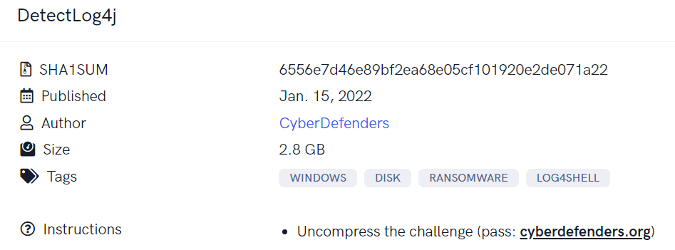
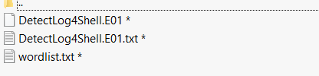
CyberDefenders BlueTeam CTF DetectLog4j
Back
Next

Slide 3
CyberDefenders BlueTeam CTF DetectLog4j
1.What is the version of the log4j library used by the installed VMware product?
2.What is the log4j library log level specified in the configuration file?
3.The attacker used the log4shell.huntress.com payload to detect if vcenter instance is vulnerable. What is the first link of the log4huntress payload?
4.When was the first successful login to vsphere WebClient?
5.What is the attacker’s IP address?
6.What is the port the attacker used to receive the cobalt strike reverse shell?
7. What is the executable used by the attacker to gain persistence?
Back
Next

Slide 4
CyberDefenders BlueTeam CTF DetectLog4j
1.What is the version of the log4j library used by the installed VMware product?
- log4j-core-2.11.2.jar
2.What is the log4j library log level specified in the configuration file?
- info
3.The attacker used the log4shell.huntress.com payload to detect if vcenter instance is vulnerable. What is the first link of the log4huntress payload?
- log4shell.huntress.com:1389/b1292f3c-a652-4240-8fb4-59c43141f55a
4.When was the first successful login to vsphere WebClient?
- 2021-12-28 20:39:29
Back
Next

Slide 5
CyberDefenders BlueTeam CTF DetectLog4j
5.What is the attacker’s IP address?
- 192.168.112.128
6.What is the port the attacker used to receive the cobalt strike reverse shell?
- 1337
7 .What is the executable used by the attacker to gain persistence?
- baaaackdoooor.exe
Back
Next

