Slide 1
Presentation Blockchain-based Crowdfunding platform
Le Hoang Tuan, Nguyen Thanh Tung
Notes:
I only present new things. What was presented, I would like to ignore.

Slide 2
Outline
Complete task add description for campaign module
Have small demo
Idea for identity management
Next work

Slide 3
Store some information of campaign
No need decentralized store with some info as name, description, image (url),...
Solution:
Store on centralized database. We choose “Redis”
Key->value
Name
Short description
Description
Image URL
Hash (name + timestamp)
Key
Notes:
Tại sao chọn Redis?
Redis là một cơ sở dữ liệu nguồn mở lưu trữ dữ liệu theo dạng key-value.
Đơn giản, truy xuất nhanh. Tham chiếu với key -> value.
Một cơ sở dữ liệu SQL có vẻ quá mức cần thiết cũng như không đem lại hiệu suất cao, các bản ghi này ko bao giờ update, chỉ insert, chẳng cần transaction và cũng chẳng có quan hệ nào giữa các bảng.
Redis cung cấp một cơ chế bảo toàn dữ liệu có thể cấu hình, dữ liệu được lưu trữ ngầm theo khoảng thời gian và có thể cài đặt để chạy master-slave

Slide 4

Process when create campaign
Startups
1
Fill form
Validate fields
(include captcha)
2
DB server
Captcha string
DB_key
Data....
4
Generate DB_key
=hash(name + timestamp)
3
DB_key
Hash (data)
Goal
Deadline
Blockchain
5

Slide 5

Identity management
Why need?
How to?

Slide 6

Why need identity?
Get information’s user ( name, ID card, number phone … )
Avoid scamming
Sponsored contact owner’s project easier
Get belief from sponsored if information’s user absolutely ‘clean’

Slide 7
How to store identity data
Store it into smart contract on Ethereum
Structure:
Includes:
Private information: some info for verify as ID card, driver license, DoB...
Public information: name, address,...
Pk_{user} is private key of user
Verified: boolean
Private information -> encrypt (Pk_{user} , data)
Public information
mapping address
Notes:
Why need private infor?
Why need encrypt private infor?
Why store on Blockchain?

Slide 8
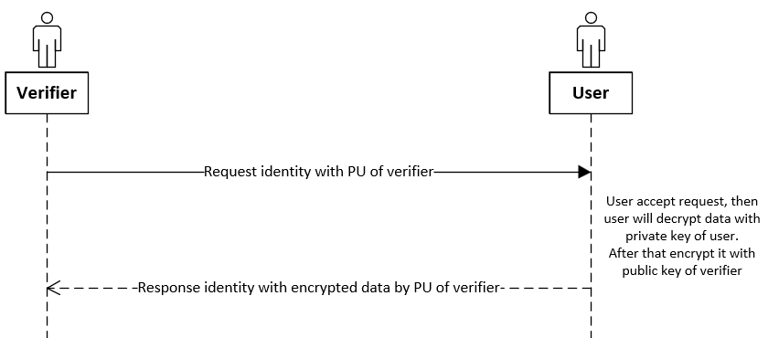
Share identity mechanism
This is mechanism share identity in verify process

Slide 9
Next work
Implement user identity management

Slide 11
Outline
Some current problems
Next work
Notes:
My presentation is devided into only 2 parts.
First one, i will talk about some current problem. Finally, i will talk my next work.
Let’s get started.

Slide 12
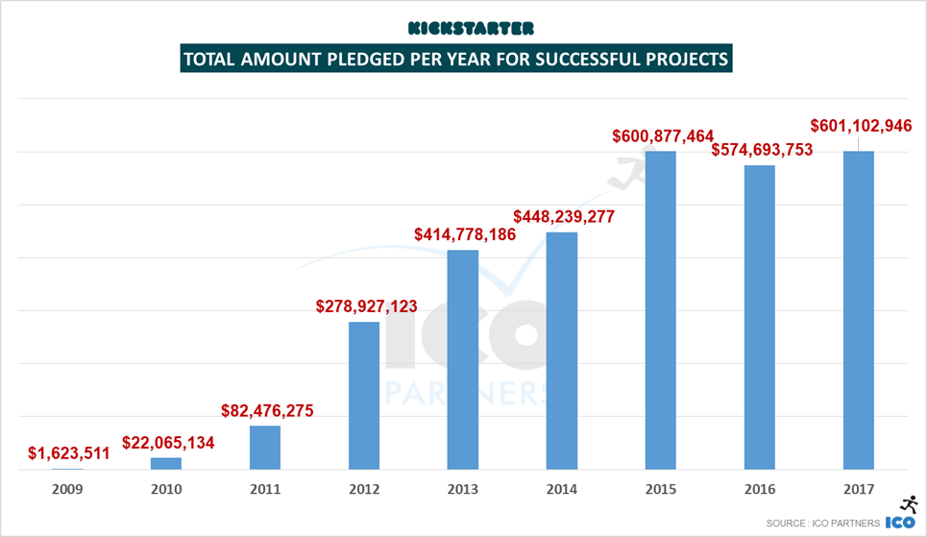
A few statistics about crowdfunding

Slide 13
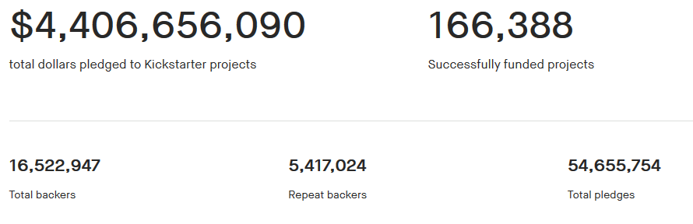
A few statistics about crowdfunding
Kickstarter stats

Slide 14
Solving some problems
User management: which and where store user data?
Store campaign info -> complete back-end
Period-disbursement -> complete smart contract -> testing and fix some issue
Notes:
In user management, we have issue about which data is stored and where store data?
Because i care to privacy problems. Information personal of user not public (except info of creator), and info of each user only creator that they invested know
In store campaign info, we choose redis db to store, because it fast and simple. We will learn more about security of redis
In Period-disbursement func., we have written smart contract, and now i’m testing and fix some issue

Slide 15
Next work
Learn more about user management models in other blockchain projects.
Combining front-end and back-end in campaign information storage.
Setting an upcoming goal is clearer

Slide 16
Outline
Improve front-end
Design/idea for “disbursement” function
Design/idea for “add more description” function
Next work
Notes:
My presentation is devided into 3 parts.
First one, i will talk about improve front-end. After that, i will talk about idea for disbursement and add more description function. Finally, i will talk my next work.
Let’s get started.

Slide 17
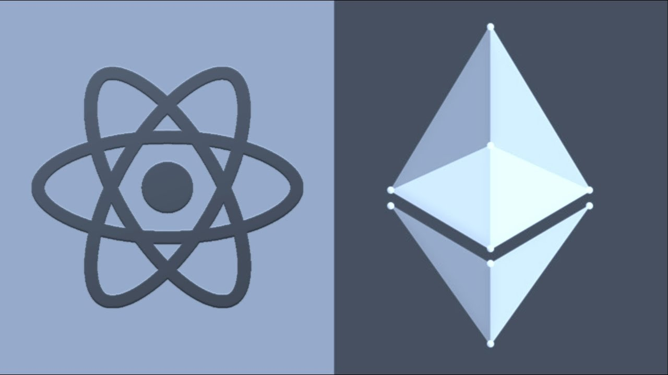
Improve font-end
Witched from plain js to ReactJS
Notes:
The idea is the frontend is just a layer which makes the interaction with DAppChains easier, instead of the user send requests directly to the blockchain, the web interface will create a gentle and elegant layer above.
Before that, I used plain js, it was difficult to expand and the speed was slow. And it also makes it difficult to debug applications.
React combined with Truffle box, it integrates very well.
I comportable with React.
I also improve demo with add some small function as: handle transaction and I have added waiting effects to improve user experience on my app.

Slide 18

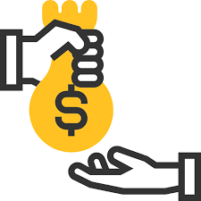

Disbursement
The disbursement will follow the period.
Total amount will be disbursed in stages. At each stage, project creator must create a voting for withdraw money.
Backers are voters.
This help to increase the rights of backers. Backers force project creators to report project progress.
Notes:
The disbursement will be divided into several stages.
Disbursing according to the project schedule after the fundraising campaign is successful, the project owner cannot withdraw all the money in one time. (If there is a project that needs the full amount at a time, the campaign will have the option to withdraw the entire amount in one time)
The goal of disbursement according to schedule: increase the rights of backers. Backers force project creators to report project progress, to avoid misuse of the project creator's money.
The total amount of capital raised will be disbursed in stages.
At each stage, the project owner wants to withdraw the money and must create a vote. Backers will decide whether or not the project creator has the right to withdraw money.
The number of stages divided can be suggested by the experts council. Consensus rates are fixed or flexible. In the case of flexibility, the withdrawn amount will be based on the number of consent votes

Slide 19
Disbursement - creation
When create a campaign:
First, creator will make disbursement options, include:
After that, the experts in the system will review those options, and suggest appropriate edits.
Number of stages
Deadline for each stages
Amount for each stages
Notes:
In this, creator must write for project plan clearly.
In pending campaign, allow creator edit some description before public. It apply only in pending time (not public)

Slide 20
Disbursement – withdraw process
When creator call withdraw campaign:
Creating voting votes for disbursement to force the campaign creator to do something.
If n_{stages} = 1, allow withdraw entire amount
If n_{stages} > 1, must voting for second stage onwards.
If voting > 50% accept, allow withdraw that stage
If voting <= 50 % accept, reject withdraw
and set campaign to failed
Notes:
If have only one stage, creator will withdraw entire amount without any voting.
If have more than one stage, creator must make a voting for second stage onwards, And creator must update stages for backers. First stage without voting.
In voting for each stages, if voting greater fifty percent accept, creator will be allow to withdraw that stage. Otherwise, campaign will be deny to withdraw, and status of campaign will be set to failed.
Creating voting votes to disburse to force the campaign creator to do something. Rather than simply writing a campaign description and getting money.

Slide 21
Disbursement – structure design for contract
STAGE structure:
struct STAGE {
int amount;
int deadline;
bool done;
int voteCount; // number of vote count for accept
}
mapping(int => STAGE[]) stages;
Campaign ID => mapping campaign id with stages
Notes:
In this case, a campaign have several stages, i will store stages as array of object and mapping it with campaign ID.

Slide 22
Disbursement – structure design for contract
Voting structure:
mapping(address => mapping (int => mapping(int => bool)) userVoting;
Campaign ID
Voted / haven’t voted
Index of stages
Address of user
Notes:
In this structure, i will only store who voted for a stages in a campaign. NOT store what they voting

Slide 23
Add more description in a campaign
Some campaign information such as long text, images, videos need to be added.
It will be store on my own DB server.
We will open an API to allow user request to add description onto DB. And after, it will be link to contract.
Current issue: we don’t have any mechanism to verify a request to DB.
Notes:
All information will be store as form as long text. Images, videos will be store with link in that text.
I originally planned to save them on IPFS, but the above information is not necessarily decentralized. To get the best performance, we decided to use a centralized server to save and retrieve them.
Now, we are finding solution for prevent spam and attack on DB server.

Slide 24
Add more description: current design
User fill creation form and Enter to submit.
1
Generate a random string, called ID
2
ID
3
ID + content
Smartcontract
DB server
→ ID = hash(timestamp + ID campaign)

Slide 25
Next work
Continue to implement disbursement function.
Continue solve problem in add more description function.

Slide 26

Q&A
Notes:
So, do you have any question?

Slide 27

Notes:
So that’s all for my presentation.
Thank you so much for listening.

Slide 28
Outline
Improve some function
Next work
Notes:
My presentation is devided into 2 parts.
First one, i will talk about improve some function. After that, i will talk about next work.
Let’s get started.

Slide 29
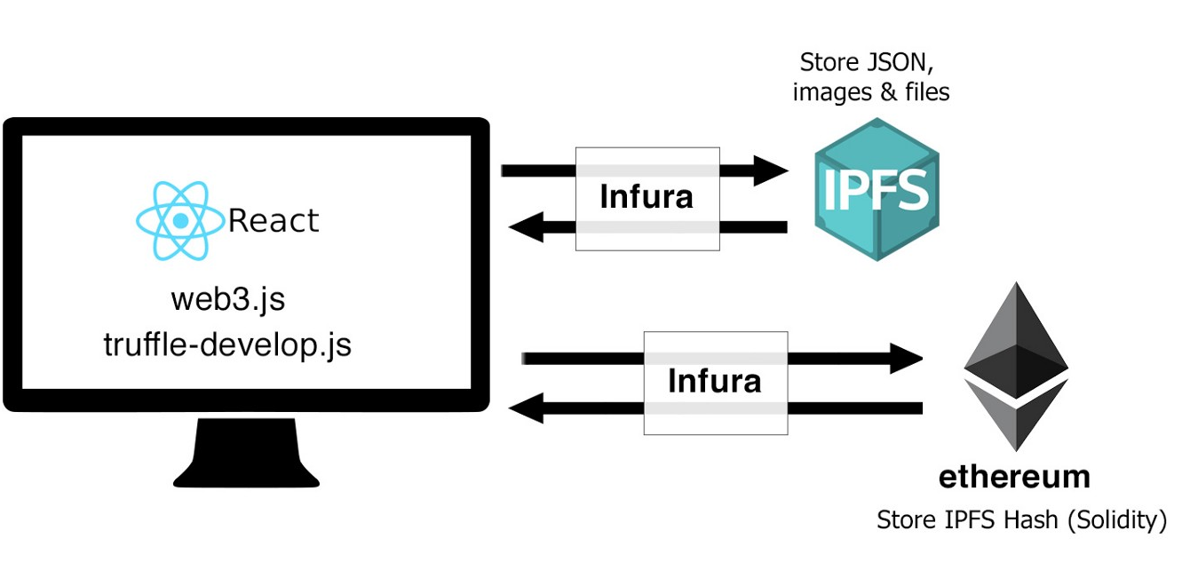
Add more description in a campaign
Some campaign information such as long text, images, videos need to be added
That files will be stored on IPFS.
After, ipfs hashes will be stored on smart contract.
Notes:
When user get info of a campaign, our platform will get ipfs hash from smart contract, after get files from ipfs hash.
Why use IPFS?
Decentralized
Cheaper
More stable than others

Slide 30
Next work
Complete some functions that presented.
Notes:
I still haven't finished the demo yet, so the next week I will try to finish it.

Slide 31
Overview
Type: donation and reward-based crowdfunding.
Fixed goal.
Disbursement: entire amount or period.
The system will have an internal exchange unit, called “Token” (Token <-> ETH).

Slide 32
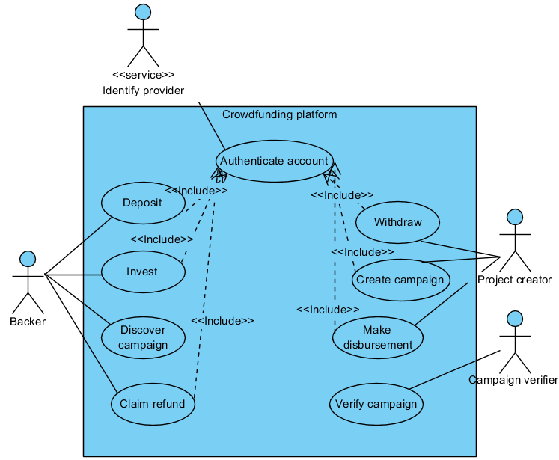
Use case diagram

Slide 33
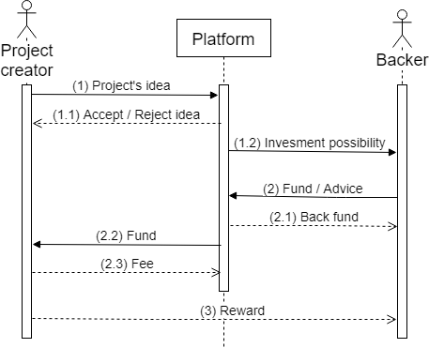
Process of a campaign

Slide 34
Implemented functions
Wrote smart contracts to implement some functions:
Deposit/withdraw ETH
Create campaign
Fund to campaign
Refund
Withdraw when campaign successful (entire amount)

Slide 35
Some problems
Auto-refund when campaign end
Reduce fraud

Slide 36

Auto-refund
Main point is at check/calculate balance
①
TokenSystem contract
Campaigns contract
call
getBalance()
②
call
getTotalInvest()
Backers
Return final balance
④
Return investment
③
Total investment = investment in during + succeed campaigns
(not include failed campaigns)
→ Final balance = initial balance - investment
Notes:
In getTotalInvest(), will return amount of tokens which investor has invested into campaigns, but it ignore with failed campaign.
Lastly, real balance is equal balance that investor deposit subtract with Total investment.
When investors fund to campaign, Campaigns contract only store investment state, not actually losing their balance in TokenSystem.

Slide 37
Reduce fraud
Verify campaign before public.
Allow discuss / report in during campaign.
The disbursement will follow the period.
Feedback after project end.
Notes:
As i said at the beginning, i will talk about how to reduce fraud in crowdfunding. Problem of fraud in crowdfunding is too difficult to solve completely. So i only suggest some methods to reduce fraud in crowdfunding.
The first method, a campaign which before being publicly available to backers, needs to be verified.
The second, in during campaign, backers can comment or report about a campaign.
The third, the disbursement will follow the period.
The last, after project ended, backers can feedback about reward.
I will detail for each method.

Slide 38
Next work
Write smart contract to handle disburchement (period)
Add some functions:
More description in create campaign (video, image,...)
List campaign in home page (sort, pagination)

Slide 39
Outline
Reduce fraud in fundraising campaign
Next work
Notes:
My presentation is devided into 2 parts.
First one, i will talk about problem fraud in crowdfunding. How to reduce fraud in fundraising campaign. After that, i will talk about next work.
Let’s get started.

Slide 40
Reduce fraud
Verify campaign before public.
Allow discuss / report in during campaign.
The disbursement will follow the period.
Feedback after project end.
Notes:
As i said at the beginning, i will talk about how to reduce fraud in crowdfunding. Problem of fraud in crowdfunding is too difficult to solve completely. So i only suggest some methods to reduce fraud in crowdfunding.
The first method, a campaign which before being publicly available to backers, needs to be verified.
The second, in during campaign, backers can comment or report about a campaign.
The third, the disbursement will follow the period.
The last, after project ended, backers can feedback about reward.
I will detail for each method.

Slide 41

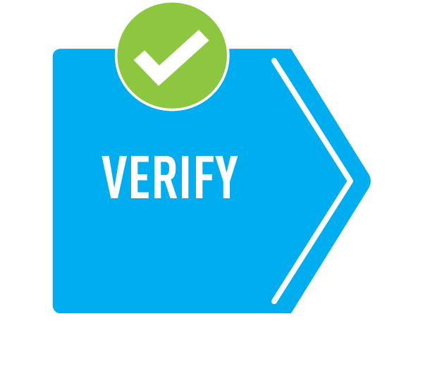
Reduce fraud
Verify campaign before public.
Who performs verification? -> an expert council
Result after verification: 4-levels
Completely allowed to public
Will be public, but have suggestions for project creators to do better.
Not yet public, have suggestions and request project creators to add documents according to the council's suggestion.
Not public.
Notes:
The goal of verification is to review the project before giving it to backers. Performing this verification is completely manual and will be verified by an expert council in each field. After the verification, the experts will give reviews and suggestions for the campaign before public.
The Expert Council will be hired by the platform. And rental costs can take from 3% of the total amount that the project creator receives.

Slide 42

Reduce fraud
Allow backers discuss / report in during campaign.
Discuss: to improve communication between backers and project creators. => help detect project creator not positive.
Report: take advantage of the “wisdom of the crowd”
Notes:
In during campaign (which has been approved to public on the system), allow backers in the system to discuss / report on the campaign if any related problems are detected.
This helps improve communication between backers and project creators. And helping to detect project creators are not positive. Therefore, it also improves the project quality through backers' suggestions.

Slide 43
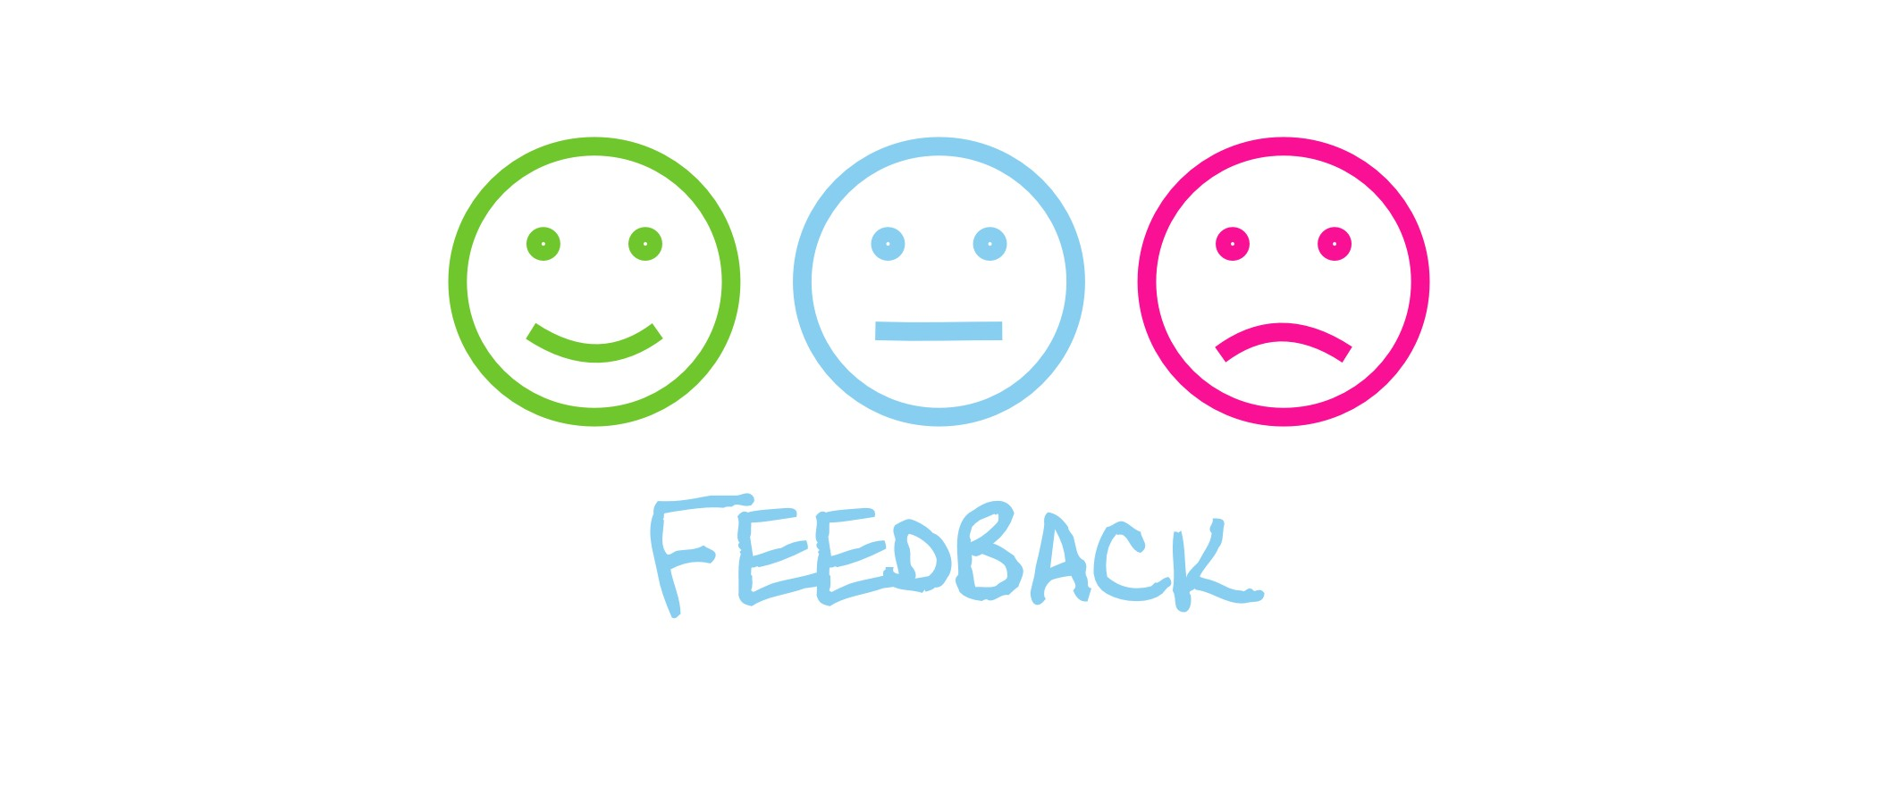
Reduce fraud
Feedback after project end.
Feedback is the source to improve verification project creators.
Notes:
After the project is produced, backers will respond to whether they have received the reward / product that the project creator has committed. Feedback will be recorded to contribute to verify potential project creators.

Slide 44
Next work
Implement methods that I presented

Slide 45

Problem: detect a unreliable campaign
Some characteristics of a scammer:
They are less likely to have engaged in prior crowdfunding activities.
They are less likely to have a social media presence.
Ref: Cumming, Douglas J., et al. "Disentangling crowdfunding from fraudfunding." Max Planck Institute for Innovation & competition research paper 16-09 (2016).

Slide 46
Problem: detect a unreliable campaign
Some characteristics of a scammer (cont.):
They use less number of words, verbs, and sentencesin their campaign pages.
Scammers make less typographical errors, 4.5-4.7 times lower than non-scammers.
Expressivity of scams is 2.6-8.5 times lower as well.
Ref: Shafqat, Wafa, et al. "The language of deceivers: Linguistic features of crowdfunding scams." Proceedings of the 25th International Conference Companion on World Wide Web. International World Wide Web Conferences Steering Committee, 2016.
Notes:
Their results indicate that byproviding less information and writing more carefully (andless informally), scammers deliberately try to deceive people;

Slide 47
Problem: detect a unreliable campaign
List of campaigns that was reported as scam:
On website: kickscammed.com
Notes:
We can refer to this site to find the campaigns we are considering. It is also useful.
Campaigns on this site are reported by users.

Slide 48
Method for verify campaign
Verify campaign
Manual process
Auto process
Auto+manual
Notes:
Manual process: This method will be verified by humans. The verifier may be expert in that field.
Auto process: We also use AI for this case. But I have not found any paper regarding this issue. I think I haven't found enough.
Auto+manual: In this case, I will divide the verification into two rounds. In the first round, AI automation will be applied to remove the most suspicious campaigns. Later in the second round, will be verified by humans with the filtered campaigns.
I am considering how to apply the auto and manual process to my system. But the initial campaign verification is only relative, not absolutely accurate. Should consider the process while the campaign is during

Slide 49
Next work
Continue research on verify a campaign problem.
Improve my previous demo.

Slide 50
Improve method auto-refund
I rewrite smart contract to improve check balance:
Only check campaigns that investor invested. Not check all

Slide 51
Demo: changelog
Added auto-refund mechanism after campaign failed.
Main point is at check/calculate balance
Investor
TokenSystem contract
Campaigns contract
①
call
getBalance()
②
call
getTotalInvest()
Return final balance
④
Return investment
③
Total investment = investment in during + succeed campaigns
(not include failed campaigns)
→ Final balance = initial balance - investment
Notes:
In getTotalInvest(), will return amount of tokens which investor has invested into campaigns, but it ignore with failed campaign.
Lastly, real balance is equal balance that investor deposit subtract with Total investment.
When investors fund to campaign, Campaigns contract only store investment state, not actually losing their balance in TokenSystem.

Slide 52
Demo: current problem
In method, I use variable now in smartcontract
But now is not really “now”
It’s alias for block.timestamp
This value pedends entirely on the clock in the machine mining that particular block.
Notes:
In the Solidity language now is actually a shorthand reference to the current block’s timestamp.
That time therefore depends entirely on the clock in the machine mining that particular block. The Ethereum Virtual Machine only requires that the timestamp of a block is greater than the referenced previous block’s timestamp.
I have not considered it now. (performance)
And If no blocks are mined to the chain, the timestamp will not be updated.
For most purposes, however, if the timestamps vary by even as much as a few minutes, this does not present a major issue.

Slide 53
Another method to auto-refund
Using a scheduling mechanism.
There are two method to schedule:
Use third-party service: ex. Ethereum Alarm Clock
Use timer schedule in NodeJS
➔ I choose Ethereum Alarm clock to focus instead of Schedule in NodeJS
Notes:
Because scheduling in NodeJS is more risk, the server can be down or not working at any time so it is not available to everyone. And it also centralized.
If i use Ethereum Alarm Clock, i can extend it for other function. It is really useful.

Slide 54
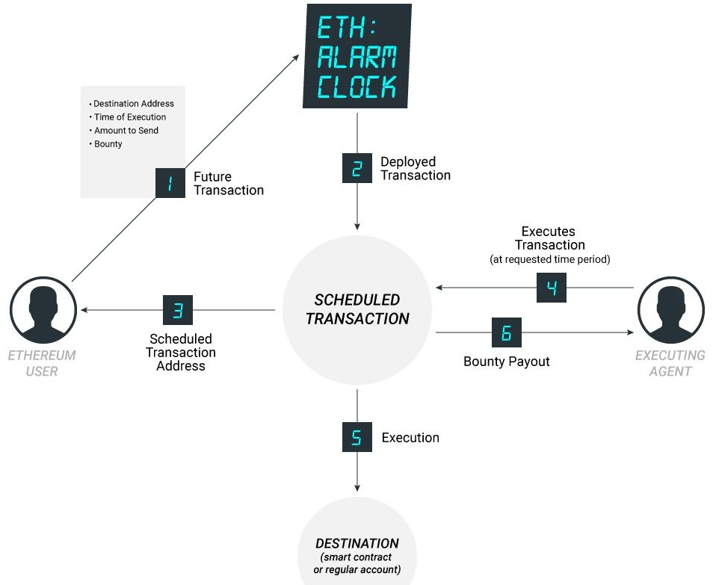
Ethereum Alarm Clock
Notes:
incentivize a network of off-chain nodes to report time.
It is a service. Allow send transaction to scheduled. And other will run it in future.
When you want to schedule a transaction, you need to provide some information such as address, time to execute and attach a reward to the person running it. Then players in the system will repeatedly run a program to review the transactions that need to be executed. If any transaction needs to be executed, the player will run it and receive a reward.

Slide 55
Ethereum Alarm Clock
Advantages:
Decentralized method
Run on Ethereum both mainnet and testnet
Disavantages:
Complicated
Non-scalable
Too expensive
And there is no guarantee that transactions are always executed
Notes:
I find these efforts complicated, non-scalable, and ultimately too expensive. And there is no guarantee that transactions are always executed.
If i apply it to project, i must to custom it.
So, I have not considered applying Ethereum Alarm Clock to the project

Slide 56
Next work
Continue to focus on Blockchain time issues.
Maybe I will consider using block.number instead of timestamp.
I can even consider using an other platform.
Notes:
Because for each time there will be a certain number of blocks is added.
As for the new platform, I have found a platform called CyberMiles with lity language, which supports scheduling in smart contracts. I am considering and learning it

Slide 57
Demo
Functions will be present:
Deposit ETH -> Token in system. And withdraw Token -> ETH
Create a campaign (startup)
Fund to a campaign (investor)
Claim refund from a campaign (investor)
Withdraw fund when campaign succeed (startup)

Slide 58
Demo
List of contracts:
TokenSystem: Only deploy once.
CampaignRegistry: Only deploy once.
Campaign: Every time the fundraiser creates a campaign, they have to deploy a contract to network.

Slide 59
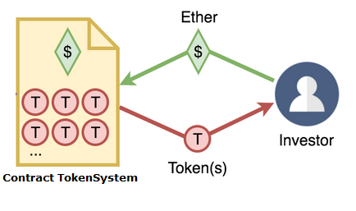
Demo
Deposit / withdraw
Token is the value that stores the amount of money that users send into the system.

Slide 61
Demo
Create a campaign
mapping
address => status
Name
Symbol
Owner
Goal
endDate
TokenCollected
investment(owner => token)
deploy
add
Startup
Contract Campaign
Contract CampaignRegistry
CampaignRegistry will store addresses with the status of campaigns.

Slide 62
Demo
Campaign status:
Pending: new campaign add to CampaignRegistry.
Accepted: is pending campaign that is verified.
Succeed: is accepted campaign that now > EndDate and TokenCollected == Goal
Failed: is accepted campaign that now > EndDate and TokenCollected < Goal
During: NOT failed and NOT succeed.
Paid: after startup withdraw token successful.

Slide 63
Demo
Fund to a campaign
Contract Campaign
Contract TokenSystem
tokens
Invest
Investor
Request burn token

Slide 64
Demo
Withdraw fund from a campaign
Contract Campaign
Contract TokenSystem
Request to withdraw
withdraw
tokens
Startup
Notes:
When campaign is succeed, startup can withdraw all fund in one time.

Slide 65
Demo
Environment:
Network: 192.168.66.167:8545 (testnet with ganache-cli)
Front-end: 192.168.66.167:3000
Web3js, Bootstrap/jQuery
Account wallet: MetaMask extension

Slide 66
Next work
Improve demo:
Sort list campaign in homepage.
Add history of transactions in campaign and account.
Add description of campaign (suggest: store on IPFS). Description include text, video, picture,...

Slide 67
Project’s process
ANALYSIS
SPECIFICATION
PROJECT
IMPLEMENT
DESIGN
TESTING
DEVELOP

Slide 68

Crowdfunding definition
“Crowdfunding is the practice of funding a project or venture by raising many small amounts of money from a large number of people, typically via the Internet” – (according to Oxford Dictionary)

Slide 69
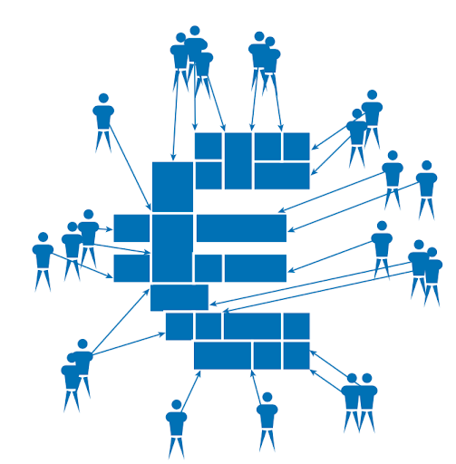
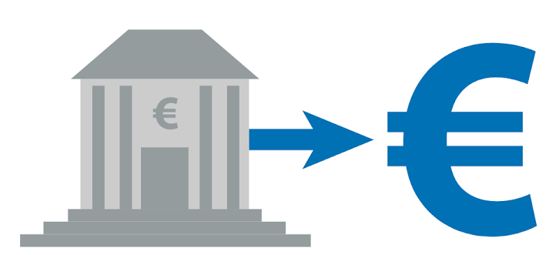
Traditional funding vs. Crowdfunding
Traditional funding
Crowdfunding
Large amounts from one or a few, sources
Many small sums from a large group of individuals

Slide 70
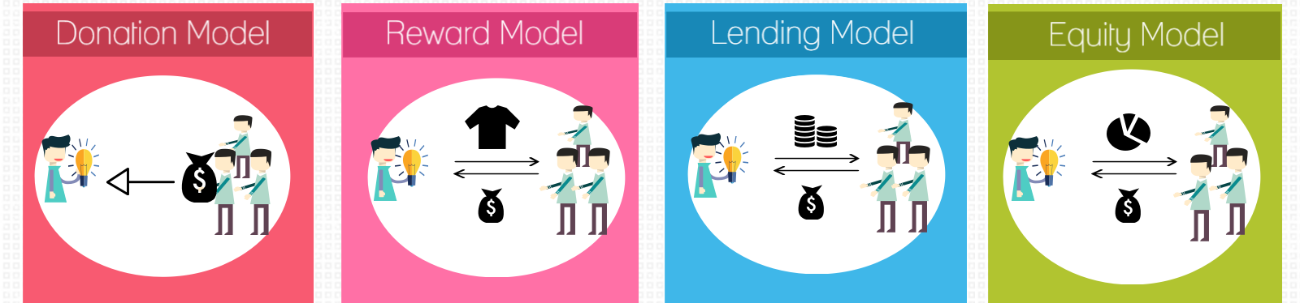
Types of crowdfunding
There are four major models of crowdfunding divided by investor profitability:
No return for money given
Tangible or intangible reward
Interest on money given
Ownership an money given
Notes:
Thêm tiêu chí phân loại vào

Slide 71
Why use Blockchain technology?
In Current World
1. Difficult to Fundraise It is difficult to fundraise for projects in early phase, even though it is publically-beneficial project.
2. Difficult to Recruit It is difficult to recruit good team members at initial stage. Giving stock option may be on option, but it is local, expensive, slow process.
In Blockchain
1. Issue and sell tokens on blockchain By issuing and selling tokens (Crypto currency) you can fundraise globally, fastly, and at low cost.
2. Pay tokens for Sharing Incentive Core teams can get thousands of supports, and pay tokens as a reward for "work"
The biggest disadvantage in current world is that it depends too much on the third party. => In Blockchain don’t need third party

Slide 72
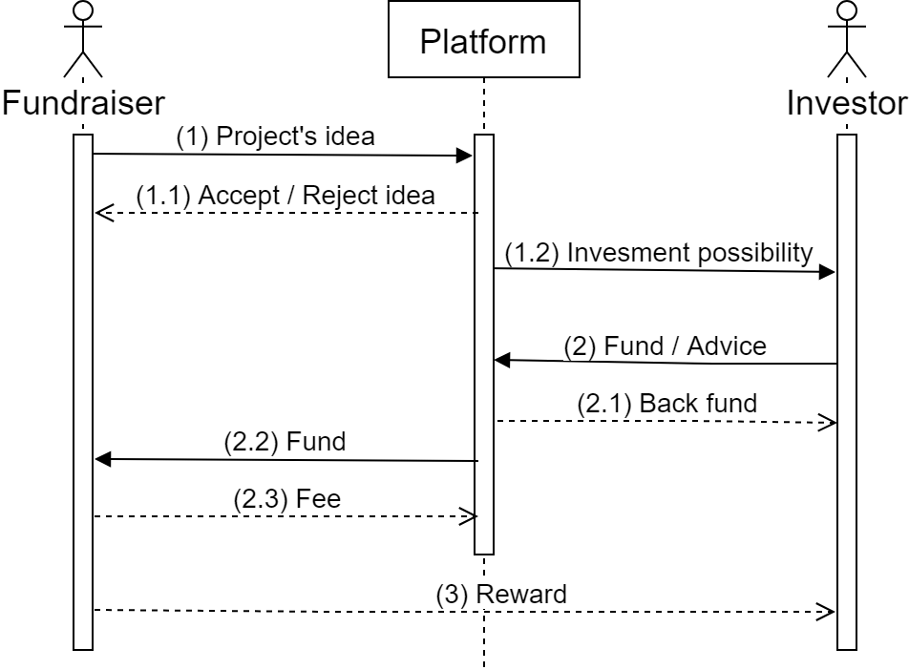
Crowdfunding process

Slide 73
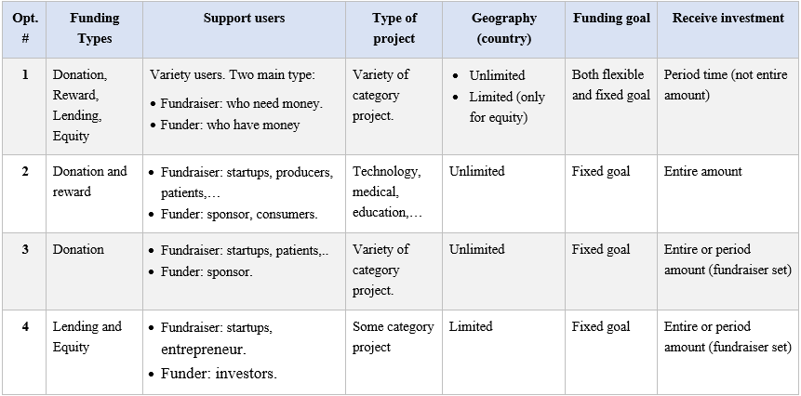
Requirement of project
=> I choose opt #2 to implement
Notes:
Fixed goal: in a period of time or specific time; and with amount of money. If the expiration date does not meet the conditions, the fundraiser will not receive anything. => “All or nothing”
Flexible goal: When the fundraising goal fails, the fundraiser can receive the money they raise. But that requires an agreement between the investor and the fundraiser, which means there should be a vote.
I will choose option #2 to implement system. Because I look it useful and possible to implement.
In the donation-based, a person in need of help can seek support from the community, and helpers are relieved because their money is transferred to the right people. For example, if a patient needs money to treat cancer, they can find crowdfunding as a help to them.
In the reward-based, producers can find opportunities to find capital to produce. And supporters will also find unique and new products. And there are many promotion for them.

Slide 74
Some current platforms
weifund.io:
Wallet: user can use a wallet in Metamask or Jaxx
Support currency: ETH
Method to fund a campaign: Setup a wallet, then send ETH to lightweight wallet (in WeiFund). Funds are typically stored in the campaign smart contracts until the campaign ends. When goal is reached, send ETH to fundraiser.
Claim a refund: not automate, investors have to click "Claim Refund Owed" in the page of campaign that has failed.
Create a campaign: is a manual process that the WeiFund team performs for our clients.
Notes:
I surveyed some of the current systems based on their white papers to create idea.

Slide 75
Some current platforms (cont.)
youtoken.io:
The total value of the YouToken platform is expressed in YTN token. YTN token could be purchased/sold/traded on external exchanges.
In addition to the tokens of the entire platform (YTN token), investors can obtain an entrepreneur’s creator tokens (YTN_creatorname).
It is not just a “MicroICO” platform. YouToken supports entrepreneurs during 100% of their “business life”
Fund will be received through many stages of project, not directly to the entrepreneur, it is stored in "Vault".
If creators want to receive fund for next stages, they made a request for investors to vote

Slide 76
Some current platforms (cont.)
pledgecamp.com:
To list a campaign, a creator must place a deposit on the blockchain with a native cryptocurrency called Pledge Coin (PLG).
Once a campaign is successfully funded, the Backer Insurance amount is automatically held in a smart contract encoded with the agreed-upon milestones and voting days.
Backer Insurance holds creators accountable to their promises and motivates them to be prepared and realistic while setting expectations.

Slide 77
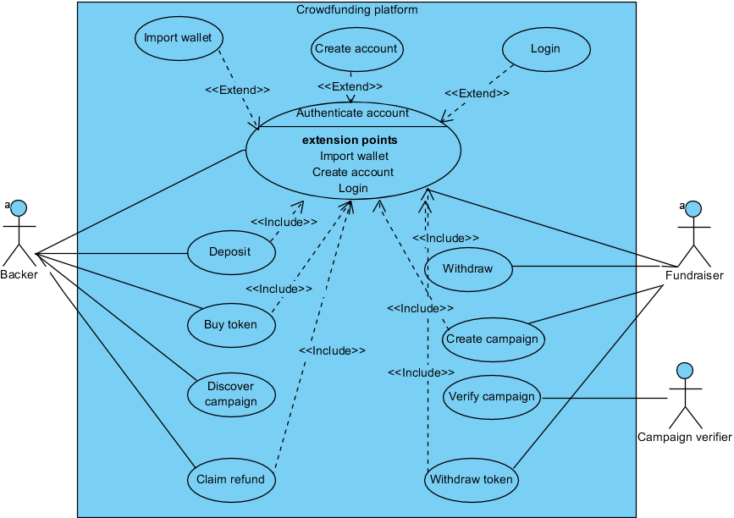
Use case diagram
Notes:
This is a general diagram for the system. I will design more details.

Slide 78
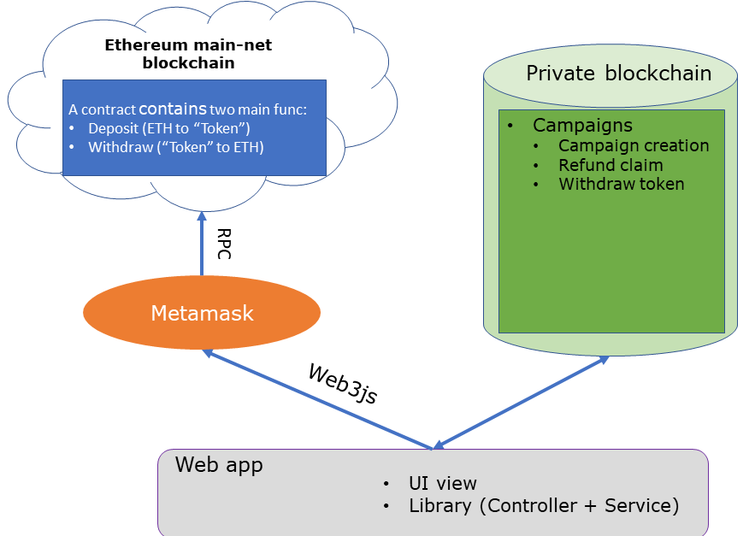
The system architecture design (suggest)

Slide 79
Method to fund
In order to invest for campaigns, investors must deposit ETH to get tokens.
The fundraiser will create a campaign.
Investors will invest token to campaign.

Slide 80
Method to withdraw fund
When the fundraising time is over, if the goal is reached, the entire fundraising amount will be transferred to the investor in the form of “tokens".
Fundraisers can withdraw “token" to ETH.

