Slide 1
Presentation Blockchain-based Crowdfunding platform
Le Hoang Tuan
Notes:
I only present new things. What was presented, I would like to ignore.

Slide 2
Outline
Overview:
Requirement
Use case diagram
Architecture diagram
Next work

Slide 3
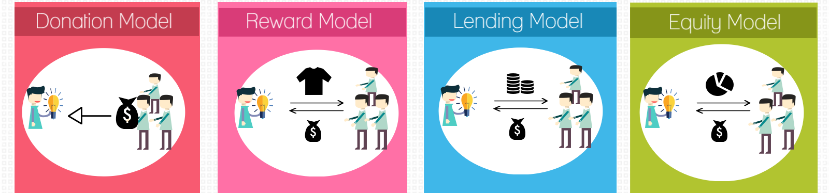
Types of crowdfunding
There are four major models of crowdfunding divided by investor profitability:
No return for money given
Tangible or intangible reward
Interest on money given
Ownership an money given
Notes:
Thêm tiêu chí phân loại vào

Slide 4
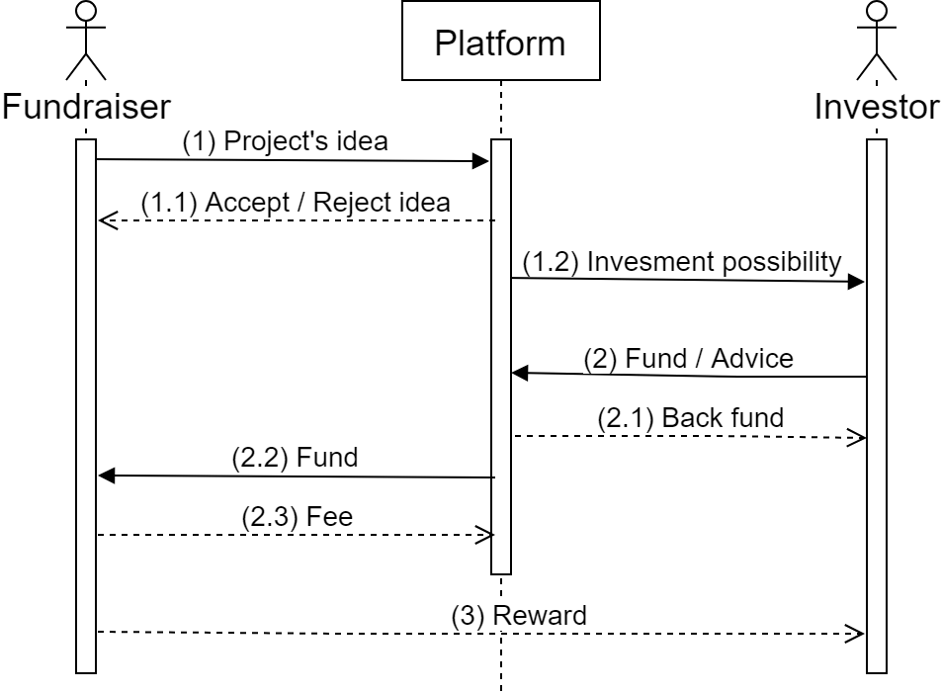
Crowdfunding process
Notes:
This is diagram based on reward crowdfunding

Slide 5
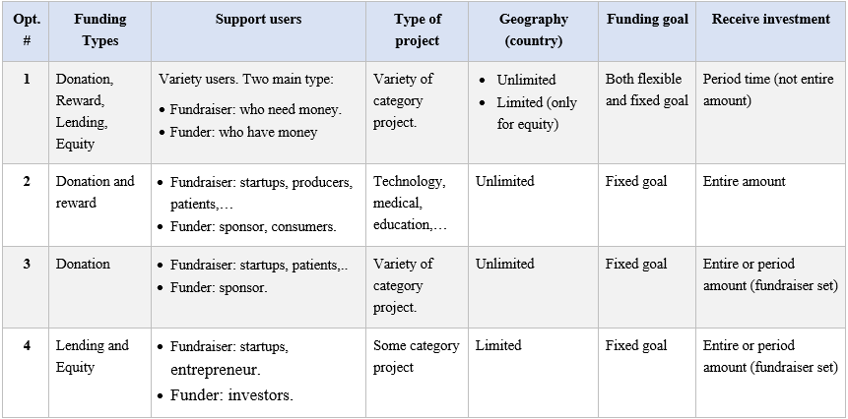
Requirement of project
=> I choose opt #2 to implement
Notes:
Fixed goal: in a period of time or specific time; and with amount of money. If the expiration date does not meet the conditions, the fundraiser will not receive anything. => “All or nothing”
Flexible goal: When the fundraising goal fails, the fundraiser can receive the money they raise. But that requires an agreement between the investor and the fundraiser, which means there should be a vote.
I will choose option #2 to implement system. Because I look it useful and possible to implement.
In the donation-based, a person in need of help can seek support from the community, and helpers are relieved because their money is transferred to the right people. For example, if a patient needs money to treat cancer, they can find crowdfunding as a help to them.
In the reward-based, producers can find opportunities to find capital to produce. And supporters will also find unique and new products. And there are many promotion for them.

Slide 6
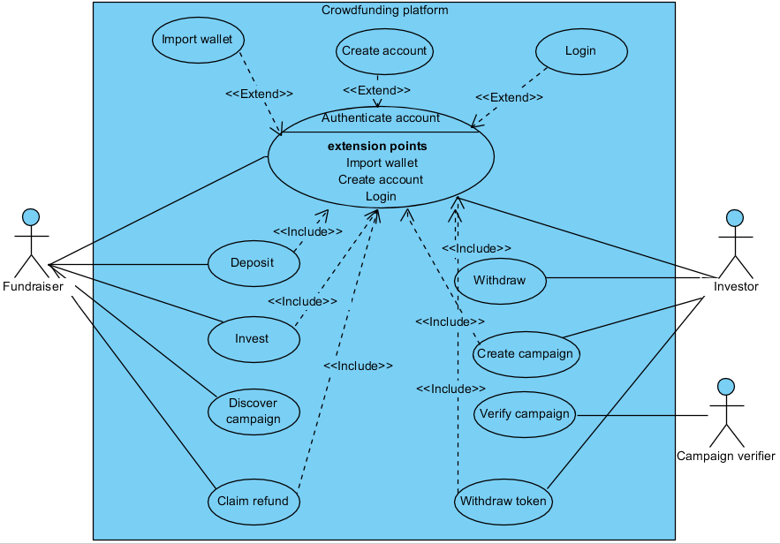
Use case diagram
Notes:
This is a general diagram for the system. I will design more details.

Slide 7
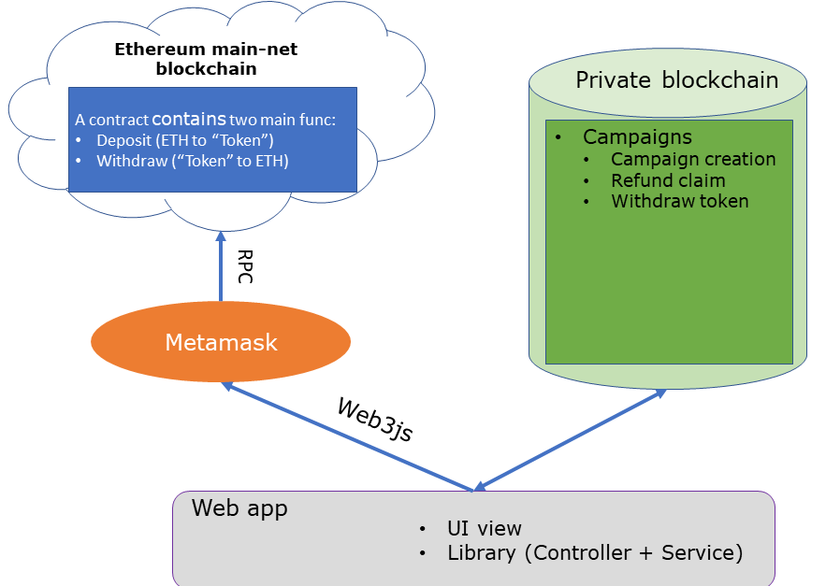
The system architecture design (suggest)

Slide 8
Next work
Continue research on verify a campaign problem.
Improve my previous demo.

Slide 9

Q&A

Slide 11
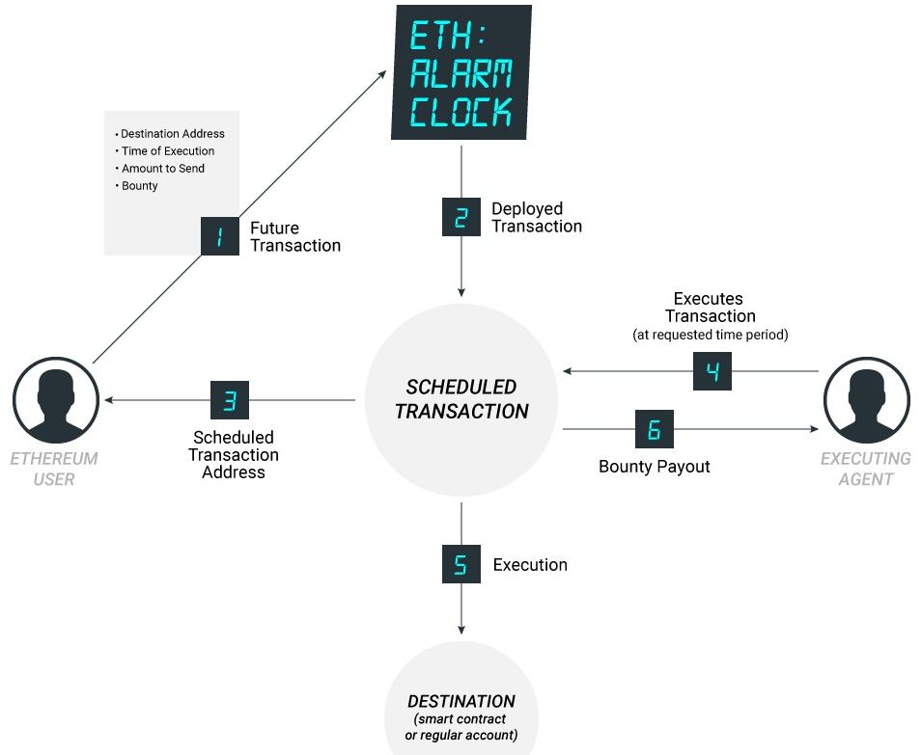
Ethereum Alarm Clock
Notes:
incentivize a network of off-chain nodes to report time.
It is a service. Allow send transaction to scheduled. And other will run it in future.
When you want to schedule a transaction, you need to provide some information such as address, time to execute and attach a reward to the person running it. Then players in the system will repeatedly run a program to review the transactions that need to be executed. If any transaction needs to be executed, the player will run it and receive a reward.

Slide 12
Ethereum Alarm Clock
Advantages:
Decentralized method
Run on Ethereum both mainnet and testnet
Disavantages:
Complicated
Non-scalable
Too expensive
And there is no guarantee that transactions are always executed
Notes:
I find these efforts complicated, non-scalable, and ultimately too expensive. And there is no guarantee that transactions are always executed.
If i apply it to project, i must to custom it.
So, I have not considered applying Ethereum Alarm Clock to the project

Slide 13
Next work
Continue to focus on Blockchain time issues.
Maybe I will consider using block.number instead of timestamp.
I can even consider using an other platform.
Notes:
Because for each time there will be a certain number of blocks is added.
As for the new platform, I have found a platform called CyberMiles with lity language, which supports scheduling in smart contracts. I am considering and learning it

Slide 14
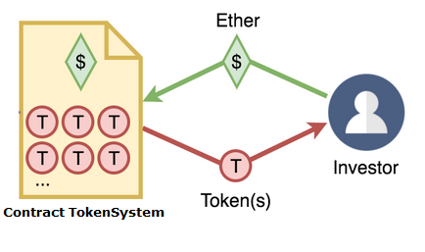
Demo
Deposit / withdraw
Token is the value that stores the amount of money that users send into the system.

Slide 15

Demo
Create a campaign
mapping
address => status
Name
Symbol
Owner
Goal
endDate
TokenCollected
investment(owner => token)
deploy
add
Startup
Contract Campaign
Contract CampaignRegistry
CampaignRegistry will store addresses with the status of campaigns.

Slide 16
Demo
Campaign status:
Pending: new campaign add to CampaignRegistry.
Accepted: is pending campaign that is verified.
Succeed: is accepted campaign that now > EndDate and TokenCollected == Goal
Failed: is accepted campaign that now > EndDate and TokenCollected < Goal
During: NOT failed and NOT succeed.
Paid: after startup withdraw token successful.

Slide 17
Demo
Fund to a campaign
Contract Campaign
Contract TokenSystem
tokens
Invest
Investor
Request burn token

Slide 18
Demo
Withdraw fund from a campaign
Contract Campaign
Contract TokenSystem
Request to withdraw
withdraw
tokens
Startup
Notes:
When campaign is succeed, startup can withdraw all fund in one time.

Slide 19
Demo
Environment:
Network: 192.168.66.167:8545 (testnet with ganache-cli)
Front-end: 192.168.66.167:3000
Web3js, Bootstrap/jQuery
Account wallet: MetaMask extension

Slide 20
Next work
Improve demo:
Sort list campaign in homepage.
Add history of transactions in campaign and account.
Add description of campaign (suggest: store on IPFS). Description include text, video, picture,...

Slide 21
Project’s process
ANALYSIS
SPECIFICATION
PROJECT
IMPLEMENT
DESIGN
TESTING
DEVELOP

Slide 22


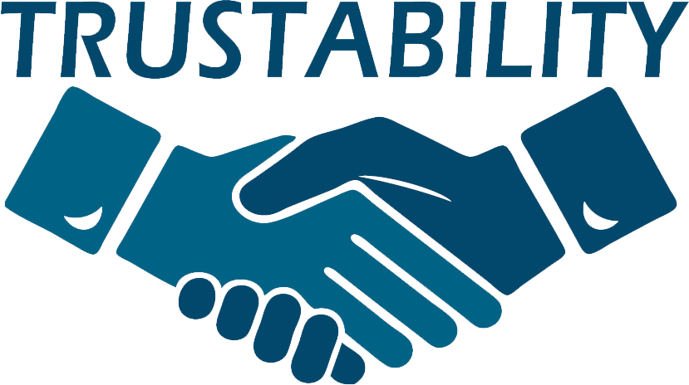
Mission
Make the system serves for the entrepreneurs and the investors.
Make entrepreneurship accessible to everyone, everywhere and trustable for investors.

Slide 23
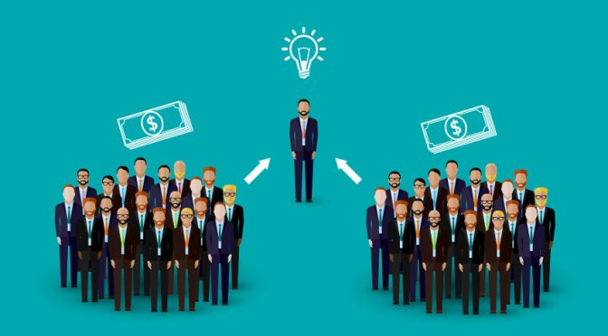
Crowdfunding definition
“Crowdfunding is the practice of funding a project or venture by raising many small amounts of money from a large number of people, typically via the Internet” – (according to Oxford Dictionary)

Slide 24
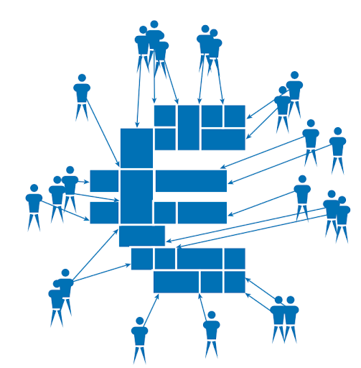
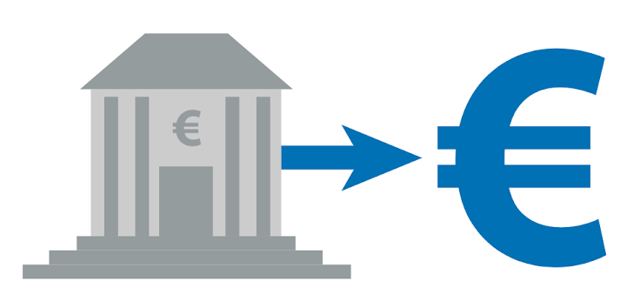
Traditional funding vs. Crowdfunding
Traditional funding
Crowdfunding
Large amounts from one or a few, sources
Many small sums from a large group of individuals

Slide 25
Why use Blockchain technology?
In Current World
1. Difficult to Fundraise It is difficult to fundraise for projects in early phase, even though it is publically-beneficial project.
2. Difficult to Recruit It is difficult to recruit good team members at initial stage. Giving stock option may be on option, but it is local, expensive, slow process.
In Blockchain
1. Issue and sell tokens on blockchain By issuing and selling tokens (Crypto currency) you can fundraise globally, fastly, and at low cost.
2. Pay tokens for Sharing Incentive Core teams can get thousands of supports, and pay tokens as a reward for "work"
The biggest disadvantage in current world is that it depends too much on the third party. => In Blockchain don’t need third party

Slide 26
Some current platforms
weifund.io:
Wallet: user can use a wallet in Metamask or Jaxx
Support currency: ETH
Method to fund a campaign: Setup a wallet, then send ETH to lightweight wallet (in WeiFund). Funds are typically stored in the campaign smart contracts until the campaign ends. When goal is reached, send ETH to fundraiser.
Claim a refund: not automate, investors have to click "Claim Refund Owed" in the page of campaign that has failed.
Create a campaign: is a manual process that the WeiFund team performs for our clients.
Notes:
I surveyed some of the current systems based on their white papers to create idea.

Slide 27
Some current platforms (cont.)
youtoken.io:
The total value of the YouToken platform is expressed in YTN token. YTN token could be purchased/sold/traded on external exchanges.
In addition to the tokens of the entire platform (YTN token), investors can obtain an entrepreneur’s creator tokens (YTN_creatorname).
It is not just a “MicroICO” platform. YouToken supports entrepreneurs during 100% of their “business life”
Fund will be received through many stages of project, not directly to the entrepreneur, it is stored in "Vault".
If creators want to receive fund for next stages, they made a request for investors to vote

Slide 28
Some current platforms (cont.)
pledgecamp.com:
To list a campaign, a creator must place a deposit on the blockchain with a native cryptocurrency called Pledge Coin (PLG).
Once a campaign is successfully funded, the Backer Insurance amount is automatically held in a smart contract encoded with the agreed-upon milestones and voting days.
Backer Insurance holds creators accountable to their promises and motivates them to be prepared and realistic while setting expectations.

Slide 29
The system architecture design (cont.)
The system will consist of two blockchain networks:
Main Ethereum Network: take on the role of deposit (from ETH to "X coins") and withdraw money (from "X coins" to ETH).
Private blockchain: taking on the role of handling internal transactions in the system including: creating campaigns, buying tokens, … and other internal transactions in the system.
Why use blockchain? -> transaction costs and the processing time. And public blockchain is too big.
Notes:
Why use a private blockchain? -> the problem of transaction costs and the processing time of transactions on the main network is not really effective, so it is necessary to create a more optimal private network of transaction cost and time confirmation. This private network only allows members of the system to use.

Slide 30
Method to fund
In order to invest for campaigns, investors must deposit ETH to get tokens.
The fundraiser will create a campaign.
Investors will invest token to campaign.

Slide 31
Method to withdraw fund
When the fundraising time is over, if the goal is reached, the entire fundraising amount will be transferred to the investor in the form of “tokens".
Fundraisers can withdraw “token" to ETH.

