Slide 1

Group 3: Movie Gallery
Students:
Nguyen Tien Dat – 20233836
Truong Cong Duc – 20233840
Bui Tuan Minh – 20233866
Supervisors: Dr. Pham Van Tien
Assoc. Prof. Tran Thi Thanh Hai

Slide 2
Outline
Introduction
Design process
Limitations
Conclusions

Slide 3
Introduction
Overview: this project aims to create a digital library for movies. The platform will be simple allowing users to store, download, and discuss a short memorable movie clips or images
Motivations: The main reason for conducting this project is that more and more people want to preserve and share memorable movie moments in an easy and organized way

Slide 4
Introduction
Objective
Objective 1: Allow people to view contents clearly, also they can download them.
Objective 2: Allow people to give their opinion for the shortcuts.
Objective 3: Decentralization, for the owner, allow him to adjust contents (add, update, delete).

Slide 5
Team building
Nguyen Tien Dat – Front-end
Truong Cong Duc – Front-end
Bui Tuan Minh – Back-end and draw diagram

Slide 6
Step 1: User requirements
The website must allow users to:
view contents,
download them
and give their opinion about them.
For an owner, it must let him add, update, and delete contents privately

Slide 7
Step 2: Specification
Functionality
Function 1: View contents
Function 2: Search contents
Function 3: Download contents
Function 4: Rating Contents
Function 5: Decentralization
Function 6: Comments

Slide 8
Step 2: Specification
Non functionality
Non- Function 1: View contents:
view on the main page
view on the 'more specific details' tab.
Non- Function 2: Search contents:
by name
by the original movie genre.
Non- Function 3: Download contents:
adjustable resolution.

Slide 9
Step 2: Specification
Non functionality
Non- Function 4: Rating contents:
rate as point from 0 to 5.
Non- Function 5: Decentralization:
Admin
Member
Guest
Non- Function 6: Comments:
opinion by word.

Slide 10
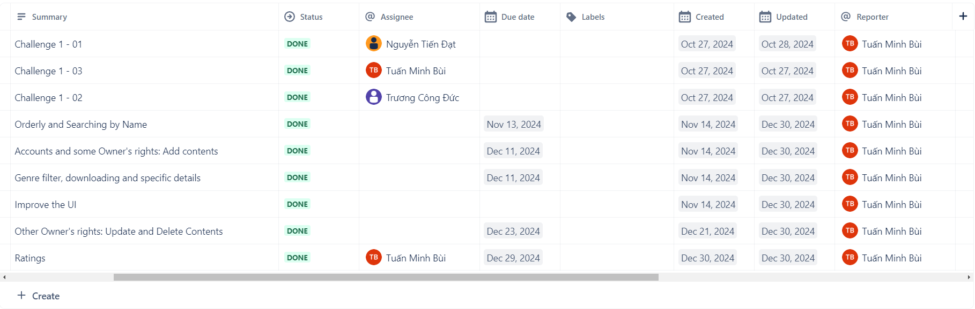
Step 3: Planning
Method for developing: Develop in gradually upgraded versions: implement each version with increasing complexity over time
Why? We are Amateurs!

Slide 11
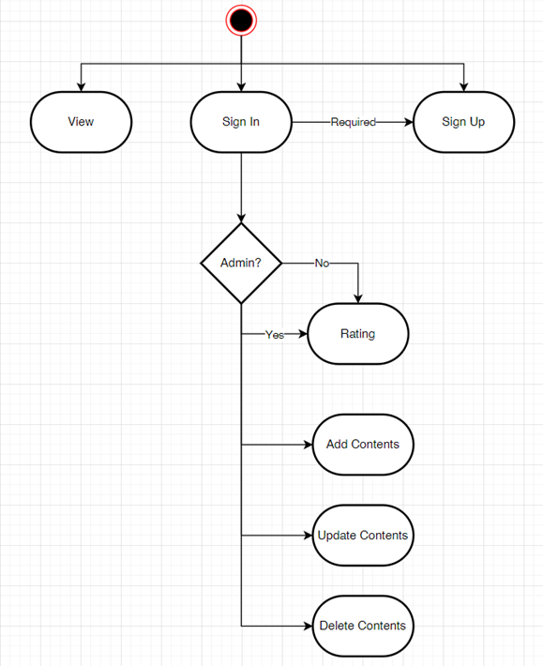
Step 4: Block design
Functional diagram

Slide 12
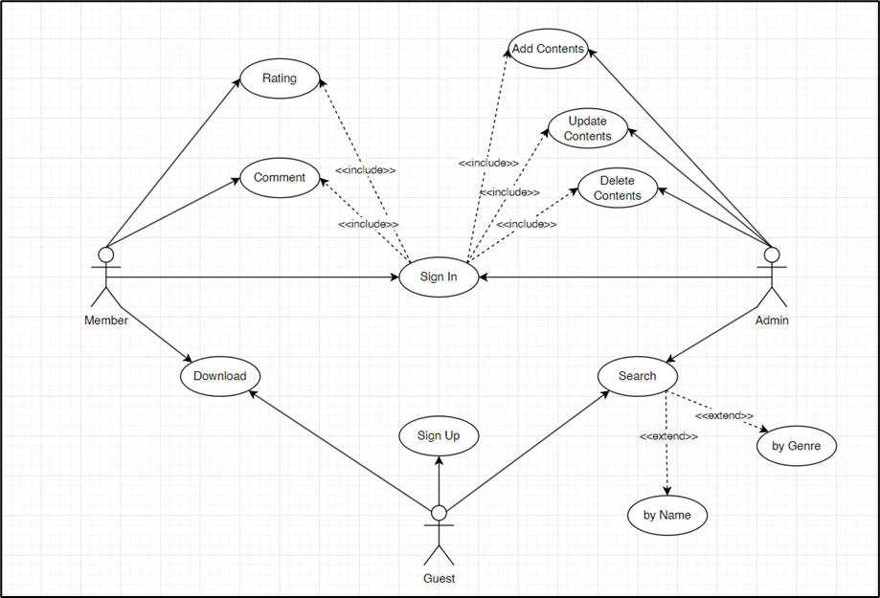
Step 4: Block design
Use Case
diagram

Slide 13
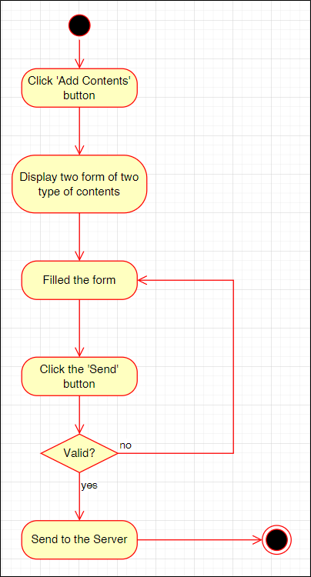
Step 5: Detail design
Activity Diagram (AD)
for Add Contents

Slide 14
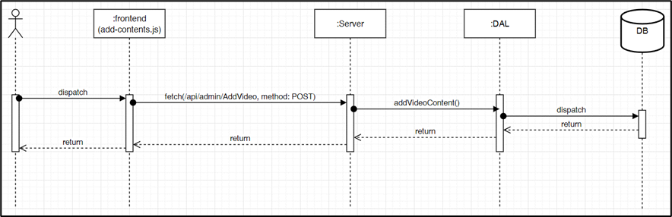
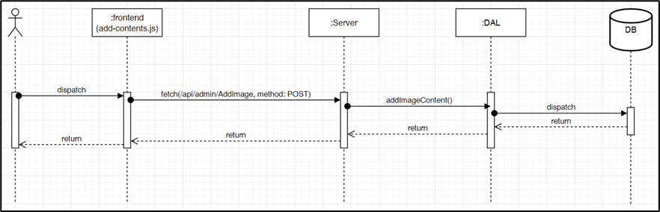
Step 5: Detail design
Sequence Diagram (SD)
for Add Contents

Slide 15
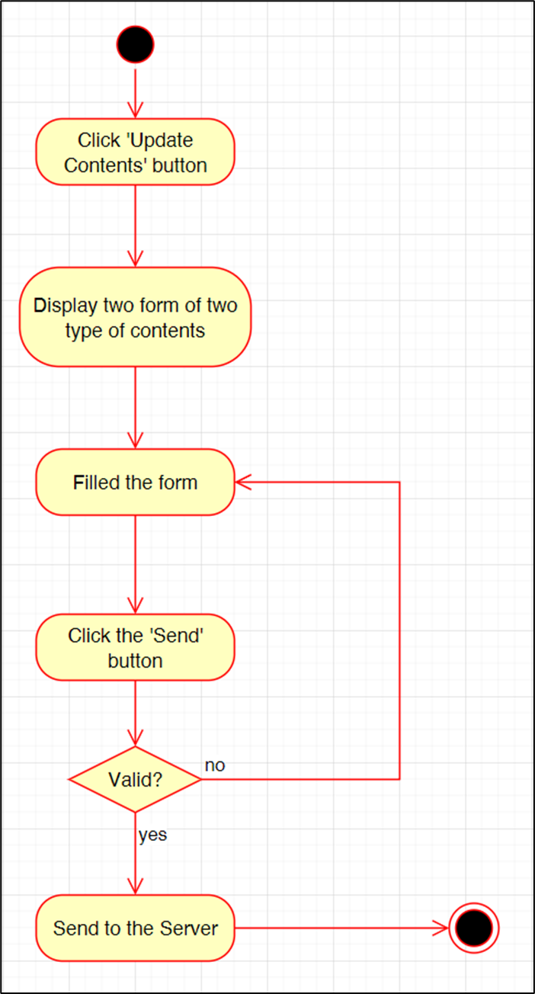
Step 5: Detail design
Activity Diagram (AD)
for Update Contents

Slide 16
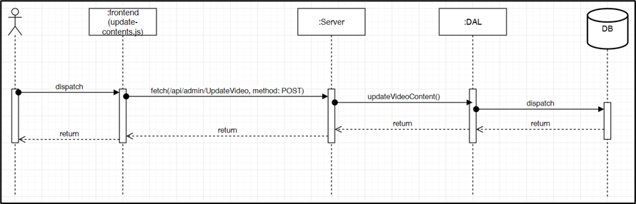
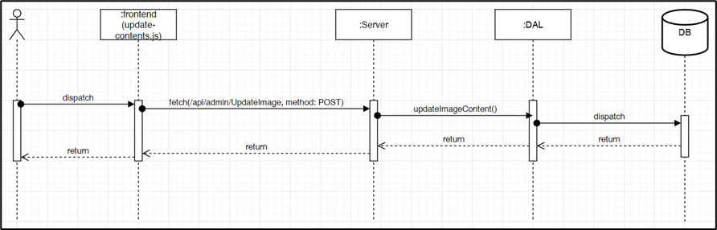
Step 5: Detail design
Sequence Diagram (SD)
for Update Contents

Slide 17
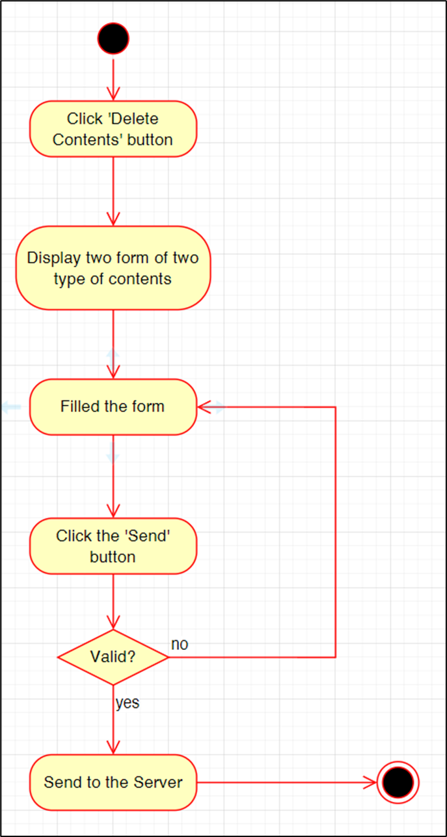
Step 5: Detail design
Activity Diagram (AD)
for Delete Contents

Slide 18
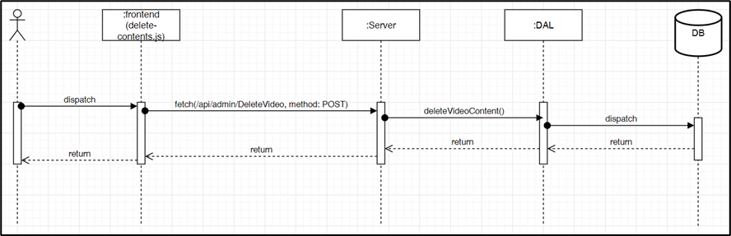
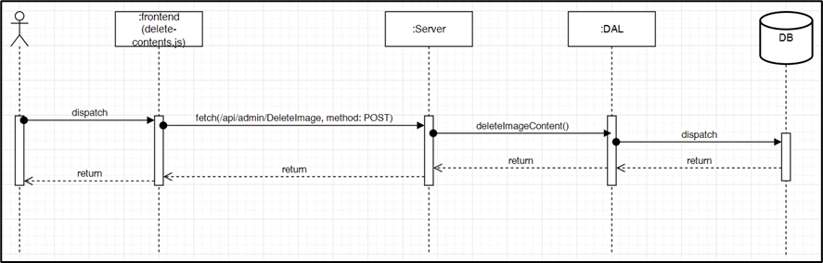
Step 5: Detail design
Sequence Diagram (SD)
for Delete Contents

Slide 19
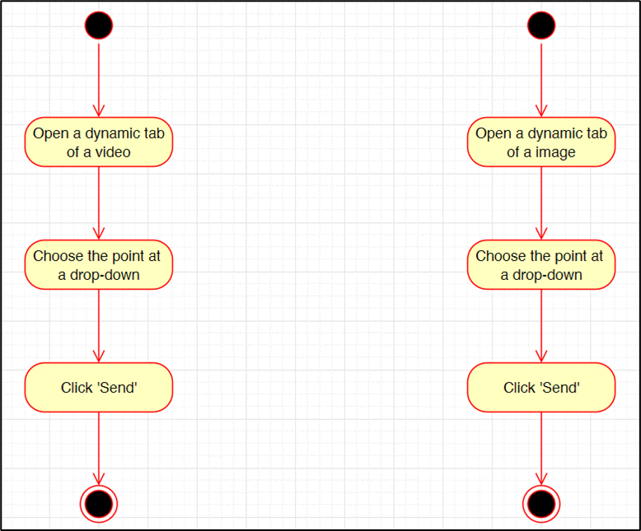
Step 5: Detail design
Activity Diagram (AD)
for Rating

Slide 20
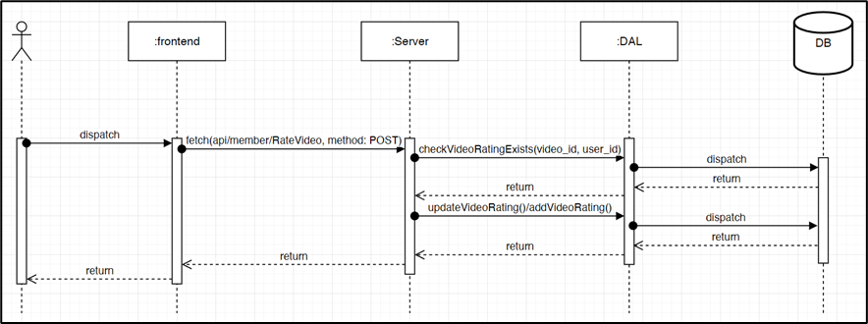

Step 5: Detail design
Sequence Diagram (SD)
for Rating

Slide 21
Step 6: Select the best altenatives
Relational Database Management System: MySQL
Programming language for the server site: JavaScript
Language for client site: HTML, CSS, JavaScript

Slide 22
Step 7: Testing
Scenario for testing (generally):
Provide two type of JSON data: one is invalid, and the others is valid.
Using Postman, to test the server independently.
After obtained a good result, test with the client’s site.

Slide 23
Step 7: Testing
Method: POST | url: http://localhost:3000/api/admin/UpdateImage
Input | { "id": 17, "title": "Wayne’s World (1992) Head banging to Bohemian Rhapsody", "storage": "cloud", "src": "https://panandslam.com/wp-content/uploads/2020/04/waynes-world-car-queen.jpg?w=636&h=424", "movie_genre": "Comedy", "image_style": "Happy", "width": 636, "height": 424, "format": "png", "download_link": "https://panandslam.com/wp-content/uploads/2020/04/waynes-world-car-queen.jpg?w=636&h=424", "upload_date": null }
Output | { "message": "Image content updated successfully", "data": { "fieldCount": 0, "affectedRows": 1, "insertId": 0, "info": "Rows matched: 1 Changed: 1 Warnings: 0", "serverStatus": 2, "warningStatus": 0, "changedRows": 1 } }
Test result for Update Image (valid data)

Slide 24
Step 7: Testing
Test result for Update Image (valid data)
Method: POST | url: http://localhost:3000/api/admin/UpdateImage
Input | { "id": -1, "title": "Wayne’s World (1992) Head banging to Bohemian Rhapsody", "storage": "cloud", "src": "https://panandslam.com/wp-content/uploads/2020/04/waynes-world-car-queen.jpg?w=636&h=424", "movie_genre": "Comedy", "image_style": "Happy", "width": 636, "height": 424, "format": "png", "download_link": "https://panandslam.com/wp-content/uploads/2020/04/waynes-world-car-queen.jpg?w=636&h=424", "upload_date": null }
Output | { "error": "Failed to update image content", "details": "Image ID not found" }

Slide 25
Limitations
Update, Delete Contents using two independent form requiring id
Do not contain Comment, Adjustable resolution for downloading.
Users have to view contents randomly that not based on their interests.

Slide 26
Conclusions
Achievement compared to the objective:
Achievement: get a local version of the website whose features:
View Contents (main page and dynamic tab);
Decentralization; Add, Update, Delete Contents;
Download Contents (no adjustable resolution),
Rating,
No Comments feature.
Compare to the objectives: 75%

Slide 27
Conclusions
Future Work:
Redesign the method about technicality and user’s experience.
Redesign the database and adjust the source code to add Comments features let the program display the contents based on users’ interests.
Learn a method to let users download contents that theses’ resolution is adjustable.

Slide 28
Acknowledgment
Creating a movie storage website was a challenging yet rewarding opportunity to apply our knowledge and grow. This success was made possible by the invaluable support of Dr. Pham Van Tien and Assoc. Prof. Tran Thi Thanh Hai.
Your guidance, from shaping ideas to solving challenges, inspired us and helped us gain essential skills like programming and teamwork.
We sincerely thank you and hope to learn from you again in future projects!

