Slide 1

Group 3: Movie Gallery
Students:
Nguyen Tien Dat – 20233836
Truong Cong Duc – 20233840
Bui Tuan Minh – 20233866
Supervisors: Dr. Pham Van Tien
Assoc. Prof. Tran Thi Thanh Hai

Slide 2
Outline
Introduction
Design process
Limitations
Conclusions

Slide 3
Introduction
Overview: this project aims to create a digital library for movies. The platform will be simple allowing users to store, download, and discuss a short memorable movie clips or images
Motivations: The main reason for conducting this project is that more and more people want to preserve and share memorable movie moments in an easy and organized way

Slide 4
Introduction
Objective
Objective 1: Allow people to view contents clearly, also they can download them.
Objective 2: Allow people to give their opinion for the shortcuts.
Objective 3: Decentralization, for the owner, allow him to adjust contents (add, update, delete).

Slide 5
Team building
Nguyen Tien Dat – Front-end
Truong Cong Duc – Front-end
Bui Tuan Minh – Back-end and draw diagram

Slide 6
Step 1: User requirements
The website must allow users to:
view contents,
download them
and give their opinion about them.
For an owner, it must let him add, update, and delete contents privately

Slide 7
Step 2: Specification
Functionality
Function 1: View contents
Function 2: Search contents
Function 3: Download contents
Function 4: Rating Contents
Function 5: Decentralization
Function 6: Comments

Slide 8
Step 2: Specification
Non functionality
Non- Function 1: When searching contents, the obtained results are returned fast.
Non- Function 2: Guests are allowed to view, searching and download contents. Members must log in to rate, or comment. Only admins can manage content approval.
Non- Function 3: The system should be accessible from modern web browsers (e.g., Chrome, Firefox, Edge) and mobile devices.

Slide 9
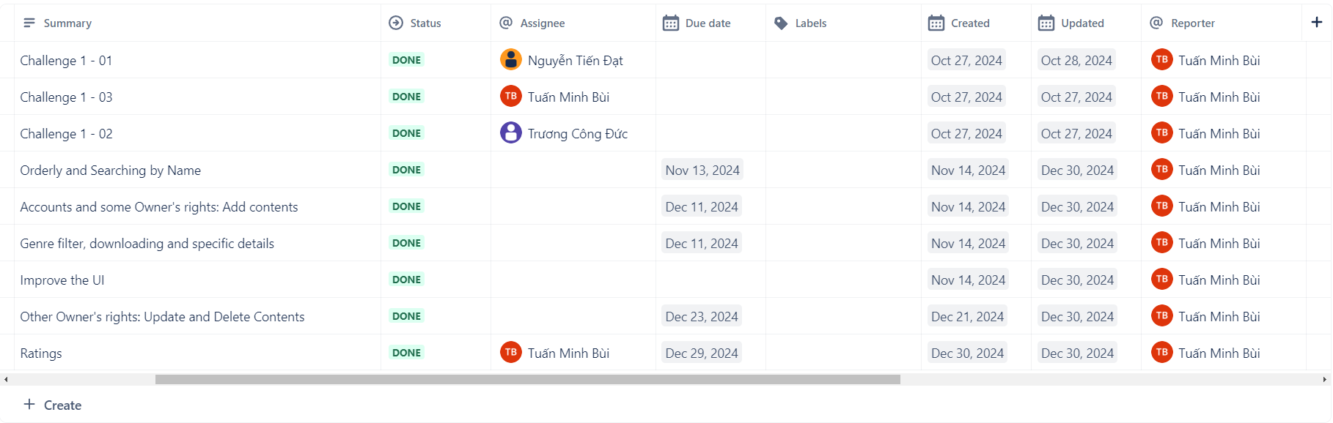
Step 3: Planning
Method for developing: Develop in gradually upgraded versions: implement each version with increasing complexity over time
Why? We are Amateurs!

Slide 10
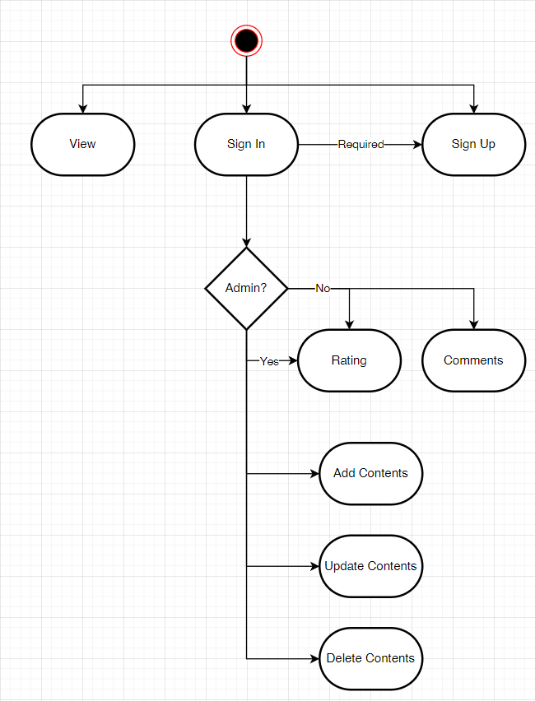
Step 4: Block design
Functional diagram
Notes:
After access the website, users can view contents, sign up and sign in. After signed in, they must sign up before, if they are admins, they are allowed to add, update, and delete contents, otherwise, only rating and comments

Slide 11
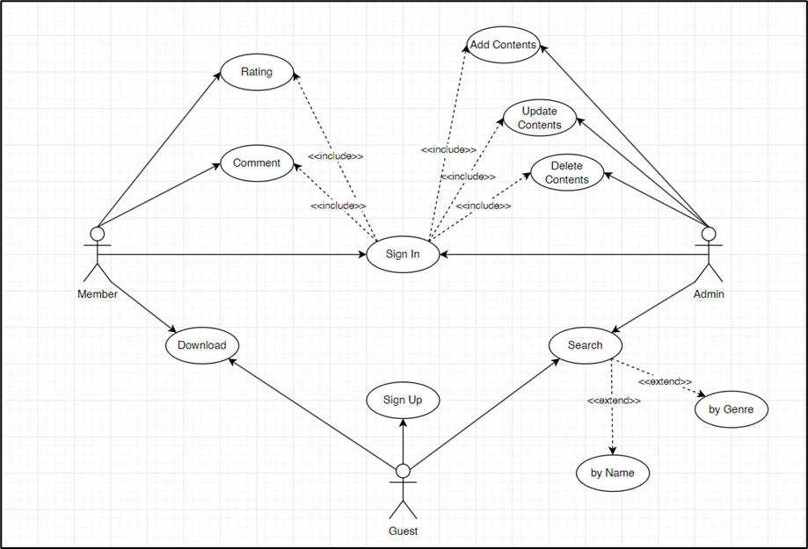
Step 4: Block design
Use Case
diagram
Notes:
The diagram demonstrates the use cases. There are three use cases: Guest, Member and Admin.
Guests are allowed to view, searching and download contents. They can sign up to become Members.
Members can rate, or comment.
Only admins can manage content approval.
However, Member and Admin must sign in before to use their privilege.

Slide 12
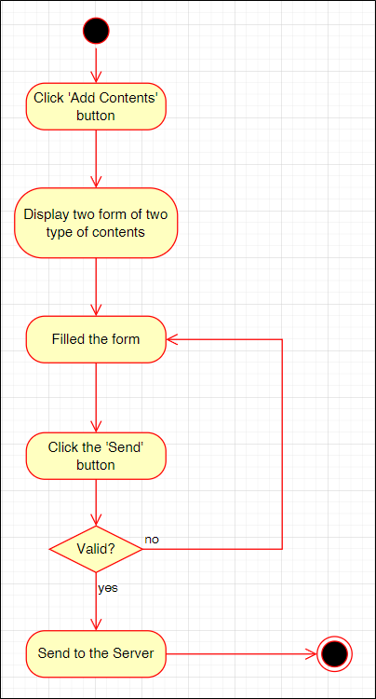
Step 5: Detail design
Activity Diagram (AD)
for Add Contents
Notes:
The video form includes title, storage, source link, movie’s genre, format, download link, upload date, video’s mood, and duration. Therein, title, storage, source link, movie’s genre, download link and video’s mood are compulsory. The image form includes title, storage, source link, movie’s genre, format, download link, upload date, image’s mood, width, and height. Therein, title, storage, source link, movie’s genre, download link and image’s mood are compulsory.
The value is considered as ‘valid’ if all compulsory attributes are filled. Also, links must start with ‘https://’ or ‘http://’
The process occurs as each following step:
The user clicks on the function button, a form will be displayed.
The user fills one of two forms (video/image) then click the corresponding button of each form.
The program checks if the value is valid? If not, the user must input again, else, a notification will appear, states that the process is successful.

Slide 13
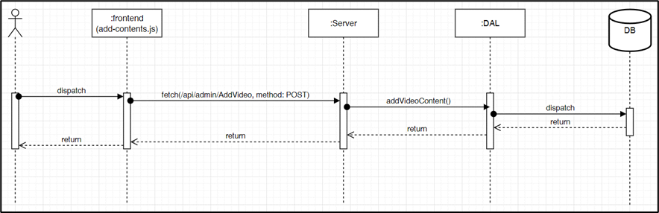
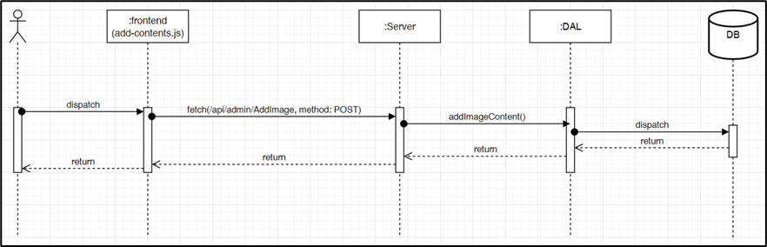
Step 5: Detail design
Sequence Diagram (SD)
for Add Contents
Notes:
After the admin clicks on the ‘Add Video’ or ‘Add Image’ button, the interface sends a POST request to the API `/api/admin/AddVideo` or `/api/admin/AddImage`. The server calls the `addVideoContent` or ‘addImageContent’ function in the DAL layer to save the content to the database and returns the result.

Slide 14
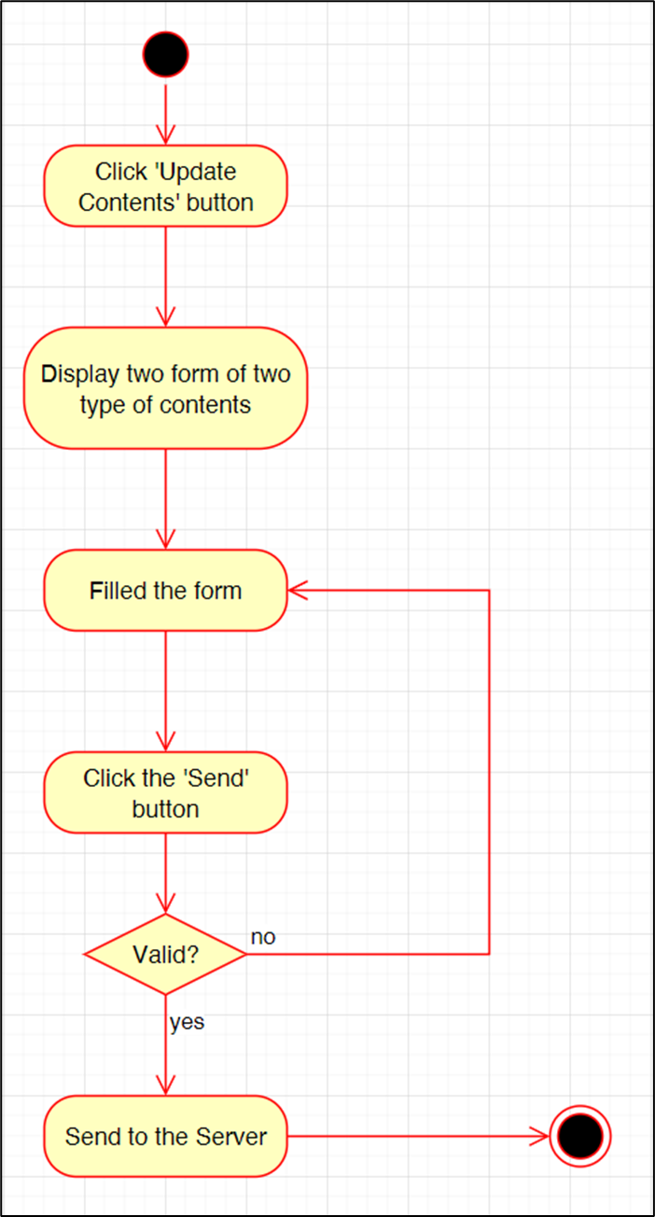
Step 5: Detail design
Activity Diagram (AD)
for Update Contents
Notes:
The video form includes video’s id, title, storage, source link, movie’s genre, format, download link, upload date, video’s mood, and duration. Therein, video’s id, title, storage, source link, movie’s genre, download link and video’s mood are compulsory. The image form includes image’s id, title, storage, source link, movie’s genre, format, download link, upload date, image’s mood, width, and height. Therein, video’s id, title, storage, source link, movie’s genre, download link and image’s mood are compulsory.
The value is considered as ‘valid’ if all compulsory attributes are filled. Also, links must start with ‘https://’ or ‘http://’ and the id must be a positive integer number and existing.
The process occurs as each following step:
The user clicks on the function button, a form will be displayed.
The user fills one of two forms (video/image) then click the corresponding button of each form. (if he wants to keep the old value, he must type the old value)
The program checks if the value is valid? If not, the user must input again, else, a notification will appear, states that the process is successful.

Slide 15
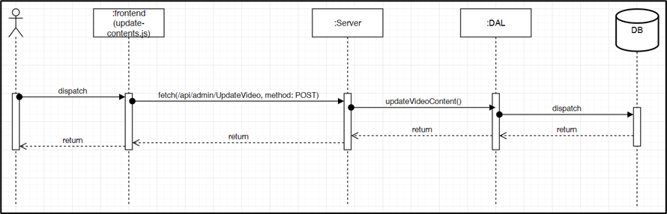
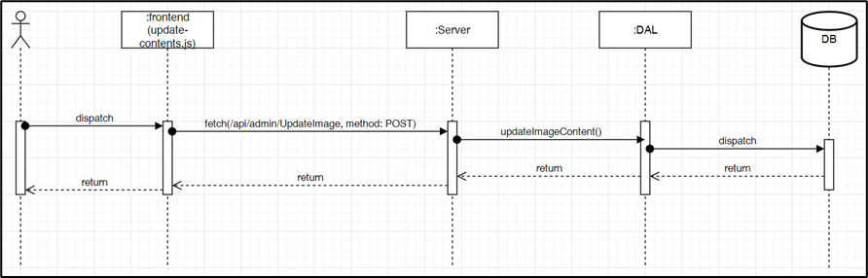
Step 5: Detail design
Sequence Diagram (SD)
for Update Contents
Notes:
After the admin clicks on the ‘Update Video’ or ‘Update Image’ button, the interface sends a POST request to the API `/api/admin/UpdateVideo` or `/api/admin/UpdateImage`. The server calls the `addVideoContent` or ‘addImageContent’ function in the DAL layer to save the content to the database and returns the result.

Slide 16
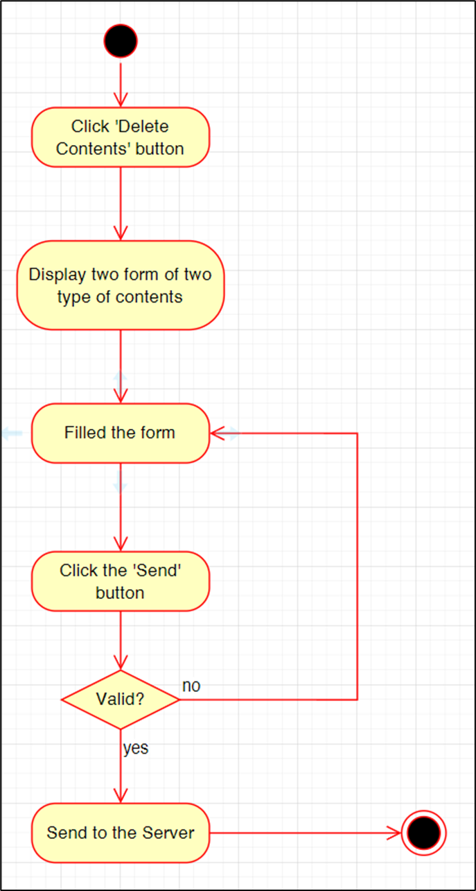
Step 5: Detail design
Activity Diagram (AD)
for Delete Contents
Notes:
Each form contains only one attribute named ‘id’. The value is considered as ‘valid’ if the id is a positive integer number and existing.
The process occurs as each following step:
The user clicks on the function button, a form will be displayed.
The user fills one of two forms (video/image) then click the corresponding button of each form.
The program checks if the value is valid? If not, the user must input again, else, a notification will appear, states that the process is successful.

Slide 17
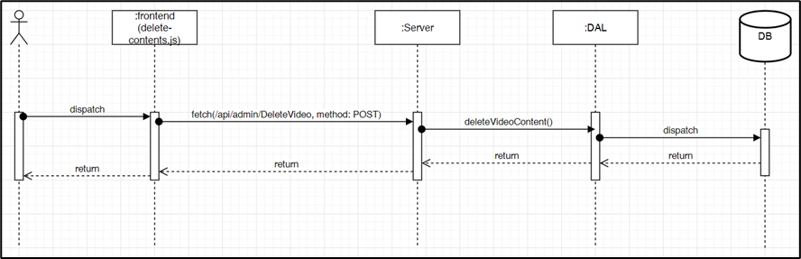
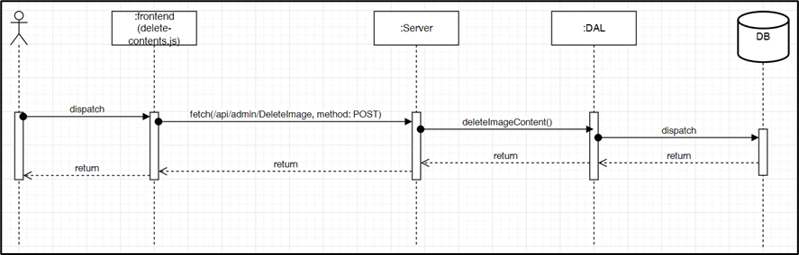
Step 5: Detail design
Sequence Diagram (SD)
for Delete Contents
Notes:
After the admin clicks on the ‘Delete Video’ or ‘Delete Image’ button, the interface sends a POST request to the API ‘/api/admin/DeleteVideo’ or ‘/api/admin/DeleteImage’. The server calls the `deleteVideoContent` or ‘deleteImageContent’ function in the DAL layer to save the content to the database and returns the result.

Slide 18
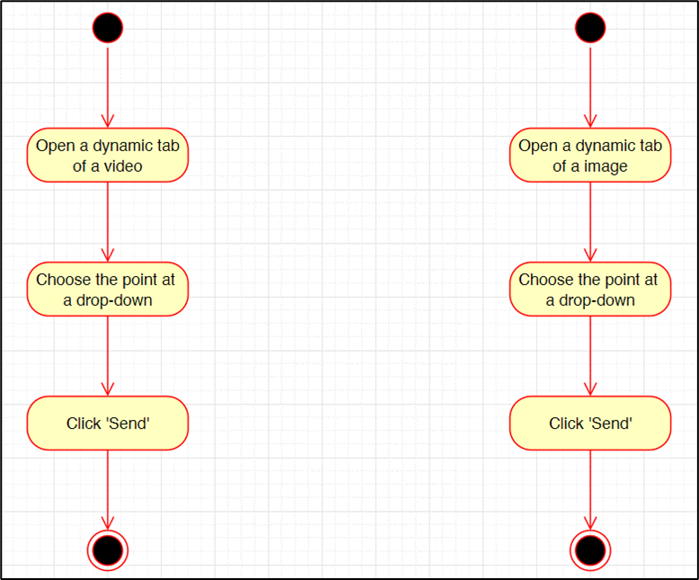
Step 5: Detail design
Activity Diagram (AD)
for Rating
Notes:
The process occurs following these steps:
In the main page, the user clicks on the title of a certain content to open the ‘specific’ tab.
There is a drop-down at the bottom of the site, the user selects the point and click the ‘Send’ button, a notification will appear, states that the process is successful.
Note: the user must sign in before to use this feature.

Slide 19
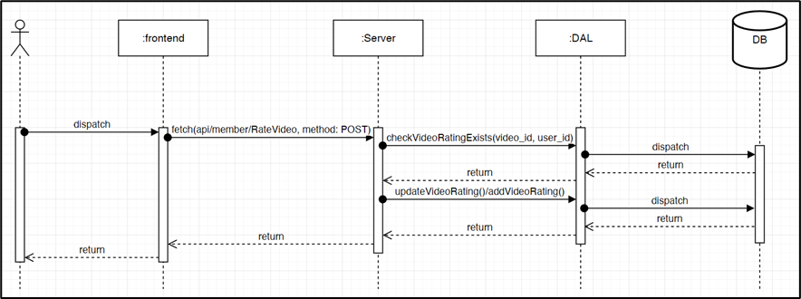

Step 5: Detail design
Sequence Diagram (SD)
for Rating
Notes:
The process occurs as following steps:
After users give a point, the interface sends a POST request to the API `/api/member/RateVideo` or `api/member/RateImage`.
The server calls the `checkVideoRatingExists` or `checkImageRatingExists` function in the DAL layer to check that weather that content is rated before, then return the result to the server.
The server then calls the suitable function: `addVideoRating`/`addImageRating` if that content has not been rated before; and `updateVideoRating`/`updateImageRating` has been rated before.
A notification will also be sent to users.

Slide 20
Step 6: Select the best altenatives
Relational Database Management System: MySQL
Programming language for the server site: JavaScript
Language for client site: HTML, CSS, JavaScript

Slide 21
Step 7: Testing
Scenario for testing (generally):
Provide two type of JSON data: one is invalid, and the others is valid.
Using Postman, to test the server independently.
After obtained a good result, test with the client’s site.

Slide 22
Step 7: Testing
Method: POST | url: http://localhost:3000/api/admin/UpdateImage
Input | { "id": 17, "title": "Wayne’s World (1992) Head banging to Bohemian Rhapsody", "storage": "cloud", "src": "https://panandslam.com/wp-content/uploads/2020/04/waynes-world-car-queen.jpg?w=636&h=424", "movie_genre": "Comedy", "image_style": "Happy", "width": 636, "height": 424, "format": "png", "download_link": "https://panandslam.com/wp-content/uploads/2020/04/waynes-world-car-queen.jpg?w=636&h=424", "upload_date": null }
Output | { "message": "Image content updated successfully", "data": { "fieldCount": 0, "affectedRows": 1, "insertId": 0, "info": "Rows matched: 1 Changed: 1 Warnings: 0", "serverStatus": 2, "warningStatus": 0, "changedRows": 1 } }
Test result for Update Image (valid data)

Slide 23
Step 7: Testing
Test result for Update Image (valid data)
Method: POST | url: http://localhost:3000/api/admin/UpdateImage
Input | { "id": -1, "title": "Wayne’s World (1992) Head banging to Bohemian Rhapsody", "storage": "cloud", "src": "https://panandslam.com/wp-content/uploads/2020/04/waynes-world-car-queen.jpg?w=636&h=424", "movie_genre": "Comedy", "image_style": "Happy", "width": 636, "height": 424, "format": "png", "download_link": "https://panandslam.com/wp-content/uploads/2020/04/waynes-world-car-queen.jpg?w=636&h=424", "upload_date": null }
Output | { "error": "Failed to update image content", "details": "Image ID not found" }

Slide 24
Limitations
Update, Delete Contents using two independent form requiring id
Do not contain Comment, Adjustable resolution for downloading.
Users have to view contents randomly that not based on their interests.

Slide 25
Conclusions
Achievement compared to the objective:
Achievement: get a local version of the website whose features:
View Contents (main page and dynamic tab);
Decentralization; Add, Update, Delete Contents;
Download Contents (no adjustable resolution),
Rating,
No Comments feature.
Compare to the objectives: 75%

Slide 26
Conclusions
Future Work:
Redesign the method about technicality and user’s experience.
Redesign the database and adjust the source code to add Comments features let the program display the contents based on users’ interests.
Learn a method to let users download contents that theses’ resolution is adjustable.

Slide 27
Acknowledgment
Creating a movie storage website was a challenging yet rewarding opportunity to apply our knowledge and grow. This success was made possible by the invaluable support of Dr. Pham Van Tien and Assoc. Prof. Tran Thi Thanh Hai.
Your guidance, from shaping ideas to solving challenges, inspired us and helped us gain essential skills like programming and teamwork.
We sincerely thank you and hope to learn from you again in future projects!

