Slide 2
Table of Contents
01
OVERVIEW AND OBJECTIVES
02
REWARD, ACTION, STATE OF SNAKE AGENT
03
RESULTS AND CONCLUSION

Slide 3
01
OVERVIEW AND OBJECTIVES

Slide 4
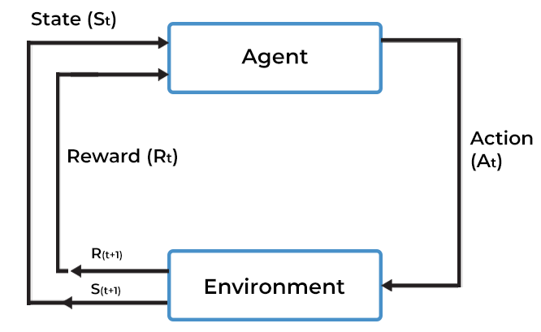
REINFORCEMENT LEARNING?
Reinforcement learning (RL) is an area of machine learning concerned with how software agents ought to take actions in an environment in order to maximize the notion of cumulative reward.
OR: RL is teaching a software agent how to behave in an environment by telling it how good it’s doing.

Slide 5
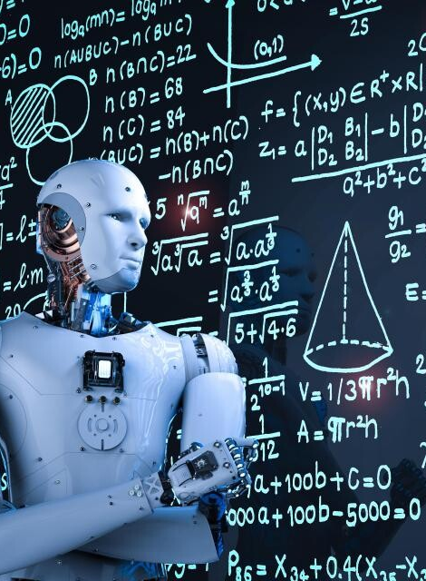
Objectives
Evaluate the performance of five RL algorithms
Value Iteration
Policy Iteration
Monte Carlo
SARSA
Q-Learning

Slide 6
02
REWARD, ACTION, STATE OF SNAKE AGENT

Slide 7
REWARD
ACTION | REWARD
EAT FOOD | +10
EACH ACTION | 0
COLLIDING WITH WALL OR ITSELF | -10

Slide 8
ACTION
ACTION
STRAIGHT | [1, 0, 0]
TURN RIGHT | [0, 1, 0]
TURN LEFT | [0, 0, 1]

Slide 9
STATE (6 Values)
DELTA_X | DELTA_Y | DIRECTION
DANGER_STRAIGHT | DANGER_LEFT | DANGER_RIGHT
DELTA_X: Relative x-coordinate of the food to the snake’s head
DELTA_Y: Relative y-coordinate of the food to the snake’s head
DIRECTION: Current direction of the snake’s head
[0, 1, 2, 3] = [up, right, down, left]
DANGER_STRAIGHT: Danger of collision when moving straight([0, 1])
DANGER_LEFT: Danger of collision when turning left ([0, 1])
DANGER_RIGHT: Danger of collision when turning right ([0, 1])

Slide 10
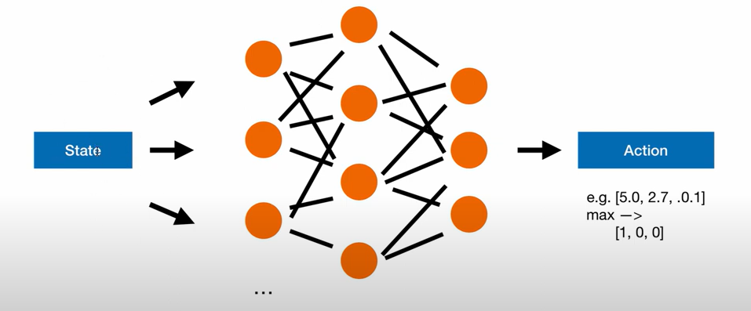
6 values state
3 value actions

Slide 11
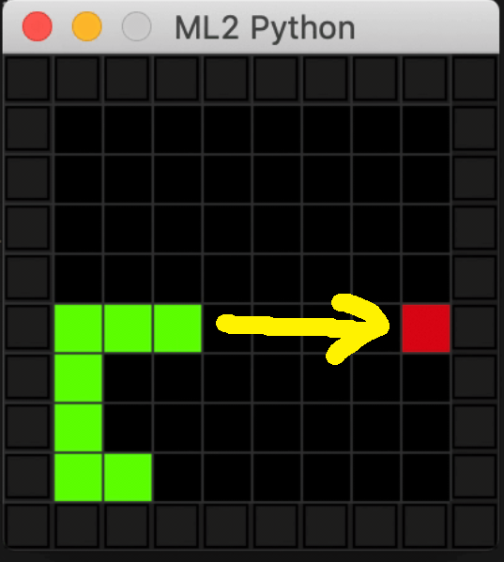
STATE
DELTA_X | DELTA_Y | DIRECTION
DANGER_STRAIGHT | DANGER_LEFT | DANGER_RIGHT
[5, 0, 0, 0, 0, 0] | [1, 0, 0]
[4, 0, 0, 0, 0, 0] | [1, 0, 0]
[3, 0, 0, 0, 0, 0] | [1, 0, 0]
[2, 0, 0, 0, 0, 0] | [1, 0, 0]
[1, 0, 0, 0, 0, 0] | [1, 0, 0]
[0, 0, 1 or 3, 1, 0, 0] | [0, 0 or 1, 0 or 1]

Slide 12
03
RESULTS AND CONCLUSION

Slide 13
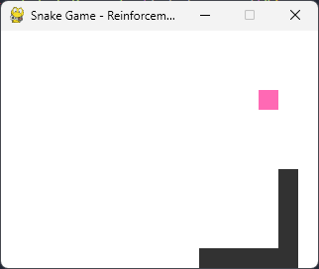
USER INTERFACE (UI)

Slide 14
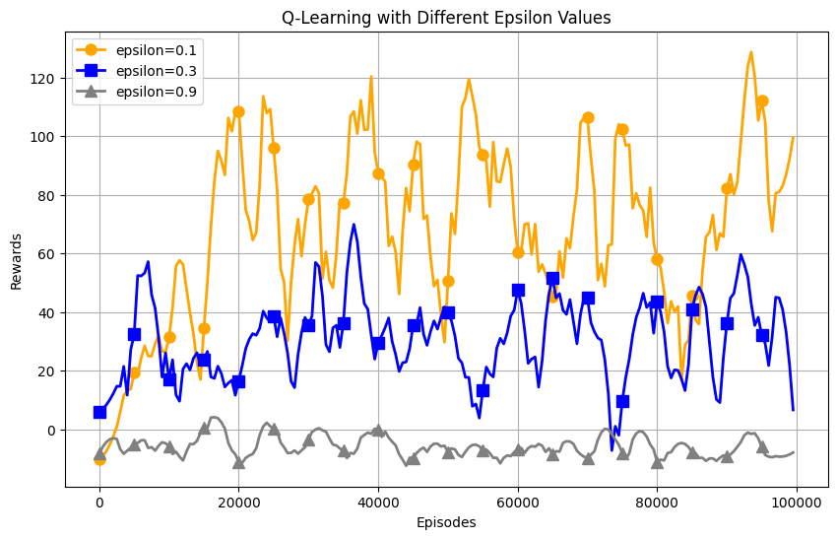
Q-Learning

Slide 15
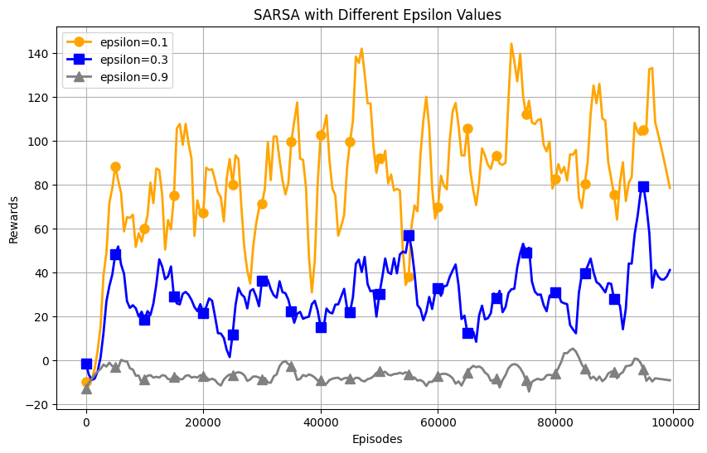
SARSA

Slide 16
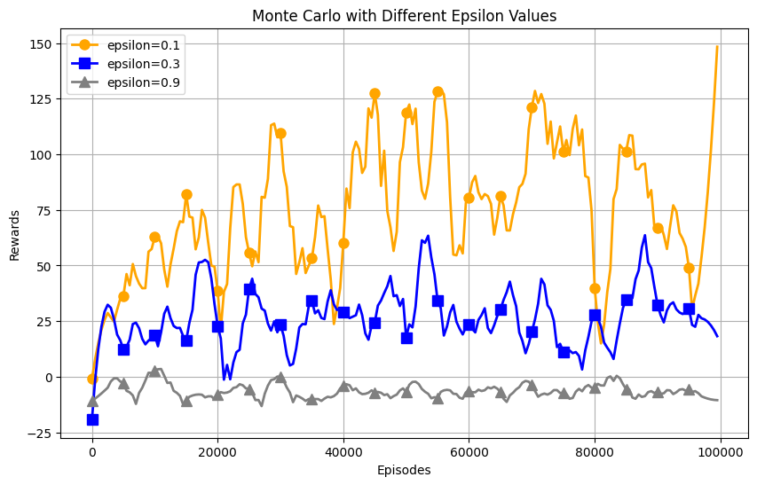
Q-Learning

Slide 17
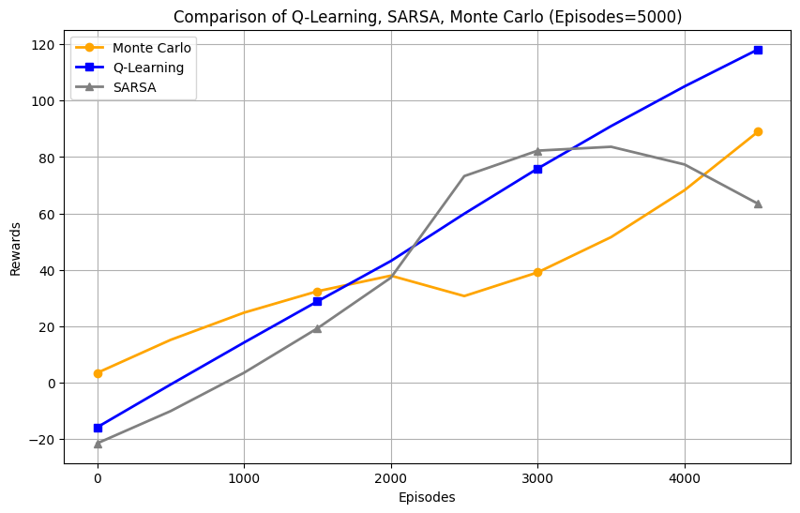
Compare Q-Learning, SARSA, Monte Carlo with episodes=100000
Notes:
Monte Carlo performed very well from the start and is a model worth looking forward to if the episode increases.

Slide 18
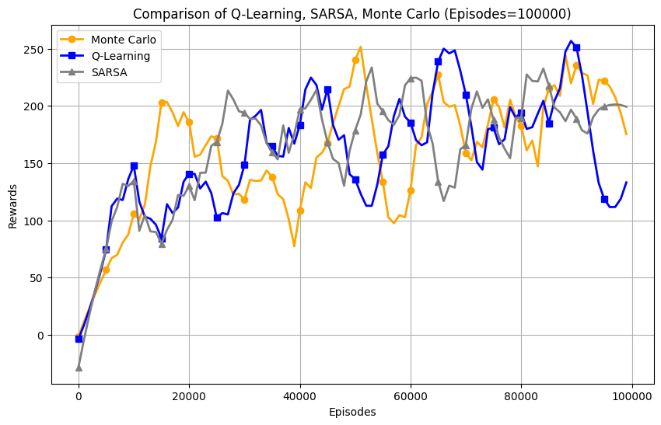
Compare Q-Learning, SARSA, Monte Carlo with episodes=100000
Notes:
Monte Carlo performed very well from the start and is a model worth looking forward to if the episode increases.

Slide 19
Conclusion
Q-Learning, which emerged as the most successful algorithm, was applied con-sistently across various scenarios with stable success.
Besides, SARSA and Monte Carlo also achieved relatively good results and achieved their goals.
Unfortunately, we excluded the results of Value Iteration and Policy Iteration due to their relatively lower performance in this context.

Slide 20
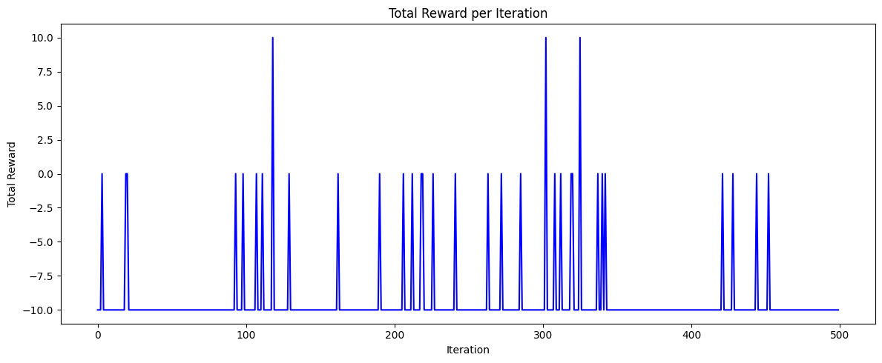

Slide 21

THANK YOU
For Your Attention

