Slide 1
Image formation

Slide 2
Image Formation
Vision infers world properties form images.
How do images depend on these properties?
Two key elements
Geometry
Radiometry
We consider only simple models of these

Slide 3
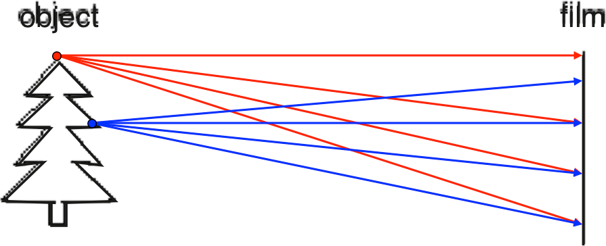
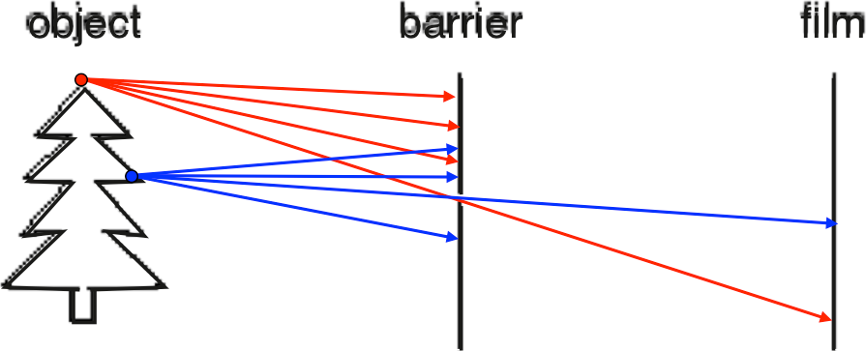
Let’s design a camera
Idea 1: put a piece of film in front of an object
Do we get a reasonable image?
Slide by Steve Seitz
Pinhole camera
Add a barrier to block off most of the rays
This reduces blurring
The opening is known as the aperture
Slide by Steve Seitz

Slide 4
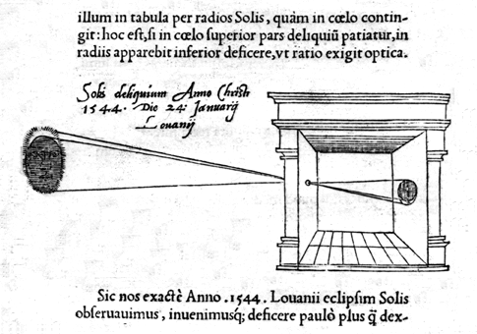
Camera Obscura
"When images of illuminated objects ... penetrate through a small hole into a very dark room ... you will see [on the opposite wall] these objects in their proper form and color, reduced in size ... in a reversed position, owing to the intersection of the rays".
Da Vinci
http://www.acmi.net.au/AIC/CAMERA_OBSCURA.html (Russell Naughton)

Slide 5
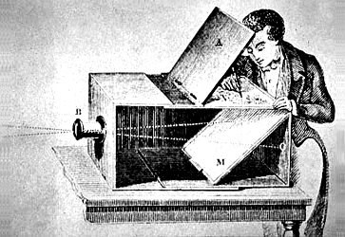
Used to observe eclipses (eg., Bacon, 1214-1294)
By artists (eg., Vermeer).

Slide 6
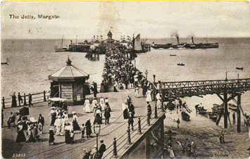
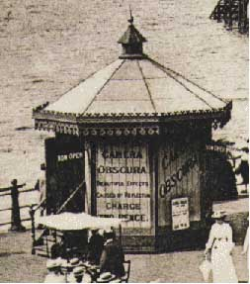
Jetty at Margate England, 1898.
http://brightbytes.com/cosite/collection2.html (Jack and Beverly Wilgus)

Slide 7
Cameras
First photograph due to Niepce
First on record shown in the book - 1822

Slide 8
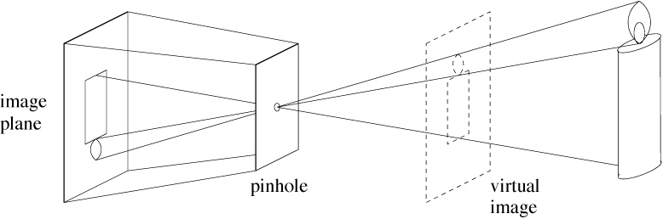
Pinhole cameras
Abstract camera model - box with a small hole in it
Pinhole cameras work in practice
(Forsyth & Ponce)

Slide 9
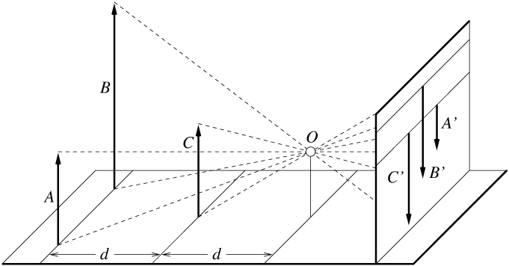
Distant objects are smaller
(Forsyth & Ponce)

Slide 10
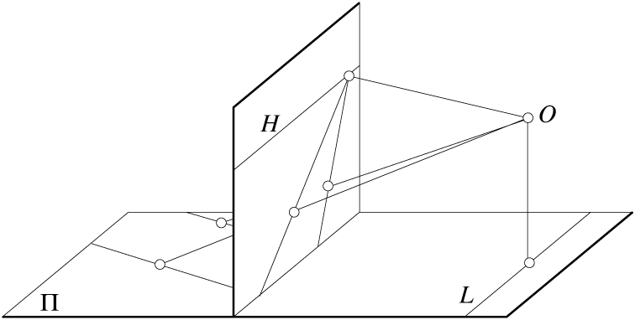
Parallel lines meet
Common to draw image plane in front of the focal point. Moving the image plane merely scales the image.
(Forsyth & Ponce)

Slide 11
Vanishing points
Each set of parallel lines meets at a different point
The vanishing point for this direction
Sets of parallel lines on the same plane lead to collinear vanishing points.
The line is called the horizon for that plane

Slide 12
Properties of Projection
Points project to points
Lines project to lines
Planes project to the whole image or a half image
Angles are not preserved
Degenerate cases
Line through focal point projects to a point.
Plane through focal point projects to line
Plane perpendicular to image plane projects to part of the image (with horizon).

Slide 13
Take out paper and pencil

Slide 14
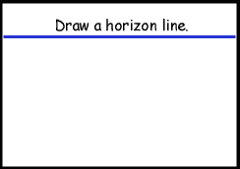
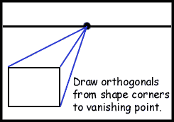
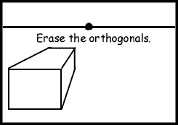
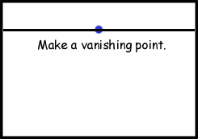
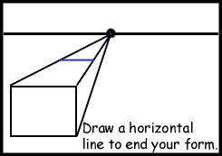
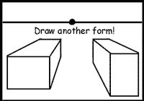
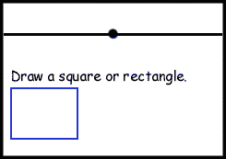
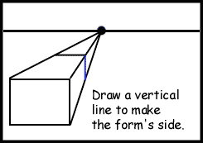
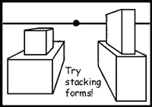
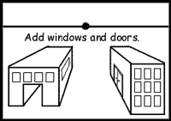

Slide 15
http://www.sanford-artedventures.com/create/tech_1pt_perspective.html

Slide 16
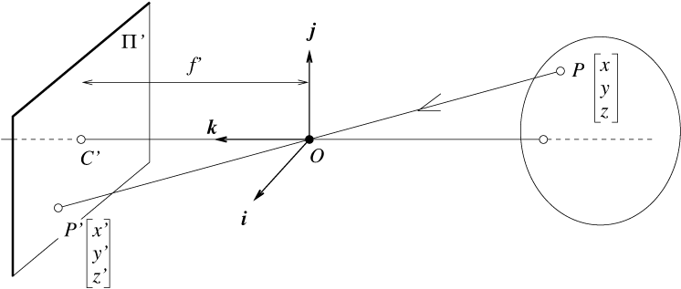
The equation of projection
(Forsyth & Ponce)

Slide 17
The equation of projection
Cartesian coordinates:
We have, by similar triangles, that
Ignore the third coordinate, and get

Slide 18
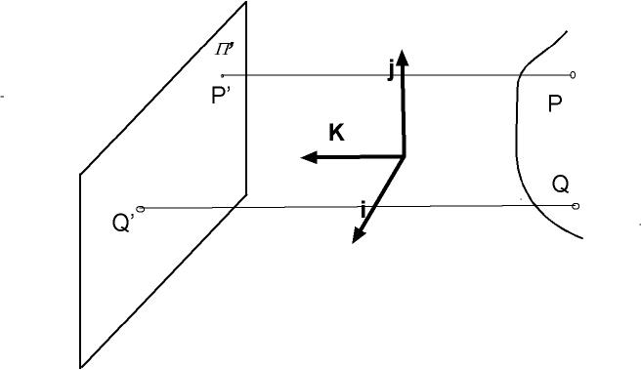
Orthographic projection

Slide 19
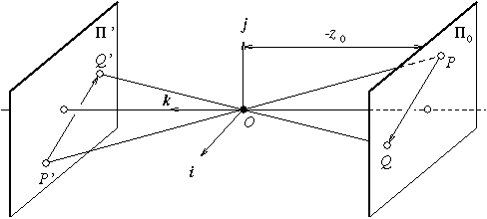
Weak perspective (scaled orthographic projection)
Issue
perspective effects, but not over the scale of individual objects
collect points into a group at about the same depth, then divide each point by the depth of its group
(Forsyth & Ponce)

Slide 20
The Equation of Weak Perspective
s is constant for all points.
Parallel lines no longer converge, they remain parallel.

Slide 21
Pros and Cons of These Models
Weak perspective much simpler math.
Accurate when object is small and distant.
Most useful for recognition.
Pinhole perspective much more accurate for scenes.
Used in structure from motion.
When accuracy really matters, must model real cameras.

Slide 22
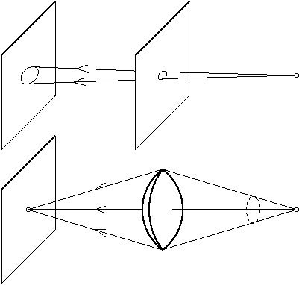
Cameras with Lenses
(Forsyth & Ponce)

Slide 23
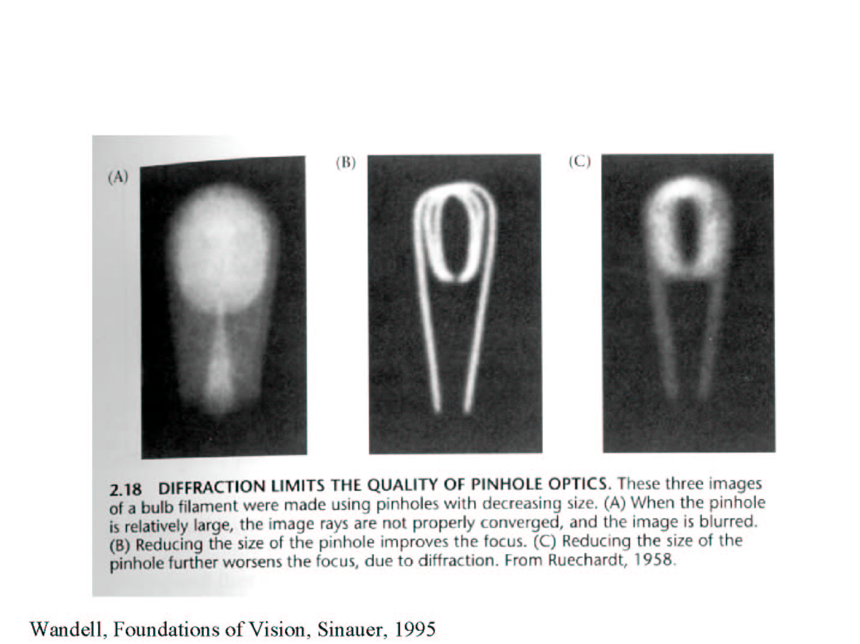
Shrinking the aperture

Slide 24
Interaction of light with matter
Absorption
Scattering
Refraction
Reflection
Other effects:
Diffraction: deviation of straight propagation in the presence of obstacles
Fluorescence:absorbtion of light of a given wavelength by a fluorescent molecule causes reemission at another wavelength

Slide 25
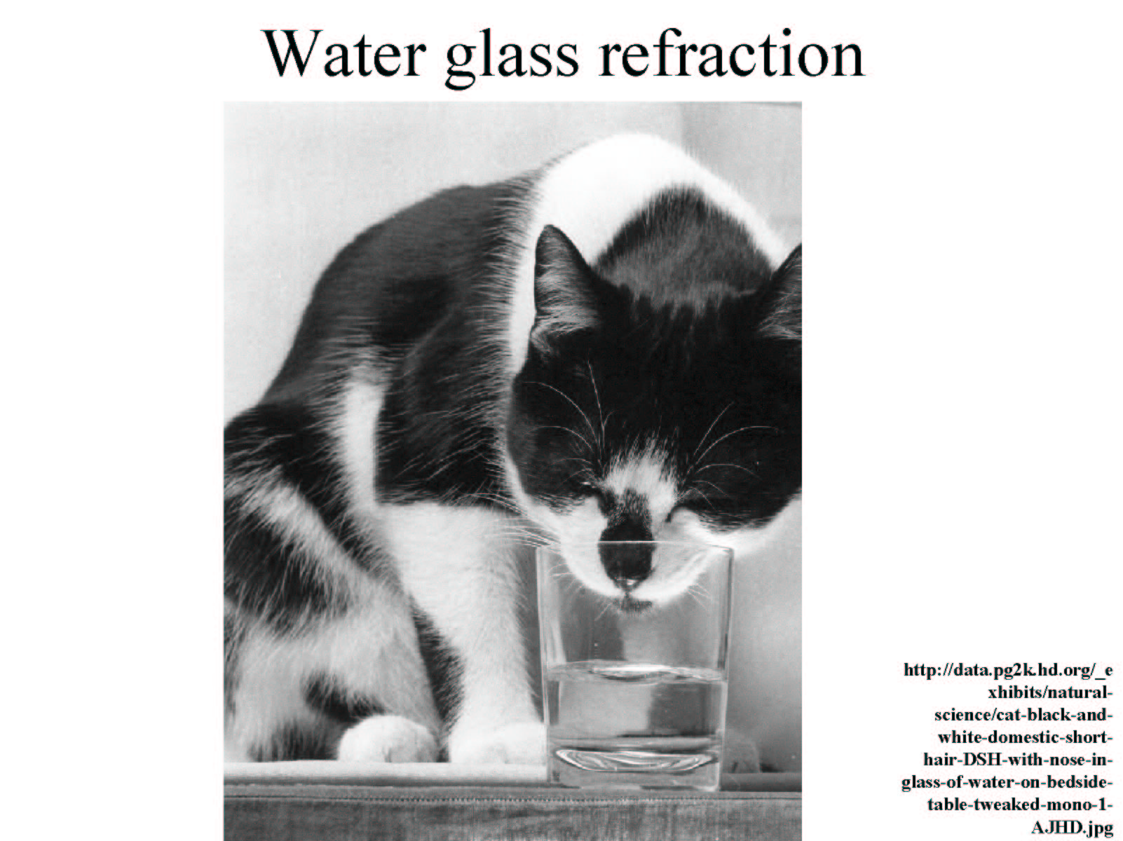

Slide 26
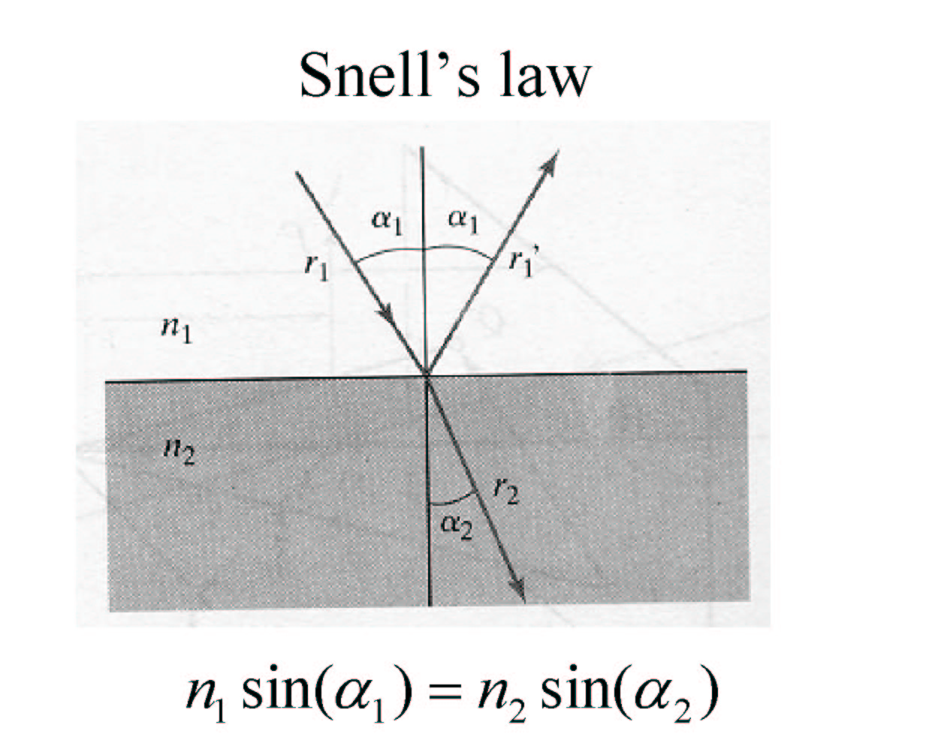
Refraction
n1, n2: indexes of refraction

Slide 27
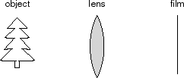
Focus and Defocus
“circle of confusion”
A lens focuses light onto the film
There is a specific distance at which objects are “in focus”
– other points project to a “circle of confusion” in the image
Changing the shape of the lens changes this distance
Slide by Steve Seitz

Slide 28
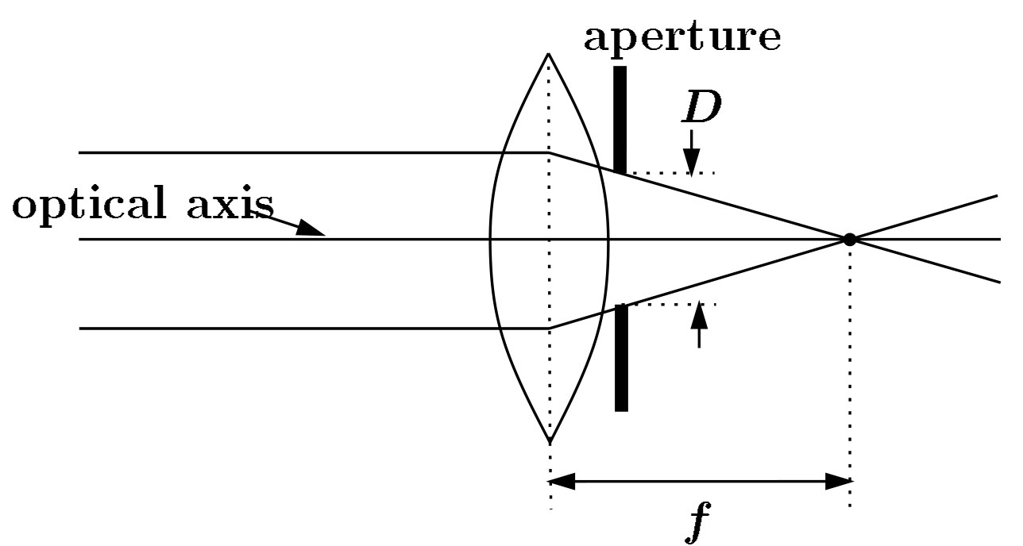
Lenses
F
focal point
optical center
(Center Of Projection)
A lens focuses parallel rays onto a single focal point
focal point at a distance f beyond the plane of the lens
f is a function of the shape and index of refraction of the lens
Aperture of diameter D restricts the range of rays
aperture may be on either side of the lens
Lenses are typically spherical (easier to produce)
Real cameras use many lenses together (to correct for aberrations)

Slide 29
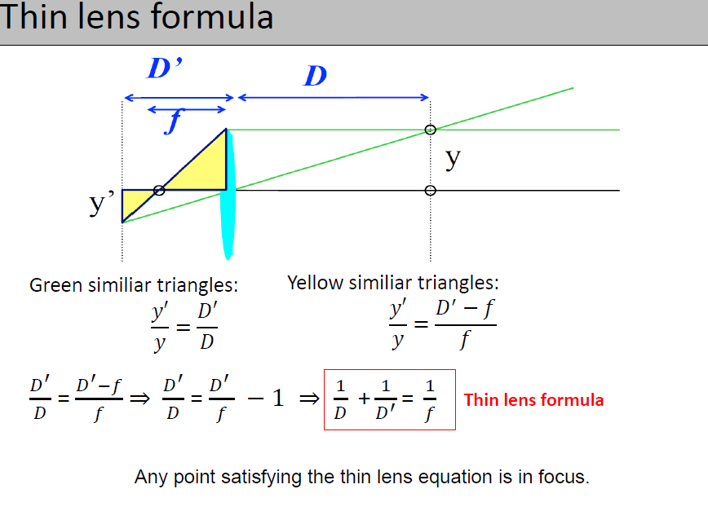

Slide 30
Thin lens formula
Similar triangles everywhere!
y’/y = D’/D
D’
D
f
y
y’
image plane
lens
object
Slide by Frédo Durand
Thin lens formula
y’/y = D’/D y’/y = (D’-f)/f
Similar triangles everywhere!
D’
D
f
y
y’
image plane
lens
object
Slide by Frédo Durand

Slide 31
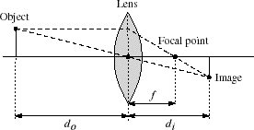

Thin lenses
Thin lens equation:
Any object point satisfying this equation is in focus
What is the shape of the focus region?
How can we change the focus region?
Slide by Steve Seitz

Slide 32
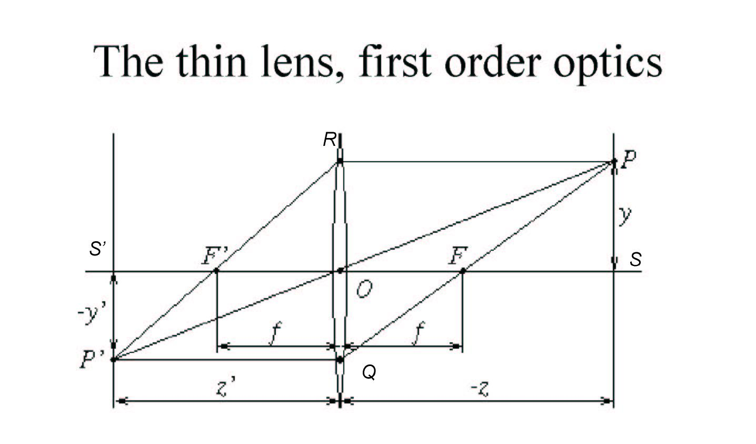
Similar triangles <P’F’S’>,<ROF’> and <PSF><QOF> →

Slide 33
Assumptions for thin lens equation
Lens surfaces are spherical
Incoming light rays make a small angle with the optical axis
The lens thickness is small compared to the radii of curvature
The refractive index is the same for the media on both sides of the lens

Slide 34
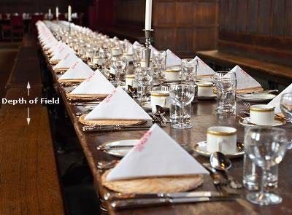
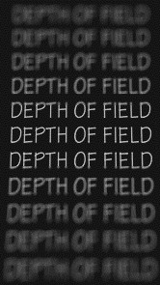
Depth of Field
http://www.cambridgeincolour.com/tutorials/depth-of-field.htm

Slide 35
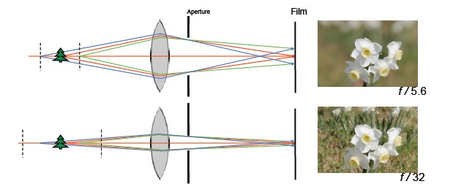
Aperture controls Depth of Field
Changing the aperture size affects depth of field
A smaller aperture increases the range in which the object is approximately in focus
But small aperture reduces amount of light – need to increase exposure

Slide 36
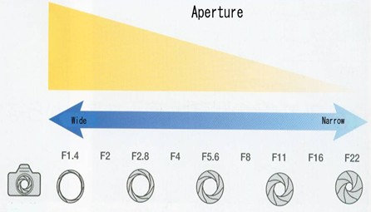
F-number: focal length / aperture diameter

Slide 37
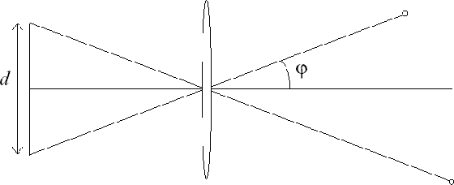
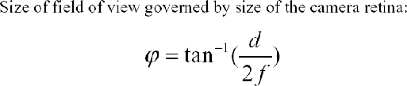
FOV depends of Focal Length
f
f
Smaller FOV = larger Focal Length

Slide 38
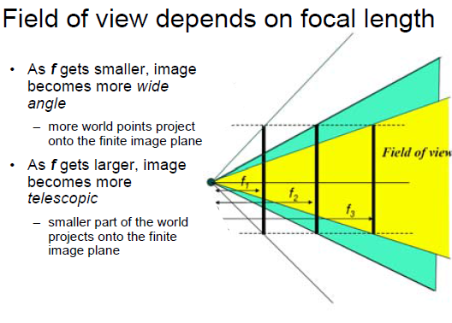

Slide 39


Field of View / Focal Length
Large FOV, small f Camera close to car
Small FOV, large f Camera far from the car

Slide 40
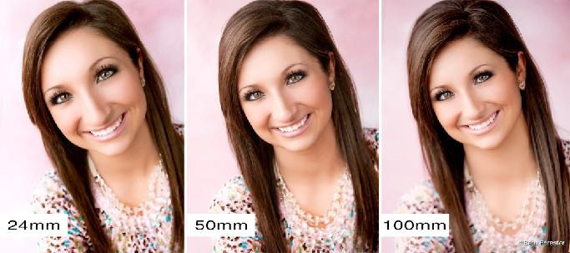
Focal length / distance in portraiture

Slide 41
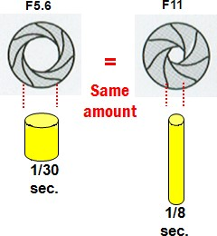
Exposure: shutter speed vs. aperture

Slide 42
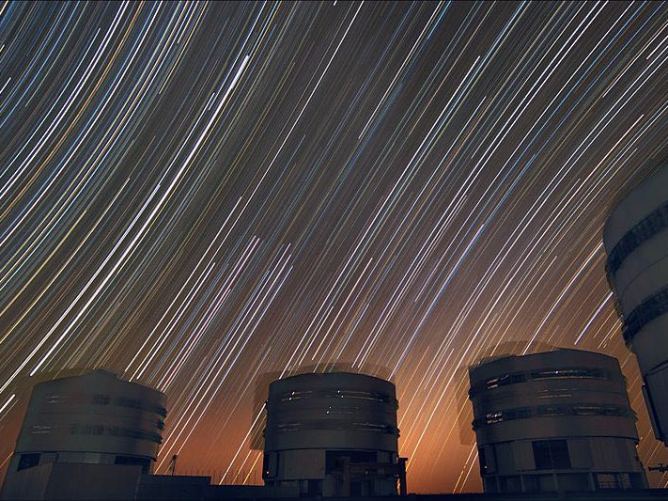

Slide 43
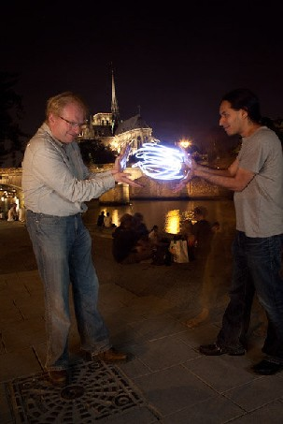
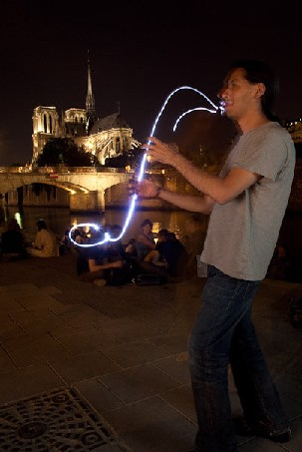
Fun with slow shutter speeds
Photos by Fredo Durand

Slide 44
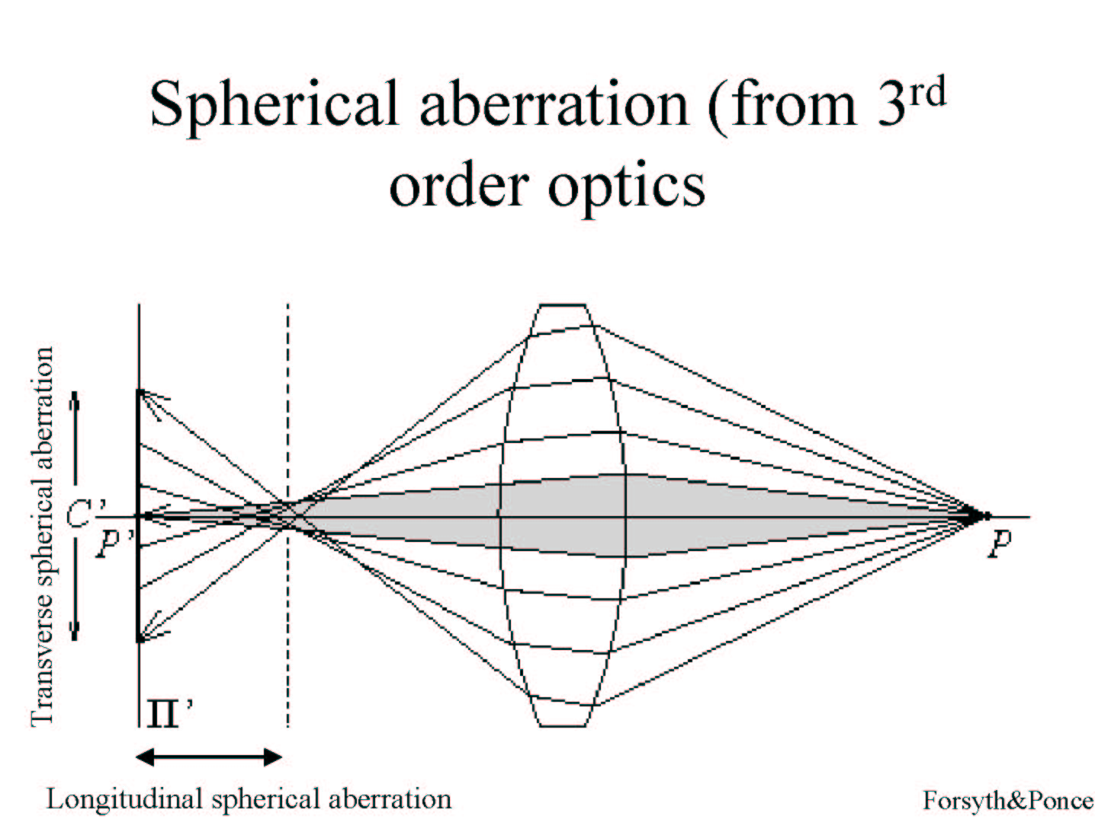

Slide 45
Other aberrations
Astigmatism: unevenness of the cornea
Distortion : different areas of lens have different focal length
Coma : point not on optical axis is depicted as asymmetrical comet-shaped blob
Chromatic aberration

Slide 46
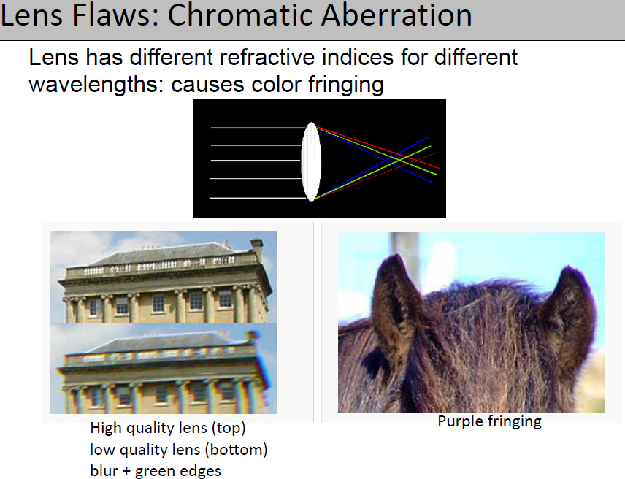

Slide 47

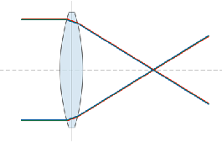
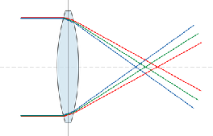
Chromatic Aberration
Slide by Carl Doersch

Slide 48

Radial Distortion (e.g. ‘Barrel’ and ‘pin-cushion’)
straight lines curve around the image center

Slide 49
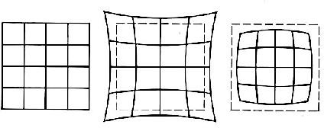
Radial Distortion
No distortion
Pin cushion
Barrel
Radial distortion of the image
Caused by imperfect lenses
Deviations are most noticeable for rays that pass through the edge of the lens

