Slide 1
Linear Algebra Review
Many slides in this review are from O. Camps (Penn Stae University)

Slide 2
Why do we need Linear Algebra?
We will associate coordinates to
3D points in the scene
2D points in the image
Coordinates will be used to
Perform geometrical transformations
Associate different coordinate systems (platform, end-effector, camera)
Associate 3D with 2D points
Images are matrices of numbers
We will find properties of these numbers

Slide 3
Matrices
Sum:
A and B must have the same dimensions
Example:

Slide 4
Matrices
Product:
A and B must have compatible dimensions
Examples:

Slide 5
Matrices
Transpose:
If
A is symmetric
Examples:

Slide 6
Matrices
Determinant:
A must be square
Example:

Slide 7
Matrices
Inverse:
A must be square
Example:

Slide 8
2D Vector
P
x2
v
θ
x1
Magnitude:
If
,
Is a UNIT vector
Is a unit vector
Orientation:

Slide 9
Vector Addition
v+w
v
w

Slide 10
Vector Subtraction
v-w
v
w

Slide 11
Scalar Product
av
v

Slide 12
Inner (dot) Product
v
α
w
The inner product is a SCALAR!

Slide 13
Vector (cross) Product
u
w
α
v
The cross product is a VECTOR!
Magnitude:
Orientation:

Slide 14


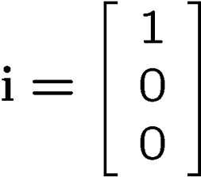
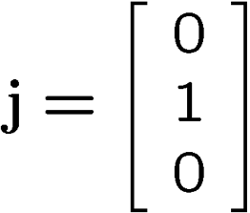
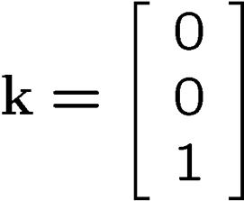




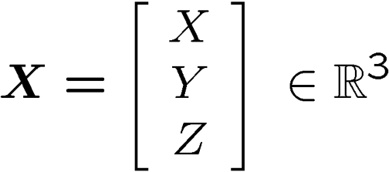
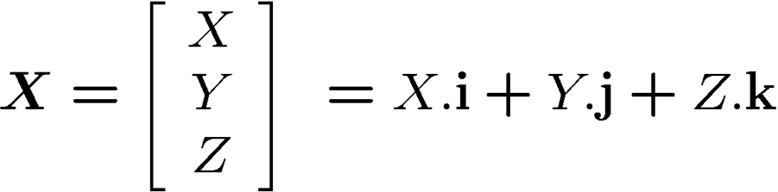
Orthonormal Basis in 3D
Standard base vectors:
Coordinates of a point
in space:

Slide 15
Vector Product Computation
u
w
α
v

Slide 16
2D Geometrical Transformations

Slide 17
2D Translation
P’
t
P

Slide 18
2D Translation Equation
P’
t
ty
P
y
x
tx

Slide 19
Homogeneous Coordinates
Multiply the coordinates by a non-zero scalar and add an extra coordinate equal to that scalar. For example,
NOTE: If the scalar is 1, there is no need for the multiplication!

Slide 20
Back to Cartesian Coordinates:
Divide by the last coordinate and eliminate it. For example,

Slide 21
2D Translation using Homogeneous Coordinates
P’
t
t
ty
P
P
y
x
tx

Slide 22

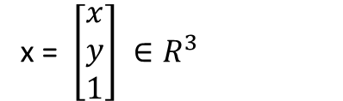
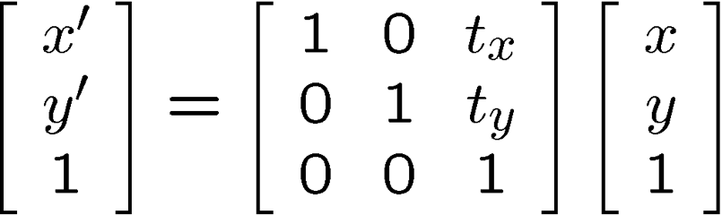

Homogeneous Coordinates
Homogeneous coordinates:
Translation using matrices:

Slide 23
Scaling
P’
P

Slide 24
Scaling Equation
P’
Sy.y
P
y
x
Sx.x

Slide 25
Scaling & Translating
P’’=T.P’
S
P’=S.P
T
P
P’’=T.P’=T.(S.P)=(T.S).P

Slide 26
Scaling & Translating
P’’=T.P’=T.(S.P)=(T.S).P

Slide 27
Translating & Scaling ≠ Scaling & Translating
P’’=S.P’=S.(T.P)=(S.T).P

Slide 28
Rotation
P
P’

Slide 29
Rotation Equations
Counter-clockwise rotation by an angle θ
P’
Y’
θ
y
P
x
X’

Slide 30
Degrees of Freedom
R is 2x2
4 elements
BUT! There is only 1 degree of freedom: θ
The 4 elements must satisfy the following constraints:

Slide 31
Scaling, Translating & Rotating
Order matters!
P’ = S.P
P’’=T.P’=(T.S).P
P’’’=R.P”=R.(T.S).P=(R.T.S).P
R.T.S ≠ R.S.T ≠ T.S.R …

Slide 32
3D Rotation of Points
Rotation around the coordinate axes, counter-clockwise:
P’
Y’
γ
y
P
x
X’
z

Slide 33
3D Rotation (axis & angle)

Slide 34
3D Translation of Points
Translate by a vector t=(t_{x},t_{y},t_{x})^{T}:
P’
t
Y’
x
x’
P
z’
y
z

Slide 35
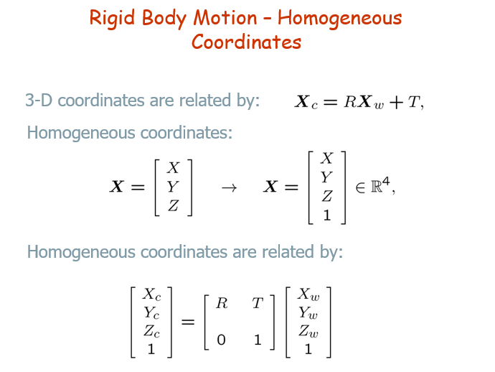

Slide 36
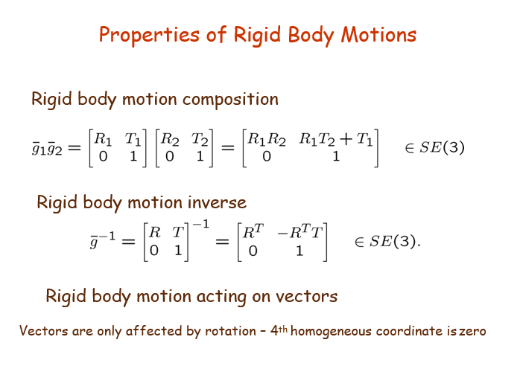

Slide 37
