Slide 1
Multiple View Geometry and Stereo

Slide 2
Overview
Single camera geometry
Recap of Homogenous coordinates
Perspective projection model
Camera calibration
Stereo Reconstruction
Epipolar geometry
Stereo correspondence
Triangulation

Slide 3
Projective Geometry
Recovery of structure from one image is inherently ambiguous
Today we focus on geometry that maps world to camera image
X?
X?
X?
x

Slide 4
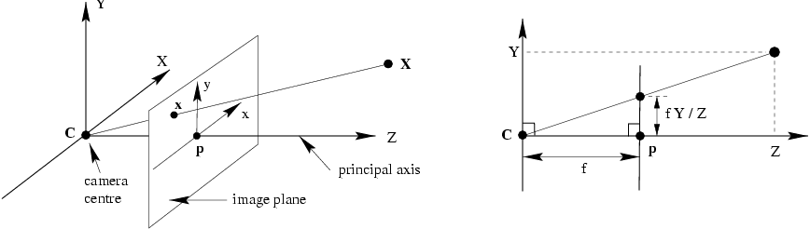
Recall: Pinhole camera model
Principal axis: line from the camera center perpendicular to the image plane
Normalized (camera) coordinate system: camera center is at the origin and the principal axis is the z-axis

Slide 5
Recall: Pinhole camera model

Slide 6
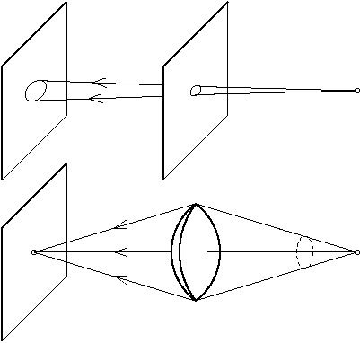
Camera Internal Parameters or Calibration matrix
Background
The lens optical axis does not coincide with the sensor
We model this using a 3x3 matrix the Calibration matrix

Slide 7
Camera Calibration matrix
The difference between ideal sensor and the real one is modeled by a 3x3 matrix K:
(c_{x},c_{y}) camera center, (a_{x},a_{y}) pixel dimensions, b skew
We end up with

Slide 8
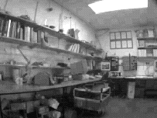
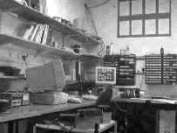
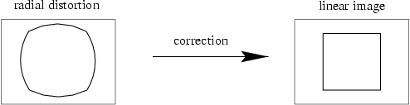
Radial distortion

Slide 9
Camera parameters
Intrinsic parameters
Principal point coordinates
Focal length
Pixel magnification factors
Skew (non-rectangular pixels)
Radial distortion
Extrinsic parameters
Rotation and translation relative to world coordinate system

Slide 10
Scenarios
The two images can arise from
A stereo rig consisting of two cameras
the two images are acquired simultaneously
or
A single moving camera (static scene)
the two images are acquired sequentially
The two scenarios are geometrically equivalent

Slide 11
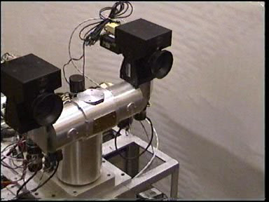
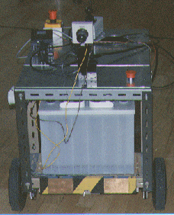
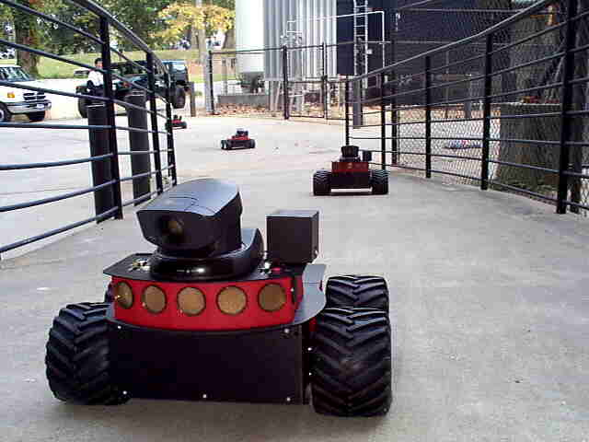
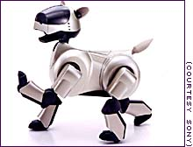
Stereo head
Camera on a mobile vehicle

Slide 12
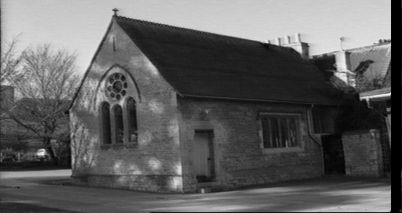
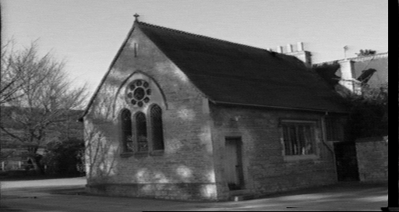
The objective
Given two images of a scene acquired by known cameras compute the 3D position of the scene (structure recovery)
Basic principle: triangulate from corresponding image points
Determine 3D point at intersection of two back-projected rays

Slide 13
Corresponding points are images of the same scene point
Triangulation
C
C
/
The back-projected points generate rays which intersect at the
3D scene point

Slide 14
An algorithm for stereo reconstruction
For each point in the first image determine the corresponding point in the second image
(this is a search problem)
For each pair of matched points determine the 3D point by triangulation
(this is an estimation problem)

Slide 15
The correspondence problem
Given a point x in one image find the corresponding point in the other image
This appears to be a 2D search problem, but it is reduced to a 1D search by the epipolar constraint

Slide 16
Outline
Epipolar geometry
the geometry of two cameras
reduces the correspondence problem to a line search
Stereo correspondence algorithms
Triangulation

Slide 17

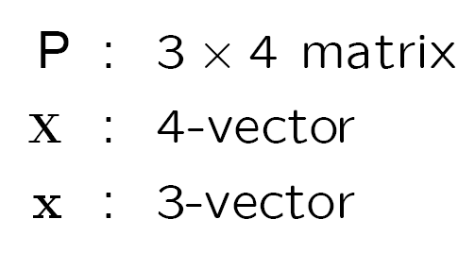
Notation
The two cameras are P and P/, and a 3D point X is imaged as
X
P
P/
x
/
x
C
C
/
Warning
for equations involving homogeneous quantities ‘=’ means ‘equal up to scale’

Slide 18
Epipolar geometry

Slide 19
Epipolar geometry
Given an image point in one view, where is the corresponding point in the other view?
?
epipolar line
C
C
/
epipole
baseline
A point in one view “generates” an epipolar line in the other view
The corresponding point lies on this line

Slide 20
Epipolar line
Epipolar constraint
Reduces correspondence problem to 1D search along an epipolar line

Slide 21
Epipolar geometry continued
Epipolar geometry is a consequence of the coplanarity of the camera centres and scene point
X
x
x
/
C
C
/
The camera centres, corresponding points and scene point lie in a single plane, known as the epipolar plane

Slide 22
Nomenclature
X
l/
right epipolar line
left epipolar line
x
/
x
e
e
/
C
C
/
The epipolar line l/ is the image of the ray through x
The epipole e is the point of intersection of the line joining the camera centres with the image plane
this line is the baseline for a stereo rig, and
the translation vector for a moving camera
The epipole is the image of the centre of the other camera: e = PC/ , e/ = P/C

Slide 23
The epipolar pencil
X
e
/
e
baseline
As the position of the 3D point X varies, the epipolar planes “rotate” about the baseline. This family of planes is known as an epipolar pencil. All epipolar lines intersect at the epipole.
(a pencil is a one parameter family)

Slide 24
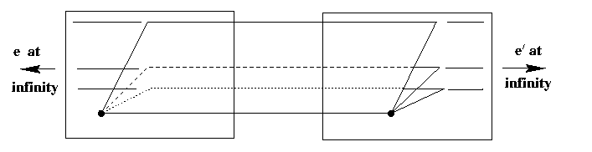
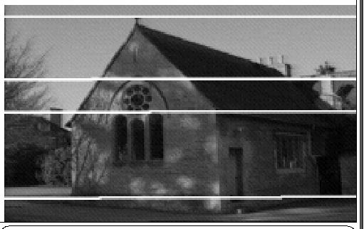
Epipolar geometry example I: parallel cameras
Epipolar geometry depends only on the relative pose (position and orientation) and internal parameters of the two cameras, i.e. the position of the camera centres and image planes. It does not depend on the scene structure (3D points external to the camera).

Slide 25
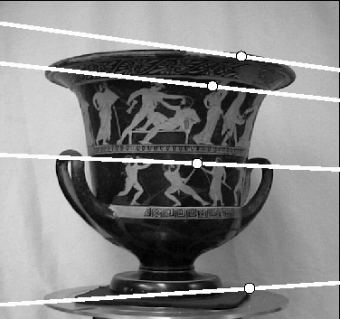
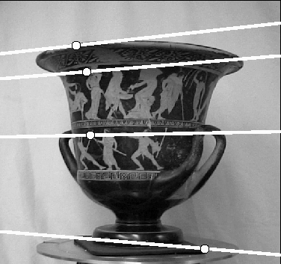
Epipolar geometry example II: converging cameras
e
e
/
Note, epipolar lines are in general not parallel

Slide 26
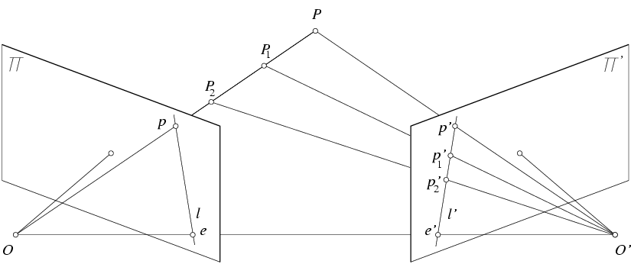
Epipolar constraint
X
x
x’
If we observe a point x in one image, where can the corresponding point x’ be in the other image?

Slide 27
Epipolar constraint
X
X
X
x
x’
x’
x’
Potential matches for x have to lie on the corresponding
epipolar line l’.
Potential matches for x’ have to lie on the corresponding
epipolar line l.

Slide 28

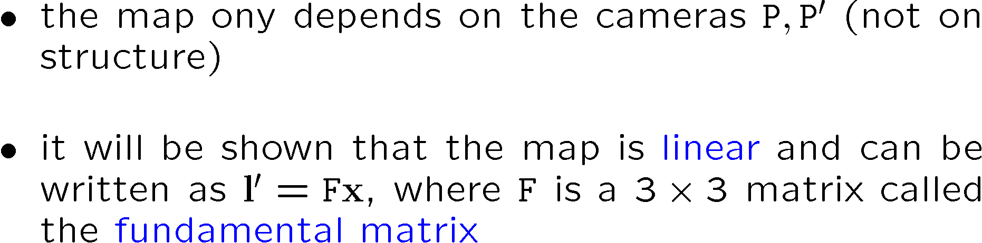
Algebraic representation of epipolar geometry
We know that the epipolar geometry defines a mapping
x l/
point in first image
epipolar line in second image

Slide 29
Matrix form of cross product

Slide 30
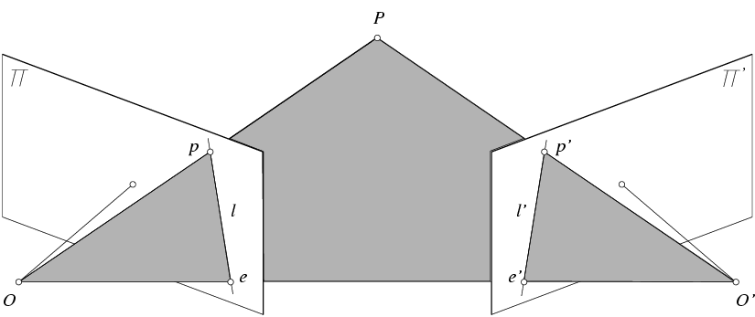
Epipolar constraint: Calibrated case
X
x
x’
Intrinsic and extrinsic parameters of the cameras are known, world coordinate system is set to that of the first camera
Then the projection matrices are given by K[I | 0] and K’[R | t]
We can multiply the projection matrices (and the image points) by the inverse of the calibration matrices to get normalized image coordinates:

Slide 31
Epipolar constraint: Calibrated case
X
= (x,1)^{T}
x
x’ = Rx+t
t
R
The vectors Rx, t, and x’ are coplanar
Notes:
X’ is X in the second camera’s coordinate system
We can identify the non-homogeneous 3D vectors X and X’ with the homogeneous coordinate vectors x and x’ of the projections of the two points into the two respective images

Slide 32
Epipolar constraint: Calibrated case
X
x
x’ = Rx+t
Recall:
The vectors Rx, t, and x’ are coplanar

Slide 33
Epipolar constraint: Calibrated case
X
x
x’ = Rx+t
Essential Matrix
(Longuet-Higgins, 1981)
The vectors Rx, t, and x’ are coplanar

Slide 34
Epipolar constraint: Calibrated case
X
x
x’
E x is the epipolar line associated with x (l' = E x)
Recall: a line is given by ax + by + c = 0 or

Slide 35
Epipolar constraint: Uncalibrated case
X
x
x’
The calibration matrices K and K’ of the two cameras are unknown
We can write the epipolar constraint in terms of unknown normalized coordinates:

Slide 36
Epipolar constraint: Uncalibrated case
X
x
x’
Fundamental Matrix
(Faugeras and Luong, 1992)

Slide 37
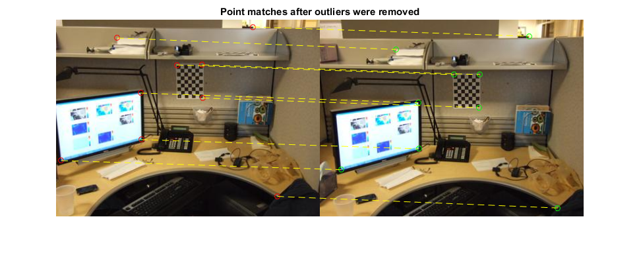
Estimating the fundamental matrix

Slide 38
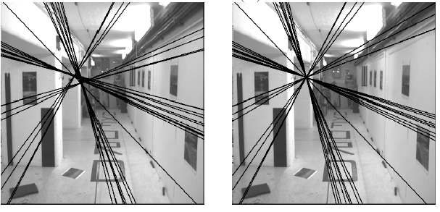
The eight-point algorithm
Solve homogeneous linear system using eight or more matches
Enforce rank-2 constraint (take SVD of F and throw out the smallest singular value)

Slide 39
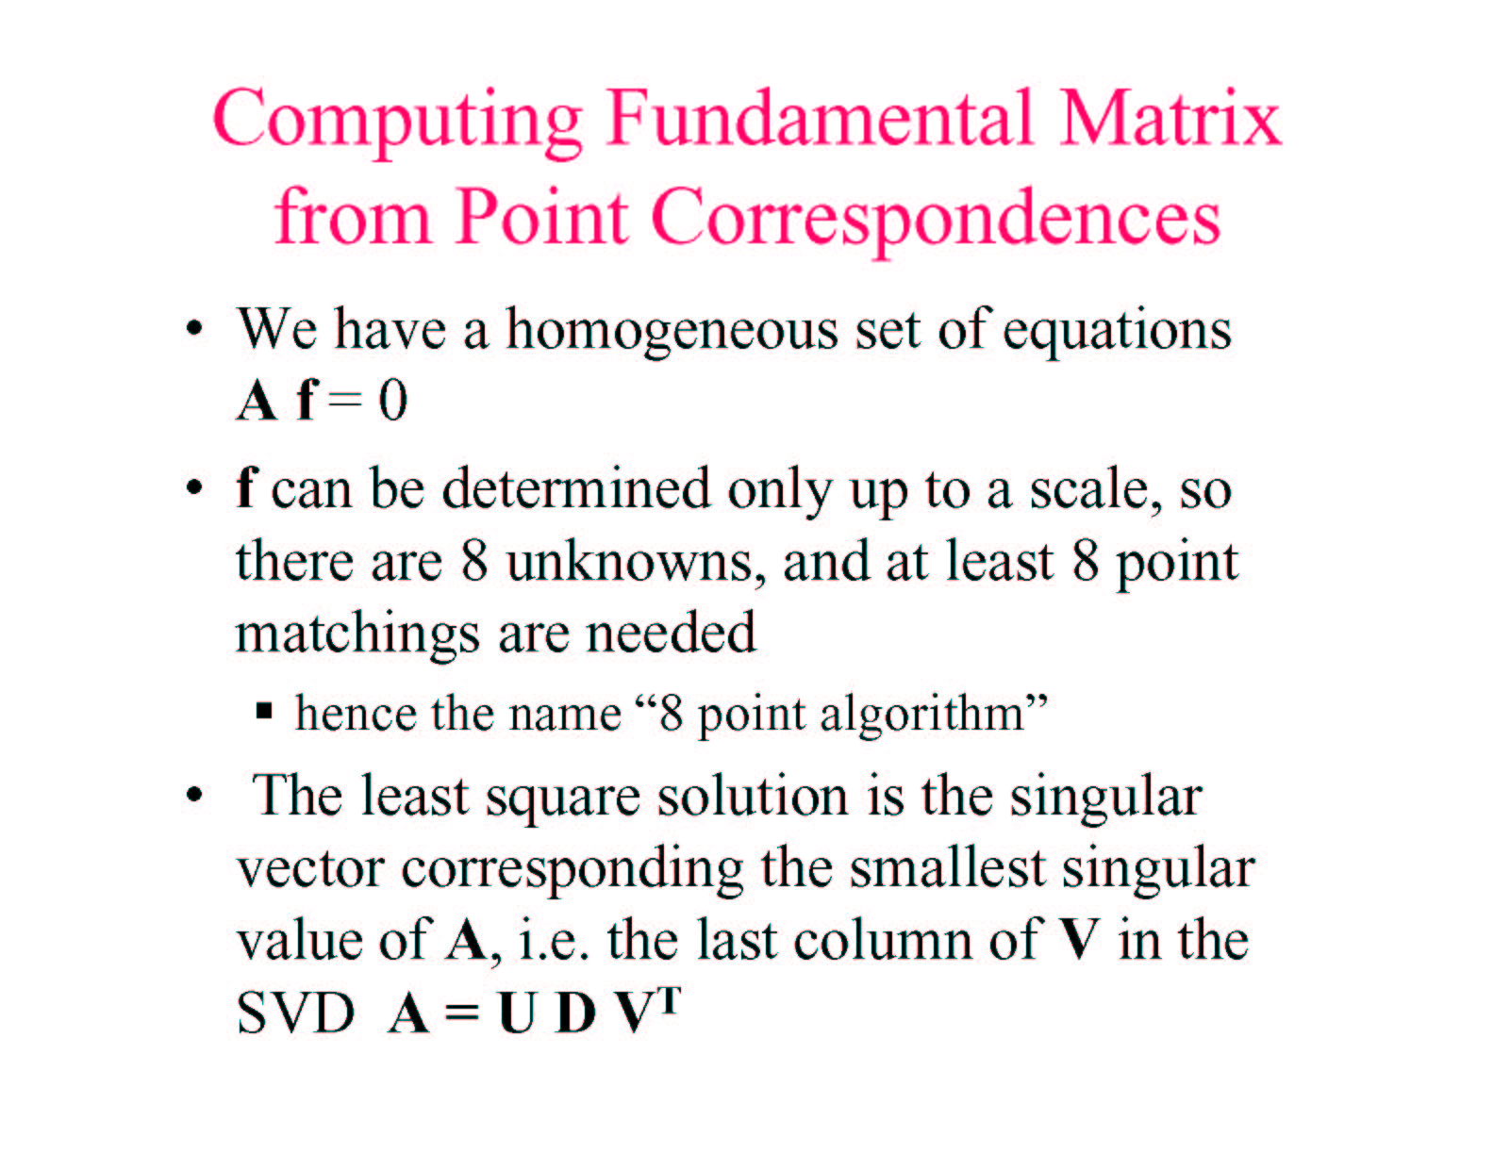

Slide 40
Problem with eight-point algorithm

Slide 41
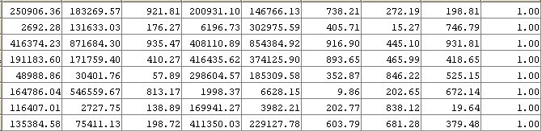
Problem with eight-point algorithm
Poor numerical conditioning
Can be fixed by rescaling the data

Slide 42
The normalized eight-point algorithm
(Hartley, 1995)
Center the image data at the origin, and scale it so the mean squared distance between the origin and the data points is 2 pixels
Use the eight-point algorithm to compute F from the normalized points
Enforce the rank-2 constraint (for example, take SVD of F and throw out the smallest singular value)
Transform fundamental matrix back to original units: if T and T’ are the normalizing transformations in the two images, then the fundamental matrix in original coordinates is T’^{T} F T

Slide 43
Nonlinear estimation
Linear estimation minimizes the sum of squared algebraic distances between points x’_{i} and epipolar lines F x_{i} (or points x_{i} and epipolar lines F^{T}x’_{i}):
Nonlinear approach: minimize sum of squared geometric distances
x_{i}

Slide 44
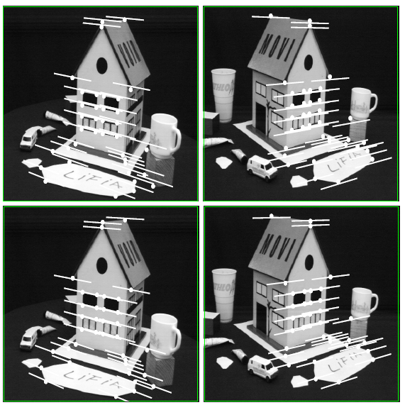
Comparison of estimation algorithms
 | 8-point | Normalized 8-point | Nonlinear least squares
Av. Dist. 1 | 2.33 pixels | 0.92 pixel | 0.86 pixel
Av. Dist. 2 | 2.18 pixels | 0.85 pixel | 0.80 pixel

