Slide 1
Background on Estimation for Computer Vision

Slide 2
Overview of the Lecture
Eigenvalues and eigenvectors
Eigen-Decomposition (applied to Covariance matrix)
SVD
Solving a (non-homogeneous) system of linear equations (LS)
Solving a homogeneous system of linear equations (Orthog. L S)
Line fitting with Orth. LS
Line fitting with LS
Line fitting using LS with Regularization
Line fitting with RANSAC

Slide 3

Mapping of Vectors
A matrix is a mapping system of vectors!
$$A_{m×n}×x_{n×1}=y_{m×1}$$
Mapping System
Original Vector
Mapped Vector
How does it work?

Slide 4

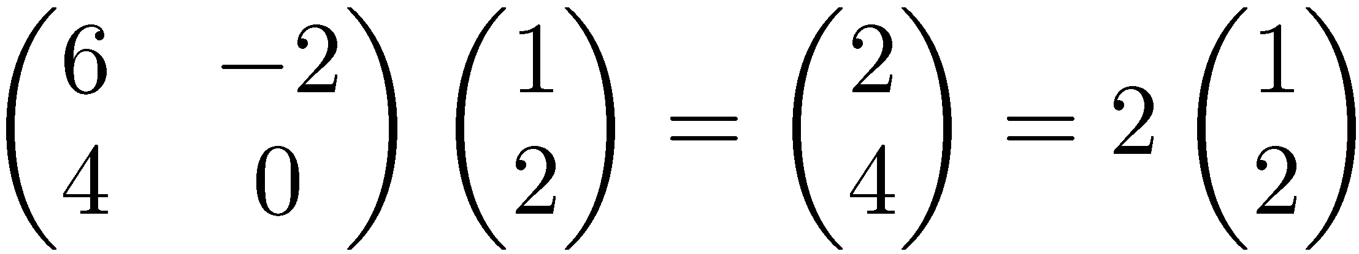
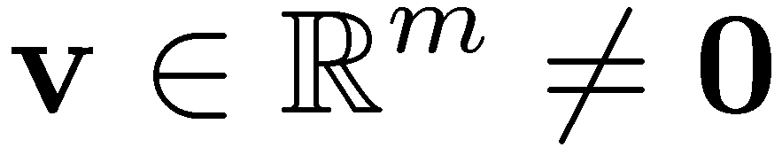

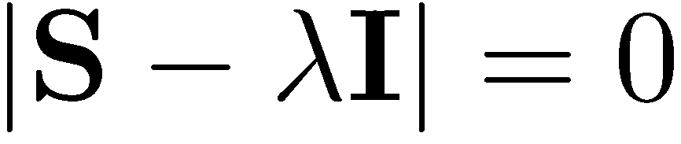
Eigenvalues & Eigenvectors
Eigenvectors (for a square m×m matrix S)
How many eigenvalues are there at most?
Example
(right) eigenvector
eigenvalue
only has a non-zero solution if
This is a m-th order equation in λ which can have at most m distinct solutions (roots of the characteristic polynomial) – can be complex even though S is real.

Slide 5
Matrix-vector multiplication
has eigenvalues 3, 2, 0 with
corresponding eigenvectors
On each eigenvector, S acts as a multiple of the identity
matrix: but as a different multiple on each.
Any vector (say x= ) can be viewed as a combination of
the eigenvectors: x = 2v₁ + 4v₂ + 6v₃

Slide 6
Eigenvalues & Eigenvectors
For symmetric matrices, eigenvectors for distinct
eigenvalues are orthogonal
All eigenvalues of a real symmetric matrix are real.
All eigenvalues of a positive semidefinite matrix
are non-negative

Slide 7
Example
Let
Then
The eigenvalues are 1 and 3 (nonnegative, real).
The eigenvectors are orthogonal (and real):
Real, symmetric.
Plug in these values and solve for eigenvectors.

Slide 8
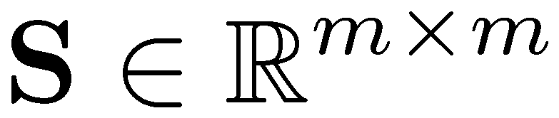
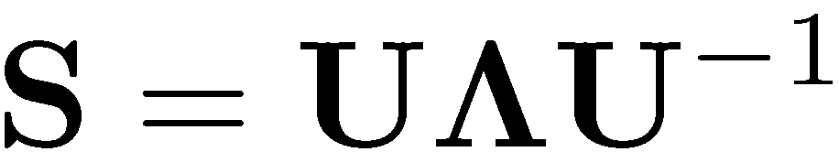


Eigen/diagonal Decomposition
Let be a square matrix with m linearly independent eigenvectors (a “non-defective” matrix)
Theorem: Exists an eigen decomposition
(cf. matrix diagonalization theorem)
Columns of U are eigenvectors of S
Diagonal elements of are eigenvalues of
Unique for distinct eigen-values
diagonal

Slide 9
Symmetric Eigen Decomposition
If is a symmetric matrix:
Theorem: Exists a (unique) eigen decomposition
where Q is orthogonal:
Q⁻¹= Q^{T}
Columns of Q are normalized eigenvectors
Columns are orthogonal.
(everything is real)

Slide 10
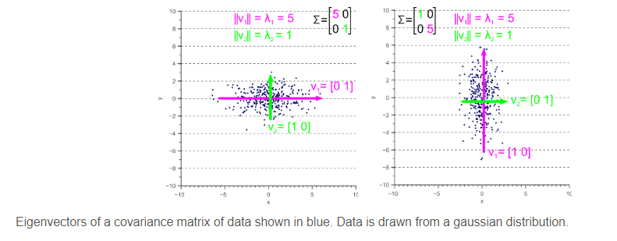

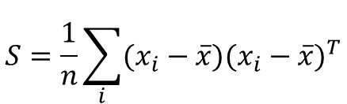
If S is co-variance matrix
$$S=\frac{1}{n}\sum_{i}{(x_{i}−\overline{x}){(x_{i}−\overline{x})}^{T}}$$
$\text{where} \overline{x}$ is the mean of the set of points $\{x_{i}\}$
Eigenvalues represent covariances
Eigenvectors represent linearly independent directions of variation in data

Slide 11
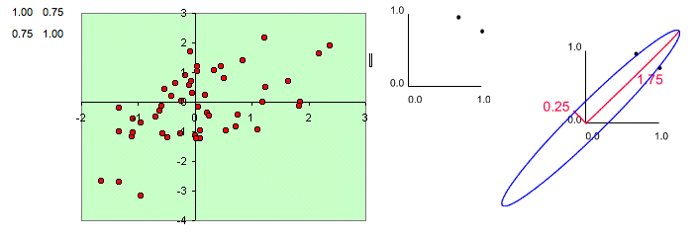
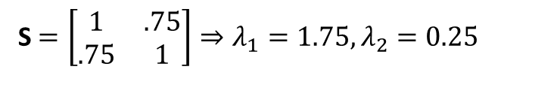
Physical interpretation
Consider a covariance matrix, S, i.e., S = 1/n A A^{T} for some A
Error ellipse with the major axis as the larger eigenvalue and the minor axis as the smaller eigenvalue
S $=\left[\begin{matrix}1 & .75 \\ .75 & 1\end{matrix}\right]⇒λ_{1}=1.75,λ_{2}=0.25$

Slide 12
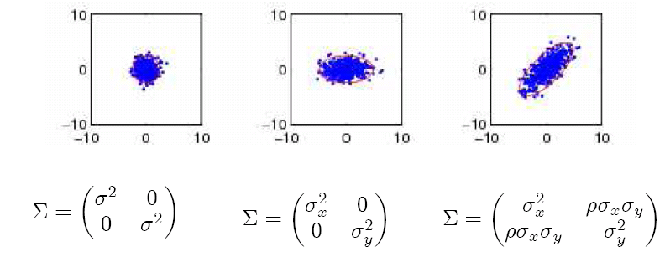
Spherical, diagonal, full covariance

Slide 13
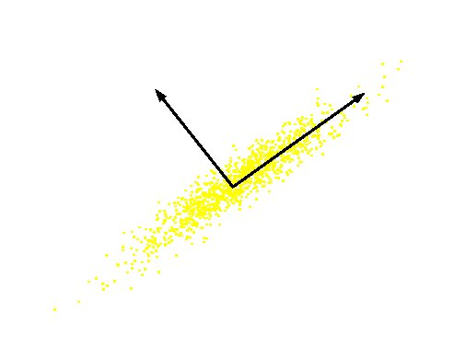
The concept is used in Principal Component Analysis (PCA)
Orthogonal directions of greatest variance in data
Projections along PC1 (Principal Component) discriminate the data most along any one axis
Original Variable B
PC 2
PC 1
Original Variable A

Slide 14
Singular Value Decomposition
For an m× n matrix A of rank r there exists a factorization
(Singular Value Decomposition = SVD) as follows:
m×m
m×n
V is n×n
The columns of U are orthogonal eigenvectors of AA^{T}.
The columns of V are orthogonal eigenvectors of A^{T}A.
Eigenvalues λ₁ … λ_{r} of AA^{T} are the eigenvalues of A^{T}A.
Singular values.

Slide 15
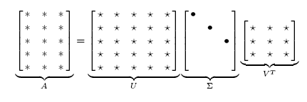
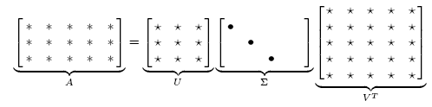
Singular Value Decomposition
Illustration of SVD dimensions and sparseness

Slide 16
SVD example
Let
Thus m=3, n=2. Its SVD is
Typically, the singular values arranged in decreasing order.

Slide 17
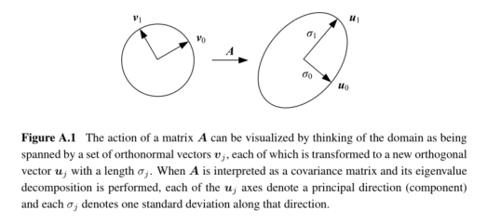
Visualization of multiplying with A

Slide 18
Applications of SVD in Linear Algebra
Inverse of a n x n square matrix, A
If A is non-singular, then A⁻¹ = (UΛV^{T})⁻¹= VΛ⁻¹U^{T} where
Λ⁻¹=diag(1/λ₁, 1/λ₁,☹, 1/λ_{n})
If A is singular, then A⁻¹ = (UΛV^{T})⁻¹¼ VΛ₀⁻¹U^{T} where
Λ₀⁻¹=diag(1/λ₁, 1/λ₂,☹, 1/λ_{i},0,0,☹,0)
Least squares solutions of a mxn system
Ax=b (A is mxn, m¸n) =(A^{T}A)x=A^{T}b ) x=(A^{T}A)⁻¹ A^{T}b=A⁺b
If A^{T}A is singular, x=A⁺b = (VΛ₀⁻¹U^{T})b where Λ₀⁻¹ = diag(1/λ₁, 1/λ₂,☹, 1/λ_{i},0,0,☹,0)
Condition of a matrix
Condition number measures the degree of singularity of A
Larger the value of λ₁/λ_{n}, closer A is to being singular
http://www.cse.unr.edu/~bebis/MathMethods/SVD/lecture.pdf

Slide 19
Line Fitting:
If we know which points belong to the line, how do we find the “optimal” line parameters?
Least squares
What if there are outliers?
Robust fitting, RANSAC
What if there are many lines?
Voting methods: RANSAC, Hough transform
What if we’re not even sure it’s a line?
Model selection

Slide 20
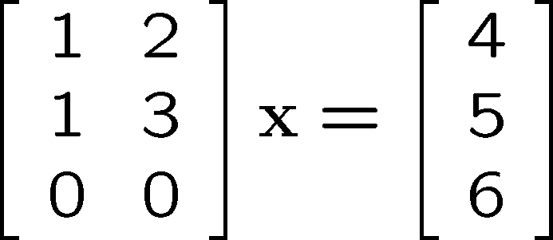





Linear equations solving with Standard Least Squares (LS)
Ax = b
Normal equations
If A has linearly independent columns, A^{T}A is square, symmetric and invertible
is so called pseudoinverse of matix A

Slide 21



Homogeneous Systems of equations
There is a unique trivial solution x = 0
We need to impose some constraint to avoid trivial Solution, for example
Find such x that
is minimized
Solution: eigenvector associated with the smallest eigenvalue of A^{T}A
or singular vector associated with smallest singular value
A = UΣV^{T :} Since singular values are sorted from large to small, this is the last column of V (last row of V^{T})

Slide 22
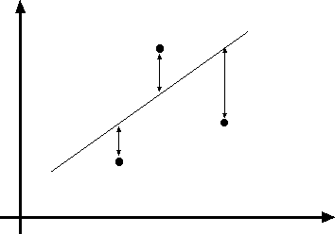
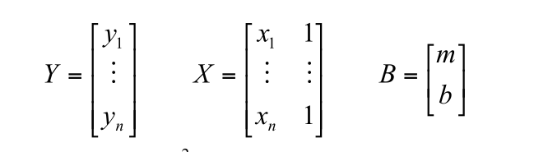


Least squares line fitting
Data: (x₁, y₁), …, (x_{n}, y_{n}) Line equation: y_{i} = m x_{i} + b Find (m, b) to minimize
y=mx+b
(x_{i}, y_{i})
E = ∑
n
( y − mx − b)²
i i
i=1
E = Y − XB ² = (Y − XB)^{T} (Y − XB) = Y^{T}Y − 2( XB)^{T} Y + ( XB)^{T} ( XB)
dE
T T
_{dB} = 2X XB − 2X Y = 0
X^{T} XB = X^{T}Y
Normal equations: Least Squares solution to
XB=Y
$$B={\left(X^{T}X\right) }^{−1}\left(X^{T}Y\right)$$

Slide 23
Problem with “vertical” least squares
Not rotation-invariant
Fails completely for vertical lines

Slide 24
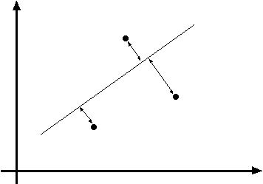
Total least squares (or Orthogonal Least Squares)
Distance between point (x_{i}, y_{i}) and line ax+by=d (a²+b²=1): |ax_{i} + by_{i} – d|
Find (a, b, d) to minimize the sum of squared perpendicular distances
ax+by=d
Unit normal:
(x_{i}, y_{i})
N=(a, b)
n ₂
E = ∑_{i=1} (ax_{i} + by_{i} − d )
E = ∑
n
i=1
(ax + by − d )²
i i
Not stable to find three values (which could have eigenvalues of very different value;
small eigenvalues are critical)
Instead, since the best fit line must pass through the center of mass of the set of points,
center the data (move mass center to origin).
This reduces the problem to finding 2 parameters (the unit vector normal to the line).
Then solve for d.

Slide 25
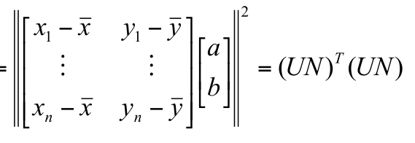
Total least squares
Distance between point (x_{i}, y_{i}) and line ax+by=d (a²+b²=1): |ax_{i} + by_{i} – d|
Find (a, b, d) to minimize the sum of squared perpendicular distances
ax+by=d
Unit normal:
(x_{i}, y_{i})
N=(a, b)
n ₂
E = ∑_{i=1} (ax_{i} + by_{i} − d )
E = ∑
n
i=1
(ax + by − d )²
i i
∂E
=
n
n
∑i=1
d = ª
_{n} ∑i=1
_{n} ∑i=1
2(ax_{i} + by_{i} − d ) = 0
x + ^{b n}
y = ax + by
∂d
i
i
Solve linear equations
in (a,b) only
E =
dE
∑
n
(a(x − x) + b( y − y))² ⎢⎢ !
i=1
i i
= 2(U ^{T}U )N = 0
dN
Solution to (U^{T}U)N = 0, subject to ||N||² = 1: eigenvector of U^{T}U associated with the smallest eigenvalue (least squares solution to homogeneous linear system UN = 0)

Slide 26
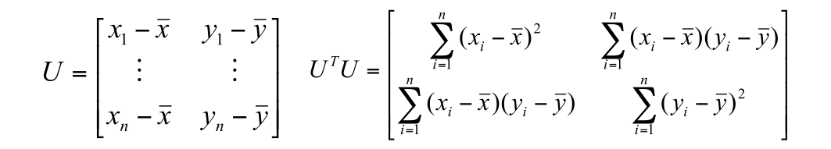
Total least squares
second moment matrix

Slide 27
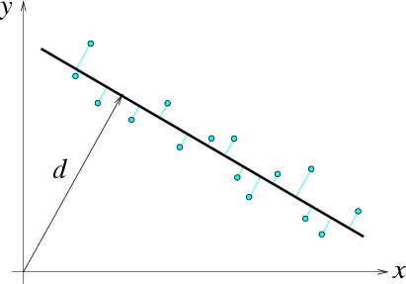

Total least squares
second moment matrix
N = (a, b)
(x_{i} − x, y_{i} − y)
(x, y)

Slide 28
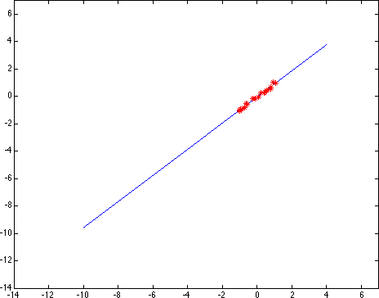
Least squares: Robustness to noise
Least squares fit to the red points:

Slide 29
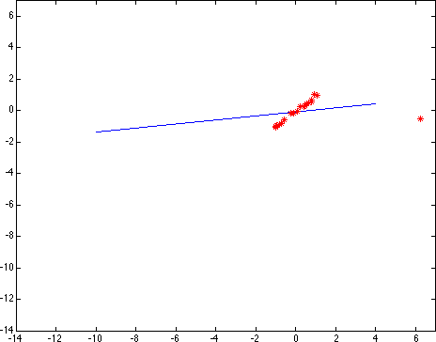
Least squares: Robustness to noise
Least squares fit with an outlier:
Problem: squared error heavily penalizes outliers

Slide 30
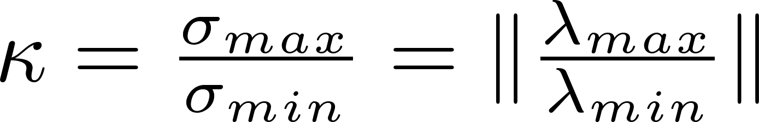

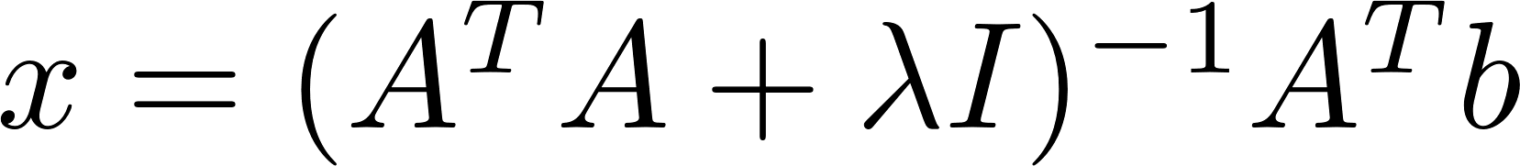
Least Squares Fitting with Regularization
Noise is amplified by inverse of Σ (matrix of eigenvalues)
Sensitivity of a matrix is characterized by condition number
(large condition number causes large noise amplification)
Instead of solving
We solve
Solution

Slide 31
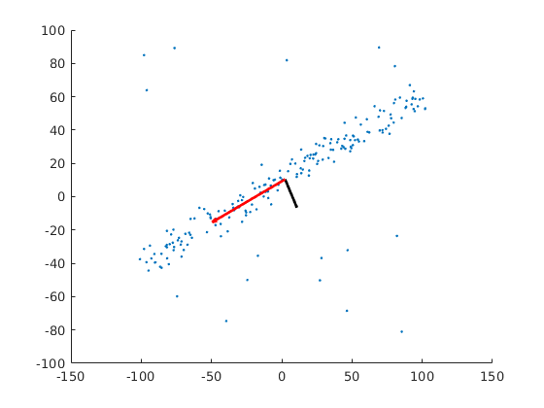
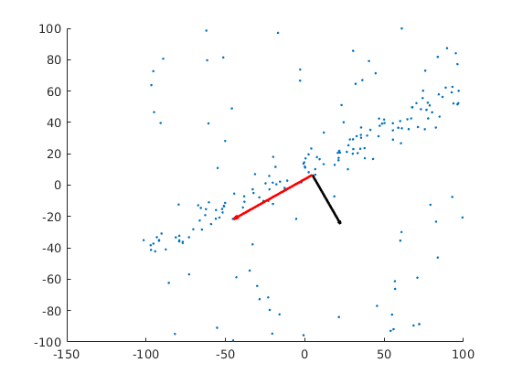
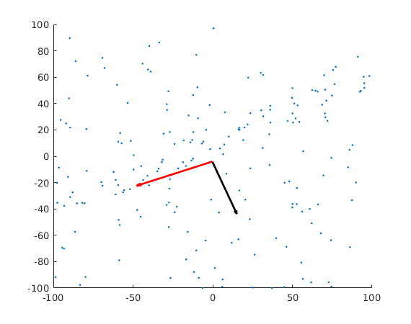
Covariance od Data in HW1

Slide 32
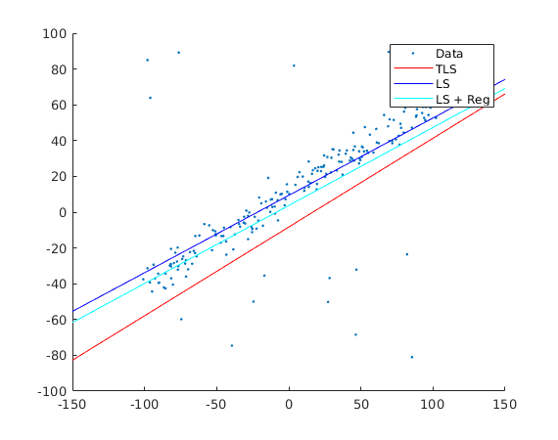
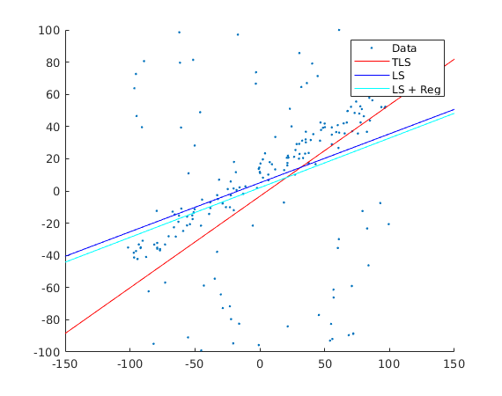
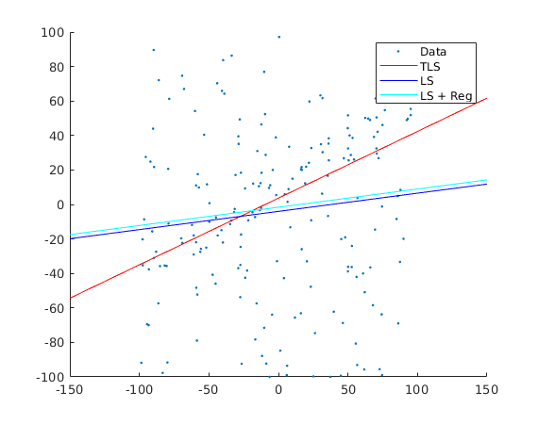
Fitting with LS, TLS and LS + Regularization

Slide 33
RANSAC
Robust fitting can deal with a few outliers – what if we have very many?
Random sample consensus (RANSAC): Very general framework for model fitting in the presence of outliers
Outline
Choose a small subset of points uniformly at random
Fit a model to that subset
Find all remaining points that are “close” to the model and reject the rest as outliers
Do this many times and choose the best model
M. A. Fischler, R. C. Bolles.
Random Sample Consensus: A Paradigm for Model Fitting with Applications to
Image Analysis and Automated Cartography. Comm. of the ACM, Vol 24, pp 381-395, 1981.

Slide 34
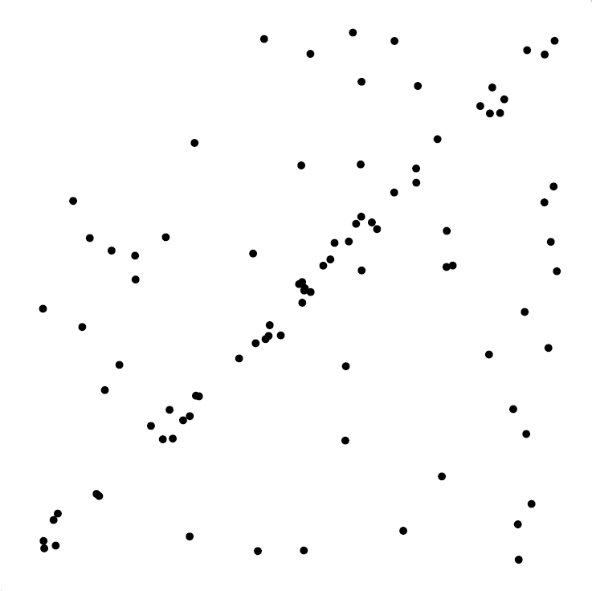
RANSAC for line fitting example
Source: R. Raguram

Slide 35
RANSAC for line fitting example
Least-­‐squares ﬁt
Source: R. Raguram

Slide 36
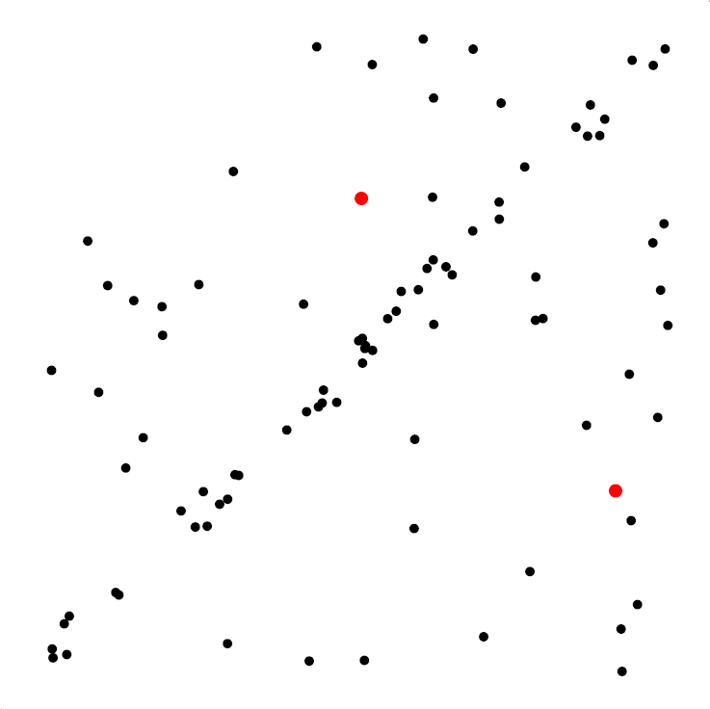
RANSAC for line fitting example
1. Randomly select minimal subset of points
Source: R. Raguram

Slide 37
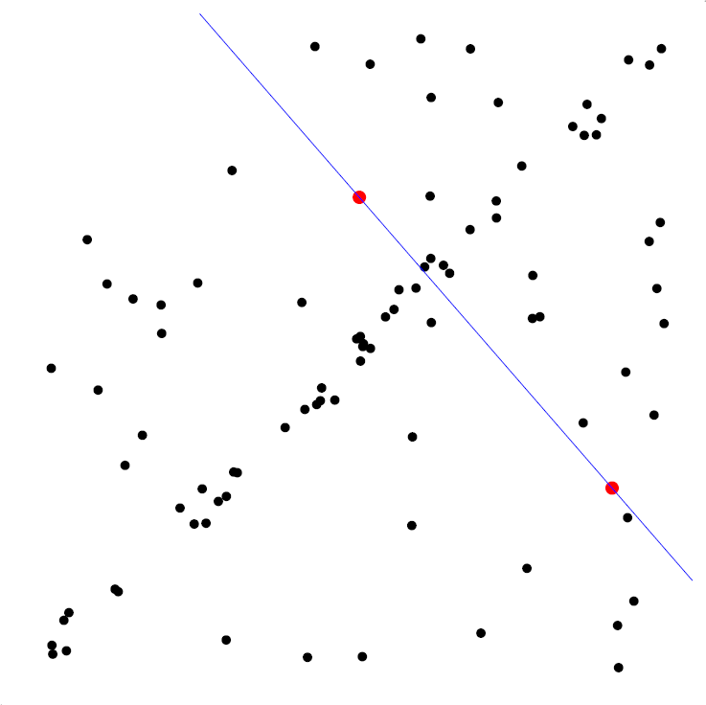
RANSAC for line fitting example
Randomly select minimal subset of points
Hypothesize a
model
Source: R. Raguram

Slide 38
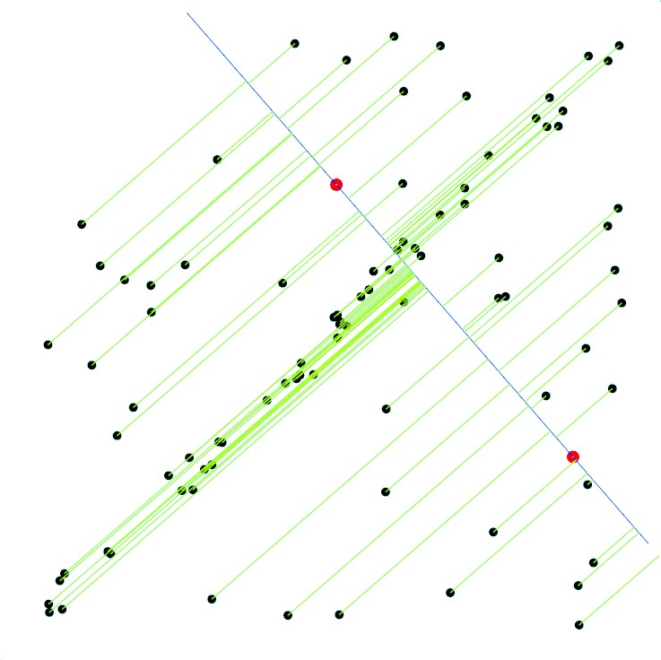
RANSAC for line fitting example
Randomly select minimal subset of points
Hypothesize a
model
Compute error function
Source: R. Raguram

Slide 39
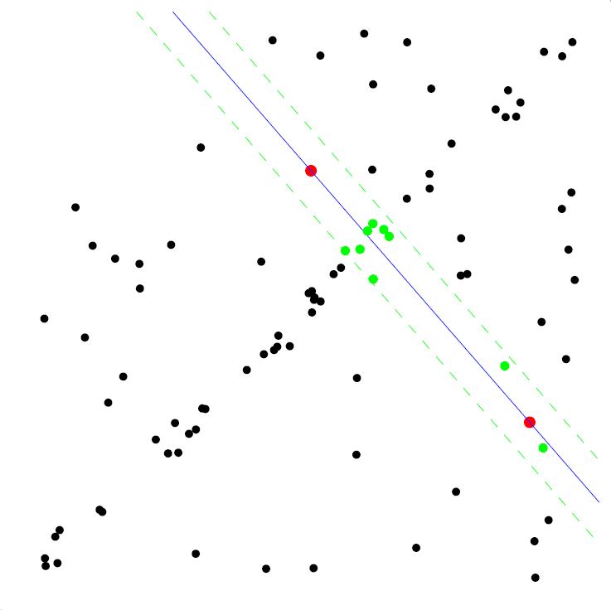
RANSAC for line fitting example
Randomly select minimal subset of points
Hypothesize a
model
Compute error func<on
Select points consistent with
model
Source: R. Raguram

Slide 40
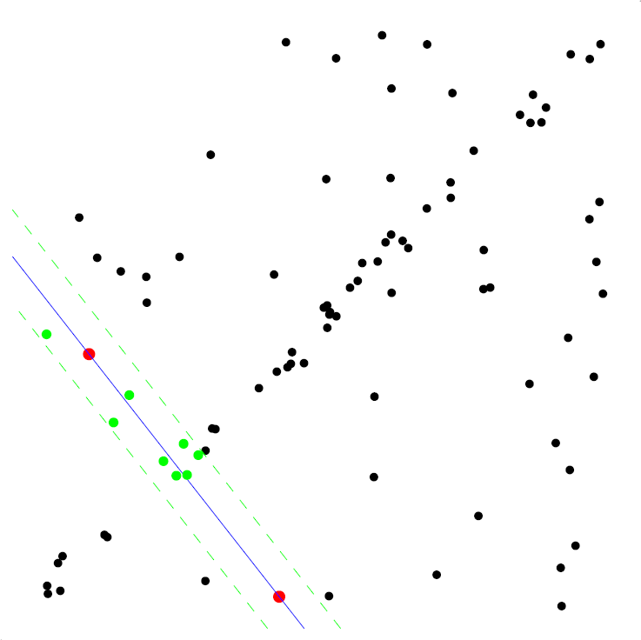
RANSAC for line fitting example
Randomly select minimal subset of points
Hypothesize a
model
Compute error func<on
Select points consistent with
model
Repeat
hypothesize-­‐and-­‐ verify loop
Source: R. Raguram

Slide 41
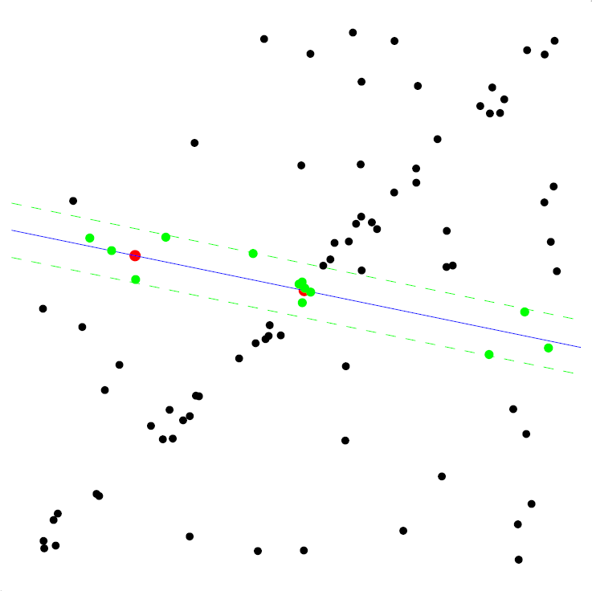
RANSAC for line fitting example
Randomly select minimal subset of points
Hypothesize a
model
Compute error func<on
Select points consistent with
model
Repeat
hypothesize-­‐and-­‐ verify loop
39
Source: R. Raguram

Slide 42
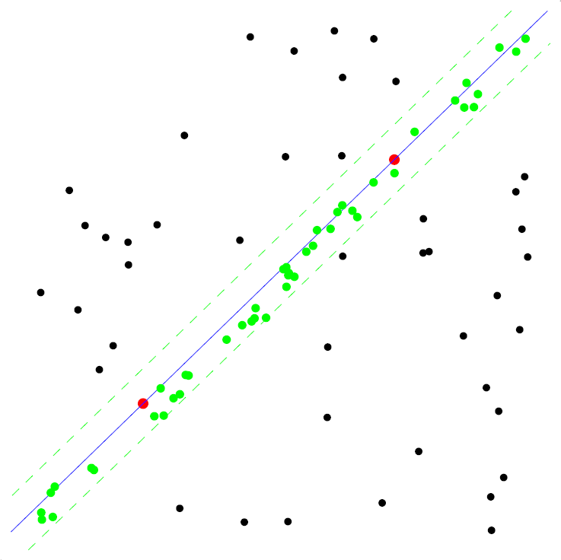
RANSAC for line fitting example
Uncontaminated sample
Randomly select minimal subset of points
Hypothesize a
model
Compute error func<on
Select points consistent with
model
Repeat
hypothesize-­‐and-­‐ verify loop
40
Source: R. Raguram

Slide 43
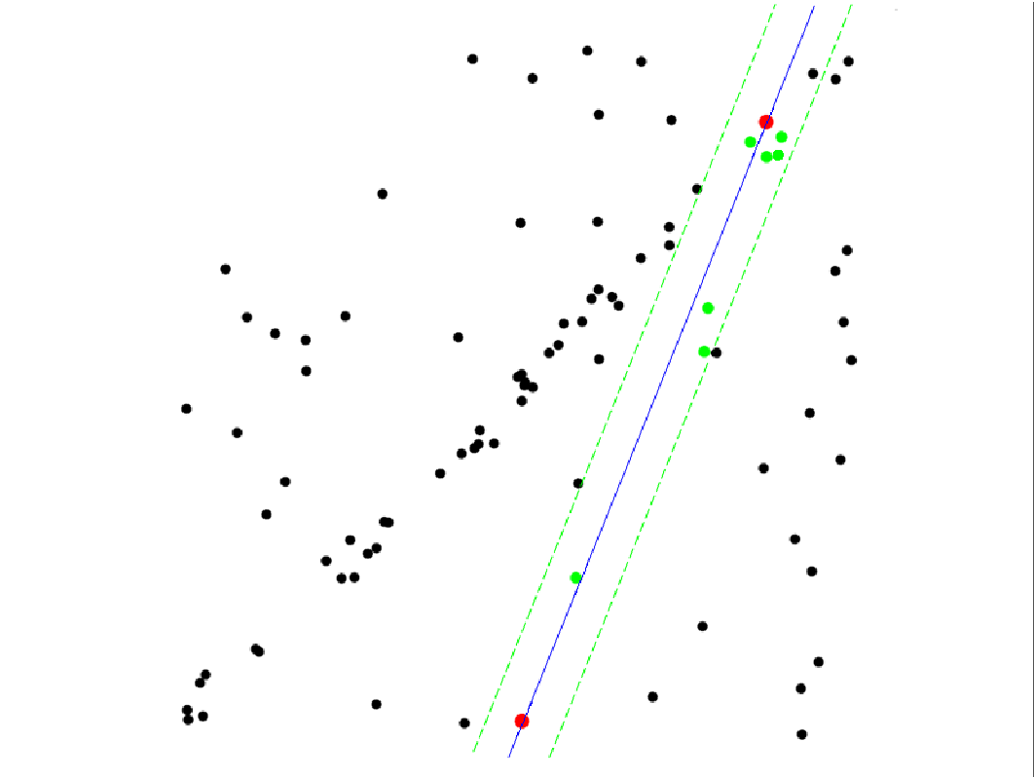
RANSAC for line fitting example
Randomly select minimal subset of points
Hypothesize a
model
Compute error func<on
Select points consistent with
model
Repeat
hypothesize-­‐and-­‐ verify loop
Source: R. Raguram

Slide 44
RANSAC for line fitting
Repeat N times:
Draw s points uniformly at random
Fit line to these s points
Find inliers to this line among the remaining points (i.e., points whose distance from the line is less than t)
If there are d or more inliers, accept the line and refit using all inliers

Slide 45
Choosing the parameters
Initial number of points s
Typically minimum number needed to fit the model
Distance threshold t
Choose t so probability for inlier is p (e.g. 0.95)
Zero-mean Gaussian noise with std. dev. σ: t²=3.84σ²
Number of samples N
Choose N so that, with probability p, at least one random sample is free from outliers (e.g. p=0.99) (outlier ratio: e)
Source: M. Pollefeys

Slide 46
Choosing the parameters
Initial number of points s
Typically minimum number needed to fit the model
Distance threshold t
Choose t so probability for inlier is p (e.g. 0.95)
Zero-mean Gaussian noise with std. dev. σ: t²=3.84σ²
Number of samples N
Choose N so that, with probability p, at least one random sample is free from outliers (e.g. p=0.99) (outlier ratio: e)
proportion of outliers e
s 5% 10% 20% 25% 30% 40% 50%
(1− (1− e) )
N
s
= 1− p
2
3
4
5
2
3
3
4
3
4
5
6
5 6 7 11 17
7 9 11 19 35
9 13 17 34 72
12 17 26 57 146
N = log(1− p)/ log(1− (1− e)^{s} )
6 | 4 | 7 | 16 | 24 | 37 | 97 | 293
7 | 4 | 8 | 20 | 33 | 54 | 163 | 588
8 5 9 26 44 78 272 1177
Source: M. Pollefeys

Slide 47
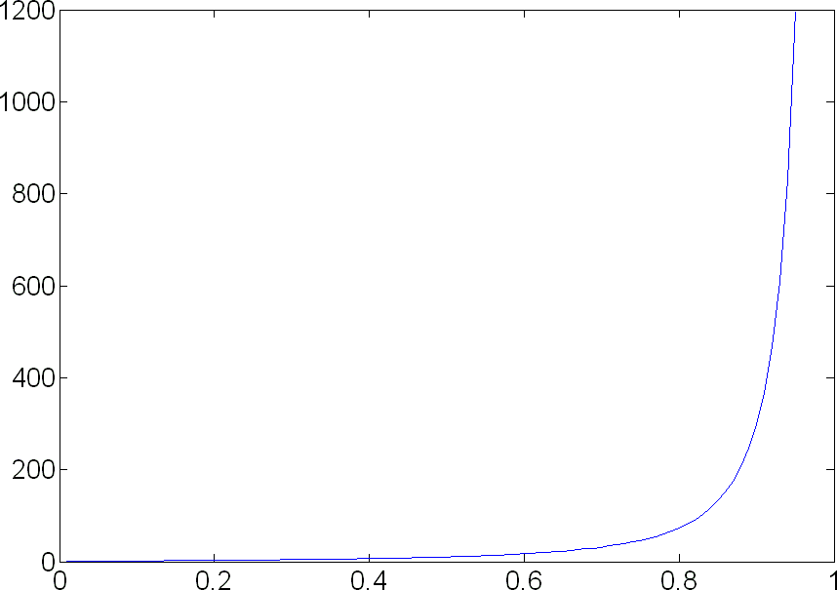
Choosing the parameters
Initial number of points s
Typically minimum number needed to fit the model
Distance threshold t
Choose t so probability for inlier is p (e.g. 0.95)
Zero-mean Gaussian noise with std. dev. σ: t²=3.84σ²
Number of samples N
Choose N so that, with probability p, at least one random sample is free from outliers (e.g. p=0.99) (outlier ratio: e)
(1− (1− e) ^{s} ) ^{N}= 1− p
N = log(1− p)/ log(1− (1− e)^{s} )
Source: M. Pollefeys

Slide 48
Choosing the parameters
Initial number of points s
Typically minimum number needed to fit the model
Distance threshold t
Choose t so probability for inlier is p (e.g. 0.95)
Zero-mean Gaussian noise with std. dev. σ: t²=3.84σ²
Number of samples N
Choose N so that, with probability p, at least one random sample is free from outliers (e.g. p=0.99) (outlier ratio: e)
Consensus set size d
Should match expected inlier ratio
Source: M. Pollefeys

Slide 49
Adaptively determining the number ofsamples
Inlier ratio e is often unknown a priori, so pick worst case, e.g. 50%, and adapt if more inliers are found, e.g. 80% would yield e=0.2
Adaptive procedure:
N=∞, sample_count =0
While N >sample_count
Choose a sample and count the number of inliers
Set e = 1 – (number of inliers)/(total number of points)
Recompute N from e:
N = log(1− p)/ log(1− (1− e)^{s} )
Increment the sample_count by 1
Source: M. Pollefeys

Slide 50
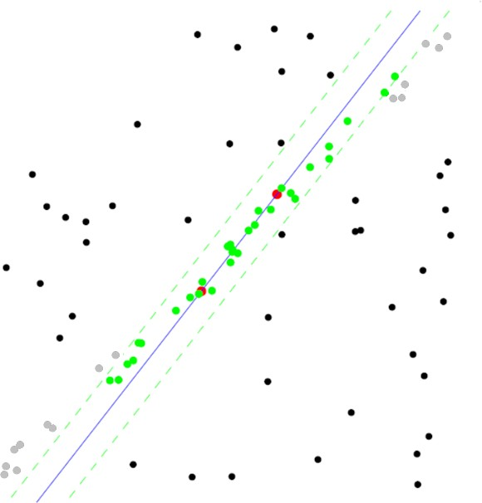
RANSAC pros and cons
Pros
Simple and general
Applicable to many different problems
Often works well in practice
Cons
Lots of parameters to tune
Doesn’t work well for low inlier ratios (too many iterations, or can fail completely)
Can’t always get a good initialization of the model based on the minimum number of samples

