Slide 1
Histograms
Thanks to David Jacobs for the use of some slides

Slide 2
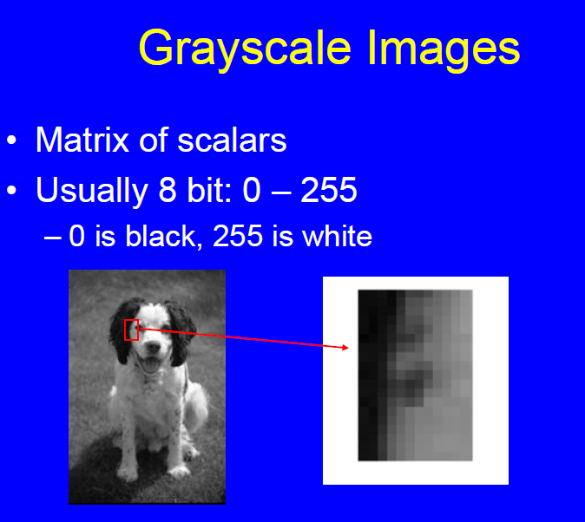

Slide 3
Image Processing
Image Processing means transforming images into new images
Simplest image processing treats every
pixel independently.
I is input image, J is output image.
I(x,y), J(x,y) are corresponding pixels.
J(x,y) = f(I(x,y)).

Slide 4
Thresholding
One of the simplest operations we can perform on an image is thresholding.
For example, if we take the swan image
and threshold it with a threshold of T,
we make all pixels >= T into 1, and all
pixels < T into 0.

Slide 5
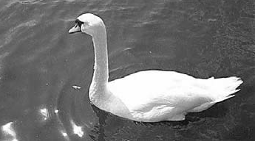
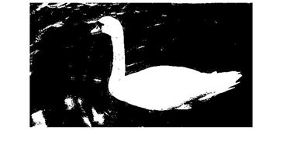
Threshold T=128

Slide 6
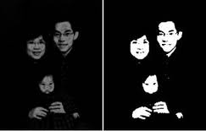
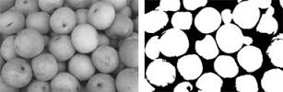
Examples

Slide 7
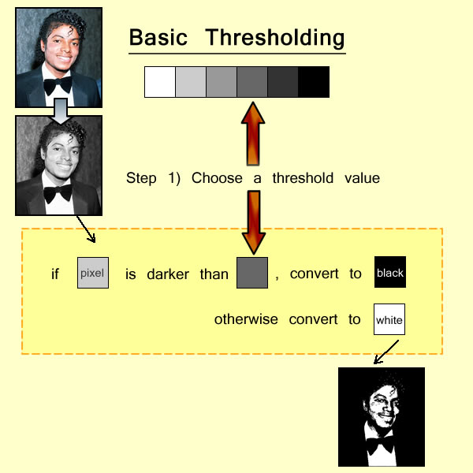
Summary

Slide 8
Grayscale Histogram
• Count intensities
• Normalize
• What determines Histogram?
– Contrast, aperture, lighting levels, scene,

Slide 9
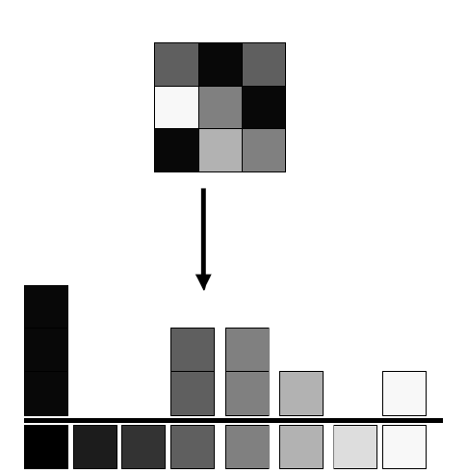
A simple image and its histogram

Slide 10
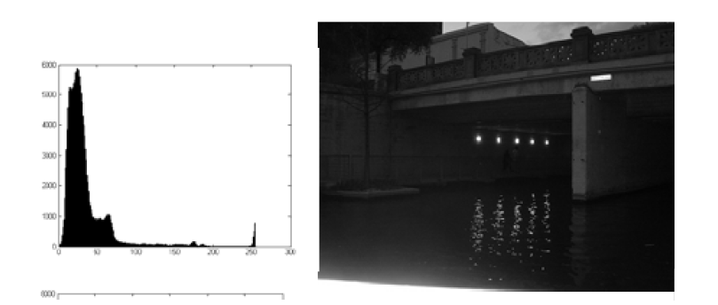
Examples

Slide 11
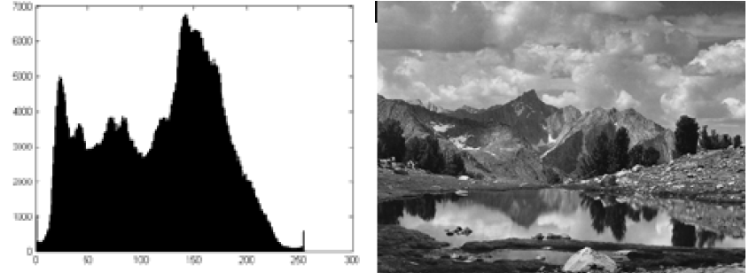

Slide 12

Definition of histogram
To write this down, we might say that we have an image, I, in which the intensity at pixel with coordinates (x,y) is I(x,y). We would write the histogram h, as h(i) indicating that intensity i, appears h(i) times in the image. If we let the expression (a=b) have the value 1 when a=b, and 0 otherwise, we can write for histogram h(i):

Slide 13

Histograms allow image manipulation
One reason to compute a histogram is that it allows us to manipulate an image by changing its histogram. We do this by creating a new image, J, in which:
The trick is to choose an f that will generate a nice or useful image. Typically, we choose f to be monotonic. This means that: if u<v then f(u) < f(v). Non-monotonic functions tend to make an image look truly different, while monotonic changes will be more subtle.

Slide 14
Histogram Equalization
The idea is to spread out the histogram so that it makes full use of the dynamic range of the image.
For example, if an image is very dark, most of the intensities might lie in the range 0-50. By choosing f to spread out the intensity values, we can make fuller use of the available intensities, and make darker parts of an image easier to understand.
If we choose f to make the histogram of the new image, J, as uniform as possible, we call this histogram equalization.

Slide 15

How to do it
Cumulative Distribution Function (CDF).
This encodes the fraction of pixels with an intensity that is equal to or less than a specific value.
If h is a histogram and C is a CDF, then h(i) indicates the number of pixels with intensity of i, while ,
indicates the fraction of pixels with intensity less than or equal to i, assuming the image has N pixels.

Slide 16
Actual construction
g is the histogram of J, and D its CDF.
If there are k intensity levels in an image, then we want g=(N/k, N/k, …), and D=(1/k, 2/k,3/k, …). This means that we want D(i) = i/k. Notice that C(i) = D(f(i)). That is, all the pixels in I that have an intensity less than or equal to i will have an intensity less than or equal to f(i) in J (since f is monotonic, if j<i, f(j) < f(i)).
Putting these together, we have D(f(i))=f(i)/k=C(i), so f(i) = kC(i).

Slide 17
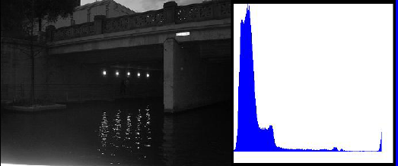
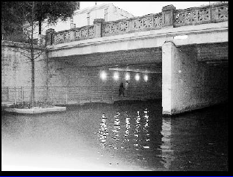
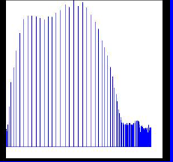
Examples of histogram equalization

Slide 18
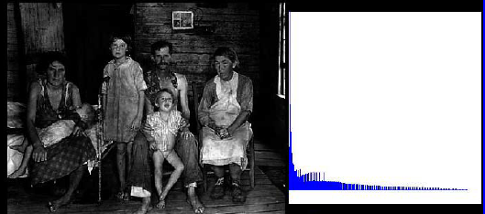
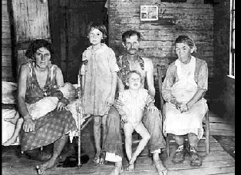
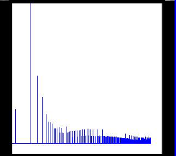
Examples

Slide 19
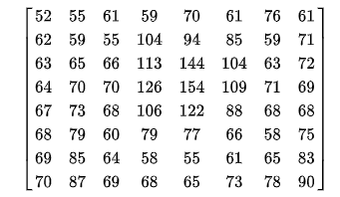
8 x 8 Image
source: wikipedia

Slide 20
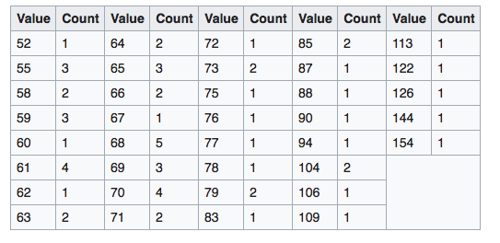
8 x 8 Image

Slide 21
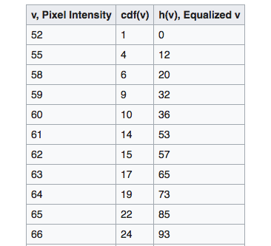
8 x 8 Image

Slide 22
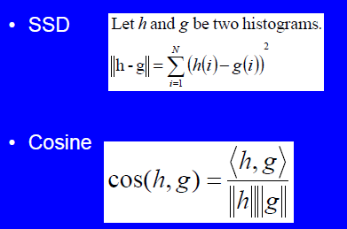
Comparing histograms

Slide 23
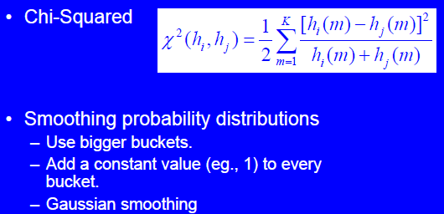
Treating histograms as probability distributions

Slide 24
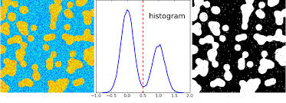
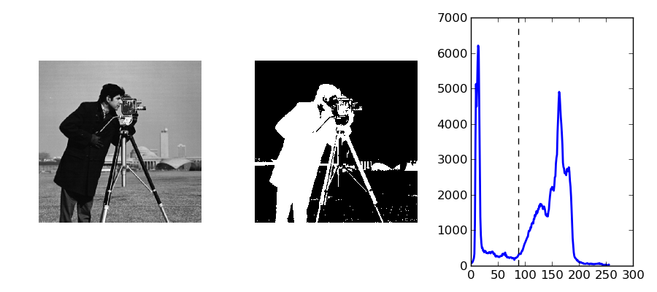
Other uses of histograms

Slide 25
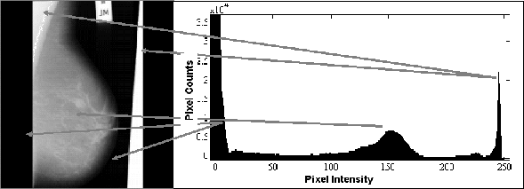
Mammograms

