Slide 1

MASTER THESIS · ITS 2024 · 21024003
Computer Science (M.Sc.) · HDA / VGU
Multimodal RAG for Leishmaniasis Diagnosis
Traceable evidence, model-dependent retrieval, and safety-gated demonstration
Nguyen Tuan Ngoc · Supervisor: Prof. Dr. Andreas Müller · Co-Supervisor: Dr. Tran Duc Khanh · May 2026

Slide 2
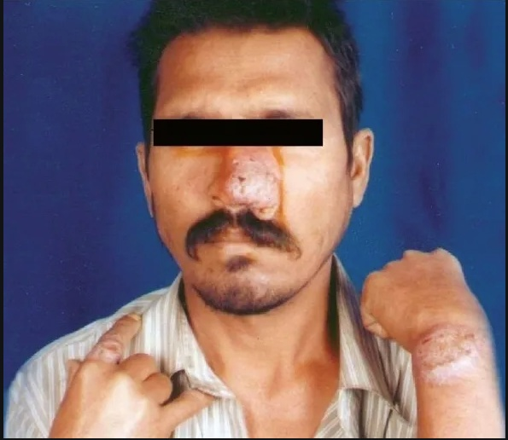
Leishmaniasis is not simple image classification
02
The Problem
SUPPORT IMAGE
PMC3140149 · PKDL/HIV case report
Overlapping CL, MCL, VL, PKDL, and non-leishmaniasis mimics; lab confirmation is often the decisive evidence.
Evidence Streams
Text
Image
Lab
Symptoms
Context
Weak reference
Why It Is Hard
Infiltrated plaques on nose, wrist, and finger — useful visual context, not standalone ground truth.
Case reports mix symptoms, captions, pathology, treatment, and author conclusions. Image appearance alone is insufficient.
Source: open-access PMC case-report image
Use this as a retrieval-ambiguity example: a support image can explain evidence flow, but it is not a direct official test query or model-proven diagnosis.

Slide 3
Four questions, one thread: does evidence help safely?
03
Each RQ asks whether more evidence improves the pipeline without creating unsupported claims.
RQ1
RQ2
Weak-Reference Evaluation
Small-Model Practicality
Can structured case reconstruction support scored diagnosis evaluation on held-out leishmaniasis cases?
Can local open models run on a single GPU with enough latency and memory transparency for audit?
RQ3
RQ4
Multimodal Evidence
Retrieval-Augmented Reasoning
Do images and image-linked context add useful signal, or mainly increase visual hallucination risk?
Does retrieving similar cases help generation compared with matched no-RAG conditions?

Slide 4
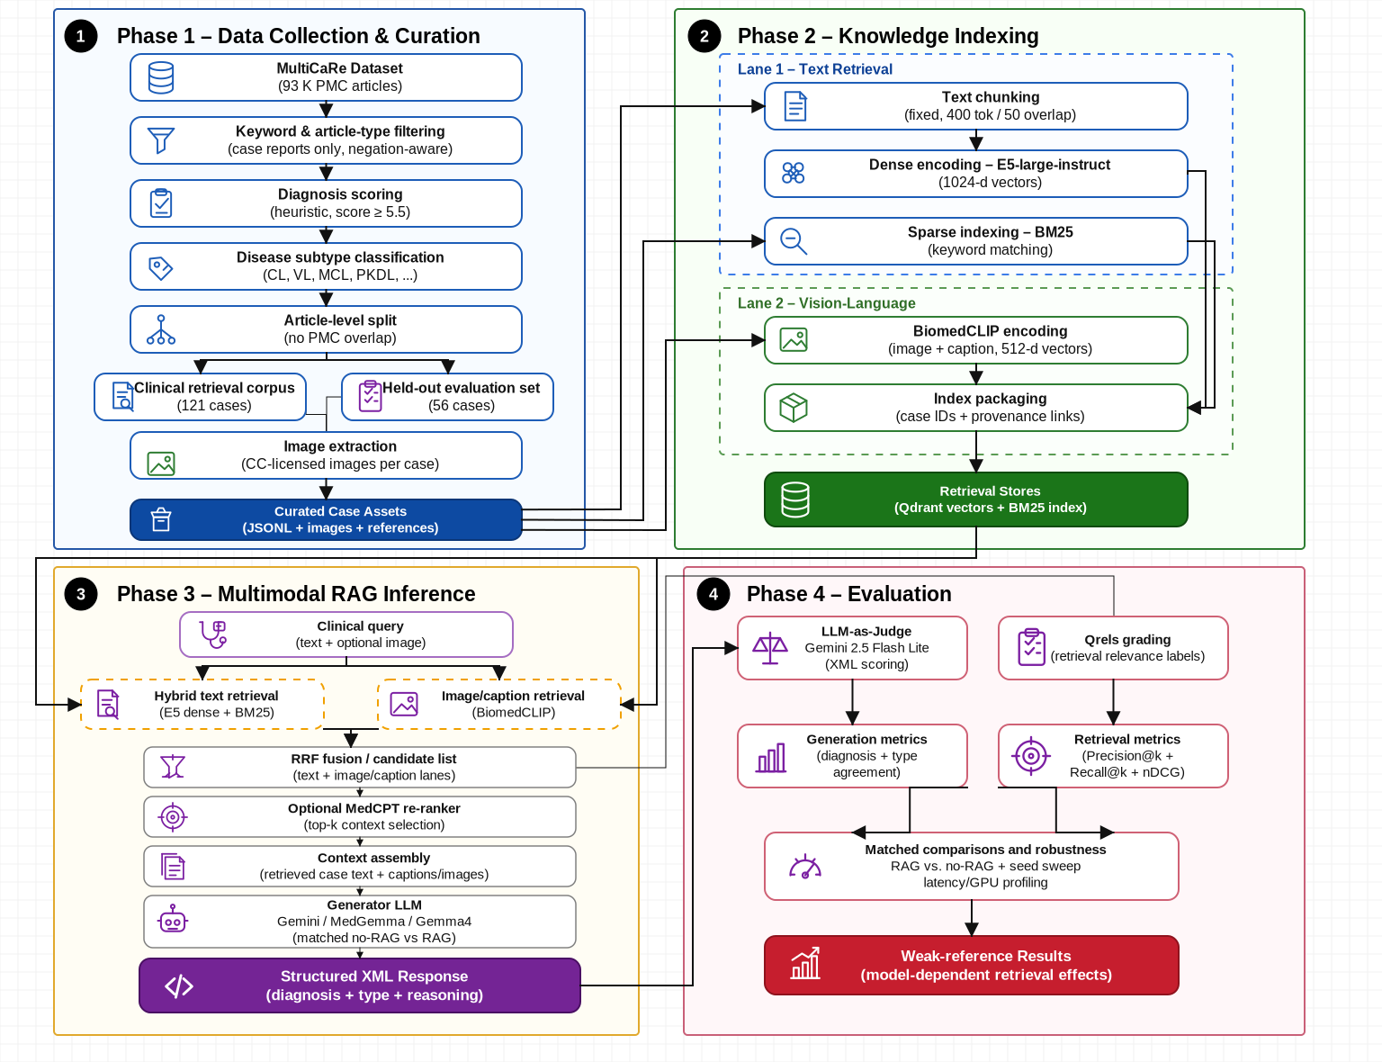
Two-lane retrieval architecture
04
Text retrieval and image-linked retrieval are fused, gated, and audited before presentation.
Architecture figure reused from the thesis pipeline diagram; the demo exposes retrieval, generation, uncertainty gate, and final route.

Slide 5
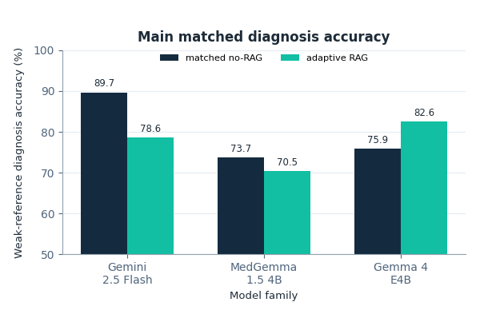
Main result: RAG effect is model-dependent
05
Weak-reference, prompt-judged diagnosis accuracy on 56 held-out cases; x-axis = model family, y-axis = diagnosis accuracy (%).
Key deltas
Gemini
−11.2 pp
statistically supported degradation
MedGemma
−3.1 pp
directional; not robust
Gemma 4
+6.7 pp
directional; CI crosses 0
Gemma 4 + images
+1.8 pp
exploratory; hallucination risk ↑
Chart: grouped bars compare matched no-RAG vs adaptive RAG for each model family. Retrieval is not uniformly beneficial.

Slide 6
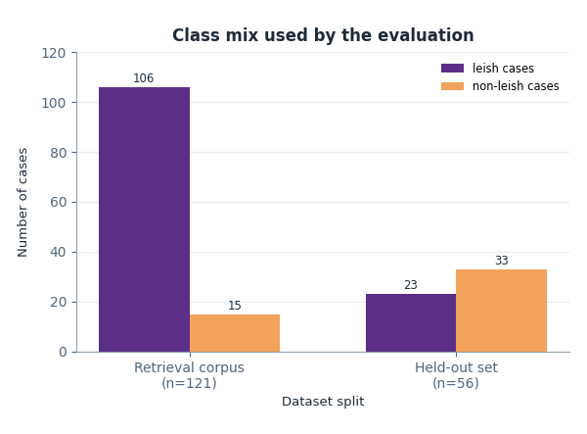
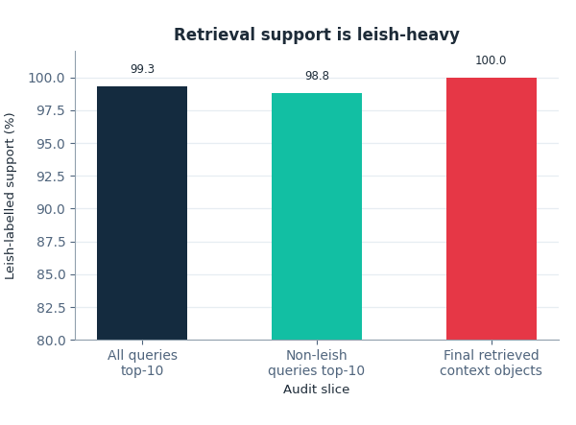
Corpus imbalance explains the specificity risk
06
Left chart: class mix by split. Right chart: leish-labelled share of retrieved support after clean-context audit.
Retrieval corpus
Held-out / support audit
Key finding: the corpus is 106/121 leish cases while the held-out set is majority non-leish. Non-leish queries still receive mostly leish-labelled top-10 support, so RAG can over-support leishmaniasis mimics.

Slide 7
Retriever quality sets the ceiling
07
Classic retrieval metrics on 23 held-out queries with qrels; 121-case corpus with 104-doc qrels coverage.
58.3%
59.5%
71.5%
P@5
nDCG@5
MRR
Top-5 precision
Ranking quality @5
First relevant hit
13.5%
23.4%
26.1%
Recall@5
Recall@10
MAP
Coverage in top 5
Coverage in top 10
Overall ranking
Top-rank precision and first-hit quality support explanations, but low recall means relevant cases often fall outside the prompt context window.

Slide 8
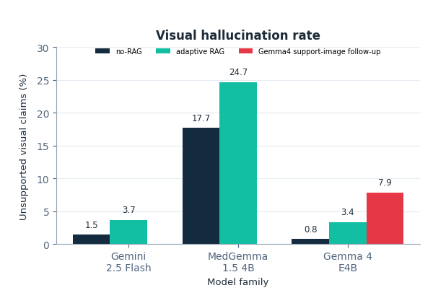
Image evidence: useful but risky
08
Chart axes now show model family (x-axis) and unsupported visual claims as a percentage (y-axis).
Image-evidence findings
✓
Images are context, not ground truth: captions, article text, and lab evidence still carry the diagnosis.
✗
PMC3140149 is a support/retrieval example, not a direct official test query.
✓
Gemma 4 support-image follow-up was directionally stronger than standard RAG, but the safety cost is visible in the red bar.
!
Unsupported visual claims rose from 3.4% to 7.9% for the Gemma4 support-image follow-up.
✗
Adding images does not automatically improve diagnosis across models.
Visual hallucination = judge-detected unsupported visual/pathology claims. This is not expert adjudication, so the safe demo shows provenance and gate decisions.

Slide 9
Small-model practicality for a live defense
09
Single 24 GB GPU local models vs. Gemini API: latency, memory, auditability, and demo reliability.
Gemini 2.5 Flash Lite
MedGemma 1.5 4B
Gemma 4 E4B
API · external
Local · medical-tuned
Local · open
Latency: 3–4 s/case
Memory: API/cloud
Best diag. acc.: 89.7%
Latency: 22–26 s/case
Memory: ~16 GB GPU
Best diag. acc.: 73.7%
Latency: 46–59 s/case
Memory: ~18–19 GB GPU
Best diag. acc.: 82.6% (RAG)
Strengths
Strengths
Strengths
✓ Fastest inference
✓ Medical domain tuning
✓ Best directional RAG delta (+6.7 pp)
✓ Highest no-RAG accuracy
✓ Full auditability
✓ Real GPU sidecar demo available
✓ Strong multimodal
✓ Privacy-safe
✓ Auditable
Limitations
Limitations
Limitations
✗ RAG degraded under matched evaluation
✗ High visual-hallucination rate
✗ Slowest inference
✗ No local GPU audit trail
✗ RAG directionally worsened
✗ Directional, not conclusive
✗ External dependency
✗ Weaker reasoning in this setting
✗ Image evidence raises hallucination risk

Slide 10
Limitations are part of the contribution
10
The thesis claims are deliberately narrow: traceable research evaluation, not bedside-use evidence.
⚠ Weak-reference labels
⚠ Corpus imbalance
No clinician adjudication; prompt-judged diagnosis accuracy is useful for controlled comparison, not clinical validation.
The retrieval corpus is leishmaniasis-heavy, so non-leishmaniasis mimics remain a specificity stress test.
⚠ Small held-out set
⚠ Adaptive RAG is route-mixed
Only Gemini's negative RAG delta is statistically supported; Gemma 4's +6.7 pp is directional only.
Some rows received retrieved context and others fell back. Route-level audit is needed before interpreting aggregate accuracy.
Future: clinician-reviewed labels · balanced mimic set · stronger recall · stricter visual-claim gating · deployment-grade validation

Slide 11
Conclusion: feasible, traceable, not deployment-ready
11
RQ1
Feasibility
RQ2
Small Models
Research pipeline works
Practical but bounded
Structured cases, retrieval, generation, gate audit, and live demo are reproducible and traceable.
Local models run on a 24 GB GPU, but latency and memory make full live evaluation risky.
RQ3
Multimodal
RQ4
RAG Effect
Useful, risky signal
Model-dependent
Image-linked evidence can help, but unsupported visual claims require conservative gating.
Gemma 4 shows a positive directional RAG pattern; Gemini and MedGemma warn against universal RAG claims.
Final claim: multimodal RAG for leishmaniasis can be evaluated traceably under constrained resources; stronger claims require balanced data, stronger labels, and expert review.

Slide 12
What v6 was missing: core result map
12
v6 was compact for a live supervisor demo; thesis_v44b-1 contains a richer result chain that needs a backup map.
Main table set
Why v6 felt short
5.1 main metrics; 5.2-5.3 clean-context; 5.5 modality; 5.6 retrieval; 5.7 route audit; 5.8 imbalance; 5.9 matched deltas.
It compressed many result families into slides 5-10 to preserve a 30-minute defense flow.
What v3 adds
Claim boundary
Labeled charts plus three backup slides for result provenance, clean-context sensitivity, routing, modality, latency, and GPU evidence.
The backup slides explain existing thesis evidence; they do not create new experimental claims.
Use this slide when supervisors ask where each result family lives in thesis_v44b-1.

Slide 13
Clean-context and route audit explain the RAG effect
13
These are the missing mechanism checks behind the short v6 RAG story.
Clean-context deltas
Prompt2 A+B tier
Gemini -7.1 pp; MedGemma +6.7 pp; Gemma4 +16.1 pp. Same 56 case IDs, sanitized query artifact; supplementary sensitivity only.
47 cases: Gemini -4.3 pp; MedGemma +4.3 pp; Gemma4 +14.9 pp. Descriptive, not confirmatory.
Route-mixed RAG
Retrieval imbalance
Gemma4 audit: 31/56 adaptive_rag rows and 25/56 no-context fallback rows. RAG did not inject context into every case.
Corpus 106/121 leish; held-out 33/56 non-leish. Non-leish top-10 support was still 98.8% leish-labelled.
Takeaway: retrieval helps conditionally because generator behavior, route policy, and corpus balance all matter.

Slide 14
Sensitivity: modality, latency, and GPU practicality
14
This slide collects appendix evidence that supports the demo story without overclaiming deployment readiness.
Modality matrix
Image-risk trade-off
Gemini strongest multimodal no-RAG: 89.7%. Gemma4 text RAG: 85.3%; multimodal RAG: 82.6%; tensor-on RAG: 84.4% supplementary.
Gemma4 support images: +1.8 pp over standard RAG but visual hallucination rose 3.4% -> 7.9%. Multi-seed +8.3 pp vs no-RAG, CI crosses 0.
Local practicality
Defense point
MedGemma: 22-26 s/case, peak 15.70 GB. Gemma4: 46-59 s/case, peak 18.84 GB. Gemini API: 3-4 s/case.
The contribution is traceability, auditability, and bounded evidence, not a deployment-ready classifier.
These are the missing core result families behind the short v6 narrative.

