Slide 1
MASTER THESIS · ITS 2024 · 21024003
Hochschule Darmstadt · Fachbereich Informatik
Multimodal RAG for Leishmaniasis Diagnosis
Traceable evidence, model-dependent retrieval, and safety-gated demonstration
Nguyen Tuan Ngoc · Supervisor: Prof. Dr. Andreas Müller · Co-Supervisor: Dr. Tran Duc Khanh · May 2026

Slide 2
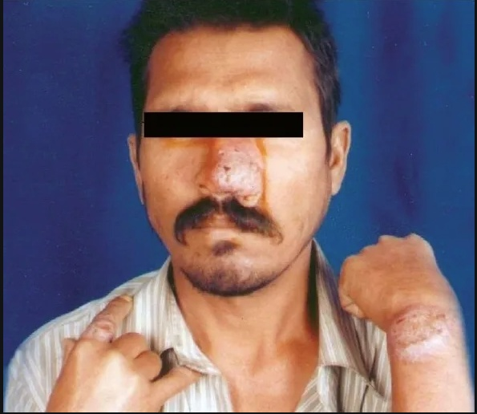
Leishmaniasis is not simple image classification
02
The Problem
SUPPORT IMAGE
PMC3140149 · PKDL/HIV case report
Overlapping CL, MCL, VL, PKDL, and non-leishmaniasis mimics; lab confirmation is often the decisive evidence.
Evidence Streams
Text
Image
Lab
Symptoms
Context
Weak reference
Why It Is Hard
Infiltrated plaques on nose, wrist, and finger — useful visual context, not standalone ground truth.
Case reports mix symptoms, captions, pathology, treatment, and author conclusions. Image appearance alone is insufficient.
Source: open-access PMC case-report image
Use this as a retrieval-ambiguity example: a support image can explain evidence flow, but it is not a direct official test query or model-proven diagnosis.

Slide 3
Four questions, one thread: does evidence help safely?
03
Each RQ asks whether more evidence improves the pipeline without creating unsupported claims.
RQ1
RQ2
Weak-Reference Evaluation
Small-Model Practicality
Can structured case reconstruction support scored diagnosis evaluation on held-out leishmaniasis cases?
Can local open models run on a single GPU with enough latency and memory transparency for audit?
RQ3
RQ4
Multimodal Evidence
Retrieval-Augmented Reasoning
Do images and image-linked context add useful signal, or mainly increase visual hallucination risk?
Does retrieving similar cases help generation compared with matched no-RAG conditions?

Slide 4
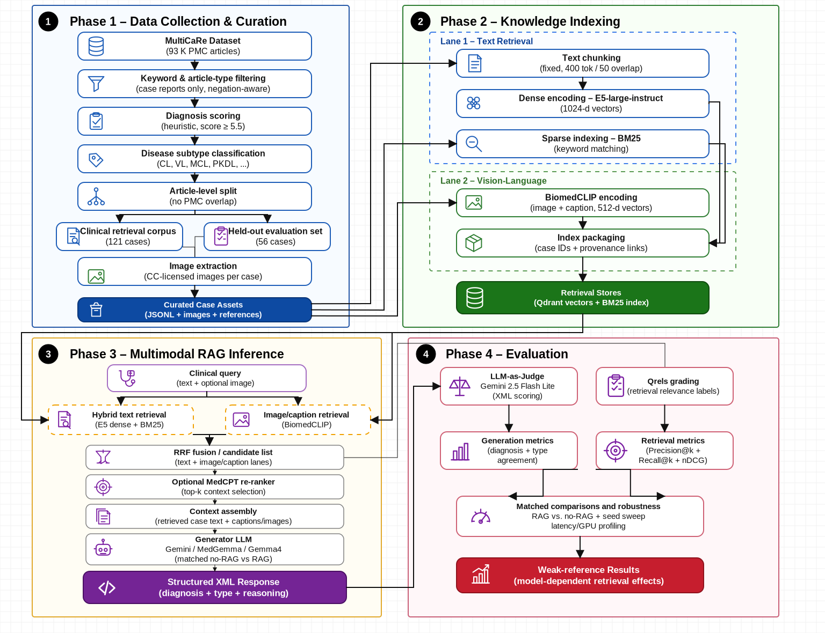
Two-lane retrieval architecture
04
Text retrieval and image-linked retrieval are fused, gated, and audited before presentation.
Architecture figure reused from the thesis pipeline diagram; the demo exposes retrieval, generation, uncertainty gate, and final route.

Slide 5
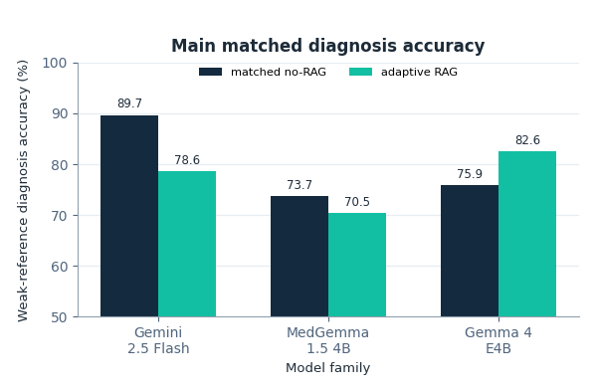
Main result: RAG effect is model-dependent
05
Weak-reference, prompt-judged diagnosis accuracy on 56 held-out cases; x-axis = model family, y-axis = diagnosis accuracy (%).
Key deltas
Gemini
−11.2 pp
statistically supported degradation
MedGemma
−3.1 pp
directional; not robust
Gemma 4
+6.7 pp
directional; CI crosses 0
Gemma 4 + images
+1.8 pp
exploratory; hallucination risk ↑
Chart: grouped bars compare matched no-RAG vs adaptive RAG for each model family. Retrieval is not uniformly beneficial.

Slide 6
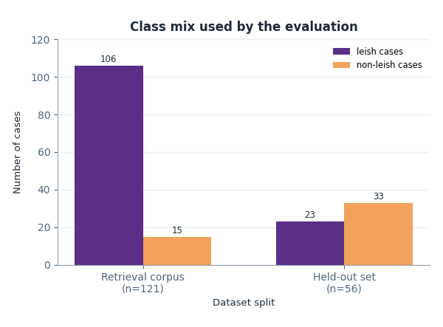
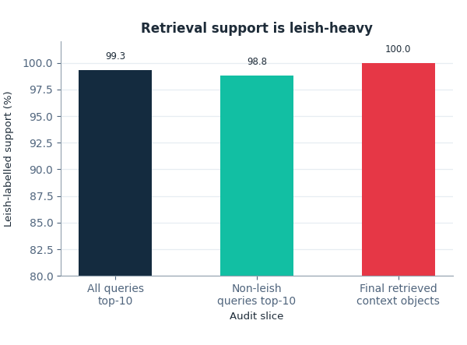
Corpus imbalance explains the specificity risk
06
Left chart: class mix by split. Right chart: leish-labelled share of retrieved support after clean-context audit.
Retrieval corpus
Held-out / support audit
Key finding: the corpus is 106/121 leish cases while the held-out set is majority non-leish. Non-leish queries still receive mostly leish-labelled top-10 support, so RAG can over-support leishmaniasis mimics.

Slide 7
Retriever quality sets the ceiling
07
Classic retrieval metrics on 23 held-out queries with qrels; 121-case corpus with 104-doc qrels coverage.
58.3%
59.5%
71.5%
P@5
nDCG@5
MRR
Top-5 precision
Ranking quality @5
First relevant hit
13.5%
23.4%
26.1%
Recall@5
Recall@10
MAP
Coverage in top 5
Coverage in top 10
Overall ranking
Top-rank precision and first-hit quality support explanations, but low recall means relevant cases often fall outside the prompt context window.

Slide 8
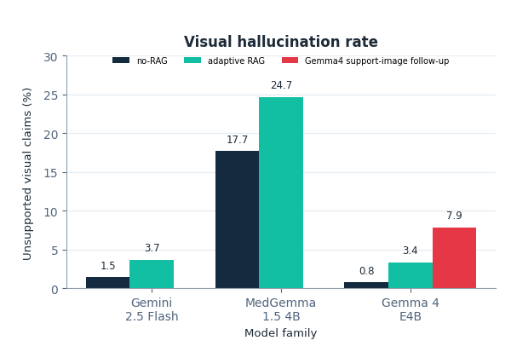
Image evidence: useful but risky
08
Chart axes now show model family (x-axis) and unsupported visual claims as a percentage (y-axis).
Image-evidence findings
✓
Images are context, not ground truth: captions, article text, and lab evidence still carry the diagnosis.
✗
PMC3140149 is a support/retrieval example, not a direct official test query.
✓
Gemma 4 support-image follow-up was directionally stronger than standard RAG, but the safety cost is visible in the red bar.
!
Unsupported visual claims rose from 3.4% to 7.9% for the Gemma4 support-image follow-up.
✗
Adding images does not automatically improve diagnosis across models.
Visual hallucination = judge-detected unsupported visual/pathology claims. This is not expert adjudication, so the safe demo shows provenance and gate decisions.

Slide 9
Small-model practicality for a live defense
09
Single 24 GB GPU local models vs. Gemini API: latency, memory, auditability, and demo reliability.
Gemini 2.5 Flash Lite
MedGemma 1.5 4B
Gemma 4 E4B
API · external
Local · medical-tuned
Local · open
Latency: 3–4 s/case
Memory: API/cloud
Best diag. acc.: 89.7%
Latency: 22–26 s/case
Memory: ~16 GB GPU
Best diag. acc.: 73.7%
Latency: 46–59 s/case
Memory: ~18–19 GB GPU
Best diag. acc.: 82.6% (RAG)
Strengths
Strengths
Strengths
✓ Fastest inference
✓ Medical domain tuning
✓ Best directional RAG delta (+6.7 pp)
✓ Highest no-RAG accuracy
✓ Full auditability
✓ Real GPU sidecar demo available
✓ Strong multimodal
✓ Privacy-safe
✓ Auditable
Limitations
Limitations
Limitations
✗ RAG degraded under matched evaluation
✗ High visual-hallucination rate
✗ Slowest inference
✗ No local GPU audit trail
✗ RAG directionally worsened
✗ Directional, not conclusive
✗ External dependency
✗ Weaker reasoning in this setting
✗ Image evidence raises hallucination risk

Slide 10
Limitations are part of the contribution
10
The thesis claims are deliberately narrow: traceable research evaluation, not bedside-use evidence.
⚠ Weak-reference labels
⚠ Corpus imbalance
No clinician adjudication; prompt-judged diagnosis accuracy is useful for controlled comparison, not clinical validation.
The retrieval corpus is leishmaniasis-heavy, so non-leishmaniasis mimics remain a specificity stress test.
⚠ Small held-out set
⚠ Adaptive RAG is route-mixed
Only Gemini's negative RAG delta is statistically supported; Gemma 4's +6.7 pp is directional only.
Some rows received retrieved context and others fell back. Route-level audit is needed before interpreting aggregate accuracy.
Future: clinician-reviewed labels · balanced mimic set · stronger recall · stricter visual-claim gating · deployment-grade validation

Slide 11
Conclusion: feasible, traceable, not deployment-ready
11
RQ1
Feasibility
RQ2
Small Models
Research pipeline works
Practical but bounded
Structured cases, retrieval, generation, gate audit, and live demo are reproducible and traceable.
Local models run on a 24 GB GPU, but latency and memory make full live evaluation risky.
RQ3
Multimodal
RQ4
RAG Effect
Useful, risky signal
Model-dependent
Image-linked evidence can help, but unsupported visual claims require conservative gating.
Gemma 4 shows a positive directional RAG pattern; Gemini and MedGemma warn against universal RAG claims.
Final claim: multimodal RAG for leishmaniasis can be evaluated traceably under constrained resources; stronger claims require balanced data, stronger labels, and expert review.

Slide 12
Core result map: evidence behind the main claims
12
The spoken deck is intentionally compact; this map links headline claims to the supporting thesis results.
Main table set
Why the spoken deck is compressed
5.1 main metrics; 5.2-5.3 clean-context; 5.5 modality; 5.6 retrieval; 5.7 route audit; 5.8 imbalance; 5.9 matched deltas.
The spoken deck compresses many result families into slides 5-10 to preserve a 30-minute defense flow.
What the backup map adds
Claim boundary
Labeled charts plus three backup slides for result provenance, clean-context sensitivity, routing, modality, latency, and GPU evidence.
The backup slides explain existing thesis evidence; they do not create new experimental claims.
Use this map when supervisors ask how each result family connects to the thesis results chapter and appendix.

Slide 13
Clean-context and route audit explain the RAG effect
13
These mechanism checks explain why the observed RAG effect is conditional.
Clean-context deltas
Prompt2 A+B tier
Gemini -7.1 pp; MedGemma +6.7 pp; Gemma4 +16.1 pp. Same 56 case IDs, sanitized query artifact; supplementary sensitivity only.
47 cases: Gemini -4.3 pp; MedGemma +4.3 pp; Gemma4 +14.9 pp. Descriptive, not confirmatory.
Route-mixed RAG
Retrieval imbalance
Gemma4 audit: 31/56 adaptive_rag rows and 25/56 no-context fallback rows. RAG did not inject context into every case.
Corpus 106/121 leish; held-out 33/56 non-leish. Non-leish top-10 support was still 98.8% leish-labelled.
Takeaway: retrieval helps conditionally because generator behavior, route policy, and corpus balance all matter.

Slide 14
Sensitivity: modality, latency, and GPU practicality
14
This slide collects appendix evidence that supports the defense narrative without overclaiming deployment readiness.
Modality matrix
Image-risk trade-off
Gemini strongest multimodal no-RAG: 89.7%. Gemma4 text RAG: 85.3%; multimodal RAG: 82.6%; tensor-on RAG: 84.4% supplementary.
Gemma4 support images: +1.8 pp over standard RAG but visual hallucination rose 3.4% -> 7.9%. Multi-seed +8.3 pp vs no-RAG, CI crosses 0.
Local practicality
Defense point
MedGemma: 22-26 s/case, peak 15.70 GB. Gemma4: 46-59 s/case, peak 18.84 GB. Gemini API: 3-4 s/case.
The contribution is traceability, auditability, and bounded evidence, not a deployment-ready classifier.
These result families support the defense narrative without implying deployment readiness.

Slide 15
FRESH LOCAL-GPU MULTIMODAL EVALUATION
Live Demo Case Inspection
CASE 1: PMC7516301_01
Silver: MCL | Live Rank 1: MCL
CASE 2: PMC7456484_01
Silver: PKDL | Live Rank 1: MCL
CASE 3: PMC10026180_04
Label conflict: verified Non-Leish / pseudolabel CL | Live Rank 1: CL
Case Inspection Setup
Three selected queries from the 56-case held-out set; illustrative, not an accuracy sample
Verified absent from the official 121-case experimental retrieval corpus
Fresh Gemma 4 live-demo outputs used the local defense demo KB on NVIDIA TITAN RTX (4-bit)
Silver labels are pipeline references; aggregate thesis metrics remain the benchmark
Selected Example Outcomes
Case 1 (MCL): live rank-1 type matches the silver reference
Case 2 (PKDL): live rank-1 stays in the leishmaniasis family but shifts to MCL
Case 3: verified Non-Leish / pseudolabel CL; live output stays leishmaniasis-family
Key Findings
Inspectable input-output-evidence traces under local GPU constraints
Case 2 exposes subtype-resolution limits
Case 3 exposes label-conflict and evidence-attribution limits
These cases do not establish clinical validity or deployment readiness
Images provide context, not diagnosis; full inputs: slides 20-22
Live case inspection - fresh local-GPU demo output
15

Slide 16
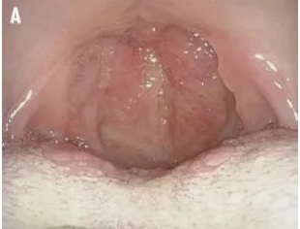
FRESH LOCAL-GPU LIVE DEMO OUTPUT
Case 1: PMC7516301_01 — Concordant Example
SILVER REFERENCE LABEL
Mucocutaneous Leishmaniasis (MCL)
MODEL RANK 1
MCL
CONFIDENCE
Medium
TIME
78.3s
Clinical Input (Blinded)
19-year-old man from Syria with 6-month throat irritation progressing to severe throat pain and fever; exam noted prior arm scar and oropharyngeal/laryngeal mucosal lesions.
Held-out case absent from the official 121-case experimental retrieval corpus; full text is on slide 20.
Fresh live output used the local defense demo KB; target and confirmatory fields were withheld.
Input image
Model Output Summary
Top diagnosis: Mucocutaneous Leishmaniasis (Mucosal involvement)
Runtime support: 3 retrieved chunks
Output route: retrieval-supported response
LLM Council Review Synthesis
Review synthesis; not Gemma output
Reviews agree MCL Rank 1 is a strong concordant positive example
Image is visually consistent/contextual, not diagnostic proof
Runtime Support Returned by Demo KB
1. Mucocutaneous leishmaniasis: runtime support returned by the backend
2. Cutaneous leishmaniasis: runtime support returned by the backend
Live case inspection - fresh local-GPU demo output
16

Slide 17
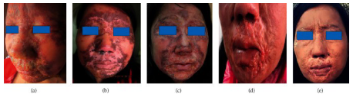
FRESH LOCAL-GPU LIVE DEMO OUTPUT
Case 2: PMC7456484_01 — Subtype Mismatch
SILVER REFERENCE LABEL
Post-Kala-Azar Dermal Leishmaniasis (PKDL)
MODEL RANK 1
MCL
CONFIDENCE
Medium
TIME
74.0s
Clinical Input (Blinded)
37-year-old woman from eastern Bhutan with extensive facial plaques, eyelid damage/scarring, nasal mucosal extension, and prior treated visceral leishmaniasis history.
Held-out case absent from the official 121-case experimental retrieval corpus; full text is on slide 21.
Fresh live output used the local defense demo KB; target and confirmatory fields were withheld.
Input image
Model Output Summary
Top diagnosis: Chronic Mucocutaneous Leishmaniasis (Mucocutaneous Leishmaniasis)
Runtime support: 3 retrieved chunks
Output route: retrieval-supported response
LLM Council Review Synthesis
Review synthesis; not Gemma output
Reviews agree the family is retained but PKDL is not named
Demo KB lacks a PKDL anchor; subtype limitation
Runtime Support Returned by Demo KB
1. Visceral leishmaniasis: runtime support returned by the backend
2. Mucocutaneous leishmaniasis: runtime support returned by the backend
Live case inspection - fresh local-GPU demo output
17

Slide 18
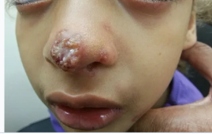
FRESH LOCAL-GPU LIVE DEMO OUTPUT
Case 3: PMC10026180_04 — Label-Conflict Stress Test
LABEL CONFLICT
Verified Non-Leish / pseudolabel CL
MODEL RANK 1
CL
CONFIDENCE
Medium
TIME
61.5s
Clinical Input (Blinded)
11-year-old girl with ataxia telangiectasia, recurrent respiratory and ear infections, low IgG, and a spreading nose rash extending to the nostrils and left cheek; the image/text are leishmaniasis-plausible but the pipeline labels conflict.
Held-out case absent from the official 121-case experimental retrieval corpus; full text is on slide 22.
Fresh live output used the local defense demo KB; target and confirmatory fields were withheld.
Input image
Model Output Summary
Top diagnosis: Mucocutaneous Leishmaniasis (or other atypical infection)
Runtime support: 3 retrieved chunks
Output route: retrieval-supported response
LLM Council Review Synthesis
Review synthesis; not Gemma output
Reviews flag a label conflict; full-text case is leishmaniasis-plausible
Live CL/MCL-family output is not specificity proof; confirmation required
Runtime Support Returned by Demo KB
1. Cutaneous leishmaniasis: runtime support returned by the backend
2. Cutaneous leishmaniasis: runtime support returned by the backend
Live case inspection - fresh local-GPU demo output
18

Slide 19

MASTER THESIS DEFENSE
Thank You
Questions?
Feasible and traceable under constraints; not deployment-ready.
Multimodal RAG for Leishmaniasis Diagnosis
Nguyen Tuan Ngoc · Computer Science (M.Sc.)
Vietnamese-German University · Hochschule Darmstadt (h_da)

Slide 20
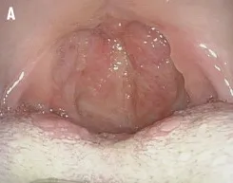
APPENDIX CASE EVIDENCE
Full Blinded Input: PMC7516301_01
CASE ID
PMC7516301_01
INPUT MODE
Text + image
SOURCE
Held-out query
USE
Q&A appendix
Full blinded clinical input
A 19-year-old man from Syria (arrived in Denmark in 2015) presented in June 2016 with a 6-month history of throat irritation that progressed over several days to severe throat pain and fever. He had no history of severe illness or excess infections; examination noted a scar on his arm that was suggestive of previous cutaneous leishmaniasis. Laryngoscopy demonstrated massive edema of the mucosa of both the pharynx and larynx; the epiglottis and uvula were swollen and red with papilloma-like lesions. Endoscopic images show marked swelling and papillomatous-appearing mucosal lesions of the oropharynx and larynx.
Input image used in test
Full blinded clinical input: diagnosis, title, abstract, captions, and confirmatory findings withheld.
Live case inspection - fresh local-GPU demo output
20

Slide 21
APPENDIX CASE EVIDENCE
Full Blinded Input: PMC7456484_01
CASE ID
PMC7456484_01
INPUT MODE
Text + image
SOURCE
Held-out query
USE
Q&A appendix
Full blinded clinical input
A 37‑year‑old woman from eastern Bhutan presented in 2014 with extensive erythematous plaques on the forehead, central face, perioral area, and cheeks extending to both ears. The left eye was damaged and there was marked swelling of the right eyelid with lid scarring and lagophthalmos. Plaques extended to the nasal mucosa without intraoral involvement. Other skin and systemic examinations were reportedly normal.
Laboratory testing showed hemoglobin 11.7 g/dl, total leukocyte count 6,390/mm3 (neutrophils 62%, lymphocytes 28%), platelets 191,000/mm3, ESR 39 mm in the 1st hour, SGOT 35 U/L, SGPT 68 U/L, bilirubin 1 mg/dl, urea 21 mg/dl, creatinine 0.8 mg/dl, fasting glucose 80 mg/dl. Tests for HIV, hepatitis B and C, and syphilis were negative. Chest radiograph, ECG, and abdominal ultrasound were normal.
Full blinded clinical input (continued)
Relevant past history: in February 1999, during pregnancy she had fever, weight loss, anemia, and hepatomegaly and “was diagnosed as VL and treated with SSG injections 850 mg/day for 20 days.” Seven months after that illness she developed erythematous lesions on her forehead that spread over the face. In 2002 a dermatologist recorded papules and plaques over the cheeks, periorbital, and perioral areas that “were suspected as chronic dermatitis or cutaneous lupus erythematosus,” and she received topical, intralesional, and oral corticosteroids. In 2007 a WHO consultant for kala azar “suspected PKDL.” Skin biopsies performed in 2006, 2010, and 2013 “failed to confirm leishmaniasis,” and no firm diagnosis had been recorded.
Full blinded clinical input: diagnosis, title, abstract, captions, and confirmatory findings withheld.
Live case inspection - fresh local-GPU demo output
21

Slide 22
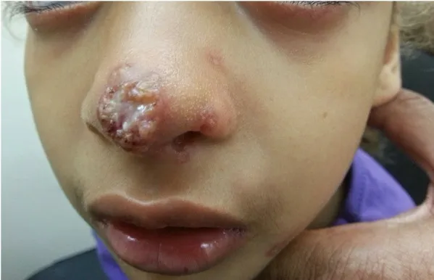
APPENDIX CASE EVIDENCE
Full Blinded Input: PMC10026180_04
CASE ID
PMC10026180_04
INPUT MODE
Text + image
SOURCE
Held-out query
USE
Q&A appendix
Full blinded clinical input
An 11-year-old Arab girl with a known diagnosis of ataxia telangiectasia (diagnosed at 1 year) presented with a spreading skin rash on her nose that extended to the nostrils and her left cheek. Family history included consanguineous parents and another sibling with AT. Her childhood course included ataxia, recurrent lung and ear infections, sclerosing cholangitis, hypothyroidism, and later diffuse large B‑cell lymphoma. She used a wheelchair and had multiple café‑au‑lait spots and telangiectasias. Immunologic testing showed a decreased immunoglobulin level (IgG 516 mg/L) with lymphocyte count and function reported as normal. Her baseline therapies included monthly IVIG, inhaled budesonide and fluticasone, and levothyroxine.
Initially she received amoxicillin–clavulanic acid and topical chloramphenicol without clinical response. On examination, the tip of the nose had an erythematous plaque with a central erosion and a circinate‑elevated border with overlying scattered pustules; the nose bridge and nostrils had small erythematous erosions. An atypical infection was considered.
Input image used in test
Full blinded clinical input: diagnosis, title, abstract, captions, and confirmatory findings withheld.
Live case inspection - fresh local-GPU demo output
22

Slide 23
APPENDIX EXPERIMENT-PIPELINE EVIDENCE
Gemma 4 RAG/No-RAG Backup: PMC7516301_01
CASE ID
PMC7516301_01
SILVER REFERENCE
MCL
USE
Q&A backup only
SOURCE
Gemma 4 pipeline
Source: official Gemma 4 experiment-pipeline comparison; same held-out case ID, Q1/Q3 multimodal query type.
NO-RAG condition
Rank 1 type: Non-Leishmaniasis
Rank 1: Non-Leishmaniasis
Confidence: High
Retrieved context chunks: 0
Experiment pipeline: no retrieved context
RAG condition
Rank 1 type: MCL
Rank 1: Mucosal Leishmaniasis (Mucocutaneous Leishmaniasis)
Confidence: High
Retrieved context chunks: 3
Experiment pipeline: retrieved context used
Presentation interpretation
Retrieval changed this selected backup example from Non-Leishmaniasis to MCL in the official Gemma 4 experiment-pipeline comparison.
Selected case-level backup only; aggregate thesis metrics remain the benchmark.
Not clinical validation and not diagnosis from image alone.
Q&A appendix only - official Gemma 4 experiment-pipeline comparison
23

Slide 24
APPENDIX EXPERIMENT-PIPELINE EVIDENCE
Gemma 4 RAG/No-RAG Backup: PMC7456484_01
CASE ID
PMC7456484_01
SILVER REFERENCE
PKDL
USE
Q&A backup only
SOURCE
Gemma 4 pipeline
Source: official Gemma 4 experiment-pipeline comparison; same held-out case ID, Q1/Q3 multimodal query type.
NO-RAG condition
Rank 1 type: MCL
Rank 1: Mucocutaneous Leishmaniasis (MCL)
Confidence: High
Retrieved context chunks: 0
Experiment pipeline: no retrieved context
RAG condition
Rank 1 type: MCL
Rank 1: Mucocutaneous Leishmaniasis (Mucocutaneous form)
Confidence: High
Retrieved context chunks: 1
Experiment pipeline: retrieved context used
Presentation interpretation
Both conditions remain inside the leishmaniasis family but miss the PKDL subtype, so this remains a subtype-resolution challenge.
Selected case-level backup only; aggregate thesis metrics remain the benchmark.
Not clinical validation and not diagnosis from image alone.
Q&A appendix only - official Gemma 4 experiment-pipeline comparison
24

Slide 25
APPENDIX EXPERIMENT-PIPELINE EVIDENCE
Gemma 4 RAG/No-RAG Backup: PMC10026180_04
CASE ID
PMC10026180_04
SILVER REFERENCE
verified Non-Leish / pseudolabel CL
USE
Q&A backup only
SOURCE
Gemma 4 pipeline
Source: official Gemma 4 experiment-pipeline comparison; same held-out case ID, Q1/Q3 multimodal query type.
NO-RAG condition
Rank 1 type: Non-Leishmaniasis
Rank 1: Mucocutaneous infection/Inflammatory dermatosis secondary to underlying i...
Confidence: High
Retrieved context chunks: 0
Experiment pipeline: no retrieved context
RAG condition
Rank 1 type: Non-Leishmaniasis
Rank 1: Mucocutaneous infection/Inflammatory dermatosis secondary to underlying i...
Confidence: High
Retrieved context chunks: 0
Experiment pipeline: retrieved context used
Presentation interpretation
The official comparison returns Non-Leishmaniasis in both conditions, but the full-text live demo and LLM council reviews make this a label-conflict/evidence-attribution stress test, not specificity proof.
Selected case-level backup only; aggregate thesis metrics remain the benchmark.
Not clinical validation and not diagnosis from image alone.
Q&A appendix only - official Gemma 4 experiment-pipeline comparison
25

Slide 26
APPENDIX RETRIEVER/RERANKER EVIDENCE
Official RAG Trace: PMC7516301_01
CASE ID
PMC7516301_01
RETRIEVER
hybrid
RERANK
True
TOP K
20
USE
Q&A trace only
qid: PMC7516301_01::Q1_Q3_multimodal_diagnosis | source: official Gemma 4 experiment-pipeline trace
Visible contexts are the rerank-enabled final context list used for generation; no separate pre-rerank list is claimed.
Context rank 1
doc_id: PMC7528117_01
score: 0.03301807008521583
diagnosis_type: MCL | label_source: train_verified
text_prefix: A 52‑year‑old woman who works in sugarcane fields in a rural area was referred to Oral Medicine for evaluation of a granulomatous lesion on the palate and for hoarseness that she thought followed a flu 3 months earlier. According
Context rank 2
doc_id: PMC7527865_05
score: 0.01497737556561086
diagnosis_type: MCL | label_source: train_verified
text_prefix: A 30-year-old Caucasian man, unemployed, HIV-negative and with no other concomitant infections, presented in 2014 with a papule on the inferior eyelid of the right eye. His past history included, in 2008, an isolated nodulation in
Context rank 3
doc_id: PMC7585787_01
score: 0.014164989939637825
diagnosis_type: MCL | label_source: train_verified
text_prefix: A 38‑year‑old man from Yayu district, western Ethiopia, presented to the outpatient clinic with multiple skin lesions on his face and hands and mutilation of the nose; his upper lip was injured and swollen. Eight years earlier he
Q&A appendix only - exact RAG trace and fresh real-GPU audit evidence
26

Slide 27
APPENDIX EXACT BACKEND EVIDENCE
Fresh Real-GPU Output Audit: PMC7516301_01
CASE ID
PMC7516301_01
PROVIDER
real_gpu_gemma4
MODEL
google/gemma-4-E4B-it
USE
Fresh audit only
request_id: v12d_recapture_live_gpu_PMC7516301_01_20260617_165636 | source: /home/ngocnt/Leishmaniasis_v3/rag/instructions/process/14/demo/presentation/v12d/re-capture/20260617_165636/PMC7516301_01_live_gpu_result.json
Exact model-output fields from fresh backend response
Rank 1 supportive consideration: Mucocutaneous Leishmaniasis (Mucosal involvement)
Rank 1 Diagnosis Type: MCL
Rank 1 Confidence: Medium
safety_state: generated_support | elapsed_seconds: 78.336 | query_image_tensor_count: 1
Exact returned evidence chunks from raw backend response
Evidence rank 1
chunk_id: mcl-002 | score: 0.3617
title: Palatal and nasal mucosal disease in leishmaniasis
diagnosis_label: Mucocutaneous leishmaniasis | confirmatory: True
excerpt: Palatal or nasal mucosal lesions with compatible epidemiology should raise concern for mucocutaneous leishmaniasis and prompt tissue confirmation.
Evidence rank 2
chunk_id: cl-001 | score: 0.3038
title: Cutaneous leishmaniasis with ulcer and smear-confirmed amastigotes
diagnosis_label: Cutaneous leishmaniasis | confirmatory: True
excerpt: A patient with an ulcerated plaque on the forearm after sandfly exposure had a lesion smear showing amastigotes. The presentation was consistent with localized cutaneous leishmaniasis.
Evidence rank 3
chunk_id: vl-001 | score: 0.2457
title: Visceral leishmaniasis with prolonged fever and splenomegaly
diagnosis_label: Visceral leishmaniasis | confirmatory: True
excerpt: Prolonged fever, weight loss, pancytopenia, and splenomegaly are classic features of visceral leishmaniasis. Bone marrow or tissue confirmation is typically required.
Q&A appendix only - exact RAG trace and fresh real-GPU audit evidence
27

Slide 28
APPENDIX RETRIEVER/RERANKER EVIDENCE
Official RAG Trace: PMC7456484_01
CASE ID
PMC7456484_01
RETRIEVER
hybrid
RERANK
True
TOP K
20
USE
Q&A trace only
qid: PMC7456484_01::Q1_Q3_multimodal_diagnosis | source: official Gemma 4 experiment-pipeline trace
Visible contexts are the rerank-enabled final context list used for generation; no separate pre-rerank list is claimed.
Context rank 1
doc_id: PMC7585787_01
score: 0.01971861471861472
diagnosis_type: MCL | label_source: train_verified
text_prefix: A 38‑year‑old man from Yayu district, western Ethiopia, presented to the outpatient clinic with multiple skin lesions on his face and hands and mutilation of the nose; his upper lip was injured and swollen. Eight years earlier he
Context rank 2
doc_id: PMC6019596_01
score: 0.019506936428773658
diagnosis_type: MCL | label_source: train_verified
text_prefix: A 78-year-old man from a rural area in western Iran was referred for multiple ulcerative, exudative lesions involving the mid-face (upper lip and anterior nasal fossa), above the eyebrows, dorsal aspects of both hands, and posteri
Context rank 3
doc_id: PMC4934146_02
score: 0.0151288056206089
diagnosis_type: DsCL | label_source: train_verified
text_prefix: A 40‑year‑old woman from Balao Chico (Guayas province, Ecuador) presented in August 1979 with a progressive widespread skin eruption. The illness began with a lesion on the lumbar region; papular lesions developed and became pustu
Q&A appendix only - exact RAG trace and fresh real-GPU audit evidence
28

Slide 29
APPENDIX EXACT BACKEND EVIDENCE
Fresh Real-GPU Output Audit: PMC7456484_01
CASE ID
PMC7456484_01
PROVIDER
real_gpu_gemma4
MODEL
google/gemma-4-E4B-it
USE
Fresh audit only
request_id: v12d_recapture_live_gpu_PMC7456484_01_20260617_165636 | source: /home/ngocnt/Leishmaniasis_v3/rag/instructions/process/14/demo/presentation/v12d/re-capture/20260617_165636/PMC7456484_01_live_gpu_result.json
Exact model-output fields from fresh backend response
Rank 1 supportive consideration: Chronic Mucocutaneous Leishmaniasis (Mucocutaneous Leishmaniasis)
Rank 1 Diagnosis Type: MCL
Rank 1 Confidence: Medium
safety_state: generated_support | elapsed_seconds: 73.986 | query_image_tensor_count: 1
Exact returned evidence chunks from raw backend response
Evidence rank 1
chunk_id: vl-002 | score: 0.5146
title: Kala-azar pattern with hepatosplenomegaly
diagnosis_label: Visceral leishmaniasis | confirmatory: False
excerpt: Kala-azar often presents with hepatosplenomegaly, chronic fever, anemia, and systemic illness rather than an isolated skin ulcer.
Evidence rank 2
chunk_id: mcl-001 | score: 0.3856
title: Mucocutaneous leishmaniasis with nasal and oral involvement
diagnosis_label: Mucocutaneous leishmaniasis | confirmatory: False
excerpt: Nasal septal destruction, oral ulceration, and mucosal inflammation after prior cutaneous disease support mucocutaneous leishmaniasis.
Evidence rank 3
chunk_id: cl-002 | score: 0.3795
title: Papulonodular skin lesion in endemic travel history
diagnosis_label: Cutaneous leishmaniasis | confirmatory: True
excerpt: A chronic papule progressing to a nodular ulcer after endemic travel supported cutaneous leishmaniasis. Biopsy and PCR were used for confirmation.
Q&A appendix only - exact RAG trace and fresh real-GPU audit evidence
29

Slide 30
APPENDIX RETRIEVER/RERANKER EVIDENCE
Official RAG Trace: PMC10026180_04
CASE ID
PMC10026180_04
RETRIEVER
hybrid
RERANK
True
TOP K
20
USE
Q&A trace only
qid: PMC10026180_04::Q1_Q3_multimodal_diagnosis | source: official Gemma 4 experiment-pipeline trace
Visible contexts are the rerank-enabled final context list used for generation; no separate pre-rerank list is claimed.
Context rank 1
doc_id: PMC5490479_01
score: 0.021050130672368734
diagnosis_type: LR | label_source: train_verified
text_prefix: A 9-year-old boy presented with multiple papular lesions on the left cheek that had been present for three months and had gradually enlarged. His medical history was notable for an episode of cutaneous leishmaniasis located on the
Context rank 2
doc_id: PMC3523429_01
score: 0.015682382133995035
diagnosis_type: CL | label_source: train_verified
text_prefix: A 52-year-old woman presented with a single lesion on the tip of her nose that had existed for 14 months. It began as a papule and was slowly increasing in size, enlarging to a plaque. A smear of the lesion performed about 1 year
Context rank 3
doc_id: PMC7585787_01
score: 0.014718614718614718
diagnosis_type: MCL | label_source: train_verified
text_prefix: A 38‑year‑old man from Yayu district, western Ethiopia, presented to the outpatient clinic with multiple skin lesions on his face and hands and mutilation of the nose; his upper lip was injured and swollen. Eight years earlier he
Q&A appendix only - exact RAG trace and fresh real-GPU audit evidence
30

Slide 31
APPENDIX EXACT BACKEND EVIDENCE
Fresh Real-GPU Output Audit: PMC10026180_04
CASE ID
PMC10026180_04
PROVIDER
real_gpu_gemma4
MODEL
google/gemma-4-E4B-it
USE
Fresh audit only
request_id: v12d_recapture_live_gpu_PMC10026180_04_20260617_165636 | source: /home/ngocnt/Leishmaniasis_v3/rag/instructions/process/14/demo/presentation/v12d/re-capture/20260617_165636/PMC10026180_04_live_gpu_result.json
Exact model-output fields from fresh backend response
Rank 1 supportive consideration: Mucocutaneous Leishmaniasis (or other atypical infection)
Rank 1 Diagnosis Type: CL
Rank 1 Confidence: Medium
safety_state: generated_support | elapsed_seconds: 61.477 | query_image_tensor_count: 1
Exact returned evidence chunks from raw backend response
Evidence rank 1
chunk_id: cl-002 | score: 0.3079
title: Papulonodular skin lesion in endemic travel history
diagnosis_label: Cutaneous leishmaniasis | confirmatory: True
excerpt: A chronic papule progressing to a nodular ulcer after endemic travel supported cutaneous leishmaniasis. Biopsy and PCR were used for confirmation.
Evidence rank 2
chunk_id: cl-001 | score: 0.2318
title: Cutaneous leishmaniasis with ulcer and smear-confirmed amastigotes
diagnosis_label: Cutaneous leishmaniasis | confirmatory: True
excerpt: A patient with an ulcerated plaque on the forearm after sandfly exposure had a lesion smear showing amastigotes. The presentation was consistent with localized cutaneous leishmaniasis.
Evidence rank 3
chunk_id: vl-002 | score: 0.0262
title: Kala-azar pattern with hepatosplenomegaly
diagnosis_label: Visceral leishmaniasis | confirmatory: False
excerpt: Kala-azar often presents with hepatosplenomegaly, chronic fever, anemia, and systemic illness rather than an isolated skin ulcer.
Q&A appendix only - exact RAG trace and fresh real-GPU audit evidence
31

