Slide 1
Current Topics: Credit Risk Analysis
Nguyen Tuan Ngoc

Slide 2
TABLE OF CONTENTS
01
02
Introduction
Traditional statistical
03
04
Methodology
Demo
What is credit risk?
How? And its weakness?
It is time to play around with code

Slide 3
—Naved Abdali
“it is not a calculated risk if you haven’t calculated it..”

Slide 4
01
Introduction
What is credit risk?

Slide 5
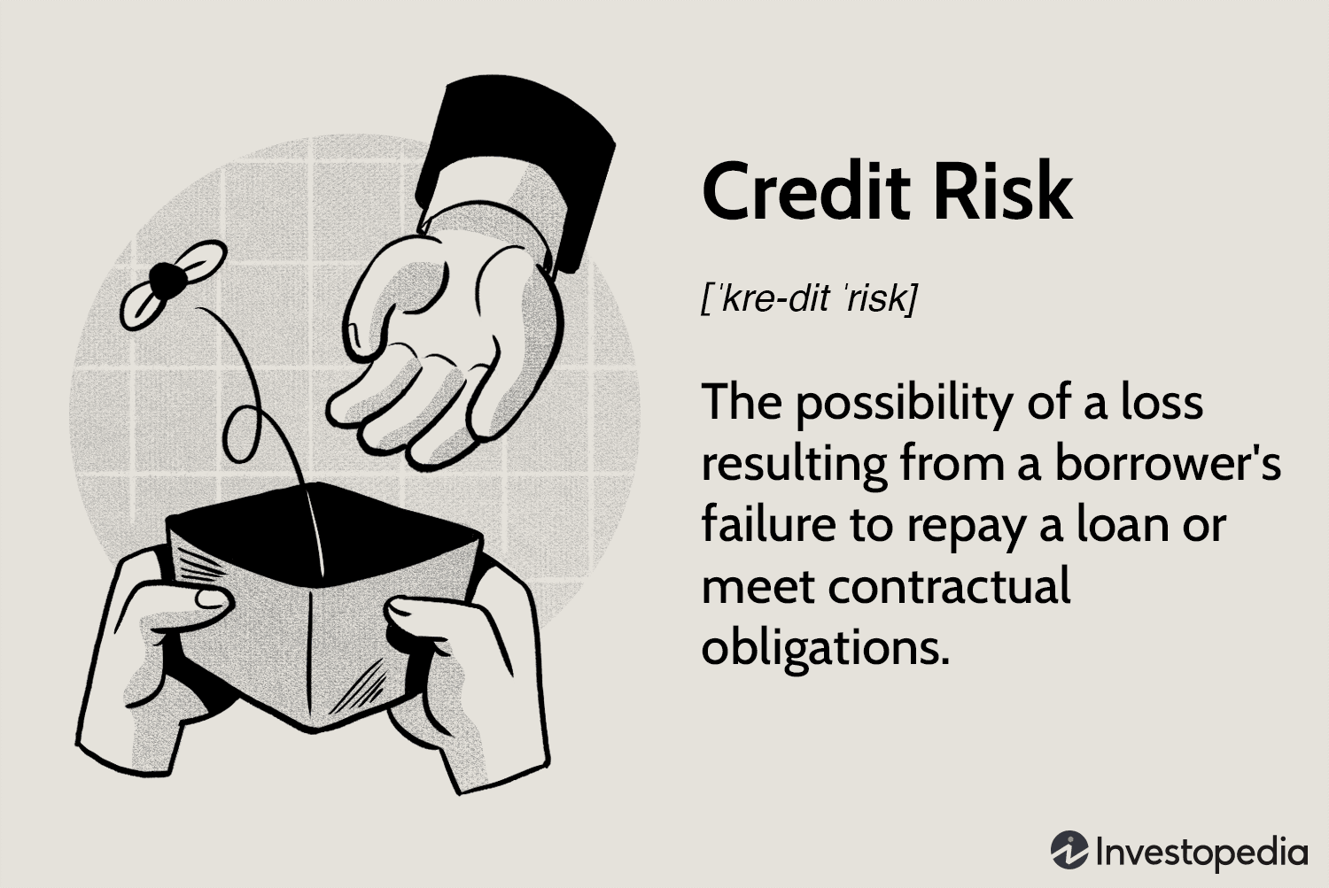
What is credit risk?

Slide 6
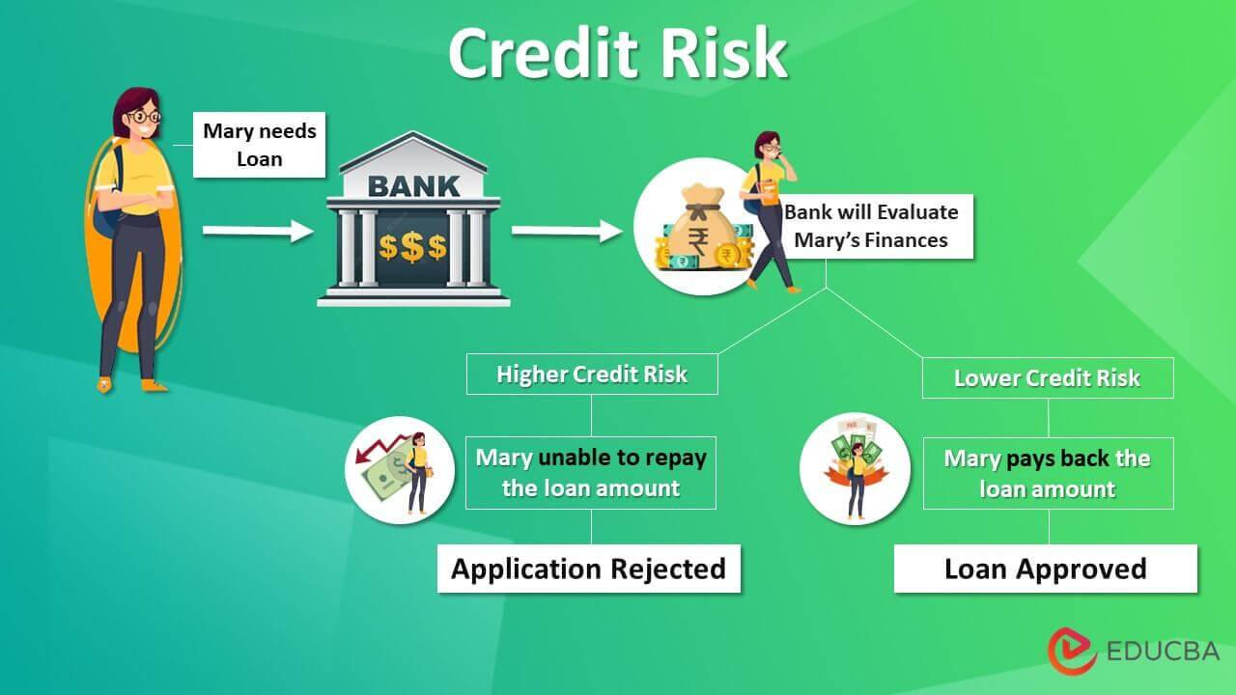
Credit risk example

Slide 7
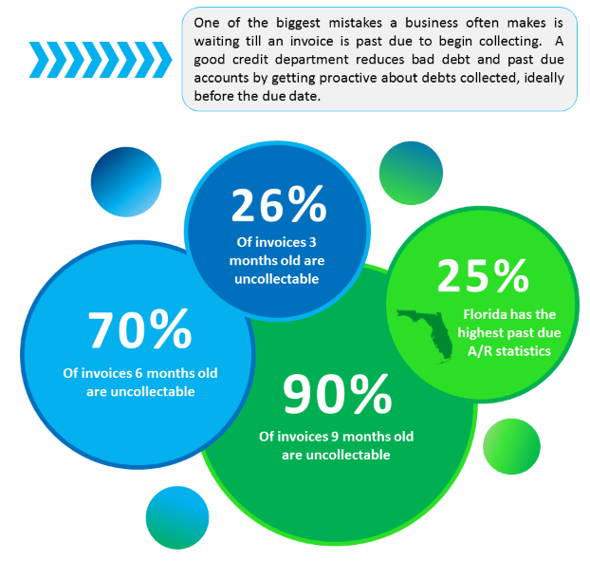
Statistics of bad loan

Slide 8
Traditional Statistical
02
Method of risk assessment
Limitations

Slide 9
Method of risk assessment
01
02
03
Statistical model
Financial ratio analysis
Qualitative analysis
There are math model use data from past loans to predict default of particular borrower
This involves evaluating the borrower’s financial statements to determine their ability to repay the loan
This approach involves evaluating the borrower’s character and reputation, and may take into other factors

Slide 10
Limitations
Reliance on historical data
Limited predictive power
Human bias
Lack of flexibility
Not take into account changes in the borrower’s circumstances
Particularly for borrowers with limited credit histories or for loans with unique characteristics
Biases of individuals who are designing and using the models
Not able to adapt changing circumstances or account for more complex or nuanced risk factors

Slide 11

Methodology
03

Slide 12
General data cleaning
Target variable
Split data
Categorize which one is good or bad from loan status column
Split data into 80:20 while keeping distribution of bad loans in test set same as that in the pre-split dataset

Slide 13
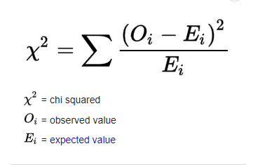
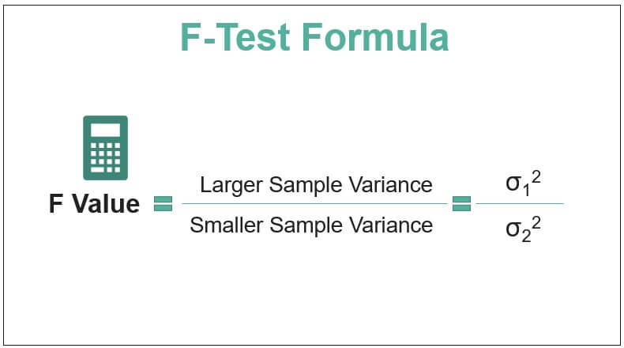
Feature selection
Chi-square
ANOVA F-statistic
measure of the association between two categorical variables.
For numerical features, and is a measure of ratio of between-group variance to within-group variance

Slide 14
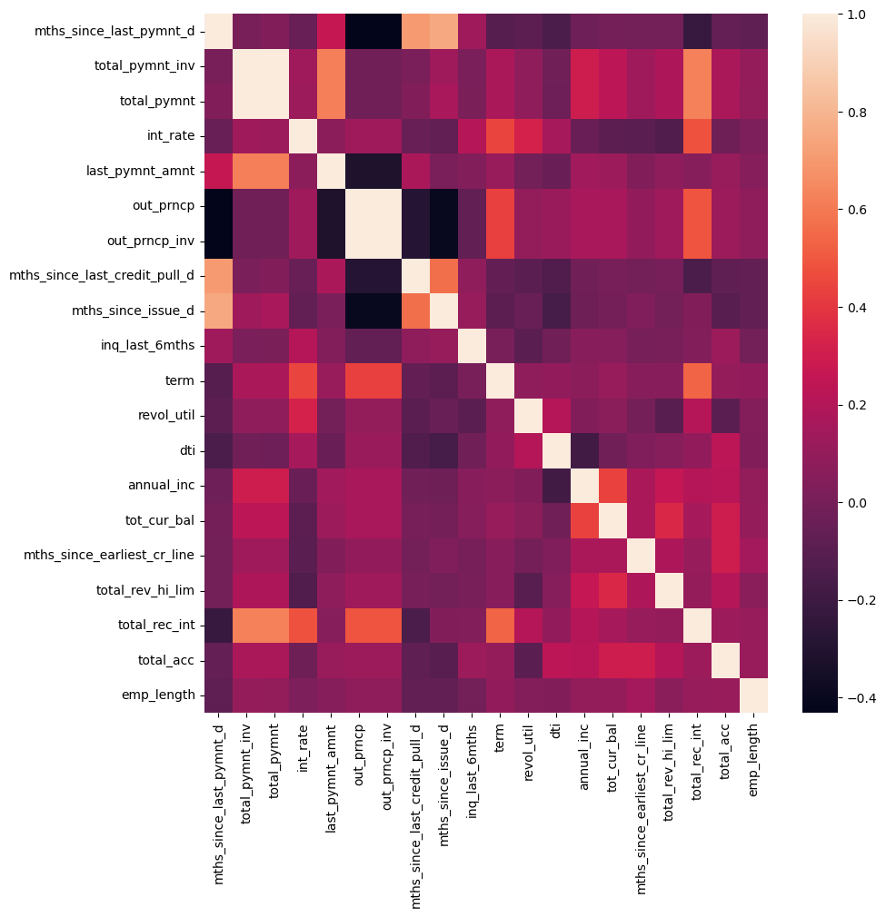
Feature selection
Pair wise correlations to detect multicollinearity
a high correlation coefficient
The following features will be safely dropped

Slide 15
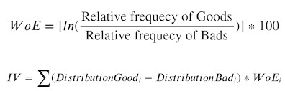
Feature engineering
WoE(weight of evidence)
IV(informative value)
WoE binning can be used to transform categorical variables into numerical variables that are more meaningful for predictive modeling
It is a measure of the quality or worth of the information, and help individuals, organizations make informed decisions and form accurate understandings of complex issues.

Slide 16
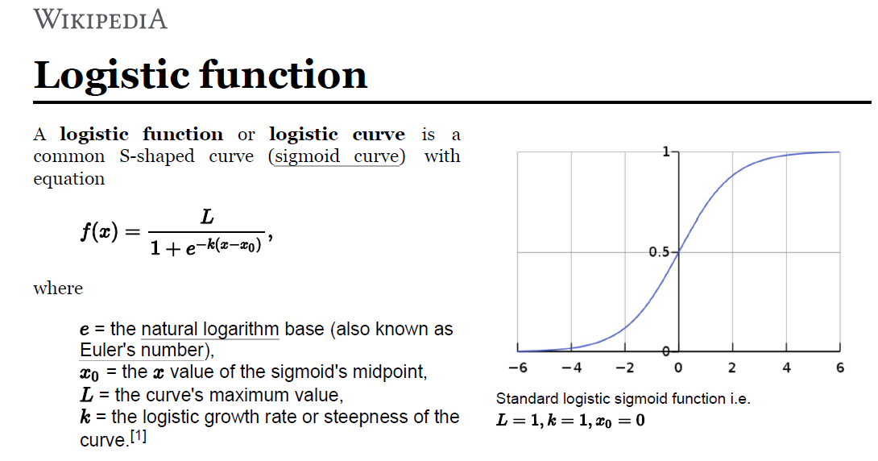
Logistic regression

Slide 17
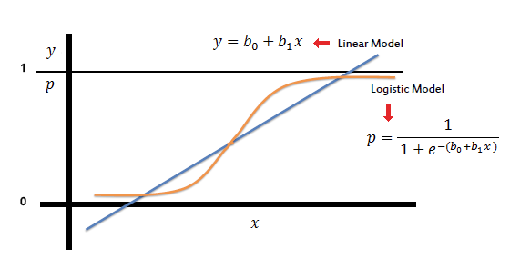
Logistic regression

Slide 18
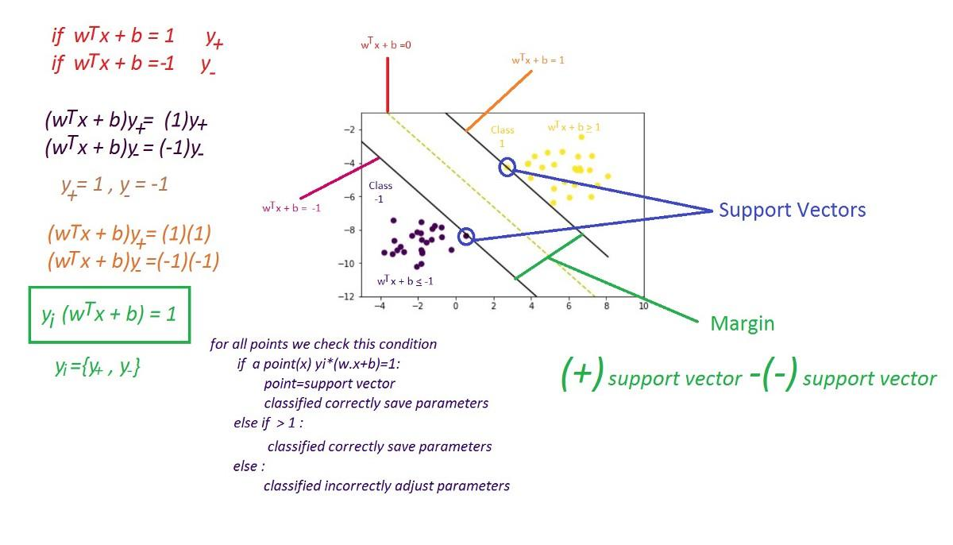
Support vector machine

Slide 19
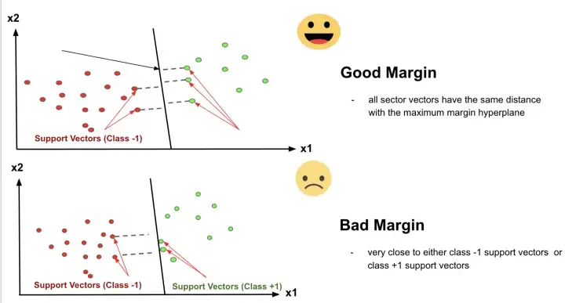
Support vector machine

Slide 20
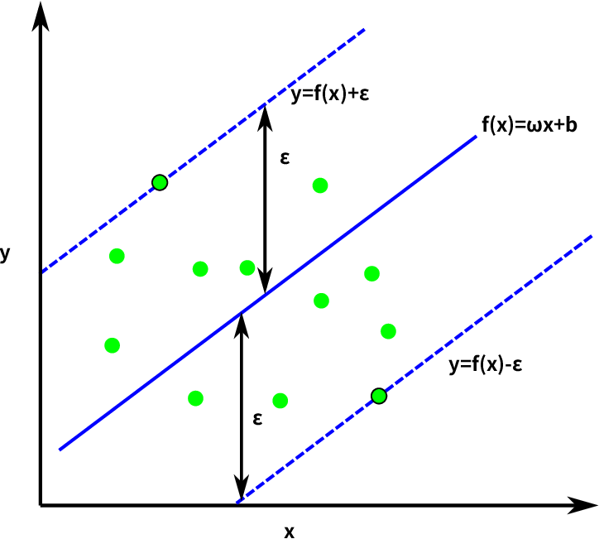
Support vector machine

Slide 21
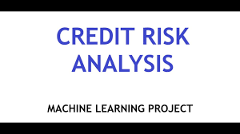
Demo
04

Slide 22
THANKS!
Do you have any questions?
ngocjaylil@gmail.com
+91 620 421 838
yourcompany.com
Please keep this slide for attribution

