Slide 1
CANDID : Preventing SQL Injection Attacks Using Dynamic Candidate Evaluations
V. N. Venkatakrishnan
Assistant Professor,
Computer Science
University of Illinois at Chicago
Joint work with:
Sruthi Bandhakavi (UIUC) Prithvi Bisht (UIC)
and P. Madhusudan (UIUC)

Slide 2






SQL Injection : Typical Query
Phonebook Record Manager
SELECT * FROM phonebook WHERE username =
‘John’ AND password = ‘open_sesame’
Username
John
Password
open_sesame
Display
Delete
John’s phonebook entries are displayed
Submit
Application Server
Web browser
User Input
Query
Database
Web Page
Result Set
Notes:
SQL injection are attacks on web applications launched through specifically crafted user inputs. Lets first see how an SQL injection attack looks like. The user types in his input in a form in a web browser, which sends it over to an application server. The application server inserts the user data into a query and sends it over to a database. The database returns the results for the query, which in turn are displayed to the user in a web page. This slide shows an example of a simple phone book manager, where the application returns the phonebook entries of a particular user, given the username and the appropriate password.

Slide 3
SQL Injection : Typical Query
Phonebook Record Manager
SELECT * FROM phonebook WHERE username = ‘John’ OR 1=1 --AND password = ‘not needed’
Username
John’ OR 1=1 --
Password
not needed
Display
Delete
All phonebook entries are displayed
Submit
Application Server
Web browser
User Input
Query
Database
Web Page
Result Set
Notes:
SQL injection are attacks on web applications launched through specifically crafted user inputs. Lets first see how an SQL injection attack looks like. The user types in his input in a form in a web browser, which sends it over to an application server. The application server inserts the user data into a query and sends it over to a database. The database returns the
results for the query, which in turn are displayed to the user in a web page. This slide shows an example of a simple phone book manager, where the application returns the phonebook entries of a particular user, given the username and the appropriate password.

Slide 4
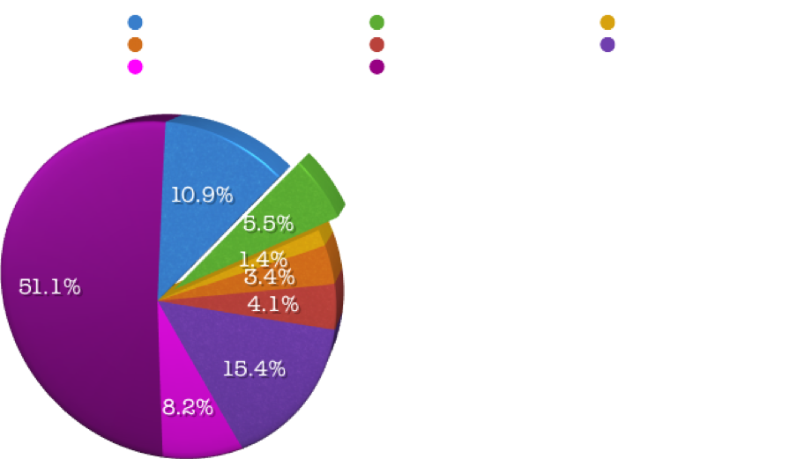
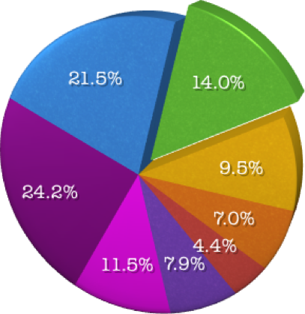
SQL Injection Attacks are a Serious Threat
XSS
XSS
SQL
Injection
SQL
Injection
CVE Vulnerabilities (2004)
CVE Vulnerabilities (2006)
CardSystems security breach(2006):
263,000 customer credit card numbers
stolen, 40 Million more exposed
Notes:
Recent vulnerability statistics show that the percentage of SQL injection attacks discovered increased drastically. This drastic increase can be attributed to the fact that the attacks are easy to engineer and the deployment of firewalls and other perimeter defenses can be defeated easily by simple script injection attacks.
The CardSystems security breach where 263 thousand customer credit card numbers were stolen illustrates how serious the threat could be.

Slide 5
Talk Overview
CANDID
Program
Transformer
Safe
Web
Application
Web
Application
[ACM CCS’07]

Slide 6
SQL Injection
Most systems separate code from data
SQL queries can be constructed by arbitrary sequences of programming constructs that involve string operations
  Concatenation, substring ….
Such construct also involve (untrusted) user inputs
  Inputs should be mere “data”, but in case of SQL results in “code”
Result: Queries intended by the programmer can be “changed” by untrusted user input

Slide 7
Parse Structure for a Benign Query
<sql_query>
<where_clause>
<cond_term>
<cond_term>
<cond>
<cond>
Select * from Table
<id>
<lit>
<id>
<lit>
WHERE username = ‘John’ AND password = ‘os’
Notes:
Conditions have two parts, joined by AND.

Slide 8
Parse Structure for a Attack Query
<sql_query>
<where_clause>
<comment>
<cond_term>
<cond_term>
Select * from
Table
<cond>
<cond>
<id>
<lit>
<lit>
<lit>
WHERE username = ‘John’ OR 1=1
-- AND …
Notes:
Query structure changes.

Slide 9

Attacks Change Query Structure
Boyd et. al [BK 04], ANCS ; Buehrer et. al. [BWS 05], SEM;
Halfond et. al.[HO 05], ASE; Nguyen-Tuong et. al. [NGGSE 05], SEC; Pietraszek et. al[PB 05], RAID; Valeur et. al. [VMV 05], DIMVA;
Su et. al. [SW 06], POPL ...
<sql_query>
<sql_query>
<where_clause>
<where_clause>
<comment>
<cond_term>
<cond_term>
<cond_term>
<cond_term>
<cond>
<cond>
<cond>
<cond>
<id>
<literal>
<id>
<lit>
<lit>
<lit>
<id>
<lit>
WHERE username = ‘John’ OR 1=1 --’ AND ...
WHERE username = ‘John’ AND password = ‘os’
Benign Query
Attack Query
Notes:
Colour change Leave with a strong stmt:
Therefore, there has been a lot of research in this area to counter this problem. One important observation made by the previous researchers is that the structure of the malicious query is different from that of the benign query. The programmer, when writing the program has an idea about how the query’s structure should be for benign inputs. If we can find the programmer intended query structure, we can compare it with the query produced by the user input and find out if it is benign or not.

Slide 10
Prepared Statements
<sql_query>
mysql> PREPARE stmt_name FROM " SELECT * FROM phonebook WHERE username = ? AND password = ?”
<where_clause>
<cond_term>
placeholder
for input
<cond_term>
<cond>
<cond>
<id>
<lit>
<id>
<lit>
Separates query structure from data
Statements are NOT parsed for every user input
WHERE username = ‘?’ AND password = ‘?’
Notes:
Allow programmer to declare and finalize the structure of every query

Slide 11
Legacy Applications
For existing applications adding PREPARE statements will prevent SQL injection attacks
Hard to do automatically with static techniques
  Need to guess the structure of query at each query issue location
  Query issued at a location depends on path taken in program
Human assisted efforts can add PREPARE statements
    Costly effort
Problem: Is it possible to dynamically infer the benign query structure?

Slide 12
High level idea : Dynamic Candidate Evaluations
Create benign sample inputs (Candidate Inputs) for every user input
Execute the program simultaneously over actual inputs and candidate inputs
Generate a candidate query along with the actual query
  The candidate query is always non-attacking
  Actual query is possibly malicious
Issue the actual query only if parse structures match
Actual
I/P
Actual
Query
Match
Application
SQL
Parser
Candidate
I/P
DB
Candidate
Query
No Match
How can we guess benign candidate inputs for every execuction?
Notes:
Similarly, even in the case of benign inputs, benign candidate inputs are produced for each input variable. In this case, however, the query structures would match and the user query is sent to the database.
.

Slide 13
Finding Benign Candidate Inputs
Have to create a set of candidate inputs which
  Are Benign
  Issue a query at the same query issue location
  By following the same path in the program
Candidate
Path
Actual
Path
Problem: Hard
  In the most general
  case it is undecidable
Query
Issue
Location
Notes:
Finding the benign candidate inputs, however, is not so straightforward. This is because the benign candidate inputs may follow a different path from the real path. This is possible in the case where the value of a conditional in the path of the program depends on the input.
Therefore, we not only have to take care that the candidate inputs are benign, but also make sure that those inputs follow the same path as the real inputs. Finding the benign inputs which take the same path as the real inputs is difficult. Instead, we force the candidate inputs to follow the same path as the real inputs. We do this by executing the conditional only on the real inputs and forcing the candidate inputs to follow the same path as that of the reals.

Slide 14
Our Solution : Use Manifestly benign inputs
For every string create a sample string of ‘a’ s having the same length
Candidate Input:
uname = ‘aaaa’
pwd = ‘aa’
Shadow every intermediate string variable that depends on input
For integer or boolean variable, use the originals
Follow the original control flow
Phonebook Record Manager
User Name
John
Password
os
Display
Delete
Submit

Slide 15
Evaluate conditionals only on actual inputs
Candidate Input :
uname = “aaaa”
pwd = “aa”
display = true
input str uname,
str pwd, bool display
User Input :
uname = “john”
pwd = “os”
display = false
Candidate
Input :
uname = “aaaa”
pwd = “aa”
true
false
display?
query = ‘SELECT * from phonebook WHERE username = ‘ + uname + ’ AND password = ’ + pwd +’
query = ‘DELETE * from phonebook WHERE
username = ‘ + uname + ’ AND password = ’ + pwd +’
Actual Query: DELETE * from phonebook WHERE username = ‘john’ AND password = ’ os’
Candidate Query: DELETE * from phonebook WHERE username = ‘aaaa’ AND password = ’aa’
Notes:
Now assume that the delete button is selected making the real value of the delete variable true. The candidate input can be either true or false. Let’s assume that it is false, then the real and candidate inputs will take different paths and result in different queries. To avoid that, we force the candidate inputs to follow the same path as the real inputs by executing the conditional only on the real inputs and forcing the candidate inputs to take the same path. In this example, both the candidate and the real inputs form the DELETE query in the end.
Forcing the candidate inputs to follow the real path may seem ad hoc, but it has a sound theoretical basis.

Slide 16
CANDID Program Transformation Example
i/p str uname; i/p str pwd; i/p bool delete;
str uname_c;
str pwd_c;
uname = input_1, pwd = input_2, delete = input_3;
uname_c = createSample(uname) , pwd_c = createSample(pwd);
false
true
display?
query = DELETE * from phonebook WHERE username = ‘ + uname + ’ AND password = ’ + pwd +’
query = DELETE * from phonebook WHERE username = ‘ + uname + ’ AND password = ’ + pwd +’
query_c = DELETE * from phonebook WHERE username = ‘ +
uname_c + ’ AND password = ’ + pwd_c +’;
query = SELECT * from phonebook WHERE username = ‘ + uname + ’ AND password = ’ + pwd +’ ;
query = SELECT * from phonebook WHERE username = ‘ + uname + ’ AND password = ’ + pwd +’ ;
query_c = SELECT * from phonebook WHERE username = ‘ + uname_c + ’ AND password = ’ + pwd_c +’;
if(match_queries(query,query_c) == true) execute_query(query)
execute_query(query)
Notes:
Only strings are transformed
Benign inputs are the same size as user input
Method call duplicatedls

Slide 17
Resilience of CANDID
Input Splitting
“Alan Turing”
Input
“aaaaaaaaaaa”
Instrumented
Input Splitting
Function
Input
Splitting
Function
space_index = 4
space_index = 4
fn = input[0..3]
= “Alan”
fn_c = input_c[0..3]
= “aaaa”
ln = input[5..9]
= “Turing”
ln_c = input_c[5..9]
= “aaaaaa”
Query
SELECT ... WHERE first_name = “Alan” AND last_name = “Turing”
SELECT ... WHERE first_name = “aaaa” AND last_name = “aaaaaa”
Notes:
Although the CANDID transformation is very simple, it is resilient to various scenarios, two of which I will discuss in the next two slides.
In the first scenario, using an example we demonstrate that the candid approach is resilient to the input splitting functions that may be used by the application program before the input is sent to the query. If the application has a filter function which splits the name into first and last names, the CANDID transformation would transform the function to also split the candidate inputs into two strings having the same length as the first and last names.

Slide 18

CANDID Implementation Architecture
Offline View
Online View
java bytecode
Original
Program
Java Bytecode
transformer
Instrumented
Web
Application
Tomcat server
Web Server
SQL Parse Tree
Checker
java
Instrumented
Web
Application
DB
Browser
MySql
java bytecode
Notes:
The CANDID architecture consists of two views. In the offline view the application programs are transformed according to the CANDID transformation we have just seen. In the online view, the transformed application is deployed on the web server, where it dynamically detects and prevents the SQL injection attacks. The details of our implementation are in the paper.

Slide 19
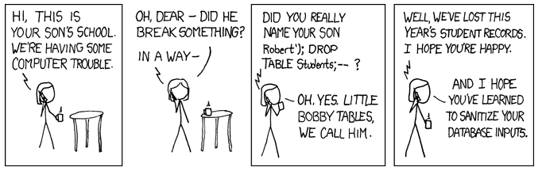
Thank You
Questions?
Acknowledgments: xkcd.com

