Slide 1
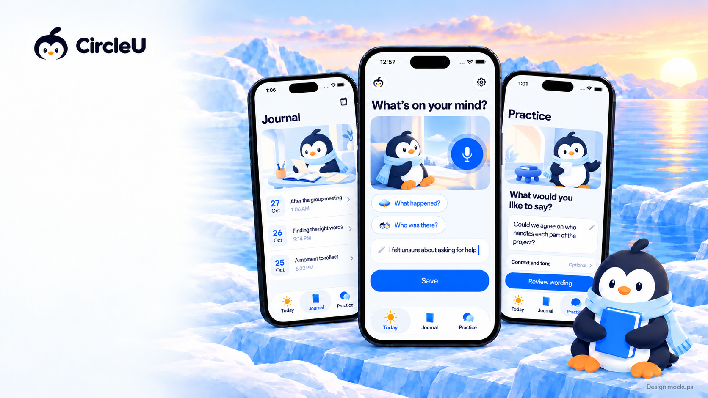

Some
conversations
stay with you
A space to reflect on what happened
and find words for what comes next
First thought
“You never help with our project.”
A possible rewrite
“Could we agree on which parts
each of us will handle?”
Illustrative example
Notes:
Local revision of the existing Direction B poster after its live Spaces connection failed. Headline and left-side copy are editable; logo, phone UI and environment are raster design mockups, not screenshots of implemented app behaviour. New image references: BrandArtwork/ScreenScenes06 (WindowPause, JournalDesk, PracticeStudio). Artwork created with built-in imagegen; exact prompt stored alongside. The UTS Apple Foundation Program mark is reused from the prior poster; no endorsement is implied. No active App Store or TestFlight availability is claimed. Source: docs/product/overview.md and docs/design/branding-guideline.md.

