Slide 1


AI Meal Planner
Say what you crave.
Get a meal that fits you.
A multi-agent meal planner · a portfolio project by Mike
Scan to try the live demo
Notes:
Hi, I'm Mike. This is AI Meal Planner, a portfolio project I built end to end. In ten minutes I'll show what it does, how it works and how I measured whether its meals are any good. You can scan the code and try it while I talk.

Slide 2
Picking a meal is easy; sizing it to your body is not
1
2
3
How much?
Is it right for me?
What do I buy?
Calorie needs change with your body, activity and goal.
Diets, allergies and health conditions rule meals out.
Recipes, nutrition and shopping lists live in different places.
Notes:
Most of us know what we feel like eating. The hard part is everything after that: how much suits my body and goal, does it fit my diet, and what do I need to buy. Those are three separate chores today, so this project joins them into one step.

Slide 3
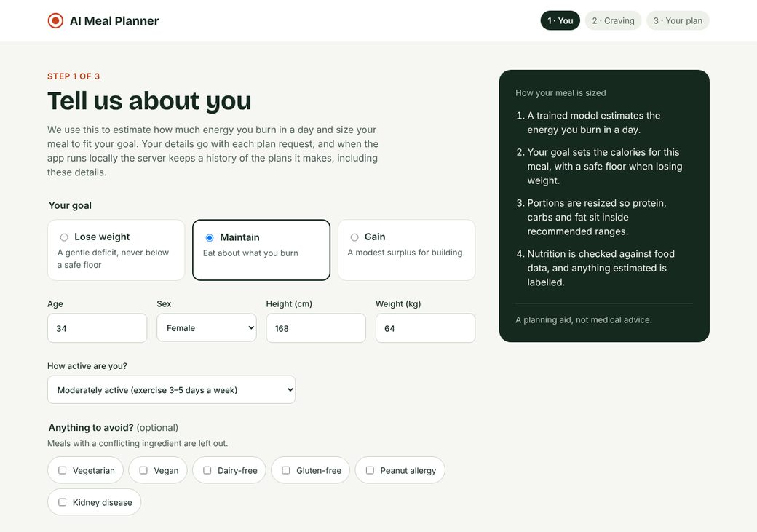
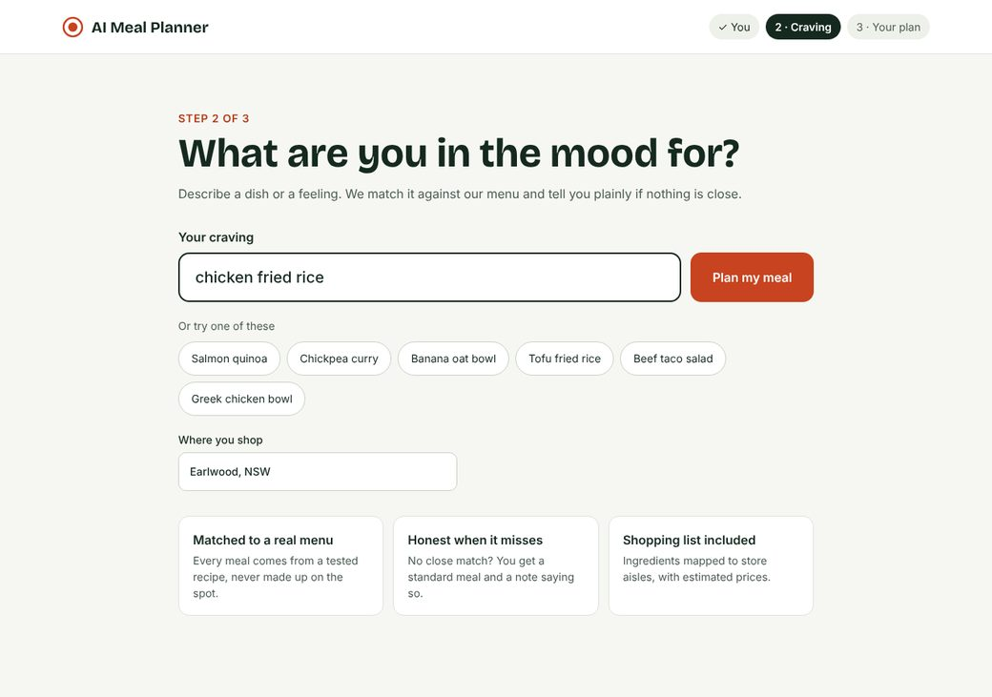
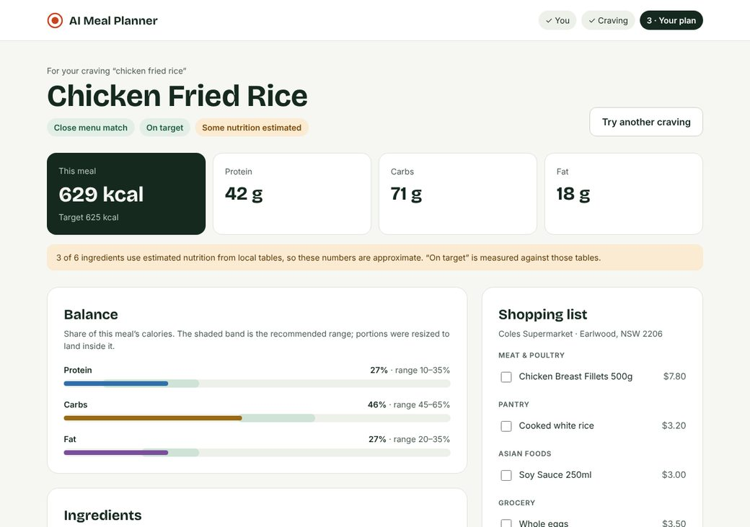
One craving in, one meal and a shopping list out
1
You
2
Craving
3
Your plan
Body, goal and what to avoid
What you feel like eating
One meal, balance, shopping list
Notes:
The app is three steps. You say who you are and your goal. You say what you feel like eating. You get one meal sized to you, its macro balance and a shopping list. These are the approved design screens for the React app.

Slide 4
Four agents work in sequence and return one typed answer
Your profile and craving
1
2
3
4
Calorie expenditure
Meal recommendation
Nutrition verification
Supermarket
A trained model predicts your daily burn and sets the meal's target
Filters unsafe meals, finds the closest recipe, resizes portions
Checks each ingredient and labels what is estimated
Maps ingredients to products with an estimated cost
One typed JSON response: meal, nutrition, shopping list and warnings
Notes:
Behind the screens is a FastAPI service with four agents. Each does one job and hands on. Because the meal comes from retrieval rather than generation, the core path works with no LLM key at all. Gemini is optional, for a final explanation only.

Slide 5
A model trained on 750,000 rows sets each meal's calorie target
750,000
0.996
2.2 kcal
training rows
R² on validation data
mean error
Safety floor
Weight-loss plans never go below 1,200 kcal a day for women or 1,500 for men.
Notes:
The first agent is a gradient-boosted model trained on a Kaggle dataset of 750,000 rows. On validation data it explains 99.6% of the variance, with a mean error of 2.2 kcal. Your goal then adjusts the target, and weight-loss plans have a hard floor so it never suggests too little.

Slide 6
Diet and allergy filters run first, then search finds the closest tested recipe
Close match
That recipe, sized to you
Your craving
Safety filters
Recipe search
and profile
Diet, allergy and health conditions
Vector RAG over 34 tested recipes
No close match
A standard meal and a note saying so
Nothing safe
The plan is refused, not guessed
Notes:
Safety comes before relevance. Conflicting meals are removed first, then vector search looks through 34 tested recipes. If nothing is genuinely close, it doesn't pretend. You get a standard meal and a note saying so, and if nothing is safe it refuses.

Slide 7
Every ingredient is checked against USDA, and estimates are labelled
Chicken Fried Rice
Where the numbers come from
Ingredient | Amount | Source
Cooked white rice | 200 g | Estimated
Mixed vegetables | 105 g | Reference
Chicken breast | 85 g | Estimated
Whole egg | 45 g | Reference
Soy sauce | 15 g | Estimated
Sesame oil | 10 g | Reference
USDA FoodData Central
1
FatSecret, if configured
2
Local reference tables
3
Here, 3 of 6 ingredients are estimates
Notes:
Nutrition is looked up per ingredient: USDA FoodData Central first, then FatSecret, then local tables. Whatever the source, the screen says so. In this example half the ingredients use estimates, and the app tells you. Being honest about that matters more to me than looking precise.

Slide 8
We defined a good meal before trying to improve one
Share of the meal's energy
Within 10%
Protein
10–35%
of the calorie target
Carbs
45–65%
72 requests
Fat
20–35%
4 body profiles, 4 diet or health limits, offline and repeatable
Notes:
Before changing anything I fixed what good means. A plan passes only if its calories are within 10% of target and each macro sits inside the adult AMDR ranges. The test set is 72 fixed requests across four body profiles and four diet or health limits. It runs offline and gives identical results every time.

Slide 9
Three fixes took the planner from 10 to 72 of 72
1
Portion balancing
Plans meeting the targets, out of 72
72
Resize each ingredient toward the ranges
2
Honest fallback
47
Say so when nothing on the menu matches
41
3
Cooking fat
Add oil to six recipes that had no fat source
10
0.3% median calorie deviation
First run
Portion balancing
Honest fallback
Cooking fat
Notes:
The first run passed only 10 of 72. Balancing portions per ingredient took it to 41. Making the planner admit when nothing matches took it to 47. Adding a cooking fat to six recipes that had none took it to all 72, with a median calorie deviation of 0.3%. Five guardrail cases, including refusals, also behave as designed.

Slide 10
It is built like a product, not a notebook
Typed API contract
Tested
Secured
FastAPI and Pydantic; OpenAPI checked in CI
596 Python tests at 95% coverage
API keys, rate limits, no history in hosted mode
Deployable
Observable
Two clients
Containers and a Cloud Run workflow
OpenTelemetry tracing, health data kept out
A live Streamlit demo and a React app
Notes:
Although it's a portfolio project, I held it to production habits. The API contract is committed and CI fails if it drifts. There are 596 Python tests at 95% coverage. It has API keys and rate limits, tracing that keeps health data out of traces, and a Cloud Run deployment workflow that is ready for a GCP project.

Slide 11
What comes next, and what it is not yet
Next
Not yet
1
A larger recipe library
1
Prices are estimates, not live store data
2
Learn from user feedback
2
Some nutrition uses labelled estimates
3
A live deployment on Cloud Run
3
A study project, not medical advice
Notes:
The next steps are a larger recipe library, using feedback to learn preferences, and a real cloud deployment. And to be clear about limits: prices are estimates from a local list, some nutrition comes from local tables, and this is a study project, not medical advice.

Slide 12
Try it and read the code
tuannm3812-ai-meal-planner.streamlit.app
github.com/tuannm3812/ai-meal-planner
A study project. Not medical advice.
Scan to try the live demo
Notes:
That's AI Meal Planner: one craving in, one meal that fits you, and all 72 test plans on target. The demo and code are here. Thanks, and I'm happy to take questions.

