Slide 1
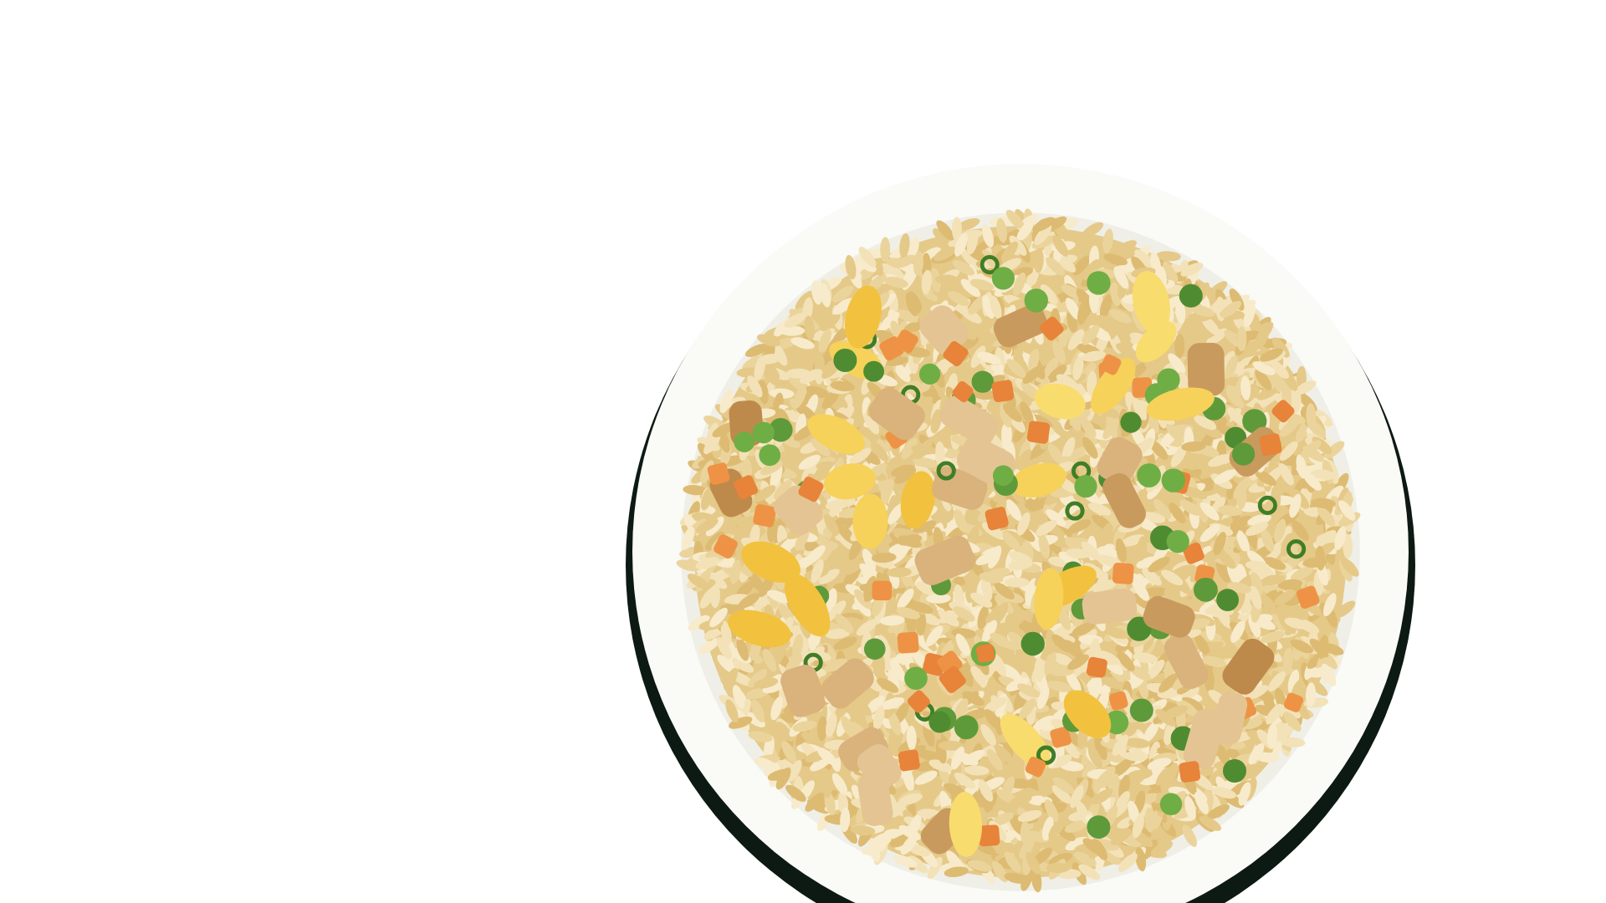



What should I eat tonight?
AI Meal Planner
SHOPPING LIST
CHICKEN BREAST $7.80
COOKED RICE $3.20
WHOLE EGG $3.50
VEGETABLES $3.50
SESAME OIL $3.50
SOY SAUCE $3.00
-----------------------
ESTIMATED $24.50
Chicken breast, 100 g
Estimated
694 kcal, target 691
chicken fried rice|
One meal sized to you, each ingredient's source shown, the shopping list ready.
Try the live demo
Scan with your phone
P1 pending
Cooked rice, 220 g
Estimated
Vegetables, 115 g
Reference
Notes:
Everyone asks this question, so that's where this project starts.
[Point: search bar]
You type a craving.
[Point: plate labels]
You get one meal sized to you, and each ingredient says where its number came from.
[Point: shopping list]
The shopping list is already written.
The rest of this deck shows how it works and how I measured it.
Reference — not read aloud
Values are the real local run of 6 November 2026: slides/captures/2026-11-06-plan.json. The plate is an illustration, slides/build_cover_art.py.

Slide 2

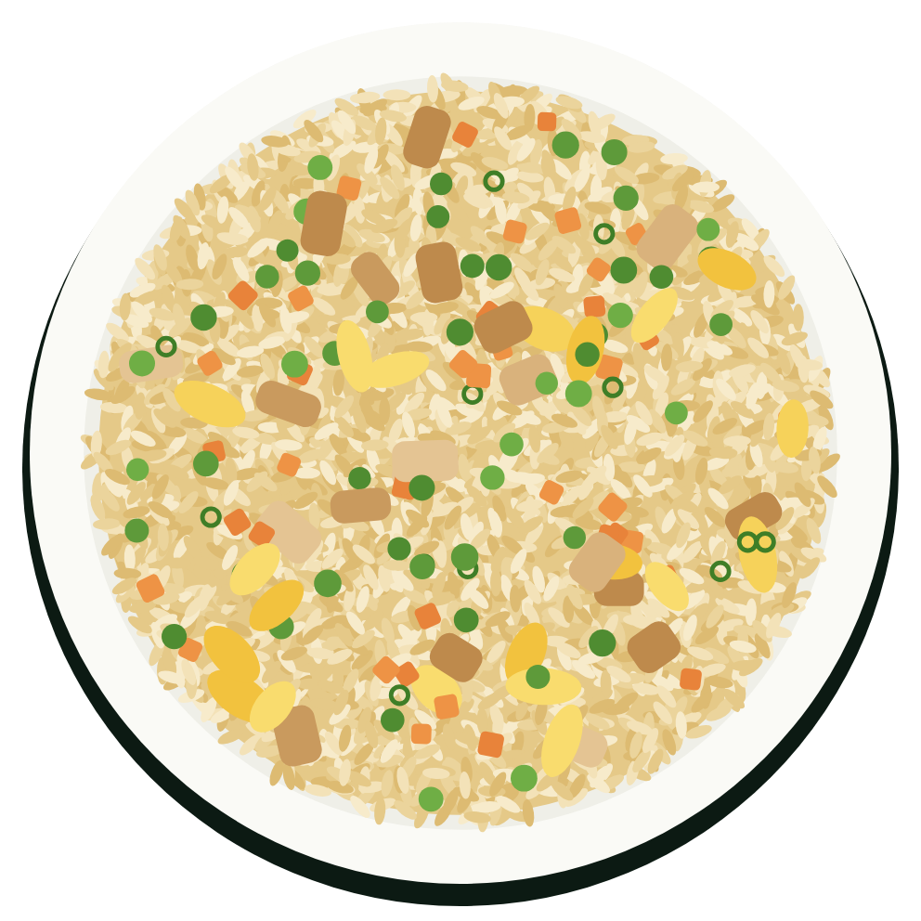
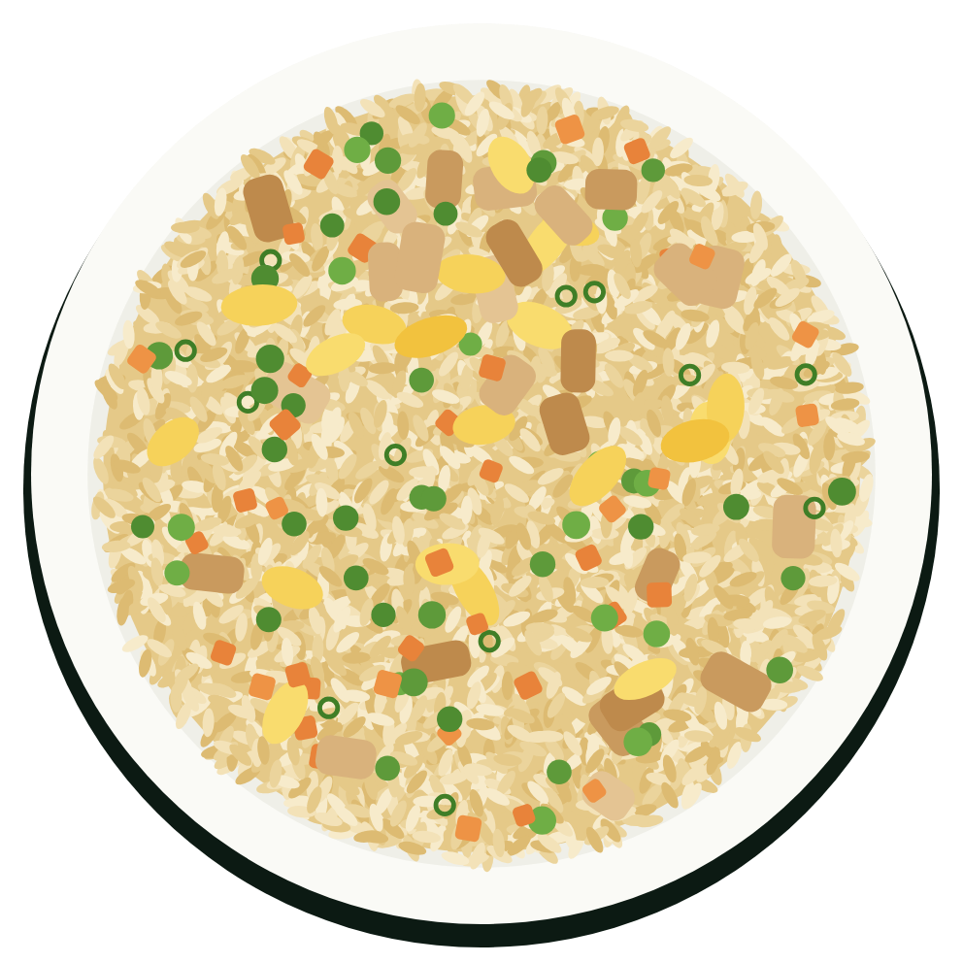
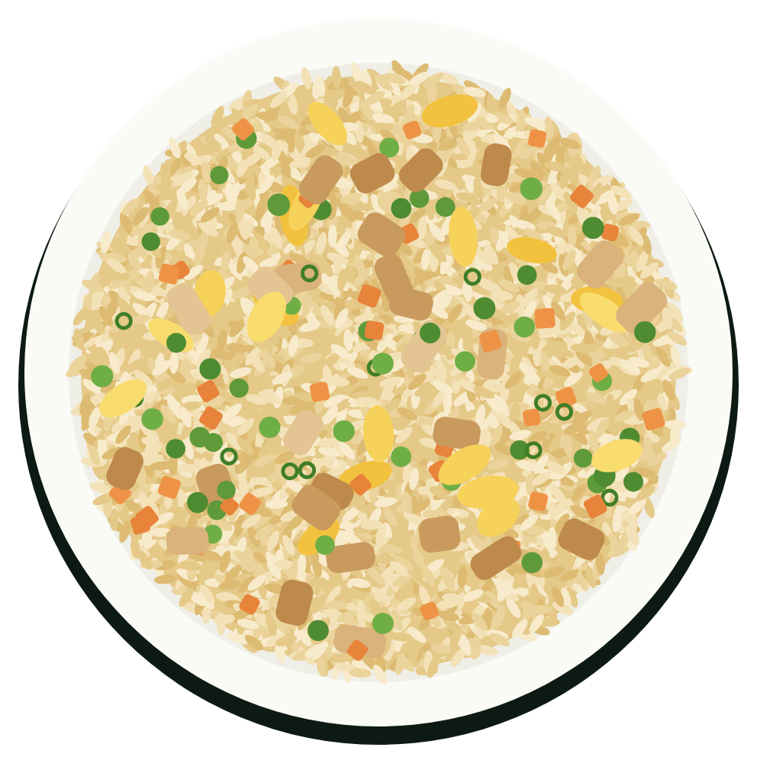
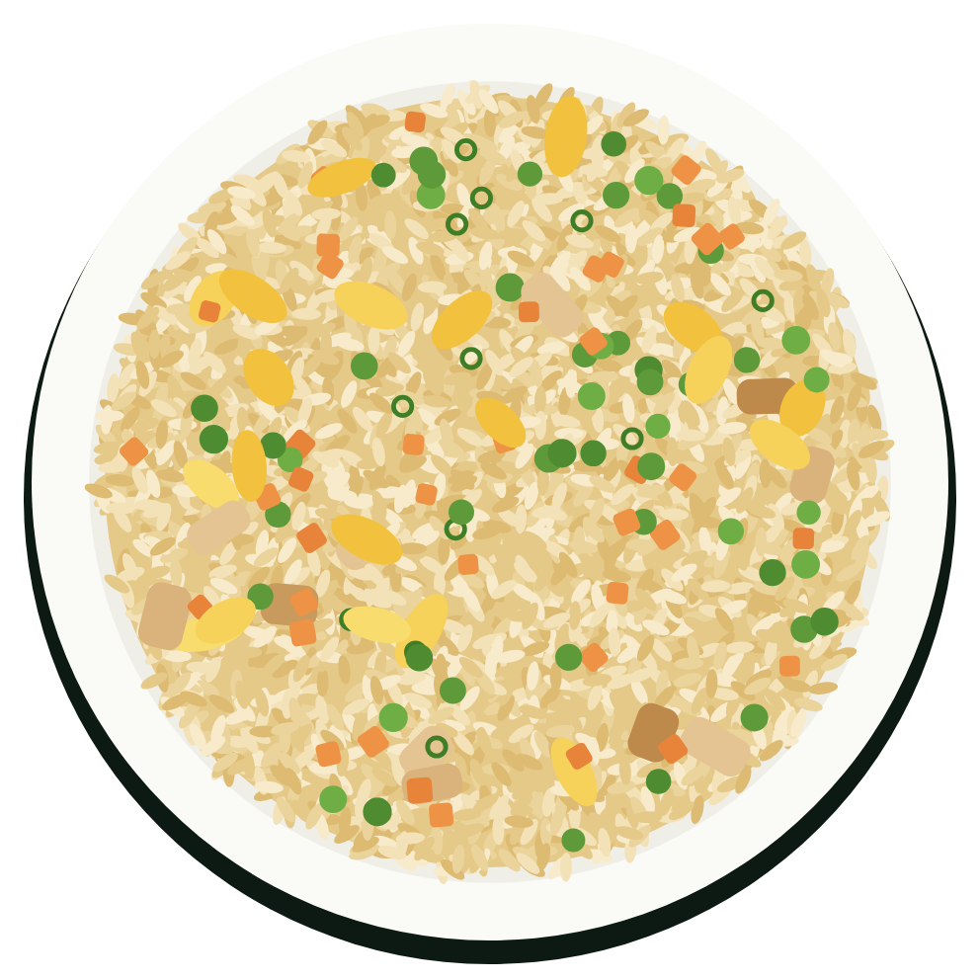




One craving, sized to four different people
EXECUTIVE SUMMARY
Four agents and 34 curated recipes size the same chicken fried rice for each person, with no LLM key needed.
363 kcal
26 g protein
Older woman,
losing weight
694 kcal
48 g protein
Active woman,
maintaining
809 kcal
60 g protein
Average man,
maintaining
850 kcal
63 g protein
Large athlete,
gaining
Sized to you
Your body, a trained exercise model and your goal set a daily budget, then this meal's target.
Fits your limits
Allergies, diets and health conditions rule out recipes or swap ingredients before a meal is picked.
Balanced and checked
Portions are resized toward target macro ranges, and each ingredient shows its source.
Ready to shop
Ingredients map to store items or category prices, with an estimated total.
0.4%
median gap to the meal target, worst 9.9%
5 of 5
guardrail cases hold, including refusals
72 of 72
benchmark plans on target, up from 10
$24.50
estimated basket, not a cost per meal
P8 pending
Note: the project's own offline test, not real users. 11 of the 72 are fallback meals; guardrails use a controlled recipe set. Meal targets stay within 350–850 kcal. Plate area shows calories.
Notes:
If you read one slide, read this one.
[Point: four plates]
This is the same craving for four people. It runs from 363 kcal for an older woman losing weight to 850 for a large athlete gaining, so the meal fits the person. Meal targets stay within 350 to 850 kcal, so the first and last plates sit at those limits.
[Point: 72 of 72]
That quality is measured: all 72 plans in the project's own benchmark meet the targets, up from 10.
[Point: Balanced and checked]
Four features do that work, and it stays honest: estimates are labelled, and it says so when nothing matches.
The rest of the deck shows how it works and how that number was reached.
Reference — not read aloud
docs/meal_quality/baseline.json, chicken fried rice rows; fact sheet, docs/showcase/README.md; docs/7_meal_quality.md §2. These are a measure of plans, not of real users.

Slide 3

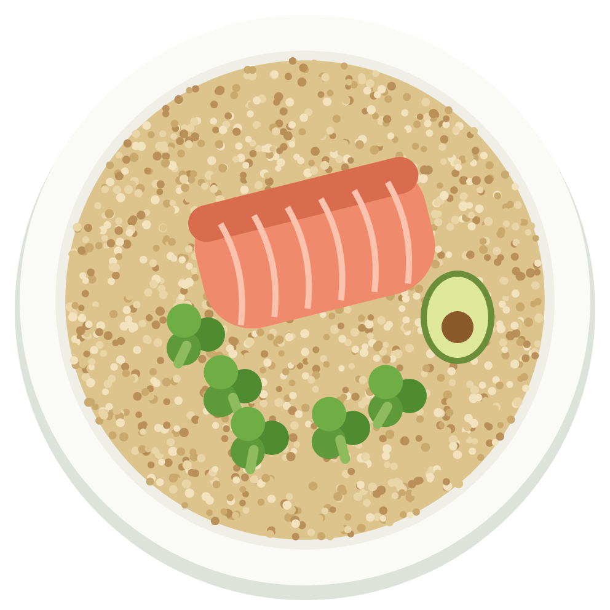



Today's menu: four courses, from the problem to the limits
AGENDA
Each course lists its pages by label. Select one to jump to it.
STARTER
Problem
Why is this worth solving?
Why it matters
4
MAIN
Solution
What does it do, and how?
The flow
5
Four agents
6
Calorie target
7
Choosing the meal
8
Nutrition
9
TASTE TEST
Evidence
Did we get there?
What good means
10
Results
11
THE BILL
Build and limits
What is unproven?
Architecture
12
Engineering
13
Limits
14
Pending tasks
15
Notes:
This deck is served as a four-course menu.
[Point: Starter]
First, why this is worth solving.
[Point: Main]
Then what it does and how it works.
[Point: Taste test]
Then what a good meal means, and whether it got there.
[Point: The bill]
Last, how it's built, what isn't proven yet and what's still pending.
Each page is a link, so you can jump straight to it.

Slide 4
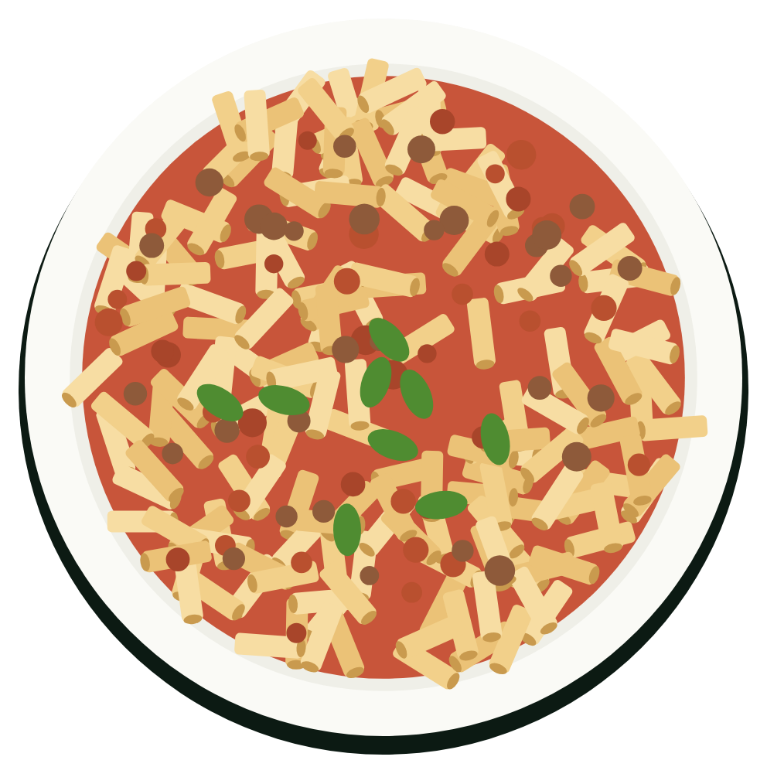



Picking a meal is easy; sizing it to you is not
PROBLEM > WHY IT MATTERS
Three questions sit between a craving and a meal you can trust.
One request answers all three.
1
The range is almost fourfold
The largest daily budget is 3.8 times the smallest, so one recipe size can't fit everyone.
Limits change the meal itself
Portions aren't enough. A limit can change the recipe or swap an ingredient.
Today is our framing
The Today chips describe the problem as this project sees it. They aren't survey results.
I feel like pasta tonight.
How much?
Daily budgets in our benchmark run from 1,200 to 4,521 kcal.
TODAY
Guess from "serves 4"
1
2
WITH THE APP
A budget, then a meal target
3
Is it right for me?
Asked for pasta, a vegan gets lentil bolognese and a coeliac gets gluten-free pasta.
TODAY
Read every label
2
WITH THE APP
Conflicts ruled out or swapped first
What do I buy?
This one pasta means five ingredients to find and price.
TODAY
Write a list, guess the cost
WITH THE APP
A list with an estimated total
Notes:
Most of us know what we feel like eating. The hard part comes after that.
[Point: How much?]
The right amount depends on the person. Across the four benchmark profiles, daily budgets run from 1,200 to 4,521 kcal.
[Point: Is it right for me?]
The same request changes with your limits. A vegan gets a different recipe, and a coeliac keeps the recipe with gluten-free pasta.
[Point: What do I buy?]
This one pasta means five ingredients to find and price.
[Point: Today, With the app]
Each question has a manual habit today, and each card shows what the app does in its place.
The next section shows how one request answers all three.
Reference — not read aloud
The three questions and the Today lines are the project's framing, from docs/1_brief.md, not research findings. Budgets: docs/meal_quality/baseline.json. Pasta examples: a local run of the craving "pasta" for the average man, 7 November 2026, no provider keys.

Slide 5
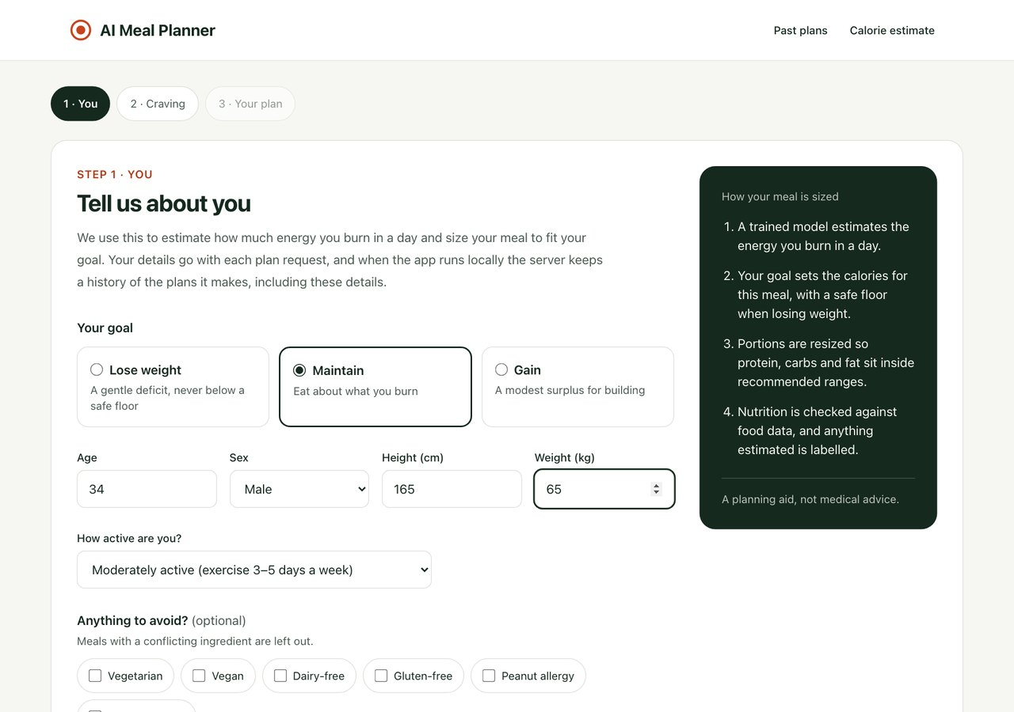
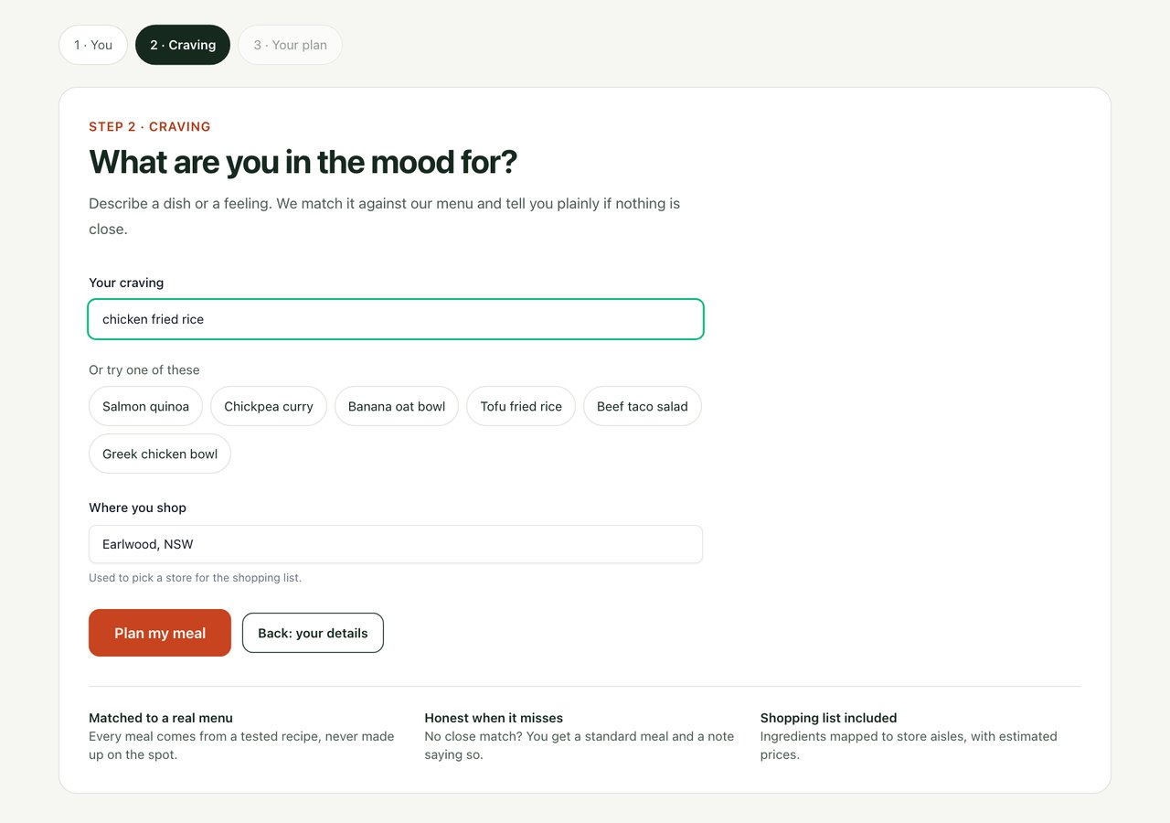
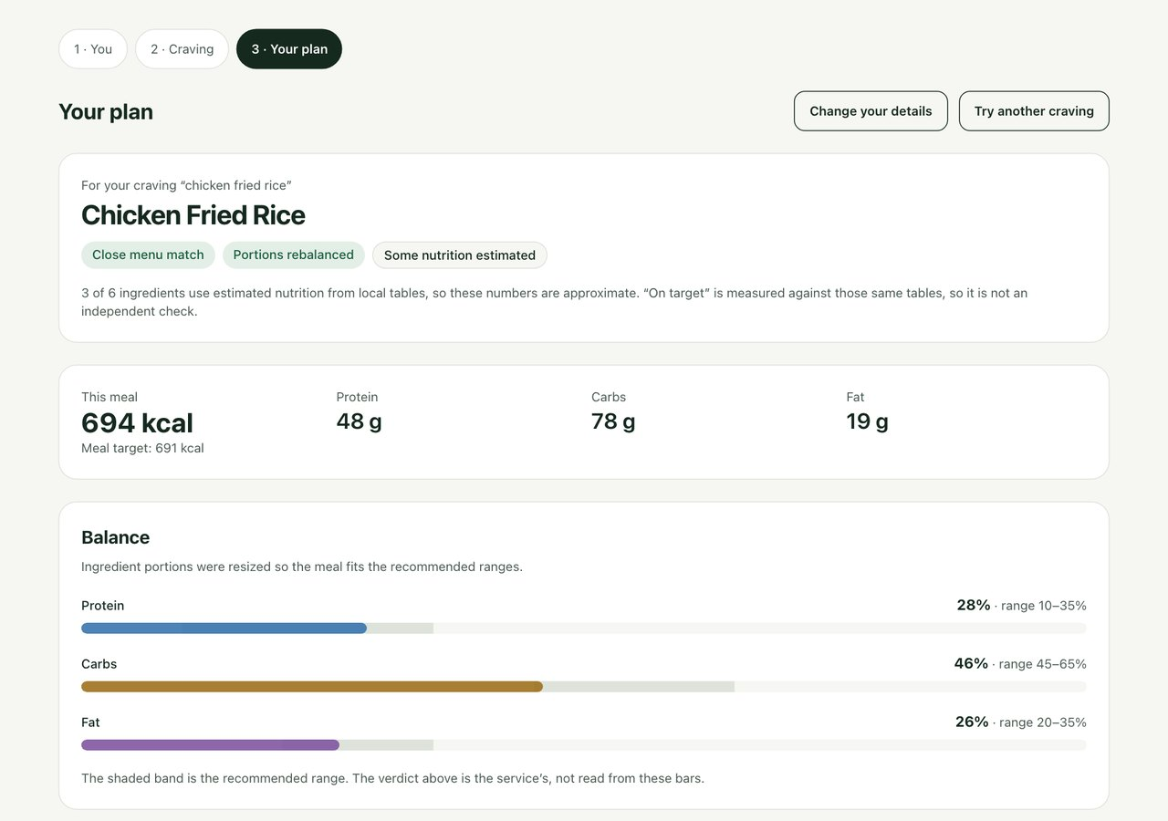


One craving in, one meal and a shopping list out
SOLUTION > THE FLOW
Three steps in the React app.
1
Two screens, then a result
Everything the planner needs fits on the first two steps, then the result is one page.
The plan shows its working
Balance, ingredient sources and estimates sit on the result page, not behind a menu.
2
1
2
1. You
Goal, body details, activity and anything to avoid.
2. Craving
Say what you feel like eating and where you shop.
3. Your plan
One meal, its balance, each ingredient's source and a shopping list.
34, male, 165 cm, 65 kg
chicken fried rice
694 kcal, target 691
Figure 1. Real captures of the React app, run locally with no provider keys, 6 November 2026.
Notes:
This is the real React app, in three steps.
[Point: You]
You enter your body, goal and anything to avoid.
[Point: Craving]
You say what you feel like eating and where you shop.
[Point: Your plan]
You get one meal, its balance, each ingredient's source and a shopping list. The badges say how it matched and what is estimated.
Next, what happens behind these screens.
Reference — not read aloud
Captured 6 November 2026 from a local run with no provider keys: slides/captures/2026-11-06-plan.json. frontend/src/features/flow/MealFlow.jsx.

Slide 6

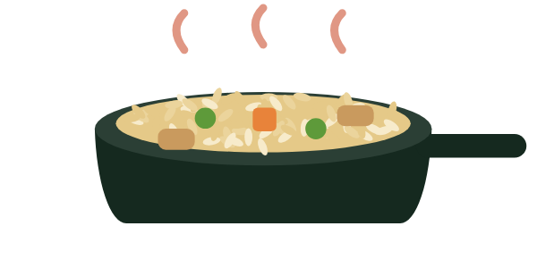


Four agents work like one kitchen
SOLUTION > FOUR AGENTS
An order comes in, each station does one job, and a planning service runs them in order.
ORDER chicken fried rice, active woman, maintaining
1
One job per station
Each agent does a single task, so it can be tested and changed on its own.
Retrieval, not generation
Meals come from 34 curated recipes, so the core path needs no LLM key, and offline the same request gives the same plan.
1
1
2
2
THE PORTION PLANNER
Calorie expenditure
Estimates what you burn in a day and sets your budget.
THE CHEF
Meal recommendation
Sets the meal target, rules out conflicts, picks a recipe and sizes it.
2
2,469 kcal budget
691 kcal target
4
3
THE SHOPPER
Supermarket
Matches ingredients to store items or category prices.
THE TASTER
Nutrition verification
Looks up each ingredient and labels what is estimated.
$24.50 estimated
694 kcal, 3 of 6 estimated
One typed JSON response: meal, nutrition, shopping list and warnings
Note: white labels show the active woman's real plan. The service balances portions after verification.
Notes:
Behind the screens is a FastAPI service, and it works like a kitchen.
[Point: The portion planner]
The calorie agent sets a daily budget.
[Point: The chef]
The recommendation agent sets the meal target, excludes conflicting meals and picks a relevant recipe.
[Point: The taster]
The nutrition agent looks up each ingredient and labels estimates.
[Point: The shopper]
The supermarket agent matches ingredients to store items or category prices, with an estimated total.
[Point: white labels]
The white labels follow one real order: a 2,469 kcal budget, a 691 kcal target, 694 kcal served and a $24.50 estimated basket.
The meal comes from retrieval, not generation, so the core path needs no LLM key.
Reference — not read aloud
docs/2_architecture.md; docs/agents/; MealPlanningService. The kitchen roles are a metaphor for the agents.

Slide 7


From your body to a meal target
SOLUTION > CALORIE TARGET
Worked example: an active woman who is keeping her weight gets a 691 kcal target for this meal.
Body and activity
Exercise
2
3
1
The model is a small part
It adds about 110–140 kcal in these plans, 3–10% of the day. Its R² of 0.996 and 2.2 kcal error describe exercise calories only.
A floor protects low budgets
Weight-loss budgets stop at 1,200 kcal for women and 1,500 for men. One test profile would otherwise get 986 kcal.
28% is a design choice
It keeps meals in proportion, but the cap holds a large athlete's meal to 19% of the day.
Goal
This meal
Size and activity give a daily estimate.
A trained model adds exercise calories.
Gain +250, lose −400, with a floor.
28% of the budget, within 350–850 kcal.
P5 pending
2
2,344 kcal
+125 kcal
2,469 kcal
691 kcal
Her day and this meal, on one scale
Daily budget: 2,469 kcal
+125 kcal from the model
3
2,344 kcal from body and activity
1
This meal: 28% of the day
691 kcal
Scale: full width is 2,469 kcal.
Note: in the meal flow, exercise inputs use defaults (30 minutes, 100 bpm), and the activity multiplier may already count that exercise.
Notes:
How does it decide how much? It's a short calculation, and this follows one real person through it.
[Point: Body and activity]
Body size and activity give about 2,344 kcal a day.
[Point: Exercise]
The trained model adds 125 kcal of exercise.
[Point: Goal]
Her goal is to maintain, so nothing changes, and her budget is 2,469 kcal.
[Point: This meal]
One meal gets 28% of that, which is 691 kcal.
[Point: Bars]
The bars show how small the model's share is. Its high score is for exercise calories only, and in these plans it adds about 110 to 140 kcal.
The exercise inputs are defaults, and the activity multiplier may already count that exercise.
Reference — not read aloud
Local run, 7 November 2026: expenditure less BMR × activity is 142, 115, 125 and 108 kcal across the four profiles, 3–10% of expenditure. metrics.json; calorie_expenditure_agent.py; meal_recommendation_agent.py; DEC-24; docs/8_design.md §3.1. The 28% share is a design choice.

Slide 8


Hard limits first, then a relevant recipe
SOLUTION > CHOOSING THE MEAL
A vegan asks for chicken fried rice: the recipes narrow down to one, and the app ends in one of three ways.
Recipes left at each step
1
Safety comes before taste
A recipe that breaks a limit is out, or adapted with a safe swap, before relevance counts.
Relevance decides what qualifies
An off-menu craving falls back with a warning. Your profile only changes the order.
All recipes
34
Safe for a vegan
13
1
2
Relevant to the craving
5
Served
1: Tofu Fried Rice
Close match
2
No close match
Nothing safe
Or a safe swap
“chicken fried rice” gets that recipe, sized to you.
“pizza” gets a standard meal and a note saying so.
Too many limits: the plan is refused, not guessed.
A coeliac who asks for pasta keeps the recipe, made with gluten-free pasta. A limit doesn't always cost you the meal.
61 of 72
benchmark plans
11 of 72
benchmark plans
2 of 5
guardrail cases
P6 pending
Note: refusals were tested on a controlled recipe set. None of the 72 benchmark plans was refused.
Notes:
This is how it picks the meal, using one real request.
[Point: Funnel]
A vegan asks for chicken fried rice. Of 34 recipes, 13 are safe, 5 are relevant to the craving, and one is served: Tofu Fried Rice.
Safety comes first, so a recipe can't win on relevance alone. Limits can also swap an ingredient rather than drop the recipe.
[Point: Outcomes]
There are three possible endings: a close match, a standard meal with a note, or a refusal.
Reference — not read aloud
Local run, 7 November 2026: backend/app/rag/retriever.py, TF-IDF at 34 recipes, relevance threshold 0.16. DEC-27. Counts: docs/meal_quality/baseline.json. Refusals come from the guardrail cases, on a controlled recipe set; none of the 72 plans was refused.

Slide 9


Each ingredient is looked up, and estimates are labelled
SOLUTION > NUTRITION
Example: chicken fried rice from a real local run, with no USDA or FatSecret keys.
Where the 694 kcal come from
Estimates carry 66% of the calories
Only 3 of 6 ingredients are estimates, but they include chicken and rice, the biggest items.
Reference still means local
With no provider keys, a plan's target check isn't an independent verification.
Ingredient | Amount | kcal | Source
Chicken breast | 100 g | 165 | Estimated
Cooked rice | 220 g | 286 | Estimated
Whole egg | 50 g | 72 | Reference
Vegetables | 115 g | 75 | Reference
Soy sauce | 15 g | 8 | Estimated
Sesame oil | 10 g | 88 | Reference
1
1
459 estimated
235
66% estimated, 34% reference
Lookup order
2
1. Trusted local reference
2. USDA, then FatSecret, if keys are set
2
P4 pending
3. Local or category estimate
Figure 1. A real plan: 694 kcal against a 691 kcal meal target.
Notes:
Can you trust the numbers? Each one shows where it came from.
[Point: Source column]
This is a real plan. Three of its six ingredients are estimates, and the app says so.
[Point: Stacked bar]
Those three carry about two thirds of the calories, because chicken and rice are the biggest items.
[Point: Lookup order]
A trusted local reference comes first. Otherwise it tries USDA and then FatSecret, if keys are set, and last a local or category estimate.
A reference value isn't an external verification either, so the plan's totals are approximate.
Reference — not read aloud
backend/app/agents/nutrition_verification_agent.py. Local run, 7 November 2026: 459 kcal estimated, 235 kcal reference, 694 kcal in all, against a 691 kcal target.

Slide 10
We defined a good meal before improving one
EVIDENCE > WHAT GOOD MEANS
A plan passes only if it clears both tests, on a fixed set of 72 requests run offline.
Test 1
Within 10%
of the meal's calorie target
1
Calories weren't the hard part
At the first run 68 of 72 plans were within 10%, but only 10 cleared both tests.
Fixed requests make runs fair
The same 72 requests run every time, offline, so each change can be measured.
Test 2 Share of the meal's energy
1
Protein
Allowed 10–35%
28%
2
Carbs
Allowed 45–65%
72 fixed requests
2
46%
Fat
Allowed 20–35%
26%
12 cravings × 4 body profiles
6 cravings × 4 limits
White dots: chicken fried rice for the active woman.
Limit: AMDR is a daily reference, applied here to one meal.
Notes:
Before changing anything, I fixed what good means. A plan has to clear two tests.
[Point: Within 10%]
First, calories have to land within 10% of the meal's target.
[Point: Macro bands]
Second, each macro has to sit inside the adult AMDR range, as a share of the meal's energy. The dots show one real plan.
[Point: 72 requests]
It runs on the same 72 requests every time, so results can be compared.
One limit: AMDR is a daily reference, applied here to one meal.
Reference — not read aloud
docs/7_meal_quality.md §1; DEC-25. Example plan: docs/meal_quality/baseline.json, 28/46/26%.

Slide 11
Three fixes took the planner from 10 to 72 of 72
EVIDENCE > RESULTS
Plans meeting both targets on the project's own benchmark, and what each fix changed.
Plans meeting the targets, out of 72
1
61 plans match; 11 are fallbacks
Both pass, but the 41 to 47 step came from those 11 moving to fallback meals, not better meals. 8 of them are pizza and dessert.
68 of 72 include an estimate
The benchmark runs without provider keys, so these plans aren't USDA-verified.
Tuned on these 72
Asked for by name, recipes passed only 49 of 68 until a further fix made it 68 of 68. Neither shows that users prefer the plans.
72
2
47
41
1
2
10
3
First run
Before any fix
Portion balancing
Each ingredient resized
Honest fallback
Off-menu cravings moved
Cooking fat, rounding retry
Oil added to 6 recipes
3
0.4%
5 of 5
68 of 68
median calorie gap, worst 9.9%
guardrail cases hold
wider check: every recipe by name
Notes:
The first run passed only 10 of 72.
[Point: Portion balancing]
Resizing each ingredient toward the ranges took it to 41, with the same meals.
[Point: Honest fallback]
The relevance gate moved 11 off-menu requests to fallback meals, which took it to 47. That rise comes from moving requests, not from better meals.
[Point: Cooking fat and rounding retry]
Adding a fat to six recipes, and a retry after rounding, took it to all 72.
[Point: 68 of 68]
The fixes were tuned on these 72, so I also asked for every recipe by name. Only 49 of 68 passed, so a further recipe fix took it to 68 of 68.
This shows plans meet the targets. It doesn't show that people prefer them.
Reference — not read aloud
docs/7_meal_quality.md §2; docs/meal_quality/baseline.md; DEC-26 to DEC-30; scripts/meal_quality_baseline.py --wider, 7 November 2026.

Slide 12



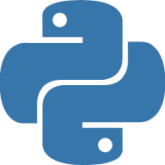








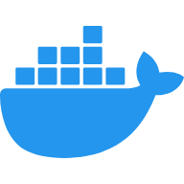




One service, two clients, four agents
BUILD AND LIMITS > ARCHITECTURE
A request flows left to right. Each box names the model, data or tool behind it.
CLIENTS
API
PLANNING SERVICE
1
One contract, two clients
Streamlit and React use the same planning service, so the logic lives in one place.
Small models, no GPU
The one trained model is 0.64 MB, and TF-IDF is enough for 34 recipes.
Balancing comes after lookup
Portions are solved on looked-up numbers, then the shopping list is written from the final amounts.
1
MealPlanningService
2
FastAPI
Typed JSON, API keys, rate limits
Calorie expenditure
Trained HistGradientBoosting model
Streamlit demo
Live and public
2
Meal recommendation
TF-IDF search of 34 recipes, diet rules
Nutrition verification
Local tables; USDA, FatSecret with keys
3
SQLite
Local history, via SQLModel
Balance and reconcile
A service step: linear programme for portions
3
React app
Guided flow, run locally
Supermarket
Local store items and category prices
P2 pending
BUILT WITH
P3 pending
Python
Docker
GitHub Actions
Cloud Run
OpenTelemetry
Gemini
Note: the hosted demo runs the same service inside Streamlit. Gemini is optional and off by default. Logos belong to their owners.
Notes:
This is the whole system on one page.
[Point: Clients]
There are two clients: the live Streamlit demo and a React app.
[Point: FastAPI]
They share one typed FastAPI contract, with API keys and rate limits.
[Point: Planning service]
A planning service runs the four agents in order.
[Point: Models and data]
Each agent has its own source: the trained model, the recipe corpus, the nutrition tables and the store reference.
[Point: Built with]
The bottom row is the delivery stack.
The hosted demo runs the agents inside Streamlit, and Cloud Run is ready but not deployed.
Reference — not read aloud
docs/2_architecture.md; pyproject.toml; frontend/package.json; backend/app/services/meal_planning_service.py; DEC-2. Logos: slides/assets/logos/NOTICE.txt.

Slide 13





Built like a product, not a notebook
BUILD AND LIMITS > ENGINEERING
Six production habits, in the order a change travels through them, each with a file behind it.
From a change to production
Runs today
1
CI stops drift
Tests, the API contract and the dependency file are checked on every pull request, so they can't quietly fall out of step.
Built is not the same as live
Cloud Run is ready, but no GCP project exists yet, so it hasn't run for real.
Privacy is tested, not promised
A test proves health data stays out of traces. A real trace still has to arrive in Cloud Trace.
Built, waiting for a GCP project
2
3
Contract
CI fails on any drift
Tests
630 Python tests
Security
API keys, rate limits
Container
One Docker image
Cloud Run
Ready, not live
Tracing
Health data kept out
2
docs/openapi.json
backend/tests/
api/auth.py
Dockerfile
deploy.yml
core/telemetry.py
P3 pending
P3 pending
3
630
95%
1
5 CI checks on every pull request
Python tests, all passing
test coverage
backend (Python 3.11)
backend (Python 3.12)
requirements drift
538 backend
92 Streamlit
CI fails below the 89% floor
frontend
container
Notes:
Although this is a portfolio project, I held it to production habits. Follow a change from left to right.
[Point: Contract]
The API contract is committed, and CI fails if it drifts.
[Point: Tests]
The last full run passed 630 Python tests at 95% coverage, and CI won't pass below 89%.
[Point: Cloud Run]
From here the line turns amber: the deployment workflow and tracing are built, but they wait for a GCP project.
[Point: CI checks]
Five checks run on every pull request, and all five passed on the latest one.
Reference — not read aloud
docs/openapi.json; .github/workflows/ci.yml and deploy.yml; docs/6_deployment.md; backend/tests/test_telemetry_redaction.py; local full run, 7 November 2026: 538 backend and 92 Streamlit tests.

Slide 14

What this project does not prove yet
BUILD AND LIMITS > LIMITS
The further right, the less has been shown.
How far the evidence goes
Each step up is less proven.
3
1
What is solid
Plans hit their targets on fixed requests, and the run can be repeated.
What is soft
Most plans lean on estimates. Name matching missed soy sauce until this review.
What is unknown
Nobody has used it, so targets say nothing yet about taste or health.
Not tested
No user testing
No clinical review
Not deployed
No database migrations
Taste and health outcomes unknown
2
2
Estimated
68 of 72 plans include an estimate
AMDR is a daily range on one meal
Default exercise inputs
Diet rules match ingredient names
1
3
Measured
72 of 72 and 68 of 68, offline
But the checks guided the fixes
11 of 72 fall back
P9 pending
A planning aid, not medical advice.
Notes:
These are the limits, arranged by how far the evidence goes. Each step up is less proven.
[Point: Measured]
The plans hit their targets on fixed requests. That's solid, but the checks also guided the fixes.
[Point: Estimated]
A lot of what's inside those plans is estimated or assumed.
[Point: Not tested]
Nobody has used it, it isn't deployed, and no clinician has reviewed it.
It's a planning aid, not medical advice.
Reference — not read aloud
docs/4_next_steps.md §7; docs/7_meal_quality.md; DEC-31; AGENTS.md, Open risks.

Slide 15
Pending tasks, in priority order
BUILD AND LIMITS > PENDING TASKS
Each paper tag in this deck points to one of these notes.
NOW
NEXT
LATER
1
Fix what visitors see first
A demo that fails on first use undoes everything else, so it leads the board.
Accuracy before scale
Better inputs and allergen tags come before more recipes.
People matter most
Only testing with people can show that the plans help.
P1 pending
1
P4 pending
2
P7 pending
3
Turn on demo mode
Run the benchmark with USDA keys
Grow to 75–100 recipes
2
P2 pending
P5 pending
P8 pending
3
Add database migrations
Ask for real exercise details
Connect live store prices
P3 pending
P6 pending
P9 pending
Deploy to Cloud Run
Tag allergens on ingredients
Use feedback, test with people
Note: the full checklist is in docs/showcase/pending-tasks.md.
Notes:
This board is the work still open, in the order I'd do it.
[Point: Now]
First, make the demo work on first use, add migrations and deploy.
[Point: Next]
Then better inputs: real nutrition data, real exercise details and proper allergen tags.
[Point: Later]
Then scale: more recipes, live prices, and testing with people.
Reference — not read aloud
docs/showcase/pending-tasks.md; docs/4_next_steps.md §6 and §7.

Slide 16
Try it and read the code
tuannm3812-ai-meal-planner.streamlit.app
github.com/tuannm3812/ai-meal-planner
A multi-agent meal planner, a portfolio project by Mike
A study project. Not medical advice.
Scan to try the live demo
The demo is the Streamlit client and may take a minute to wake.
P1 pending
Notes:
That's AI Meal Planner: one craving in, one meal sized to you, with each ingredient's source shown.
[Point: QR code]
The demo and code are here.
Reference — not read aloud
README.md.

