Slide 1
PORTFOLIO PROTOTYPE
Text-to-SQL agent
Ask a database a question in plain English, get read-only SQL you can check, and see exactly what the model was given.
SQLite, DuckDB and PostgreSQL local Ollama or hosted Gemini
Evaluated on Spider, BIRD and a 1,222-question large-schema suite
Manh Tuan Nguyen November 2026
Notes:
This is a text-to-SQL agent: you ask a database a question in plain English, and it answers with SQL you can read and a result you can check.
[Point: Text-to-SQL agent]
It works with SQLite, DuckDB and PostgreSQL, with a local or hosted model, and I have evaluated it on two public benchmarks and a large-schema suite I built.
Reference — not read aloud
Cover. A portfolio prototype, refined since the May 2026 UTS group project. Numbers in this deck are from the README's Evaluation Results at f3a4e93 and AGENTS.md's current state (2026-11-05).

Slide 2
EXECUTIVE SUMMARY
Accurate enough to demo, measured enough to trust the numbers
Where the agent stands on 5 November 2026, and what the October work established
What it is
A question becomes one read-only SELECT, checked by the application and run under each engine's own read-only mode. Answers show the rows, the SQL and the schema text sent. Result rows never reach the model.
How well it answers
64.6 % on Spider dev and 35.2 % on BIRD dev with evidence, with a local 9B model and 95 % intervals on every figure.
What October established
On 21- to 65-table databases, sending the top 6 tables scored +3.6 points over full DDL plus hints, with 69 % fewer prompt tokens. Five later ideas were measured; none was a measurable accuracy gain.
What is next
Gemini under the same contract, hint coverage beyond the 20-value ceiling, and recovering the 128 questions whose needed table is not sent.
Text-to-SQL agent
‹#›
Notes:
Here is the whole story on one slide before the detail.
[Point: What it is]
The model only proposes one read-only query; the application decides whether it runs.
[Point: How well it answers]
With a small local model it answers about two in three Spider questions, and every figure carries an interval.
[Point: What October established]
The October work found where choosing tables pays, and tested five more ideas honestly: none of them was a measurable accuracy gain.
[Point: What is next]
Next is the hosted model under the same rules, and the questions whose tables we miss.
Reference — not read aloud
Executive summary. Sources: README (What It Does, Evaluation Results, Large schemas); AGENTS.md 2026-11-04 and 2026-11-05 entries.

Slide 3
CONTEXT > PROBLEM
Useful answers need checkable SQL and a database that cannot change
The problem, and exactly what is sent to the model
WHAT THE MODEL SEES
1
The model sees structure
Names, types, keys and DDL, plus a few category values so it can spell a filter. That is enough to write SQL without reading the data.
Metadata, not data
Rows stay local. The one feature that would send stored values matching the question was measured and kept off.
Schema metadata
Table and column names, types, keys, CREATE TABLE DDL
sent
1
Value hints
Up to 6 frequent values of text columns with at most 20 distinct values; a cut list says so
sent, bounded
1
2
Question value matching
Stored values matching words in the question, from any text column
built, off
2
Result rows
The answer's rows
never sent
2
Text-to-SQL agent
‹#›
Notes:
This slide is about the problem and, just as important, what the model is allowed to see.
[Point: Schema metadata]
The model gets the structure of the database: names, types, keys and the table definitions.
[Point: Value hints]
It also gets a few common category values, so it can spell a filter correctly.
[Point: Result rows — never sent]
It never sees the rows of an answer, and a feature that would send matching stored values stays switched off, because it did not measurably help.
Reference — not read aloud
Problem and what the model sees. Source: README, What It Does. Value hints are row-derived but bounded: up to six of the most frequent values of text columns with at most 20 distinct values, labelled when the list is cut (fe90991). Question value matching is built, measured on bird_train_large (+0.4 [-0.9, +1.6]) and off by the owner's decision of 2026-10-19.

Slide 4
SYSTEM > ARCHITECTURE
The model proposes the SQL; the application decides whether it runs
One question, five steps, from schema to answer
1
2
1
Selection is the only model-facing choice
Which tables the model sees is decided before generation, and the app reports which were picked and why.
Execution authority stays in Python
Unsafe SQL is refused before any database call; a failed safe query gets one repair attempt.
Schema
One chunk per table: DDL, keys, value hints
Select
BM25, name matches, trigrams; top 6 plus foreign-key neighbours
Generate
Question and that schema to Ollama or Gemini; one statement back
Check
AST check in the dialect, then the engine's read-only mode, a work budget and a row cap
Show
Rows, a chart where it fits, the SQL, the selection report
2
One repair try
If a safe query fails to run, the error goes back to the model once
Text-to-SQL agent
‹#›
Notes:
Now how one question becomes an answer, left to right.
[Point: Select]
The only choice that shapes what the model sees is which tables to send: the top six plus their neighbours.
[Point: Generate]
The model writes one statement.
[Point: Check]
Then the application, not the model, decides: a parser check first, then the engine's own read-only mode.
[Point: One repair try]
If a safe query fails, the error goes back once for a repair.
Reference — not read aloud
Architecture. Source: README, Architecture and Schema RAG; docs/2_architecture.md. Scorer weights chosen 2026-10-21 on bird_train_large (text_to_sql_agent/config.py). A dense-embedding signal exists but is off by default.

Slide 5
SYSTEM > SAFETY
Two independent read-only guarantees on every engine
What the application checks, what each engine enforces, and how it is tested
Engine
Application check
Engine guarantee
1
Each guarantee holds alone
The same conformance suite runs on every engine with no skips allowed; neither the parser nor the engine is trusted by itself.
Refusing is measured too
The model declined every write request. Internals requests came back as unanswerable rather than refused, and the gate still blocked them.
Scope: safety accuracy 73.3 % [53.3, 93.3] on 15 cases.
SQLite
one SELECT or WITH, parsed in this dialect; internals blocked
read-only URI, query_only, an authorizer denying writes, attach and pragmas
1
DuckDB
one SELECT or WITH, parsed in this dialect; internals blocked
opened read_only with external access off
PostgreSQL
one SELECT or WITH, parsed in this dialect; internals blocked
least-privilege role in a read-only transaction; refuses to connect as a superuser
2
2
45 / 0
conformance tests passed / skipped, 15 per engine
1,870
tests passed against live PostgreSQL 16, 4 Nov
6 / 6
data-change requests refused on the safety suite
1
Text-to-SQL agent
‹#›
Notes:
Safety rests on two guarantees that each hold by themselves.
[Point: Application check]
The application parses the SQL in the engine's dialect and refuses anything but a single read.
[Point: Engine guarantee]
Each engine is also opened so it cannot write, whatever the SQL says.
[Point: 45 / 0]
One conformance suite runs on all three engines, with no skips allowed, and it passed against a live PostgreSQL server on the fourth of November.
[Point: 6 / 6]
On the safety suite the model declined every request to change data. The overall safety score is 11 of 15, so this is a small suite.
Reference — not read aloud
Safety. Sources: README Safety Model; docs/0_coding_standards.md section 3 and 4; engines/duckdb.py (read_only plus enable_external_access=False). Live PostgreSQL 16 in Docker on 2026-11-04: 1,870 passed / 6 skipped with the DSN; conformance 45 / 0 skipped, 15 per engine (AGENTS.md). Safety suite 2026-10-10: 11 of 15 correct, 73.3 % [53.3, 93.3]; all 6 data-change requests refused; 3 internals requests declined as unanswerable, not counted correct.

Slide 6
EVALUATION > METHOD
Every reported number comes from a citable, paired run
The contract behind the results, and the suites it runs on
Suite
Questions
1
Typed result comparison
EX compares result sets by type, not SQL text
1
Comparisons, not single scores
Each change is judged paired on the same questions against a named baseline, so small effects are not read from separate intervals.
A suite built for the question
Spider and BIRD dev have too few tables to show whether choosing tables helps, so a large-schema suite was built from BIRD train.
Note: EX here is this contract's typed comparison, not each benchmark's scorer.
Spider 1.0 dev
≤ 14 tables per database
1,034
BIRD dev
with and without evidence hints
1,534
95 % bootstrap intervals
over cases, on every rate
2
bird_train_large
4 databases of 21 to 65 tables
1,222
2
demo
the 3 demo databases
12
A manifest per run
commit, suite and database hashes, prompt hash, model, settings
safety
refusals and unanswerables
15
Paired comparisons
two runs differing in one setting, same questions
Text-to-SQL agent
‹#›
Notes:
Before the results, how they were measured.
[Point: Suite]
Two public benchmarks, Spider and BIRD, and a large-schema suite built from BIRD's training set, because the public dev sets have too few tables to test table selection.
[Point: Typed result comparison]
An answer counts as right when its result matches the reference result, not its SQL text.
[Point: Paired comparisons]
And every change is compared on the same questions against a named baseline, so small differences are not read off two separate intervals.
Reference — not read aloud
Evaluation method. Source: docs/superpowers/specs/2026-10-08-evaluation-contract-v2-design.md; README Evaluation Results; evaluation/results/bird_train_large/README.md. scripts/evaluate_v2.py --compare pairs runs that differ in one setting.

Slide 7
RESULTS > STANDARD BENCHMARKS
A local 9B model answers about two in three Spider questions
Execution accuracy on full dev sets, Ollama qwen3.5:9b, thinking off, 10 Oct 2026
1
Evidence hints are worth 10 points
On the same BIRD questions, the benchmark's hints add 10.1 points [8.1, 12.1].
Thinking off was the largest fix
With thinking on, long thoughts used the output cap and no SQL came back. Off: +8.5 points [5.8, 11.3] on Spider, paired.
Note: not comparable with leaderboard figures, which use each benchmark's scorer.
2
Spider 1.0 dev
1,034 questions
64.6 %
[61.6, 67.5]
1
BIRD dev, with evidence
1,534 questions
35.2 %
2
[32.9, 37.6]
BIRD dev, without evidence
1,534 questions
25.1 %
[22.9, 27.3]
0 %
20 %
40 %
60 %
80 %
Execution accuracy, point and 95 % bootstrap interval
Text-to-SQL agent
‹#›
Notes:
Results on the public benchmarks, with a local nine-billion-parameter model.
[Point: Spider 1.0 dev — 64.6 %]
About two in three Spider questions are answered correctly.
[Point: BIRD dev, with evidence — 35.2 %]
BIRD is much harder. Its hints are worth about ten points on the same questions.
The biggest single fix was turning the model's thinking off: with thinking on, it often ran out of tokens before writing any SQL. These are not leaderboard numbers, because the scoring is this project's own.
Reference — not read aloud
Standard benchmarks. Release runs 2026-10-10 at 7708295, qwen3.5:9b-q4_K_M, thinking off, RAG on k=6. Re-run after the hint label (fe90991): Spider 64.0, BIRD with evidence 35.7, without 25.4; none a measurable change. BIRD evidence hints +10.1 [8.1, 12.1] paired. Thinking off +8.5 [5.8, 11.3] on Spider against the default-thinking full run. Mean time per question 2.9 s Spider, 6.2 s BIRD. RAG ablation (gate G8): +3.0 [+1.1, +4.9] on Spider, nothing measurable on BIRD.

Slide 8
RESULTS > LARGE SCHEMAS
On large schemas, choosing tables beats sending them all
Execution accuracy on bird_train_large: 1,222 BIRD train questions, 4 databases of 21 to 65 tables
1
Selection pays where there is choice
The 65- and 34-table databases carry the gain, about 5 to 6 points each. On Spider and BIRD dev it added nothing measurable.
No measurable effect from hints here
Full DDL plus hints against plain DDL: -1.3 points [-2.9, +0.2]. Half the needed literals sit in columns over the 20-value ceiling.
The cost is time
The default is slower but smaller and more accurate; the fast layouts on the next slide trade accuracy back.
2
Full DDL plus value hints
25.5 %
Plain full DDL (RAG off)
26.8 %
1
Top 6 tables plus neighbours
29.1 %
2
Execution accuracy, 0 to 35 % scale, 19 Oct 2026
+3.6 points
[+1.4, +5.8] over full DDL plus hints, paired
69 % fewer
prompt tokens than full DDL plus hints
3
About 2 s slower
per question: each prompt's schema differs, so Ollama cannot reuse its cache
3
Text-to-SQL agent
‹#›
Notes:
This is the result the October work was built around.
[Point: Top 6 tables plus neighbours — 29.1 %]
On databases with 21 to 65 tables, sending the top six tables beats sending them all by 3.6 points, with 69 percent fewer prompt tokens.
[Point: Full DDL plus value hints]
The category hints that helped on Spider show no measurable effect here.
[Point: About 2 s slower]
The price is time: each question gets a different schema, so the local model cannot reuse its cache.
Reference — not read aloud
Large schemas. bird_train_large full suite, three arms at 47284f5, 2026-10-19; evidence hints on. Top 6 vs full DDL plus hints +3.6 [+1.4, +5.8], 69 % fewer prompt tokens; carried by the 65- and 34-table databases (+5 to +6 each). Full DDL plus hints vs plain DDL -1.3 [-2.9, +0.2]. Top 6 is about 2 s slower: Ollama prefills each question's schema (the 19 Oct profiling, AGENTS.md). Source: evaluation/results/bird_train_large/README.md.

Slide 9
RESULTS > WHAT WAS TRIED
Only selection delivered a measurable accuracy gain
Paired change in execution accuracy on the 1,222 questions, each against its named baseline
1
Top 6 plus neighbours
vs full DDL plus hints
+3.6
default
1
Only selection is a measured gain
Its interval is the only one entirely above zero.
Kept for retrieval, not for accuracy
The scorer change raised retrieval MRR from 0.853 to 0.891; its +0.9 on answers is inside its interval.
Faster prompts cost accuracy
Sending every table lets Ollama reuse its cache: 58 % faster, 2.4 points lower. Why is not settled; length, content and placement changed together.
Note A: compared across commits, so not a controlled comparison.
Question value matching
vs top 6, 47284f5
+0.4
off
2
Scorer signals
vs top 6, 47284f5
+0.9
kept
2
Dense embeddings
vs the kept scorer
+0.2
off
3
Shared layout
vs fresh top 6, 20ee05f
-2.4
opt-in
3
Shared plus summaries
vs fresh top 6, 20ee05f
-2.1
opt-in
A
-6
-3
0
+3
+6
Points, paired 95 % interval
Text-to-SQL agent
‹#›
Notes:
After that, five ideas were tested, each against a named baseline.
[Point: Top 6 plus neighbours]
Only table selection has an interval entirely above zero.
[Point: Scorer signals — kept]
A scorer change was kept because it found the right tables more often; its effect on answers is inside its interval.
[Point: Shared layout]
Sending every table made answers 58 percent faster but cost 2.4 points. Why is not settled, because those layouts changed several things at once.
Reference — not read aloud
What was tried, 19 Oct to 4 Nov. README table at f3a4e93. Baselines are not a chain: top 6 ran three times (29.1 % at 47284f5, 30.0 % with the kept scorer at 28f21bc, 30.0 % again at 20ee05f). Value matching 29.5 %; scorer 30.0 %; dense 30.2 %; shared 27.7 %; shared-summary 27.9 %. Shared latency 4.3 s vs 10.2 s for the fresh selected run. Summary's comparisons are across commits (5ec3893 vs 20ee05f), so not controlled.

Slide 10
RESULTS > RETRIEVAL AND ANSWERS
Sending the right tables more often did not mean more right answers
Correct answers by subgroup on bird_train_large, under the default and two full-schema layouts
Prompt layout
128 with a needed table not sent
The other 1,094
Seconds per question
3
1
Recall is not accuracy
Embeddings fixed many missing-table questions, but changed table sets flipped about as many other answers the wrong way. Both are reported, separately.
The few gain, the many lose
Sending every table helps the 128 and costs the 1,094 more. That is what these layouts did, not a limit on better retrieval.
Next test
Recover the missing tables for the 128 without changing what the other 1,094 receive.
Selected tables (default)
8
359
10.2
2
Every table, selected named
23
315
4.3
Every table, plus summaries
21
320
4.4
2
Dense embeddings, against the kept scorer
Questions with a needed table not sent: 128 to 74. Correct among the original 128: 8 to 26. Whole suite: +0.2 points [-1.6, +2.0].
1
3
Text-to-SQL agent
‹#›
Notes:
This slide explains why better retrieval did not mean better answers.
[Point: Dense embeddings, against the kept scorer]
Embeddings cut the questions missing a needed table from 128 to 74, and fixed many of them, but flipped about as many other answers the wrong way.
[Point: 128 with a needed table not sent]
Sending every table helps those 128 questions,
[Point: The other 1,094]
and costs the other 1,094 more. That is what these layouts did, not a limit on what better retrieval could reach. The next test is to recover the 128 without changing what the others receive.
Reference — not read aloud
Retrieval versus answers. README 'What this says'; evaluation/results/dense_embeddings and shared_layout READMEs; evaluation/results/retrieval/README.md (MRR 0.891, every needed table sent in 89.5 % at top 6). 'Selected tables plus neighbours' is 6 to 20 tables, exactly six in 127 cases. Subgroup counts are observations, not a bound on better retrieval.

Slide 11
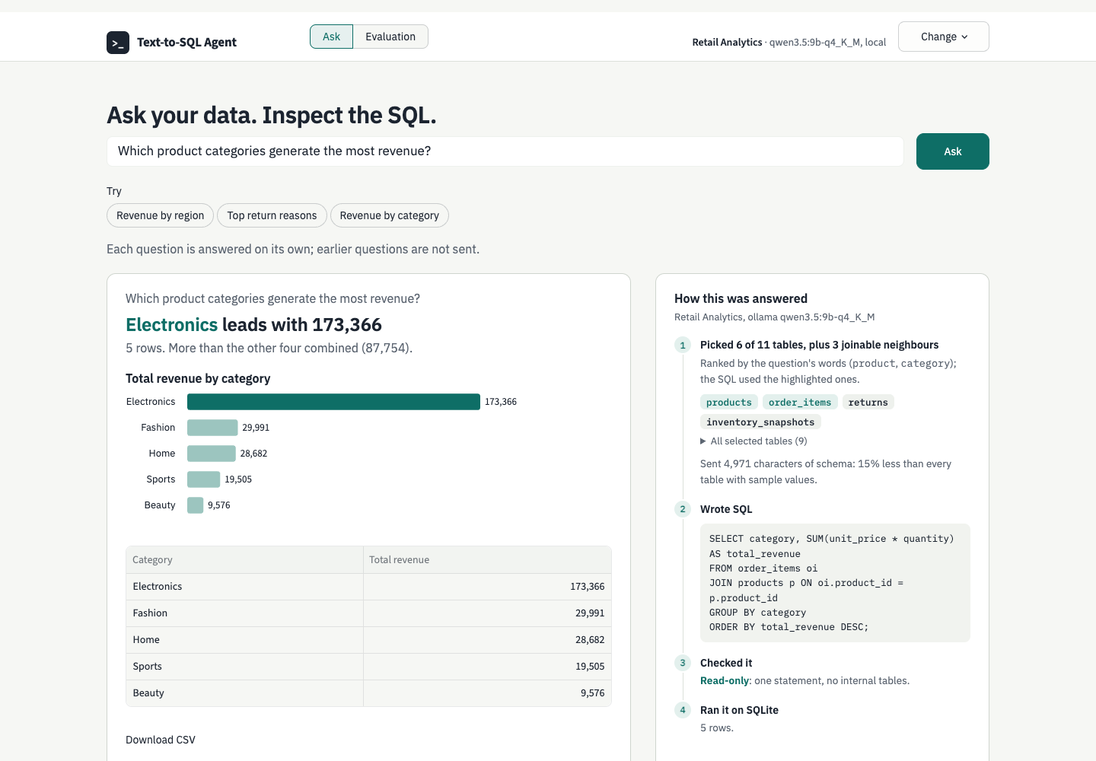
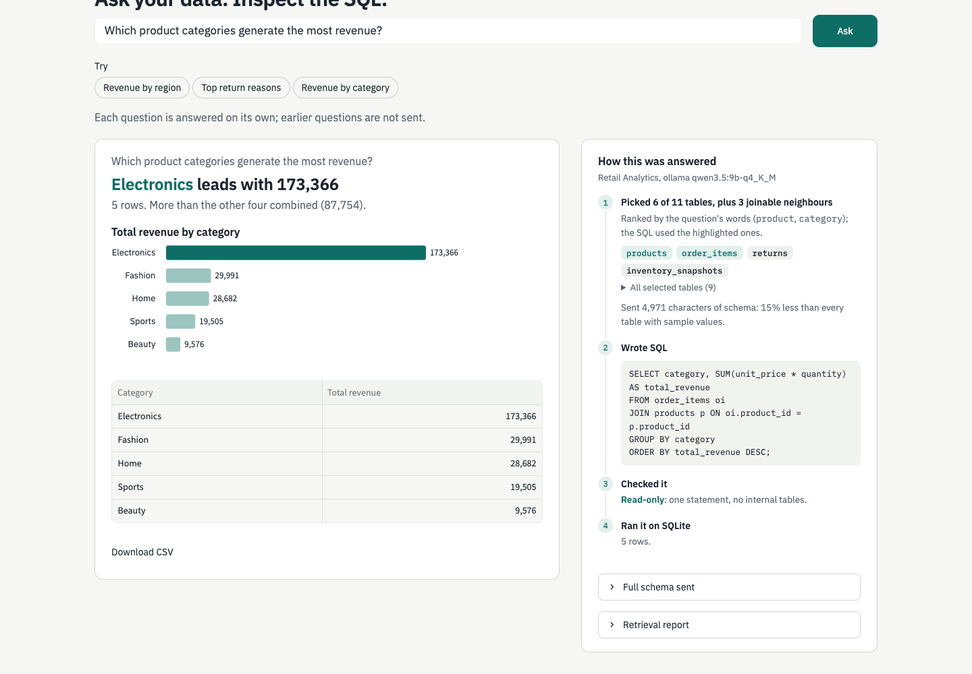
PRODUCT > INTERFACE
The answer comes first; the evidence is one glance away
Redesigned Streamlit interface, real captures from a local model on the demo database
1
2
1
Answers state what the rows say
A headline from the result, a bar chart when the result is one category and one number, and the table.
Evidence is recorded, not rebuilt
Tables picked and why, the schema size sent, the SQL and the read-only check are kept from the moment of answering.
2
Answer: headline from the rows, chart, table
How this was answered: tables and why, SQL, the check, the run
Text-to-SQL agent
‹#›
Notes:
Finally the product itself, redesigned so the answer comes first.
[Point: Answer screenshot]
The answer states what the rows say, with a chart when it fits and the table.
[Point: How this was answered]
Beside it, the evidence: which tables were picked and why, the SQL and the read-only check, all recorded when the question was answered. A request to change data is declined and nothing runs.
Reference — not read aloud
Interface. Real captures from scripts/capture_screenshots.py (local Ollama qwen3.5:9b-q4_K_M, Retail Analytics demo); provenance in docs/screenshots/capture.json. Teal and IBM Plex direction approved 2026-10-21, docs/design/design.md. Screens show the interface, not benchmark accuracy.

Slide 12
NEXT STEPS
What the results do not yet show, in priority order
Limits to keep beside the numbers, and the tests that would address them
1 Measure Gemini under the same contract
Supported but unmeasured since May. Its thinking shares the 512-token output cap; set a thinking budget and record it in the run identity once a key is available.
2 Recover the 128 missing-table questions
Find their tables without lengthening the prompt for the other 1,094.
3 Widen hint coverage
Half the needed literals sit in columns over the 20-value ceiling. Listing more values needs a privacy decision first.
4 Test more large schemas
The selection gain comes from two of four BIRD train databases; other schemas are untested.
Scope: all v2 accuracy figures use one local model, qwen3.5:9b-q4_K_M via Ollama; EX is this project's typed comparison, not a leaderboard score.
Text-to-SQL agent
‹#›
Notes:
What the results do not yet show, in priority order.
[Point: 1 Measure Gemini]
First, the hosted model has not been measured under these rules.
[Point: 2 Recover the 128]
Second, the questions whose tables are missed.
[Point: 3 and 4]
Then hint coverage, which needs a privacy decision, and more large schemas, since the gain comes from two databases. All of this uses one local model.
Reference — not read aloud
Next steps. Source: docs/4_next_steps.md (Evaluation v2 item 3, Phase 4); README Evaluation Results. Gemini: thinking tokens count against max_output_tokens=512 and no thinking budget is set; no key is configured locally, so the empty-answer rate is unmeasured.

Slide 13
THANK YOU
Grounded, visible, read-only and measured, including the ideas that did not work.
Live demo aipa-text-to-sql-agent.streamlit.app
Code, runs and decision log github.com/tuannm3812/text-to-sql-agent
Began as a UTS group project in May 2026 with Huy Duc Vu, Ngoc Bao Tran Nguyen, Manh Tuan Nguyen and Nguyen Nghia Doan Dang; refined since by Manh Tuan Nguyen.
Text-to-SQL agent
‹#›
Notes:
To close: the agent is grounded, its work is visible, it cannot write, and it is measured, including the ideas that did not work.
[Point: Live demo]
The demo and the full record of runs and decisions are public. It began as a group project in May with Huy Duc Vu, Ngoc Bao Tran Nguyen and Nguyen Nghia Doan Dang, and I have refined it since. Thank you.
Reference — not read aloud
Close. Origin: UTS AT3 group project, May 2026 (docs/academic/). Refinement since then on tuannm3812/main-refinement.

