Slide 1
UNSW MARKETING ANALYTICS HACKATHON · FINAL
Beyond a Good Story
When — and for whom — does persuasive loan language actually speed up funding?
Team Cultural Blend · Kiva loan data · 1.45 million real loans (2016–2025)
Notes:
(Sophia, ~30s) Good morning — we're Cultural Blend: I'm Sophia, and my teammate Tuan will take you through what survives when we test it hard. Kiva is built on stories — every loan page leads with one, the way a landing page leads with copy. We asked 1.45 million real loans a single question: does the story actually move the money?
[Sources] reports/generated_full_dataset/association_summary.txt (authoritative numbers); docs/presentation/deck_content.md SS2 numbers table

Slide 2
MOTIVATION
2/10
The question
▪ When a loan's story leans on family, competence, or urgency — does it fund faster?
▪ Does the answer depend on WHO is asking and WHEN?
▪ Why it matters: framing is the one thing a platform can coach — loan size, sector and geography can't be rewritten after the fact.
Cultural Blend · Kiva 2016–2025 · 1.45M loans
Notes:
(Sophia, ~50s) Why should a marketing audience care? Because on Kiva, the lender is the customer and the loan page is the product page. Loan size, sector, geography — fixed at listing. The story is the one element a platform can coach, test, and optimise — classic conversion territory. So: when a story leans on family, competence, or urgency, does the loan fund faster? And does that depend on who's asking, and when? That's a testable claim — so we tested it, hard.
[Sources] reports/generated_full_dataset/association_summary.txt (authoritative numbers); docs/presentation/deck_content.md SS2 numbers table

Slide 3
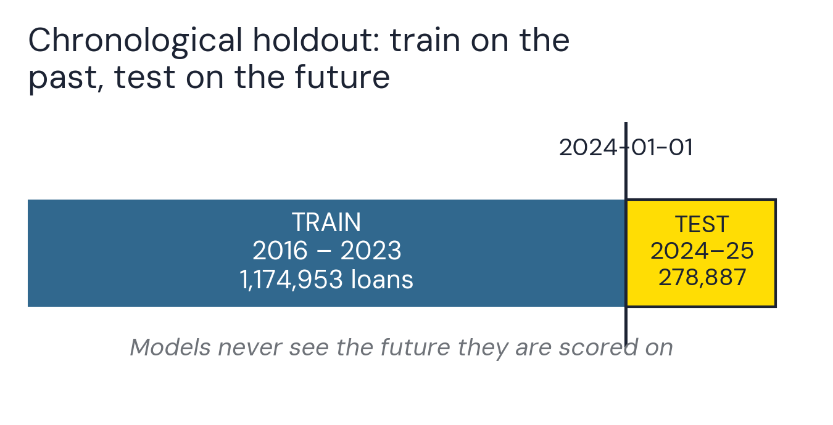
METHOD
3/10
How we stress-tested our findings
▪ Predictive claims: trained only on the past, tested only on loans posted 2024–2025 — no peeking at the future.
▪ Framing claims: every 'significant' result re-tested with country-clustered standard errors, then a harsher few-cluster reference where a result rests on a handful of countries.
▪ Most headline-looking results did NOT survive — that is the point of the method.
▪ SHAP importance shown as complementary predictive evidence only — it cannot confirm or refute a statistical finding.
Figure 1. Chronological train/test split.
Notes: The 278,887 test loans stayed sealed during training - the models never see the future they are scored on. Counts: analysis_summary.json (boundary 2024-01-01).
Cultural Blend · Kiva 2016–2025 · 1.45M loans
Notes:
(Sophia, ~65s) Two disciplines before any findings — because in a dataset this size it is dangerously easy to find things that aren't there. For prediction: train only on the past, score only on loans posted in 2024-25 — the models never see the future they're graded on. For the framing claims: every 'significant' result had to survive country-clustered standard errors — ten thousand loans from one country are not ten thousand independent customers — and where a result rested on just a couple of countries, an even harsher few-cluster screen on top. Most headline-looking results did not survive. Hold that thought, because it decides everything that follows.
[Sources] Split schematic drawn from analysis_summary.json split sizes (train 1,174,953 / holdout 278,887; boundary 2024-01-01).

Slide 4
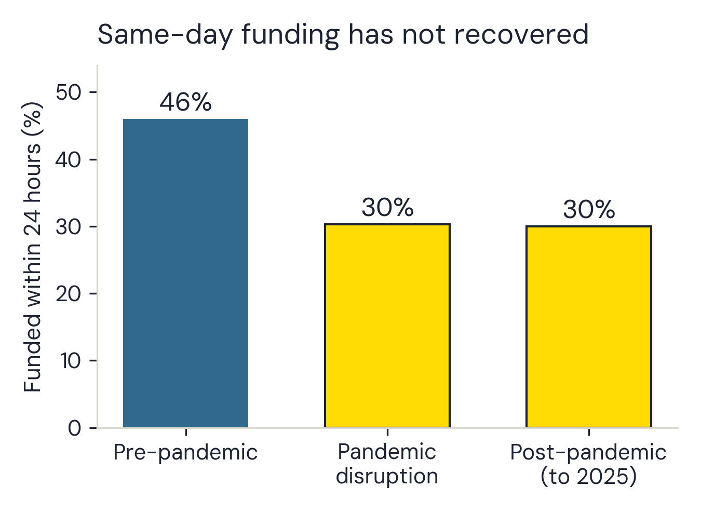
FINDING 1 · THE MARKET
4/10
A marketplace that hasn't recovered
46% → 30% → 30% funded within 24 hours
▪ Pre-pandemic, almost half of all loans funded within a day.
▪ Since 2020: under a third — and through the end of the data (2025) it has NOT recovered. Persistence to date, not proof it never will.
▪ 589,823 loans before vs. 565,474 after — not a small, noisy sample.
Figure 2. Share of loans funded within 24 hours, by analysis period.
Notes: The drop is 16 points; the 'recovery' is -0.3. Exact shares 46.0% / 30.3% / 30.0% (589,823 / 298,549 / 565,474 loans). EDA notebook §4.
Cultural Blend · Kiva 2016–2025 · 1.45M loans
Notes:
(Sophia, ~65s) Start with the market, because every other number lives inside it. Before the pandemic, 46% of loans funded within 24 hours — nearly half converting same-day. Since 2020 it's been under a third — and through 2025, the 'recovery' is minus 0.3 points. With over half a million loans on each side of that divide, this isn't noise: it's a structurally slower, more selective marketplace. For a marketer that reframes the whole job — when customers get pickier, knowing what actually drives conversion matters more, not less. Four years without a recovery is also why our recommendations start with acting rather than waiting for the market to fix itself.
[Sources] Chart rebuilt from EDA SS4 printed shares (0.460/0.303/0.300) and period counts; association_summary.txt audit trail.

Slide 5
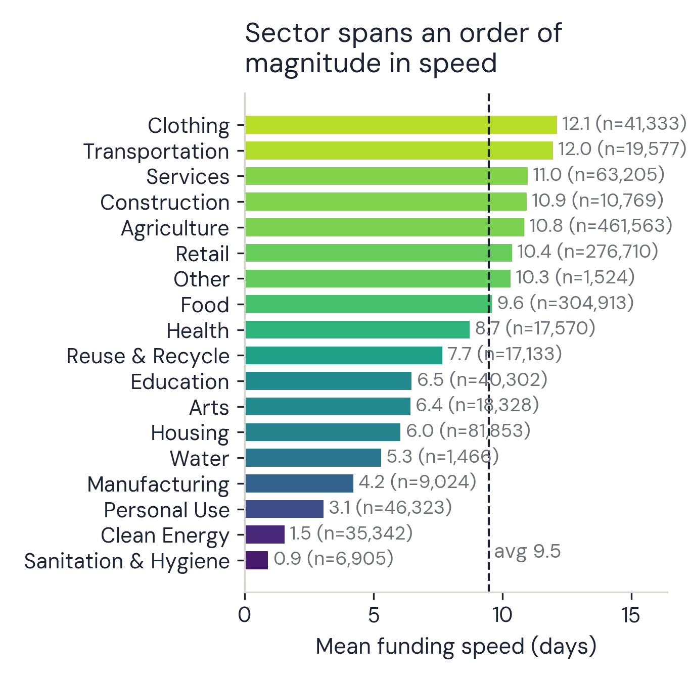
FINDING 2 · STRUCTURE
5/10
Structure beats story
2.3 vs 7.7 days median funding speed — female- vs male-posted loans
▪ Loan amount + repayment terms: linked to funding speed ~10x more strongly than any single narrative choice.
▪ Sector alone spans well over an order of magnitude in speed (0.9–12.1 days); country gaps are wider still — 0.2 to 20.5.
▪ None of this is causal — but it dwarfs anything the words do.
Figure 3. Mean funding speed by sector.
Notes: Sanitation loans fund ~13x faster than Clothing (0.9 vs 12.1 days). Computed from the raw data replicating EDA §5 grouping; every count matches the executed notebook.
Cultural Blend · Kiva 2016–2025 · 1.45M loans
Notes:
(Sophia, ~65s) And what drives it is structure. Loan amount and repayment terms correlate with funding speed roughly ten times more strongly than any narrative signal. Sector alone spans an order of magnitude — sanitation stories fund in under a day, clothing takes twelve. And the starkest gap in the data: loans posted by women fund in a median of 2.3 days, by men 7.7 — three times longer. None of this is causal, but it's enormous, it's stable, and it dwarfs anything the words do. Which brings us to the question we actually came here to answer. Tuan —
[Sources] Sector means computed from data/Kiva_Loans.pkl replicating EDA SS5 grouping (counts verified vs executed notebook). Gender medians: EDA SS4 printout.

Slide 6
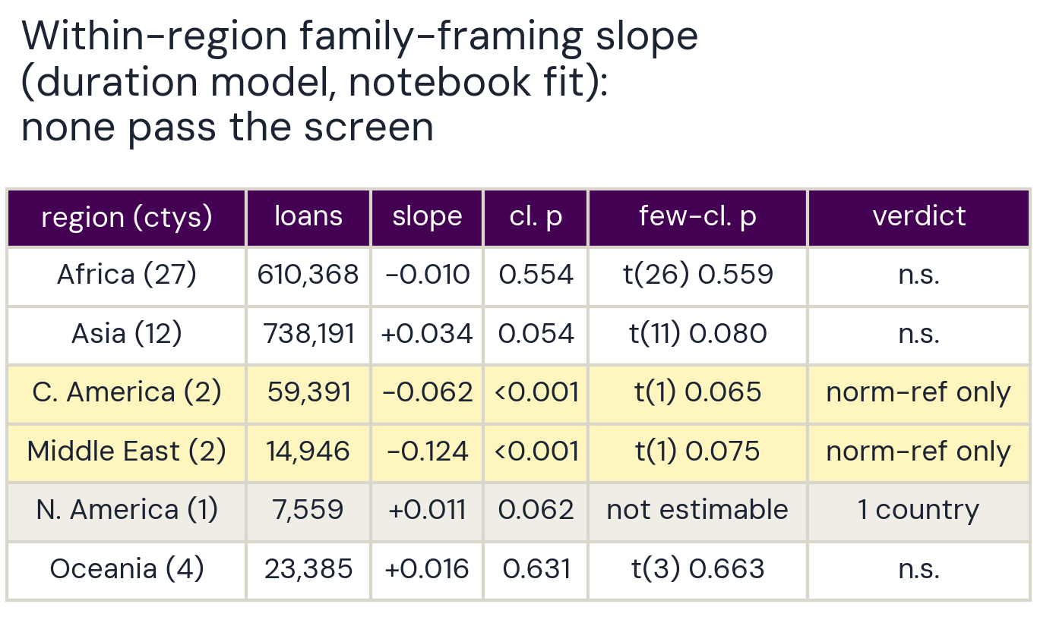
FINDING 3 · THE HEADLINE
6/10
What survives scrutiny
No narrative result is robust enough to support a recommendation
▪ Urgency: looked universal (p<0.001) — collapses under country clustering (p≈0.44). Not recommended.
▪ Family: corrected test → Middle East (Palestine+Yemen) & Central America (Honduras+Nicaragua) same direction in every fit — but 2 countries each; few-cluster t(1) screen bar is 12.7, not 1.96: p≈0.06–0.21. A hypothesis, not a finding.
▪ Sentiment: positive tone <-> slower funding, but significance flips between specifications — genuinely open.
▪ SHAP: no family / agency / urgency feature in the model's top 15 — complementary evidence, not confirmation.
Figure 4. Average within-region family-framing slope (duration model).
Notes: Against the few-cluster screen - a conservative heuristic (t(1) critical value 12.7), able to downgrade a claim but never certify one - nothing clears it. Typeset from executed §7.2 (v15); 4-dp values in analysis_summary.json.
Cultural Blend · Kiva 2016–2025 · 1.45M loans
Notes:
(Tuan, ~1m50s) Thanks, Sophia. So: does the story matter? Our honest answer: no narrative result is robust enough across specifications to support a recommendation. Urgency language looked like a universal win — significant at p below 0.001. Cluster by country, and it collapses to 0.44. Gone. Family framing — and here our own first version got it wrong: we tested whether regions differ from Africa, which is not the same as whether family framing helps within a region. Corrected, two pooled categories — Palestine plus Yemen, and Honduras plus Nicaragua — do show faster funding in every fit we ran. But each rests on exactly two countries, and against a deliberately harsh few-cluster screen — a conservative heuristic, not calibrated inference: a t distribution with one degree of freedom, critical value 12.7, not 1.96 — neither is significant: p between 0.06 and 0.21. So we report a hypothesis worth testing, not a finding. Sentiment is the honest illustration: it survives country clustering in one of our two specifications and not the other — genuinely open, robust in neither direction. We'd rather report no robust evidence than one exciting result we can't defend — because a recommendation you'd ship to real borrowers deserves that bar.
[Sources] Table typeset from the executed modeling notebook SS7.2 printout (v15); authoritative few-cluster values: analysis_summary.json within_region_slopes.

Slide 7
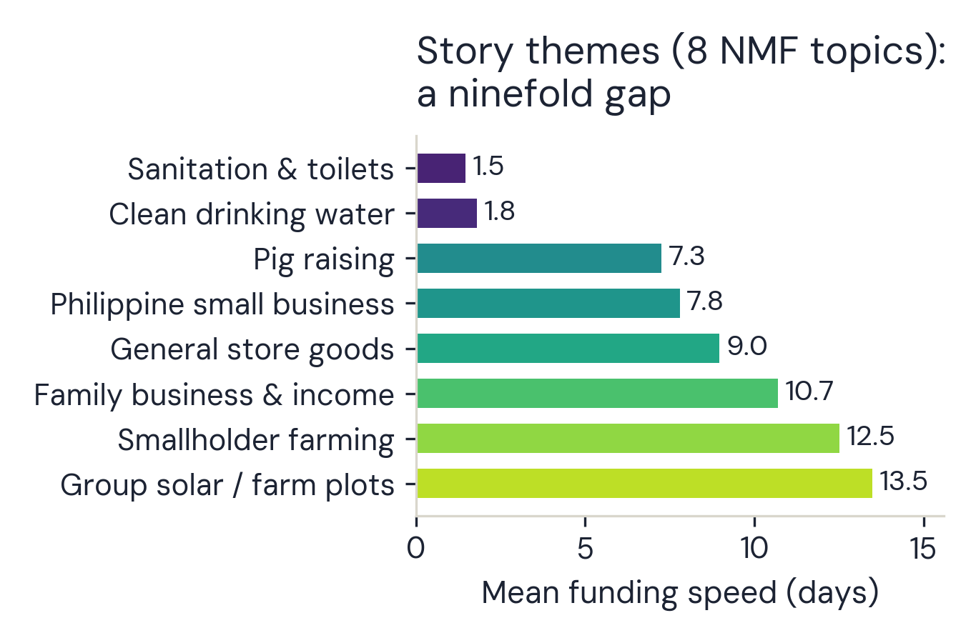
FINDING 4 · TOPICS
7/10
Beyond keywords
1.5 → 13.5 days mean funding speed across story topics — a >9x swing
▪ Topic modeling on the descriptions (TF-IDF + NMF, 8 topics — not keyword counts) surfaces coherent themes: sanitation, clean water, pig raising, family business, smallholder farming.
▪ The largest single gap anywhere in the analysis — but a topic mostly encodes what the loan is FOR. Structure again, not persuasion.
Figure 5. Mean funding speed by story theme.
Notes: Water and sanitation stories fund in under 2 days; group farming waits ~2 weeks - themes track what the loan is FOR. EDA §8 printed means (TF-IDF + NMF, 8 topics, 20K sample).
Cultural Blend · Kiva 2016–2025 · 1.45M loans
Notes:
(Tuan, ~50s) One more layer before the recommendations — we went past keyword counting. Topic modelling finds eight coherent story themes, and mean funding speed swings ninefold across them — descriptively, not as a tested effect: sanitation and clean-water stories in under two days, group farming closer to two weeks. But notice what a theme mostly encodes: what the loan is FOR. Structure again — not persuasion — and it's why the structural review we're about to recommend should cover what loans are FOR, not just which sector they sit in. So what should Kiva actually do with all of this?
[Sources] Chart rebuilt from EDA SS8 printed topic means and top-words (8 NMF topics).

Slide 8
RECOMMENDATIONS
8/10
What this means in practice
▪ DON'T ship writing tips — a platform-wide 'add urgency' nudge would be built on a result that doesn't survive testing.
▪ DO run a country-stratified A/B test of family framing in exactly those 4 markets — that's how a hypothesis becomes a decision.
▪ DO review the structural gaps (programme / sector / region / gender) — they are ~10x the size of any wording effect.
▪ PROTOTYPE, then re-validate: the 24h classifier ranks well among eventually-funded loans (AUC ≈ 0.90, strictly future data) — but expired/withdrawn listings aren't in the data, so an early-warning flag first needs all posted listings, a defined target, and retraining on that population.
▪ FOR FIELD PARTNERS (and borrowers): don't optimise wording — no robust evidence it pays. Timing is a partner capital-cycle matter, not a borrower wait: 96% of loans are already disbursed before the page goes live (median 24 days), and a bigger ask sits on the platform longer (~2 vs ~19 days). Still NOT a recommendation to ask for less.
Cultural Blend · Kiva 2016–2025 · 1.45M loans
Notes:
(Tuan, ~1m25s) Three moves for the platform — and notice the verbs, because the evidence sets them. One: don't ship writing tips — a firm don't, because a robust null is the one thing we did find; for the content team that's a build spared, and for borrowers it's not being coached into copy we found no robust evidence for. Two — an experiment, not an action, because there we have a pattern we could not confirm: for the growth team and the field partners in exactly four markets — Palestine, Yemen, Honduras, Nicaragua — run the country-stratified A/B test: family-framing prompt versus standard at listing. Test before you ship. Three — review, not change, because these are associations and not causes: for the product team, the structural gaps are the real levers — how the consistently slower programmes, sectors and regions get surfaced and supported — because those gaps are ten times any wording effect. And the classifier stays a prototype, not a deployment — a retrospective ranking prototype among funded loans — AUC 0.90 on strictly future data — so data science retrains on all listings, including expired ones, first. [advance to the borrower page] (Tuan, ~40s) And the borrower page — expectations, not tactics. The timing story belongs to field partners: a bigger ask sits on the platform longer — two days for the smallest loans against nineteen for the largest — and since 96% of these loans are already disbursed before the page even goes live, that is a partner capital-cycle fact, not a borrower's waiting time. Which is why we are not telling anyone to ask for less — this page sets expectations by profile, amount and sector, and none of them is a lever to game.
[Sources] Classifier metrics: analysis_summary.json binary_classifier. Few-cluster screen: SS7.2 / within_region_slopes.

Slide 9
LIMITS
9/10
What this can't tell us
▪ Association, never causation — no borrower was randomly assigned a writing style.
▪ Measures how fast a FUNDED loan funds — not whether a loan gets funded at all (expired/withdrawn listings never enter the data).
▪ Framing measured with transparent, simple rules — not every nuance of persuasive writing.
Cultural Blend · Kiva 2016–2025 · 1.45M loans
Notes:
(Tuan, ~35s) Three honest limits. Association, never causation — nobody randomly assigned writing styles. We measure how fast funded loans fund — not whether a loan funds at all. And our framing measures are transparent, simple rules — not every nuance of persuasion. We'd rather you know exactly what this can and cannot say — that's what makes the parts we do claim worth trusting.
[Sources] reports/generated_full_dataset/association_summary.txt (authoritative numbers); docs/presentation/deck_content.md SS2 numbers table

Slide 10
“The story barely registers.
The structure carries the signal.”
Thank you — questions.
Team Cultural Blend · UNSW Marketing Analytics Hackathon 2026
Notes:
(Both, ~20s) (Tuan) In this data, the story barely registers — the structure carries the signal. (Sophia) And testing hard enough to say, honestly, that there is no robust evidence for the story — that's worth more to a platform than a good-sounding tip. Thank you — we're happy to take your questions.
[Sources] reports/generated_full_dataset/association_summary.txt (authoritative numbers); docs/presentation/deck_content.md SS2 numbers table

Slide 11
Appendix
Q&A backup — not part of the 10-minute presentation.
Notes:
Divider only. Everything after this slide exists to be pulled up during Q&A if a question calls for it.
[Sources] reports/generated_full_dataset/association_summary.txt (authoritative numbers); docs/presentation/deck_content.md SS2 numbers table

Slide 12
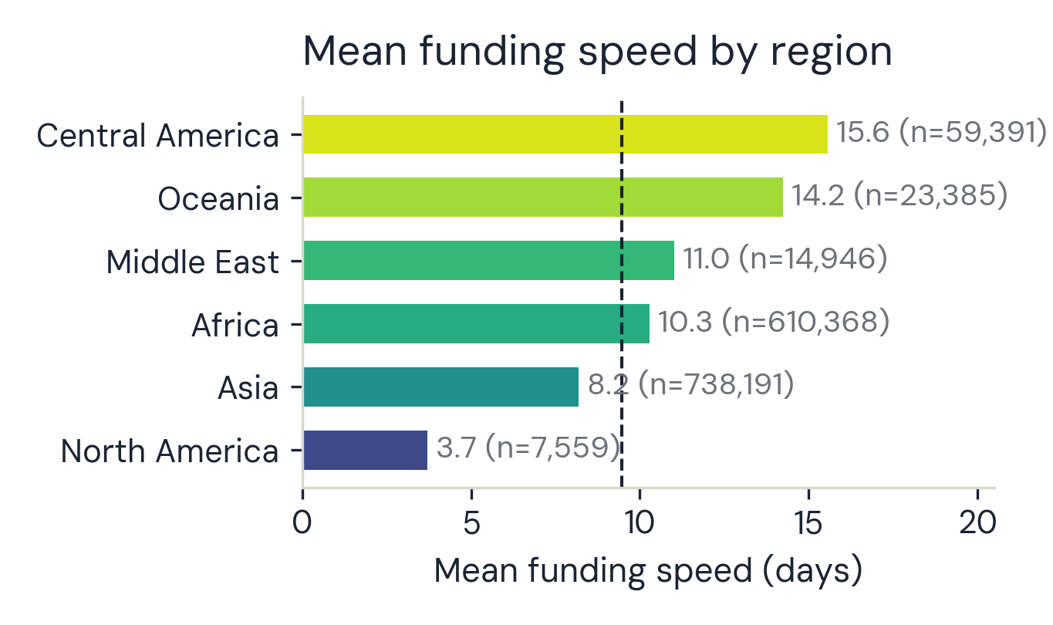
APPENDIX · A1
A1
The two-country problem, in full
▪ Pooled categories: Middle East = Palestine + Yemen (14,946 loans); Central America = Honduras + Nicaragua (59,391); North America = Haiti alone.
▪ Few-cluster screen p (duration / 24h / notebook fit): ME 0.12 / 0.21 / 0.08 · CA 0.06 / 0.14 / 0.07 — same direction in every fit, none significant; t(1) critical value 12.7.
▪ North America: single country — between-country uncertainty not estimable at all.
▪ The screen is a conservative heuristic: it can downgrade a claim, never certify one. Next step: country-stratified A/B test in those four markets.
Figure 6. Mean funding speed by region.
Notes: North America is Haiti alone (n = 7,559) - fastest region, and exactly why single-cluster inference is off the table. Computed from the raw data (counts verified vs executed notebook).
Cultural Blend · Kiva 2016–2025 · 1.45M loans
Notes:
Backup for Slide 6 probes: exact pooled definitions, all p-values, the single-country boundary, and the honest status of the screen.
[Sources] Region means computed from data/Kiva_Loans.pkl replicating EDA SS5 grouping (counts verified). Pooled definitions + p-values: association_summary.txt.

Slide 13
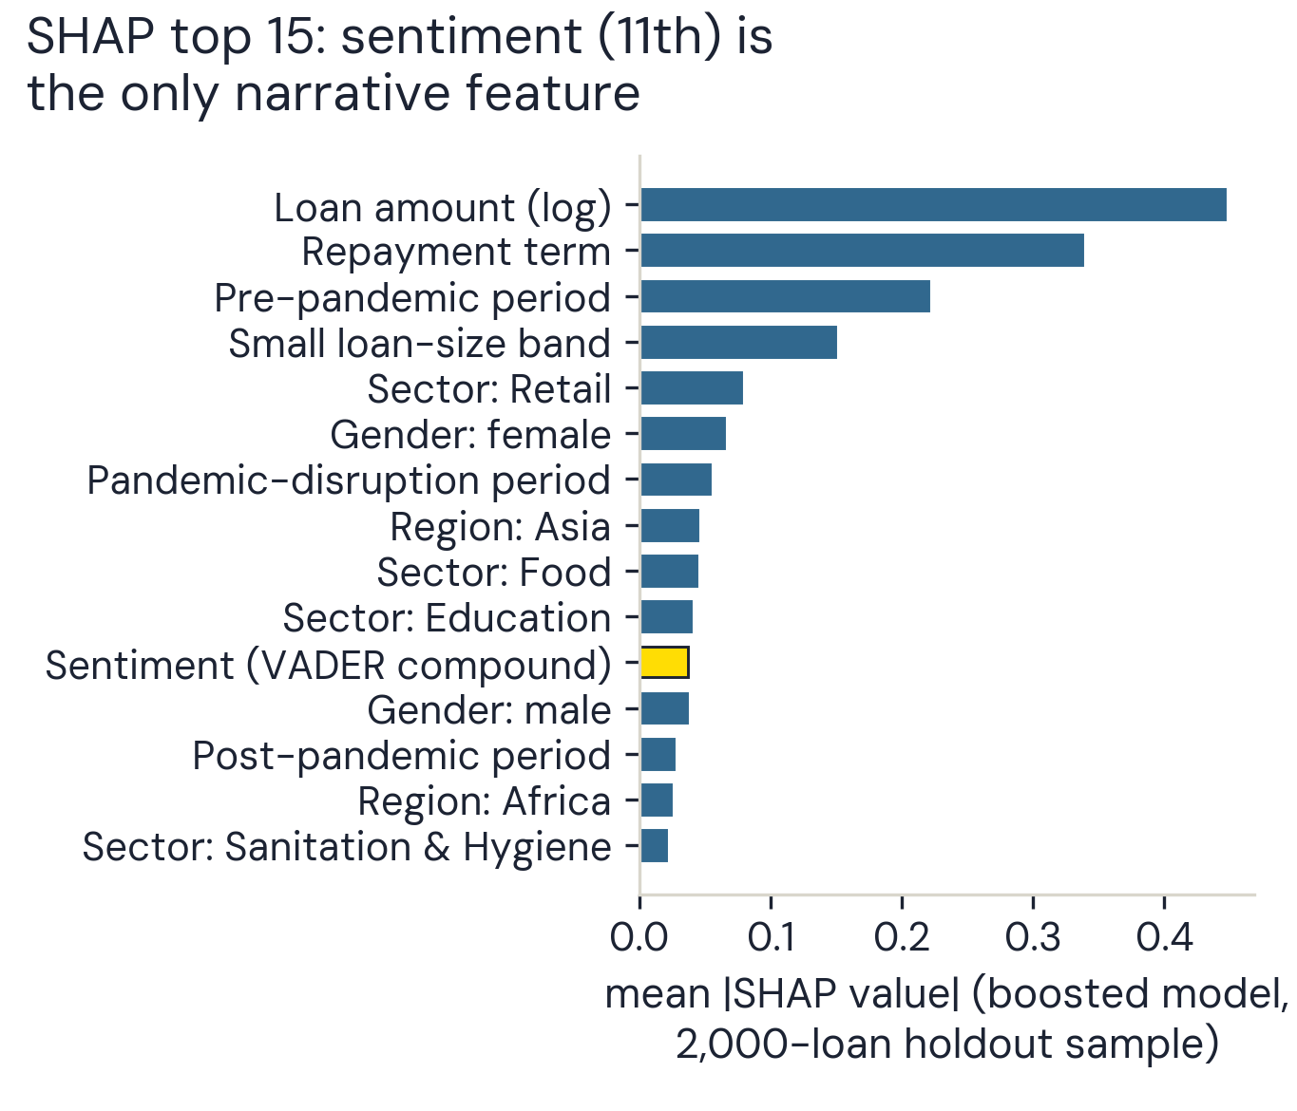
APPENDIX · A2
A2
Predictive weight ≠ statistical robustness
▪ SHAP importance from the boosted forecasting model: structure fills the top ranks (amount, term, period, size band, sector, gender).
▪ No family, agency, or urgency feature reaches the top 15; sentiment is 11th despite its disputed significance.
▪ Complementary predictive evidence only — a different model, no region interactions; it cannot confirm or refute any coefficient's sign or uncertainty.
Figure 7. Top 15 features by mean |SHAP| value, boosted model.
Notes: Ten structural features outrank the first narrative one. Rebuilt from modeling §8 printed values (2,000-loan holdout sample).
Cultural Blend · Kiva 2016–2025 · 1.45M loans
Notes:
Backup for SHAP questions: what the ranking shows, and exactly what it cannot corroborate.
[Sources] Chart rebuilt from modeling SS8 printed SHAP top-15 values (v14/v15 runs).

Slide 14
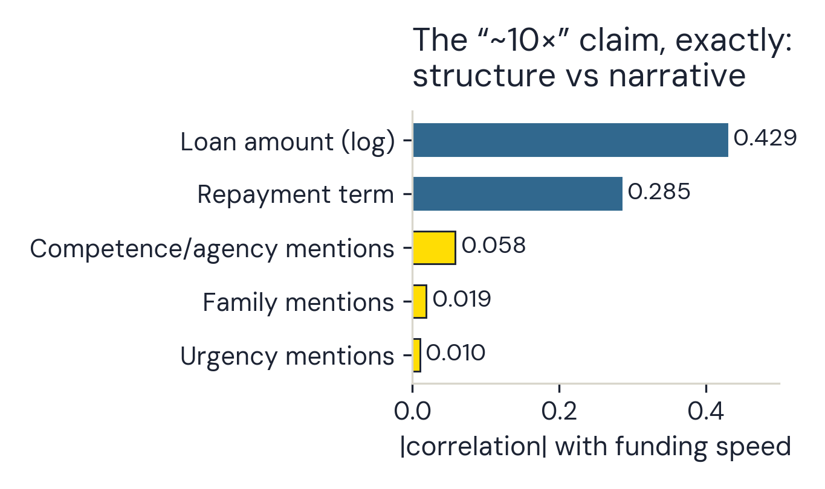
APPENDIX · A3
A3
The '~10x' comparison, exactly
▪ Correlation with funding speed: loan amount (log) r = 0.43, repayment term r = 0.28 — vs competence 0.058, family 0.019, urgency 0.010.
▪ Loan-amount deciles also rise almost monotonically (~2 days for the smallest asks, ~18 for the largest) — monotonicity, not the 10x basis itself.
▪ Gender: female-posted median 2.3 days vs male 7.7 (male coefficient +0.430 survives HC3 AND country clustering, p < 0.0001 — still associational).
Figure 8. Correlation with funding speed: structural vs narrative features.
Notes: Loan amount correlates ~7x stronger with speed than the best narrative signal (0.429 vs 0.058). EDA §9 printed correlation table.
Cultural Blend · Kiva 2016–2025 · 1.45M loans
Notes:
Backup for Slide 5 probes: the amount gradient and the gender gap's robustness status.
[Sources] Chart rebuilt from EDA SS9 printed correlation table; decile curve: EDA SS9 figure.

Slide 15
APPENDIX · A4
A4
24h classifier — operating detail
▪ Holdout (posted 2024-01-01 onward): 278,887 loans; 87,466 funded within 24h vs 191,421 not.
▪ ROC AUC 0.8997 · average precision 0.8301 · Brier 0.1156 · accuracy 0.840 — structure does the work: no framing feature in the SHAP top 10 (sentiment is 11th).
▪ Boundary: negative class = 'eventually funded, but not within 24h'. Expired/withdrawn listings never enter the data — a retrospective ranking prototype among eventual funders.
▪ Path to deployment: all posted listings incl. expired/withdrawn outcomes -> define operational target + censoring window -> retrain, validate -> threshold, calibration, fairness, prospective test.
Cultural Blend · Kiva 2016–2025 · 1.45M loans
Notes:
Backup for classifier questions: exact metrics, class balance, and the population boundary stated before anyone asks.
[Sources] reports/generated_full_dataset/association_summary.txt (authoritative numbers); docs/presentation/deck_content.md SS2 numbers table

