Slide 1
↗
UNSW MARKETING ANALYTICS HACKATHON 2026
Beyond a Good Story
When and for whom does persuasive loan language actually speed up funding?
Team Cultural Blend
University of Technology Sydney
Kiva loan data · 1.45 million real loans · 2016–2025
UNSW Marketing Analytics Hackathon 2026
Notes:
(Sophia, ~30s) Good morning — we're Cultural Blend: I'm Sophia, and my teammate Tuan will take you through what survives when we test it hard. Kiva is built on stories — every loan page leads with one. We asked 1.45 million real loans a single question: does the story actually move the money?
[Sources] reports/generated_full_dataset/association_summary.txt

Slide 2
EXECUTIVE SUMMARY · THE VERDICT
01
02
03
04
05
06
07
08
In 1.45M loans, the story barely registers. The structure carries the signal.
WHAT PLATFORMS BELIEVE
“Storytelling is the only lever a platform can coach.”
• Loan amount, sector, and country are fixed at listing.
• Conventional marketing advice suggests adding urgency, mentioning family, or perfecting copy to speed up conversion.
• Naive regressions seem to back this up (p < 0.001).
WHAT 1.45M LOANS REVEAL
“Structural loan factors beat storytelling by ~10×.”
• Urgency dissolves under country-clustering (p ≈ 0.49).
• Family framing rests on a 2-country screen illusion (t(1)=12.7).
• Loan size, terms, sector, and gender dwarf narrative choices.
• 96.4% of loans pre-disbursed: partner capital waits, not borrower.
THE STRATEGIC TAKEAWAY FOR KIVA
Do not waste product and marketing resources shipping generic copywriting nudges. Shift platform investment toward structural bottlenecks, partner liquidity cycles, and country-stratified A/B experiments.
UNSW Marketing Analytics Hackathon 2026
Notes:
(Sophia, ~55s) Why are we here? Kiva is built on the belief that loan copy is the coachable lever. Loan size, country, sector — fixed at listing. So the platform wants to coach borrowers to tell better stories. We tested that premise across 1.45 million loans. Our verdict right up front: in this data, the story barely registers; the structure carries the signal. Storytelling advice does not survive rigorous testing. Today, we show you why that happens, and where Kiva should actually invest its product energy.
[Sources] EDA §1–§5, modeling §7.

Slide 3
TABLE OF CONTENTS · PROJECT BLUEPRINT
OVERVIEW
How the 1.45M loan investigation is structured
ACT I · CONTEXT
SLIDES 4–5
The Operating Reality
Why narrative advice is pitched, and what really happens on the ground.
▪ The Platform Dilemma: Text is the only unsealed lever at listing; platforms want to coach it.
▪ Market Slowdown: Same-day funding collapsed from 46% to 30% post-pandemic.
▪ Capital Reality: 96.4% pre-disbursed; partner working capital waits, not borrowers.
ACT II · INFERENCE
SLIDES 6–9
Empirical Stress-Test
Testing narrative claims against 1.45M loans with econometric rigor.
▪ Methodological Screen: 64 of 120 coefficients collapse under country-clustering.
▪ Structural Dominance: Amount, terms, and sector beat storytelling by ~10×.
▪ Narrative Scrutiny: Urgency dissolves (p ≈ 0.49); family rests on 2-country screen.
▪ Topic Modeling: Topics track loan purpose (water vs farming; 9× swing).
ACT III · STRATEGY
SLIDES 10–12
The Strategic Playbook
High-ROI platform decisions, borrower realism, and epistemic bounds.
▪ 4-Quadrant Playbook: Kill generic tips, A/B test family framing, fix structural lag.
▪ Borrower Realism: Set cash-flow expectations; do NOT game gender or story.
▪ Scientific Bounds: Observational associations, completed-loans survival truncation.
APPENDIX · AUDITS
SLIDES 14–17
Methodological Audits
Full numerical proofs and statistical architecture for defense.
▪ Two-Country Problem: The conservative t(1) = 12.7 heuristic screen in full.
▪ Predictive vs Causal: Why SHAP importance cannot certify policy rules.
▪ The ~10× Comparison: Decile monotonicities and correlation breakdown.
▪ 24h Early Warning: LightGBM classifier architecture (ROC AUC 0.8997).
PORTFOLIO METHODOLOGY & REPRODUCIBILITY STACK · 1,453,846 REAL LOANS (2016–2025)
Econometric OLS Duration Modeling · Binomial GLM · Country-Clustered Standard Errors · Conservative Few-Cluster t(1)=12.7 Screen · NMF Topic Extraction (8 Components) · LightGBM Predictive Benchmark (Strict Chronological Split, Zero Future Leakage)
UNSW Marketing Analytics Hackathon 2026
Notes:
(Portfolio Blueprint) This executive architecture maps the full 1.45 million loan investigation. Readers can navigate the sequence across three core phases: from the initial platform dilemma (Act I) through our econometric stress-testing and statistical falsification (Act II), into Kiva's high-ROI platform strategy (Act III), supported by complete methodological proofs in the Technical Appendix.
[Navigation] Slides 4–5 (Act I), Slides 6–9 (Act II), Slides 10–12 (Act III), Slides 14–17 (Technical Appendix).

Slide 4
ACT I · OPERATING REALITY
01
02
03
04
05
06
07
08
Why platforms coach story: the only lever unsealed at listing
1. THE NARRATIVE QUESTION
When a loan's story leans on family, competence, or urgency, does it get funded faster?
2. THE MODERATION QUESTION
Does the result shift by WHO the borrower is (gender, geography) and WHERE & WHEN they posted?
WHY IT MATTERS TO PLATFORM MARKETING
Loan story framing is the one lever a platform can actually coach. Loan size, sector, country, and partner terms are fixed at listing — narrative choices are the only active conversion lever.
UNSW Marketing Analytics Hackathon 2026
Notes:
(Sophia, ~50s) Why should a marketing audience care? Because on Kiva, the lender is the customer and the loan page is the product page. Loan size, sector, geography — fixed at listing. The story is the one element a platform can coach, test, and optimise. So: when a story leans on family, competence, or urgency, does the loan fund faster? And does that depend on who's asking, and when? That's a testable claim — so we tested it, hard.
[Sources] EDA notebook §1–§3.

Slide 5
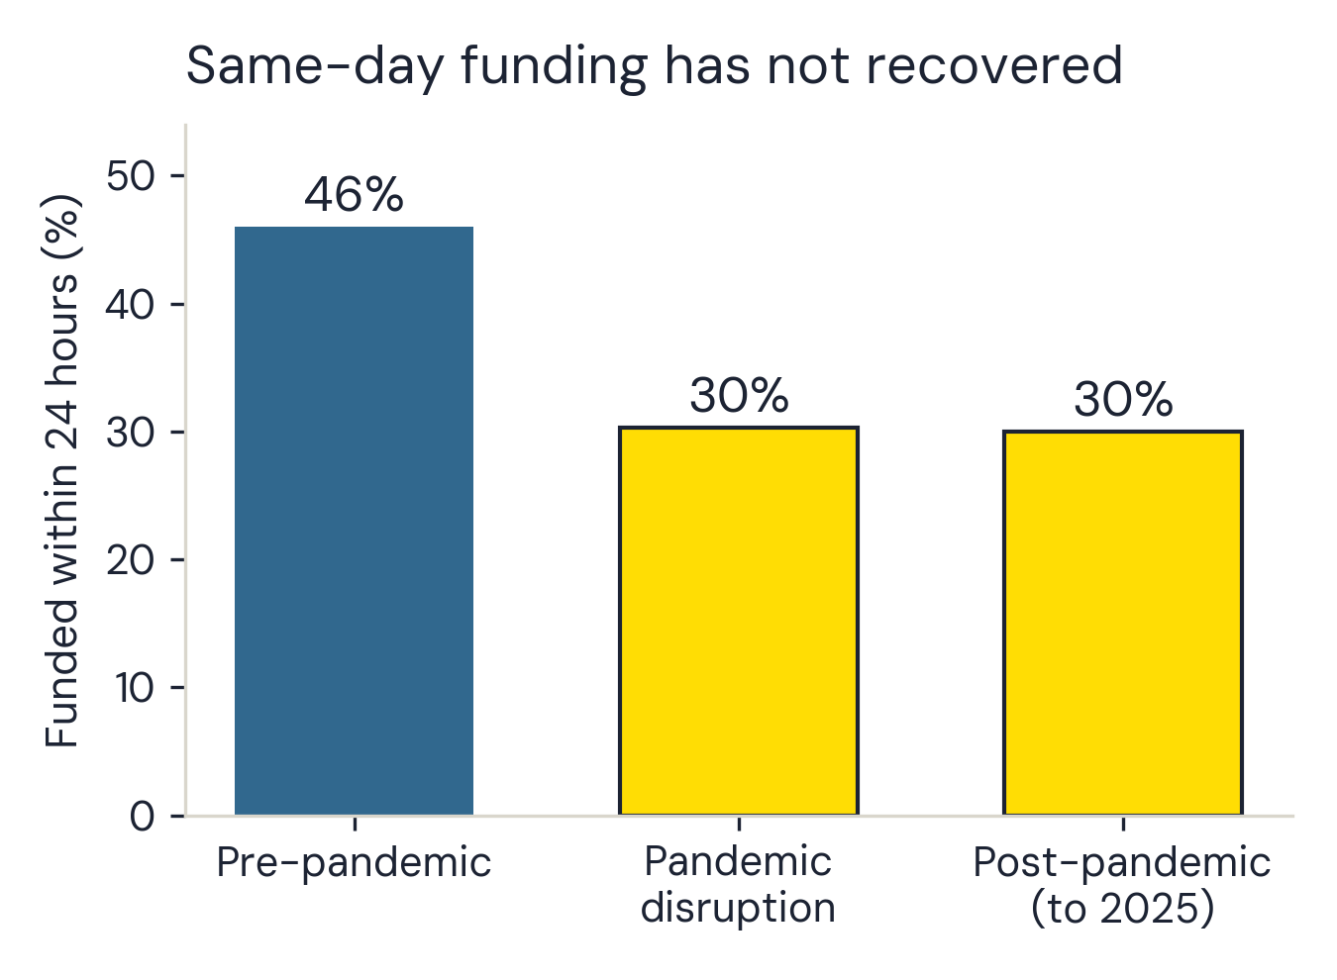
ACT I · OPERATING REALITY
01
02
03
04
05
06
07
08
A slower market is the operating reality — and it is partner capital that waits.
46.0% → 30.3% → 30.0% funded within 24 hours
▪ Pre-pandemic, almost half of all loans funded within a day.
▪ Since 2020: under a third — and four years on, still not recovered (-0.3 points recovery).
▪ 589,823 loans before vs 565,474 after — not a thin sample, and the slowdown persists to date.
THE OPERATIONAL REALITY · 96.4% PRE-DISBURSED
Day 0: Cash Disbursed ➔ Day 24: Kiva Listing ➔ Day 27+: Reimbursed
Borrowers do NOT wait for crowdfunding — field partners disburse upfront. A slower market means field partner working capital waits longer to replenish.
Figure 2. Share of loans funded within 24 hours, by analysis period.
Notes: The drop is 16 points; the 'recovery' is -0.3. Exact shares 46.0% → 30.3% → 30.0% (589,823 / 298,549 / 565,474 loans).
UNSW Marketing Analytics Hackathon 2026
Notes:
(Sophia, ~65s) Start with the market, because every other number lives inside it. Before the pandemic, 46.0% of loans funded within 24 hours — nearly half converting same-day. Since 2020 it's been under a third — and through 2025, the 'recovery' is minus 0.3 points. Partner capital now waits longer, not the borrower, because 96% of loans are already disbursed before the page goes live. With over half a million loans on each side of that divide, this isn't noise: it's a structurally slower, more selective marketplace.
[Sources] EDA notebook §4.

Slide 6
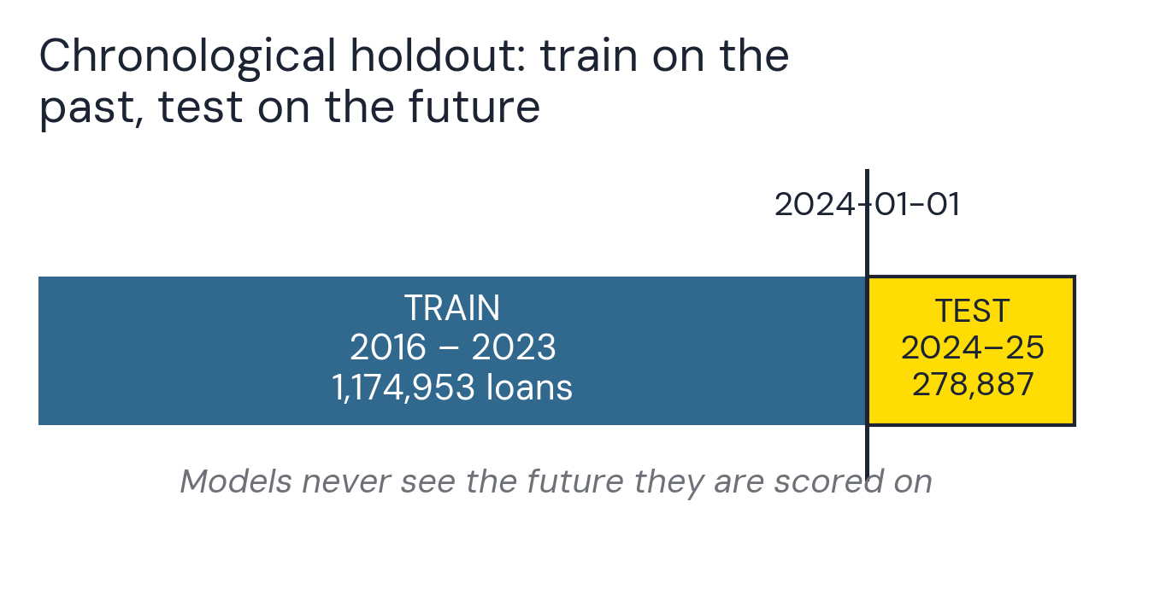
ACT II · THE STRESS-TEST
01
02
03
04
05
06
07
08
Why big data lies without clustering: how we stress-tested our claims
64 of 120 significant coefficients lost significance
▪ Chronological Holdout: Trained strictly on loans up to 2023; 278,887 loans from 2024–2025 sealed until evaluation. Zero future leakage.
▪ Country-Clustered Standard Errors: Standard errors clustered across 80+ countries to remove artificial significance inflation from massive sample sizes.
▪ Stricter Few-Cluster Screen: Where regional claims rested on only 1–2 countries, required the conservative t(1) critical value of 12.7 (not 1.96).
▪ Role of Machine Learning: SHAP importance used as complementary predictive validation only; cannot certify causal signs or policy rules.
Figure 1. Chronological train/test split.
Notes: The 278,887 test loans stayed sealed during training — the models never see the future they are scored on.
UNSW Marketing Analytics Hackathon 2026
Notes:
(Sophia, ~60s) Two tests separated what is real from what is statistical noise. First, chronological holdout: 278,887 loans from 2024–2025 stayed sealed. Second, country-clustered standard errors: in a 1.45 million row dataset, standard errors shrink mechanically, making noise look 'highly significant.' Across both explanatory models, 64 of 120 significant coefficients did not survive country-clustering. That is the point of the method.
[Sources] analysis_summary.json

Slide 7
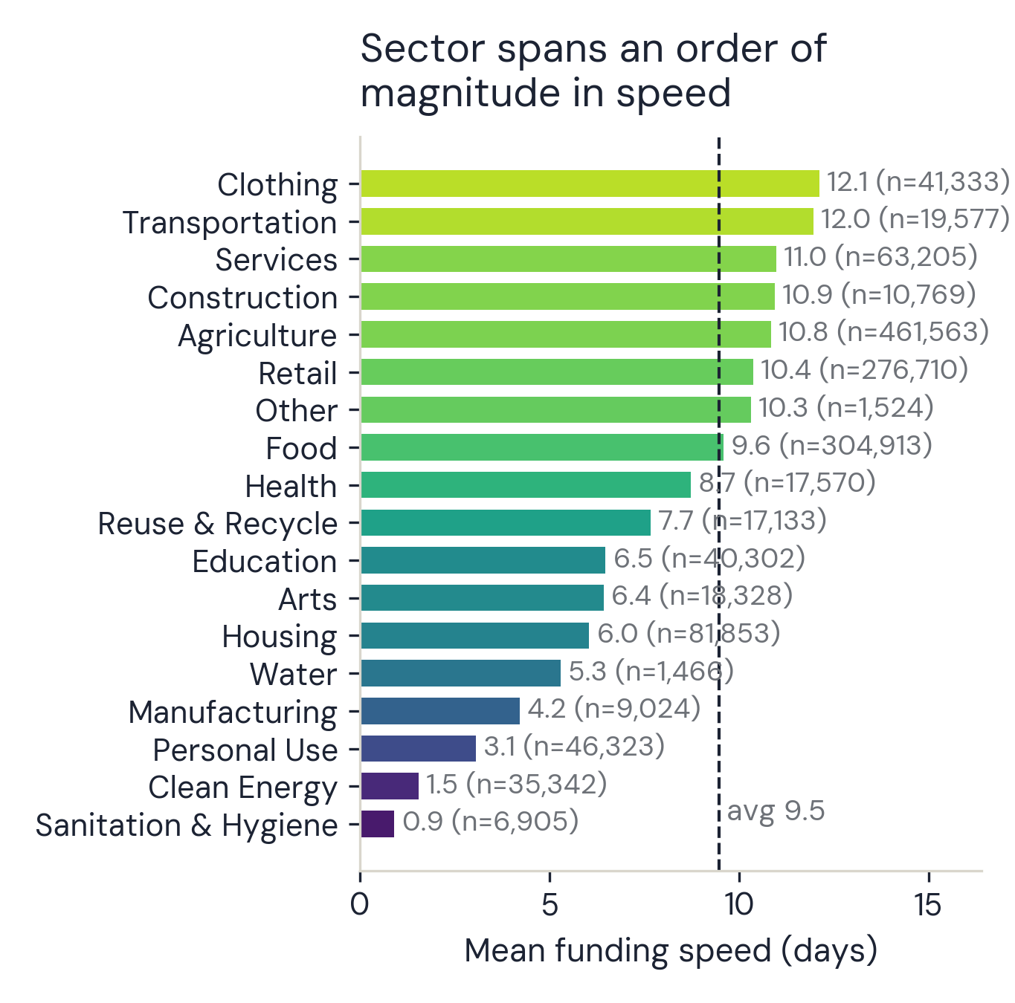
ACT II · THE STRESS-TEST
01
02
03
04
05
06
07
08
Structural loan factors beat storytelling by an order of magnitude
2.3 vs 7.7 days median speed — female vs male loans
▪ Loan amount + repayment terms: linked to funding speed ~10× more strongly than any single narrative choice. Bigger ask, longer on the platform.
▪ Sector alone spans well over an order of magnitude in speed (0.9–12.1 days); country gaps are wider still — 0.2 to 20.5 days.
▪ Loans posted by women fund in a median 2.3 days; by men, 7.7. None of this is causal — but it dwarfs anything the words do.
▪ Programme label (whySpecial) spans 0.2 to 30.9 days across 141 well-populated levels — institutional design dominates.
Figure 3. Mean funding speed by sector.
Notes: Sanitation loans fund ~13x faster than Clothing (0.9 vs 12.1 days). Counts verified vs executed notebook.
UNSW Marketing Analytics Hackathon 2026
Notes:
(Sophia, ~65s) And what drives it is structure. Loan amount and repayment terms correlate with funding speed roughly ten times more strongly than any narrative signal. Bigger ask, longer on the platform. Sector alone spans an order of magnitude — sanitation in under a day, clothing takes twelve. And loans posted by women fund in a median of 2.3 days, by men 7.7 — three times longer. None of this is causal, but it dwarfs anything the words do. Tuan will now take you through what happened when we put storytelling to the test.
[Sources] EDA notebook §5, §9.

Slide 8
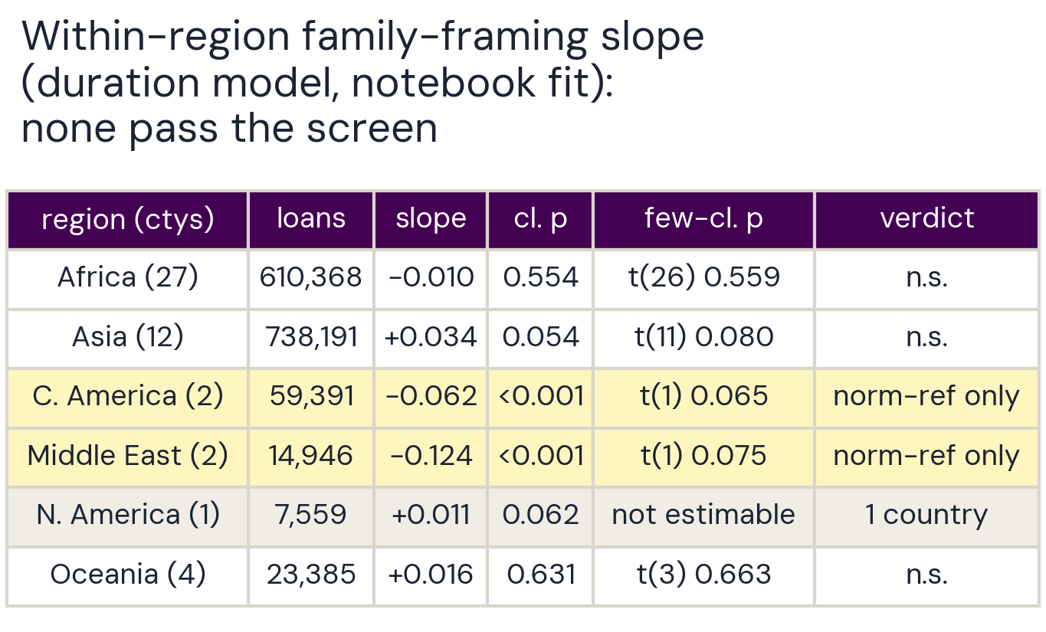
ACT II · THE STRESS-TEST
01
02
03
04
05
06
07
08
Storytelling coaching: no robust evidence it moves the needle.
No narrative result is robust enough to support a writing recommendation
▪ Urgency: looked universal (p<0.001) — collapses under country clustering (p≈0.49). Not recommended.
▪ Family: corrected within-region tests in Middle East (Palestine+Yemen) & Central America (Honduras+Nicaragua) same direction in every fit — but 2 countries each; few-cluster t(1) screen bar is 12.7, not 1.96: p≈0.06–0.12. A hypothesis, not a finding.
▪ Sentiment: positive tone <-> slower funding, but significance flips between specifications — genuinely open.
▪ SHAP: no family / agency / urgency feature in the model's top 15 — complementary evidence.
Figure 4. Average within-region family-framing slope (duration model).
Notes: Against the few-cluster screen (t(1) critical value 12.7), nothing clears it. Authoritative values in analysis_summary.json.
UNSW Marketing Analytics Hackathon 2026
Notes:
(Tuan, ~1m50s) Thanks, Sophia. So: does the story matter? Our honest answer: no narrative result is robust enough across specifications to support a recommendation. Urgency language looked like a universal win — significant at p below 0.001. Cluster by country, and it collapses to 0.49. Gone. Family framing — Middle East and Central America do show faster funding in every fit we ran. But each rests on exactly two countries, and against a deliberately harsh few-cluster screen — critical value 12.7, not 1.96 — neither is significant: p between 0.06 and 0.12. So we report a hypothesis worth testing, not an established rule.
[Sources] modeling notebook §7.2

Slide 9
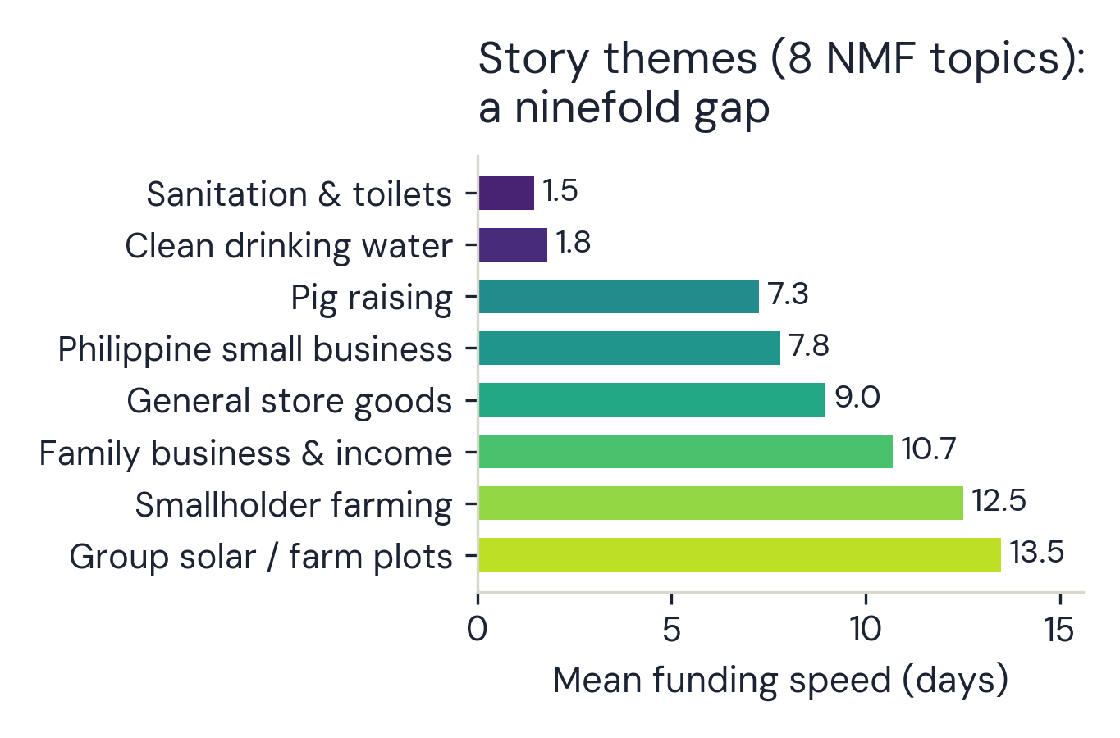
ACT II · THE STRESS-TEST
01
02
03
04
05
06
07
08
The themes come down to loan purpose, not persuasion.
1.5 → 13.5 days mean speed across topics — ninefold swing
▪ Topic modeling on descriptions (TF-IDF + NMF, 8 topics — not keyword counts) surfaces coherent themes: sanitation, clean water, pig raising, family business, smallholder farming.
▪ The largest single gap anywhere in the analysis: clean water funds in under 2 days; group farming loans take ~2 weeks.
▪ A theme mostly encodes what the loan is FOR. Lenders prioritize clean water cause, not because the borrower wrote better prose. Structure again, not persuasion.
Figure 5. Mean funding speed by story theme.
Notes: Water and sanitation stories fund in under 2 days; group farming loans take ~2 weeks — themes track what the loan is FOR.
UNSW Marketing Analytics Hackathon 2026
Notes:
(Tuan, ~50s) Topic modelling finds eight coherent story themes, and mean funding speed swings ninefold across them — sanitation and clean-water in under two days, group farming loans take ~2 weeks. But notice what a theme mostly encodes: what the loan is FOR. Structure again — not persuasion — and it's why the structural review should cover what loans are FOR, not just which sector they sit in.
[Sources] EDA notebook §8

Slide 10
ACT III · STRATEGIC PLAYBOOK
01
02
03
04
05
06
07
08
What this means in practice for the Kiva team: a 4-action playbook
DON'T SHIP · Generic Writing Tips
A platform-wide 'add urgency' nudge would be built on unclustered statistical noise (p ≈ 0.49). Withhold writing coaching to save engineering resources and avoid confusing borrowers.
A/B TEST · Targeted Family Framing
Run a country-stratified A/B test strictly in the 4 candidate markets: Palestine, Yemen, Honduras, Nicaragua. Randomize prompts at listing; evaluate causal funding speed country-by-country.
REVIEW STRUCTURE · The ~10× Levers
Review structural friction: Programme label (whySpecial, 0.2–30.9 days), sector, region, and gender. These structural factors drive ten times the variance of any wording effect.
PROTOTYPE & AUDIT · 24h Classifier
The 24h LightGBM classifier achieves AUC ≈ 0.90 (accuracy 0.840) among funded loans. Before operational deployment, retrain on all listings (including expired and withdrawn).
⚡ OPERATIONAL REALITY: 96% of loans are disbursed before listing — funding speed is the partner's capital cycle, not borrower waiting.
UNSW Marketing Analytics Hackathon 2026
Notes:
(Tuan, ~1m25s) Three moves for the platform. One: don't ship writing tips — a firm don't, because a robust null is what we found. Two: run the country-stratified A/B test in Palestine, Yemen, Honduras, Nicaragua — test before you ship. Three: review the structural gaps — programme, sector, region, and gender. And the classifier stays a prototype among funded loans until retrained on all listings including expired ones.
[Sources] analysis_summary.json

Slide 11
ACT III · STRATEGIC PLAYBOOK
01
02
03
04
05
06
07
08
What to expect when listing: setting expectations, not gaming levers
FOR BORROWERS & FIELD PARTNERS: WHAT TO EXPECT — NOT WHAT TO GAME
PROFILE & GENDER · Loans posted by women fund in a median 2.3 days vs 7.7 male-posted.
A gap for Kiva to investigate, not a lever for borrowers. DO NOT manipulate who represents the household.
LOAN SIZE & TERMS · The two strongest speed predictors (linked ~10x more strongly than words).
Amounts are partner-set against real business capital need. Plan cash flow around them; DO NOT shrink the ask.
SECTOR & CAUSE · Speed varies ~13x by sector (0.9 to 12.1 days; water <2d vs farming ~2wks).
Category is dictated by loan purpose. Set realistic expectations by sector; DO NOT misclassify category to chase speed.
Note: A bigger ask sits on the platform longer (~2 vs ~19 days). Because 96% of loans are pre-disbursed, this affects partner liquidity cycles, not borrower survival.
UNSW Marketing Analytics Hackathon 2026
Notes:
(Tuan, ~40s) And for borrowers — expectations, not tactics. We are not advising anyone to game demographic fields, switch sectors, or shrink their loan request. The timing story belongs to field partners: a bigger ask sits on the platform longer, and since 96% of these loans are already disbursed before the page goes live, that is a partner capital-cycle fact, not a borrower's waiting time.
[Sources] EDA notebook §4, §5, §7.

Slide 12
ACT III · STRATEGIC PLAYBOOK
01
02
03
04
05
06
07
08
What this can't tell us: three boundaries on the evidence
01 · ASSOCIATION, NEVER CAUSATION
No borrower was randomly assigned a writing style. All results are observational associations. Narrative features correlate with geographic, economic, and institutional realities that cannot be causally attributed to the borrower's text alone.
02 · COMPLETED FUNDRAISES ONLY
Measures how fast a FUNDED loan funds — not whether it gets funded at all. The dataset contains completed fundraisers (1,452,203 funded loans). Expired or withdrawn campaigns never enter the platform data, creating survival truncation.
03 · TRANSPARENT LEXICAL BOUNDS
Framing measured with transparent, simple rules — not every nuance of persuasion. Lexicon word-rate frequencies and sentiment compound scores capture broad stylistic patterns, but cannot capture deep storytelling craft, emotional subtlety, or cultural context.
UNSW Marketing Analytics Hackathon 2026
Notes:
(Tuan, ~35s) Three honest limits. Association, never causation — nobody randomly assigned writing styles. We measure how fast funded loans fund — not whether a loan funds at all. And our framing measures are transparent, simple rules — not every nuance of persuasion. We'd rather you know exactly what this can and cannot say — that's what makes the parts we do claim worth trusting.
[Sources] association_summary.txt

Slide 13
“In this data, the story barely registers.
The structure carries the signal.”
Thank you — questions.
Team Cultural Blend · UNSW Marketing Analytics Hackathon 2026
UNSW Marketing Analytics Hackathon 2026
Notes:
(Both, ~20s) (Tuan) In this data, the story barely registers — the structure carries the signal. (Sophia) And testing hard enough to say, honestly, that there is no robust evidence for the story — that's worth more to a platform than a good-sounding tip. Thank you — we're happy to take your questions.
[Sources] docs/presentation/deck_content.md

Slide 14
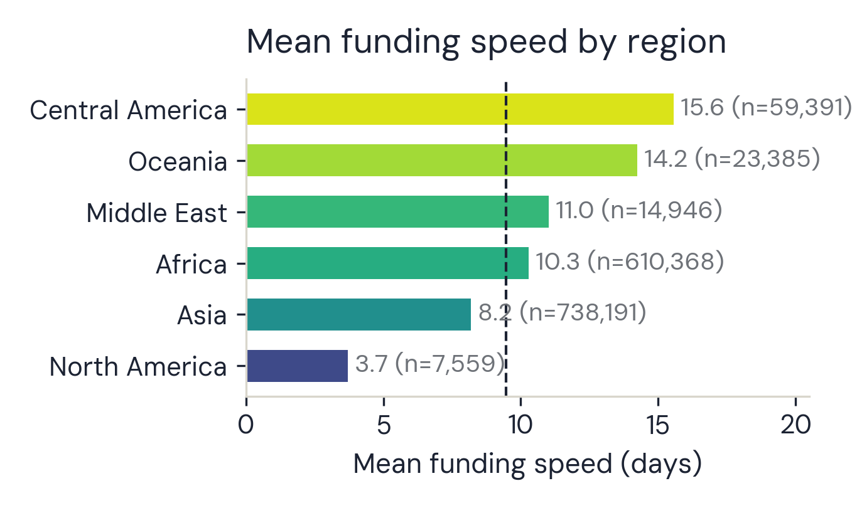
APPENDIX · A1
A1
The two-country problem, in full
▪ Pooled categories: Middle East = Palestine + Yemen (14,946 loans); Central America = Honduras + Nicaragua (59,391); North America = Haiti alone.
▪ Few-cluster screen p (duration / 24h / notebook fit): ME 0.12 / 0.21 / 0.08 · CA 0.06 / 0.14 / 0.07 — same direction in every fit, none significant; t(1) critical value 12.7.
▪ North America: single country — between-country uncertainty not estimable at all.
▪ The screen is a conservative heuristic: it can downgrade a claim, never certify one. Next step: country-stratified A/B test in those four markets.
Figure 6. Mean funding speed by region.
Notes: North America is Haiti alone (n = 7,559) — fastest region, and exactly why single-cluster inference is off the table.
UNSW Marketing Analytics Hackathon 2026
Notes:
Backup for Slide 8 probes: exact pooled definitions, all p-values, the single-country boundary, and the honest status of the screen.
[Sources] analysis_summary.json

Slide 15
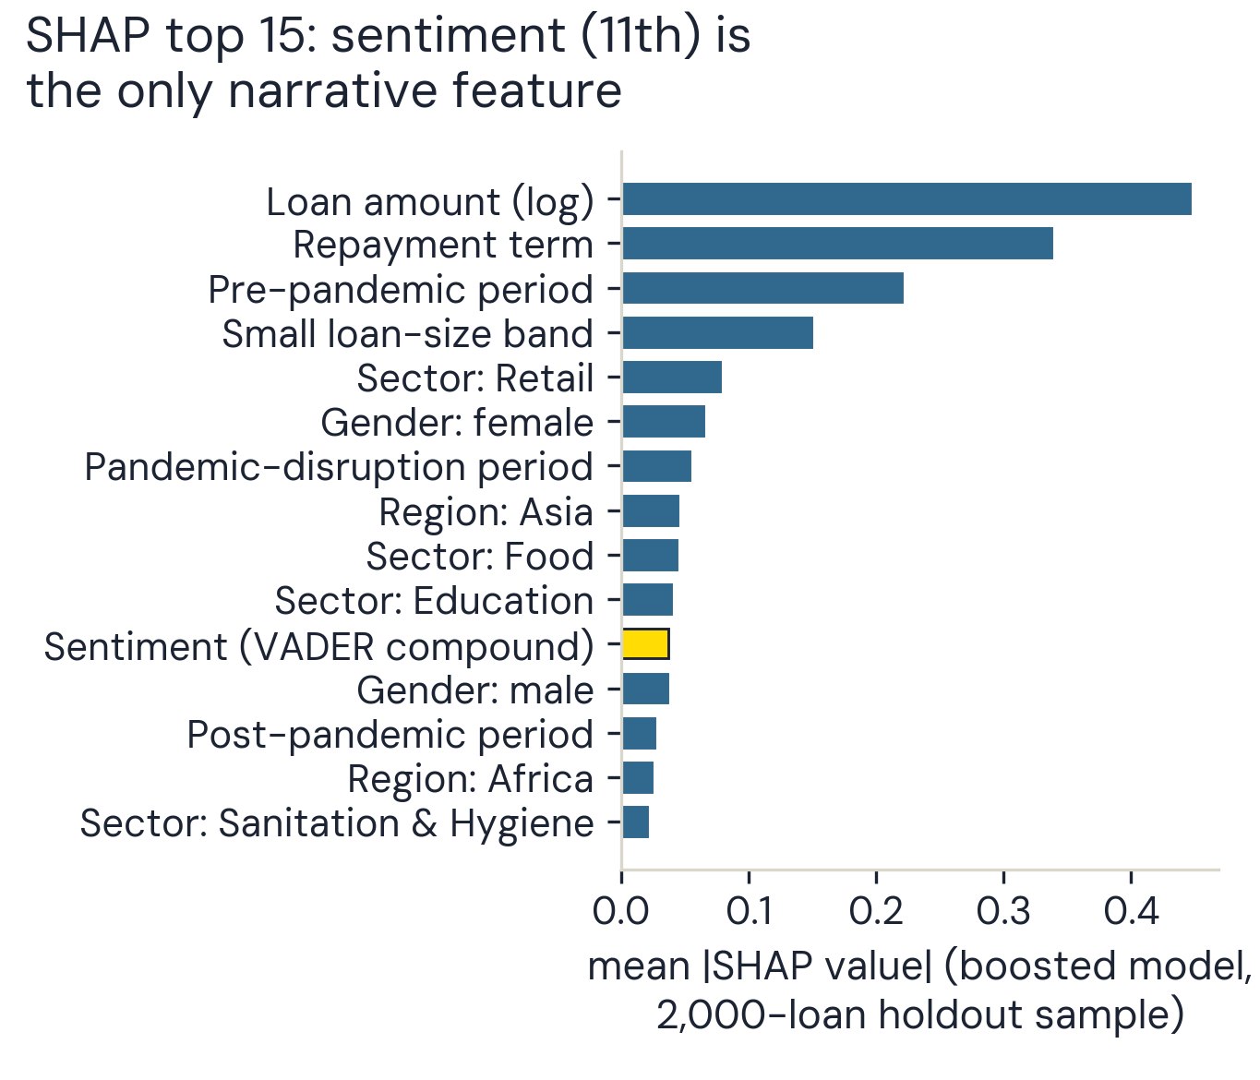
APPENDIX · A2
A2
Predictive weight ≠ statistical robustness
▪ SHAP importance from the boosted forecasting model: structure fills the top ranks (amount, term, period, size band, sector, gender).
▪ No family, agency, or urgency feature reaches the top 15; sentiment is 11th despite its disputed significance.
▪ Complementary predictive evidence only — a different model, no region interactions; it cannot confirm or refute any coefficient's sign or uncertainty.
Figure 7. Top 15 features by mean |SHAP| value, boosted model.
Notes: Ten structural features outrank the first narrative one. Rebuilt from modeling §8 printed values.
UNSW Marketing Analytics Hackathon 2026
Notes:
Backup for SHAP questions: what the ranking shows, and exactly what it cannot corroborate.
[Sources] analysis_summary.json

Slide 16
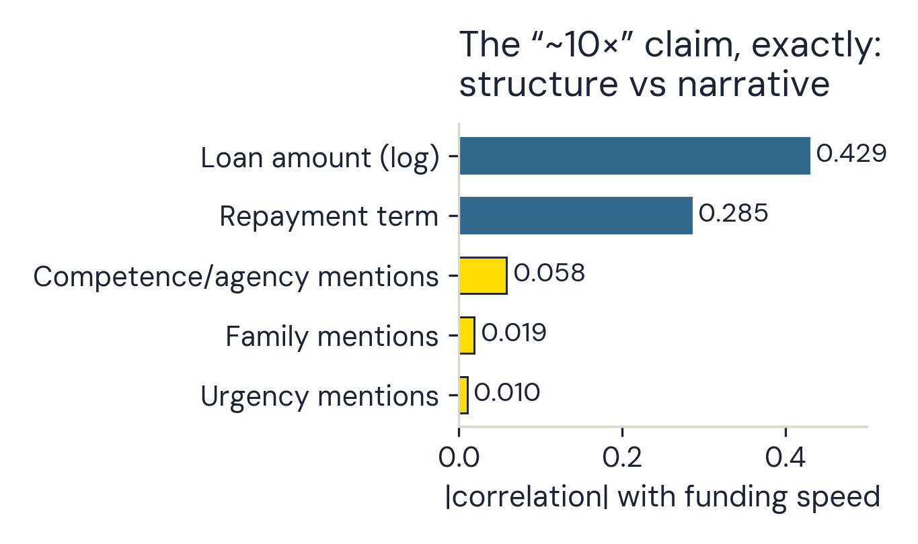
APPENDIX · A3
A3
The '~10x' comparison, exactly
▪ Correlation with funding speed: loan amount (log) r = 0.43, repayment term r = 0.28 — vs competence 0.058, family 0.019, urgency 0.010.
▪ Loan-amount deciles also rise almost monotonically (~2 days for the smallest asks, ~18 for the largest) — monotonicity, not the 10x basis itself.
▪ Gender: female-posted median 2.3 days vs male 7.7 (male coefficient +0.430 survives HC3 AND country clustering, p < 0.0001 — still associational).
Figure 8. Correlation with funding speed: structural vs narrative features.
Notes: Loan amount correlates ~7x stronger with speed than the best narrative signal (0.429 vs 0.058).
UNSW Marketing Analytics Hackathon 2026
Notes:
Backup for Slide 7 probes: the amount gradient and the gender gap's robustness status.
[Sources] analysis_summary.json

Slide 17
APPENDIX · A4
A4
24h classifier — operating detail
▪ Holdout (posted 2024-01-01 onward): 278,887 loans; 87,466 funded within 24h vs 191,421 not.
▪ ROC AUC 0.8997 · average precision 0.8301 · Brier 0.1156 · accuracy 0.840 — structure does the work: no framing feature in the SHAP top 10 (sentiment is 11th).
▪ Boundary: negative class = 'eventually funded, but not within 24h'. Expired/withdrawn listings never enter the data — a retrospective ranking prototype among eventual funders.
▪ Path to deployment: all posted listings incl. expired/withdrawn outcomes -> define operational target + censoring window -> retrain, validate -> threshold, calibration, fairness, prospective test.
UNSW Marketing Analytics Hackathon 2026
Notes:
Backup for classifier questions: holdout metrics, censoring boundary, and the retraining path before operational deployment.
[Sources] analysis_summary.json

