Slide 1
Introduction to Kubernetes

Slide 2
The Problems
Monolithic -> Microservices
Resilient - EG: service downtime -> Auto rollback or re-run
Horizontal Auto-scaling
Better management tool - by the Control-Plane
…
⇒ Using Container Orchestration like Kubernetes solve these problems

Slide 3
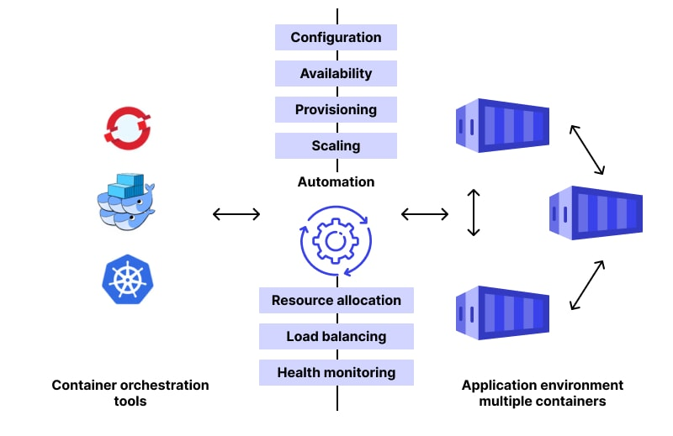
II. What is K8s
Container Orchestration tool.
Created by Google, open source in 2014.
Help manage thousands nodes/container.
Alternatives to Kubernetes:
Openshift, Hashicorp Nomad

Slide 4
**Important! What Cloudrity (SDF) used
Link Github: https://github.com/kubernetes/kubernetes
Star: 115k
⇒ It not perfect. It design for portable, so it missing so many features like: Service Load Balancing, Storage, Networking Service,...
=> Using K3s, RKE2, Microk8s, AWS EKS, GKE (google).

Slide 5
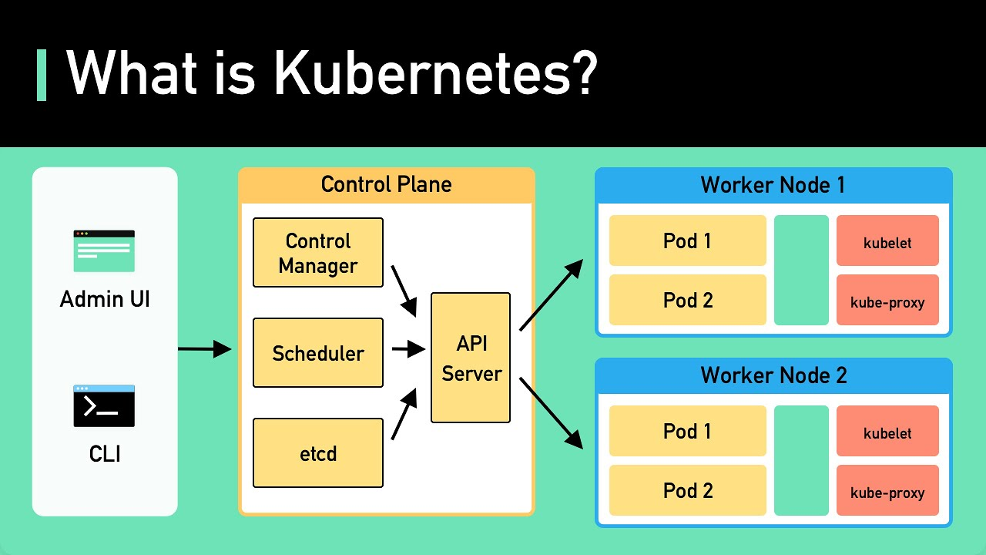
III. Kubernetes Architecture
Overview
Control-Plane & Worker
API Server, etcd, Scheduler, Controller, kubelet, kube-proxy

Slide 6
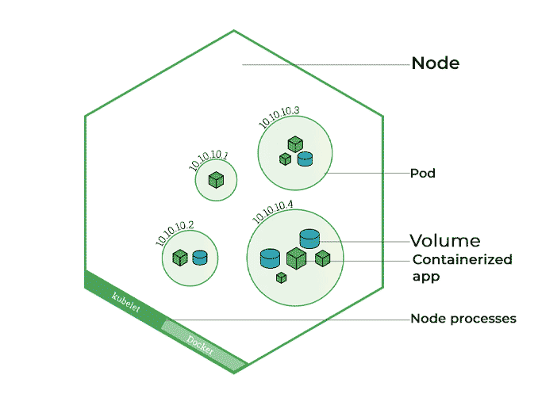
III. Kubernetes Architecture
2. Pod
Smallest Unit of k8s
It has container/our application inside
Every Pod running has assigned one internal-IP

Slide 7
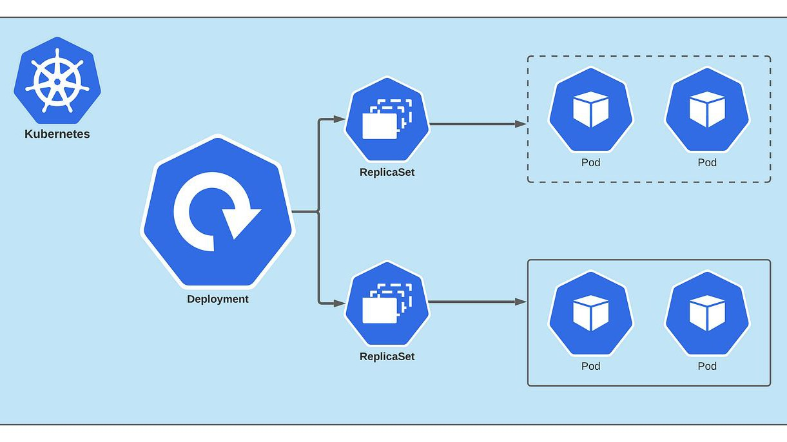
III. Kubernetes Architecture
3. Deployment + Replicasets
The answer of How K8s deploy/update applications. (Backend service, Scheduler Job…)
Deployment: Which App, Version, Names, how many RAM/CPU,...
Replica Sets: ensure that we really have n instance of Pod.

Slide 8
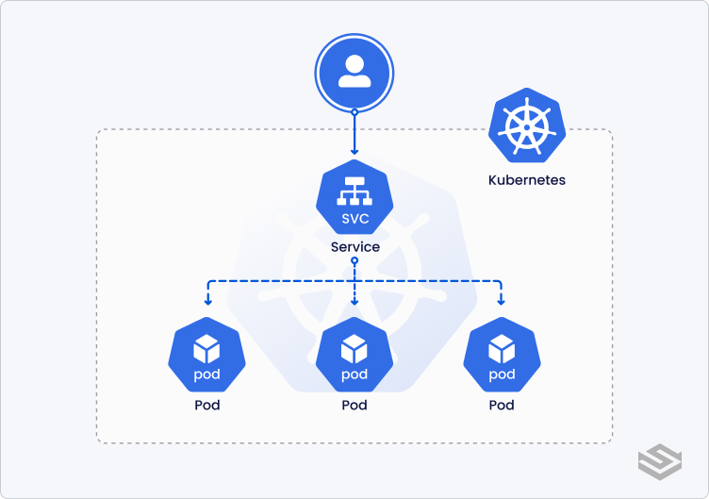
III. Kubernetes Architecture
4. Service
It just a networking load balancer.
Every request go to service first, then go to the pod after
Support service discovery via service-name

Slide 9
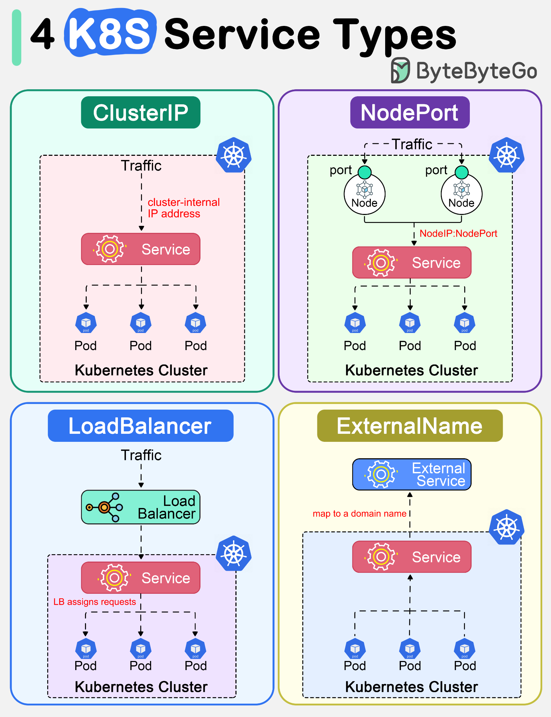
III. Kubernetes Architecture
4.1 Service Types
ClusterIP: Assign private IP that only resource at K8s cluster can reach out
NodePort: Access the cluster via <node-ip>:port
LoadBalancer: produce a Public IP that outside can go to K8s cluster
ExternalName: map service to domain.

Slide 10
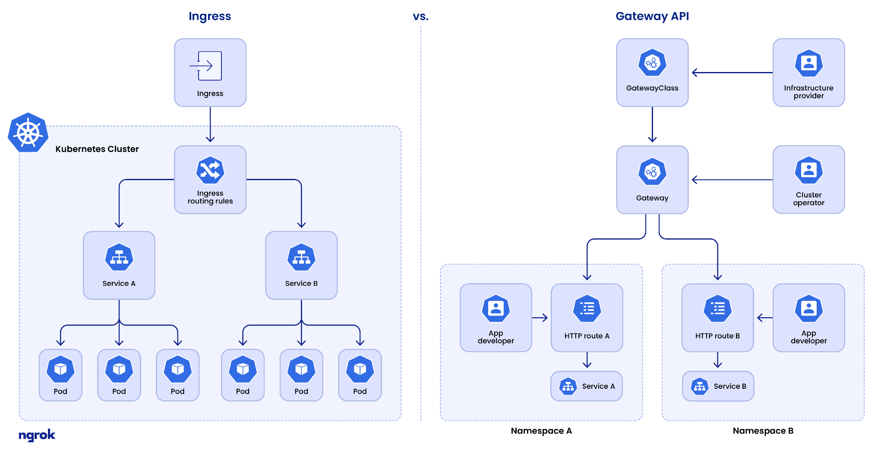
III. Kubernetes Architecture
4.2 Ingress & Gateway API
Ingress: Single entry-point for accessing to the cluster instead of create Load Balancer for every service (it waste of Public IP)
Gateway API: newer version of Ingress

Slide 11
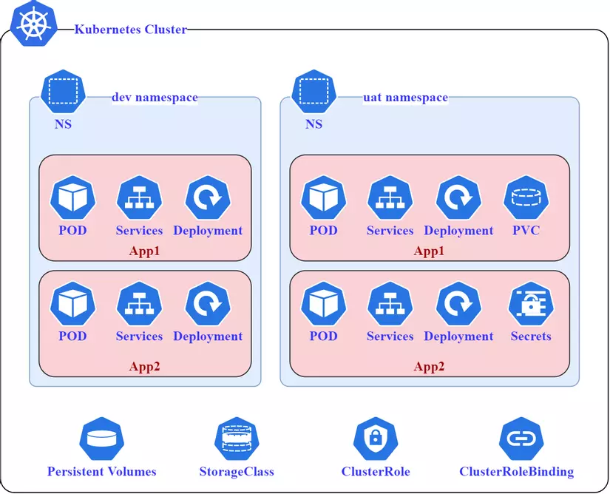
III. Kubernetes Architecture
5. Namespace
Separate resources

Slide 12
III. Kubernetes Architecture
6. Configmap + secret
Configmap: file to mount inside Pod
Secret: env

Slide 13
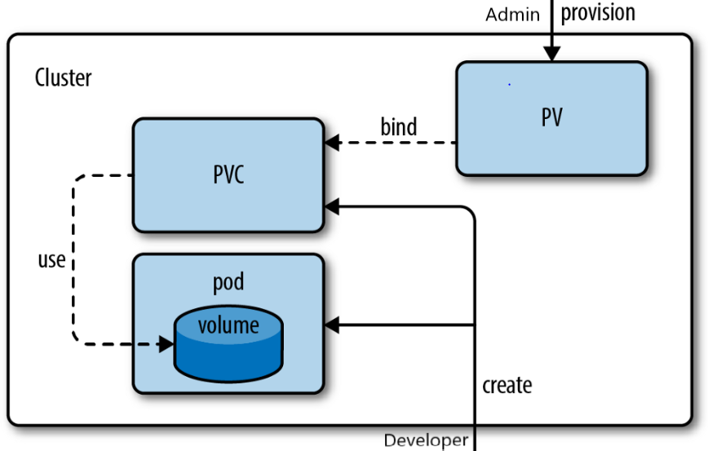
III. Kubernetes Architecture
7. Persistent Volume + Persistent Volume Claim

Slide 14
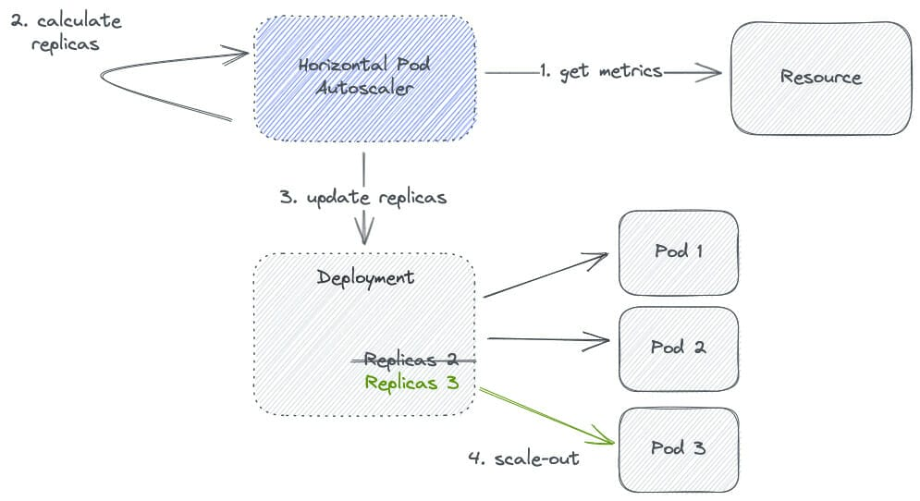
III. Kubernetes Architecture
8. Horizontal Pod Autoscaler
It make k8s know when/what strategy to scale the pod, define minimum/maximum replicas
** Must installed Metrics server before use it
https://github.com/kubernetes-sigs/metrics-server

Slide 15
III. Kubernetes Architecture
9. Many More..
install kubectl and kubectl completions, then type:
kubectl get + <tab>
-> We will see many others resources,
EG: cluster role binding, cluster role, event, jobs. job batch, network policy, CRD,...
⇒ CDR is CustomResourceDefination, means we can create our own things like Pod/Service but different names.
EG: SDF use Traefik ingressroute, which is CRD created from Traefik -> alternatives to ingress

Slide 16
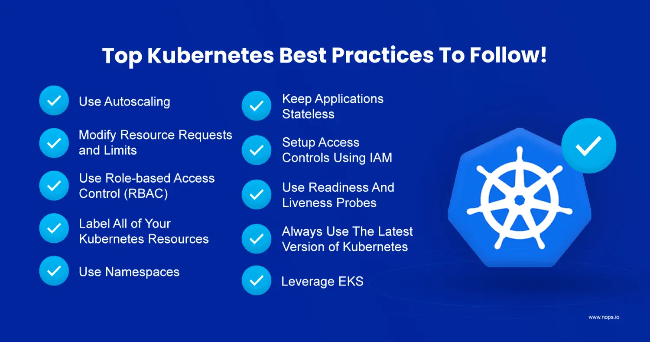
IV. Kubernetes common practice
Sample

Slide 17
IV. Kubernetes common practice
2. Deployment Flow

Slide 18
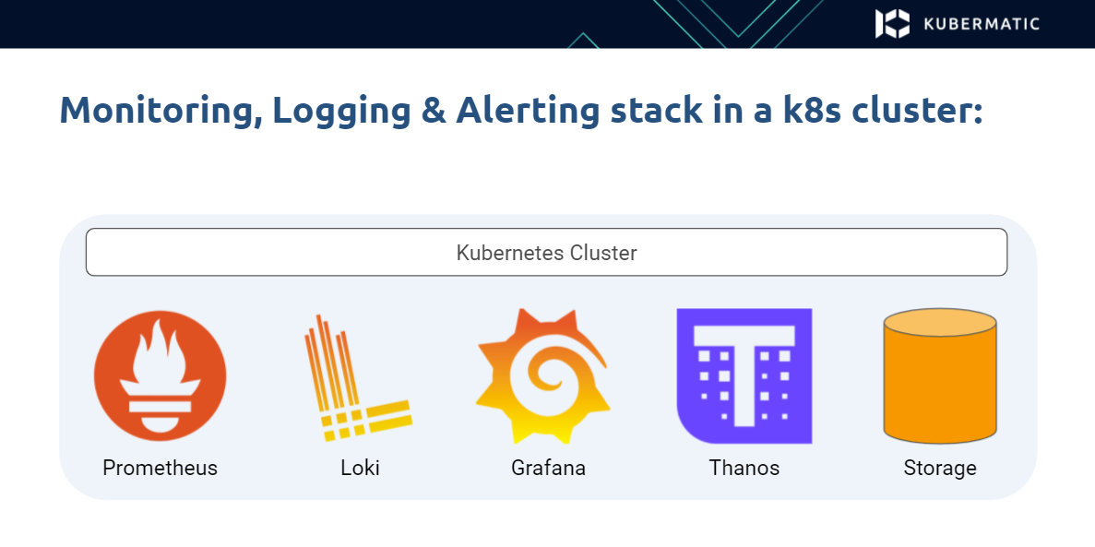
IV. Kubernetes common practice
3. Logging + Monitoring
kubectl logs, kubectl top
and other common tools like
ELK Stack, Prometheus, grafana dashboard, fluentbit log shipping

Slide 19
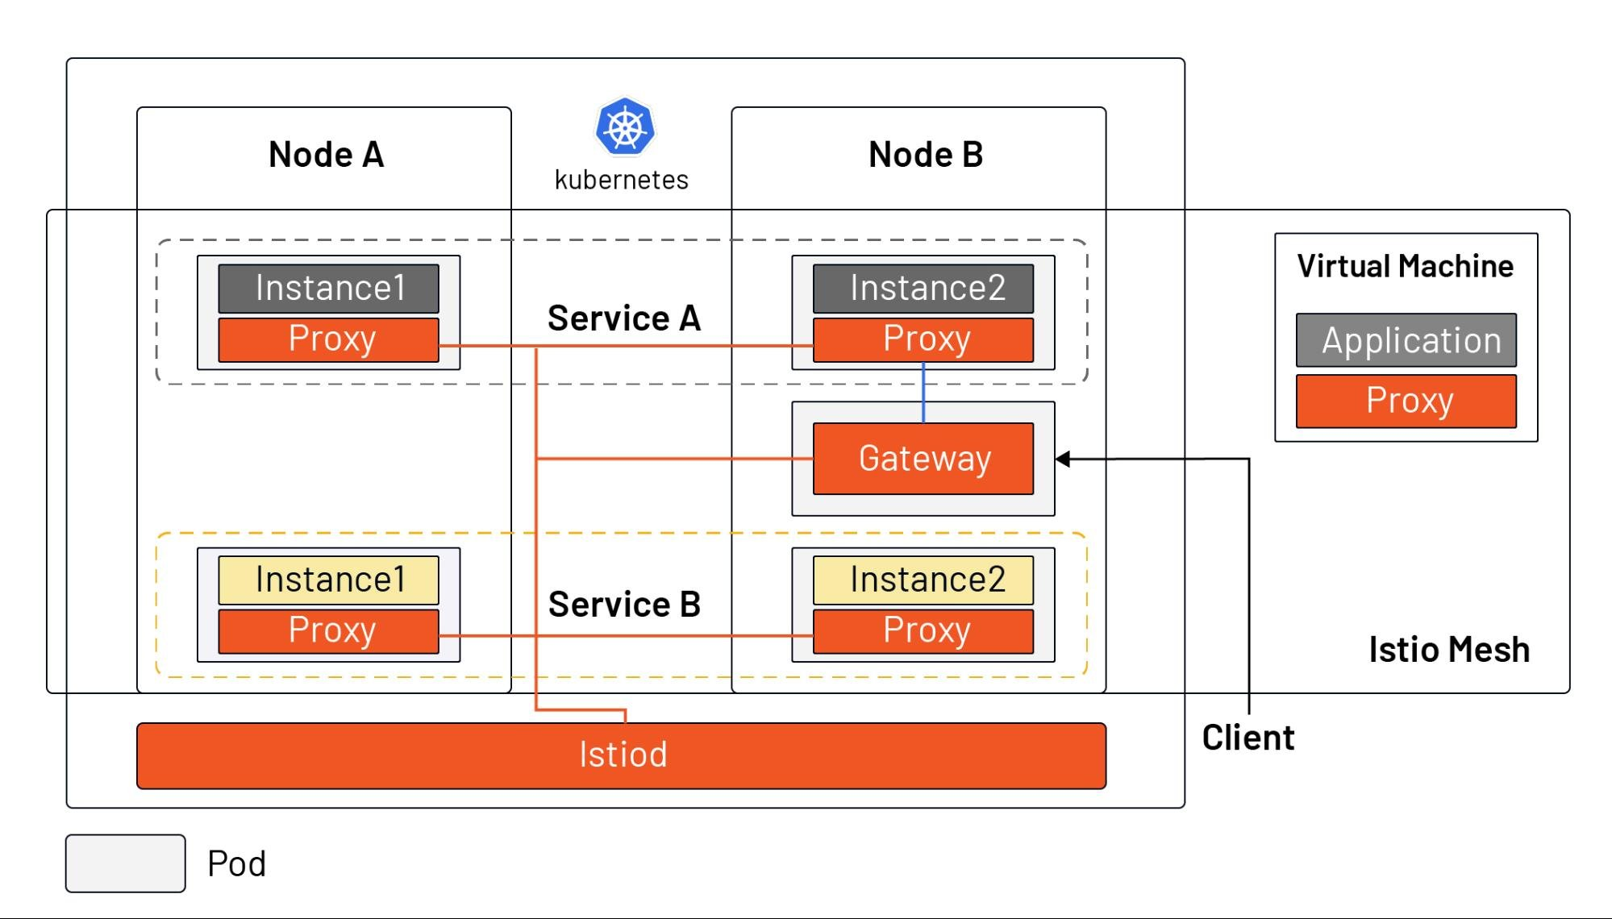
IV. Kubernetes common practice
4. Service Mesh Layer Add-ons
Traffic Management
Observability
Security
Reliability

Slide 20
V. Hands-on, interaction to k8s using kubectl
alternative: helm, kustomize (now builtin with kubectl)

Slide 21
Thanks for watching

