Slide 1
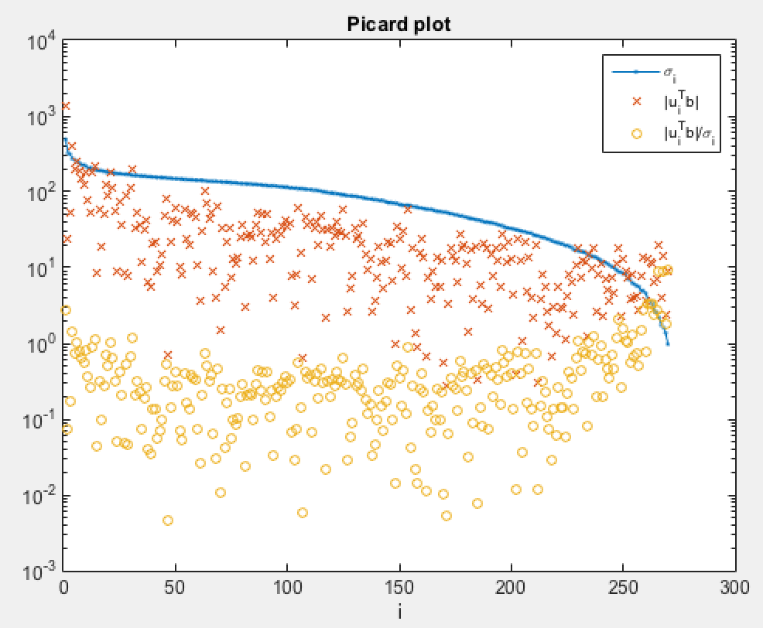
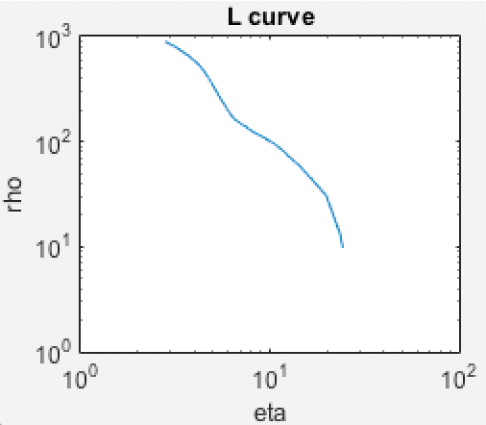
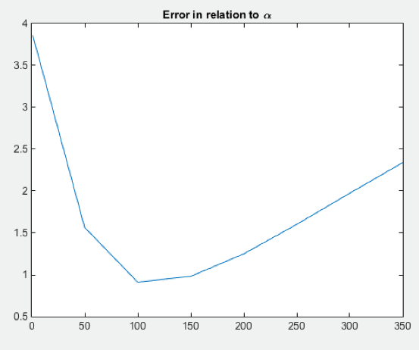
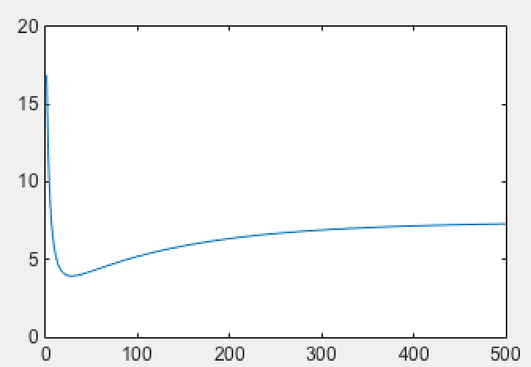
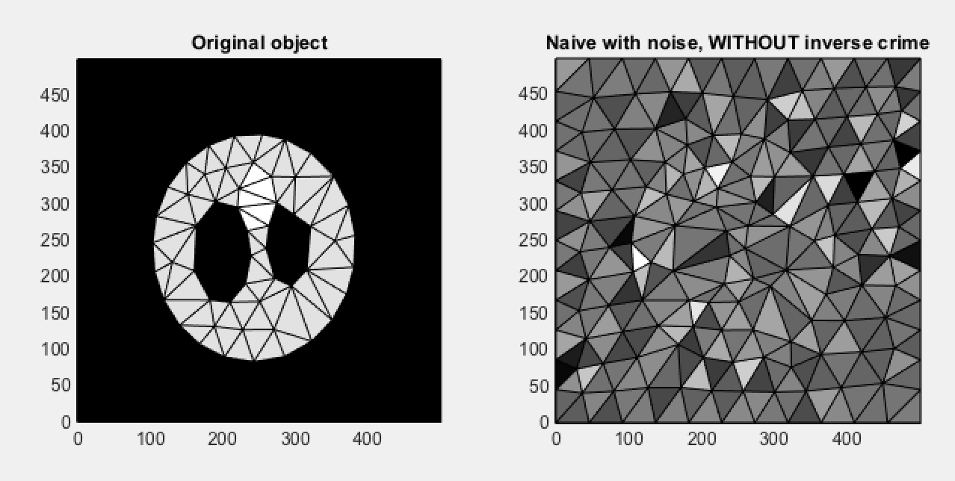
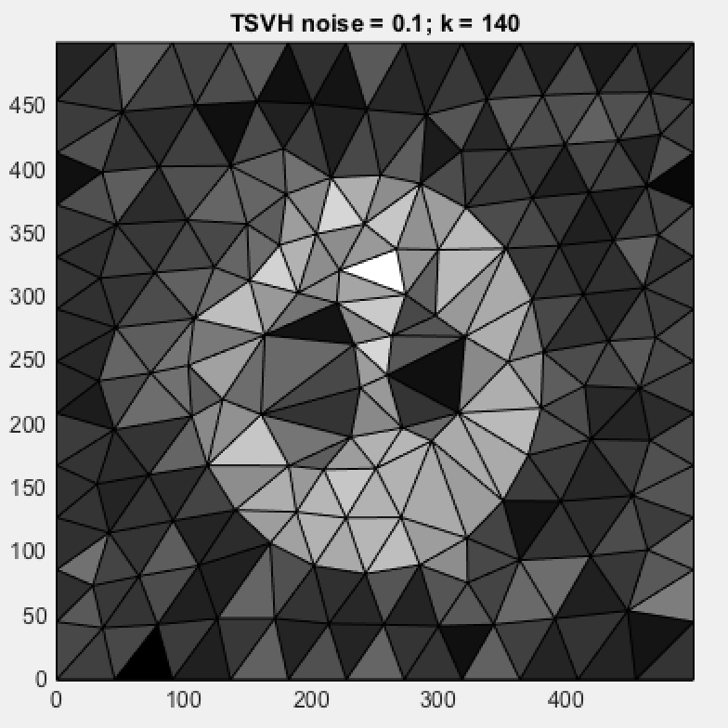
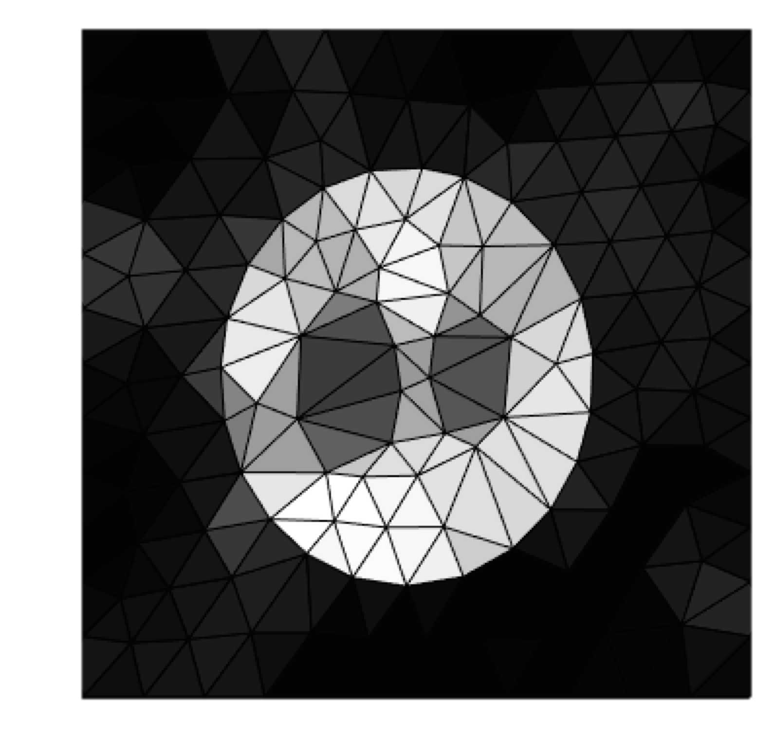
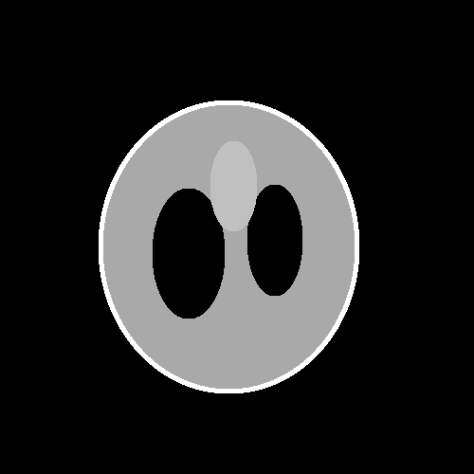
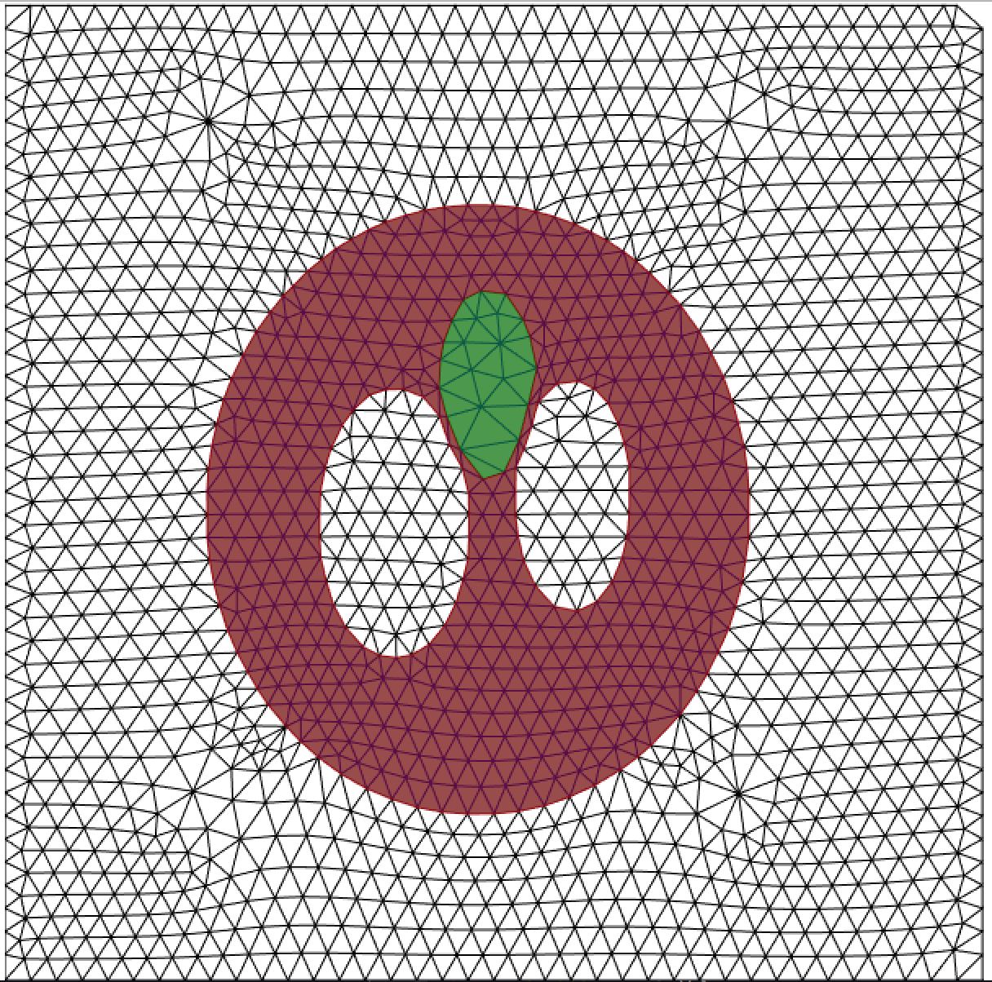
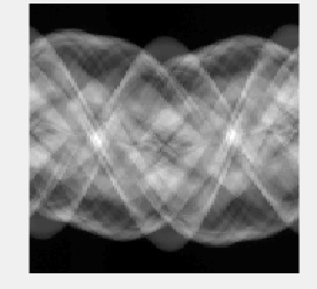
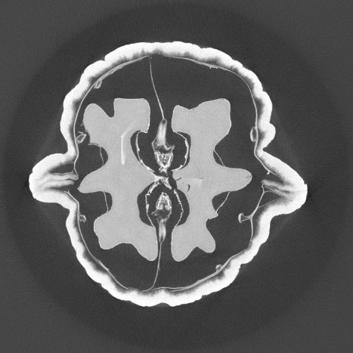
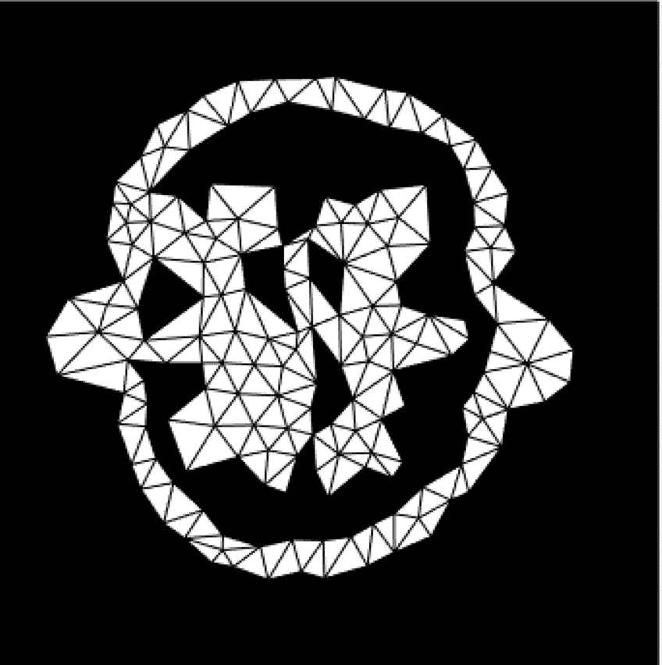
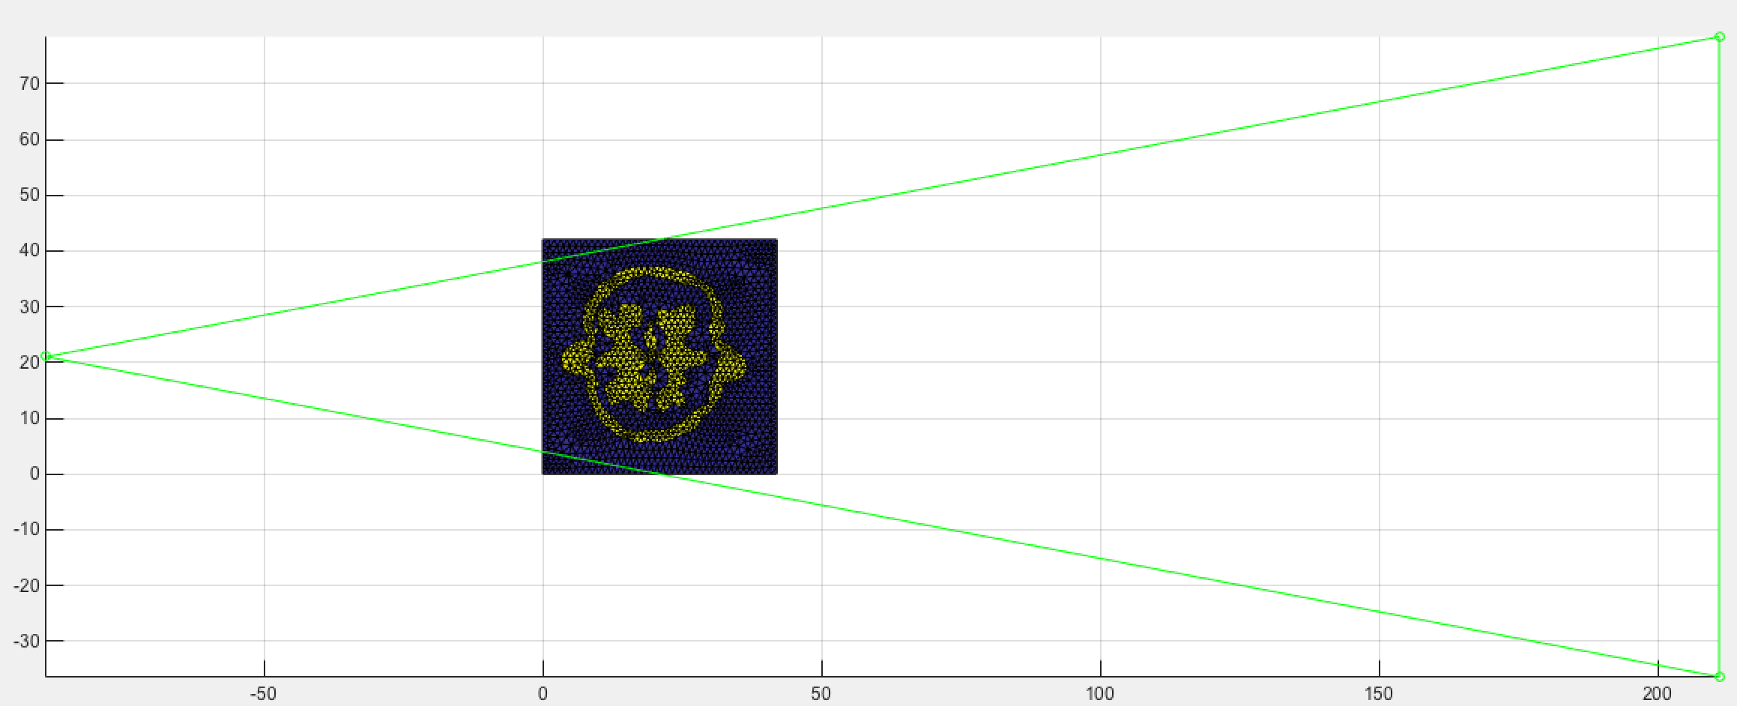
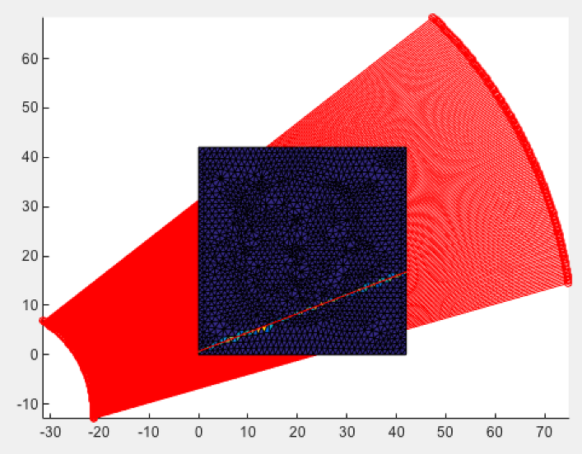
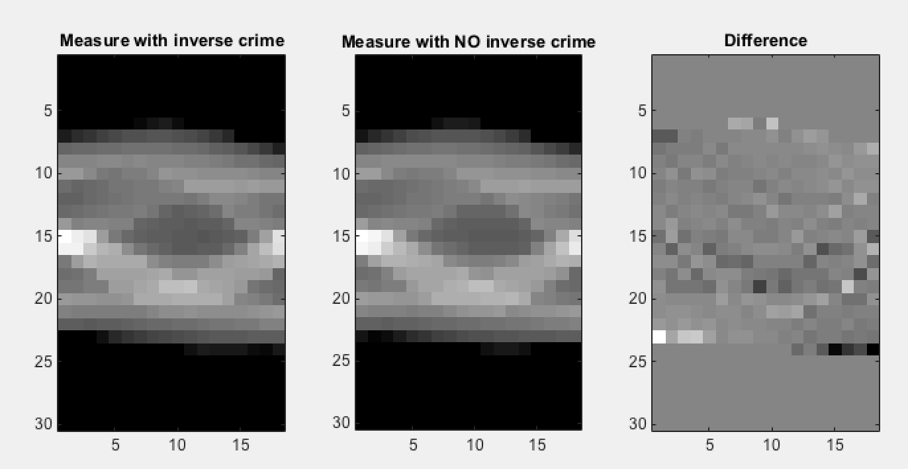
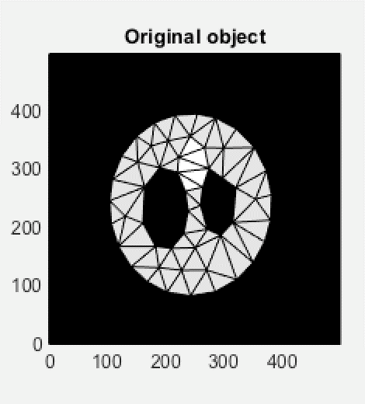
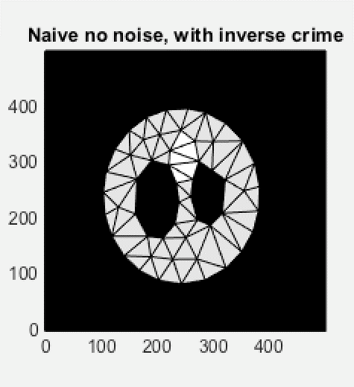
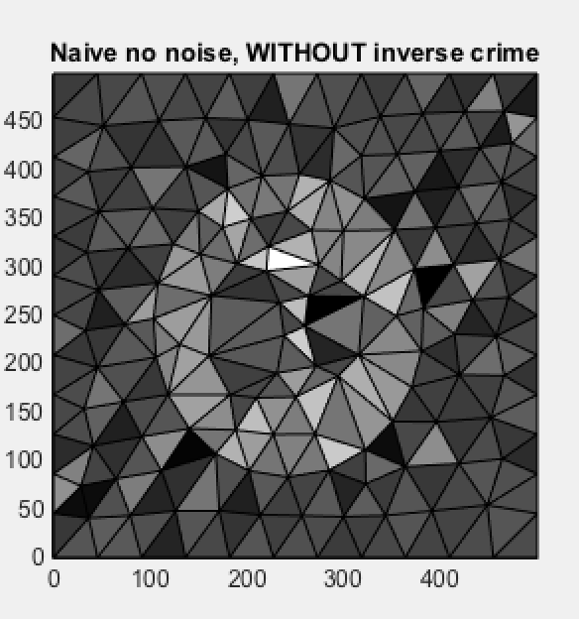
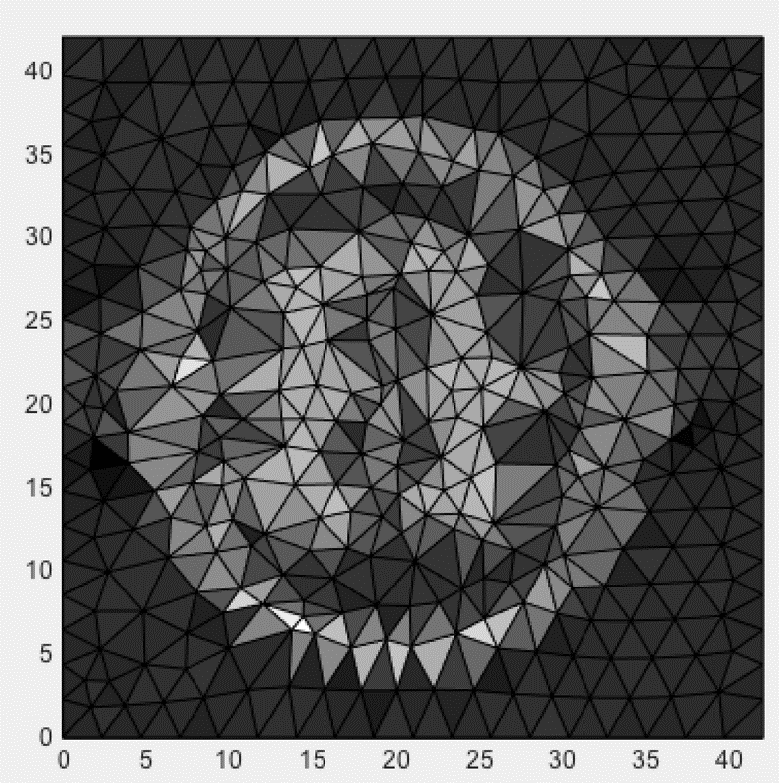
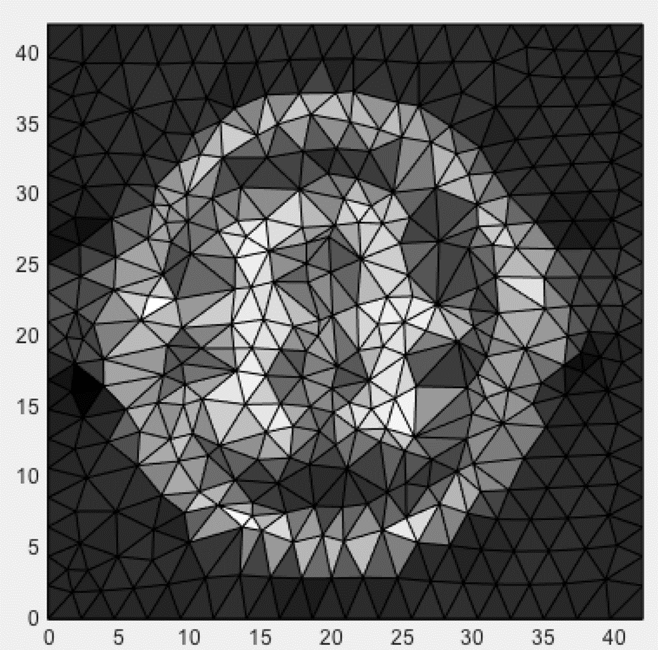
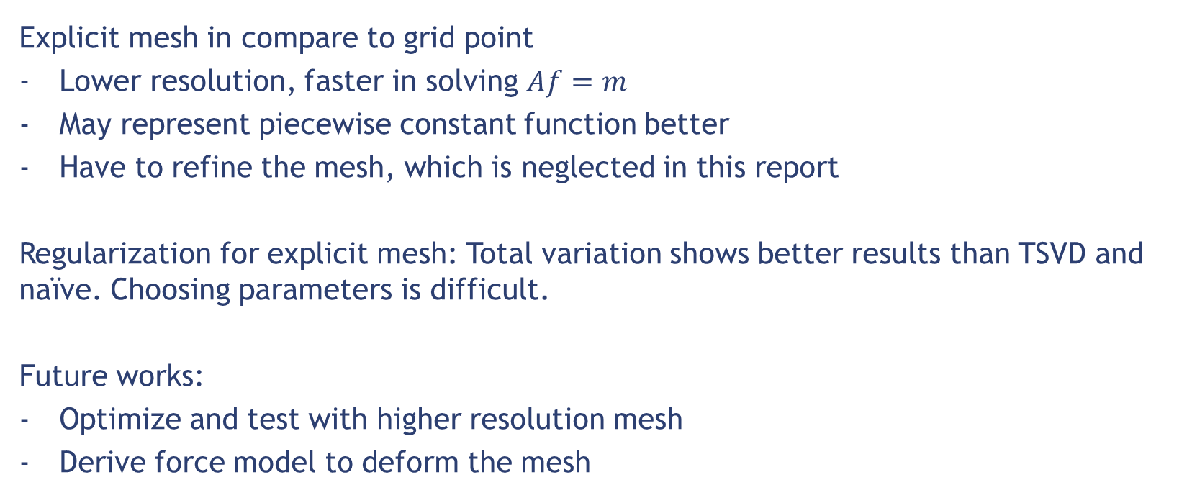
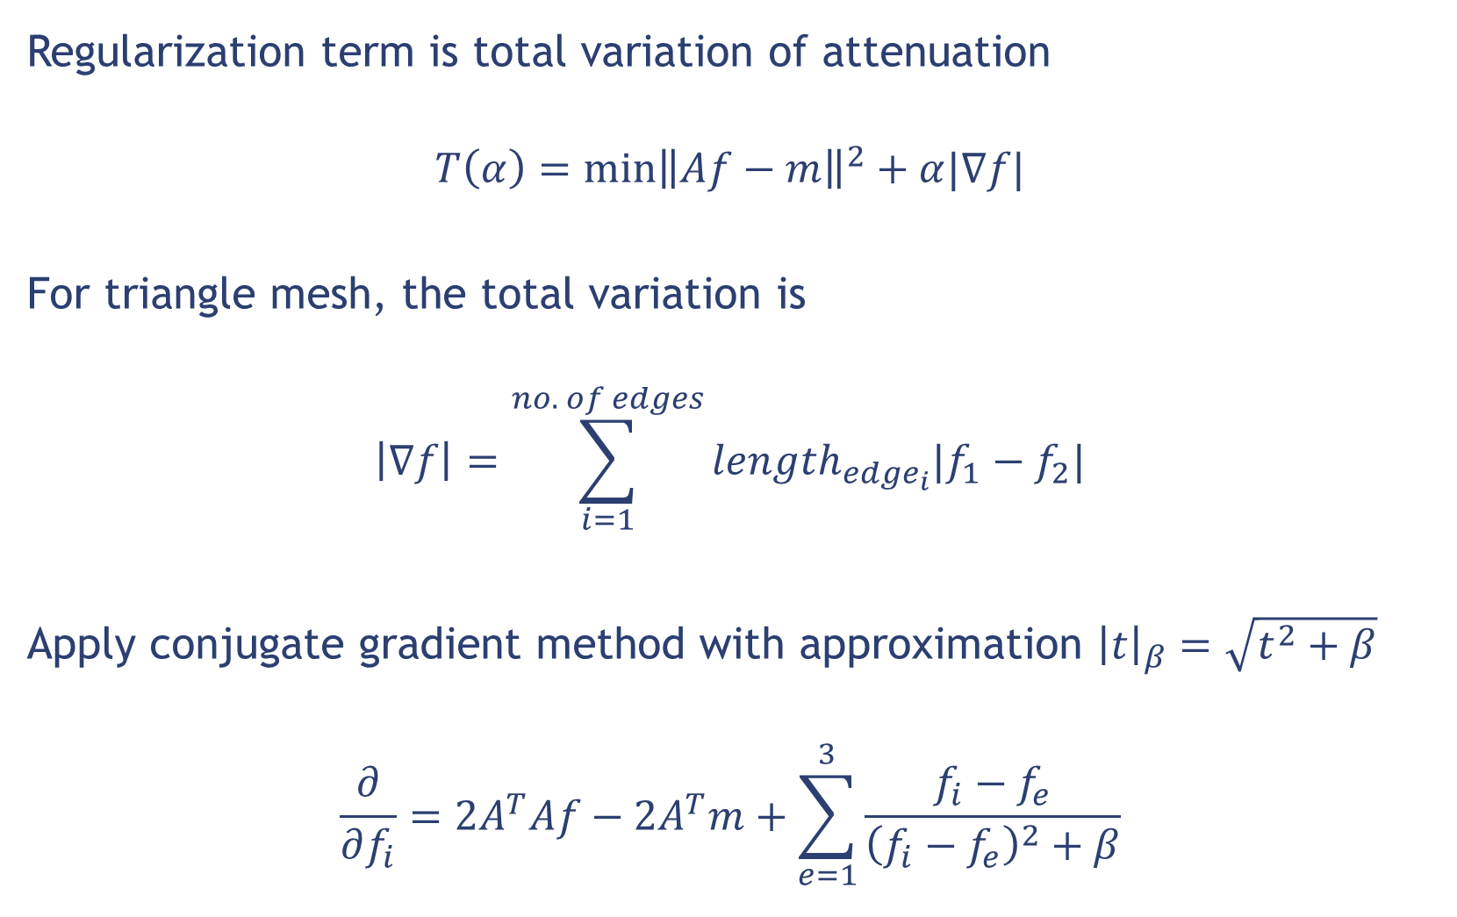




Tomography with Explicit Mesh
Tuan Nguyen
Discrete Inverse Problem, Summer 2015
ABSTRACT
PARAMETERS CHOICE
We reconstruct object from X-ray tomography data using explicit mesh (or Lagrangian mesh). In compare to normal methods, which use uniform grid points (or Eulerian mesh), Lagrangian mesh offers some advantages:
Explicit information can be extracted easier
Represent object with lower resolution of the mesh
Even though they are different in representation, the problem is still linear. This report applies regularization methods (TSVD and total variation) to explicit mesh model. We also evaluate the method with sparse data.
L-curve can not be applied. We use error to real solution to find optimal parameters
Picard plot, TSVD
L curve, TSVD
Error and coefficient $α$, total variation
Error of total variation to number of iterations, total variation
EXPLICIT MODEL
COMPARE REGULARIZATION METHODS
Explicit mesh representation
We discretize the 2D domain to triangular mesh. The attenuation inside each triangle is constant.
There are two jobs
Find attenuation in each triangle
Refine the mesh to reserve edge
10x18 measurements; 284 triangle; 10% noise
My work focuses on finding the attenuations. We assume the mesh already tracks the object.
Original object
Naïve solution
TSVD solution
Total variation
Phantom object
Mesh representation
TOMOGRAPHY WITH WALNUT SCAN
Forward model
We compute each measurement base on intersection between ray and triangles.
The relation between them are linear
The inverse problem can be solved with discrete inverse methods.
Tomography walnut model with $164×120$ measurements.
$$m_{i}=\sum_{j=1}^{all intersections}{l_{j}f_{j}}$$
$$Af=m$$
Sinogram with 120 projections
Construction from high resolution
Initialized mesh
AVOID INVERSE CRIME
Build matrix A
Inverse crime: To avoid inverse crime, we construct forward model with higher resolution phantom.
Cone beams set up
Find intersections to build $A$
Naïve solution and total variation
TOTAL VARIATION METHOD
Regularization term is total variation of attenuation
$$T\left(α\right)=\min{{\left\|Af−m\right\|}^{2}+α|∇f|}$$
For triangle mesh, the total variation is
$$\left|∇f\right|=\sum_{i=1}^{no. of edges}{length_{edge_{i}}|f_{1}−f_{2}|}$$
Apply conjugate gradient method with approximation ${\left|t\right|}_{β}=\sqrt{t^{2}+β}$
$$\frac{∂}{∂f_{i}}=2A^{T}Af−2A^{T}m+\sum_{e=1}^{3}{\frac{f_{i}−f_{e}}{{\left(f_{i}−f_{e}\right)}^{2}+β}}$$
Naïve solution
Total variation
CONCLUSIONS AND DISCUSSIONS
Explicit mesh in compare to grid point
Lower resolution, faster in solving $Af=m$
May represent piecewise constant function better
Have to refine the mesh, which is neglected in this report
Regularization for explicit mesh: Total variation shows better results than TSVD and naïve. Choosing parameters is difficult.
Future works:
Optimize and test with higher resolution mesh
Derive force model to deform the mesh

