Slide 1
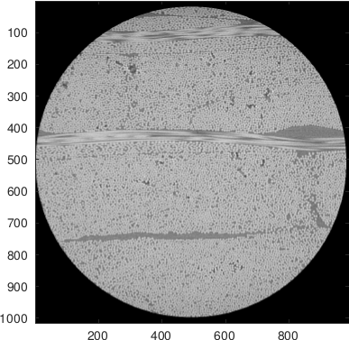
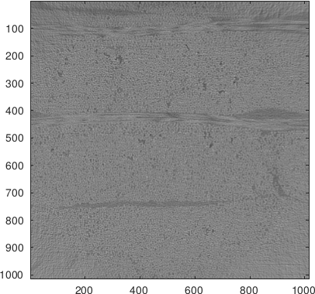
Center slice: vendor vs FDK, cone

Slide 2
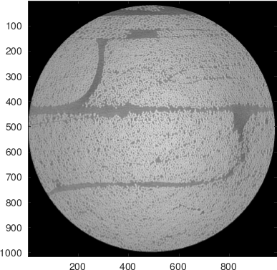
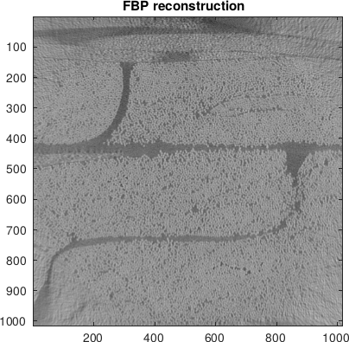
Off center, slice 10, vendor vs FBP

Slide 3
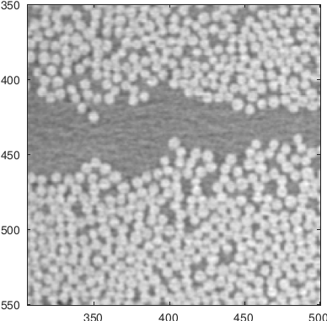
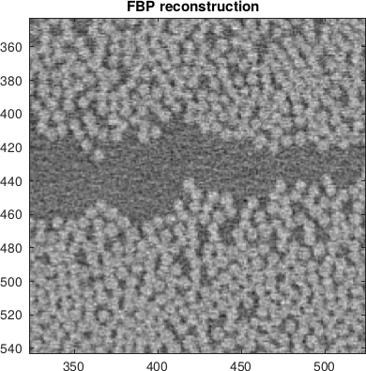
Previous slide zoomed

Slide 4
3D Reconstruction
Small MATLAB run

Slide 5
Lessons learned
3D Reconstructions from projection data
Reconstruction with wrong assumptions
Inside knowledge gives ‘better’ reconstructions
Iterative methods ‘may’ requires some tweaking

