Slide 1
openSUSE® Asia Summit 2016
Workshop
Estu Fardani
estu@opensuse.id

Slide 2
Centralized Logs using ELK
(Elasticsearch, Logstash, Kibana) Stack

Slide 3
Who am I?

Slide 4
Estu Fardani | @tuanpembual
Product Engineer at GO-JEK
DevOps Practitioner
Part-time sysadmin
Traveler SELO
Github.com/tuanpembual
Tuanpembual.wordpress.com

Slide 5
DevOps
“The most powerful tool we have as developers is automation.”
- Scott Hanselman

Slide 6
ELK Stack, How they work?

Slide 7
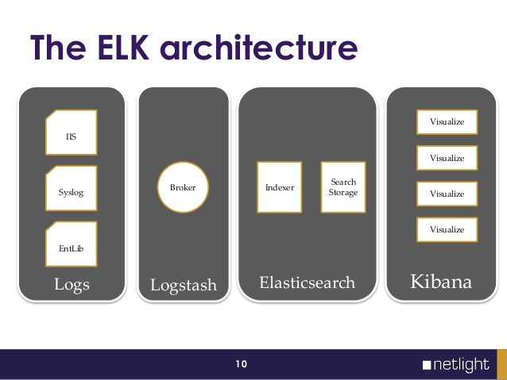

Slide 8
Join the conversation,
contribute & have a lot of fun!
DevOps Meetup #Jogja

