Slide 1

Centralized Logs using ELK Stack
FUDCon APAC, Phnom Penh
6 November 2016

Slide 2
About Me
Estu Fardani | @tuanpembual
I am from Indonesia

Slide 3
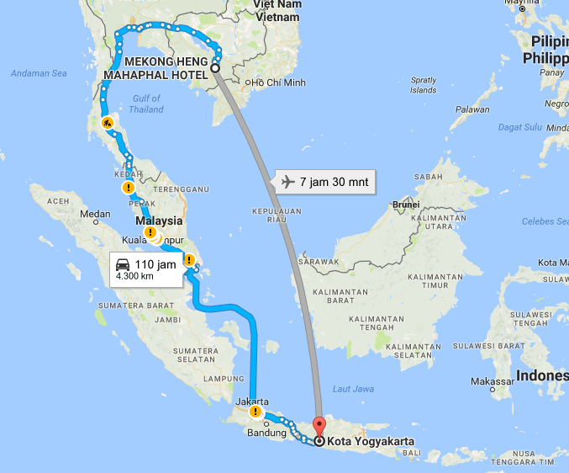
Where is it?

Slide 4
About Me
Working as Product Engineer in GO-JEK, online booking transportation, using motorcycle
Documentation Team at BlankOn Linux
Local Committee of
- openSUSE.Asia Summit 2016
- GNOME.Asia 2015
Fedora User

Slide 5
ELK Stack
I am not Elastic Sales Marketing :D

Slide 6
How to monitor lot of servers?
Log, Status
There are many tools to do that. I believe

Slide 7
Where is the starting point?
Last March 2016, starting move to DevOps
- Working with Ruby, chef DK, Vagrant, Jenkins.
My Project have 3 Env with 28 Box
3 service run in six box (each Env)
How to monitoring its logs?

Slide 8
Start with ELK
Log sender in client
- Beat, Filebeat and Topbeat
- Using certificate to verify sender
Log collector in server
- Logstash
Search engine in server
- Elasticsearch
Dashboard for visualization
- Kibana

Slide 9
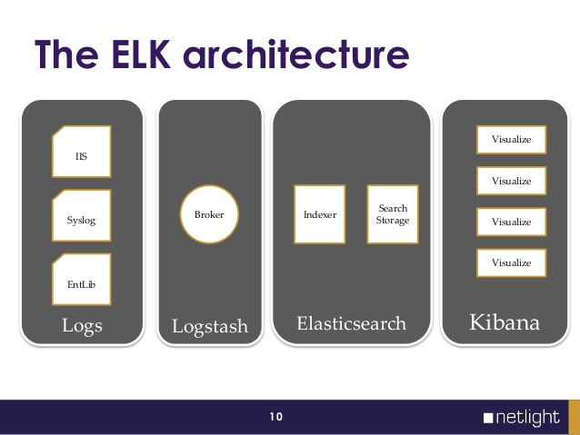
How ELK Work

Slide 10
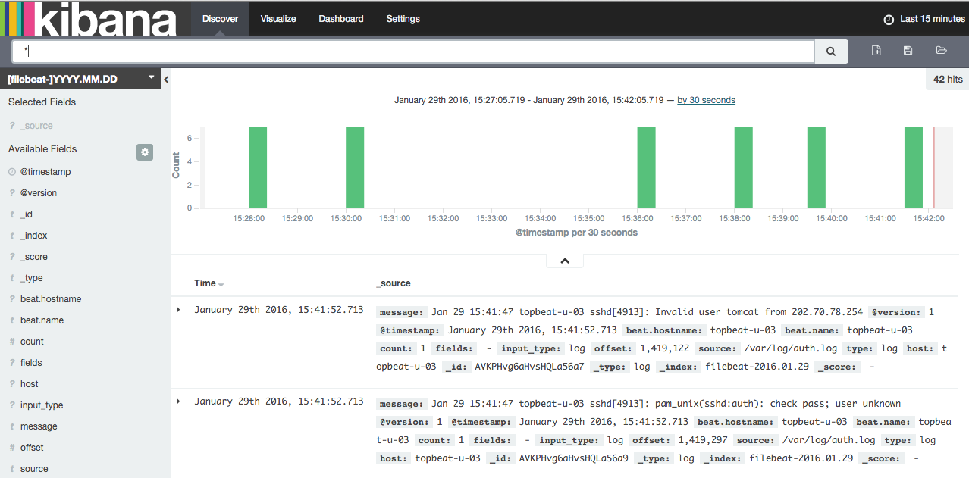
Demo

Slide 11
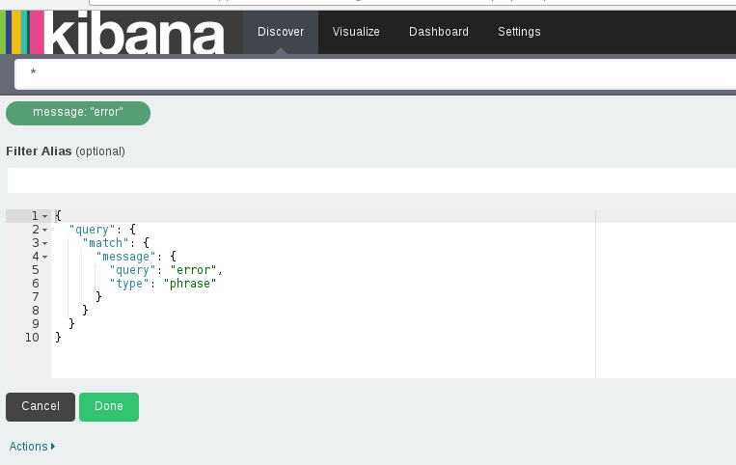
Search
Text, Phrase

Slide 12
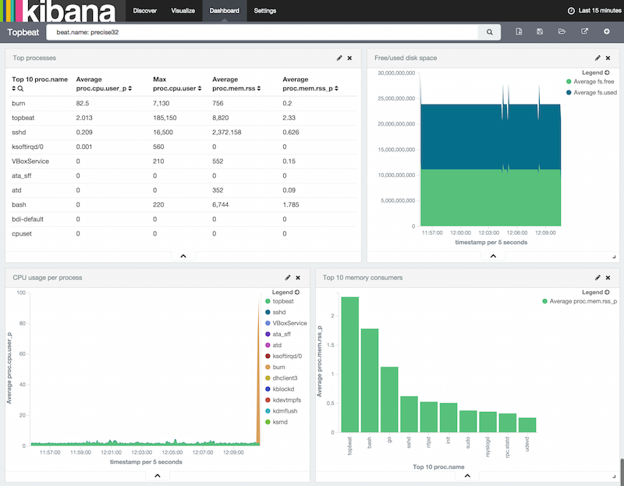
Status
Topbeat Dashboard

Slide 13
Questions

Slide 14
Thank you
Contact me:
Estu Fardani | FB estu@jogja.linux.or.id
@tuanpembual

