Slide 1
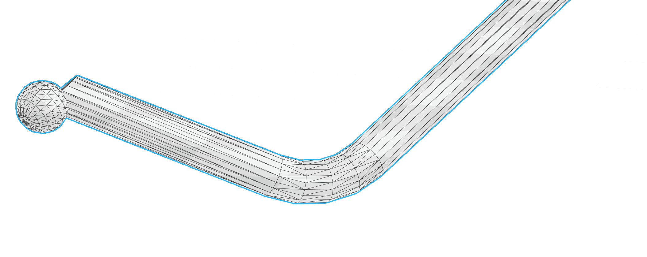
2.3mm
0.31mm
0.31mm
0.31mm
0.31mm

