Slide 1

Statistics
Reconnaissance stages:
  Number of benign flows: 24849
  Number of reconnaissance flows: 4405
Lateral Movement stages (on private network):
  Number of benign flows: 8456
  Number of lateral movement flows: 2314

Slide 2
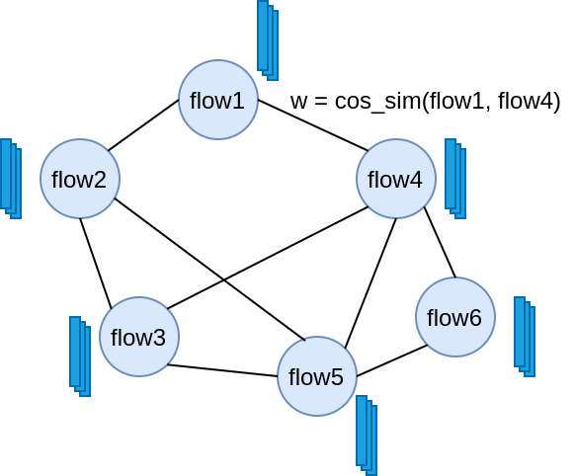
Method
Use GCN to detect reconaissance/lateral movement.
Node classification, each flow is represented by a flow the graph.
Nodes are connected if the two flows have cosine similarity > T.
Edge weight will be assigned as the cosine similarity.

Slide 3
Method
 | Reconnaissance | Lateral Movement
n_train | 1000 | 400
n_val | 11,301 | 4148
n_test | 16,953 | 6222
Number of samples from train/val/test set

Slide 4
Results
 | Benign | Reconnaissance
Precision | 0.97620279 | 0.5905903
Recall | 0.90410678 | 0.86256936
F1-score | 0.93877261 | 0.70112749
Support | 14610 | 2343
 | Benign | Lateral Movement
Precision | 0.99431431 | 0.68109589
Recall | 0.88251918 | 0.98028391
F1-score | 0.93508716 | 0.8037504
Support | 4954 | 1268

Slide 5
Conclusion
This implementation use multi-class GCN, while the method they used 1-class classifier (anomalies detection).
The initial results show that the GCN has the potential to outperform the algorithms used for classifying in the DAPT-2020 paper.
Improvements can be made
  Incorporate better graph structure to capture relationships between flows
  Use 1-class GCN as in the paper to handle the problem of few malicious samples
  Feature selection: using only important features.
  Logs data?

