Slide 1
RTOS
Design & Implementation
Swetanka Kumar Mishra & Kirti Chawla

Slide 2
Introduction
Introduction
Structure of RTOS
Components of RTOS
RTOS Kernel
Tasks
Memory
Timers
I/O
IPCs
Device Drivers
Expectations
Examples
A variant of OS that operates in constrained environment in which computer memory and processing power is limited. Moreover they often need to provide their services in definite amount of time.
Hard, Soft & Firm RTOS
Example RTOS: VxWorks, pSOS, Nucleus, RTLinux…

Slide 3
Structure of a RTOS
Introduction
Structure of RTOS
Components of RTOS
RTOS Kernel
Tasks
Memory
Timers
I/O
IPCs
Device Drivers
Expectations
Examples
Applications
RTOS-kernel
BSP
Custom-Hardware

Slide 4
Components of RTOS
Introduction
Structure of RTOS
Components of RTOS
RTOS Kernel
Tasks
Memory
Timers
I/O
IPCs
Device Drivers
Expectations
Examples
The most important component of RTOS is its kernel (Monolithic & Microkernel).
BSP or Board Support Package makes an RTOS target-specific (It’s a processor specific code onto (processor) which we like to have our RTOS running).

Slide 5
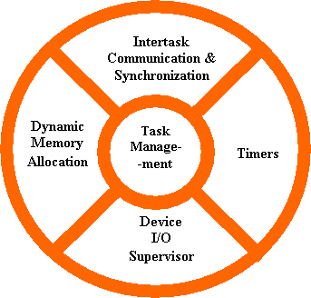
RTOS KERNEL
Introduction
Structure of RTOS
Components of RTOS
RTOS Kernel
Tasks
Memory
Timers
I/O
IPCs
Device Drivers
Expectations
Examples

Slide 6
RTOS KERNEL: Tasks(1)
Introduction
Structure of RTOS
Components of RTOS
RTOS Kernel
Tasks
Memory
Timers
I/O
IPCs
Device Drivers
Expectations
Examples
A task is basic unit of execution in RTOS.
RTOS scheduler needs to be deterministic ~ O(1) or O(n).
Scheduling policies that are available in a RTOS are:
  Clock driven
  Priority driven (RMS & EDF)

Slide 7
RTOS KERNEL: Tasks(2)
Introduction
Structure of RTOS
Components of RTOS
RTOS Kernel
Tasks
Memory
Timers
I/O
IPCs
Device Drivers
Expectations
Examples
.
.
TID
SAVED_TASK_STATE
Resource 1 (signals)
Resource 2 (events)
Resource 3 (shared memory)
System Variables
Task Control Block

Slide 8
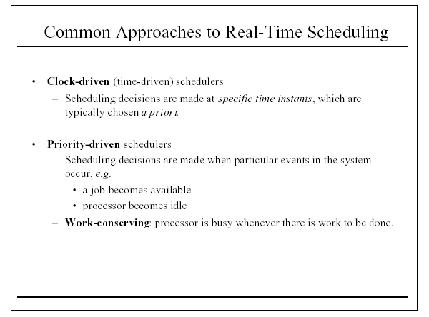
RTOS KERNEL: Tasks(3)
Introduction
Structure of RTOS
Components of RTOS
RTOS Kernel
Tasks
Memory
Timers
I/O
IPCs
Device Drivers
Expectations
Examples

Slide 9
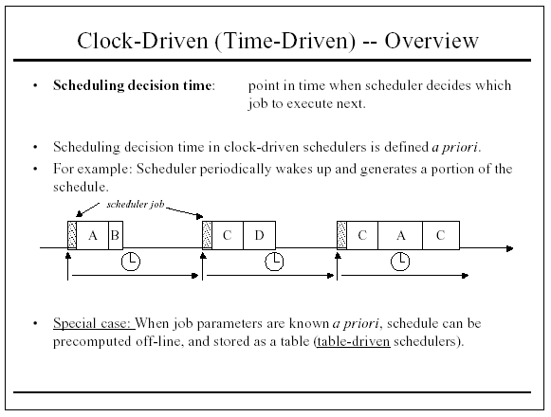
RTOS KERNEL: Tasks(4)
Introduction
Structure of RTOS
Components of RTOS
RTOS Kernel
Tasks
Memory
Timers
I/O
IPCs
Device Drivers
Expectations
Examples

Slide 10
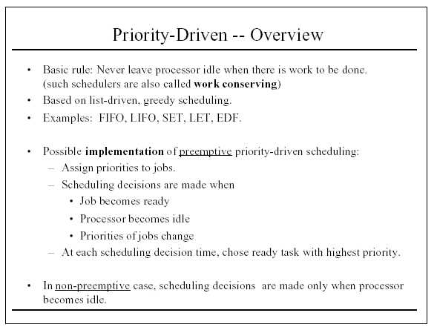
RTOS KERNEL: Tasks(5)
Introduction
Structure of RTOS
Components of RTOS
RTOS Kernel
Tasks
Memory
Timers
I/O
IPCs
Device Drivers
Expectations
Examples
RMS, EDF

Slide 11
RTOS KERNEL: Tasks(6)
Introduction
Structure of RTOS
Components of RTOS
RTOS Kernel
Tasks
Memory
Timers
I/O
IPCs
Device Drivers
Expectations
Examples
XXX_CreateTask
XXX_AddtoProcessQueue
XXX_ChangePriority
XXX_KillTask
XXX_CreateTaskQueues
…

Slide 12
RTOS KERNEL: Memory(1)
Introduction
Structure of RTOS
Components of RTOS
RTOS Kernel
Tasks
Memory
Timers
I/O
IPCs
Device Drivers
Expectations
Examples
Memory is premium in environments where RTOS work.
Supports Virtual Memory (MMU) and Memory Protection (MPU) models.
User space and Kernel space memory.

Slide 13
RTOS KERNEL: Memory(2)
Introduction
Structure of RTOS
Components of RTOS
RTOS Kernel
Tasks
Memory
Timers
I/O
IPCs
Device Drivers
Expectations
Examples
Physical Address
M
Virtual Address
.
.
.
.
.
PHY1 VIRT1
PHY2 VIRT2
PHY3 VIRT3
PHY4 VIRT4
Virtual Memory Concept

Slide 14
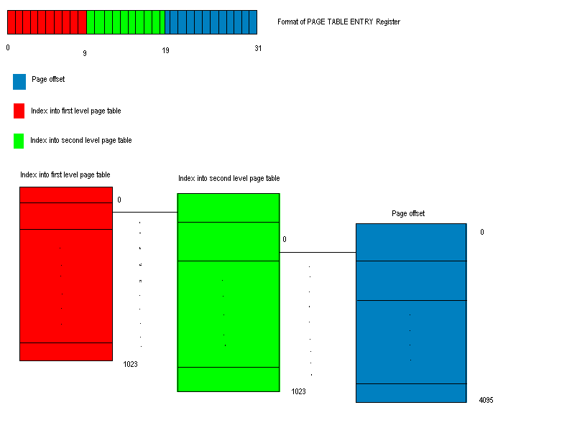
RTOS KERNEL: Memory(3)
Introduction
Structure of RTOS
Components of RTOS
RTOS Kernel
Tasks
Memory
Timers
I/O
IPCs
Device Drivers
Expectations
Examples
Virtual Memory Concept

Slide 15
RTOS KERNEL: Memory(4)
Introduction
Structure of RTOS
Components of RTOS
RTOS Kernel
Tasks
Memory
Timers
I/O
IPCs
Device Drivers
Expectations
Examples
Participation of User space programs with kernel for services and as a central pool of memory for specialized applications.
User Space memory
P1
P2
Kernel Space Memory
M1
M2

Slide 16
RTOS KERNEL: Memory(5)
Introduction
Structure of RTOS
Components of RTOS
RTOS Kernel
Tasks
Memory
Timers
I/O
IPCs
Device Drivers
Expectations
Examples
XXX_Kmap
XXX_PassToUserSpace
XXX_Mmap
XXX_PurgeMemory/Kfree
XXX_Kmalloc
…

Slide 17
RTOS KERNEL: Timer(1)
Introduction
Structure of RTOS
Components of RTOS
RTOS Kernel
Tasks
Memory
Timers
I/O
IPCs
Device Drivers
Expectations
Examples
Timer is software entity derived from hardware clock.
Timer provides mechanism to introduce task-delays and/or to help synchronize and provide time off-course.
Watchdog Timers, Programmable Timers

Slide 18
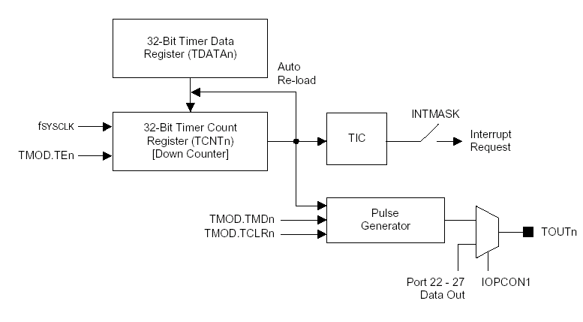
RTOS KERNEL: Timer(2)
Introduction
Structure of RTOS
Components of RTOS
RTOS Kernel
Tasks
Memory
Timers
I/O
IPCs
Device Drivers
Expectations
Examples

Slide 19
RTOS KERNEL: Timer(3)
Introduction
Structure of RTOS
Components of RTOS
RTOS Kernel
Tasks
Memory
Timers
I/O
IPCs
Device Drivers
Expectations
Examples
Based upon these hardware-programmable timers, RTOS kernel can use to create software structures of timers associated with tasks.
Scheduling, Synchronization, time-stamping…

Slide 20
RTOS KERNEL: Timer(4)
Introduction
Structure of RTOS
Components of RTOS
RTOS Kernel
Tasks
Memory
Timers
I/O
IPCs
Device Drivers
Expectations
Examples
XXX_SetTimer
XXX_AddtoTimerQueue
XXX_isExpired
XXX_RunAtExpiry
XXX_PurgeTimerQueue
…

Slide 21
RTOS KERNEL: I/O(1)
Introduction
Structure of RTOS
Components of RTOS
RTOS Kernel
Tasks
Memory
Timers
I/O
IPCs
Device Drivers
Expectations
Examples
I/O is slow as compared to CPU.
I/O: Interrupt-driven, Polling, DMA.
I/O map: Memory Space & IO Space.

Slide 22
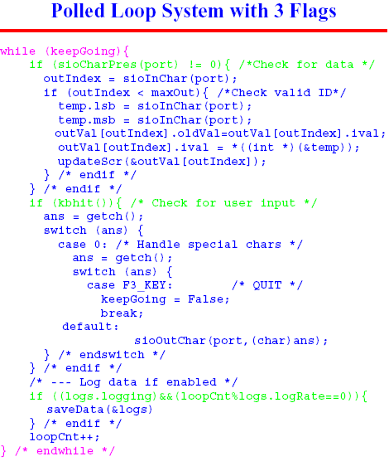
RTOS KERNEL: I/O(2)
Introduction
Structure of RTOS
Components of RTOS
RTOS Kernel
Tasks
Memory
Timers
I/O
IPCs
Device Drivers
Expectations
Examples

Slide 23
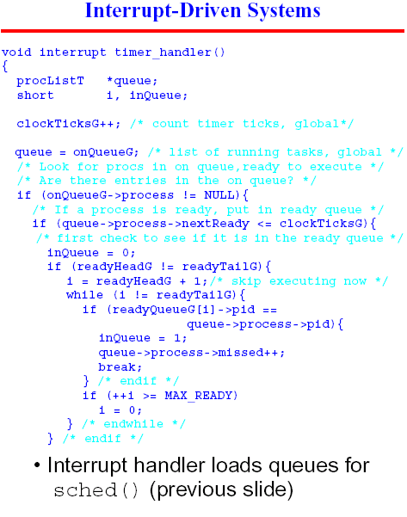
RTOS KERNEL: I/O(3)
Introduction
Structure of RTOS
Components of RTOS
RTOS Kernel
Tasks
Memory
Timers
I/O
IPCs
Device Drivers
Expectations
Examples

Slide 24
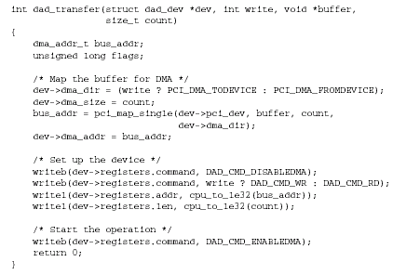
RTOS KERNEL: I/O(4)
Introduction
Structure of RTOS
Components of RTOS
RTOS Kernel
Tasks
Memory
Timers
I/O
IPCs
Device Drivers
Expectations
Examples
DMA driven I/O

Slide 25
RTOS KERNEL: I/O(5)
Introduction
Structure of RTOS
Components of RTOS
RTOS Kernel
Tasks
Memory
Timers
I/O
IPCs
Device Drivers
Expectations
Examples
XXX_IORead/IOWrite
XXX_IOMap/Unmap
XXX_BindInterrupt
…

Slide 26
RTOS KERNEL:
Inter-process Communication(1)
Introduction
Structure of RTOS
Components of RTOS
RTOS Kernel
Tasks
Memory
Timers
I/O
IPCs
Device Drivers
Expectations
Examples
Most of the time tasks cannot run in isolation. They require to talk to each other.
Synchronization, Protection and Sharing are goals of IPC.

Slide 27

RTOS KERNEL:
Inter-process Communication(2)
Introduction
Structure of RTOS
Components of RTOS
RTOS Kernel
Tasks
Memory
Timers
I/O
IPCs
Device Drivers
Expectations
Examples
Semaphores (Binary, Mutual)
Message Queues
Pipes/Named Pipes
Shared Memory
Signals/Slots
Mail slots
Sockets/XTI …

Slide 28
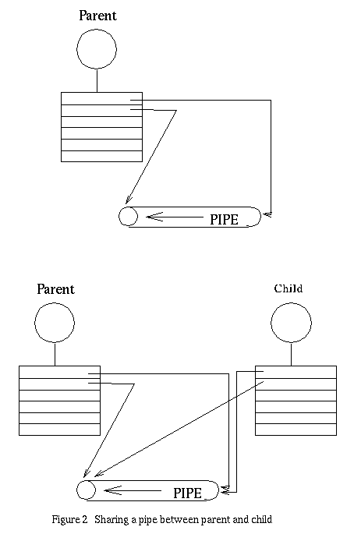
RTOS KERNEL:
Inter-process Communication(3)
Introduction
Structure of RTOS
Components of RTOS
RTOS Kernel
Tasks
Memory
Timers
I/O
IPCs
Device Drivers
Expectations
Examples
A common shared data-structure residing in kernel or user space.
Mechanism to access it.

Slide 29
RTOS KERNEL:
Device Drivers(1)
Introduction
Structure of RTOS
Components of RTOS
RTOS Kernel
Tasks
Memory
Timers
I/O
IPCs
Device Drivers
Expectations
Examples
A piece of software that enables devices connected to particular processor, via various interfaces.
Controls, manages and configures devices connected to system.

Slide 30
RTOS KERNEL:
Device Drivers(2)
Introduction
Structure of RTOS
Components of RTOS
RTOS Kernel
Tasks
Memory
Timers
I/O
IPCs
Device Drivers
Expectations
Examples
Client Drivers
Protocol Layers
Host Controller Drivers
Hardware

Slide 31
RTOS KERNEL:
Device Drivers(3)
Introduction
Structure of RTOS
Components of RTOS
RTOS Kernel
Tasks
Memory
Timers
I/O
IPCs
Device Drivers
Expectations
Examples
A host controller driver enables system to accept a particular type of device.
Client drivers are device specific.
Protocol layer converts device request to form that is understood by corresponding host controllers through their drivers.

Slide 32
Expectations from RTOS
Introduction
Structure of RTOS
Components of RTOS
RTOS Kernel
Tasks
Memory
Timers
I/O
IPCs
Device Drivers
Expectations
Examples
Deadline-driven
Work with Dearth of Resources
Intricate I/O interfaces (Touch panels, Push buttons …)
Fail-safe and Robust
Availability

Slide 33
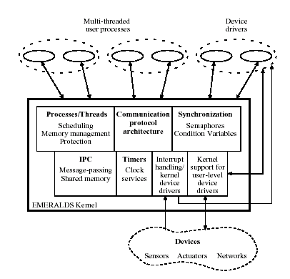
An Example RTOS
Introduction
Structure of RTOS
Components of RTOS
RTOS Kernel
Tasks
Memory
Timers
I/O
IPCs
Device Drivers
Expectations
Examples
EMERALDS architecture

Slide 34
Relevant books and websites
http://www.intelinfo.com/it_training_materials_and_books/free_real_time_operating_systems_training_materials.html
Linux Device Drivers – Alexander Rubini, Oreilly publications
http://www.ddjembedded.com : Dr. Dobb’s Journal
http://www.embedded.com
Some RTOS based Embedded Systems
http://www.ll.mit.edu/HPEC/agendas/proc02/abstracts/ahlander.pdf
http://www.cs.berkeley.edu/~culler/cs294-f03/papers/emeralds.pdf

