Slide 1
Nehmedia Assignment
By: Tuan (Tony) Tran

Slide 2
Task 1 Requirement
Write a script (using Nightmare, PhantomJS, CasperJS, Selenium, or any environment of your choice) to do the following:
* Navigate to htt[s://www.netdirectautosales.com/inventory/ *For each item in the “Make” filter on the left (for example, “Chevrolet”, “Dodge”, “Ford”, etc) click that item, and then count the number of time its label appears in the first page of search results.
The output of this task should look something like: Chevrolet: 12 Dodge: 3 Ford: 12 GMC: 6 Jeep: 7

Slide 3
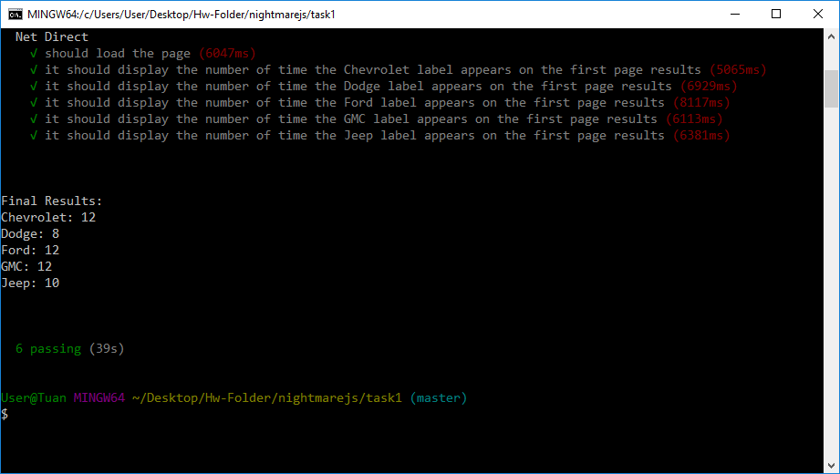
Results using NightmareJS and Chai

Slide 4
Possible Improvements
There are repeated code within the file and I would like to dry it down by creating a function with a set parameter that contains an on-click value of the cars model. This can significantly reduce the current code.
I would also like to find a faster and more efficient method to reduce electrons testing period. (Which currently takes 25-35 seconds to complete.)

Slide 5
Task 2 Requirements
Take a look at https://www.netdirectautosales.com/used/2013-ford-f-150-4x4-supercrew-xlt-4334/
The first vehicle image has a big red bar that says “Brand New Lift, Wheels, and Tries. “We’d like to remove that red bar from images that have it, but leave the other images (that don’t have it) intact. How would you do that? Please do not assume that only the first image has the red bar. They can be in random images.

Slide 6
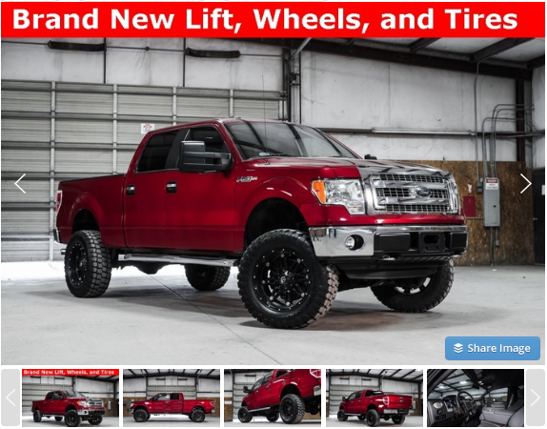
Current:
I noticed that the big red bars are actually embedded into the image.
I did a quick measurement on the height of the bar, which equivalent to 50px.

Slide 7
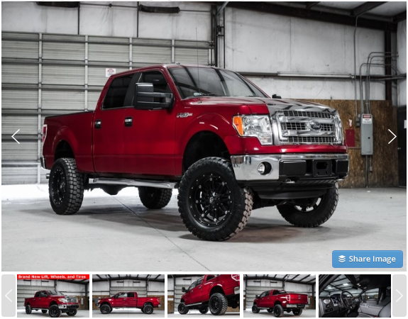
Results:
The method would vary depending if the image was hard coded into the carousel html page or dynamically added. Assuming that it was dynamically added, I recommend providing a class for the larger image. EX: .largeImageTagRemoval{
position: absolute; top: -50px; height: calc(100% + 50px);
};

Slide 8


Results:
Before:
After:
Results using NightmareJS and Chai
The smaller images below would have the same method, but with a slight modification to the px sizing. Which turns out to be 8px. EX: .smallerImageTagRemoval{
position: absolute; top: -8px; height: calc(100% + 8px);
};

Slide 9
Pros:
Cons:
This method guarantees the removal of all red bars from every images with the given classes.
Due to the red bar being embedded into the image itself. Images that does not have the red bars will lose the specify height of either 50px or 8px from the top of the image, but still fill its container.
This isn’t an ideal solution, but I believe this is one method we can definitely consider.

