Slide 1
Chapter 4. High-Level Database Model

Slide 2
Objectives
Understand the Database Design Process
Understand data modeling basing on entity relationship
Design a suitable database adapted business requirements in reality

Slide 3
Contents
Database design process
Entity relationship model
What are entity, entity set, attribute, relationship?
Entity Relationship Diagram (ERD)
Attributes on Relationships
Weak Entities
Sub-class

Slide 4
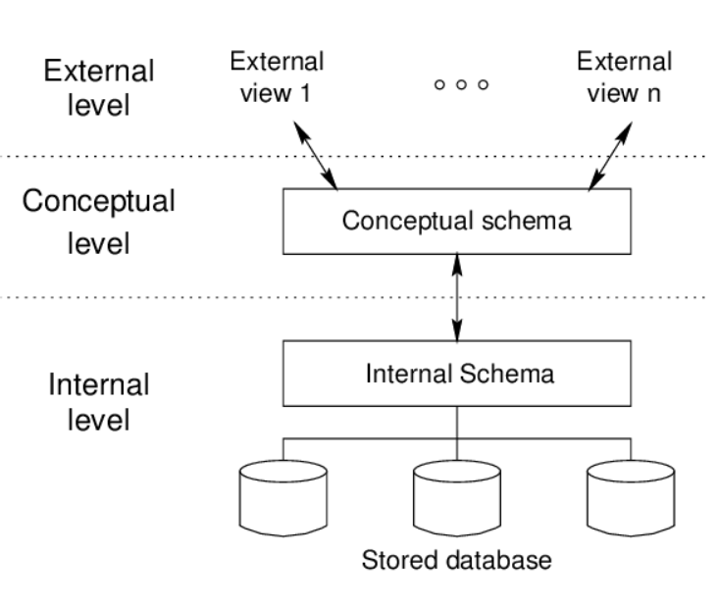
Data model - Overview

Slide 5
Database modeling and implementation process
Getting
User
Requirement
High-Level
Design
Relational
Database
Schema
Design
Relational DBMS
ER diagram
Relational Database Schema
Figure 4.1: The database modeling and implementation process
Notes:
Data Model - a group of conceptual tools that describes data, its relationships and semantics. It also consists of the consistency constraints that the data adheres to.

Slide 6
Steps in Database Design
Requirements Analysis
- user needs; what must database do?
Conceptual Design
- high level description (Entity Relationship diagram)
Logical Design
- translate ERD into DBMS data model
Schema Refinement
- consistency, normalization
Physical Design
- indexes, disk layout
Security Design
- who accesses what, and how

Slide 7
ERD – How to construct
Gather all the data that needs to be modeled.
Identify data that can be modeled as real world entities.
Identify the attributes for each entity.
Sort entity sets as weak or strong entity sets.
Sort entity attributes as key attributes, multi-valued attributes, composite attributes, derived attributes.
Identify the relations between the different entities.
Using the different symbols draw the entities, their attributes and their relationships. Use appropriate symbols while drawing attributes.

Slide 8
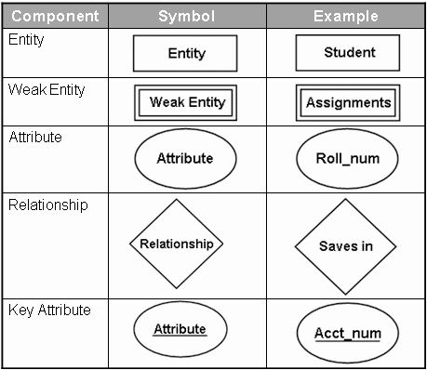
Entity Relationship Diagram - Notations

Slide 9
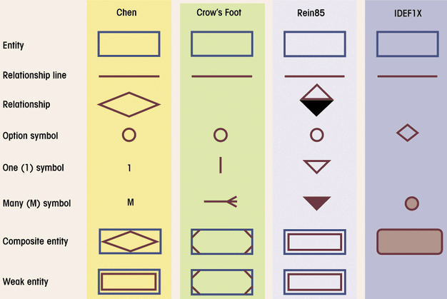
Comparison of E-R Modeling notations

Slide 10
ERD - Entity
Entity:
Real-world thing, distinguishable from other objects.
Noun phrase
Entity described by set of attributes.
Entity Set: A collection of similar entities. E.g., all employees.
All entities in an entity set have the same set of attributes. (Until we consider hierarchies, anyway!)
Each attribute has a domain.
name
ssn
lot
Employee

Slide 11
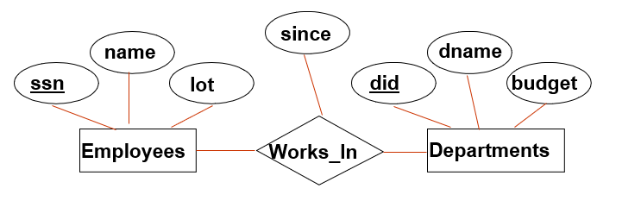
Relationship
Relationship: Association among two or more entities
relationships can have their own attributes (descriptive attributes).
verb phrases
1-1
1-M/M-1
M-M
Degree Constraints
Recursive relationship
Unary, Binary, Ternary relationship
A referential integrity constraints
A value appearing in one context must also appear in another

Slide 12
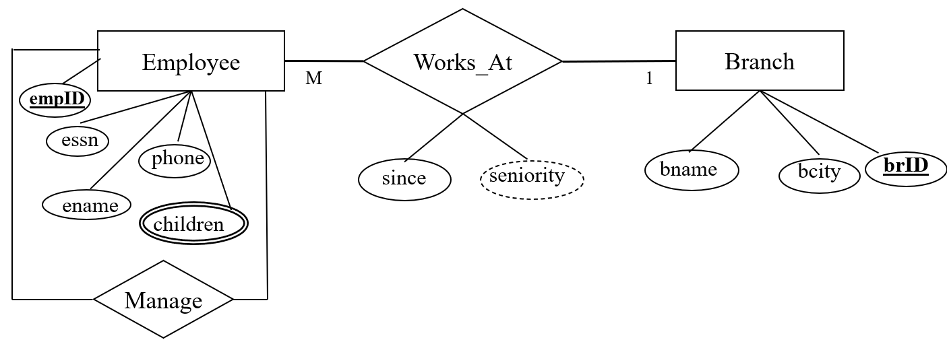
Type of Attributes
Key attribute
Multivalued attribute
Derived attribute
Composite attribute
EmpID
children
seniority
Address
Address

Slide 13
Weak Entity Sets
Consider the relationship
An entity set’s key to be composed of attributes, some or all of which belong to another entity set. Such an entity set is called a weak entity set.
number
crewChief
name
address
Crews
Unit-of
Studios
M
1
Weak entity set
Supporting entity set
1

Slide 14
Requirements for Weak Entity Sets
R is a relationship from E to F
R is called supporting relationship if
R must be a binary, many-one relationship from E to F
R must have referential integrity from E to F
The attributes that F supplies for the key of E must be key attributes of F

Slide 15
Weak Entity Sets
Example weak entity set
Contracts
salary
M
Studio-of
Movie-of
Star-of
1
1
1
Stars
Studios
Movies
genre
year
length
name
addr
title
name
addr

Slide 16
Subclasses in E/R Model
Consider Cartoons and Murder Mysteries are the special kinds of movies, with some special properties
to Stars
length
title
year
genre
Movies
Voices
isa
isa
weapon
Cartoons
Murder Mysteries

Slide 17
Example COMPANY Database – Construct ERD
Requirements of the Company (oversimplified for illustrative purposes)
The company is organized into DEPARTMENTs. Each department has a name, number and an employee who manages the department. We keep track of the start date of the department manager.
Each department controls a number of PROJECTs. Each project has a name, number and is located at a single location.

Slide 18
Example COMPANY Database (Cont.)
We store each EMPLOYEE’s social security number, address, salary, sex, and birthdate. Each employee works for one department but may work on several projects. We keep track of the number of hours per week that an employee currently works on each project. We also keep track of the direct supervisor of each employee.
Each employee may have a number of DEPENDENTs. For each dependent, we keep track of their name, sex, birthdate, and relationship to employee.

Slide 19
Exercises
Following are the business rules, draw ERD
PATIENT Has Recorded PATIENT HISTORY. Each patient has one or more patient histories. Each instance of PATIENT HISTORY “belongs to” exactly one PATIENT.
EMPLOYEE Is Assigned To PROJECT. Each PROJECT has at least one EMPLOYEE assigned to it. (Some projects have more than one.) Each EMPLOYEE may or (optionally) may not be assigned to any existing PROJECT or may be assigned to one or more PROJECTs.
PERSON Is Married To PERSON. This is an optional zero or one cardinality in both directions, because a person may or may not be married at a given point in time.

Slide 20
Exercises
Following are the business rules, draw ERD
A department must have at least one employee who works there, and each employee must be assigned to exactly one department.
Each department must have exactly one manager who manages that department.
Each employee may have exactly one supervisor (Supervised By). Conversely, each employee may supervise any number of employees, or may not be a supervisor.

Slide 21
The Extended E-R Model
The Extended Entity Relationship Model (EERM) sometimes referred to as the enhanced entity relationship model, is the result of adding more semantic constructs to the original ER model.
A diagram that uses the EERM is called an EER diagram (EERD).

Slide 22
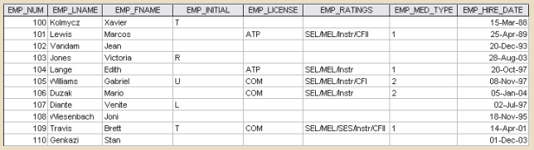
The Extended E-R Model
For example:
A business that employs pilots, mechanics, secretaries, accountants, database managers, and many other types of employees
Notes:
A retail company could group employees as salaried and hourly, while a university could group employees as faculty, staff, and administrators.

Slide 23
The Extended E-R Model
The grouping of employees into various types provides two important benefits:
It avoids unnecessary nulls in attributes when some employees have characteristics that are not shared by other employees.
It enables a particular employee type to participate in relationships that are unique to that employee.

Slide 24
The Extended E-R Model
supertype/subtype relationships is “is-a” relationships
A subtype is a subgrouping of the entities in an entity type that is meaningful to the organization. A supertype is a generic entity type that has a relationship with one or more subtypes
For example:
EMPLOYEE supertype and three entity subtypes—PILOT, MECHANIC, and ACCOUNTANT.

Slide 25
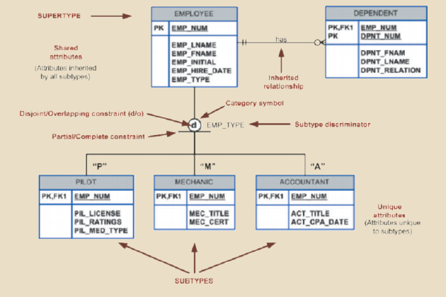
The Extended E-R Model

Slide 26
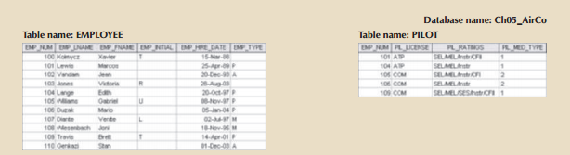
Subtype discriminator
A subtype discriminator is the attribute in the supertype entity that determines to which subtype the supertype occurrence is related

Slide 27
Disjoint and overlapping Constraints
Disjoint subtypes, also known as nonoverlapping subtypes, are subtypes that contain a unique subset of the supertype entity set;
In other words, each entity instance of the supertype can appear in only one of the subtypes.
For example:
employee (supertype) who is a pilot (subtype) can appear only in the PILOT subtype, not in any of the other subtypes.
In an ERD, such disjoint subtypes are indicated by the letter dinside the category shape.

Slide 28
Disjoint and overlapping Constraints
Overlapping subtypesare subtypes that contain nonunique subsets of the supertype entity set; that is, each entity instance of the supertype may appear in more than one subtype.
For example, in a university environment,
a person may be an employee, a student, or both. In turn, an employee may be a professor as well as an administrator. Because an employee may also be a student, STUDENT and EMPLOYEE are overlapping subtypes of the supertype PERSON, just as PROFESSOR and ADMINISTRATOR are overlapping subtypes of the supertype EMPLOYEE.
overlapping subtypes with the letter o inside the category shape

Slide 29
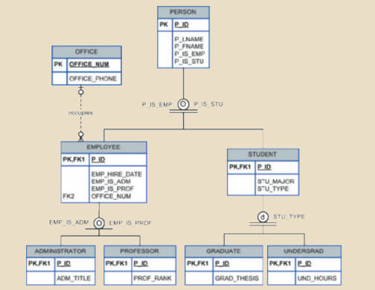
Disjoint and overlapping Constraints

Slide 30
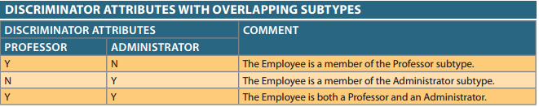
Disjoint and overlapping Constraints
The implementation of disjoint subtypes is
based on the value of the subtype discriminator attribute in the supertype.
implementing overlapping subtypes requires the use of one discriminator attribute for each subtype.

Slide 31
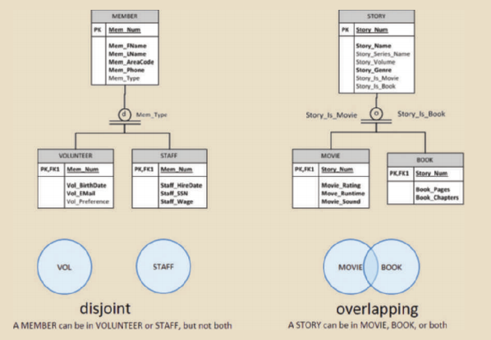
Disjoint and overlapping Constraints

Slide 32
Completeness Constraints
A completeness constraint addresses the question of whether an instance of a supertype must also be a member of at least one subtype.
The completeness constraint has two possible rules:
total specialization
partial specialization.

Slide 33
Completeness Constraints
The total specialization rulespecifies that each entity instance of the supertype must be a member of some subtype in the relationship.
The partial specialization rulespecifies that an entity instance of the supertype is allowed not to belong to any subtype.
In ERD:
A single horizontal line under the circle represents a partial completeness constraint;
a double horizontal line under the circle represents a total completeness constraint

Slide 34
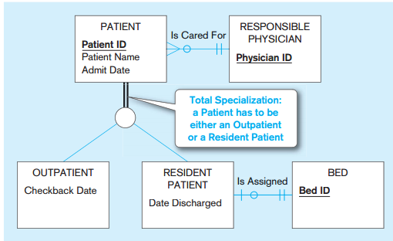
Total completeness

Slide 35
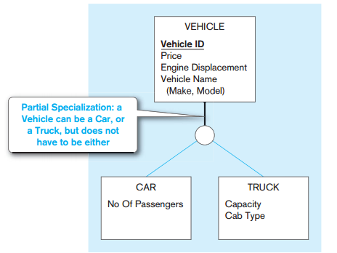
Total completeness

Slide 36
From ER Diagram to Relational Model
Overview:
1 entity = 1 relation
attributes of entity ~ attributes of relation
key of entity ~ key of relation
Convert 1-1 relationship
Convert 1-M relationship
Put key attribute of one-side to M-side
Convert M-M relationship
Generate 1 relation, Primary key of this relation combined from two relations. Attributes of new relation ~ attributes of relationship (if have)

Slide 37
ER Model to Relational mapping
Mapping ERM (Entity Relationship Model) to Relation
Step 1: Mapping of Regular Entity Types
Step 2: Mapping of Weak Entity Types
Step 3: Mapping of Binary 1:1 Relationship Types
Step 4: Mapping of Binary 1:N Relationship Types
Step 5: Mapping of Binary M:N Relationship Types
Step 6: Mapping Unary Relationship Types
Step 7: Mapping of Multivalued attributes
Step 8: Mapping of n-ary Relationship Types
Step 9: Mapping Supertype/Subtype Relationships

Slide 38
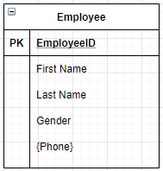
Step 1: Mapping strong/regular Entity
For each strong/regular entity, create a relation that includes all the simple attributes
Primary key of the entity becomes the primary key of the relation.
Exclude multivalued attribute from the mapping relation.
Example:
Employee(EmployeeID, FirstName, LastName, Gender)
Note: Phone is a multivalued attribute.

Slide 39
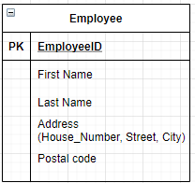
Step 1: Mapping strong/regular Entity
When a regular entity type has a composite attribute, only the simple components of the composite attribute are included in the new relation as its attributes
Example:
Employee(EmployeeID, FirstName, LastName, House_Number, Street, City, PostalCode)

Slide 40
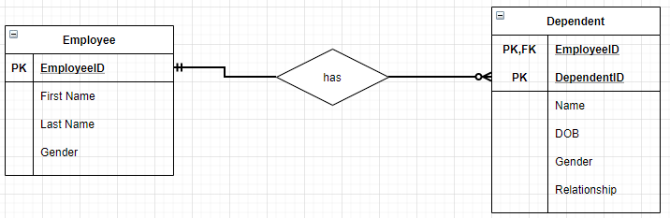
Step 2: Mapping of Weak Entity
Create separate relation and include all simple attributes
The primary key of the relation is the combination of all the primary key attributes from the owner and the partial key of the weak entity, if any
=> Dependent(EmployeeID, DependentID, Name, DOB, Gender, Relationship)
Employee(EmployeeID, FirstName, LastName, Gender)

Slide 41
Step 3: Mapping Binary 1:1 relationship
Step 3: Mapping Binary 1:1 relationship
Before tackling a 1:1 relationship, we need to know its optionality.
There are three possibilities the relationship can be:
1. mandatory at both ends
2. mandatory at one end and optional at the other
3. optional at both ends

Slide 42
Step 3: Mapping Binary 1:1 relationship
1. Mandatory at both ends
Combine two entity into one when the relationship is mandatory at both ends.
The choice of which entity type subsumes the other depends on which is the most important entity type (more attributes, better key, semantic nature of them).
The key of the subsumed entity type becomes a normal attribute
When not to combine a 1:1 mandatory relationship:
the two entity types represent different entities in the ‘real world’.
the entities participate in very different relationships with other entities.
efficiency considerations when fast responses are required or different patterns of updating occur to the two different entity types
=> The primary key of one entity type comes the foreign key in the other.

Slide 43
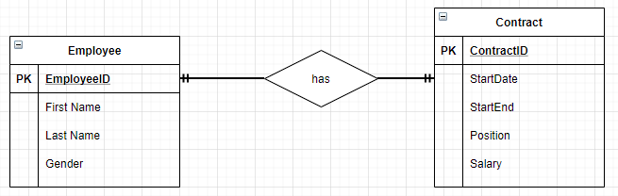
Step 3: Mapping Binary 1:1 relationship
Example: Two entity types; employee and contract.
Each member of employee must have one contract and each contract must have one member of employee associated with it.
It is therefore a mandatory relations at both ends.

Slide 44
Step 3: Mapping Binary 1:1 relationship
3 options to mapping:
Combine two entity into one.
Employee(EmployeeID, FirstName, LastName, Gender, ContractID, StartDate, StartEnd, Position, Salary)
or kept apart and a foreign key used
Employee(EmployeeID, FirstName, LastName, Gender, ContractID)
Contract(ContractID, StartDate, StartEnd, Position, Salary)
or
Employee(EmployeeID, FirstName, LastName, Gender)
Contract(ContractID, StartDate, StartEnd, Position, Salary, EmployeeID)

Slide 45
Step 3: Mapping Binary 1:1 relationship
2. Mandatory at one end and optional at the other
Take the primary key from the ‘mandatory end’ and add it to the ‘optional end’ as a foreign key.
The entity type of the optional end may be subsumed into the mandatory end as in the previous example.
It is better NOT to subsume the mandatory end into the optional end as this will create null entries.
Given entity types A and B, where A, B is in a relationship where the A end it optional, the result would be:
A (primary key,attribute,...,foreign key to B)
B (primary key,attribute,...)

Slide 46
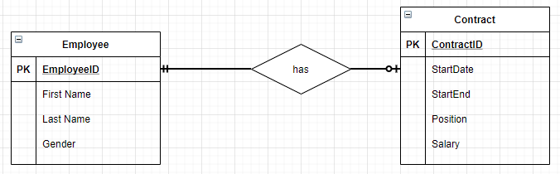
Step 3: Mapping Binary 1:1 relationship
2. Mandatory at one end and optional at the other
Example: Contract is optional (each employee may have at most one contract)
=> Employee(EmployeeID, FirstName, LastName, Gender)
=> Contract(ContractID, StartDate, StartEnd, Position, Salary, EmployeeID)
Notes:
Map the foreign key into Staff - the key is null for staff without a contract.
Staff(emp_no, name, contract_no)
Contract(cont_no, start, end, position, salary)
Map the foreign key into Contract - emp_no is mandatory thus never null.
Staff(emp_no, name)
Contract(cont_no, start, end, position, salary, emp_no)

Slide 47
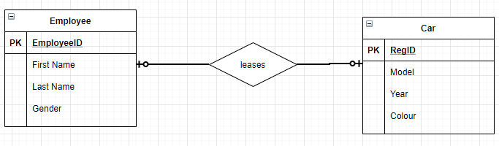
Step 3: Mapping Binary 1:1 relationship
2. Optional at both ends
Use a foreign key approach.
Example: Each staff member may lease up to one car, Each car may be leased by at most one member of staff
=>Can not combine two entity into one.
Employee(EmployeeID, FirstName, LastName, Gender)
Car(RegID, Model, Year, Colour, EmployeeID)
Notes:
Each staff member may lease up to one car
Each car may be leased by at most one member of staff
If these were combined together...
Staff_car(emp_no, name, reg_no, year, make, type, colour)
what would be the primary key?
If emp_no is used then all the cars which are not being leased will not have a key.
Similarly, if the reg_no is used, all the staff not leasing a car will not have a key.
A compound key will not work either.

Slide 48
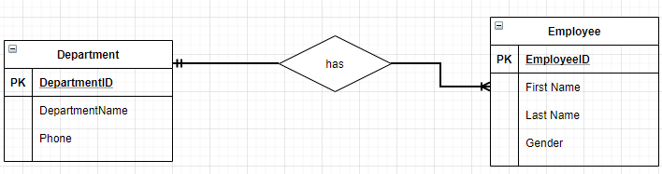
Step 4: Mapping Binary 1:M relationship
The primary key on the ‘one side’ of the relationship is added to the ‘many side’ as a foreign key.
Example:
=> Department(DepartmentID, DempartmentName, Phone)
=> Employee(EmployeeID, FirstName, LastName, Gender, DepartmentID)

Slide 49
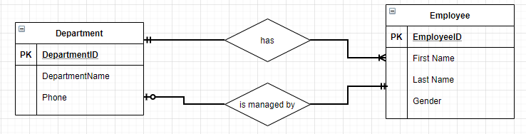
Step 4: Mapping Binary 1:M relationship
Parallel relationships occur when there are two or more relationships between two entity types
Example:
In order to distinguish between the two roles we can give the foreign keys different names.
=>Employee(EmployeeID, FirstName, LastName, Gender, DepartmentID)
=>Department(DepartmentID, DepartmentName, ManagerID)

Slide 50
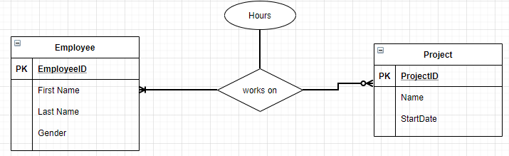
Step 5: Mapping Binary M:N relationship
Create a new relation containing the primary keys of both participating entity types and descriptive attribute (if any)
These primary keys form a composite primary key of the new relation.
=> WorksOn(EmployeeID, ProjectID, Hours)

Slide 51
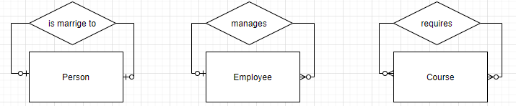
Step 6: Mapping Unary relationship
Unary relationships (or recursive relationships) is one in which a relationship can exist between occurrences of the same entity set.
Example:
1-1 relationship
1-M relationship
M-N relationship

Slide 52
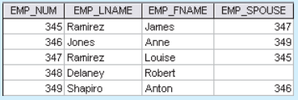
Step 6: Mapping Unary relationship
Mapping the 1:1 unary relationship “EMPLOYEE is married to EMPLOYEE” => Employee( EmpNum, Emp_Lname, Emp_Fname, Emp_Spouse)
Implementation
=>The foreign key is the primary key of the same table, but is given a different name.

Slide 53
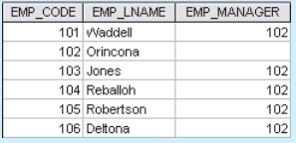
Step 6: Mapping Unary relationship
Mapping the 1:M unary relationship “EMPLOYEE manages EMPLOYEE” => Employee( Emp_Code, Emp_Lname, Emp_Manager)
Implementation
=>The foreign key is the primary key of the same table, but is given a different name.
Notes:
the relationship is optional in both directions because not all staff can be managers, and the top manager is not managed by anybody else.

Slide 54
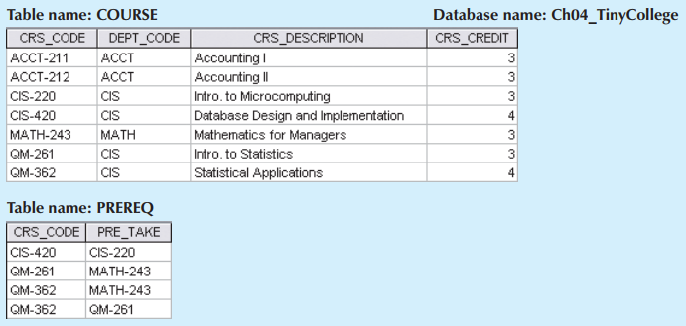
Step 6: Mapping Unary relationship
Mapping the M-N unary relationship “COURSE requires COURSE”
=> Course( Crs_code, Dept_code, Crs_Description, Crs_credit)
=> PreReq( Crs_code, Pre_Take)
Notes:
A COURSE may be a prerequisite to many other COURSEs, and each COURSE may have many other COURSEs as prerequisites. Another the M:N recursive relationship “PART contains PART” PART(PNUMBER, DESCRIPTION, ...) COMPRISE( MAJOR-PNUMBER, MINOR-PNUMBER, QUANTITY)

Slide 55
Step 7: Mapping Multivalued Attributes
Create a new relation R for each multivalued attribute
Add primary key of the original entity to the new relation R as a foreign key.
The primary key of R is the combination of R and the original entity. If the multivalued attribute is composite, we include its simple components.
=> Phone(EmployeeID, PhoneNumber, type)
=>Employee(EmployeeID, FirstName, LastName, Gender)

Slide 56
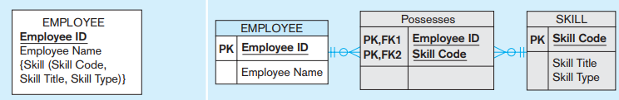
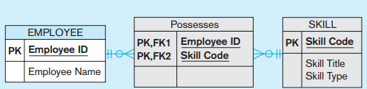
Step 7: Mapping Multivalued Attributes
Another example: In ER model
In the relation shema:
=>Skill(SkillCode, Skill Title, Skill Type)
=>Possesses(EmployeeID, SkillCode)
=>Employee(EmployeeID, EmployeeName)

Slide 57
Step 8: Mapping n-ary Relationship types
Mapping Ternary (and n-ary) relationship type:
One relation for each entity and one for the associative entity
Associative entity has foreign keys to each entity in the relationship

Slide 58
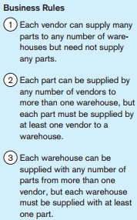
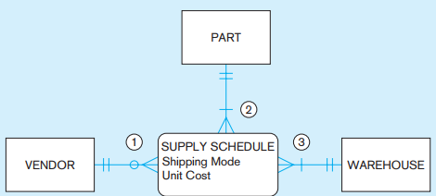
Step 8: Mapping n-nary Relationship types
Example
In relational schema
=>Vendor( VendorID,…)
=>Warehouse(WareHouseID,…)
=>Part(PartID,…)
=>Supply(VendorID, WareHouseID, PartID, shippingMode, UnitCode)

Slide 59
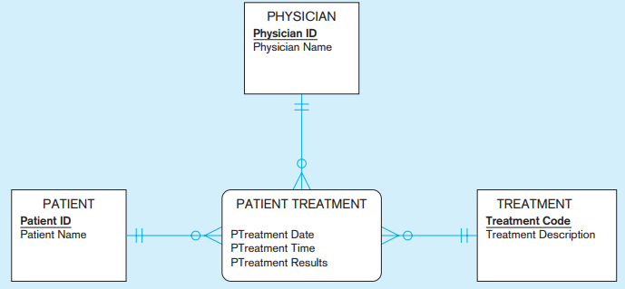
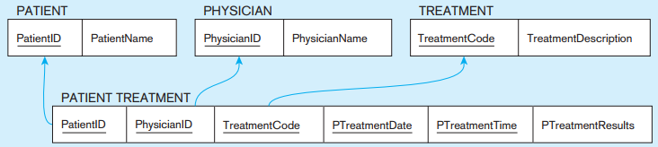
Step 8: Mapping n-nary Relationship types
Another example:
In relational schema

Slide 60
Mapping Supertype/Subtype Relationships
One relation for supertype and for each subtype
Supertype attributes (including identifier and subtype discriminator) go into supertype relation
Subtype attributes go into each subtype; primary key of supertype relation also becomes primary key of subtype relation
1:1 relationship established between supertype and each subtype, with supertype as primary table

Slide 61
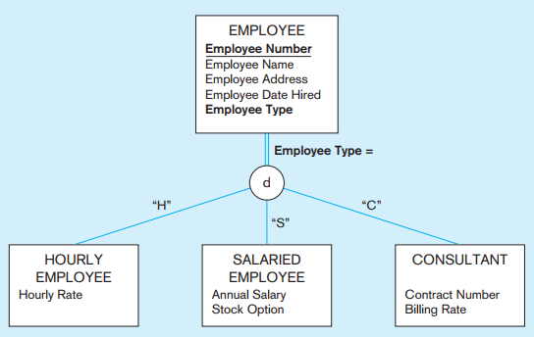
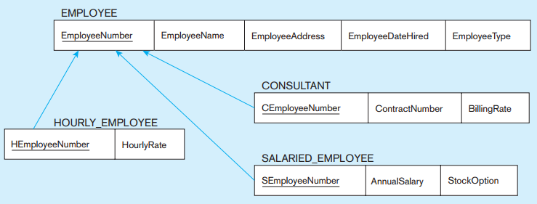
Mapping Supertype/Subtype Relationships
Example
Mapping
Notes:
SELECT * FROM Employee_T, SalariedEmployee_T WHERE EmployeeNumber = SEmployeeNumber;

Slide 62
From ER Diagram to Relational Model Convert 1-1 relationship
For one-to-one relationship w/out total participation
Build a table with two columns, one column for each participating entity set’s primary key. Add successive columns, one for each descriptive attributes of the relationship set (if any).
For one-to-one relationship with one entity set having total participation
Augment one extra column on the right side of the table of the entity set with total participation, put in there the primary key of the entity set without complete participation as per to the relationship.

Slide 63
Convert N-ary Relationship Set
P-Key1
D-Attribute
A-Key
E-Set 1
P-Key2
A relationship
Another Set
E-Set 2
P-Key3
E-Set 3
P-Key1 | P-Key2 | P-Key3 | A-Key | D-Attribute
9999 | 8888 | 7777 | 6666 | Yes
1234 | 5678 | 9012 | 3456 | No
* Primary key of this table is P-Key1 + P-Key2 + P-Key3

Slide 64
Representing Composite Attribute
Relational Model Indivisibility Rule Applies
One column for each component attribute
NO column for the composite attribute itself
SSN
Name
SSN | Name | Street | City
9999 | Dr. Smith | 50 1st St. | Fake City
8888 | Dr. Lee | 1 B St. | San Jose
Professor
Address
Street
City

Slide 65
Representing Multivalue Attribute
For each multivalue attribute in an entity set/relationship set
Build a new relation schema with two columns
One column for the primary keys of the entity set/relationship set that has the multivalue attribute
Another column for the multivalue attributes. Each cell of this column holds only one value. So each value is represented as an unique tuple
Primary key for this schema is the union of all attributes

Slide 66
Example – Multivalue attribute
SID
Name
The primary key for this table is Student_SID + Children, the union of all attributes
Children
Student
Major
GPA
Stud_SID | Children
1234 | Johnson
1234 | Mary
5678 | Bart
5678 | Lisa
5678 | Maggie
SID | Name | Major | GPA
1234 | John | CS | 2.8
5678 | Homer | EE | 3.6

Slide 67
Representing Class Hierarchy
Two general approaches depending on disjointness and completeness
For non-disjoint and/or non-complete class hierarchy:
create a table for each super class entity set according to normal entity set translation method.
Create a table for each subclass entity set with a column for each of the attributes of that entity set plus one for each attributes of the primary key of the super class entity set
This primary key from super class entity set is also used as the primary key for this new table

Slide 68
Example
SSN
Name
Person
SID
Status
Gender
ISA
Student
Major
GPA
SSN | Name | Gender
1234 | Homer | Male
5678 | Marge | Female
SSN | SID | Status | Major | GPA
1234 | 9999 | Full | CS | 2.8
5678 | 8888 | Part | EE | 3.6

Slide 69
Representing Class Hierarchy
Two general approaches depending on disjointness and completeness
For disjoint AND complete mapping class hierarchy:
DO NOT create a table for the super class entity set
Create a table for each subclass entity set include all attributes of that subclass entity set and attributes of the superclass entity set
Simple and Intuitive enough, need example?

Slide 70
Example
SSN
Name
No table created for superclass entity set
SJSU people
ISA
SID
Student
Faculty
Disjoint and Complete mapping
Major
GPA
Dept
SSN | Name | SID | Major | GPA
1234 | John | 9999 | CS | 2.8
5678 | Mary | 8888 | EE | 3.6
SSN | Name | Dept
1234 | Homer | C.S.
5678 | Marge | Math

Slide 71
Representing Aggregation
Name
SSN
Name
M
Advisor
1
Student
Professor
Dept
SID
Name
member
Primary Key of Advisor
Dept
SID | Code
1234 | 04
5678 | 08
Code
Primary key of Dept

Slide 72
From E/R Relationship to Relations
Stars
Contracts
Movies
Studio
of star
Producing
studio
Studios
Contracts(starName, title,year, studioOfStar_name, producingStudio_name)

Slide 73
Combining Relations
name
address
Movies(title,year,length,genre)
Owns(title,year,studioName)
Stars
title
year
Stars-in
name
Movies
Studios
Owns
length
genre
address
Movies(title,year,length,genre,studioName)
Suppose an entity set E and a many-one relationship R from E to F. We can combine two relations E and R into one relation with a schema consisting of:
All attributes of E,
The key attributes of F, and all own attributes belonging to relationship R

Slide 74
Handling Weak Entity Sets
If W is a weak entity set, construct for W a relation whose schema consists of:
All attributes of W
All own attributes of supporting relationships for W
For each supporting relationship for W, say a many-one relationship from W to entity set E, all the key attributes of E
Rename attributes, if necessary, to avoid name conflicts
Do not construct a relation for any supporting relationship for W
number
crewChief
name
address
Crews
Unit-of
Studios
Studios(name,address)
Crews(number,crewChief,studioName)

Slide 75
SUBCLASS STRUCTURES TO RELATIONS

Slide 76
Converting Subclass Structures to Relations
How we convert this structure to relations?
to Stars
length
title
year
genre
Movies
Voices
isa
isa
weapon
Cartoons
Murder Mysteries

Slide 77
Converting Subclass Structures to Relations
The principal conversion strategies
Follow E/R viewpoint
For each entity set E in the hierarchy, create a relation that includes the key attributes from the root and any attributes belong to E
Treat entities as object-oriented
For each possible subtree that includes the root, create one relation, whose schema includes all the attributes of all the entity sets in the subtree
Use null values
Create only one relation with all attributes of all entity sets in the hierarchy. Each entity is represented by one tuple, and that tuple has a NULL value for whatever attributes the entity does not have

Slide 78
E/R Style Conversion
to Stars
length
title
year
genre
Movies
Voices
isa
isa
weapon
Cartoons
Murder Mysteries
Movies(title,year,length,genre)
MurderMysteries(title,year,weapon)
Cartoons(title,year) ← remove
Voices(title,year,starName)

Slide 79
An Object-Oriented Approach
to Stars
length
title
year
genre
Movies
Voices
isa
isa
weapon
Cartoons
Murder Mysteries
Movies(title,year,length,genre)
MoviesC(title,year,length,genre)
MoviesMM(title,year,length,genre,weapon)
MoviesCMM(title,year,length,genre,weapon)

Slide 80
Using Null Values
to Stars
length
title
year
genre
Movies
Voices
isa
isa
weapon
Cartoons
Murder Mysteries
Movie(title,year,length,genre,weapon)

Slide 81
Unified Modeling Language –self studying
Introduction
UML is designed to model software in an object-oriented style, but has been adapted as a database modeling language
UML offers much the same capabilities as the E/R model, with the exception of multi-way relationships, only binary relationships in UML.

Slide 82
UML vs. E/R Model
UML | E/R Model
Class | Entity Set
Association | Binary relationship
Association class | Attributes on a relationship
Subclass | is-a hierarchy
Aggregation | Many-one relationship
Composition | Many-one relationship with referential integrity
Figure 4.34: Comparison between UML and E/R terminology

Slide 83
UML Classes
Movies
title PK year PK length genre init() modify()
Class’ name
State
Behavior

Slide 84
Associations
Consider an associations between Movies, Stars, and Studios in UML
Studios
name PK
address
0..1
Owns
Movies
title PK
year PK
length
genre
0..*
Stars
name PK
address
0..*
0..*
Stars-in

Slide 85
Associations
Comparison with E/R Multiplicities
E/R UML
0..* 0..*
0..* 0..1
0..* 1..1

Slide 86
Self-Associations
An association can have both ends at the same class; such an association is called a self-association
Example
Movies
title PK
year PK
length
genre
0..1
theOriginal
0..*
theSequel

Slide 87
Association Classes
Movies
title PK
year PK
length
genre
Stars
name PK
address
0..*
Stars-in
0..*
Compensation
salary
residuals

Slide 88
Subclasses in UML
Consider Movies and its three subclasses
Figure 4.40: Cartoons and murder mysteries as disjoint subclasses of movies
Movies
title PK
year PK
length
genre
Murder Mysteries
weapon
Cartoons
Cartoon-Murder Mysteries
weapon

Slide 89
Aggregations and Compositions
MovieExecs
cert# PK
name
address
networth
Movies
title PK
year PK
length
genre
Studios
name PK
address
Presidents
1..*
0..1
0..1
1..1
Figure 4.41: An aggregation from Movies to Studios and
a composition from Presidents to Studios

Slide 90
UML-to-Relations Basics
Classes to Relations
For each class, create a relation
name is the name of the class
attributes are the attributes of the class
Associations to Relations
For each association, create a relation
name is the name of that association
attributes are the key attributes of the two connected classes

Slide 91
UML-to-Relations Basics
Studios
name PK
address
0..1
Owns
Movies
title PK
year PK
length
genre
0..*
Stars
name PK
address
0..*
0..*
Stars-in
Movies(title,year,length,genre)
Stars(name,address)
Studios(name,address)
Stars-In(movieTitle,movieYear,starName)
Owns(movieTitle,movieYear,studioName)

Slide 92
From UML Subclasses to Relations
We can use any of the three strategies outlined for E/R to convert a class and its subclasses to relations
E/R-style: each subclass’ relation stores only its own attributes, plus key
OO-style: relations store attributes of subclass and all super-classes
Nulls: One relation, with NULL’s as needed

Slide 93
From Aggregations and Composition to Relation
No relation for the aggregation or composition
Add to the relation for the class at the non-diamond end the key attribute(s) of the class at the diamond end
In the case of an aggregation, it is possible that these attributes can be null

Slide 94
From Aggregations and Composition to Relation
MovieExecs
cert# PK
name
address
networth
MovieExecs(cert#,name,address,netWorth)
Presidents(cert#,studioName)
Movies(title,year,length,genre,studioName)
Studios(name,address)
Movies
title PK
year PK
length
genre
Studios
name PK
address
President
1..*
0..1
0..1
1..1

Slide 95
The UML Analog of Weak Entity Sets
We use the composition, which goes from the weak class to the supporting class, for a weak entity set
Example:
Studios(name,address)
Crews(number,crewChief,studioName)
Crews
number PK
crewChief
Studios
name PK
address
0..*
1..1
PK

