Slide 1
Chapter 6
THE DATABASE LANGUAGE SQL

Slide 2
Objectives
Student can write a SQL script.
Student can compose SQL queries using set (and bag) operators, correlated subqueries, aggregation queries.
Student can manipulate proficiently on complex queries

Slide 3
Contents
Integrity constraints
Structure Query Language
DDL
DML
DCL (self studying)
Sub query

Slide 4
REVIEW
Getting
User
Requirement
High-Level
Design
Relational
Database
Schema
Design
Relational DBMS
ER diagram
Relational Database Schema
Figure 4.1: The database modeling and implementation process
Studied:
ER diagram
Relational model
Convert ERD 🡪 Relational model
Now: we learn how to set up a relational database on DBMS

Slide 5
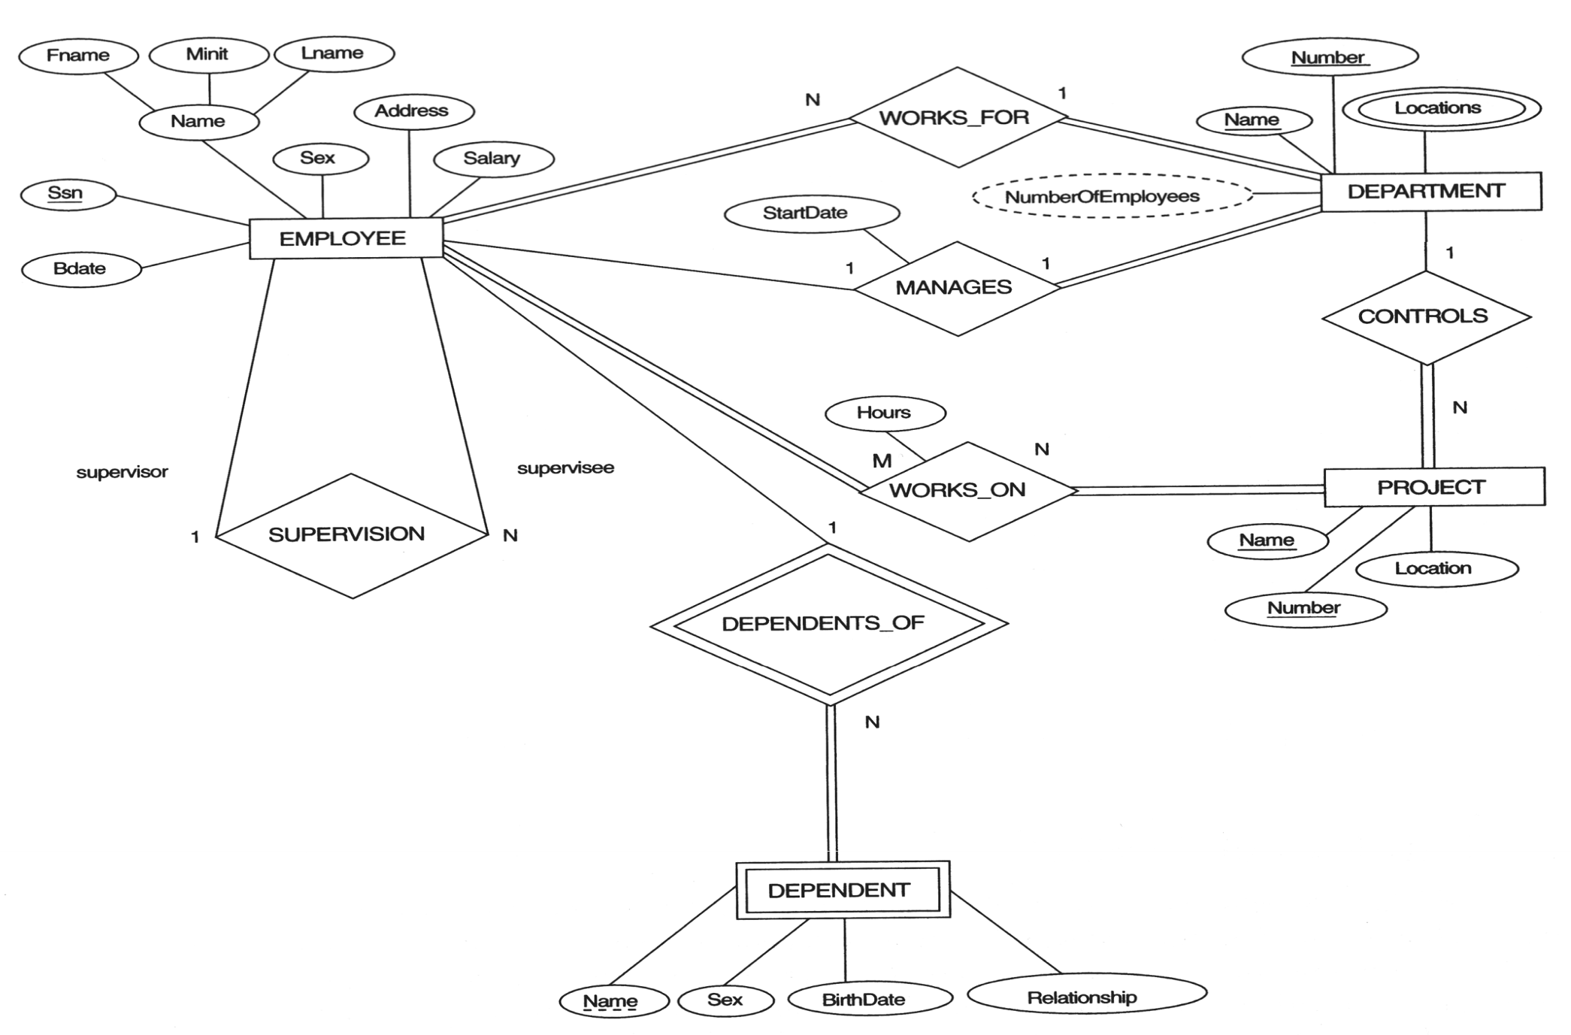
REVIEW – Entity Relationship Diagram
COMPANY Database

Slide 6
Integrity constraints
Purpose: prevent semantic inconsistencies in data
Kinds of integrity constraints:
1. Key Constraints (1 table): Primary key, Candidate key (Unique)
2. Attribute Constraints (1 table): NULL/NOT NULL; CHECK
3. Referential Integrity Constraints (2 tables): FOREIGN KEY
4. Global Constraints (n tables): CHECK or CREATE ASSERTION (self studying)
We will implement these constraints by SQL

Slide 7
Comparison of Strings
Two strings are equal (=) if they are the same sequence of characters
Other comparisons: <, >, ≤, ≤, ≠
Suppose a=a₁a₂…a_{n} and b=b₁b₂…b_{m} are two strings, the first is less than the second if ∃ k≤min(n,m):
∀i, 1≤i≤k: a_{i} = b_{i}, and
a_{k+1}<b_{k+1}
Example
fodder < foo
bar < bargain

Slide 8
Pattern Matching in SQL
Like or Not Like
Two special characters
% means any sequence of 0 or more characters
_ means any one character
SELECT
FROM
WHERE s LIKE p;
SELECT
FROM
WHERE s NOT LIKE p;

Slide 9


Pattern Matching in SQL
Example 5.1:
Find all employees named as ‘Võ Việt Anh’
Example 5.2
Find all employees whose name is ended at ‘Anh’

Slide 10
Pattern Matching in SQL
USING ESCAPE keyword
SQL allows us to specify any one character we like as the escape character for a single pattern
Example
WHERE s LIKE ‘%20!%%’ ESCAPE !
Or WHERE s LIKE ‘%20@%%’ ESCAPE @
🡺 Matching any s string contains the 20% string
WHERE s LIKE ‘x%%x%’ ESCAPE x
🡺 Matching any s string that begins and ends with the character %

Slide 11
Dates and Times
Dates and times are special data types in SQL
A date constant’s presentation
DATE ‘1948-05-14’
A time constant’s presentation
TIME ‘15:00:02.5’
A combination of dates and times
TIMESTAMP ‘1948-05-14 12:00:00’
Operations on date and time
Arithmetic operations
Comparison operations

Slide 12
Null Values
Null value: special value in SQL
Some interpretations
Value unknown: there is, but I don’t know what it is
Value inapplicable: there is no value that makes sense here
Value withheld: we are not entitled to know the value that belongs here
Null is not a constant
Two rules for operating upon a NULL value in WHERE clause
Arithmetic operators on NULL values will return a NULL value
Comparisons with NULL values will return UNKNOWN

Slide 13
The Truth-Value UNKNOWN
Truth table for True, False, and Unknown
We can think of TRUE=1; FALSE=0; UNKNOWN=1/2, so
x AND y = MIN(x,y); x OR y = MAX(x, y); NOT x = 1-x
x | y | x AND y | x OR y | NOT x
TRUE | TRUE | TRUE | TRUE | FALSE
TRUE | UNKNOWN | UNKNOWN | TRUE | FALSE
TRUE | FALSE | FALSE | TRUE | FALSE
UNKNOWN | TRUE | UNKNOWN | TRUE | UNKNOWN
UNKNOWN | UNKNOWN | UNKNOWN | UNKNOWN | UNKNOWN
UNKNOWN | FALSE | FALSE | UNKNOWN | UNKNOWN
FALSE | TRUE | FALSE | TRUE | TRUE
FALSE | UNKNOWN | FALSE | UNKNOWN | TRUE
FALSE | FALSE | FALSE | FALSE | TRUE

Slide 14
The Truth-Value Unknown
SQL conditions in Where clause produce three truth values: True, False, and Unknown
Those tuples which condition has the value True become part of the answer
Those tuples which condition has the value False or Unknown are excluded from the answer

Slide 15
SQL Overview
SQL (sequel) is a database language designed for managing data in relational database management systems, and originally based upon relational algebra.
There are many different dialects of SQL
Ansi SQL (or SQL-86), SQL-92, SQL-99
SQL:2003, SQL:2006, SQL:2008, SQL:2009
Transact-SQL (T-SQL) is Microsoft's and Sybase's proprietary extension to SQL.
PL/SQL (Procedural Language/Structured Query Language) is Oracle Corporation's procedural extension for SQL and the Oracle relational database.
Today, SQL is accepted as the standard RDBMS language

Slide 16
Data Definition Language - CREATE
Database schema
Simple syntax: CREATE DATABASE dbname
Full syntax: https://docs.microsoft.com/en-us/sql/database
Relation schema ~ table
CREATE TABLE tableName
(
fieldname1 datatype [integrity_constraints],
fieldname2 datatype [integrity_constraints],
….
)
Full syntax: https://docs.microsoft.com/en-us/sql/table

Slide 17
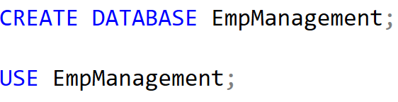
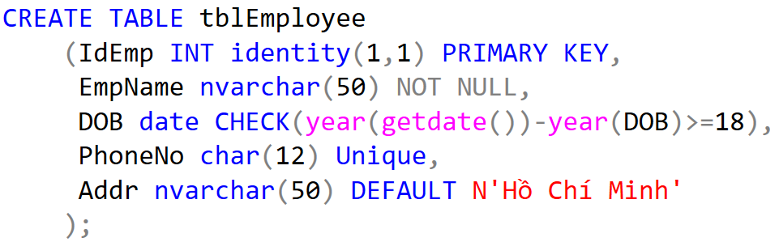
Data Definition Language - Demo

Slide 18
Data Definition Language – ALTER, DROP
Used to modify the structure of table, database
Add more columns
ALTER TABLE tableName
ADD columnName datatype [constraint]
Remove columns
ALTER TABLE tableName
DROP columnName datatype [constraint]
Modify data type
ALTER TABLE tableName
ALTER columnName datatype [constraint]

Slide 19
Data Definition Language– ALTER, DROP
Add/remove constraints
ALTER TABLE tablename
ADD CONSTRAINT constraintName PRIMARY KEY
(<attribute list>);
ALTER TABLE tablename
ADD CONSTRAINT constraintName FOREIGN KEY (<attribute list>)
REFERENCES parentTableName (<attribute list>);
ALTER TABLE tablename
ADD CONSTRAINT constraintName CHECK (expressionChecking)
ALTER TABLE tablename
DROP CONSTRAINT constraintName

Slide 20
Data Definition Language– ALTER, DROP
DROP TABLE tableName
DROP DATABASE dbName

Slide 21
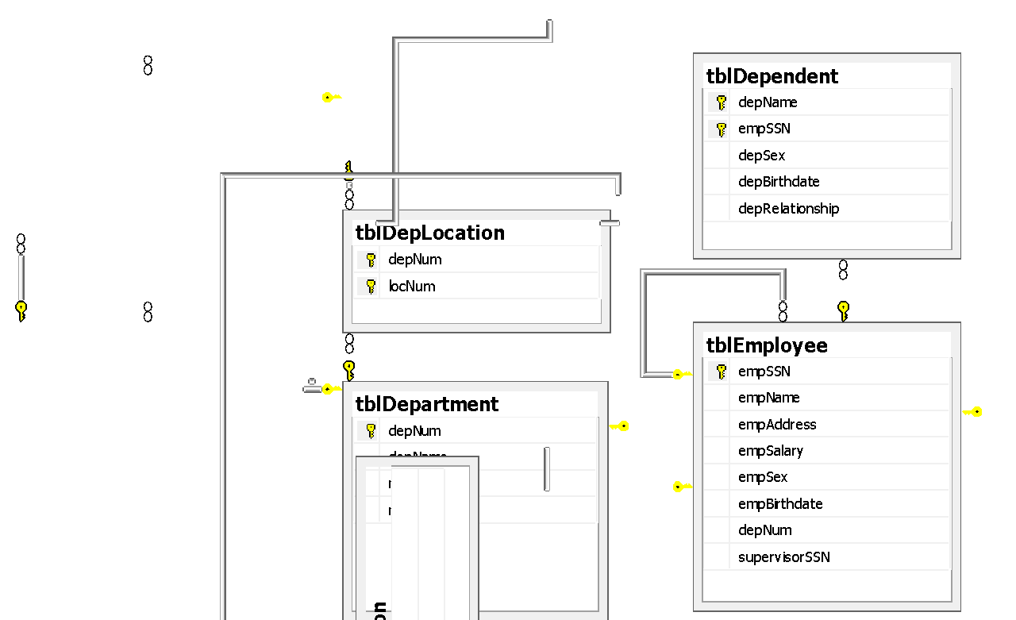
Physical Diagram - FUHCompany

Slide 22
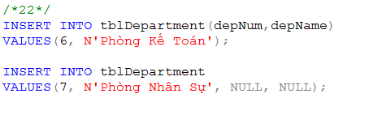
Data Manipulation Language (DML)
Key words: INSERT, UPDATE, DELETE, SELECT
INSERT INTO tableName
VALUES (<value 1>, ... <value n>)
INSERT INTO tableName(<listOfFields>)
VALUES (<value 1>, ... <value m>)
INSERT INTO tableName
SELECT listOfFields FROM another_tableName

Slide 23

Data Manipulation Language (DML)
UPDATE tableName
SET columnName = newValue
[WHERE condition]
Note: newValue could be a value/ an expression/ a SQL statement
Example: Update new salary and depNum for the employee named ‘Mai Duy An’

Slide 24
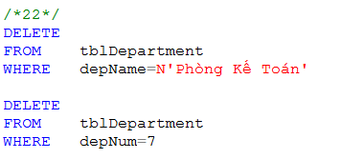
Data Manipulation Language (DML)
DELETE FROM tableName
[WHERE condition]
TRUNCATE TABLE tableName
What is difference between DELETE and TRUNCATE?
What should we do before implement DELETE or TRUNCATE? (referential integrity constraint)
Example:
remove a department named ‘Phòng Kế Toán’
remove a department which depNum is 7

Slide 25
Data Manipulation Language (DML)
SQL Queries and Relational Algebra
SELECT L
FROM R
WHERE C
π_{L}(σ_{C}(R))

Slide 26
T-SQL : Basic Syntax for a simple SELECT queries
SELECT [ ALL | DISTINCT ] [ TOP n [ PERCENT ] ]
* | {column_name | expression [alias],…}
[FROM table]
[WHERE conditions]
SELECT identifies what columns
ALL: Specifies that duplicate rows can appear in the result set. ALL is the default
DISTINCT: Specifies that only unique rows can appear in the result set. Null values are considered equal for the purposes of the DISTINCT keyword
TOP n [ PERCENT ]:Specifies that only the first n rows are to be output from the query result set. n is an integer between 0 and 4294967295. If PERCENT is also specified, only the first n percent of the rows are output from the result set. When specified with PERCENT, n must be an integer between 0 and 100
FROM identifies which table
The WHERE clause follows the FROM clause. Condition: is composed of column names, expressions, constants, and a comparison operator

Slide 27
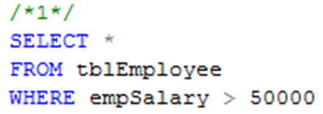
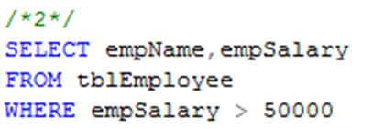
Common Query in SQL
Example 1: Listing all employees whose salary exceed at 50000
Example 2: Listing name and salary of all employees whose income exceed 50000

Slide 28
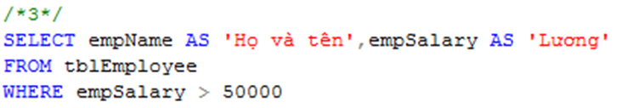
Projection in SQL
Using alias name in select clause
Example 3:
Listing full name and salary of all employees whose income exceed 50000

Slide 29
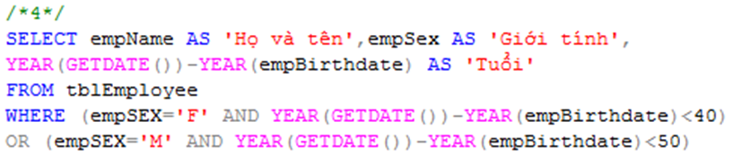
Selection in SQL
Example 4
List all under 40 year-old female or under 50 year-old male employees

Slide 30
Ordering the Output
Presenting the tuples produced by a query in sorted order
The order may be based on the value of any attribute
Syntax
Order by clause follows Where and any other clauses. The ordering is performed on the result of the From, Where, and other clauses, just before Select clause
Using keyword ASC for ascending order and DESC for descending order
SELECT <list of attributes>
FROM <list of tables>
WHERE <conditions>
ORDER BY <list of attributes>

Slide 31

Ordering the Output
Example 6:
Listing all employee by department number ascreasingly, then by salary descreasingly

Slide 32
6.2 QUERIES INVOLVING MORE THAN ONE RELATION

Slide 33
Queries Involving More Than One Relation
SQL allows we combine two or more relations through joins, products, unions, intersections, and differences

Slide 34
Products and Joins in SQL
When data from more than one table in the database is required, a join condition is used.
Simple way to couple relations: list each relation in the From clause
Other clauses in query can refer to the attributes of any of the relations in the From clause

Slide 35

Products and Joins in SQL
Example 7:
List all employees who work on ‘Phòng Phần mềm trong nước’ department

Slide 36
What we do if …
… a query involves several relations, and there are two or more attributes with the same name?

Slide 37
Tuple Variables
We may list a relation R as many times as we need
We use tuple variables to refer to each occurrence of R

Slide 38

Disambiguating Attributes
Example 8:
Find all cities in which our company is

Slide 39

What we do if …
… a query involves two or more tuples from the same relation?
Example 9:
Find all those project numbers which have more than two members

Slide 40
Union, Intersection, Difference of Queries
We combine relations using the set operations of relational algebra: union, intersection, and difference
SQL provides corresponding operators with UNION, INTERSECT, and EXCEPT for ∪, ∩, and -, respectively

Slide 41

Union, Intersection, Difference of Queries
Example 10.1
Find all those employees whose name is begun by ‘H’ or salary exceed 80000

Slide 42

Union, Intersection, Difference of Queries
Example 10.2
Find all those normal employees, that is who do not supervise any other employees

Slide 43
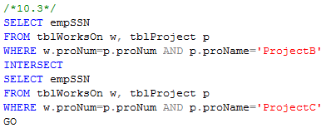
Union, Intersection, Difference of Queries
Example 10.3
Find all employees who work on projectB and projectC

Slide 44
Sub-queries
One query can be used to help in the evaluation of another
A query that is part of another is called a sub-query
Sub-queries return a single constant, this constant can be compared with another value in a WHERE clause
Sub-queries return relations, that can be used in WHERE clause
Sub-queries can appear in FROM clauses, followed by a tuple variable

Slide 45
Sub-queries that Produce Scalar Values
An atomic value that can appear as one component of a tuple is referred to as a scalar
Let’s compare two queries for the same request

Slide 46
Sub-queries that Produce Scalar Values
Example 7: Find the employees of Phòng Phần mềm trong nước department

Slide 47
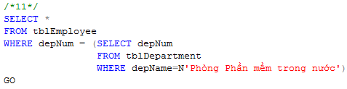
Sub-queries that Produce Scalar Values
Example 11:
Find the employees of Phòng Phần mềm trong nước department

Slide 48
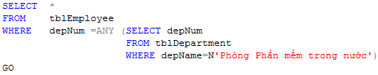
Sub-queries that Produce Scalar Values
Example 11:
Find the employees of Phòng Phần mềm trong nước department

Slide 49
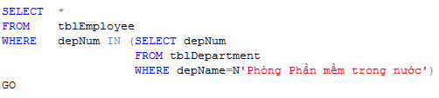
Sub-queries that Produce Scalar Values
Example 11:
Find the employees of Phòng Phần mềm trong nước department

Slide 50
Conditions Involving Relations
Some SQL operators can be applied to a relation R and produce a bool result
(EXISTS R = True) ⇔ R is not empty
(s IN R = True) ⇔ s is equal to one of the values of R
(s > ALL R = True) ⇔ s is greater than every values in unary R
(s > ANY R = True) ⇔ s is greater than at least one value in unary R

Slide 51
Conditions Involving Tuples
A tuple in SQL is represented by a list of scalar values between ()
If a tuple t has the same number of components as a relation R, then we may compare t and R with IN, ANY, ALL

Slide 52
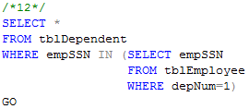
Sub-queries that Produce Scalar Values
Example 12:
Find the dependents of all employees of department number 1

Slide 53
Correlated Sub-queries
To now, sub-queries can be evaluated once and for all, the result used in a higher-level query
But, some sub-queries are required to be evaluated many times
That kind of sub-queries is called correlated sub-query
Note: Scoping rules for names

Slide 54
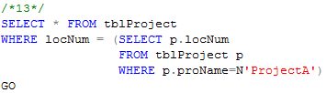
Correlated Sub-queries
Example 13:
Find all those projects have the same location with projectA

Slide 55
Correlated Sub-queries
Another example:
Find the titles that have been used for two or movies
SELECT title
FROM Movies Old
WHERE year < ANY
(SELECT year
FROM Movies
WHERE title =Old.title)

Slide 56
Sub-queries in FROM Clauses
In a FROM list we can use a parenthesized sub-query
We must give it a tuple-variable alias
Example: Find the employees of Phòng Phần mềm trong nước
SELECT *
FROM tblEmployee e, (SELECT depNum
FROM tblDepartment
WHERE depName=N'Phòng phần mềm trong nước') d
WHERE e.depNum=d.depNum

Slide 57
SQL Join Expressions
SQL Join Expressions can be stand as a query itself or can be used as sub-queries in FROM clauses
Cross Join in SQL= Cartesian Product
Syntax: R CROSS JOIN S;
Meaning: Each tuple of R connects to each tuple of S
Theta Join with ON keyword
Systax: R JOIN S ON R.A=S.A;
Meaning: Each tuple of R connects to those tuples of S, which satisfy the condition after ON keyword

Slide 58

SQL Join Expression
Example 15.1
Product two relations Department and Employee
Example 15.2
Find departments and employees who work in those departments, respectively

Slide 59
SQL Join Expression
More Example

Slide 60
Natural Joins
A natural join differs from a theta-join in that:
The join condition: all pairs of attributes from the two relations having a common name are equated, and there are no other condition
One of each pair of equated attributes is projected out
Syntax : Table1 NATURAL JOIN Table2
Microsoft SQL SERVER DONOT SUPPORT NATURAL JOINS AT ALL

Slide 61
Outer Joins
The outer join is a way to augment the result of join by the dangling tuples, padded with null values
When padding dangling tuples from both of its arguments, we use full outer join
When padding from left/right side, we use left outer join/right outer join

Slide 62

Outer joins
Example 17.1:
For each location, listing the projects that are processed in it

Slide 63

Outer joins
Example 17.2:
For each department, listing the projects that it controls

Slide 64
6.4 Full-Relation Operations
Study some operations that acts on relations as whole, rather than on tuples individually

Slide 65
Eliminating Duplicates
A relation, being a set, cannot have more than one copy of any given tuple
But, the SQL response to a query may list the same tuple several times, that is, SELECT preserves duplicates as a default
So, by DISTINCT we can eliminate a duplicates from SQL relations

Slide 66
Eliminating Duplicates
Example 17.3: List all location in which the projects are processed.
Location name is repeated many times
SELECT DISTINCT l.locNum, l.locName
FROM tblLocation l JOIN tblProject p ON l.locNum=p.locNum
SELECT DISTINCT l.locNum, l.locName
FROM tblLocation l JOIN tblProject p ON l.locNum=p.locNum

Slide 67
Duplicates in Unions, Intersections, and Differences
Set operations on relations will eliminate duplicates automatically
Use ALL keyword after Union, Intersect, and Except to prevent elimination of duplicates
Syntax:
R UNION ALL S;
R INTERSECT ALL S;
R EXCEPT ALL S;

Slide 68
Grouping and Aggregation in SQL
Grouping operator partitions the tuples of relation into groups, based on the values of tuples in one or more attributes
After grouping the tuples of relation, we are able to aggregate certain other columns of relation
We use GROUP BY clause in SELECT statement

Slide 69
Aggregation Operators
Five aggregation operators
SUM acts on single numeric column
AVG acts on single numeric column
MIN acts on single numeric column
MAX acts on single numeric column
COUNT act on one or more columns or all of columns
Eliminating duplicates from the column before applying the aggregation by DISTINCT keyword

Slide 70


Aggregation Operators
Example 18.1
Find average salary of all employees
Example 18.2
Find number of employees

Slide 71
Grouping
To partition the tuples of relation into groups
Syntax
SELECT <list of attributes>
FROM <list of tables>
WHERE <condition>
GROUP BY <list of attributes>

Slide 72

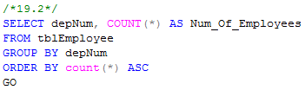
Grouping
Example 19.1:
Group employees by department number
Example 19.2
List number of employees for each department number

Slide 73
Grouping
There are two kinds of terms in SELECT clause
Aggregations, that applied to an attribute or expression involving attributes
Grouping Attributes, that appear in GROUP BY clause
A query with GROUP BY is interpreted as follow:
Evaluate the relation R expressed by the FROM and WHERE clauses
Group the tuples of R according to the attributes in GROUP BY clause
Produce as a result the attributes and aggregation of the SELECT clause

Slide 74

Grouping
Example 20
Compute the number of employees for each project

Slide 75
Grouping, Aggregation, and Nulls
When tuples have nulls, there are some rules:
The value NULL is ignored in any aggregation
Count(*): a number of tuples in a relation
Count(A): a number of tuples with non-NULL values for A attribute
NULL is treated as an ordinary value when forming groups
The count of empty bag is 0, other aggregation of empty bag is NULL

Slide 76
Grouping, Aggregation, and Nulls
Example: Suppose R(A,B) as followed
A | B
NULL | NULL
The result of query
SELECT A, count(B)
FROM R
GROUP BY A;
is one tuple (NULL,0)
The result of query
SELECT A, sum(B)
FROM R
GROUP BY A;
is one tuple (NULL,NULL)

Slide 77
Considerations …
If we want to apply conditions to tuples of relations, we put those conditions in WHERE clause
If we want to apply conditions to groups of tuples after grouping, those conditions are based on some aggregations, how can we do?
In that case, we follow the GROUP BY clause with a HAVING clause

Slide 78
HAVING clause
Syntax:
SELECT <list of attributes>
FROM <list of tables>
WHERE <conditions on tuples>
GROUP BY <list of attributes>
HAVING <conditions on groups>

Slide 79
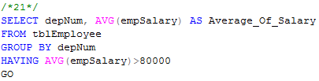
HAVING clause
Example 21:
Print the number of employees for each those department, whose average salary exceeds 80000

Slide 80
HAVING clause
Some rules about HAVING clause
An aggregation in a HAVING clause applies only to the tuples of the group being tested
Any attribute of relations in the FROM clause may be aggregated in the HAVING clause, but only those attributes that are in the GROUP BY list may appear un-aggregated in the HAVING clause (the same rule as for the SELECT clause)

Slide 81
HAVING clause
Example:
SELECT proNum, COUNT(empSSN) AS Number_Of_Employees,
FROM tblWorksOn
GROUP BY proNum
HAVING AVG(workHours)>20
SELECT proNum, COUNT(empSSN) AS Number_Of_Employees,
FROM tblWorksOn
GROUP BY proNum
HAVING proNum=4

Slide 82
SubQuery
Subquery is a query inside another query
A subquery can be nested inside a SELECT, INSERT, UPDATE or DELETE statement or inside another subquery.
A subquery is usually added within the WHERE clause of another SQL SELECT statement.
In a subquery SELECT statement, can not include:
the keyword DISTINCT in the SELECT phrase,
an ORDER BY phrase.

Slide 83
Subquery
Subqueries can be:
Noncorrelated subqueries (Self-contained subqueries)
have no dependency on outer query
execute once for the entire outer query
Correlated subqueries
depend on values from outer query
execute once for each row returned by the outer query
Can use the EXISTS operator

Slide 84
Subquery
A subquery is must be enclosed within parentheses
Subquery can return:
One single value (Scalar Subquery) - One column and one row
A list of values (Multi-Valued Subquery) - One column and multiple rows
A virtual table - Multicolumn, multirow set of values
No value - Output of the outer query might result in an error or a null empty set

Slide 85
Subquery
The most common type of subquery uses an inner SELECT subquery on the right side of a WHERE comparison expression (WHERE subqueries)
A subquery can be used within a SQL data manipulation language (DML) statement such as INSERT, UPDATE, or DELETE

Slide 86
WHERE Subqueries
Syntax
The subquery (inner query) executes once before the main query.
The result of the subquery is used by the main query (outer query).
SELECT column_list
FROM table
WHERE expression OPERATOR
(SELECT column_list
FROM table)

Slide 87
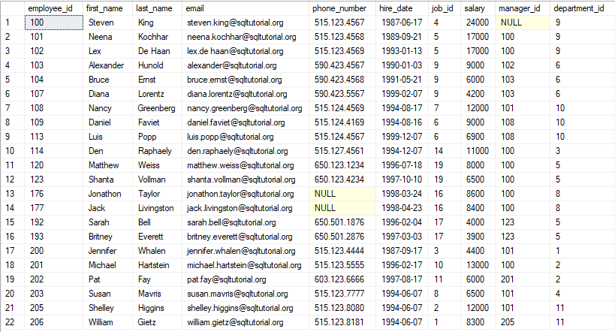
The contents of Employees table

Slide 88
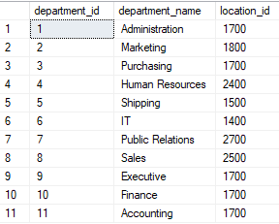
The contents of Departments table

Slide 89
Scalar Subquery
The Scalar sub query returns one single value to outer query
Uses operators: can be >, <, =, >=, or <=, <>
Value generated by the subquery must be of a comparable data type
If the query returns multiple values, the DBMS will generate an error.
If inner query returns an empty set, result is converted to NULL

Slide 90
Scalar Subquery
Syntax
θ can be = <>
>
>=
<
<=
SELECT ......
FROM ......
WHERE ...... θ
( SELECT ......
FROM ......
WHERE ...... )
Must ensure that the subquery returns a SINGLE VALUE, i.e. a table of one row and one column, or an ERROR results.

Slide 91

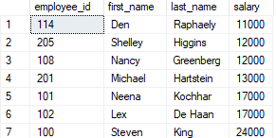
Scalar Subquery
Example
SELECT employee_id, first_name, last_name, salary
FROM Employees
WHERE salary >(SELECT AVG(salary) FROM employees)
ORDER BY salary
Inner query results

Slide 92
Multi-Valued Subquery
Multi-valued subquery returns multiple values to the outer query
Query uses the set comparion operators (IN, ALL, ANY).
SYMBOL | MEANING
IN | Equal to any member in a list
ANY | Return rows that match any value on a list
ALL | Return rows that match all values in a list

Slide 93
Multi-Valued Subquery
Syntax:
θθ can be IN NOT IN
θ ANY
θ ALL
EXISTS
NOT EXISTS
SELECT ......
FROM ......
WHERE ...... θθ
( SELECT ......
FROM ......
WHERE ...... )
θ is any of =, <>, >, >=, <, <=
The subquery can return MULTIPLE VALUES, i.e. one column of many rows. However there is no problem if only one row is returned.

Slide 94
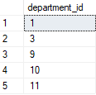
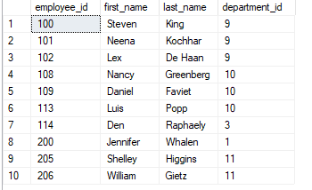
Multi-Valued Subquery with IN
Example
SELECT employee_id, first_name, last_name, department_id
FROM Employees
WHERE department_id IN (SELECT department_id
FROM departments
WHERE location_id = 1700)
Can’t use ‘=’ comparison. Subquery can return many department_id
Inner query results

Slide 95
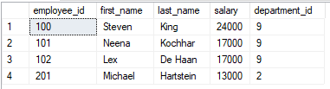
Multi-Valued Subquery with ALL
Example
SELECT employee_id, first_name, last_name, salary, department_id
FROM Employees
WHERE salary > ALL (SELECT salary
FROM employees
WHERE department_id = 10)
AND department_id<>10
If ‘>’ is true for every value,
ALL returns true, else false.

Slide 96
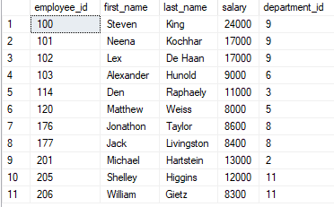
Multi-Valued Subquery with ANY
Example
SELECT employee_id, first_name, last_name, salary, department_id
FROM Employees
WHERE salary > ANY (SELECT salary
FROM employees
WHERE department_id = 10)
AND department_id<>10
If ‘>’ is true for at least one value, ANY returns true, else false.

Slide 97
EXISTS/NOT EXISTS
When a subquery is used with the keyword EXISTS, it functions as an existence test
True or false only – no rows passed back to outer query
EXISTS evaluates to TRUE or FALSE
If any rows are returned by the subquery, EXISTS returns TRUE
If no rows are returned, EXISTS returns FALSE
Syntax:
WHERE [NOT] EXISTS (subquery)

Slide 98
EXISTS/NOT EXISTS
The keyword EXISTS does not follow a column name or other expression
The SELECT list of a subquery introduced by EXISTS typically only uses an asterisk (*)

Slide 99
EXISTS/NOT EXISTS
Example: Show all the employees information if there is at least one employee with a salary in excess of 200,000
SELECT employee_id, first_name, last_name, salary, department_id
FROM Employees
WHERE EXISTS (SELECT * FROM employees WHERE salary > 200000)
The SELECT list typically only uses an asterisk because no data will be returned

Slide 100
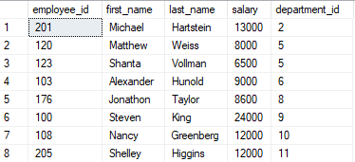
Correlated subqueries
Example 1: Finds all employees whose salary is higher than the average salary of the employees in their departments:
SELECT employee_id, first_name, last_name, salary, department_id
FROM employees e
WHERE salary > (SELECT AVG(salary) FROM employees
WHERE department_id = e.department_id)
Notes:
For each employee, the database system has to execute the correlated subquery once to calculate the average salary of the employees in the department of the current employee.

Slide 101

Correlated subqueries
Example 2: returns all departments which have no employees:
SELECT
department_id, department_name
FROM
departments d
WHERE NOT EXISTS( SELECT * FROM employees e
WHERE e.department_id = d.department_id)

Slide 102
Correlated subqueries
Example 3: Which departments have exactly 2 employees working on them ?
SELECT * FROM Departments d
WHERE 2 = (SELECT count(*) FROM employees e
WHERE e.department_id = d.department_id)

Slide 103
Subqueries in FROM clause
Example: Get the maximum of the average departmental salaries.
SELECT FORMAT(MAX( AvSal ),'C2') AS MaxAvSal
FROM ( SELECT department_id, ROUND(AVG( Salary),2) AS AvSal
FROM employees
GROUP BY department_id ) AS Emp_Averages
This is a useful way of applying an aggregate function to the result of an aggregate function.

Slide 104
Subqueries in SELECT clause
Example: Get the additional amount of salary that each employee receives over and above the minimum company salary.
SELECT employee_id, first_name, last_name,
( Salary - ( SELECT Min(Salary)
FROM employees ) ) AS Additional
FROM employees
This is a useful way of doing a scalar calculation in each row that requires the resulting value of an aggregation.

Slide 105
Multiple Table joins

Slide 106
Multiple Tables Joins
Ability to combine (join) tables on common attributes is most important distinction between a relational database and other databases
Join clause is used to combine rows from two or more tables, based on a related column between them.
Join is generally composed of an equality comparison between the foreign key and the primary key of related tables

Slide 107
Multiple Tables Joins
Type of joins
Equijoin or Inner Join
Self join
Outer join
Cross Join

Slide 108
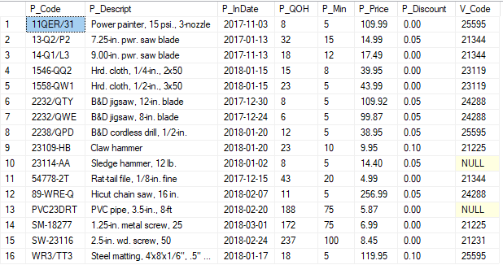
The contents of Product table

Slide 109
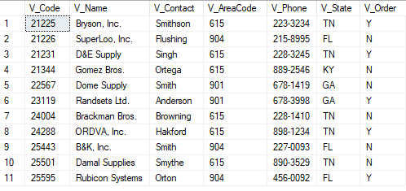
The contents of Vendor table

Slide 110
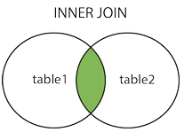
Inner Join
Also called as Equijoin
This join combines the rows retrieved from two or more tables, based on a common field between them.
This join creates a new result table by combining columns values of the tables based upon the join condition.
To join n tables together, you need a minimum of n-1 join conditions
Uses an equality operator (=) to join tables.
INNER JOIN or simply JOIN is used in the query

Slide 111
Inner join
The INNER JOIN keyword selects all rows from tables as long as there is a match between the columns
ANSI syntax
You can join more than two tables based upon the join conditions.
SELECT column_name(s) FROM table1 INNER JOIN table2 ON table1.column_name = table2.column_name

Slide 112
Inner join
Example
Or use EquiJoin based on equality V_Code (old-style join)
SELECT Product.P_Descript, Product.P_Price, Vendor.V_Name, Vendor.V_Contact,Vendor.V_AreaCode, Vendor.V_Phone
FROM Product INNER JOIN Vendor
ON Product.V_Code = Vendor.V_Code
SELECT Product.P_Descript,Product.P_Price,Vendor.V_Name, Vendor.V_Contact,Vendor.V_AreaCode, Vendor.V_Phone
FROM Product, Vendor
WHERE Product.V_Code = Vendor.V_Code

Slide 113
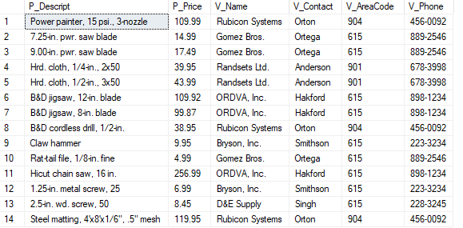
Inner join
Result

Slide 114
Inner join
Joining Tables With a Alias
An alias may be used to identify the source table from which the data is taken
SELECT P.P_Descript,P.P_Price,V.V_Name, V.V_Contact,V.V_AreaCode, V.V_Phone
FROM Product P INNER JOIN Vendor V
ON P.V_Code = V.V_Code

Slide 115
Self Join
A Self join or Recursive Join is a type of SQL join which is used to join a table to itself.
The table has a Foreign key that references its own Primary key.
An alias is especially useful when a table must be joined to itself in a recursive query to avoid column ambiguity.

Slide 116
Self Join
Example: list of all employees with their managers names by joining the EMP table to itself.
SELECT E.EMP_Num, E.EMP_LName, E.EMP_MGR, M.EMP_LName
FROM EMP E
INNER JOIN EMP M
ON E.EMP_MGR = M.EMP_Num
ORDER BY E.EMP_MGR

Slide 117
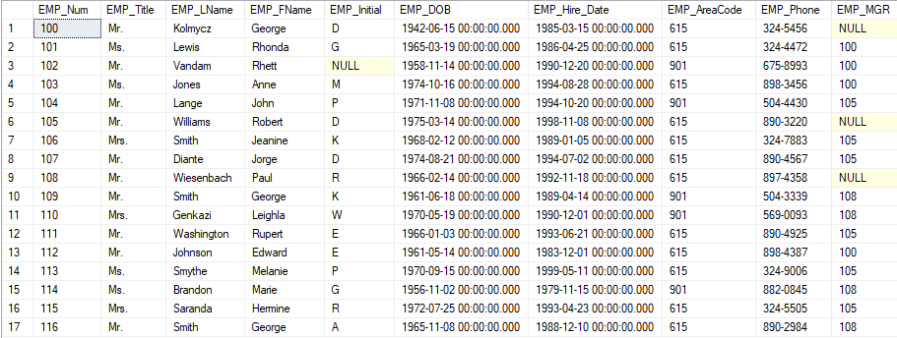
The content of Emp table

Slide 118
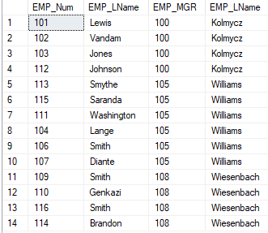
Self Join
Result

Slide 119
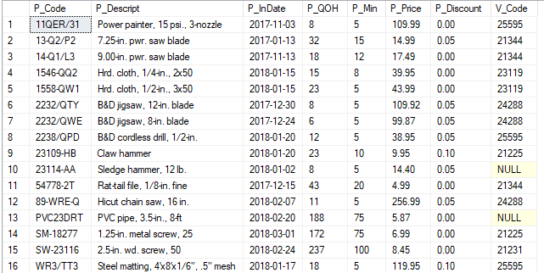
The content of Product table

Slide 120
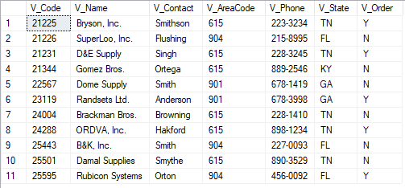
The content of Vendor table

Slide 121
Outer join
Outer join is a join in which rows that do not have matching values in common columns are also included in the result table .
Null values appear in columns where there is not a match between tables
Outer join
Left outer join
Right outer join
Full outer join
Notes:
https://www.sqlshack.com/sql-outer-join-overview-and-examples/

Slide 122
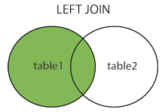
Left Outer Join
In Left outer join (or Left Join)
Returns all rows from the left table (table1) and the matching rows from the right table (table2)
If no records match from the left table, it shows those records with NULL values
Syntax:
SELECT column_name(s) FROM table1 LEFT JOIN table2 ON table1.column_name = table2.column_name

Slide 123
Left Outer Join
Example: Show V_Code, V_Name for all vendors listed in the Vendor table. Include P_Code, P_Descript even if there is no product for that vendor.
SELECT V.V_Code, V_Name, P.P_Code, P.P_Descript
FROM VENDOR V LEFT JOIN PRODUCT P
ON V.V_Code = P.V_Code

Slide 124
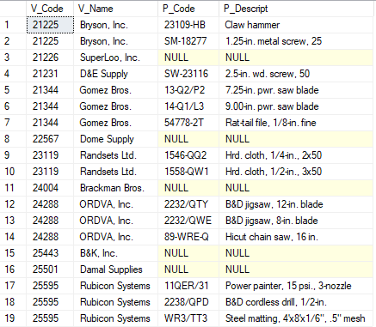
Left Outer Join
Result

Slide 125
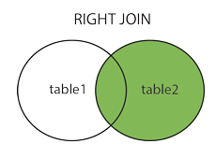
Right Outer Join
In Right outer join (or Right Join)
Returns all rows from the right table (table2) and the matching rows from the left table (table1)
If no records match from the right table, it shows those records with NULL values
Syntax
SELECT column_name(s) FROM table1 RIGHT JOIN table2 ON table1.column_name = table2.column_name

Slide 126
Right Outer Join
Example: Show P_Code, P_Descript for all products listed in the Product table. Include V_Code, V_Name even if there is no Vendor for that product.
SELECT P.P_Code, P.P_Descript, P.V_Code, V_Name
FROM VENDOR V RIGHTJOIN PRODUCT P
ON V.V_Code = P.V_Code

Slide 127
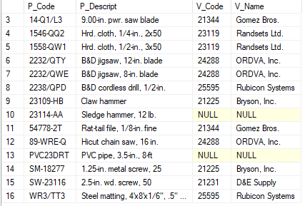
Right Outer Join
Result

Slide 128
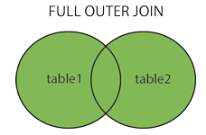
Full Outer Join
Full Outer Join or Full Join
returns all records when there is a match in left (table1) or right (table2) table records.
Syntax
SELECT column_name(s) FROM table1 FULL OUTER JOIN table2 ON table1.column_name = table2.column_name WHERE condition

Slide 129
Full Outer Join
Example: List P_Code, P_Descript, V_Code and V_Name of all products and vendors, regardless of whether or not the products have vendor or the vendors supply the products.
SELECT P.P_Code, P.P_Descript, V.V_Code, V_Name
FROM VENDOR V FULL JOIN PRODUCT P
ON V.V_Code = P.V_Code

Slide 130
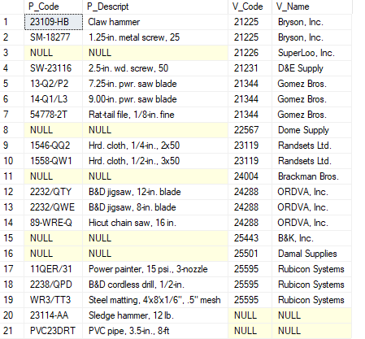
Full Outer Join
Result

Slide 131
Cross Join
A cross join performs a relational product (also known as the Cartesian product) of two tables
SELECT column_name(s) FROM table1 CROSS JOIN table2

Slide 132
Cross Join
Example
Or using other syntax (all DBMSs use this style)
SELECT P.P_Code, P.P_Descript, V.V_Code, V_Name
FROM VENDOR V CROSSJOIN PRODUCT P
SELECT P.P_Code, P.P_Descript, V.V_Code, V_Name
FROM VENDOR V, PRODUCT P

Slide 133
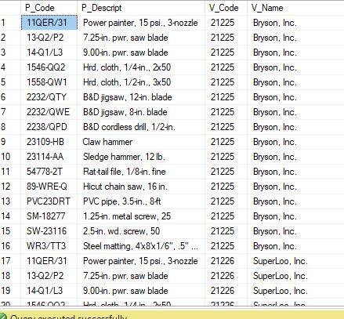
Cross Join
The command performs a cross join of the VENDOR and PRODUCT tables that generates 176 rows. (There are 11 vendor rows and 16 product rows, yielding 11 × 16 = 176 rows.)
Some rows of the result
Notes:
https://www.w3resource.com/sql-exercises/

