Slide 1
Air Pollution Sensor (Virida)
Product Comparisons

Slide 2
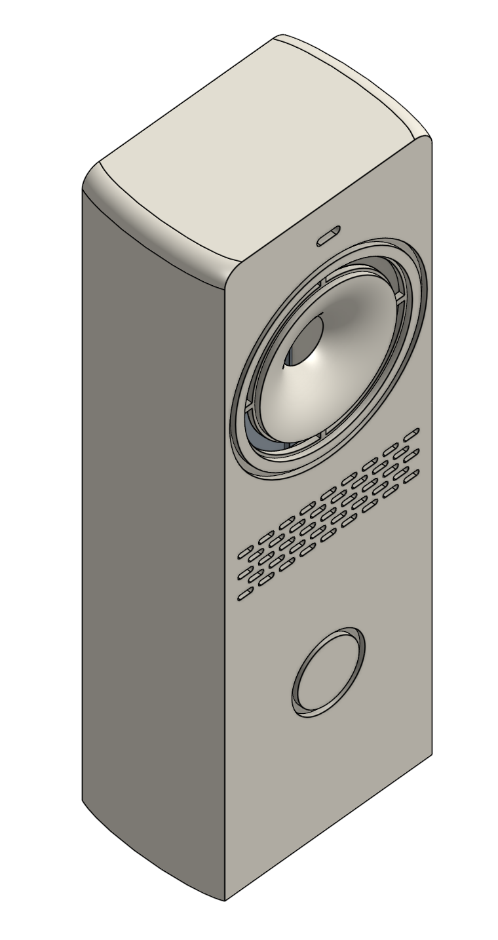
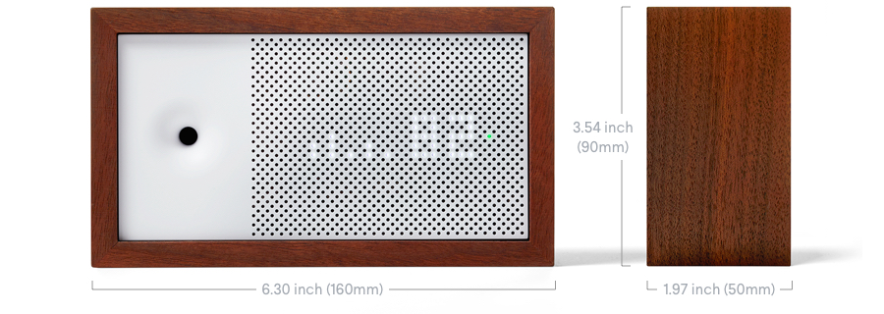
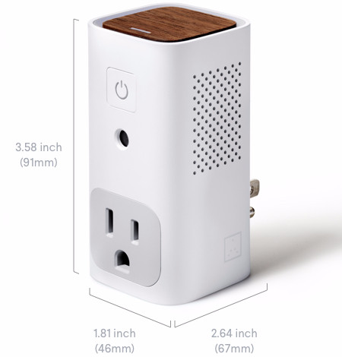

Virida
Prototype 2
AWair
AWair Glow
Dimensions
Width
1.57”
6.3”
1.81”
Height
4.75”
3.54”
3.58”
Depth
1.08”
1.97”
2.64”
Volume
8.05
43.9
17.1
Sensor Types
PM25
0 - 600 ug/m^3
0 - 500 ug/m^3
None
CO2
NA for now
0 - 4000 ppm
0 - 4000 ppm
VOC
0 - 1000 ppm
0 - 2014 ppb
0 - 2014 ppb
Carbon monoxide
Ethanol
Hydrogen
Ammonia
Methane
Temp & Humidity
Yes
Yes
Yes

Slide 3
Virida
Prototype 2
AWair
AWair Glow
Features
Android & iOs Apps
Yes
Yes
Yes
BLE
Yes
Yes
Yes
WiFi &
Smart Device
(IOT)
Required
dock station
IFTTT , Amazon Echo, Cortana?
(2.4 ghz only)
Yes
IFTTT, Nest, Amazon Echo
(2.4 ghz only)
Yes
IFTTT, Nest, Amazon Echo
(2.4 ghz only)
Realtime
Pollution Tracking
Yes
Yes
Yes
Tracking Pollution
Over Time
(graphs & records)
Yes
(years of data)
Only 7 Days of Data
Only 7 Days of Data
Cloud Integration
Map & History
Pollution Data
Yes
(shared public data)
No
No
Notifications &
Actionable Tips
Yes
(tips from server)
Yes
(tips hardcoded in app)
Yes
(tips hardcoded in app)

Slide 4
Virida
Prototype 2
AWair
AWair Glow
Other Features
Temp & Humidity
Compensation
Yes
?
?
Auto Calibration
Yes
Yes
Yes
Portability
Yes
(~6 hours battery life)
Not Portable
Not Portable
Issues
?
- Amazon reviews show some
accuracy problems
- App connectivity issues
Accuracy & Stability
TBD
?
WiFi dropping
Poor Android app support
WiFi is required to operate?
Required online account
WiFi dropping
Poor Android app support
WiFi is required to operate?
Required online account
App & WiFi
TBD

Slide 5
Virida
Prototype 2
AWair
AWair Glow
Cost
$119
($109 sale)
Standalone
$99
$199
WiFi & Charging
Dock Station
$40?
NA
NA

