Slide 1

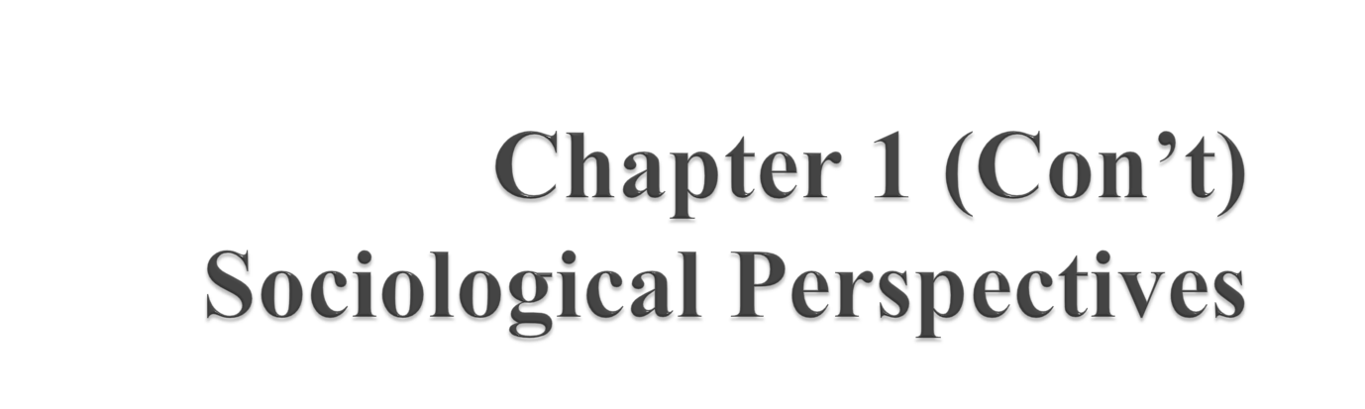
Brym, Robert J. and Lie, John (2007) Sociology: Your Compass for a New World . 3rd edn. Belmont , CA : Thomson/Wadsworth. Ch. 1.

Slide 2

Learning Objectives:
1. History of Sociology
2. Sociological Perspective
MMH: 302001 Ch.1: SOC Perspectives

Slide 3
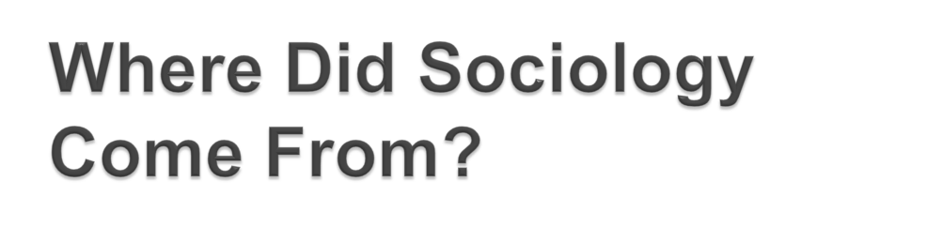
Before “Sociology”
- “The Age of Reason”; “Enlightenment”
• “social contract”/individuality (Locke)
• the “general will”/community (Rousseau)
- Declaration of Independence
(Jefferson)
MMH: 302001 Ch.1: SOC Perspectives

Slide 4
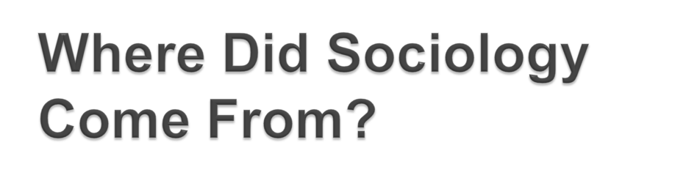
The Invention of Sociology
The nature of community
The nature of government
The nature of the economy
The meaning of individualism
The rise of secularism
The nature and direction of change
MMH: 302001 Ch.1: SOC Perspectives

Slide 5

Functionalism
  Durkheim
  Parsons
  Merton
Symbolic Interactionism
  Weber
  Mead
  Goffman
MMH: 302001 Ch.1: SOC Perspectives

Slide 6
Conflict Theory
  Marx
  Weber
  C. Wright Mills
Feminist Theory
  Martineau
  Addams
MMH: 302001 Ch.1: SOC Perspectives

Slide 7

- Auguste Comte
• founder of sociology
• social statics and dynamics
- Alexis de Tocqueville
• Democracies
MMH: 302001 Ch.1: SOC Perspectives

Slide 8
- Karl Marx
• The Communist Manifesto
• capitalism and worker rebellion
MMH: 302001 Ch.1: SOC Perspectives

Slide 9

Emile Durkheim
• Suicide
• Integration and regulation
• social solidarity
- mechanical and organic
MMH: 302001 Ch.1: SOC Perspectives

Slide 10
Max Weber (VAY-bur)
• interpretive and value free
• class most significant division
- status and party
MMH: 302001 Ch.1: SOC Perspectives

Slide 11

George Simmel (ZIM-mel)
• forms of social interaction
• individuality
- discovery and expression
American Sociological Thinkers
- Thorstein Veblen
• the “productive” (workers)
• the “pecuniary” (owners)
MMH: 302001 Ch.1: SOC Perspectives

Slide 12

George Herbert Mead
• the “I” and the “me”
• generalized other
The “Other” Canon
- Frederick Douglas
- W.E.B. DuBois
- Charlotte Perkins Gillman
MMH: 302001 Ch.1: SOC Perspectives

Slide 13

What could sociology contribute to the study of the self?
What processes ensure social order?
Symbolic Interaction and the Sociology of the Self
- development of the self through interactions with others
- dramaturgical model (Goffman)
• back stage and front stage
MMH: 302001 Ch.1: SOC Perspectives

Slide 14
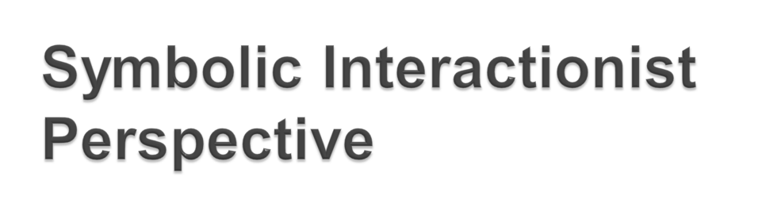
Believes the root of society comes from its symbols
Society is fluid, meaning it is always in the process of change because the symbols we use and their interpretations change
Disputes arise when people do not share the same definitions of symbols
MMH: 302001 Ch.1: SOC Perspectives

Slide 15

Structural Functionalism and Social Order
- stability, order and meaning (Parsons)
- paradigm of how society works
- manifest and latent functions (Merton)
MMH: 302001 Ch.1: SOC Perspectives

Slide 16


- . . . “if it exists it serves a purpose and shouldn’t be changed”
MMH: 302001 Ch.1: SOC Perspectives

Slide 17

society is a system of connected parts working together to keep society intact
it is important to consider the function of any issue
MMH: 302001 Ch.1: SOC Perspectives

Slide 18
society is fairly stable, which means that things occur in society for a specific function
suggests society will find a balance point of its own
MMH: 302001 Ch.1: SOC Perspectives

Slide 19

Conflict Theories:
- An Alternative Paradigm
- the dynamics of society resulted from conflict among different groups
MMH: 302001 Ch.1: SOC Perspectives

Slide 20
Conflict Perspective
focuses on social classes and their drastic differences in wealth, power, and prestige
upper class controls society’s wealth and resources and exploits the lower class
once a group has power, they want to keep it, so they are likely to create advantages for themselves
MMH: 302001 Ch.1: SOC Perspectives

Slide 21
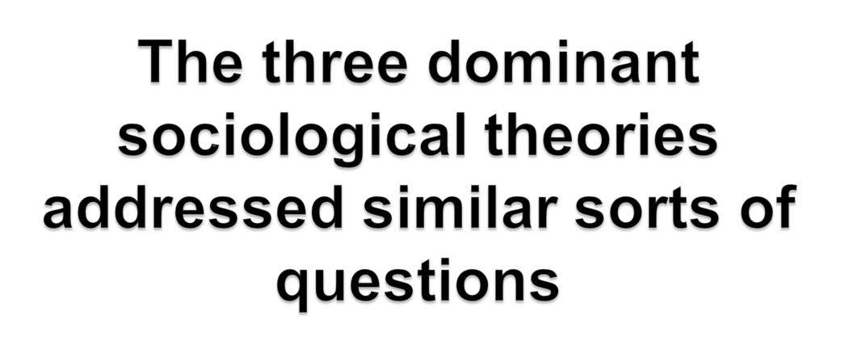
• What holds society together?
• How are individuals connected to larger social processes and institutions?
• What are the chief tensions that pull society apart?
• What causes social change?
MMH: 302001 Ch.1: SOC Perspectives

Slide 22


Slide 23

Which sociological perspective do you feel explains the most to you about our society?
    a. Structural-functional
    b. Conflict
    c. Symbolic interactionist
    d. Feminist
MMH: 302001 Ch.1: SOC Perspectives

Slide 24

Which sociological perspective do you think is generally the weakest in explaining things in our society?
    a. Structural-functional
    b. Conflict
    c. Symbolic interactionist
    d. Feminist
MMH: 302001 Ch.1: SOC Perspectives

Slide 25
1. Durkheim explained variations in the suicide rate by focusing on:
    a. personal troubles
    b. microstructures
    c. power
    d. social solidarity
MMH: 302001 Ch.1: SOC Perspectives

Slide 26
2. According to Durkheim, the more a group's members share beliefs and values, and the more frequently and intensely they interact, the more social solidarity there is in a group.
  True
  False
MMH: 302001 Ch.1: SOC Perspectives

Slide 27
3. Sociologists call stable patterns of social relations:
  microstructures
  macrostructures
  global structures
  social structures
MMH: 302001 Ch.1: SOC Perspectives

Slide 28
4. The main question of _________________ theory is, how do the institutions of society contribute to social stability and instability?
Symbol Interactionist
Functionist
Conflict Theorist
Feminist
MMH: 302001 Ch.1: SOC Perspectives

Slide 29

The three sociological paradigms often overlap with one another. Choose a sociologist discussed about a topic in the chapter. Discuss how his or her ideas connect to all three sociological paradigms.
MMH: 302001 Ch.1: SOC Perspectives

Slide 30

MMH: 302001 Ch.1: SOC Perspectives

