Slide 1


John Carl. Chapter 3

Slide 2

Humans are social beings; we share our lives with others in different social groups
These groups may be:
families,
schools,
workplaces,
friendship groups
MMH: 302001 Ch.3: Culture

Slide 3
Culture means: things shared by members of a society: learned behavior, language, beliefs, values, norms, customs, roles, knowledge and skills which make up a ‘way of life’ of any society
The process of learning a culture is called ‘socialization’ and it is a life-long process
MMH: 302001 Ch.3: Culture

Slide 4

Some animal species are ‘social’ because they carry out certain roles within their complex societies (ants, bees etc) but their behavior is instinctual.
Humans have few instincts (they have reflexes however): human babies helpless if left to fend for themselves.
MMH: 302001 Ch.3: Culture

Slide 5
Plenty of written evidence to prove above: Eg The Puppy Boy Horst and The Wild Boy of Aveyron to show how humans who have been isolated from society do not acquire social habits on their own and find it difficult to later acquire them.
MMH: 302001 Ch.3: Culture

Slide 6
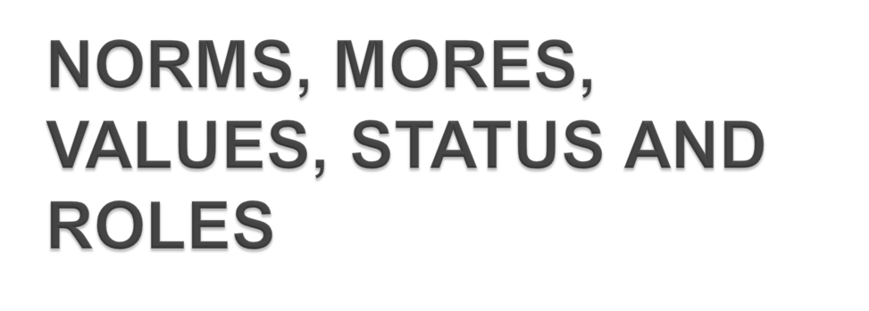
Rules , Regulations and Laws: Apply to all society, written, punishable if broken
Mores: Stronger form of norms: moral ways of behaving which most of society sees as decent.
MMH: 302001 Ch.3: Culture

Slide 7
Norms: tell us what we should/shouldn’t do in particular situations.
Can be explicitly or implicitly taught.
Unspoken and unwritten rules of correct and acceptable behavior.
MMH: 302001 Ch.3: Culture

Slide 8
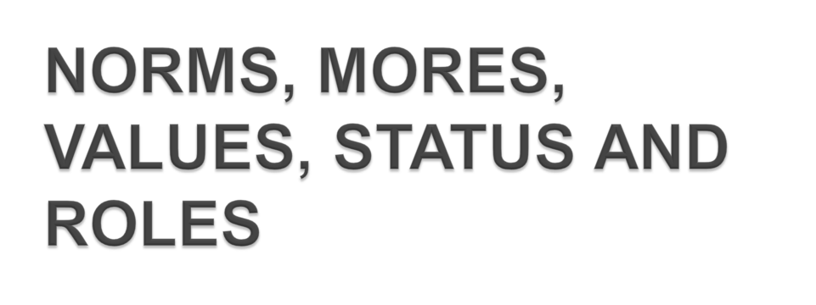
Values: beliefs which lie behind norms, shared by majority of people within culture but not necessarily same in all cultures. Learned from others within society. Can originate from religious beliefs shared by culture.
MMH: 302001 Ch.3: Culture

Slide 9
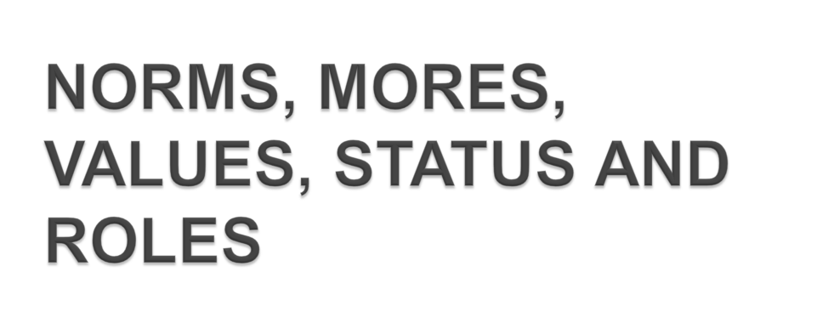
Status: Position held by individual within society
It can be ascribed or achieved)
MMH: 302001 Ch.3: Culture

Slide 10

Cultures around the world share some features although there are also some huge differences
Cultural diversity refers to the wide range of different cultural habits, customs, traditions, languages, dress, norms etc which are found in our world
MMH: 302001 Ch.3: Culture

Slide 11
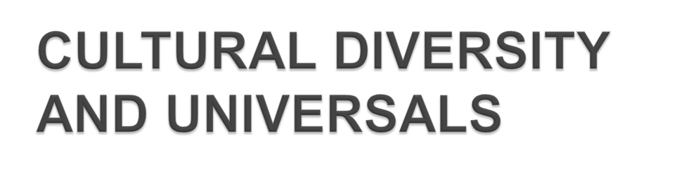
Cultural universals are the forms of behavior which are found in all cultures:
- We all speak languages,
we all have some form of marriage and family, we all have some kind of belief system which is worshipped,
MMH: 302001 Ch.3: Culture

Slide 12
we all believe in the idea that individuals can claim things as their own (ie property) and
finally we all agree on a ban on incest.
These are cultural universals because they are shared among all cultures.
MMH: 302001 Ch.3: Culture

Slide 13

Cultures are diverse in many ways. Give five examples of ways in which another culture differs from your own but which you find unusual
Clothes:
Food:
Marriage:
Languages:
MMH: 302001 Ch.3: Culture

Slide 14
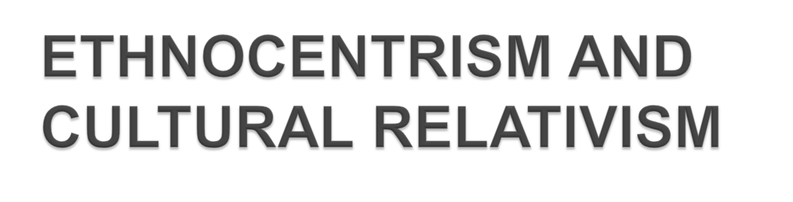
In studying other cultures it is important not to assume that your own way is necessarily better than anyone else’s. This is called ethnocentrism.
Give an example of an ethnocentric view of another culture.
MMH: 302001 Ch.3: Culture

Slide 15
When we try to understand another’s culture from their perspective and not our own, we call it cultural relativism.
Cultural relativism is a challenge to ordinary thinking. Why?
Please, give an example
MMH: 302001 Ch.3: Culture

Slide 16

Through technology the Internet, satellites, and cable TV are readily available throughout the world at the click of the mouse.
Global entertainment and media reach a wide range of cultures
MMH: 302001 Ch.3: Culture

Slide 17

Globalisation has effects on the environment, on culture, on political systems, on economic development and on human physical well-being in societies around the world.
MMH: 302001 Ch.3: Culture

Slide 18
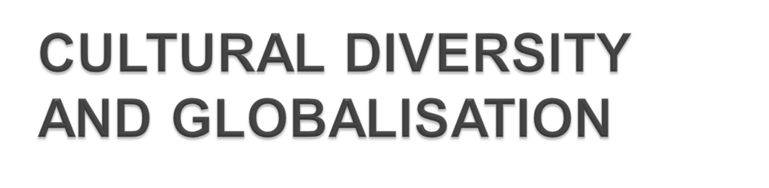
The spread of globalization will undoubtedly bring changes to all countries it reaches.
It is argued that one of the result of globalization will be the end of cultural diversity, and the emergence of one mono-culture.
MMH: 302001 Ch.3: Culture

Slide 19

Discuss:
Will local cultures inevitably fall victim to this global "consumer" culture?
Will English eradicate all other languages?
Will consumer values overwhelm peoples' sense of community and social solidarity?
Is globalization a threat to our traditional and local cultures?
MMH: 302001 Ch.3: Culture

Slide 20


Slide 21
_________ is the term for the language, beliefs, values, norms, behaviors, and material objects that are important enough to pass on to future generations of a society.
a. Social system
b. Social structure
c. Society
d. Culture
MMH: 302001 Ch.3: Culture
Notes:
Answer: d

Slide 22
Religion is an example of:
human nature.
nonmaterial culture.
material culture.
cultural shock.
Which of the following is an example of material culture?
shoes
ships
woven cloth
all of the above
MMH: 302001 Ch.3: Culture

Slide 23

is any word or phrase that carries meaning to a "receiver".
represents, suggests, or stands for something else.
is any gesture that carries meaning to a "receiver".
is a verbal representation of the material or nonmaterial culture.
MMH: 302001 Ch.3: Culture
Notes:
Answer: b

Slide 24
The tendency to judge other cultures by the standards of our own culture:
cultural relativity
prejudice
ethnocentrism
measuring-up
MMH: 302001 Ch.3: Culture
Notes:
Answer: c

Slide 25
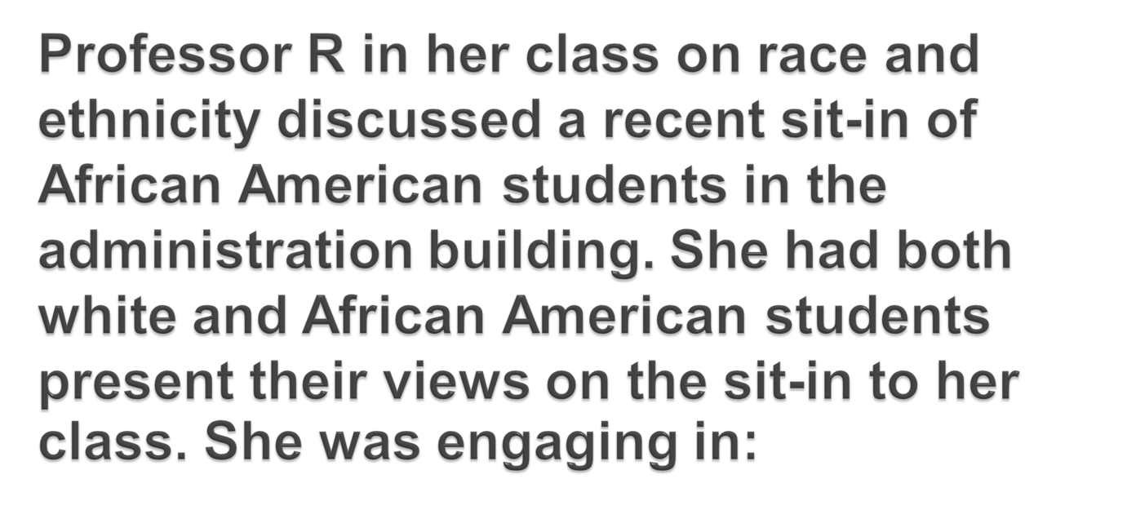
cultural relativity
liberalism
ethnocentrism
multiculturalism
MMH: 302001 Ch.3: Culture
Notes:
Answer: d

Slide 26
The fact that a significant percentage of married men and women are sexually unfaithful to their spouses is an example of the __________ culture, while the fact that most adults acknowledge the importance of sexual fidelity is an example of the __________ culture.
real, ideal
sensate, ideational
ideational, sensate
ideal, real
MMH: 302001 Ch.3: Culture
Notes:
Answer: a

Slide 27
A system of speech and/or written symbols used to convey meaning and communicate is called: material culture
material culture
language
society
subculture
MMH: 302001 Ch.3: Culture
Notes:
Answer: b

Slide 28
A subculture refers to
subsets of the dominant culture that have distinct values, beliefs, and norms.
people who embrace only part of a culture.
people who embrace popular culture.
people in the population at large who lack culture.
MMH: 302001 Ch.3: Culture
Notes:
Answer: a

Slide 29
Multiculturalism is:
a perspective to establish English as the national language of the United States.
a perspective that the United States should have only one dominant culture.
a concept that supports the inherent value of different cultures in a society.
a perspective that encourages immigration to the United States.
MMH: 302001 Ch.3: Culture
Notes:
Answer: c

Slide 30
Counterculture refers to:
people who don’t support immigration.
subcultures whose values and/or beliefs are in opposition to the dominant group.
cultural patterns that strongly support those widely accepted within a society.
people who support immigration.
MMH: 302001 Ch.3: Culture
Notes:
Answer: b

Slide 31

MMH: 302001 Ch.3: Culture

