Slide 1


John D. Carl. Ch. 5

Slide 2

Learning Objectives: Students know
What is culture?
What differences one culture from another? How does culture influence sociological theory and study?
MMH: 302001 Ch.5: Socialization

Slide 3

Socialization is the life-long process of learning the culture of any society
Culture has to be learned; it is not instinctual
Babies are not born knowing how to talk, walk, eat, behave
MMH: 302001 Ch.5: Socialization

Slide 4
Differences between different cultures exists: referred to as cultural diversity
This diversity makes us share common values with our own culture but makes us feel different to other cultures
MMH: 302001 Ch.5: Socialization

Slide 5
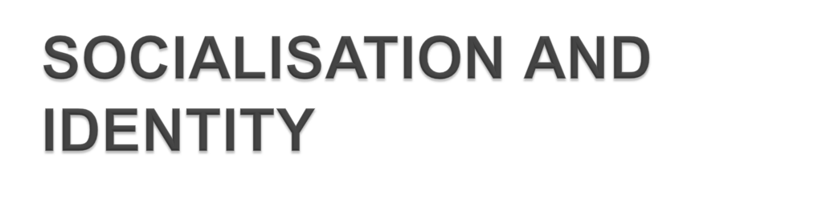
Socialization forms an important part of forming our identity.
Agencies of socialization (such as family, school, friends, the mass media) will influence our identities
MMH: 302001 Ch.5: Socialization

Slide 6
At the same time individuals have the free will to enable them to ‘carve out’ own personal identity and influence how other see them
MMH: 302001 Ch.5: Socialization

Slide 7
Many factors influence our identities.
Through choices we make we can influence how others see us and the image we project to others.
MMH: 302001 Ch.5: Socialization

Slide 8
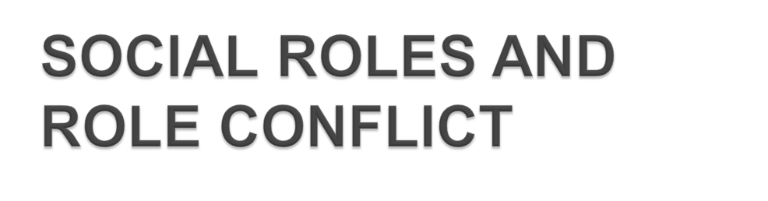
Roles: the normal behavior which is expected to go with a particular status is called a role.
People have multiple roles (can have family roles, work-related roles and social roles) which they switch between quite easily but which have been learnt.
MMH: 302001 Ch.5: Socialization

Slide 9
Roles: the normal behavior which is expected to go with a particular status is called a role.
Some roles are played continuously, some only occasionally , some roles adopted over time as individuals face new circumstances in their lives.
MMH: 302001 Ch.5: Socialization

Slide 10

Sometimes roles don’t fit together well: you can be the dutiful daughter at home and the rebellious student at school!
You can be the oldest son who is expected to achieve at home and the struggling student at school.
MMH: 302001 Ch.5: Socialization

Slide 11
You can be the caring mum at home and the ambitious worker in a company . These differing expectations can cause a conflict.
Primary Socialization: Starts at an early stage (family)- Learn basic norms, values and roles of their culture
MMH: 302001 Ch.5: Socialization

Slide 12
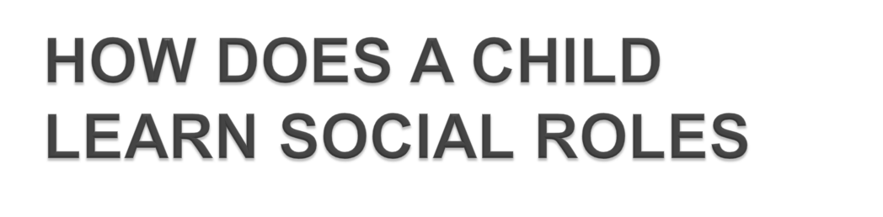
How?
Watching, copying…praise reinforces positive behavior, earns approval, experiment with behavior to test reactions. May reject some of what is taught and gain disapproval
MMH: 302001 Ch.5: Socialization

Slide 13
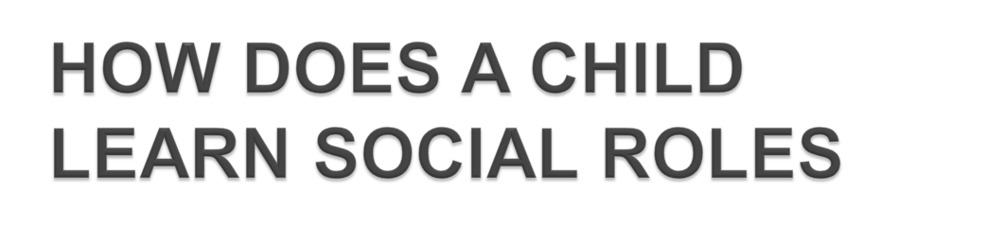
Secondary socialization: At school: learn to get on with others, to conform to rules and regulations, to become independent, to learn useful (to society)knowledge and skills. May challenge rules and authority
MMH: 302001 Ch.5: Socialization

Slide 14
Other influences: Peers (evidence of their influence on the young), mass media,(evidence that advertisers are targeting an even younger audience than before) religion (threatens punishment for wrong behaviour, learnt at home and in school)
MMH: 302001 Ch.5: Socialization

Slide 15
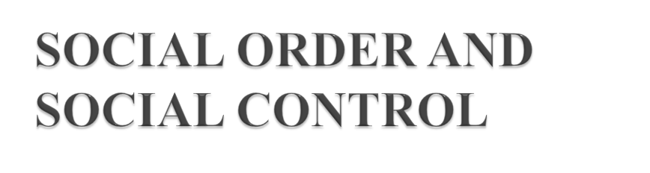
What’s the difference between the two?
Social order assumes that the socialization of individuals in society is a good thing, necessary for co-operation within the society.
Essentially they explain the same thing but from two different perspectives
MMH: 302001 Ch.5: Socialization

Slide 16
What’s the difference between the two?
Social control focuses on the use of manipulation, force or punishment to make individuals conform to societies norms
Social control ensures harmony and agreement within society. Without it there would be chaos.
Essentially they explain the same thing but from two different perspectives
MMH: 302001 Ch.5: Socialization

Slide 17

The Consensus Approach is adopted by Functionalists.
Compares society to a human body, interrelated parts all working together (in consensus) to maintain order in society.
MMH: 302001 Ch.5: Socialization

Slide 18
Institutions such as
family,
school,
law,
mass media
work together in harmony to maintain order (exert influence through socialisation)
MMH: 302001 Ch.5: Socialization

Slide 19
People mostly agree to this because it makes society stable
Does not emphasise the conflict between people and groups. Sees non-conformity as deviance
MMH: 302001 Ch.5: Socialization

Slide 20
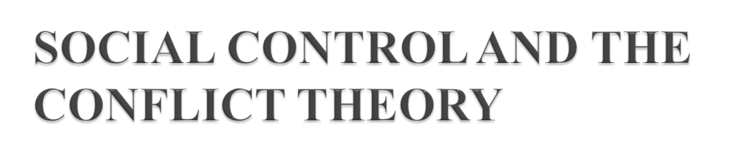
Social Control: The term given to methods used to persuade /force individuals to do what society wants, to conform to values and norms of that society , to prevent deviance
Sanctions are used to achieve conformity (positive and negative)
MMH: 302001 Ch.5: Socialization

Slide 21
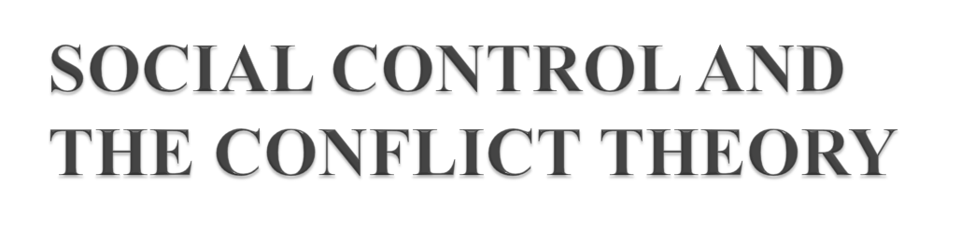
Conflict theory: Marx and Weber
View society as conflicting; inequalities in wealth, power and status creates conflict between groups/individuals
b) Conflict theory says groups have different interests and values with no consensus (agreement) in modern society
MMH: 302001 Ch.5: Socialization

Slide 22
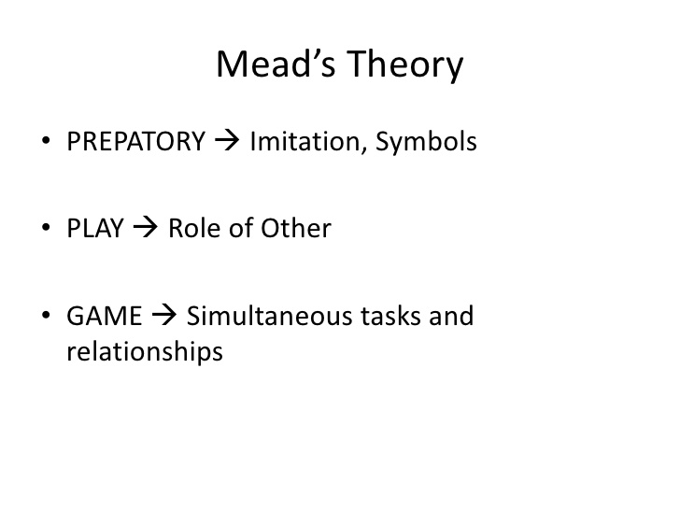
MMH: 302001 Ch.5: Socialization

Slide 23
AGENTS
of
SOCIALIZATION
MMH: 302001 Ch.5: Socialization

Slide 24
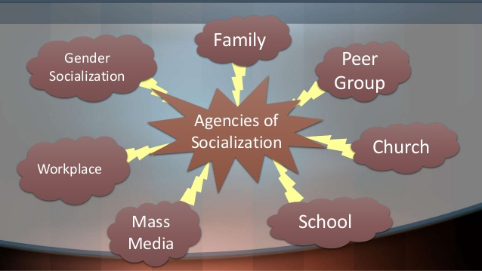

MMH: 302001 Ch.5: Socialization

Slide 25


Slide 26


Activities: in pair, discuss your key social/ cultural influences?
Homework: how has facebook changed the way people socialize?
What is socialization?
Anticipatory socialization
Re-socialization
MMH: 302001 Ch.5: Socialization

Slide 27
Mead’s theory
- Prepatory: symbols
- Play: role-taking
- Game: taking the OTHER’s position
Gottman
- Impression management
- Dramaturgical
- Face – work
Agents
MMH: 302001 Ch.5: Socialization

Slide 28

MMH: 302001 Ch.5: Socialization

