Slide 1


John D. Carl. Ch. 14, 15, 16

Slide 2

The structures and mechanisms of social order.
Cooperation governing the behavior of a set of individuals within a given human collectivity.
- Institutions: family, religion, peer group, economic systems, legal systems, language, and the media,…
MMH: 302001 Ch.5: Social Institutions

Slide 3
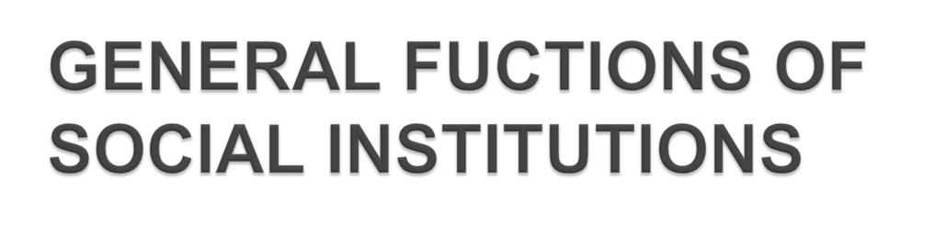
1. Institution Satisfy the Basic Needs of Society.
2. Institution Define Dominant Social Values. “Bill of Rights”
3. Institutions Establish Permanent Patterns of Social Behavior Monogamy
4. Institutions Support Other Institutions. “Adultery”.
5. Institutions Provide Roles for Individuals .
MMH: 302001 Ch.5: Social Institutions

Slide 4

1. According to sociology, what are the functions of a family?
2. How has the family changed?
Vocabulary
• Family
Nuclear Family
Family of Orientation
Family of Procreation
Extended Family
Kinship
Monogamy
• Polygamy
• Heterogamy
• Dual-earner families
• Sandwich Generation
MMH: 302001 Ch.5: Social Institutions

Slide 5

Definition: Group of people who are related by marriage, blood, or adoption and who often live together and share economic resources
• The family is the most universal social institution, but what constitutes a “family” varies across cultures.
MMH: 302001 Ch.5: Social Institutions

Slide 6

The family is the first agent of socialization, so societies rely on the family to teach the norms of the society.
All societies regulate sexual activity to some extent.
Regulation of Sexual Activity
Socialization
MMH: 302001 Ch.5: Social Institutions

Slide 7
Incest taboo is found in every society, but categories of restricted relatives differ across cultures.
Parents, siblings, and other relatives serve as the earliest role models
Regulation of Sexual Activity
Socialization
MMH: 302001 Ch.5: Social Institutions

Slide 8

Family is the basic economic unit.
Family is the approved social unit for producing members to replace those who die or move away.
Reproduction
Economic and Emotional Security
MMH: 302001 Ch.5: Social Institutions

Slide 9
Family is expected to guide the psychological development of its members and provide a loving environment
Rules are set in place about who can raise children and how children should be raised
Reproduction
Economic and Emotional Security
MMH: 302001 Ch.5: Social Institutions

Slide 10

Nuclear family
Family of orientation
Extended family
Kinship
MMH: 302001 Ch.5: Social Institutions

Slide 11
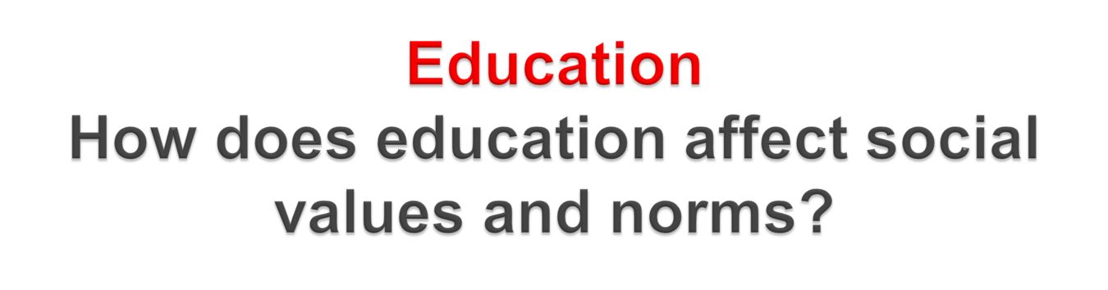
Vocabulary
• Education
• Schooling
• Hidden curriculum
• Tracking
• Charter school
MMH: 302001 Ch.5: Social Institutions

Slide 12

Schooling is formal education
Definition: a system consisting of the roles and norms that ensure the transmission of knowledge, values, and patterns of behavior from one generation to the next.
MMH: 302001 Ch.5: Social Institutions

Slide 13

• Functionalist view: Studies the ways in which education aids society
• Conflict view: Studies the ways in which education maintains the imbalance of power in society
• Interactionist view: Studies the face-to-face interaction of the classroom.
MMH: 302001 Ch.5: Social Institutions

Slide 14
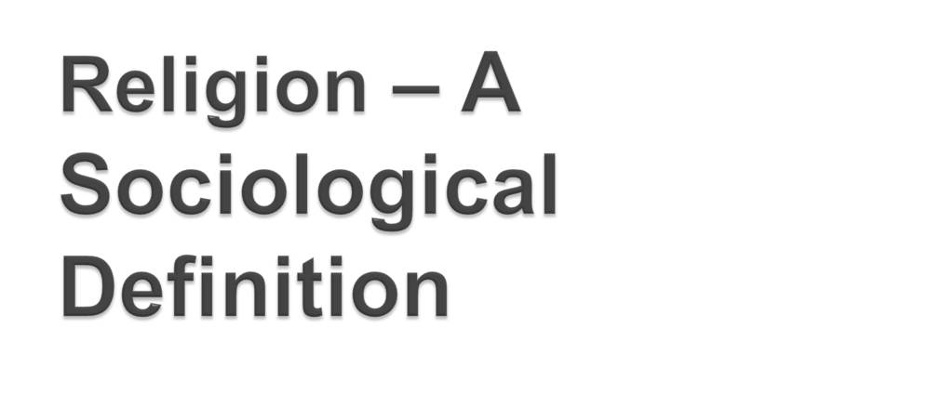
Religion: A system of roles and norms that is organized around the sacred realm and that binds people together in social groups
MMH: 302001 Ch.5: Social Institutions

Slide 15
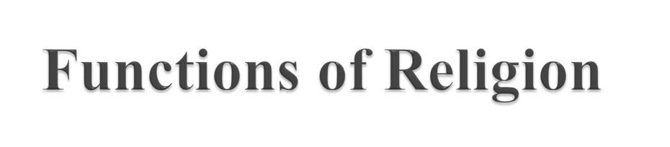
Emotional Support: Provides comfort in times of personal suffering and natural disaster
Social Cohesion: Encourages the strengthening of bonds among people.
MMH: 302001 Ch.5: Social Institutions

Slide 16
Social Control: Encourages conformity to the norms and values of society
MMH: 302001 Ch.5: Social Institutions

Slide 17

• Factors of production
• Primary sector
• Secondary sector
• Tertiary sector
• Capitalism
• Socialism
• Communism
• Law of supply
• Law of demand
• Laissez-fair Capitalism
• Corporation
• Protectionism
• Free trade
MMH: 302001 Ch.5: Social Institutions

Slide 18
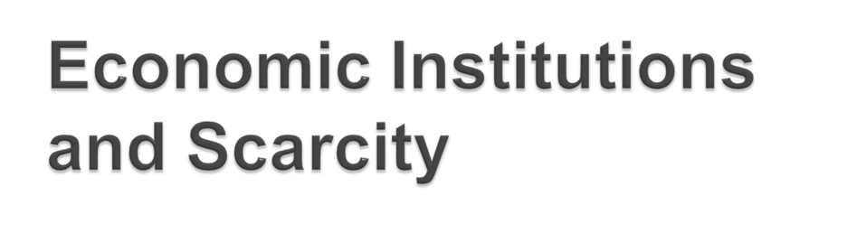
Scarcity = Needs/Wants vs. Resources
• What goods and services should be produced?
• How should these goods and services be produced?
• For whom should these goods and services be produced?
MMH: 302001 Ch.5: Social Institutions

Slide 19

Vocaburary
• Traditional authority
• Charismatic authority
• Rational-legal authority
• Political party
• Interest group
• Power-elite model
• Pluralist model
MMH: 302001 Ch.5: Social Institutions

Slide 20
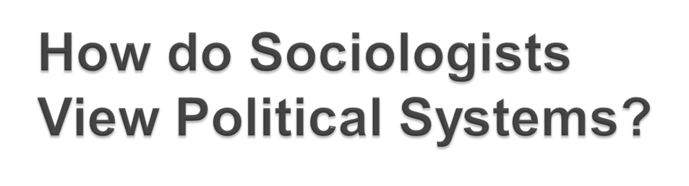
Functionalism: power is divided among groups who must work together.
power is dispersed among different groups
groups must work together for society to function properly
global cooperation is beneficial for everyone
Politic system of checks and balances
MMH: 302001 Ch.5: Social Institutions

Slide 21
Conflict Theory: only the power elite have power.
power is held by a small group of elites
elites are in a struggle to keep power, and non-elite are in a struggle to gain power
MMH: 302001 Ch.5: Social Institutions

Slide 22
Symbolic Interactionism: leaders must be charismatic to gain power and prestige.
leaders must have charisma in order to gain power
charismatic leaders can persuade people to do things they normally wouldn’t do
leader's sway can be used for good or evil
MMH: 302001 Ch.5: Social Institutions

Slide 23

Government as the institution by which an independent society makes and carries out those rules of action which are necessary to enable men to live in a social state, or which are imposed upon the people for that society by those who possess the power or authority of prescribing them.
MMH: 302001 Ch.5: Social Institutions

Slide 24
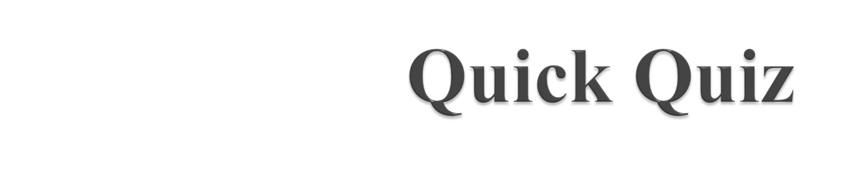

Slide 25

MMH: 302001 Ch.5: Social Institutions

