Slide 1


John D. Carl. Chapters: 6, 7
MMH: 302001 Ch.6: Society&Social Groups

Slide 2

WHAT IS A SOCIETY?
The community of people living in a particular region and having shared customs, laws, and organizations.
The word „society‟ is derived from french word „societe‟ which meansfellowship.
MMH: 302001 Ch.6: Society&Social Groups

Slide 3

Tribal Societies
Horticultural societies
Agrarian societies
Feudal societies
Industrial societies
Post-industrial societies
MMH: 302001 Ch.6: Society&Social Groups

Slide 4

Professional Societies
Charitable Societies
Economic Co-operative Societies
Religious And Cultural Societies
MMH: 302001 Ch.6: Society&Social Groups

Slide 5
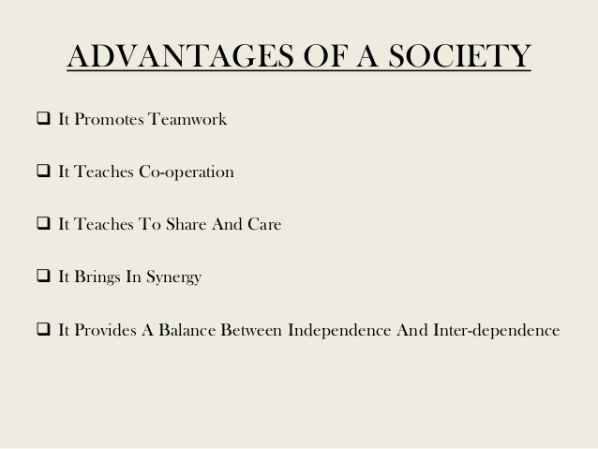

MMH: 302001 Ch.6: Society&Social Groups

Slide 6
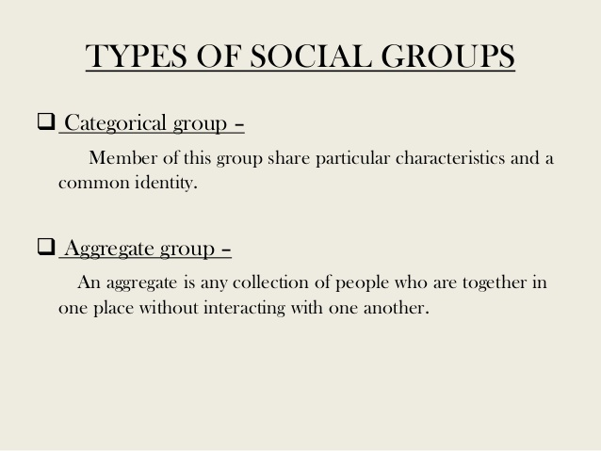

MMH: 302001 Ch.6: Society&Social Groups

Slide 7

Collective groups
Association group
MMH: 302001 Ch.6: Society&Social Groups

Slide 8
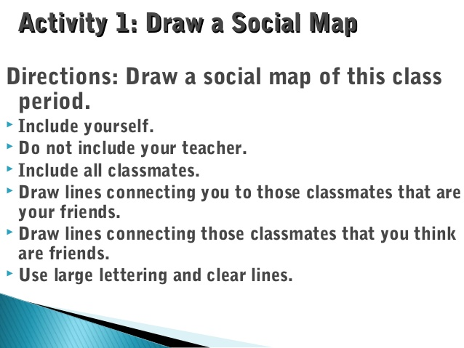
MMH: 302001 Ch.6: Society&Social Groups

Slide 9

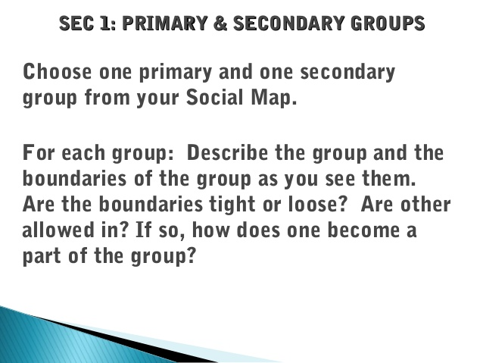
MMH: 302001 Ch.6: Society&Social Groups

Slide 10
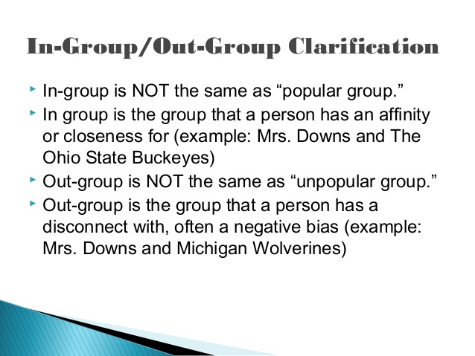
MMH: 302001 Ch.6: Society&Social Groups

Slide 11


Slide 12

MMH: 302001 Ch.6: Society&Social Groups

