Slide 1


John D. Carl. Ch. 8, 10, 11

Slide 2

describes the way in which different groups of people are placed within society
Wealth and income - This is the most common basis of stratification
Social class Ethnicity
Gender Political status
Religion (e.g. the caste system in India)
MMH: 302001 Ch.7: Social Stratification

Slide 3
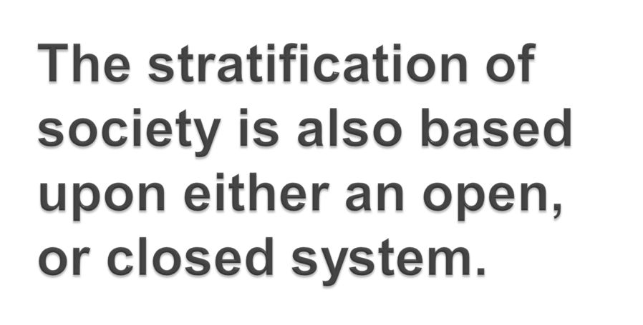
OPEN : Status is achieved through merit, and effort.
This is sometimes known as meritocracy.
MMH: 302001 Ch.7: Social Stratification

Slide 4
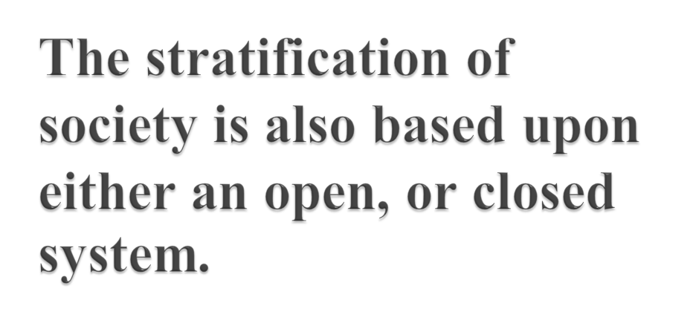
Closed: Status is ascribed, rather than achieved. Ascribed status can be based upon some factors, such as family background, Political factors may also play a role
MMH: 302001 Ch.7: Social Stratification

Slide 5
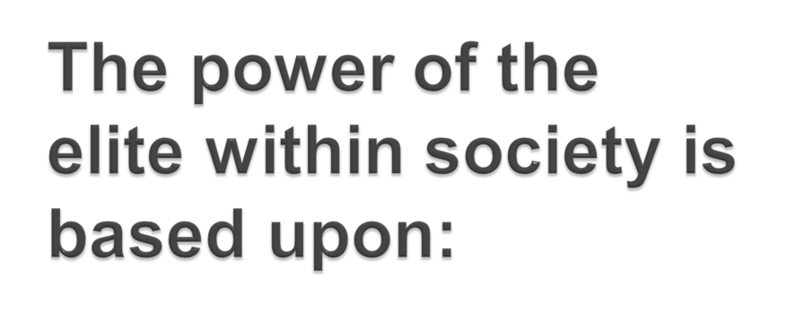
Income
Wealth
A network of social connections – sometimes known as the ‘old boys network’
MMH: 302001 Ch.7: Social Stratification

Slide 6

Work in pairs and find the connection between these words/phrases.
poverty – least powerful – few opportunities
neither rich nor poor – people – middle-class
MMH: 302001 Ch.7: Social Stratification

Slide 7

Work in pairs and find the connection between these words/phrases.
Life chances exist
• glass ceiling
• work
• discrimination
MMH: 302001 Ch.7: Social Stratification

Slide 8

For example ethnic minorities often face a glass ceiling at work due to discrimination upon racial grounds;
which can be either overt (or obvious), or covert (in other words, hidden).
Women also face the same problem.
MMH: 302001 Ch.7: Social Stratification

Slide 9

classification of persons into groups based on shared socio-economic conditions ... a relational set of inequalities with economic, social, political and ideological dimensions.
It is a system by which society ranks categories of people in a hierarchy .
MMH: 302001 Ch.7: Social Stratification

Slide 10

1. Social stratification is a trait of society, not simply a reflection of individual differences;
2. Social stratification carries over from generation to generation;
3. Social stratification is universal but variable;
4. Social stratification involves not just inequality but beliefs as well.
MMH: 302001 Ch.7: Social Stratification

Slide 11

Four main classes
the upper class,
the white collar workers,
The petite bourgeoisie,
and the manual working class.
MMH: 302001 Ch.7: Social Stratification

Slide 12

(work in pairs and analyze what each concept is about and after that share your information with your classmates )
Power
Domination
Communal & Societal Action
MMH: 302001 Ch.7: Social Stratification

Slide 13

POWER -> ability of an actor (or actors) to realize his or her will in a social action, even against the will of other actors. Power relates to the ability to command resources in a particular domain.
Economic power, then, is the ability to control material resources: to direct production, to monopolize accumulation, to dictate consumption.
MMH: 302001 Ch.7: Social Stratification

Slide 14

Societal power includes economic power, social power, legal or political power, and so forth.
Although the control of these domains of resources usually go together, they represent different mechanisms of power, and are conceptually distinct.
MMH: 302001 Ch.7: Social Stratification

Slide 15

Work in groups and summarize the key concepts and share your findings with the rest of the class .
• Class
• Status
• Party
MMH: 302001 Ch.7: Social Stratification

Slide 16


Slide 17

MMH: 302001 Ch.7: Social Stratification

