Slide 1


John D. Carl. Ch. 4, 7, 8

Slide 2

Individuals are normally recognized in society through statuses they occupied and roles they enact.
Not only society is dynamic but also the individuals are dynamic.
MMH: 302001 Ch.8: Social Mobility

Slide 3
Social mobility mean move from lower position to the higher position, secure previous job from an inferior one.
“People in society continue to move up and down the status scale, this movement is called social mobility’.
The study of social mobility is an important aspect of social stratification.
MMH: 302001 Ch.8: Social Mobility

Slide 4

“Social mobility refers to the movement of a person or person’s from one social status to another”.
“Social mobility refers to the movement of an individual or group from one social position, class or social stratum to another”.
Wallace and Wallace:
W.P Scott:
MMH: 302001 Ch.8: Social Mobility

Slide 5

Sociology Dictionary:
Thus it is clear that social mobility mean movement of an individual or group form one social position or status to another.
MMH: 302001 Ch.8: Social Mobility

Slide 6
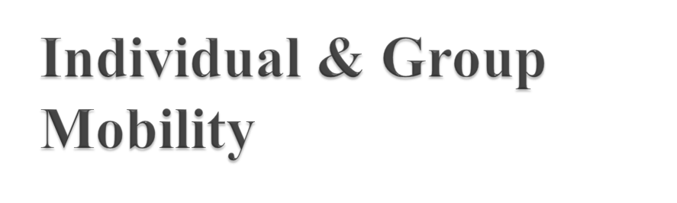
Individual Mobility: When individuals get into seats of political position. They are said to have achieved individual mobility.
Group Mobility: Like individuals even groups also attain high social mobility. The Jews as a community in America and Parsis as a group in India.
MMH: 302001 Ch.8: Social Mobility

Slide 7

i. vertical social mobility.
ii. Horizontal social mobility. This typology is normally followed by the other sociologist also.
Vertical social mobility:Vertical social mobility refers to the movement of an individual or people or groups from one status to another. it involves change in class, occupations or power positions.
MMH: 302001 Ch.8: Social Mobility

Slide 8
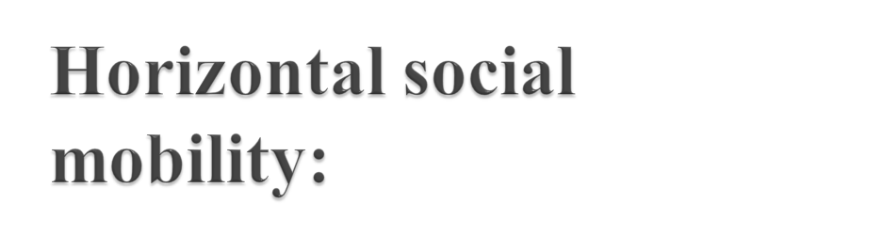
Horizontal mobility is change in position without the change in status. It indicates a change in position with in the range of the same position or status.
“It is movement from one status to its equivalent”.
MMH: 302001 Ch.8: Social Mobility

Slide 9
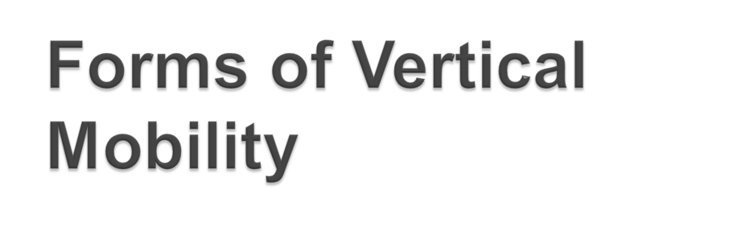
Upward Mobility.
Downward Mobility.
Inter- generational Mobility.
Intra- generational Mobility.
Structural Mobility
MMH: 302001 Ch.8: Social Mobility

Slide 10
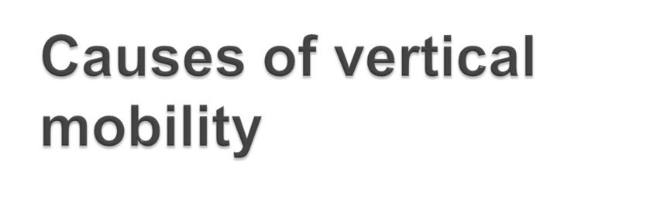
The necessity of filling in emptied or vacant positions.
Obtaining eligibility by imitating the Life-styles of the upper strata.
To fill in the social vacuum created.
Inability to perform the tasks assigned.
Effect of widespread changes in the social-cultural and political environment.
MMH: 302001 Ch.8: Social Mobility

Slide 11
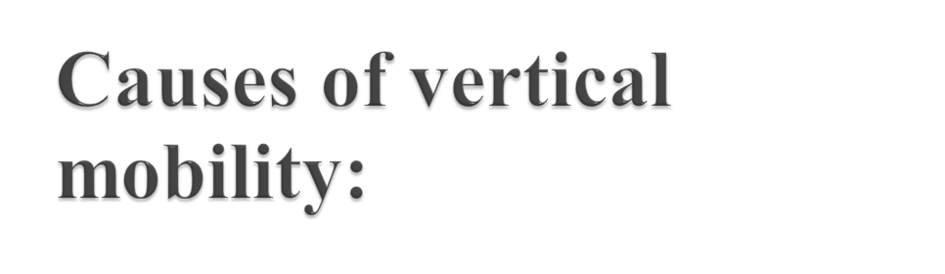
Inability to perform the tasks assigned
The unfitness of many individuals to perform the proper functions relevant to their stratum often causes vertical mobility.
MMH: 302001 Ch.8: Social Mobility

Slide 12
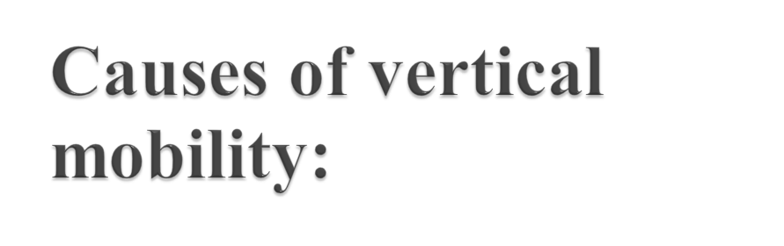
The Necessity of Filling in Emptied or vacant positions:
In most of the societies some upper positions are filled in for a fixed period by some persons. On the expiry of their term, they will have to be replaced by some new persons.
MMH: 302001 Ch.8: Social Mobility

Slide 13
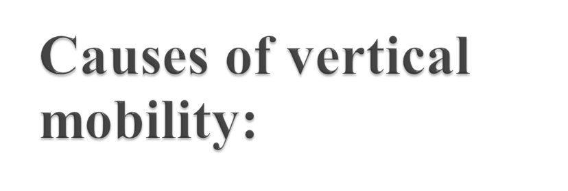
Obtaining eligibility by imitating the life-styles of the upper strata:
There are various criteria by which the social status of the people is evaluated. “Life Styles” represent, and people of the lower strata to the upper.
MMH: 302001 Ch.8: Social Mobility

Slide 14
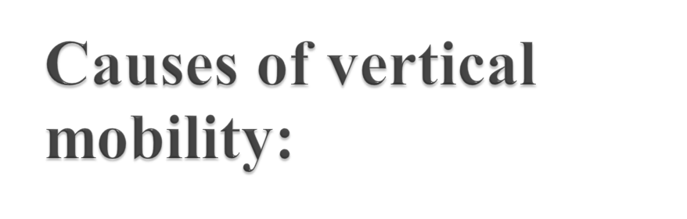
To fill in the social vacuum created:
Because of a lower birth rate within the upper strata, a social vacuum is created. This can be filled in by the persons recruited from the lower layers.
MMH: 302001 Ch.8: Social Mobility

Slide 15
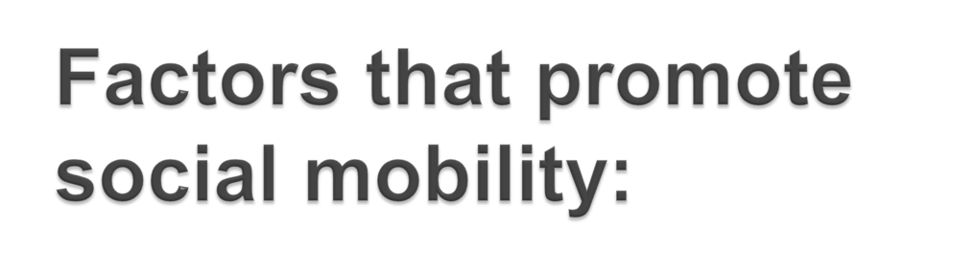
individual factor mobility
occupation and economic activities
religious institutions
political institutions
family and marriage
Windfall or the luck factor.
MMH: 302001 Ch.8: Social Mobility

Slide 16

Mobility applies for both to individuals and groups.
Social mobility is in both directions.
Social mobility have both costs and gains (benefits and expectations)
MMH: 302001 Ch.8: Social Mobility

Slide 17
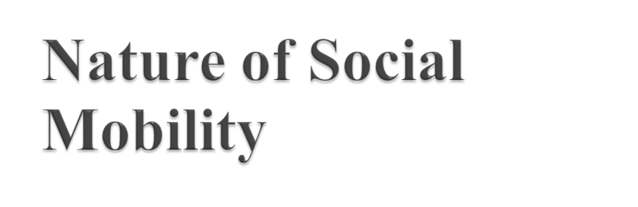
In modern world countries are increasing social mobility to make people happier and search best suited work.
People have unequal social origin.
Otherwise most people are frozen in status of their ancestors.
MMH: 302001 Ch.8: Social Mobility

Slide 18
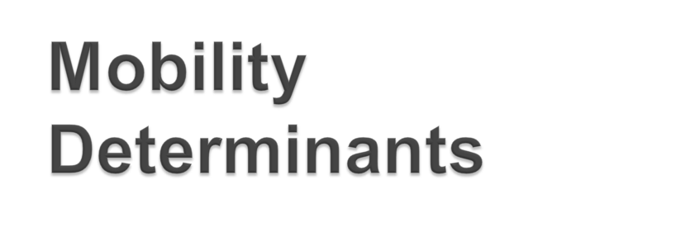
The Rate of Mobility in Modern Societies is Determined by
Structural Factors .
Individual Factors .
MMH: 302001 Ch.8: Social Mobility

Slide 19
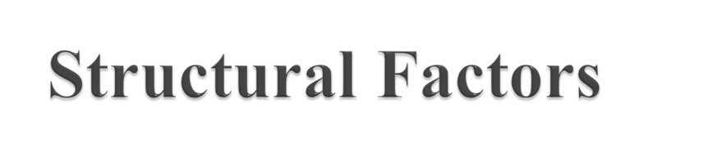
a/ Occupational Structure
b/ Difference in Fertility
c/ The Dual Economy.
d/ Mobility Aids and Barriers
MMH: 302001 Ch.8: Social Mobility

Slide 20

a/ Ability Differences
b/ Mobility Oriented Behavior
c/ Deferred gratification pattern
d/ Mobility game playing
e/ Value stretch hypothesis
f/ The Luck Factor:
g/ Interaction of All Factors.
MMH: 302001 Ch.8: Social Mobility

Slide 21


Slide 22

MMH: 302001 Ch.8: Social Mobility

