Slide 1

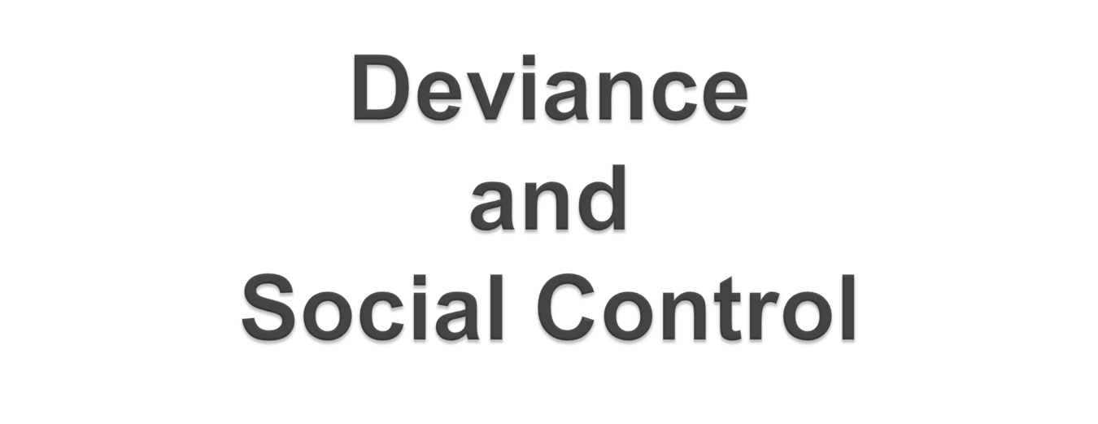
John D. carl: Ch. 13
MMH: 302001 Ch.9: Deviance&social Control

Slide 2
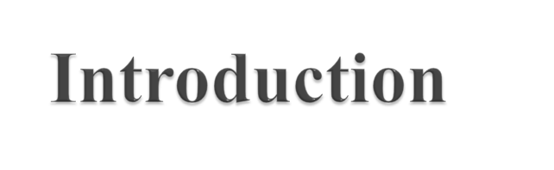
Deviance- the violation of social norms
Stigma- the disapproval attached to disobeying the expected norms
Crime- the forms of deviance in which formal penalties are imposed by the society We are all deviant at some time or another and in some places
MMH: 302001 Ch.9: Deviance&social Control

Slide 3
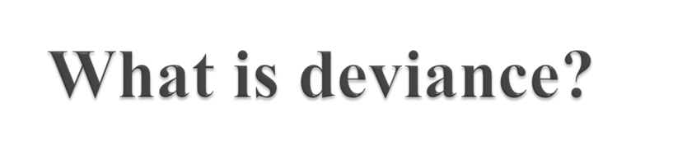
Deviance is a violation of ever-changing social norms
– Deviance is culturally dependent and historically located, exists always in juxtaposition with some “normality”
– Deviance is socially constructed even though some of it might be characterized as an immoral absolute
– Deviance is overlooked in some situations
MMH: 302001 Ch.9: Deviance&social Control

Slide 4
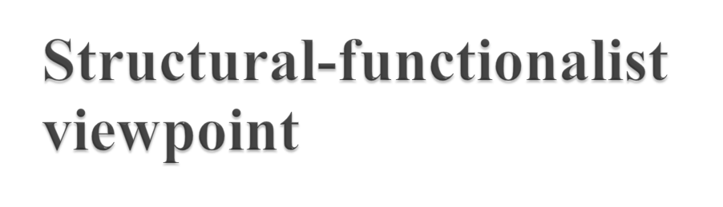
Deviance serves vital functions for society
Sets examples of unacceptable behavior
Provides guidelines for (opposite) behavior that is necessary to maintain social order
Bonds people together through their common rejection of deviant behavior
MMH: 302001 Ch.9: Deviance&social Control

Slide 5
Deviance serves vital functions for society
Provides jobs for those who deal with deviants
Can signal problems in a society that need addressed (stimulate positive change)
Opens societies to new and creative paths of thinking
MMH: 302001 Ch.9: Deviance&social Control

Slide 6
Differential association theory conformity or deviance is learned from those we spend time with
MMH: 302001 Ch.9: Deviance&social Control

Slide 7
Labeling theory - behavior is not intrinsically deviant, but becomes deviant because it is labeled as such
– Members of a society define (label) what is deviant and impose sanctions for that behavior
– Individuals who engage in primary deviance are not labeled, but those who engage in secondary deviance are
MMH: 302001 Ch.9: Deviance&social Control

Slide 8
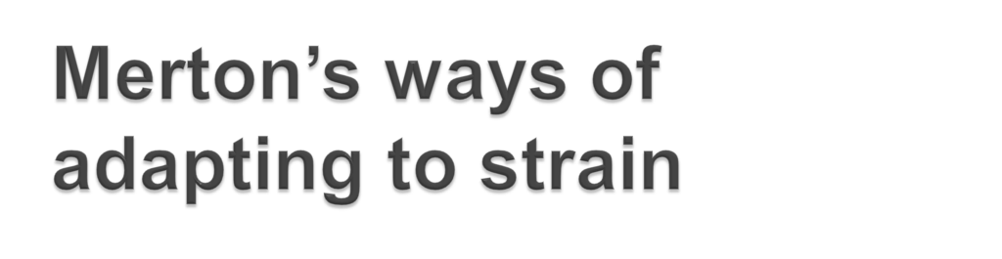
Conformity
Innovation
Ritualism
culturally
MMH: 302001 Ch.9: Deviance&social Control

Slide 9
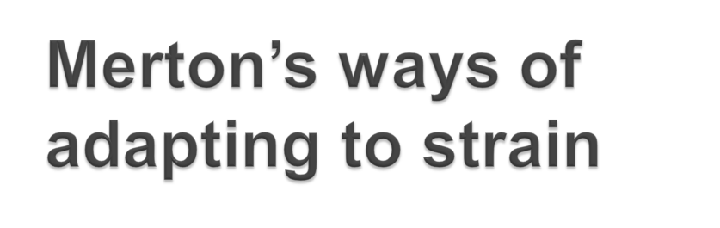
Retreatism - giving up on both the goals and the means
Rebellion - rejecting the socially approved ideas of "success" and the means of attaining that success, but replaces those with alternative definitions of success and alternative strategies for attaining the new goals
MMH: 302001 Ch.9: Deviance&social Control

Slide 10
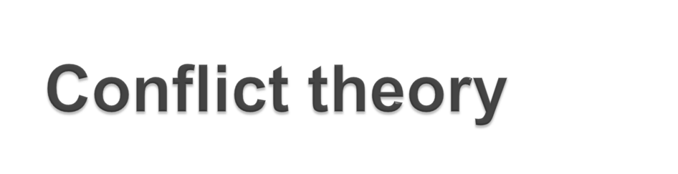
– Elites want to maintain control, so they define what is deviant to benefit themselves and deflect attention from their own behaviors
MMH: 302001 Ch.9: Deviance&social Control

Slide 11
– The greater the power differentials and inequalities, especially class, the greater the conflict in a society
– Conflict is inevitable under the current capitalist power arrangement
MMH: 302001 Ch.9: Deviance&social Control

Slide 12
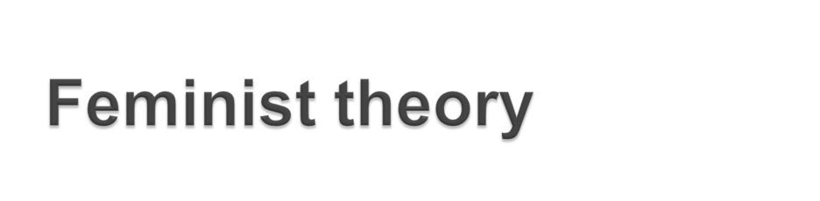
– The causes include the gendered division of labor, the separation of spheres, and the socialization of children
– Cultural attitudes toward crime against women differ based on the status of women in that society
MMH: 302001 Ch.9: Deviance&social Control

Slide 13
– Women are less often in a position to commit crimes and often commit crimes that are different from men’s
MMH: 302001 Ch.9: Deviance&social Control

Slide 14
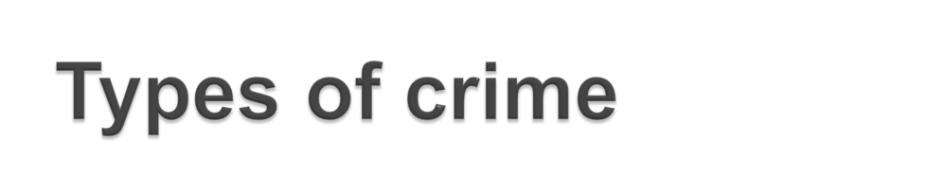
Predatory or street crime
Victimless or public order crimes
Hate crimes
Organized crime
Occupational or white collar crime
State organized crimes
Global crimes
MMH: 302001 Ch.9: Deviance&social Control

Slide 15
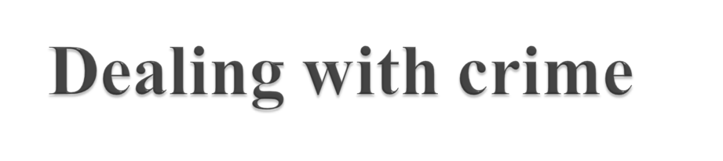
Structural-functionalist- the justice system is important for maintaining order in society
Conflict- the criminal justice system presents crime as a threat from poor people and minorities and disproportionately arrests and sentences them
MMH: 302001 Ch.9: Deviance&social Control

Slide 16
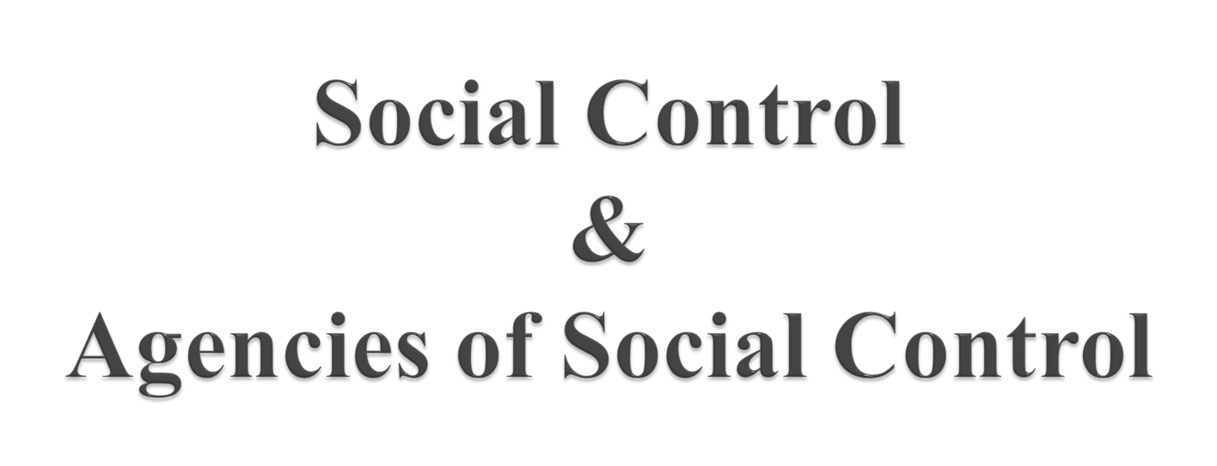
MMH: 302001 Ch.9: Deviance&social Control

Slide 17
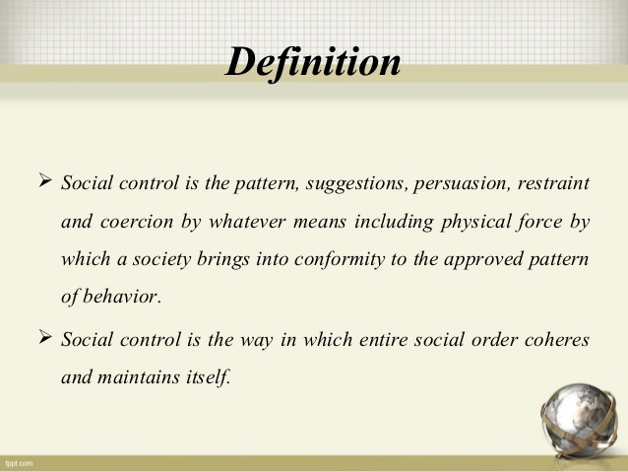
MMH: 302001 Ch.9: Deviance&social Control

Slide 18
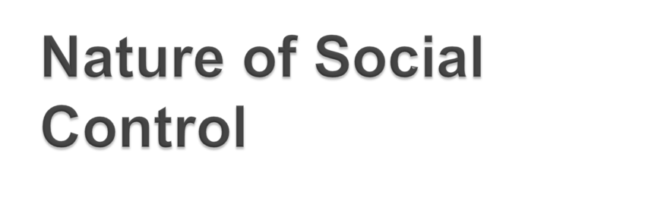
The influence of social control is exercised for promoting the welfare of all the individuals or the group as a whole.
Social control is as old as human society. It is an essential condition of the human society.
MMH: 302001 Ch.9: Deviance&social Control

Slide 19
The influence of social control is universal. Where there is society, there is social control.
Social control is exercised through both formal and informal agencies
MMH: 302001 Ch.9: Deviance&social Control

Slide 20
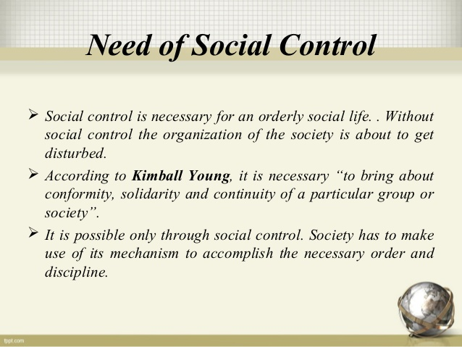
MMH: 302001 Ch.9: Deviance&social Control

Slide 21
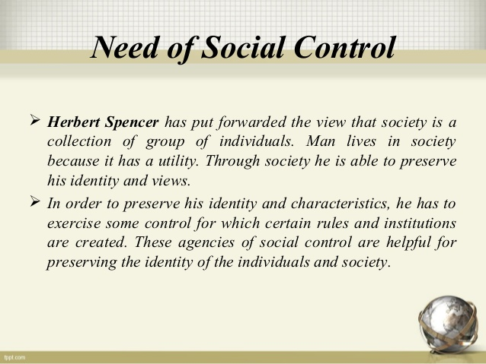
MMH: 302001 Ch.9: Deviance&social Control

Slide 22
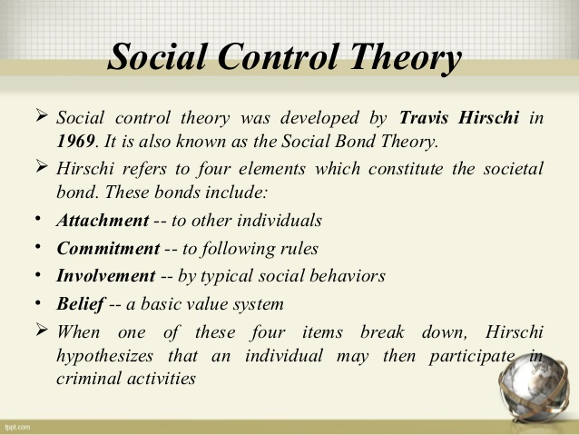
MMH: 302001 Ch.9: Deviance&social Control

Slide 23
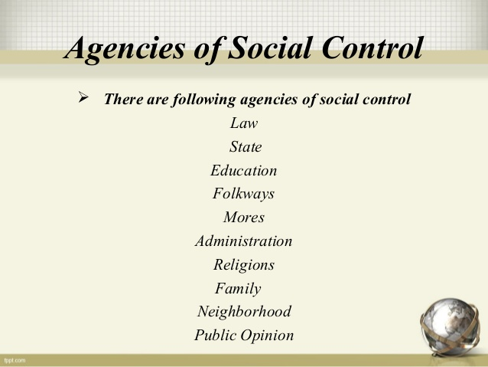
MMH: 302001 Ch.9: Deviance&social Control

Slide 24
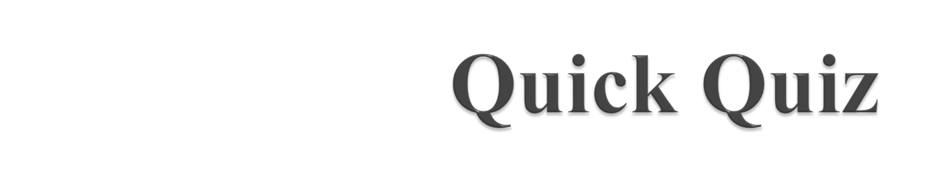

Slide 25
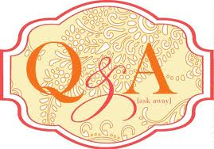
MMH: 302001 Ch.9: Deviance&social Control

