Slide 1
Gcontest report
TRINH DINH TUAN

Slide 2
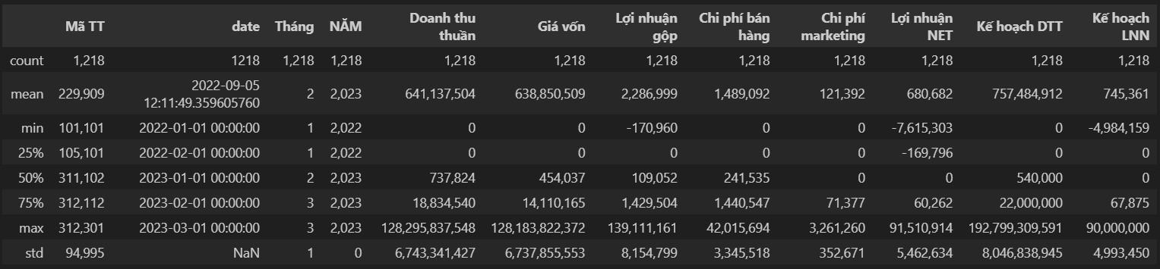
I. Understand and Prepare the Data
1. Exploratory Data Analysis - EDA
The data shows a right-skewed distribution.
The largest values of Net Revenue, Cost of Goods Sold, Selling Expenses, and NET Profit significantly exceed the mean and the 75th percentile -> Outliers.
The level of selling and marketing expenses is relatively high compared to gross profit, putting pressure on NET profit.
Some negative values in Gross Profit and NET Profit indicate that certain stores are struggling to cover their costs.
In both years, net revenue and net profit did not meet the set targets.

Slide 3
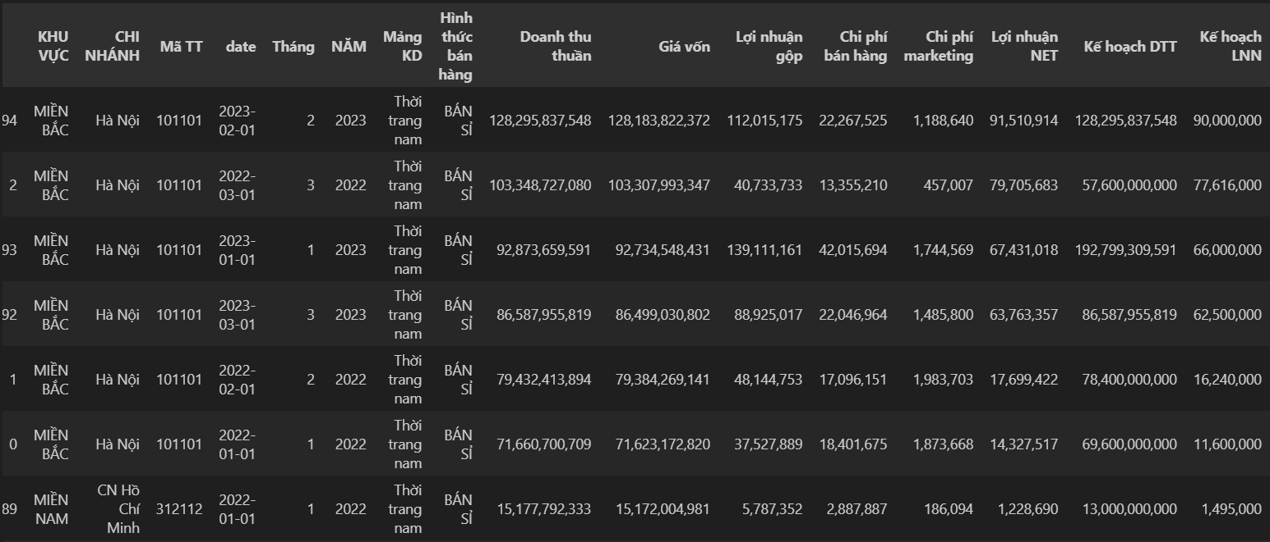
I. Understand and Prepare the Data
2. Data Preprocessing
Create an additional column for the date based on the Quarter and Year columns.
Identify the outlier as store 101101 located in the Hanoi branch -> Proceed to remove it for analysis.

Slide 4
II. Overview
1. Some key metrics analysis
Overall growth is positive: Gross revenue and Total cost increased by 52%.
Selling expenses increased at a lower rate than revenue (43%), which could be a positive indicator of operational efficiency.
Marketing costs rose excessively (91%), especially in the Southern region (161%). ROI and the actual effectiveness of these campaigns need to be reviewed.
The Northern region showed steady and most efficient growth among the three regions, particularly in selling expenses.
The Central region faces difficulties: revenue declined, while costs (especially marketing and selling expenses) surged significantly.
Negative profits are prevalent in the Southern region: despite a strong revenue increase (78%), negative profit (-105%) indicates that costs (particularly marketing) far exceed actual benefits."

Slide 5
II. Overview
2. Cost Control Efficiency
The Northern region stands out the most: strong operational performance, effective control of marketing and selling expenses, with the highest net profit/revenue ratio.
The Central region has very low business efficiency, with negligible profit. Improvements in cost of goods sold and a focus on more effective marketing strategies are needed.
The Southern region, despite high revenue, reports negative net profit: selling and marketing costs relative to revenue are relatively high but fail to generate net profit.

Slide 6
II. Overview
3. Analysis of Each Business Segment
Men's Fashion: The main contributor to revenue (96.56%) but with a very low net profit margin (0.05%) due to high cost of goods sold -> Needs cost control.
Accessories and Women's Fashion: The most efficient in terms of profit margin. Accessories have a high net margin (5.01%) despite very small revenue. Women's fashion has the highest net margin (19.81%) with the lowest selling and marketing costs -> Significant potential to expand revenue without substantial cost increases.
Unisex Fashion: Shows potential but has excessively high costs. Selling and marketing expenses take up a large proportion, reducing efficiency. However, the net profit margin is relatively high (4.17%) -> This segment still holds potential if costs can be optimized."

Slide 7
III. Demographic segmentation
1. Northern Region
Revenue Growth: Decreased by 0.88% – The decline is minor, indicating good customer retention.
Net Profit Growth: Decreased by 13.5% – Profit declined more sharply than revenue, suggesting a decline in operational efficiency.
Selling Expenses: Decreased by 20.4% – This is a positive signal, showing that the Northern region has optimized operational costs.
Marketing Expenses: Decreased by 6.3% – Despite the reduction, it did not significantly impact revenue, reflecting effective promotional strategies in this region.
=> Insight: The Northern region has efficient operational mechanisms but needs to grow revenue to sustain profitability. Cost reduction is a strength, but new investment strategies might be necessary to achieve long-term growth.

Slide 8
III. Demographic segmentation
2. Central Region
Revenue Growth: Decreased sharply by 29.3% – This is the most severe revenue decline across all regions, requiring investigation into potential causes such as reduced market demand or loss of market share.
Net Profit Growth: Decreased by 31.6% – Profit decreased almost proportionally to revenue, reflecting a significant burden of fixed costs.
Selling Expenses: Increased slightly by 1.8% – With revenue declining sharply, the lack of control over selling expenses has further reduced business efficiency.
Marketing Expenses: Increased significantly by 27.8% – The increased marketing investment did not translate into revenue growth, indicating ineffective promotional strategies in the Central region.
=> Insight: The Central region is facing a severe revenue crisis, likely due to loss of market share. Marketing strategies need to be revised, focusing on more suitable products or segments. At the same time, tighter control over selling expenses is required to alleviate the burden of fixed costs.

Slide 9
III. Demographic segmentation
3. Southern Region
Revenue Growth: Increased significantly by 22.5% – The Southern region is the only area to achieve notable revenue growth, indicating substantial market potential.
Net Profit Growth: Loss increased by 41% (from -140,910 to -198,945) – The larger negative profit reflects that the revenue increase is not enough to offset costs.
Selling Expenses: Increased by 14% – While the increase in selling expenses is necessary for expanding revenue, its effectiveness needs to be evaluated.
Marketing Expenses: Increased by 79.9% – This is the highest increase in marketing costs among all regions, yet profits did not improve, reflecting a low marketing ROI.
=> Insight: The Southern region has potential for revenue growth, but excessively high operational costs are driving greater losses. Selling and marketing costs need to be optimized, with a particular focus on reassessing the ROI of promotional campaigns.

Slide 10
IV. Suggestion
Northern Region
Maintain Cost Control: Continue optimizing selling and marketing expenses.
Invest in Revenue Growth: Experiment with new marketing strategies to boost revenue, particularly in potential segments.
Central Region
Review Marketing Strategies: Cut ineffective campaigns and focus on high-potential market segments.
Control Selling Expenses: Conduct deeper analyses to reduce unnecessary operational costs.
Southern Region
Improve Operational Efficiency: Review all sales and marketing processes, optimizing costs to reduce losses.
Focus on Marketing ROI: Measure the effectiveness of each campaign and eliminate expenses that do not add value.

