Slide 1
mShopping - K17
1. Dinh Bao
2. Xuan Thao
3. Van Thanh
4. Anh Tuan

Slide 2
Introduction
mShopping is an Android Mobile Application helps user to find: baby store, bookstore, clothing store, Malls & shopping center base on user’s location.
With this application, user can find the best place via information details of each place, view place on map… then add it into favorite.
mShopping runs on Android OS v2.3 or later.

Slide 3
Introduction
Key Features:
    Show list categories
    Search nearest places
    Get detail information
    Show places on map
    Get driving direction
    Show web for more information
    Call, email to someone
    Favorite List Management
    Change Location

Slide 4
Architecture Diagram
GUI
Activity
Search Service
Model
SQLite
Data Service
Utility

Slide 5
Package Diagrams
Activities package
MainActivity
ListcategoriesActivity
SearchResultActivity
DetailInfoActivity
ViewMapActivity
ViewWebActivity
SendMailActivity
MyFavoriteActivity
GetDirectionActivity

Slide 6
Package Diagrams
Models package
Models package
CategoryItem
ListResult
SearchResult
PhoneNumbers
Utilities package
CommonConfiguration
CustomCursorAdapter

Slide 7
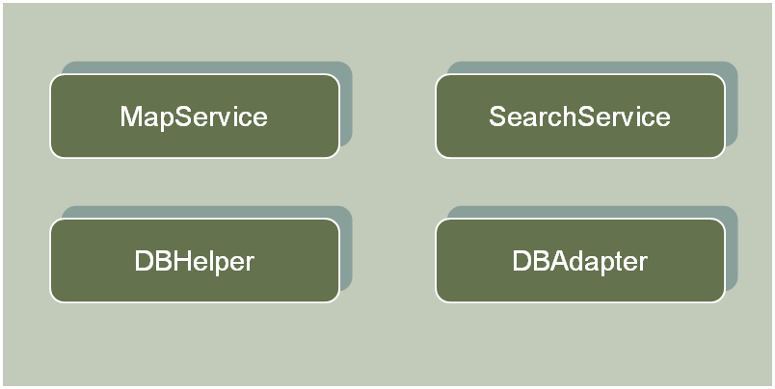
Package Diagrams
Services package

Slide 8
List Categories – Search Result
1. Requirement:
  List Categories screen show items:
    Baby store
    Book store
    Clothing store
    Malls & shopping
  Display current location

Slide 9
List Categories – Search Result
Search Result screen shows:
  The list of nearest places according to the category that user choose.
  Each item contains:
      Name
      Address
      Distance
  List is sorted by distance.

Slide 10
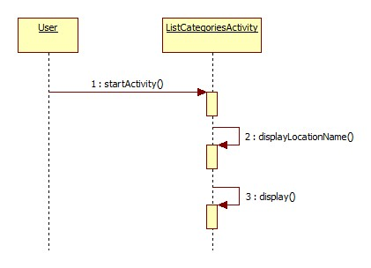
List Categories – Search Result
2. Design:
  List Categories Design

Slide 11
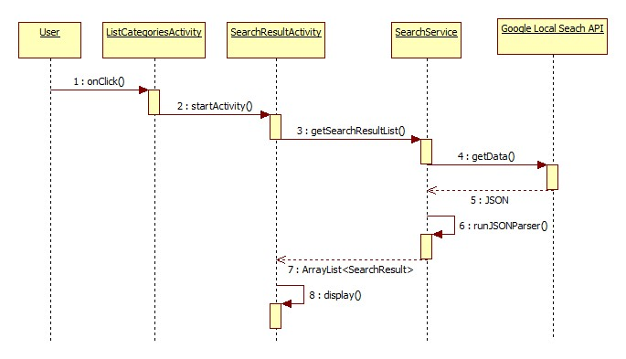
List Categories – Search Result
  Search Result Design

Slide 12
List Categories – Search Result
3. Implementation:
List Categories
    Package: com.ttc.mShopping.activities
      MainActivity.java
      ListCategoriesActivity.java
    Package: com.ttc.mShopping.utilities
      CommonConfiguration.java

Slide 13
List Categories – Search Result
Search Result
  Package: com.ttc.mShopping.activities
    SearchResultActivity.java
  Package: com. ttc.mShopping.models
    SearchResult.java
    ListResult.java
    PhoneNumber.java
  Package: com. ttc.mShopping.services
    SearchService.java
  Package: com. ttc.mShopping.utilities
    CommonConfiguration.java

Slide 14
List Categories – Search Result
Search Result
  Package: com.ttc.mShopping.activities
    SearchResultActivity.java
  Package: com. ttc.mShopping.models
    SearchResult.java
    ListResult.java
    PhoneNumber.java
  Package: com. ttc.mShopping.services
    SearchService.java
  Package: com. ttc.mShopping.utilities
    CommonConfiguration.java

Slide 15
View Detail Information
1. Requirement:
  Show detail information of a place
  Make some actions relative to that item
    Call
    See web for more detail
    Show places on Map
    Send mail
    …

Slide 16
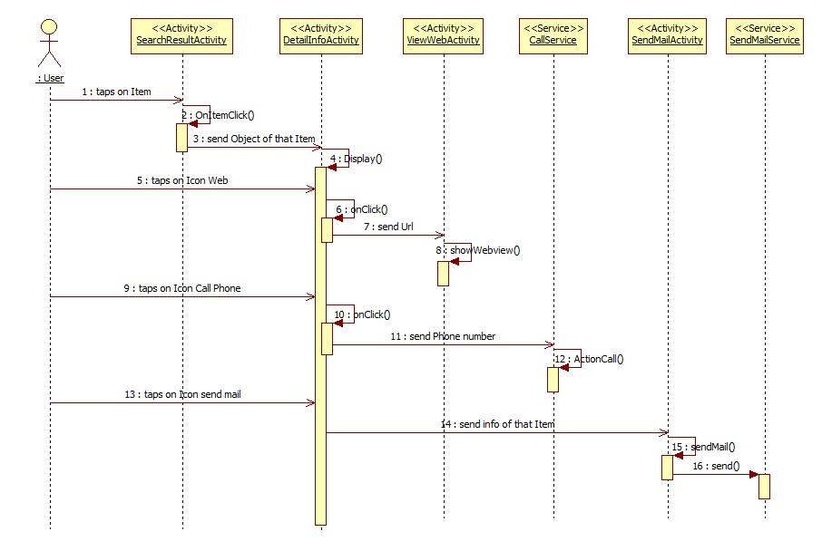
View Detail Information
2. Design:

Slide 17
View Detail Information
3. Implementation:
  Package: com. ttc.mShopping.activities
    SearchResultActivity.java
    DetailInfoActivity.java
    ViewWebActivity.java
  Package: com.ttc.mShopping.models
    PhoneNumbers.java
    SearchResult.java
  Package: com.ttc.mShopping.utilities
    CommonConfiguration.java

Slide 18
Show place on map
1. Requirement:
  Show all places on Map
  Show a specific place on Map
  Show the driving direction from start-point to end-point

Slide 19
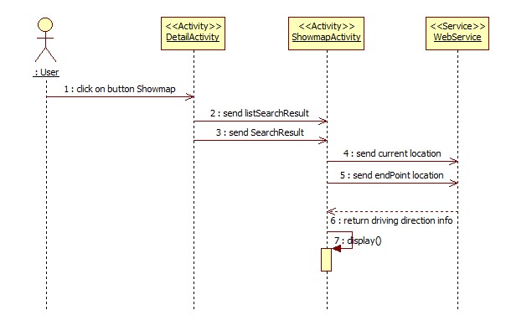
Show place on map
2. Design:

Slide 20
Show place on map
3. Implementation:
  Package com.ttc.mShopping.activities
    SearchResultActivity.java
    DetailInfoActivity.java
    ViewMapActivity.java
  Package com.ttc.mShopping.models
    SearchResult.java
  package: com.ttc.mShopping.utilities
    CommonConfiguration.java

Slide 21
Get driving direction
1. Requirement:
  Show the direction info in English or Vietnamese depends on user’s decision
  Send the route info to MapActivity to draw the driving path

Slide 22
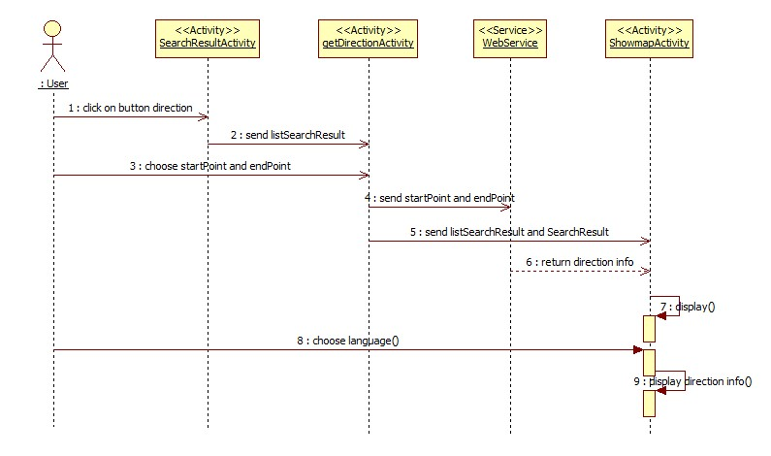
Get driving direction
2. Design:

Slide 23
Get driving direction
3. Implementation:
  Package com.ttc.mShopping.activities
    SearchResultActivity.java
    DetailInfoActivity.java
    ViewMapActivity.java
  Package com.ttc.mShopping.models
    SearchResult.java
  Package: com.ttc.mShopping.utilities
    CommonConfiguration.java
  Webserivice

Slide 24
Favorite List Management
1. Requirement:
  Save favorite places on the phone (local).
  Show favorite list on screen
  Add a new place into favorite list.
  Delete one or many (multi-delete) item(s) from favorite list

Slide 25
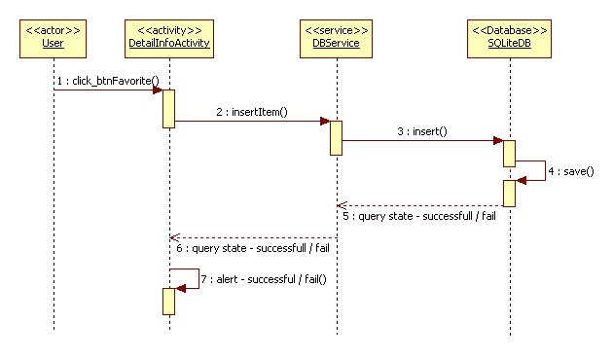
Favorite List Management
2. Design:

Slide 26
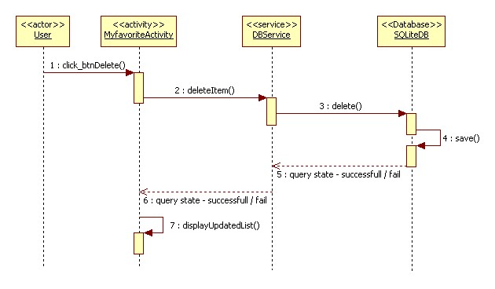
Favorite List Management
2. Design:

Slide 27
Favorite List Management
3. Implementation:
  Activities:
    MyFavouriteActivity.java
  Services: (SQLite database)
    DBAdapter.java
    DBHelper.java

Slide 28
Favorite List Management
3. Implementation:
  Models:
    SearchResult.java
    Other files:
    PhoneNumbers.java
    CustomCursorAdapter.java
    my_favourite.xml
    row_my_favourite.xml

Slide 29
Change Location
1. Requirement:
  Allow users to search places such as Hotel, Restaurant, Gas station or Banks, etc… at another location, not at their current location.

Slide 30
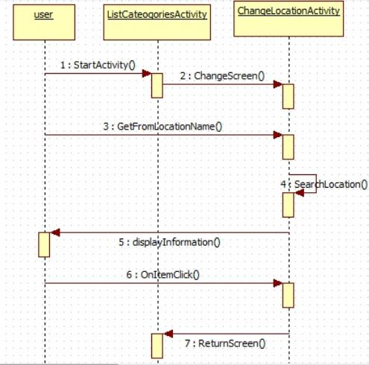
Change Location
2. Design:

Slide 31
Change Location
3. Implementation:
  Create an AutoCompleteTextView for user to type the location they want to search
  AutoCompleteTextView txtLocation;
  Button btnSearch;
  txtLocation = (AutoCompleteTextView)findViewById(R.id.txtSearch);
  btnSearch = (Button) findViewById(R.id.btnSearch);
  lvLocationList = (ListView) findViewById(R.id.listResult);

Slide 32
mShopping - K17
Thank You

