Slide 1
Revision 1.0
How to use AIS Latex template (for Windows user)
Ho Tuan Vu
Akagi Laboratory
Japan Advanced Institute of Science and Technology
April 24, 2020

Slide 2
Step 0: Installation
Download the following programs and follow the default installation instruction.
TexLive (tex compiler): this may take long time...
https://www.tug.org/texlive/
TexMaker (tex editor GUI):
https://www.xm1math.net/texmaker/
Restart after finished!

Slide 3
Step 1: Configure tex editor
Open Texmaker
From the menu bar:
Options > Configure Texmaker
Select “Commands” tab:
Edit the following command:
LaTex
platex -interaction=nonstopmode %.tex

Slide 4
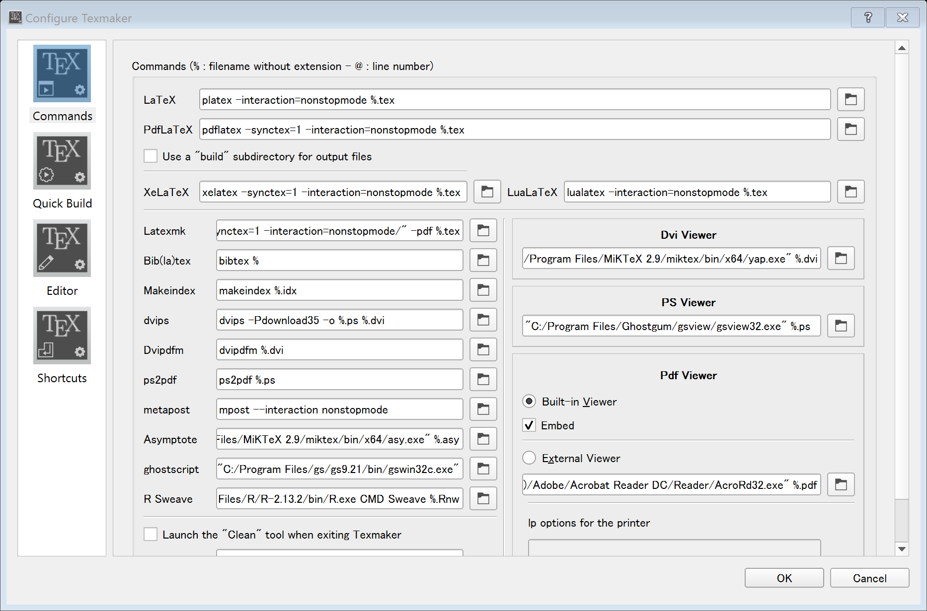

Slide 5
Step 1: Configure tex editor (cont.)
Select Quick Build tab
Select Latex + dvips + ps2pdf + View Pdf
(or Latex + dvipdfm + View PDF)

Slide 6
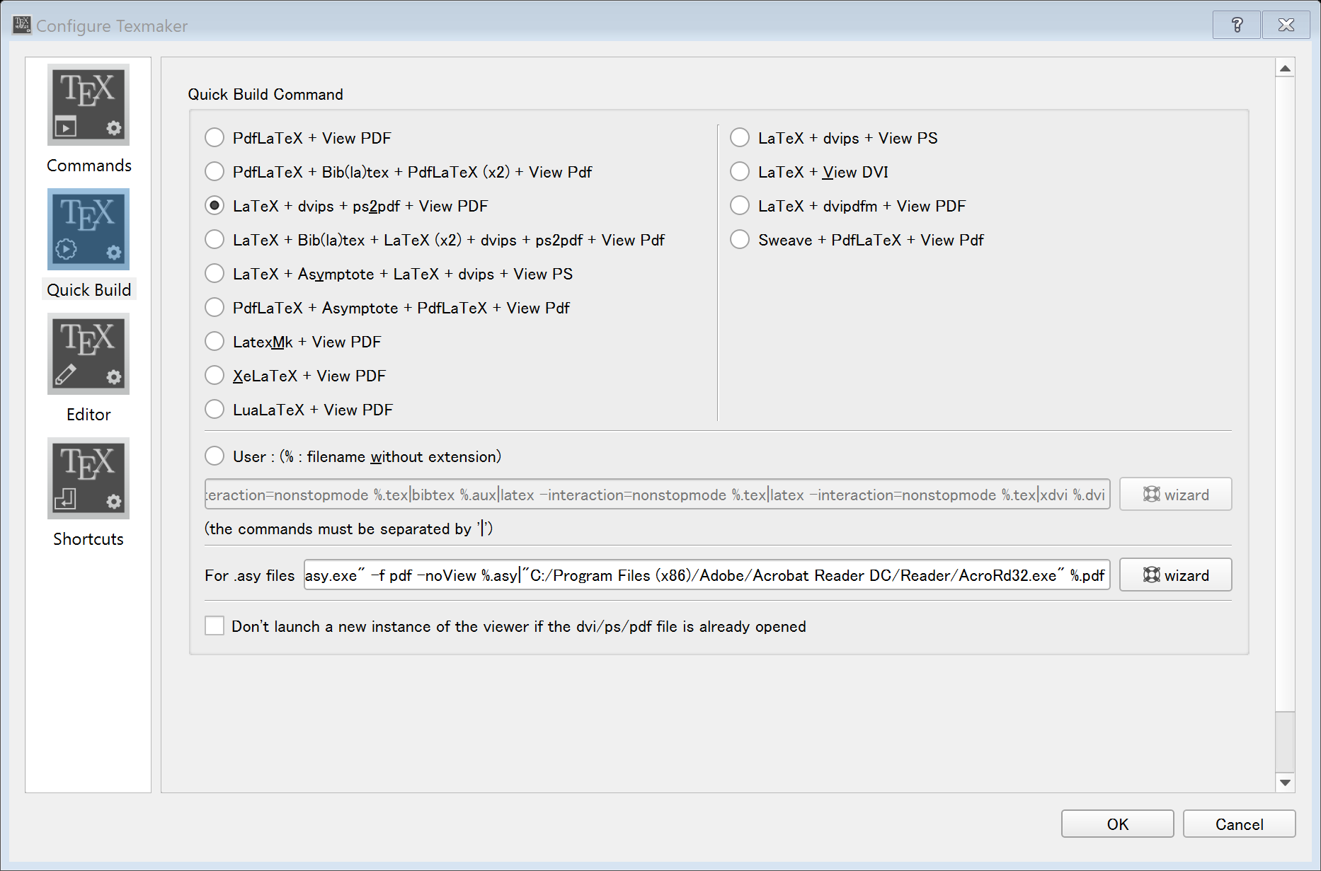

Slide 7
Step 2: Compile sample tex file
Download LM tex template package and extract
Open sample.tex by Texmaker
Press F1 for quick build. Check if the pdf file is generated

Slide 8
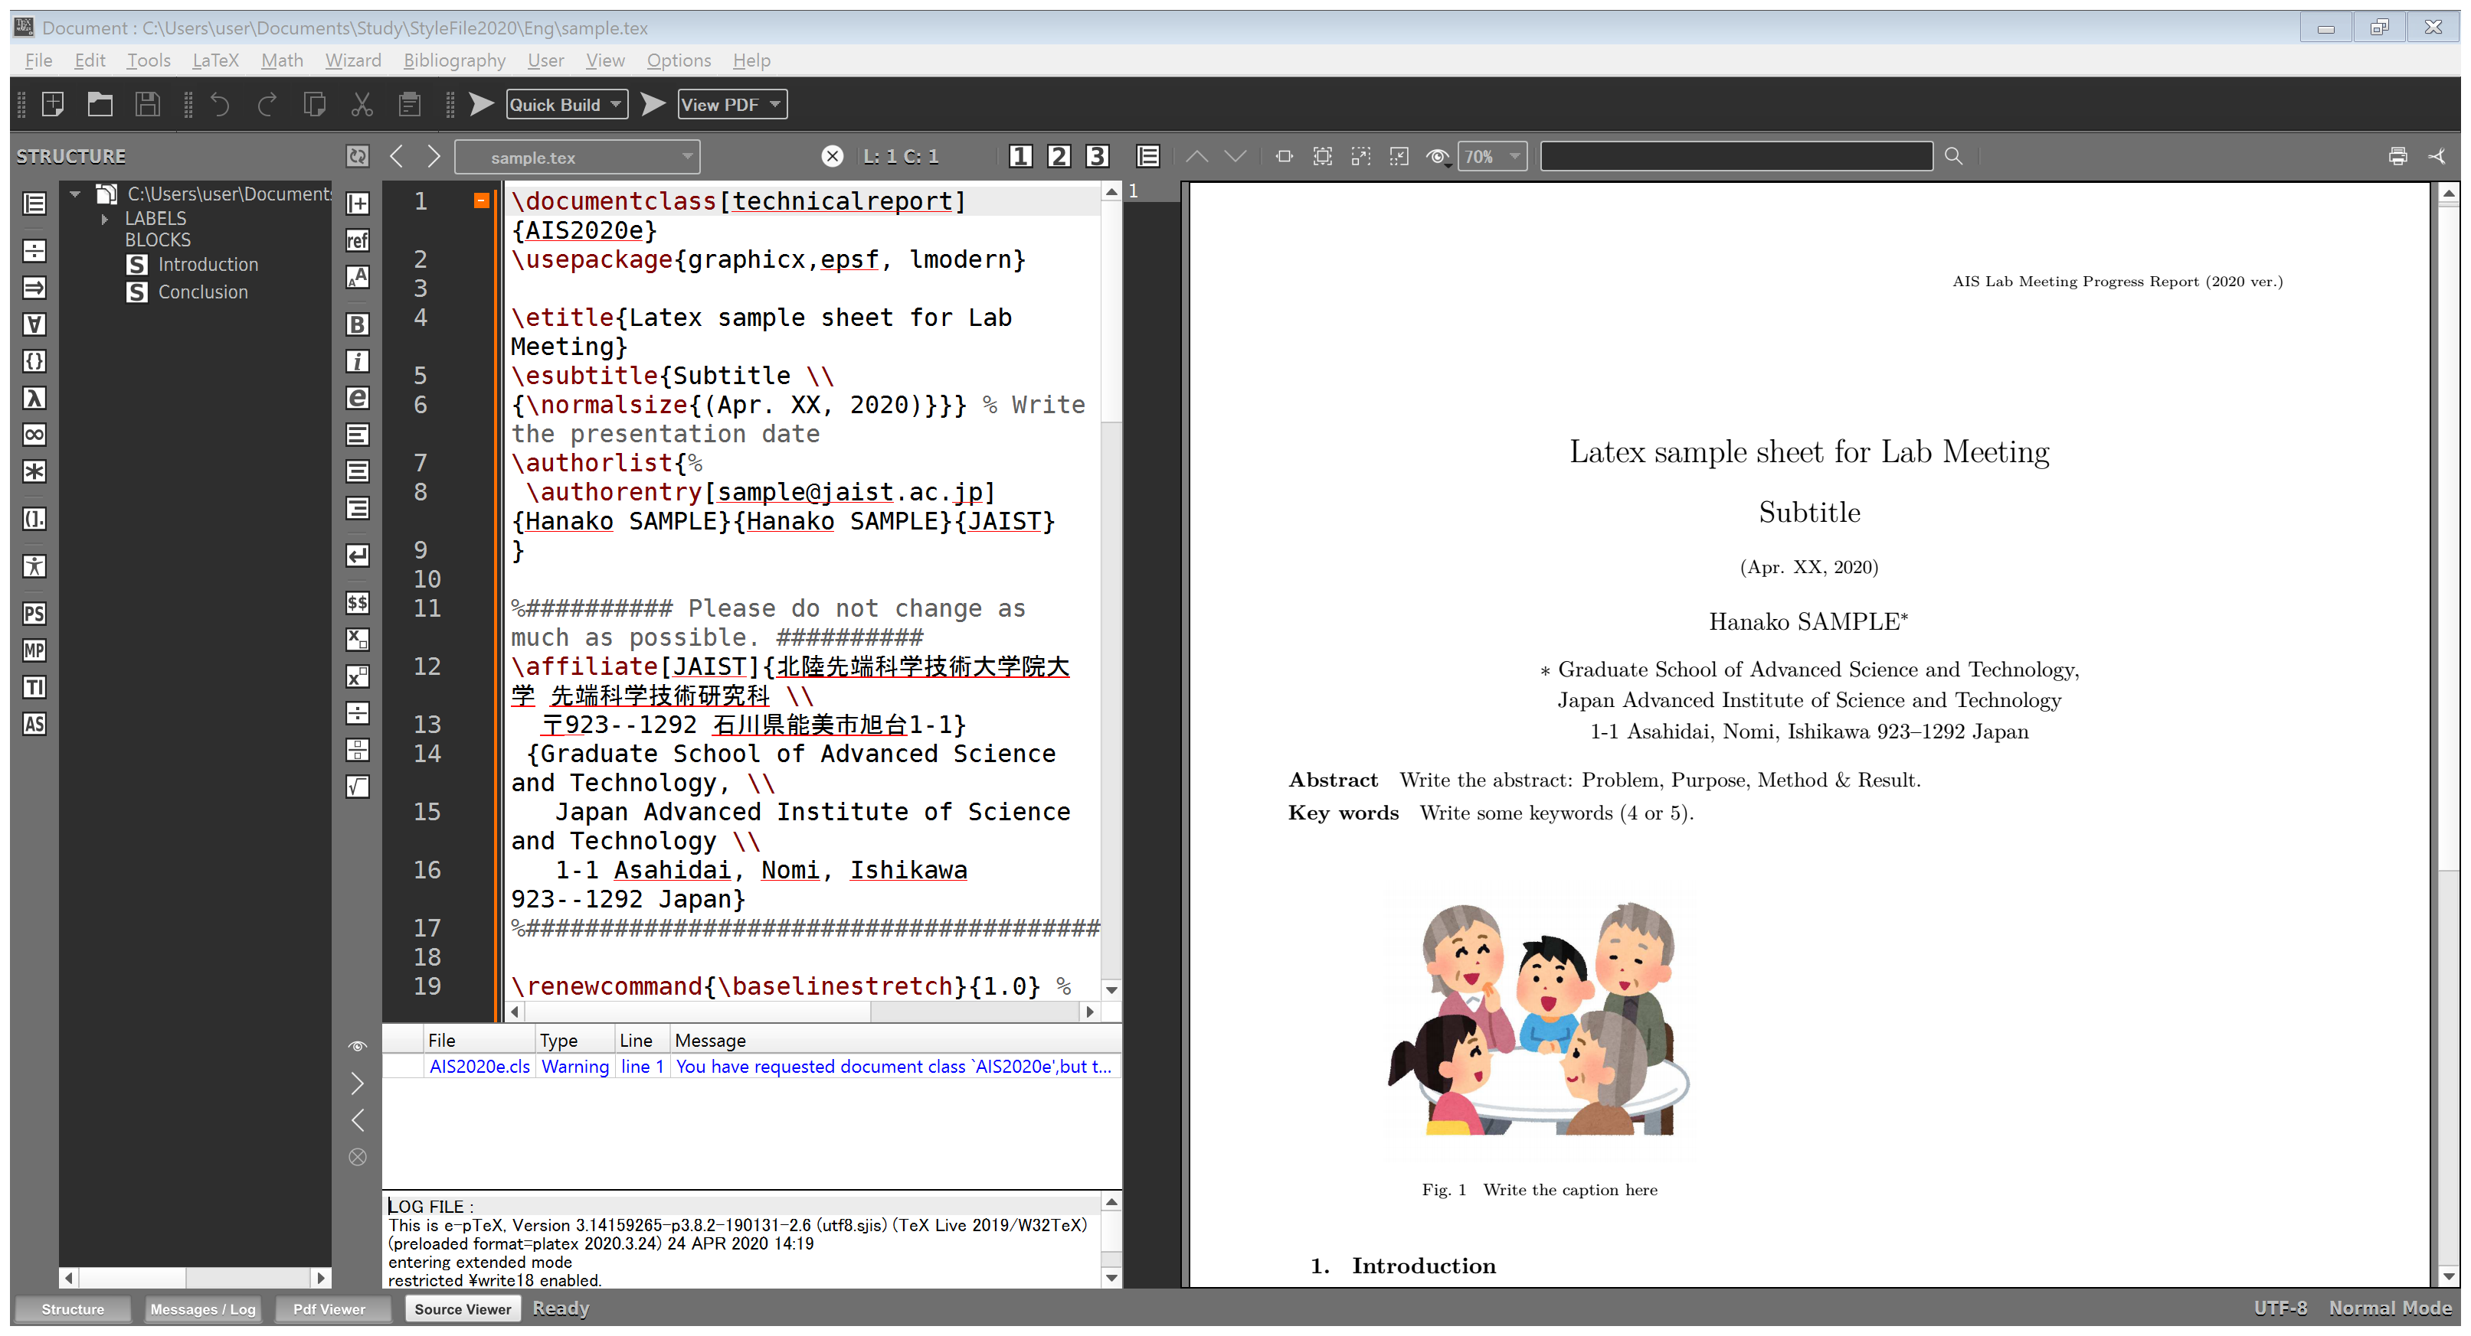

Slide 9
Tips and tricks
Online tex equation generator:
https://www.codecogs.com/latex/eqneditor.php
Generate eps figure from powerpoint:
Install metafile2eps: https://wiki.lyx.org/Windows/MetafileToEPSConverter
Paste the figure to the new pptx file and save as emf file: Save as > Enhanced Windows Metafile
Open Metafile with Metafile to EPS Convert and export EPS

Slide 10
Good luck!

