Slide 1
Delivery Time Forecasting Through Data Analytics and Machine Learning
Tuan Vu
January 25, 2025

Slide 2
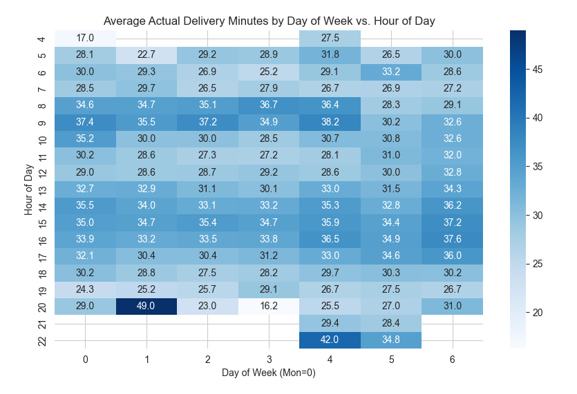
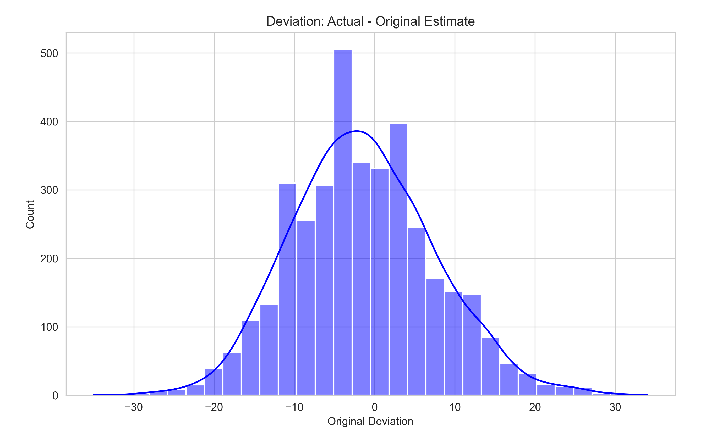
Time and Deviation Insights
Peak times: Longer delivery times during 8:00–10:00 and 13:00–17:00.
Outliers: Rare spikes like 49 or 42 minutes at specific times.
Weekend patterns: No significant difference in delivery times compared to weekdays.
Centered around zero: Most predictions are accurate, but delays are more common than early arrivals.
Positive deviations: Early deliveries are still notable but less frequent.

Slide 3
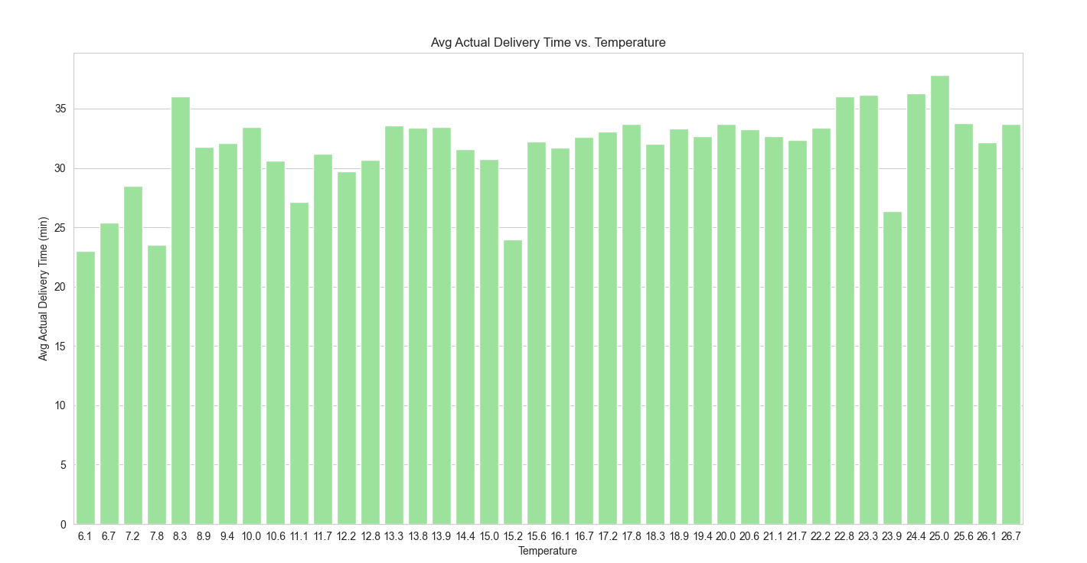
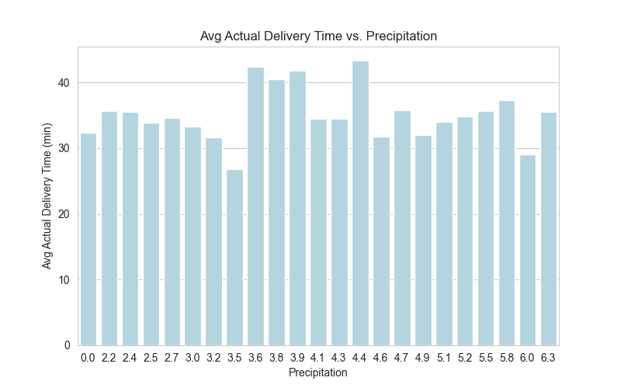
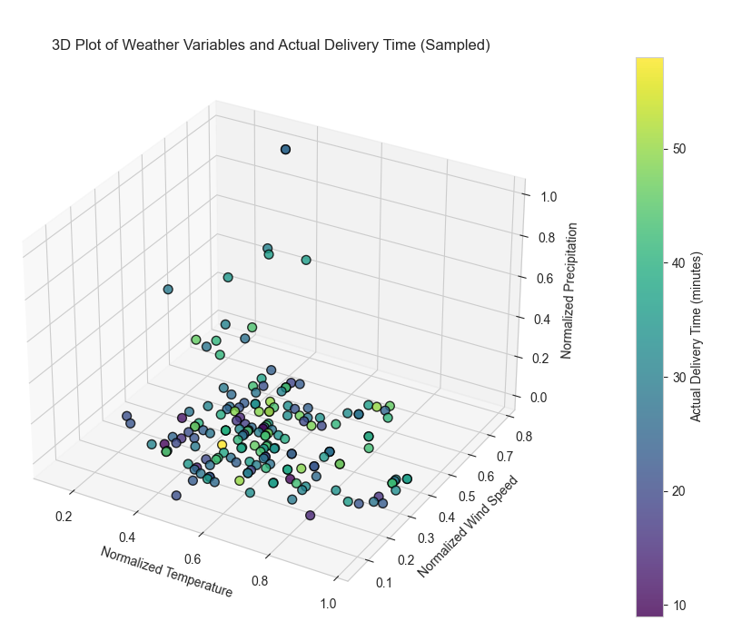
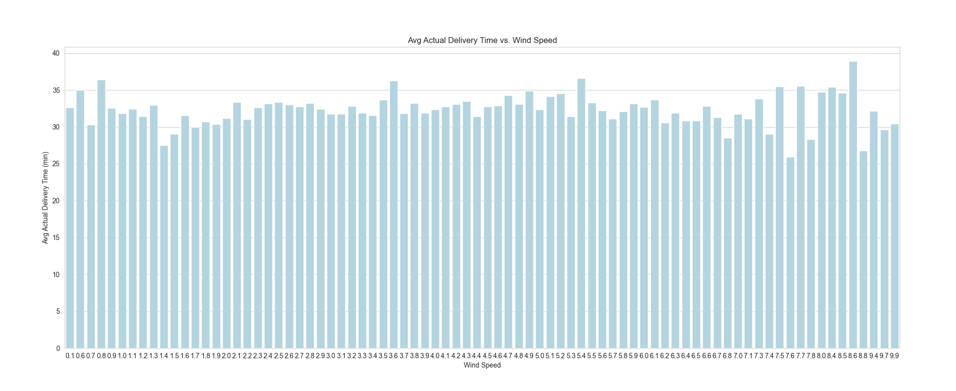
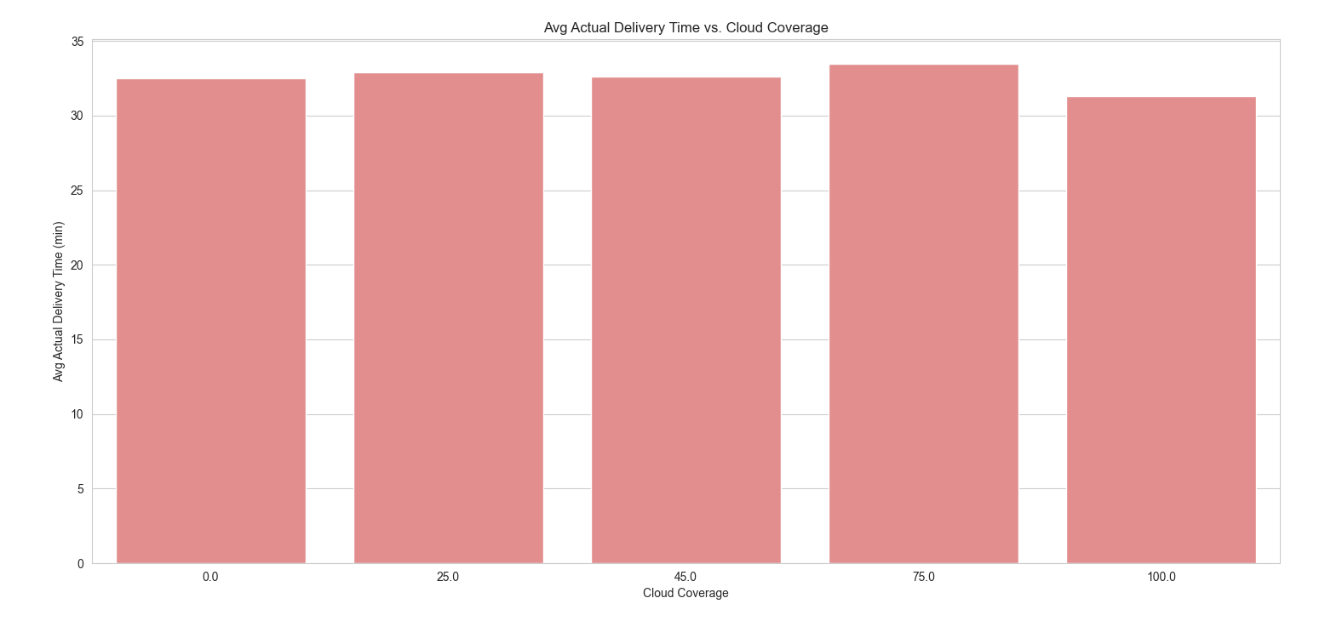
Impact of Weather on Delivery Times
Precipitation: Levels between 3.6–4.4 lead to longer delivery times; other levels show minimal impact.
Temperature: Low temperatures correlate with faster deliveries, while high temperatures show little effect.
Wind Speed: Slightly affects delivery times but likely combined with other factors.
Cloud Coverage: Minimal influence on delivery times.
Weather Impact: Delivery times are affected by precipitation, wind, and temperature.
Other Factors: Variability under similar weather conditions highlights the role of traffic and courier availability.

Slide 4
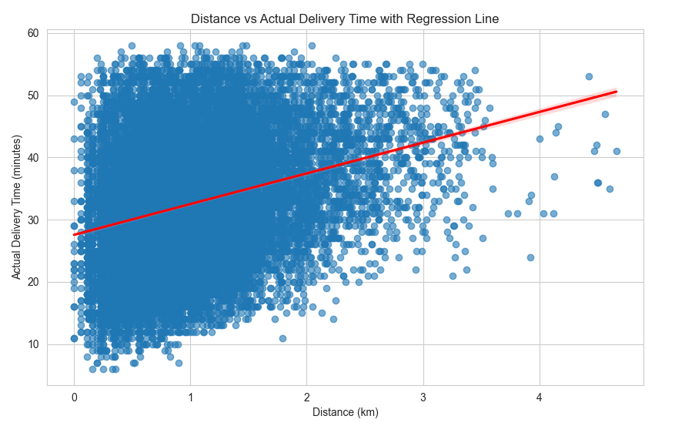
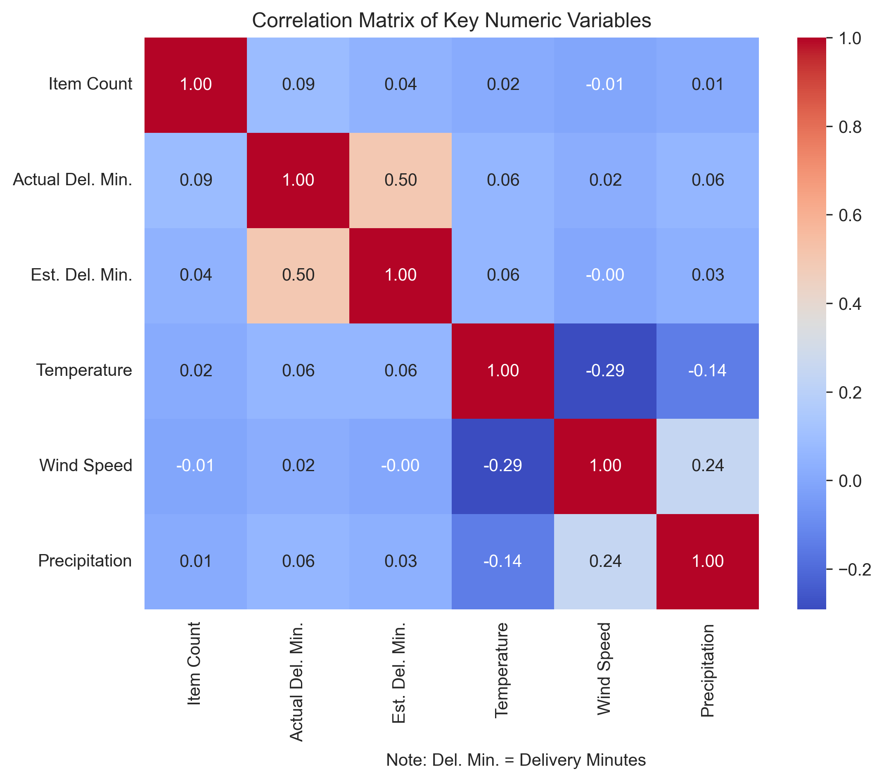
Distance and Correlation Analysis
Trend: Longer distances generally lead to longer delivery times, as expected.
Variability: Significant variability exists for deliveries over the same distance, influenced by factors like traffic or courier availability.
Weak Weather Impact: Weather variables show weak individual correlations but may collectively impact variability.
Estimated vs. Actual: A stronger correlation (0.50) exists between estimated and actual delivery times, reflecting the baseline model’s predictive value.

Slide 5
Feature Engineering and Model Selection
Original Dataset
Random Forest
Basic MLP
Setup: 50 decision trees for a balance of speed and accuracy.
Why Chosen: Performs well on smaller datasets, robust to noise and outliers, and provides feature importance insights.
Setup: Two hidden layers (64 neurons each) with dropout, trained for 200 epochs using Adam optimizer.
Why Chosen: Captures non-linear patterns efficiently with minimal risk of overfitting.
Feature Engineering
Cleaned Data: Removed nulls, unrealistic values (e.g., negative times), and parsed timestamps.
Distance: Computed using the Haversine formula.
Time: Extracted hour, day, and month from timestamps.
Weather: Scaled variables (temperature, wind speed) and added a rain indicator.
Scaling: Applied min-max normalization.
Advanced MLP
Setup: Three hidden layers (128, 128, 64 neurons), similar optimizer and training as Basic MLP.
Why: Explores deeper patterns with higher learning capacity for complex data.

Slide 6
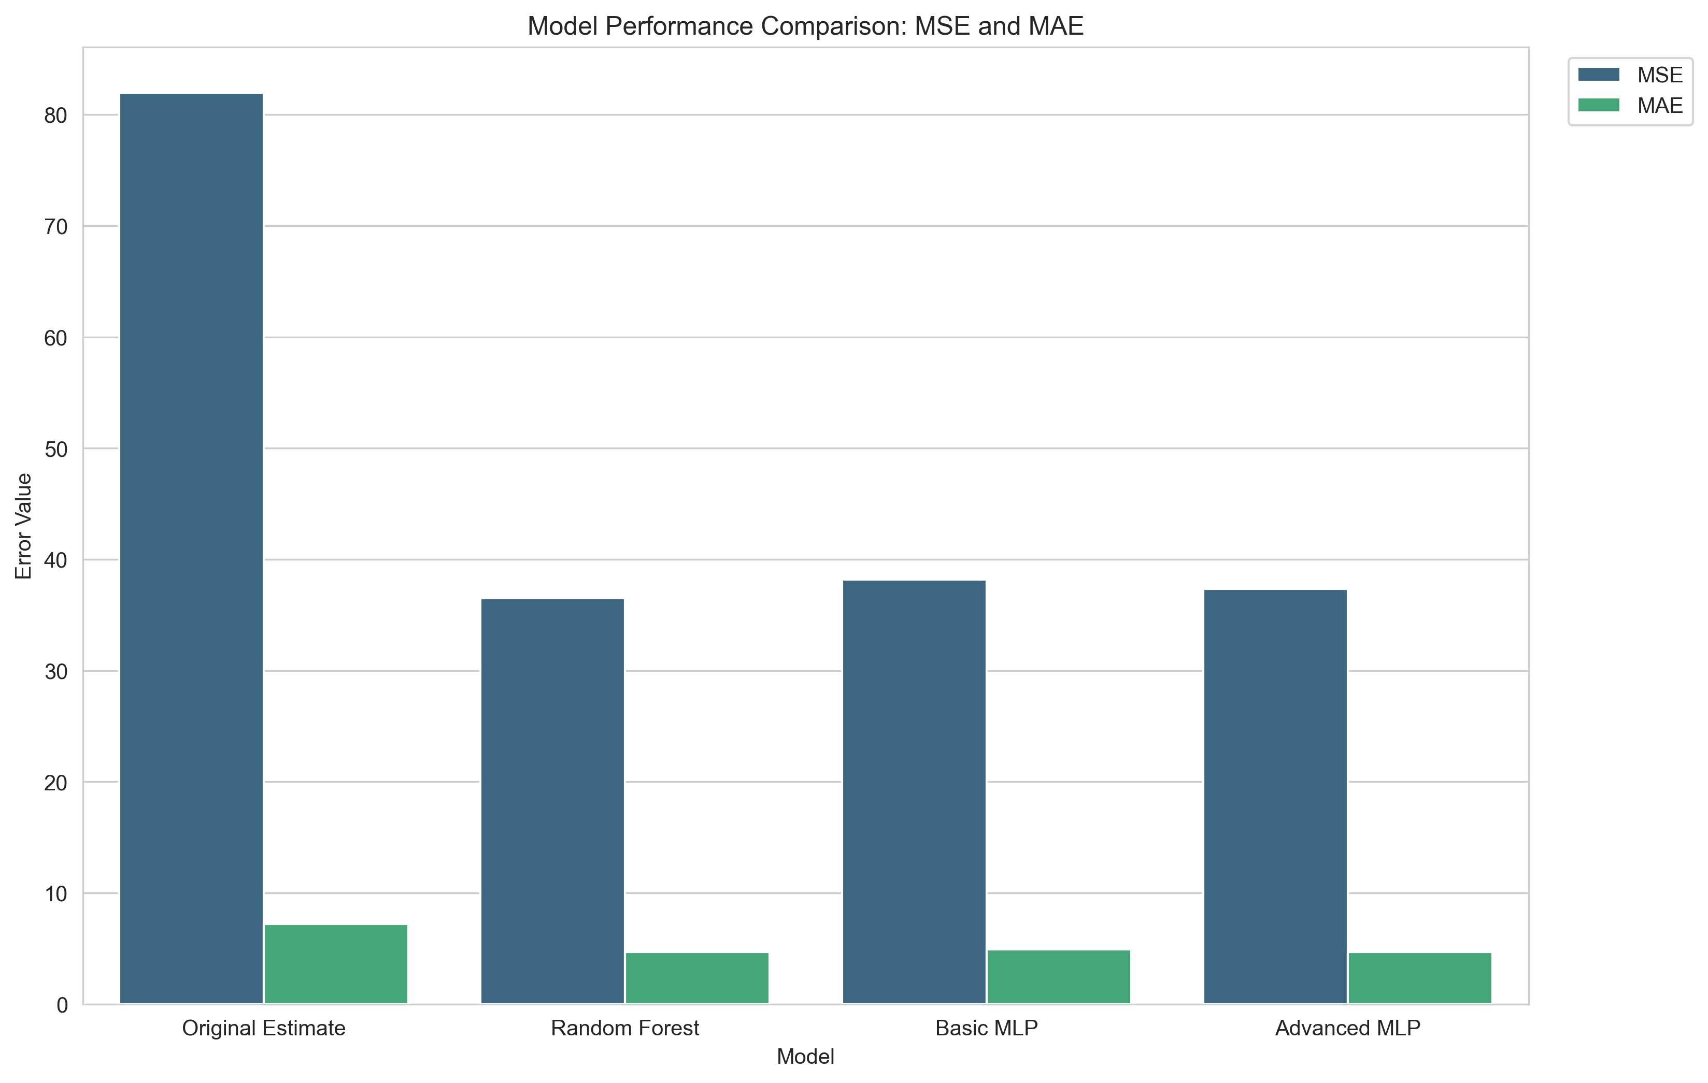
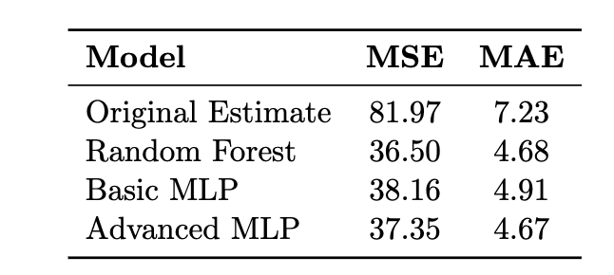
Model Performance
Model Comparison: Random Forest achieves the lowest MSE and MAE, outperforming baseline and neural networks.
Advanced MLP Potential: Performs closely to Random Forest; promising with additional data or tuning.
Baseline vs. Models: All models significantly outperform the original dataset’s estimates.

Slide 7
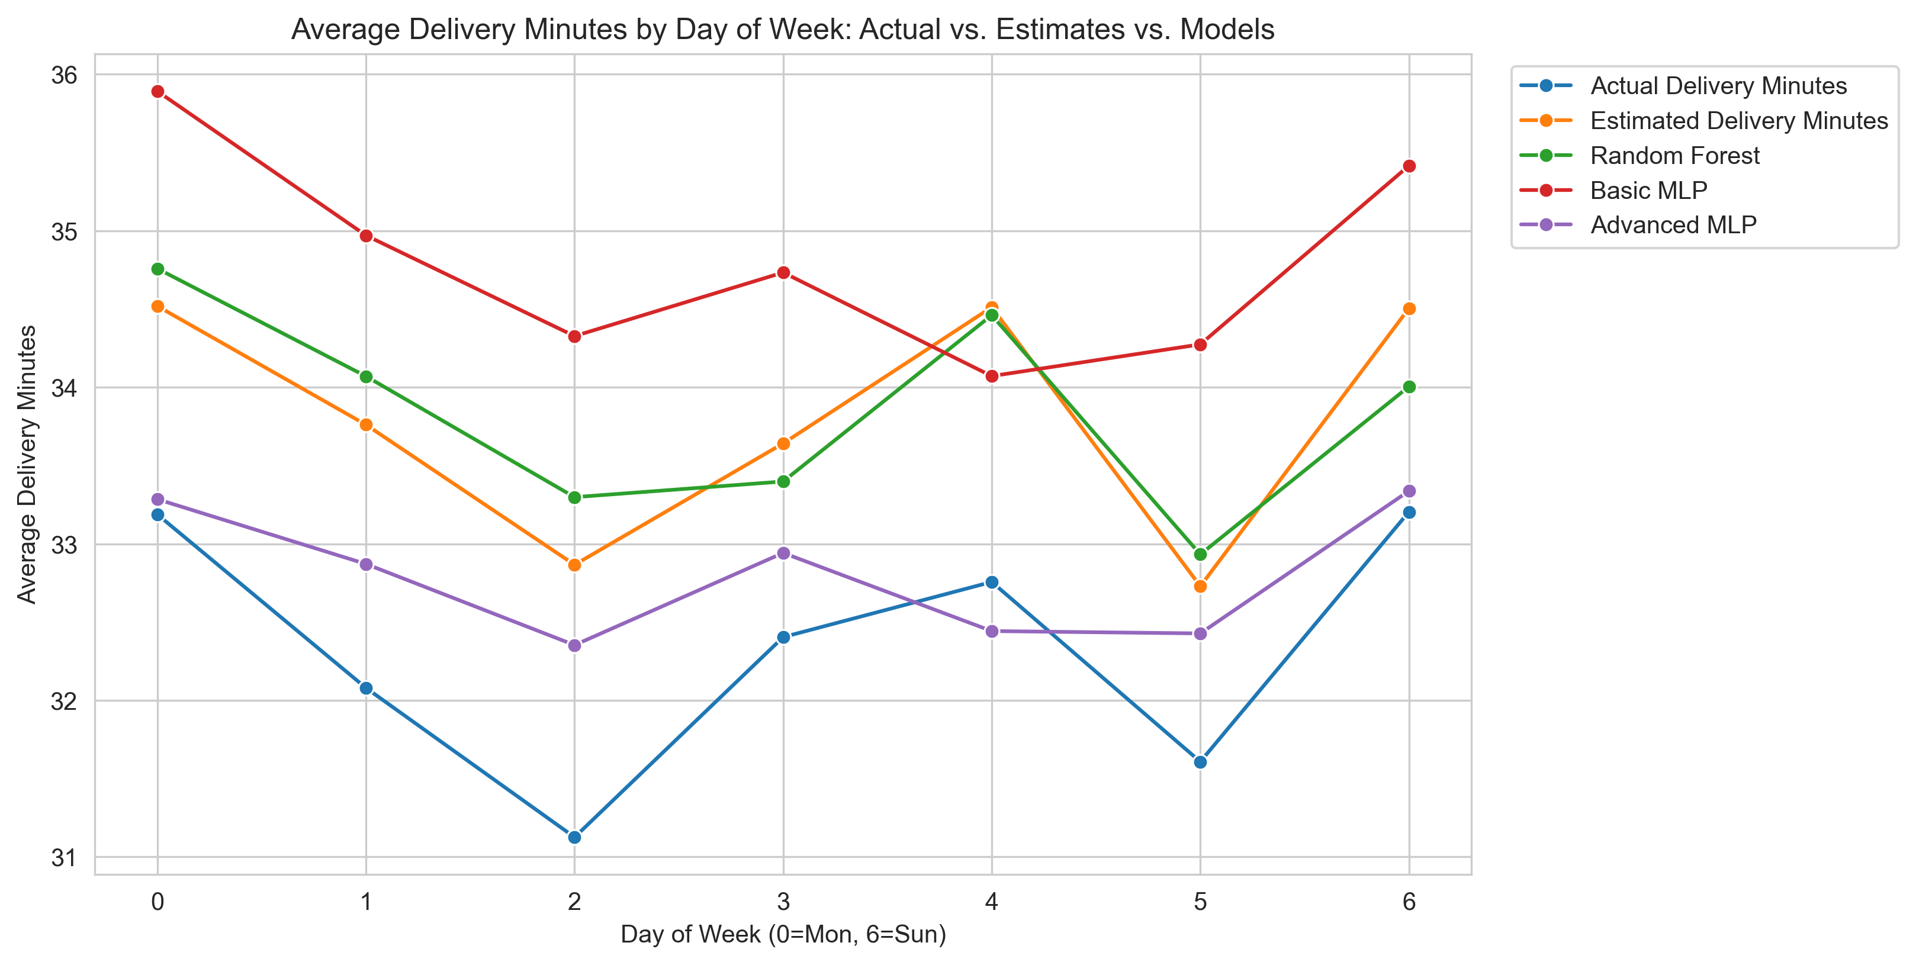
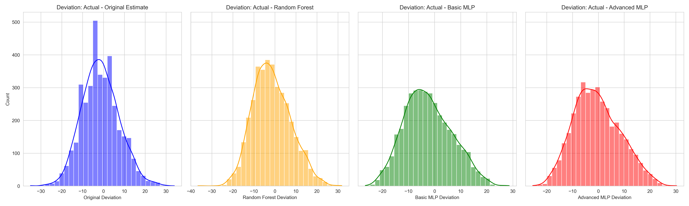
Time and Deviation Insights
Random Forest Performance: Improves accuracy across all days, outperforming the baseline.
Advanced MLP Alignment: Closely resembles actual delivery times, especially on weekends.
Weekday Variability: Some underperformance on weekdays due to higher variability in data.
Random Forest Reliability: Errors are tightly centered around zero, indicating consistent predictions.
Advanced MLP Potential: Broader deviations suggest room for improvement with more data and refined features.

Slide 8


